Slide 1





A Multi-Excitation Projective Simulation Agent
Philip A. LeMaitre
August 20, 2026
In Collaboration with Marius Krumm and Hans J. Briegel
Artificial Intelligence 352, 104489 (2026)
Notes:
Hi everyone, thanks for coming to my presentation. My name is Phil and I am a PhD student from the University of Innsbruck in the group of Hans Briegel. Today I will be talking about Multi-Excitation Projective Simulation.
Timing: 0:00-0:30. Open by saying that the talk first has to make Projective Simulation concrete. The paper's contribution is not just another reinforcement-learning benchmark; it changes the object that moves through the Projective Simulation memory. In the computer-maintenance setting, this lets a deliberation path expose symptoms, hypothesized component-cause pairs, and chosen fixes as part of one interpretable chain.
[Sources]
- Philip A. LeMaitre, Marius Krumm, Hans J. Briegel, "Multi-excitation projective simulation with a many-body physics-inspired inductive bias," Artificial Intelligence 352, article 104489, DOI: 10.1016/j.artint.2026.104489.
- arXiv:2402.10192v4, last revised February 4, 2026.

Slide 2

Introduction and Motivation
Quantum machine learning is great but currently limited compared to classical ML
Why do AI agents make certain decisions? How can we explain them?
Use ideas from quantum to improve classical ML!
Quantum-inspired inductive biases
$$→$$
Limits on interaction size of network nodes
Explainable quantum-inspired machine learning
Notes:
Why should people care about this work? What is the take home message? Does it address an interesting problem? What has been done before in this area? What did those works struggle with that yours addresses?
In this work we make an explainable AI model more robust and improve its performance using a quantum-inspired inductive bias, then we outline the quantum version

Slide 3
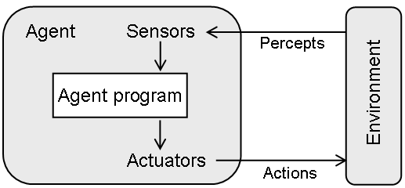




Projective Simulation (PS)
Episodic and compositional memory (ECM)
PS agent
Learn
…
$$p_{12}$$
Clip 2
$$p_{24}$$
Clip 1
Clip 4
Clip 6
Reward
$$p_{13}$$
$$p_{45}$$
Clip 3
actuator
ECM
percept
Clip 5
…
Deliberate
H. J. Briegel & G. De las Cuevas, Sci. Rep., 2, 400 (2012)
Notes:
Timing: 0:30-1:35. Introduce Projective Simulation without assuming the audience has seen it. The Episodic and Compositional Memory is a weighted directed graph. Its vertices are clips, which have semantic content. Its edges carry h-values, the trainable parameters. Given a current clip, the agent converts outgoing h-values into transition probabilities and samples the next clip. A deliberation is the resulting random walk from percept clips to action clips. Once the environment gives a reward, the h-values along the sampled path are updated, with glow and forgetting available for delayed reward and adaptation.
[Sources]
AIJ_new.tex lines 190-226 introduce PS, the ECM as a weighted directed graph, clips, h-values, transition probabilities, percept/action coupling, and the standard PS update rule.
Focus on meaning of clips:
- Percept: Customer walks in to café and orders
- Clip 1: Get food ready quickly to keep customer happy
- Clip 2: Feed cats so they are happy
- Clip 4: Make sure customers get to interact with cats so they are happy
- Clip 6: Give food to cats and customers, then position cats at customer table
Imagine an AI agent whose task is to manage a cat café, a cozy place where people come to enjoy coffee and the company of resident cats. The reinforcement learning model is tasked with maximizing customer satisfaction and cat well-being. This setup provides a rich, humorous context for exploring complex decision-making and the importance of explainability in AI. Here's how it could unfold:
Objective: Keep both the cats and the customers happy. The AI must learn to balance the needs of the cats (feeding, playtime, rest) with the desires of the customers (interaction with cats, a peaceful environment, and quality café service).
Rewards: The AI receives positive feedback for satisfied customers (measured by their dwell time and reviews) and content cats (measured by their health and behavior). Negative feedback comes from unhappy customers or stressed cats.
Challenges: The AI faces unpredictable scenarios, such as a cat deciding to nap in the middle of the café floor, a sudden rush of customers, or a coffee spill. Each scenario requires the AI to make decisions that could have complex implications.
Explainability Aspect: The presentation can humorously explore how the AI makes its decisions and the importance of being able to explain those decisions to the café owner, the customers, and perhaps even the cats! For example, why did the AI choose to play a particular type of music, or why did it decide to create a play area for the cats at a specific spot in the café?
The CENTRAL FEATURE of this framework is a type of EPISODIC MEMORY (remembering = a dynamic process) which the agent uses for deliberation and learning.
- The DELIBERATION process corresponds to a RANDOM WALK on a WEIGHTED GRAPH, or network, with a special semantics.
- LEARNING is realized by adapting both the WEIGHTS and the TOPOLOGY of the graph over time.
Forgetting parameter allows agent to forget past experiences; useful when environment changes.
The model combines three important features:
It is INTERPRETABLE,
it can be QUANTIZED (at least in its BASIC VERSION),
and it can be extended with other machinery from CS & QI
*The basic units are so-called CLIPS, and you may think of clips as excitations of a many-body hamiltonian, and of deliberation as propagation of such excitations in episodic memory.
As far as the dynamics of decision making and learning concerned, there is a probability rule and a learning rule. The hopping probabilities are determined by real WEIGHTS (h-values) associated with the edges, which change after every interaction with the environment. Initially h = 1 on all edges.
The way the h-values change is described by a learning rule which, IN THE SIMPLEST CASE, is given here. Two terms, LOSS and GAIN.
Glow status (another real WEIGHT):
Imagine, all edges glow, more or less, depending on how long it has been since the transition was taken last time.
The glow mechanism strengthens edges that were visited, as part of the deliberation, a few steps before the rewarded action.
Every time an edge is visited, the corresponding g-value is set to 1, after which it is decreased each time step with a rate of η.
DIFFERENCE between PS and standard RL.
In RL the FOCUS lies on the ENVIRONMENT in which the agent operates, which is usually described as a MARKOV DECISION PROCESS (MDP). The GOAL of the agent is to find a `solution' to the MDP, that is, a policy that maximizes the long-term expected return starting from any state s. …AND SO ON…
In PS, the focus is DIFFERENT. It lies on the MEMORY OF THE AGENT and on the INTERNAL structures of deliberation, which are described as a CLIP NETWORK (ECM). If we put a PS agent in an environment described by a MDP, we are not only interested in HOW FAST the agent learns the optimal policy. EQUALLY INTERESTING is the question how the structure of the MEMORY (NETWORK of CLIPS) develops as the agent learns, and how these changes affect the agent’s general behavior.
NB: The structure of ECM /= structure of MDP. Clips can represent states (the agent has perceived) and actions (it has taken) in the agent’s memory, but also more abstract entities; they can be created, erased, or modified as part of the agent’s learning history and deliberation.
Advantage in quantum reinforcement learning
- proven in PRL by Hans and Vedran
- also mention Fulvios paper

Slide 4




Limitations of PS
Clips have no composite structure here
Only connections between two clips are accounted for
…
$$p_{12}$$
Clip 2
$$p_{24}$$
Clip 1
Clip 4
Clip 6
$$p_{13}$$
$$p_{45}$$
Limited expressivity of chains-of-thought
Clip 3
actuator
percept
Clip 5
…
We need to extend PS to make it more robust and explainable!

Slide 5
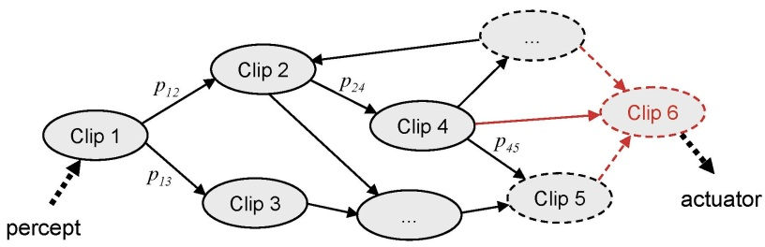
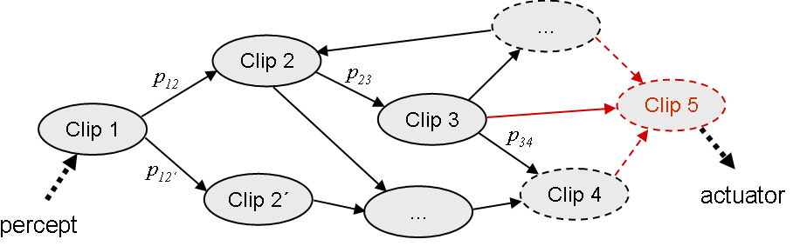
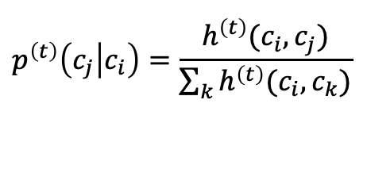
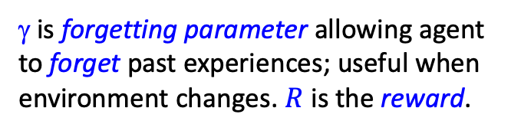
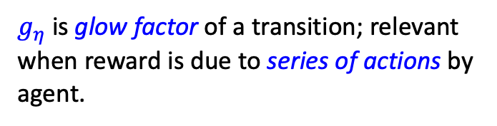

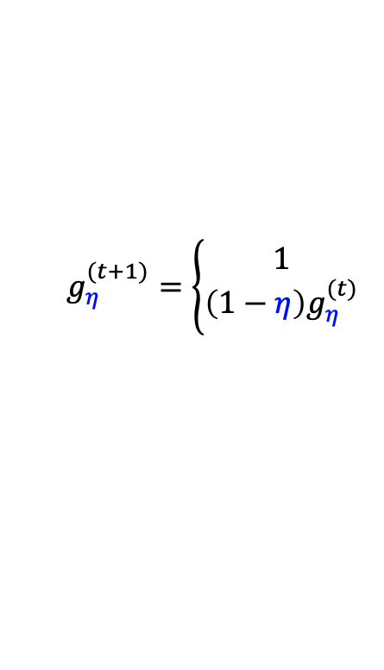

Projective Simulation (PS)
Episodic and compositional memory (ECM)
PS agent
Briegel & De las Cuevas, Sci. Rep., 2, 400 (2012)
PS agents use episodic memory for deliberation (random walk) and learning
PS is interpretable
PS can be quantized
ECM
Probability rule
Learning rule
$g_{η}$is glow factor of a transition; relevant when reward is due to series of actions by agent.
$$h^{(t+1)}=h^{(t)}−γ\left(h^{\left(t\right)}−h^{\left(0\right)}\right)+Rg_{η}^{\left(t\right)}$$
$$p^{\left(t\right)}\left(c_{j} | c_{i}\right)=\frac{h^{\left(t\right)}(c_{i}, c_{j})}{\sum_{k}{h^{\left(t\right)}(c_{i},c_{k})}}$$
γ is forgetting parameter allowing agent to forget past experiences; useful when environment changes. $R$ is the reward.
$$g_{η}^{(t+1)}=\left\{\begin{aligned}1 \\ \left(1−η\right)g_{η}^{(t)}\end{aligned}\right.$$
, $c_{i}→c_{j}$
, else
Notes:
The CENTRAL FEATURE of this framework is a type of EPISODIC MEMORY (remembering = a dynamic process) which the agent uses for deliberation and learning.
- The DELIBERATION process corresponds to a RANDOM WALK on a WEIGHTED GRAPH, or network, with a special semantics.
- LEARNING is realized by adapting both the WEIGHTS and the TOPOLOGY of the graph over time.
The model combines three important features:
It is INTERPRETABLE,
it can be QUANTIZED (at least in its BASIC VERSION),
and it can be extended with other machinery from CS & QI
*The basic units are so-called CLIPS, and you may think of clips as excitations of a many-body hamiltonian, and of deliberation as propagation of such excitations in episodic memory.
As far as the dynamics of decision making and learning concerned, there is a probability rule and a learning rule. The hopping probabilities are determined by real WEIGHTS (h-values) associated with the edges, which change after every interaction with the environment. Initially h = 1 on all edges.
The way the h-values change is described by a learning rule which, IN THE SIMPLEST CASE, is given here. Two terms, LOSS and GAIN.
Glow status (another real WEIGHT):
Imagine, all edges glow, more or less, depending on how long it has been since the transition was taken last time.
The glow mechanism strengthens edges that were visited, as part of the deliberation, a few steps before the rewarded action.
Every time an edge is visited, the corresponding g-value is set to 1, after which it is decreased each time step with a rate of η.
DIFFERENCE between PS and standard RL.
In RL the FOCUS lies on the ENVIRONMENT in which the agent operates, which is usually described as a MARKOV DECISION PROCESS (MDP). The GOAL of the agent is to find a `solution' to the MDP, that is, a policy that maximizes the long-term expected return starting from any state s. …AND SO ON…
In PS, the focus is DIFFERENT. It lies on the MEMORY OF THE AGENT and on the INTERNAL structures of deliberation, which are described as a CLIP NETWORK (ECM). If we put a PS agent in an environment described by a MDP, we are not only interested in HOW FAST the agent learns the optimal policy. EQUALLY INTERESTING is the question how the structure of the MEMORY (NETWORK of CLIPS) develops as the agent learns, and how these changes affect the agent’s general behavior.
NB: The structure of ECM /= structure of MDP. Clips can represent states (the agent has perceived) and actions (it has taken) in the agent’s memory, but also more abstract entities; they can be created, erased, or modified as part of the agent’s learning history and deliberation.

Slide 6
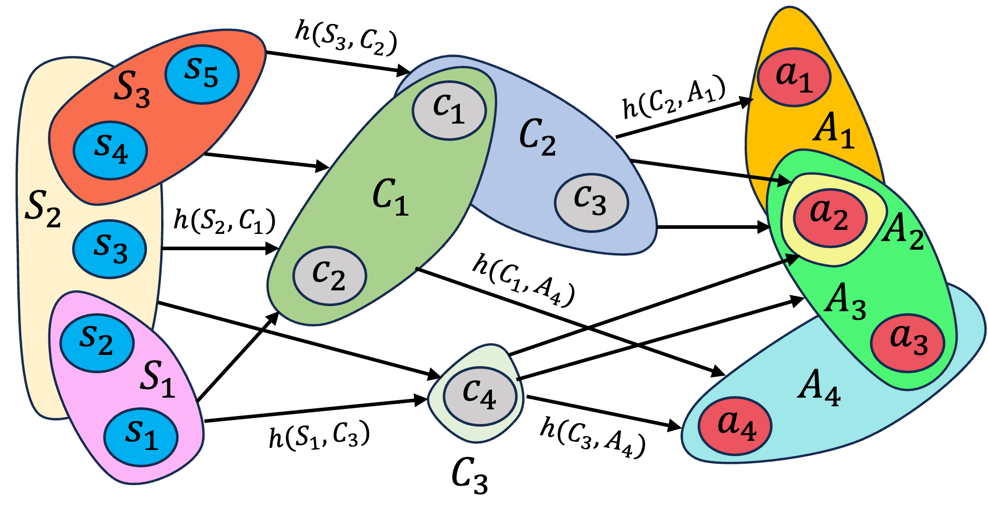
Multi-Excitation Projective Simulation (MEPS)
ECM is now a hypergraph with hyperedges connecting groups of clips
Access to composite structure
Can consider influence of clips together
= percept clips
= intermediate clips
= action clips
Notes:
Timing: 2:25-3:15. Now define MEPS as the minimal modification of the PS picture. The vertices are still atomic clips. Instead of one current clip, the state is an excitation configuration, a set of active clips. A deliberation step samples the next configuration from the current one, so ordinary edges are replaced by directed hyperedges. The learning idea remains continuous with PS: h-values define transition probabilities and rewards update the sampled path.
[Sources]
- Paper Figure 2, arXiv v4 source file Hypergraph.png.
- AIJ_new.tex lines 228-319 define MEPS agents, excitation configurations, directed weighted hypergraphs, input/output coupling, random-walk steps, and the MEPS update rule.
*** This slide assumes you have already introduced PS ***
mePS ECM is now hypergraph which is a graph where edges can join more than 2 vertices together; edges are now called hyperedges
mePS agent is functionally identical to basic PS, just allowing groups of clips now as well. In particular, transition probabilities concern transitions between groups of clips.
Clips now represent elementary concepts, so we can look at composite structure and explicitly account for correlations between these elements
For hypergraph diagram:
Capital letters denote a group of clips, which is one set of a hyperedge
Reference previous PS example here

Slide 7







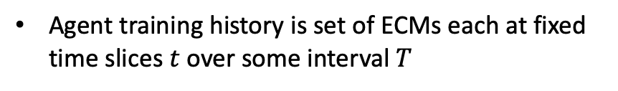















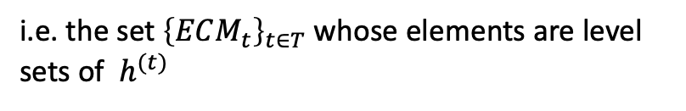
























Training History of mePS as a Dynamic Hypergraph
Agent training history is set of ECMs each at fixed time slices $t$ over some interval $T$
$$s_{5}$$
$$h(S_{3}, C_{2})$$
$$h(S_{3}, C_{2})$$
$$a_{1}$$
h-values are representation of their ECMs and update rule defines flow through the set
$$S_{3}$$
$$s_{5}$$
$$h(S_{3}, C_{1})$$
$$a_{1}$$
$$S_{3}$$
$$s_{5}$$
$$c_{1}$$
$$c_{1}$$
$$h(C_{2}, A_{1})$$
$$a_{1}$$
$$s_{4}$$
$$S_{3}$$
$$C_{2}$$
$$h(C_{2}, A_{1})$$
$$A_{1}$$
$$s_{4}$$
$$c_{1}$$
$$C_{2}$$
$$h(C_{2}, A_{1})$$
$$A_{1}$$
$$s_{4}$$
$$C_{2}$$
$$A_{1}$$
$$C_{1}$$
$$c_{3}$$
$$S_{2}$$
$$C_{1}$$
$$C_{1}$$
$$c_{3}$$
$$a_{2}$$
$$→$$
Dynamic hypergraph as hypergraph foliation
$$S_{2}$$
$$h(S_{2}, C_{1})$$
$$c_{3}$$
$$a_{2}$$
$$A_{2}$$
$$s_{3}$$
$$S_{2}$$
$$h(S_{2}, C_{1})$$
$$a_{2}$$
$$A_{2}$$
$$s_{3}$$
$$s_{3}$$
$$c_{2}$$
$$A_{2}$$
$$c_{2}$$
$$h(C_{1}, A_{4})$$
$$A_{3}$$
i.e. the set ${\left\{ECM_{t}\right\}}_{t∈T}$ whose elements are level sets of $h^{(t)}$
$$s_{2}$$
$$c_{2}$$
$$h(C_{1}, A_{4})$$
$$A_{3}$$
$$a_{3}$$
$$s_{2}$$
$$h(C_{3}, A_{3})$$
$$A_{3}$$
$$s_{2}$$
$$C_{3}$$
$$a_{3}$$
$$a_{3}$$
$$S_{1}$$
$$c_{4}$$
$$A_{4}$$
$$S_{1}$$
$$c_{4}$$
$$A_{4}$$
$$s_{1}$$
$$S_{1}$$
$$h(S_{1},C_{3})$$
$$c_{4}$$
$$a_{4}$$
$$a_{4}$$
$$A_{4}$$
$$s_{1}$$
$$h(S_{1},C_{3})$$
$$h(C_{3}, A_{4})$$
$$h(C_{3}, A_{4})$$
$$a_{4}$$
Explainability of mePS means we can look at how meaning changes over time
$$s_{1}$$
$$h(S_{1},C_{3})$$
$$C_{3}$$
$$h(C_{3}, A_{4})$$
$$C_{3}$$
Applications to hypergraph visualization and hypergraph-based machine learning
$$t$$

Slide 8


















A Physics-Inspired Inductive Bias
Hyperedge space $E⊆𝒫\left(V\right)×𝒫(V)$
$$→$$
Memory cost of $Ω(2^{2|V|})$
Quantum many-body physics
Cutoff on # of excitations
Classical inductive bias
$$→$$
$$→$$
Agent decomposes clip groups and selects a subset during deliberation
$$h_{(1, 1)}^{\left(t\right)}$$
$$h_{(2, 2)}^{\left(t\right)}$$
$$c_{i_{1}}$$
$$c_{j_{1}}$$
$$h^{\left(t\right)}\left(C_{in}, C_{out}\right)$$
$$c_{i_{1}}$$
$$c_{j_{1}}$$
$$+$$
$$+$$
$$…$$
$$=$$
$$c_{i_{2}}$$
$$c_{j_{2}}$$
Scaling cost is now upper-bounded by
All 1-clip transitions with others unchanged
All 2-clip transitions with others unchanged
$$𝒪\left(\max{I}\max{O}{\left|V\right|}^{\max{IO}}\right)$$
Notes:
Timing: 3:15-4:00. The price of replacing one clip by a set of clips is that the unrestricted model wants to range over the power set of the clip set. The paper controls this with a many-body inductive bias: each elementary transition can involve only a bounded number of excitations. The same idea is used in the computer-maintenance agent by placing cutoffs on how many symptoms, components, causes, and fixes can participate. This is a tractability condition and also an explainability condition, since an explanation that activates everything is not a useful explanation.
[Sources]
- AIJ_new.tex lines 516-546 state the unrestricted scaling and Proposition 11, bounding trainable parameters by O(max I * max O * |V|^max IO).
- AIJ_new.tex lines 682-688 explain the computer-maintenance inductive-bias configuration and cutoffs for symptoms, components, causes, and fixes.
Naïve implementation of hypergraph leads to exponential size, so use quantum many-body physics as inspiration for classical inductive bias -> many-body cutoff on # of excitations
For h-matrix decomposition diagram:
Input set of clips is decomposed into its subsets up to the length of the many-body cutoff
The example shows 3 excitations at layer 1 and 1 excitation being chosen at layer 2. If the first of our inductive biases is applied then in this example, only one of the excitations in the first layer is selected.
Reduces complexity from exponential to polynomial
Similar to how humans decompose information

Slide 9
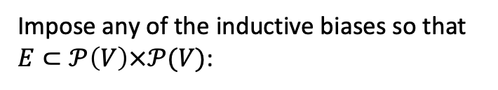
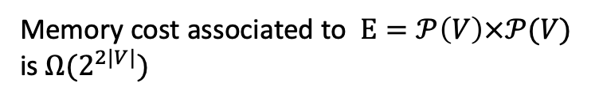

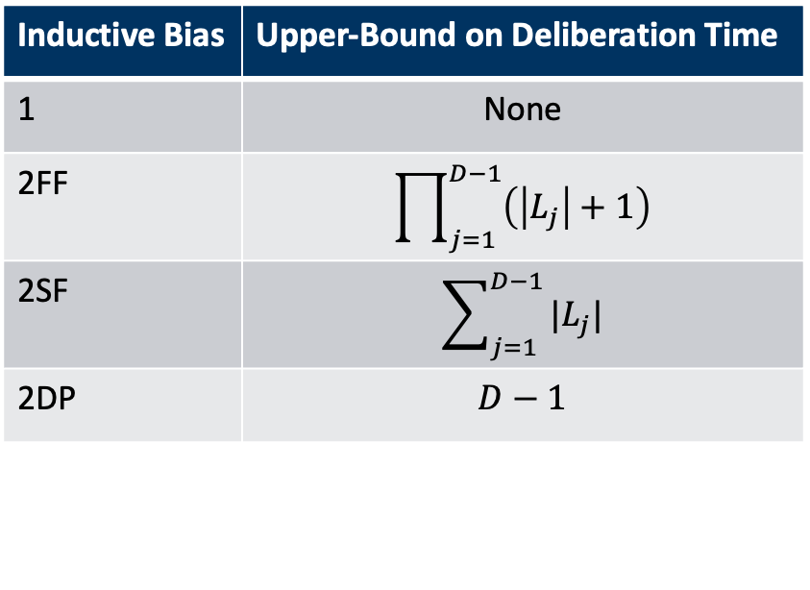

A Physics-Inspired Inductive Bias
Memory cost associated to $E=𝒫\left(V\right)×𝒫(V)$ is $Ω(2^{2|V|})$
For ECM depth $D$ and layers $L_{j}$
Inductive Bias | Upper-Bound on Deliberation Time
1 | None
2FF | $$\prod_{j=1}^{D−1}{\left(\left|L_{j}\right|+1\right)}$$
2SF | $$\sum_{j=1}^{D−1}{|L_{j}|}$$
2DP | $$D−1$$
Impose any of the inductive biases so that $E⊂𝒫\left(V\right)×𝒫(V)$:
Scaling cost is now upper-bounded by
$$𝒪\left(\max{I}\max{O}{\left|V\right|}^{\max{IO}}\right)$$
Reduces complexity from exponential to polynomial
Similar to how humans decompose information

Slide 10
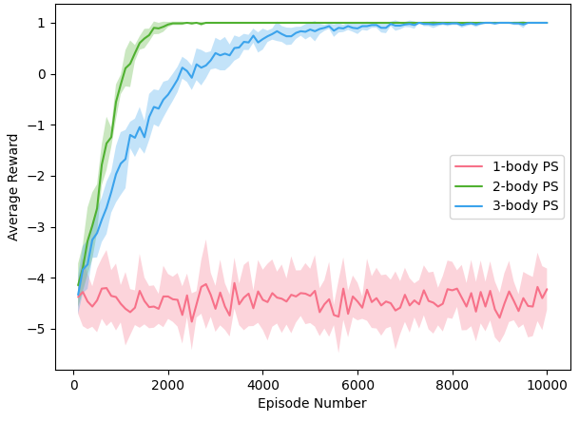
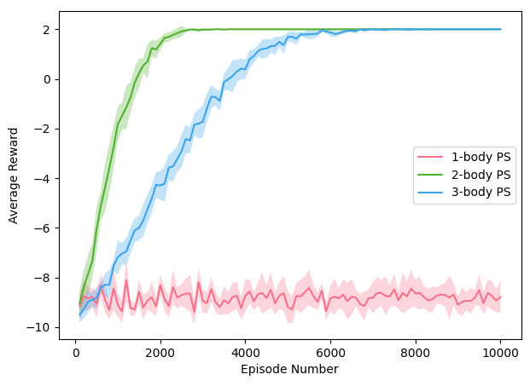
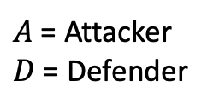


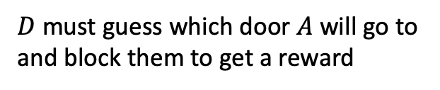
Two Invasion Game Environments
1) Invasion Game with Distraction
2) Deceptive Invasion Game
+
=
Same as 1) but now correct door changes based on parity of
Correct door
$A$ = Attacker
$D$ = Defender
is irrelevant
+
?
$$A$$
?
?
$$D$$
?
$D$ must guess which door $A$ will go to and block them to get a reward
Both show utility of picking the right inductive bias!
Notes:
Mention that we have another more complex environment that we successfully trained the agent on

Slide 11
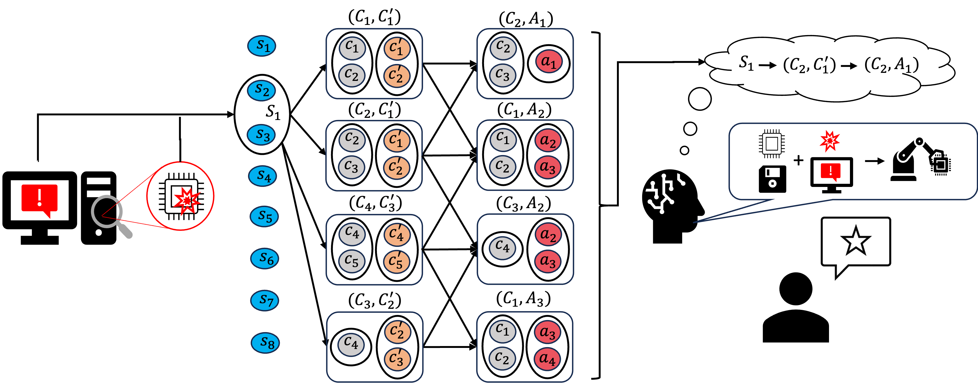
The Computer Maintenance Environment
What is cause of issue?
What fix to use given cause?
= symptom clips
= component clips
= cause clips
= fix clips
Given problem scenario
Agent
Customer
Notes:
Demonstrate mePS and inductive bias on a real-world-inspired task: computer maintenance
Here we use a 3-layer agent where intermediate layer represents hypotheses about causes of problems
We get around credit assignment issues by using dual rewards that apply to different layers; one of these rewards (plausibility) encodes causal relations between causes and fixes,
which provides weak generalization capability since transitions that are not associated with specific scenarios will get trained
For Computer diagram:
The boxes denote pairs of hyperedges that the agent can transition to/from.
The agent first observes a pair of symptoms that get coupled into a percept hyperedge $S_1$ which triggers deliberation through pairs of components/causes ($C_i, C^{'}_j$) and components/fixes ($C_i, A_j$), ending with a chain-of-thought that the agent then converts into an explanation to the customer who determines their reward.
As an example, consider a clumsy owner who drops their computer on the ground, causing physical damage to the motherboard (MoBo) that results in a software error in the storage unit (SSD), leading to physical damage in the SSD, which then also causes physical damage to the MoBo in a feedback loop. Such a situation in which software interacts with hardware can occur when faulty programs overuse resources (resulting in heat or electrical damage to the computer) or create conflicting processes that lead to this.
In the Computer Maintenance environment, this scenario would be coded as: [[`files disappearing', `visible markings on components'], [`MoBo', `SSD'], [`physical damage', `software damage'], [`replace components’]].
mePS agent can handle this complex environment well and inductive bias helps them to learn faster compared with unrestricted agent

Slide 12

The Computer Maintenance Environment
What is cause of issue?
What fix to use given cause?
= symptom clips
= component clips
= cause clips
= fix clips
$$→$$
Dual reward model
Given problem scenario
Agent
Customer
Point 3) encodes causal relations into reward
1) Correct causes and components?
Hypothesis reward
Plausibility reward
2) Consistent choices?
3) Plausible fixes given causes?
Enables partial generalization by training transitions outside scenario set
Notes:
Timing: 1:35-2:25. Introduce the single running example. In the computer-maintenance environment, the technician observes symptoms and has to infer components and causes before selecting fixes. A single-excitation PS path can still be readable, but its current clip must package the relevant short-term context. If files disappearing and visible markings indicate a coupled MoBo/SSD problem with physical and software damage, the representation we want is not one large composite label. We want the elementary facts to remain separate while still being part of the same deliberation.
[Sources]
- AIJ_new.tex lines 638-680 define the Computer Maintenance environment, the symptom/component/cause/fix sets, and the example scenario involving files disappearing, visible markings, MoBo, SSD, physical damage, software damage, and replace components.
- AIJ_new.tex lines 228-236 motivate multiple excitations by noting that PS cannot naturally represent composite reasoning steps.
Timing: 4:00-5:10. This is the only example slide to discuss in detail. The customer brings a broken computer. Symptoms enter as percepts. The MEPS agent moves through a hidden layer whose active clips encode component-cause hypotheses, and then moves to fixes. The explanation is not a post-hoc label attached after the action. It is the sampled sequence of active percepts, intermediate hypotheses, and fixes. The reward is split into hypothesis and plausibility parts so that the intermediate layer receives feedback as an explanation layer rather than becoming an opaque bridge.
[Sources]
- Paper Figure 8, arXiv v4 source file CompMaintenance_v2.png.
- AIJ_new.tex lines 680-718 describe the hidden component-cause layer, the split hypothesis and plausibility rewards, and the role of internal consistency in the Computer Maintenance environment.
Demonstrate mePS and inductive bias on a real-world-inspired task: computer maintenance
Here we use a 3-layer agent where intermediate layer represents hypotheses about causes of problems
We get around credit assignment issues by using dual rewards that apply to different layers; one of these rewards (plausibility) encodes causal relations between causes and fixes,
which provides weak generalization capability since transitions that are not associated with specific scenarios will get trained
For Computer diagram:
The boxes denote pairs of hyperedges that the agent can transition to/from.
The agent first observes a pair of symptoms that get coupled into a percept hyperedge $S_1$ which triggers deliberation through pairs of components/causes ($C_i, C^{'}_j$) and components/fixes ($C_i, A_j$), ending with a chain-of-thought that the agent then converts into an explanation to the customer who determines their reward.
As an example, consider a clumsy owner who drops their computer on the ground, causing physical damage to the motherboard (MoBo) that results in a software error in the storage unit (SSD), leading to physical damage in the SSD, which then also causes physical damage to the MoBo in a feedback loop. Such a situation in which software interacts with hardware can occur when faulty programs overuse resources (resulting in heat or electrical damage to the computer) or create conflicting processes that lead to this.
In the Computer Maintenance environment, this scenario would be coded as: [[`files disappearing', `visible markings on components'], [`MoBo', `SSD'], [`physical damage', `software damage'], [`replace components’]].
mePS agent can handle this complex environment well and inductive bias helps them to learn faster compared with unrestricted agent

Slide 13
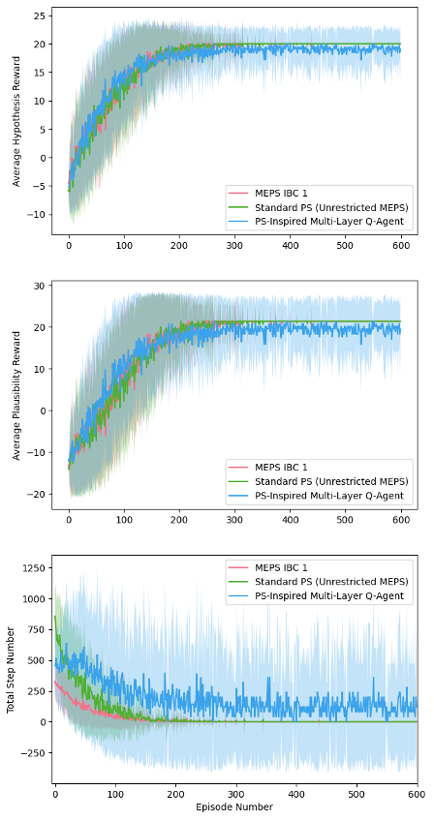
The Computer Maintenance Environment
114,375
1,429,968
16,766
trainable parameters for the inductive-bias MEPS agent
trainable parameters for the unrestricted and tabular baselines
average steps to optimum vs. 35,817 and 115,261
The agent can reach near-optimal hypothesis and plausibility rewards while keeping the explanation path structured enough to inspect.
Notes:
Timing: 5:10-6:00. Close with only the computer-maintenance evidence. The inductive-bias MEPS agent uses 114,375 trainable parameters, while the unrestricted MEPS and tabular PS-inspired multi-layer Q-learning baselines use 1,429,968. The inductive-bias agent reaches near-optimal hypothesis and plausibility rewards with about 16,766 average steps to optimum, compared with 35,817 and 115,261 for the two baselines. Close by restating the conceptual message: MEPS preserves the PS random-walk interpretation, but the state of the walk is rich enough to represent several active concepts.
[Sources]
- Paper Figure 9, arXiv v4 source file BrokenComp_InductiveBiasandQ_Training_New2.png.
- AIJ_new.tex lines 688-718 give the 114,375 vs. 1,429,968 trainable parameter comparison and the average step totals 16,766, 35,817, and 115,261.
- MariusKrumm/ManyBodyMEPS GitHub repository provides code and results for the MEPS paper.
mePS agent can handle this complex environment well and inductive bias helps them to learn faster compared with unrestricted agent
Both inductive bias and unrestricted agents learn to fix many different computer problems near-optimally
Inductive bias helps the agent to find the solution much faster
- Difference of $\sim 2700$ steps
Comparable performance from inductive bias agent using 16x less parameters!
So what we have here is

Slide 14


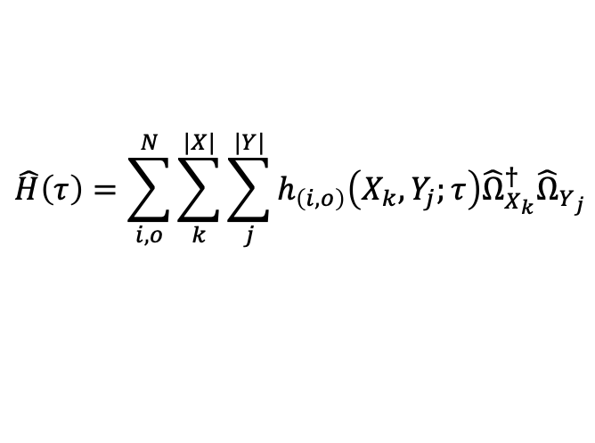









Quantum mePS - Preliminaries
$X_{i}≡\{x_{1},x_{2},…, x_{|X_{i}|}\}$,
$$X≡S, C, A$$
$$0_{X_{i}}≡\{0_{1},0_{2},…, 0_{|X_{i}|}\}$$
Vacuum state:
Time evolution from $τ_{0}$ to $τ$:
$$\left|vac\right\rangle =|0_{S},0_{C}, 0_{A}⟩$$
$$\hat{U}\left(τ, τ_{0}\right)=e^{i(τ−τ_{0})\hat{H}}$$
Creation operator: ${\hat{α}}^{†}$
Time-evolution of creation/annihilation operators:
$${\hat{Ω}}_{X_{i}}^{†}≡{\hat{α}}_{x_{1}}^{†}⋯{\hat{α}}_{x_{|X_{i}|}}^{†}$$
Annihilation operator: $\hat{α}$
$${\hat{Ω}}_{X_{i}}^{†}\left(τ\right)=\hat{U}\left(τ, τ_{0}\right){\hat{Ω}}_{X_{i}}^{†}\left(τ_{0}\right){\hat{U}}^{†}\left(τ, τ_{0}\right)$$
$${\hat{Ω}}_{X_{i}}≡{\hat{α}}_{x_{1}}⋯{\hat{α}}_{x_{|X_{i}|}}$$
Hamiltonian:
$$\hat{H}\left(τ\right)=\sum_{i,o}^{N}{\sum_{k}^{|X|}{\sum_{j}^{|Y|}{h_{\left(i, o\right)}\left(X_{k}, Y_{j};τ\right){\hat{Ω}}_{X_{k}}^{†}{\hat{Ω}}_{Y_{j}}}}}$$
Notes:
$$\hat{V}\left(τ, τ_{0}\right)=𝒯e^{i\int_{τ_{0}}^{τ}{dt}\hat{H\left(t\right)}}=\lim_{N→∞}{\lim_{k→∞}{\prod_{n}^{N}{{\left(I+\frac{i}{k}\hat{H}\left(ndt\right)dt\right)}^{k}}}}$$
$$\hat{V}\left(∆t\right)=\lim_{k→K}{{\left(I+\frac{i∆t}{k}\hat{H}\right)}^{k}}$$
$$P_{\left\{τ, τ_{0}\right\}}^{\left(n\right)}\left(A_{j} | S_{i}\right)=tr\left({\hat{ρ}}_{S_{i}}\left(τ\right){\hat{Π}}_{A_{j}}\right)=tr\left({\hat{U}}^{†}(τ, τ_{0}){\hat{ρ}}_{S_{i}}\left(τ_{0}\right)\hat{U}(τ, τ_{0}){\hat{Π}}_{A_{j}}\right)=tr\left({\hat{U}}^{†}\left(τ, τ_{0}\right)|S_{i}, 0_{S\backslash S_{i}}, 0_{C}, 0_{A}⟩⟨S_{i}, 0_{S\backslash S_{i}}, 0_{C}, 0_{A}| \hat{U}(τ, τ_{0}){\hat{Π}}_{A_{j}}\right)=tr\left({\hat{U}}^{†}\left(τ, τ_{0}\right){\hat{Ω}}_{S_{i}}^{†}|vac⟩⟨vac|{\hat{Ω}}_{S_{i}} \hat{U}(τ, τ_{0}){\hat{Π}}_{A_{j}}\right)$$
Where ${\hat{Π}}_{A_{j}}={\hat{Ω}}_{A_{j}}^{†}|vac⟩⟨vac|{\hat{Ω}}_{A_{j}}$ is a projective measurement of the action modes corresponding to action hyperedge $A_{j}$. In practice however, one could just use the projector for all action modes and then couple out all the actions (or some subset of them; i.e. the subset generation that happens in mePS, but with some consistency constraints) that have nonzero excitations.
- How to decide which action hyperedges get coupled out? We can first apply consistency condition to punish and/or eliminate conflicting actions, then apply a probability distribution to all subsets of the remaining actions and sample one subset (basically another 2-layer PS).
- What to do when none of the measured modes are action modes? We can just reset the deliberation until we get action modes, or we can dilate the space with many copies of the actions so that action modes are guaranteed to be measured.
Can we teleport the chosen action states to a new state that is then the input for a circuit that represents the environment and then repeat this procedure but for the environment circuit so that we have quantum interactions only?

Slide 15












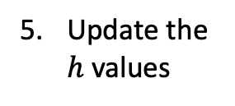


Quantum mePS
Deliberate
Learn
Excite percept modes
Entangle all states then move excitations through ECM
Measure action modes until condition is met
Perform actions from step 3
Update the $h$ values
$$\left|s_{1}, …,s_{\left|S\right|}\right\rangle$$
$$\hat{U}\left(τ_{2}, τ_{1}\right)$$
$$\left|c_{1}, …,c_{N_{1}}\right\rangle$$
Learn
$$\hat{U}\left(τ_{3}, τ_{2}\right)$$
$$\left|c_{N_{1}+1}, …,c_{N_{2}}\right\rangle$$
$$\hat{U}\left(τ_{4}, τ_{3}\right)$$
$$⋯$$
$$\hat{U}\left(τ_{1}, τ_{0}\right)$$
$$⋯$$
$$\hat{U}\left(τ_{m−1}, τ_{m−2}\right)$$
$$\left|c_{N_{n−1}+1}, …,c_{\left|C\right|}\right\rangle$$
$$\hat{U}\left(τ, τ_{m−1}\right)$$
$$\left|a_{1}, …,a_{\left|A\right|}\right\rangle$$
Notes:
$$\hat{V}\left(τ, τ_{0}\right)=𝒯e^{i\int_{τ_{0}}^{τ}{dt}\hat{H\left(t\right)}}=\lim_{N→∞}{\lim_{k→∞}{\prod_{n}^{N}{{\left(I+\frac{i}{k}\hat{H}\left(ndt\right)dt\right)}^{k}}}}$$
$$\hat{V}\left(∆t\right)=\lim_{k→K}{{\left(I+\frac{i∆t}{k}\hat{H}\right)}^{k}}$$
$$P_{\left\{τ, τ_{0}\right\}}^{\left(n\right)}\left(A_{j} | S_{i}\right)=tr\left({\hat{ρ}}_{S_{i}}\left(τ\right){\hat{Π}}_{A_{j}}\right)=tr\left(\hat{U}(τ, τ_{0}){\hat{ρ}}_{S_{i}}\left(τ_{0}\right){\hat{U}}^{†}(τ, τ_{0}) {\hat{Π}}_{A_{j}}\right)=tr\left(\hat{U}(τ, τ_{0}) |S_{i}, 0_{S\backslash S_{i}}, 0_{C}, 0_{A}⟩⟨S_{i}, 0_{S\backslash S_{i}}, 0_{C}, 0_{A}|{\hat{U}}^{†}\left(τ, τ_{0}\right){\hat{Π}}_{A_{j}}\right)=tr\left(\hat{U}(τ, τ_{0}) {\hat{Ω}}_{S_{i}}^{†}|vac⟩⟨vac|{\hat{Ω}}_{S_{i}}{\hat{U}}^{†}\left(τ, τ_{0}\right){\hat{Π}}_{A_{j}}\right)$$
Where ${\hat{Π}}_{A_{j}}={\hat{Ω}}_{A_{j}}^{†}|vac⟩⟨vac|{\hat{Ω}}_{A_{j}}$ is a projective measurement of the action modes corresponding to action hyperedge $A_{j}$. In practice however, one could just use the projector for all action modes and then couple out all the actions (or some subset of them; i.e. the subset generation that happens in mePS, but with some consistency constraints) that have nonzero excitations.
- How to decide which action hyperedges get coupled out? We can first apply consistency condition to punish and/or eliminate conflicting actions, then apply a probability distribution to all subsets of the remaining actions and sample one subset (basically another 2-layer PS).
- What to do when none of the measured modes are action modes? We can just reset the deliberation until we get action modes, or we can dilate the space with many copies of the actions so that action modes are guaranteed to be measured.
Can we teleport the chosen action states to a new state that is then the input for a circuit that represents the environment and then repeat this procedure but for the environment circuit so that we have quantum interactions only?

Slide 16


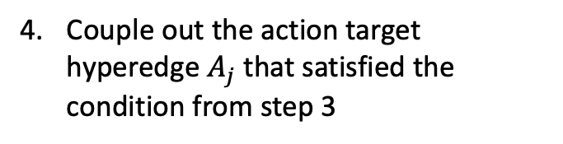




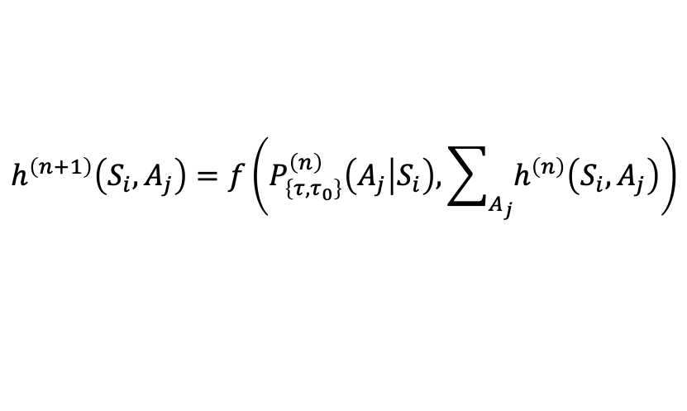
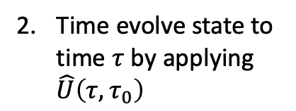

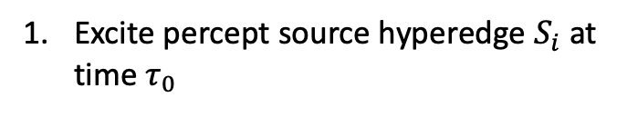






Quantum mePS
Deliberate
Excite percept source hyperedge $S_{i}$ at time $τ_{0}$
Time evolve state to time $τ$ by applying $\hat{U}\left(τ, τ_{0}\right)$
Repeatedly measure excitation numbers of action modes until some condition is met
$${\hat{Ω}}_{S_{i}}^{†}|0_{S},0_{C}, 0_{A}⟩=|S_{i}, 0_{S\backslash S_{i}}, 0_{C}, 0_{A}⟩$$
$$P_{\left\{τ, τ_{0}\right\}}^{\left(n\right)}(A_{j}|S_{i}) = {\left|\left\langle A_{j}\left(τ\right) | S_{i}\left(τ_{0}\right)\right\rangle \right|}^{2}$$
$$s_{1}$$
$$⋯$$
$$s_{|S|}$$
Learn
Couple out the action target hyperedge $A_{j}$ that satisfied the condition from step 3
$$c_{1}$$
$$\hat{U}\left(τ, τ_{0}\right)$$
$$⋯$$
Update the $h$ values
$$c_{|C|}$$
$$a_{1}$$
$$⋯$$
$$h^{\left(n+1\right)}\left(S_{i}, A_{j}\right)=f\left(P_{\left\{τ, τ_{0}\right\}}^{\left(n\right)}\left(A_{j} | S_{i}\right), \sum_{A_{j}}{h^{\left(n\right)}\left(S_{i}, A_{j}\right)}\right)$$
$$a_{|A|}$$
Notes:
$$\hat{V}\left(τ, τ_{0}\right)=𝒯e^{i\int_{τ_{0}}^{τ}{dt}\hat{H\left(t\right)}}=\lim_{N→∞}{\lim_{k→∞}{\prod_{n}^{N}{{\left(I+\frac{i}{k}\hat{H}\left(ndt\right)dt\right)}^{k}}}}$$
$$\hat{V}\left(∆t\right)=\lim_{k→K}{{\left(I+\frac{i∆t}{k}\hat{H}\right)}^{k}}$$
$$P_{\left\{τ, τ_{0}\right\}}^{\left(n\right)}\left(A_{j} | S_{i}\right)=tr\left({\hat{ρ}}_{S_{i}}\left(τ\right){\hat{Π}}_{A_{j}}\right)=tr\left(\hat{U}(τ, τ_{0}){\hat{ρ}}_{S_{i}}\left(τ_{0}\right){\hat{U}}^{†}(τ, τ_{0}) {\hat{Π}}_{A_{j}}\right)=tr\left(\hat{U}(τ, τ_{0}) |S_{i}, 0_{S\backslash S_{i}}, 0_{C}, 0_{A}⟩⟨S_{i}, 0_{S\backslash S_{i}}, 0_{C}, 0_{A}|{\hat{U}}^{†}\left(τ, τ_{0}\right){\hat{Π}}_{A_{j}}\right)=tr\left(\hat{U}(τ, τ_{0}) {\hat{Ω}}_{S_{i}}^{†}|vac⟩⟨vac|{\hat{Ω}}_{S_{i}}{\hat{U}}^{†}\left(τ, τ_{0}\right){\hat{Π}}_{A_{j}}\right)$$
Where ${\hat{Π}}_{A_{j}}={\hat{Ω}}_{A_{j}}^{†}|vac⟩⟨vac|{\hat{Ω}}_{A_{j}}$ is a projective measurement of the action modes corresponding to action hyperedge $A_{j}$. In practice however, one could just use the projector for all action modes and then couple out all the actions (or some subset of them; i.e. the subset generation that happens in mePS, but with some consistency constraints) that have nonzero excitations.
- How to decide which action hyperedges get coupled out? We can first apply consistency condition to punish and/or eliminate conflicting actions, then apply a probability distribution to all subsets of the remaining actions and sample one subset (basically another 2-layer PS).
- What to do when none of the measured modes are action modes? We can just reset the deliberation until we get action modes, or we can dilate the space with many copies of the actions so that action modes are guaranteed to be measured.
Can we teleport the chosen action states to a new state that is then the input for a circuit that represents the environment and then repeat this procedure but for the environment circuit so that we have quantum interactions only?

Slide 17

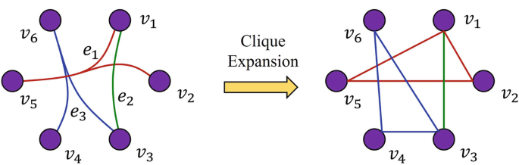

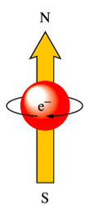
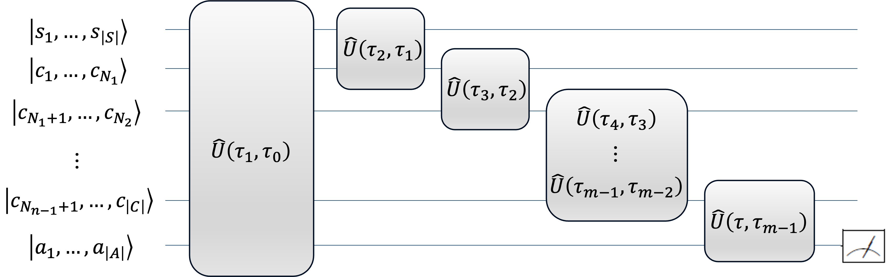
Outlook
Dai, Q., Gao, Y. (2023). Mathematical Foundations of Hypergraph. In: Hypergraph Computation. Artificial Intelligence: Foundations, Theory, and Algorithms. Springer, Singapore
Behavioural biology
Hypergraph results
Generated by DALL-E
Neuro-symbolic AI
Many-body features
Quantum mePS
https://quizlet.com/537524242/15-electrons-in-atoms-flash-cards
Notes:
PS has already been successfully applied to modelling animal foraging and behaviour patterns
Flexibility of mePS would be beneficial
Further incorporate many-body features into inductive bias such as Pauli-exclusion
Would also be interesting to explore effect of particle statistics on deliberation
Incorporate more advanced results from hypergraph literature to improve mePS scalability
Explore possible connections with Neuro-Symbolic logic
Further develop quantum mePS and find useful application where quantum advantage can be achieved

Slide 18

Questions?
Artificial Intelligence 352, 104489 (2026)
Notes:
How is MEPS interpretable beyond ANNs:
Update rule is local and it is clear what each term means and how each weight is reinforced
Clips have clear semantics and composite structure
Random walk coincides with a deliberative episode recall chain since clips have clear semantics
Its really the case that the random walk is actually the path used by the agent during deliberation and this is inspectable, unlike for ANNs (although I guess you could also implement sampling in ANNs?)
You can also inspect local alternatives in the deliberation chain to get explanation probabilities (due to clip semantics)

