Slide 1

Atomic Shell Structure IN A Polymer-Based Approach to Orbital-Free Density-Functional Theory
Phil LeMaitre, University of Waterloo, Department of Physics and Astronomy Supervisor: Dr. Russell B. Thompson

Slide 2
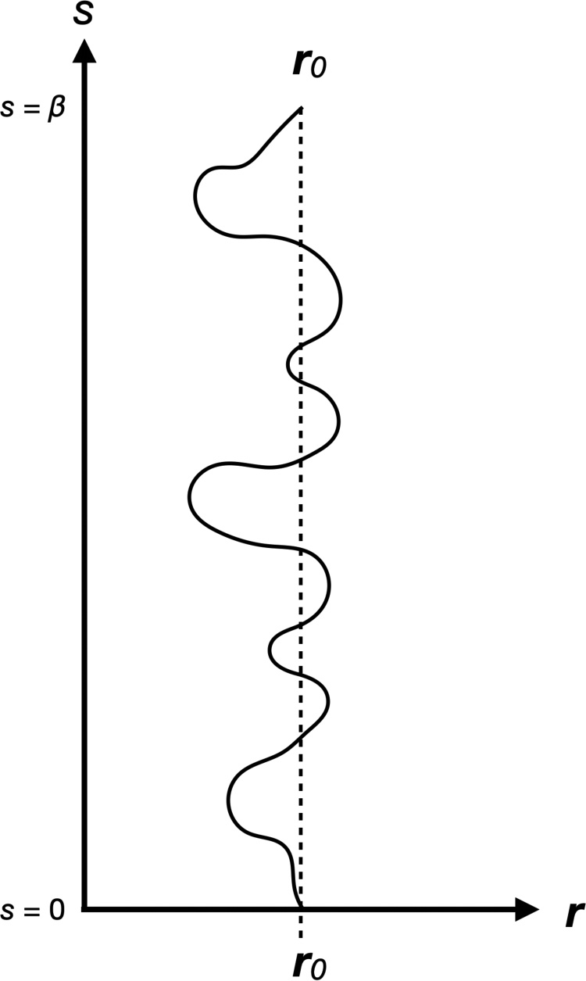
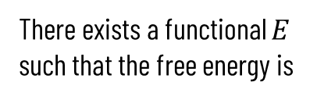

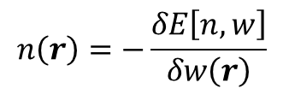


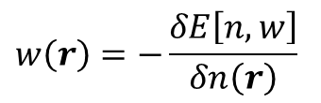
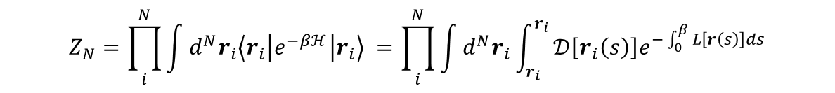

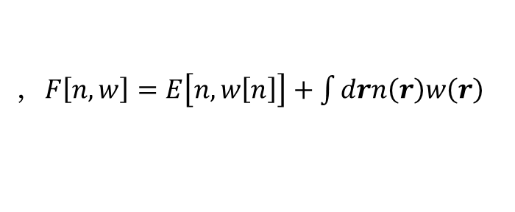
Brief Background
Feynman’s Quantum-Classical correspondence:
Quantum particles in $ℝ^{3}$ $↔$ ring polymers in $ℝ^{3}×ℂ$
Comes from identical form of quantum time-evolution operator with Boltzmann operator in partition function in path-integral representation when $t=−iℏβ$
$$Z_{N}=\prod_{i}^{N}{\int{d^{N}r_{i}\left\langle r_{i} | e^{−βℋ} | r_{i}\right\rangle }} =\prod_{i}^{N}{\int{d^{N}r_{i}}\int_{r_{i}}^{r_{i}}{𝒟\left[r_{i}\left(s\right)\right]e^{−\int_{0}^{β}{L\left[r\left(s\right)\right]ds}}}}$$
In the spirit of polymer field theory we can translate wavefunction description into density-functional description through Hohenberg-Kohn-Mermin theorems:
There exists a functional $E$ such that the free energy is
$$F=\min_{n}\left\{F\left[n, w\right]\right\}$$
, $F\left[n, w\right]=E\left[n, w\left[n\right]\right]+\int{drn\left(r\right)w\left(r\right)}$
By treating free energy as functional of density $n\left(r\right)$ and field $w\left(r\right)$, they can be calculated self-consistently through the variational principle
$$n\left(r\right)=−\frac{δE\left[n, w\right]}{δw\left(r\right)}$$
$$w\left(r\right)=−\frac{δE\left[n, w\right]}{δn\left(r\right)}$$
$$δF\left[n, w\right]=0$$
$$→$$
,
Polymer contour starting and ending at the same position Phys. Rev. A 102, 012813 (2020).
Notes:
The parameter $s$ is not a time, but plays the role of a time in this model
Mermin formalism says that there exists a functional $E[n]$independent of the field $w$, such that $F$ is minimum and equal to the free energy associated to $w$ when $n$ is the equilibrium density in the presence of $w$
The density $n$ is subject to the given field $w,$ and we can make the Hamiltonian a functional of $n$ and also add a field dependence to the partition function through the functional dirac delta, so I think it is justified to allow the functional $E$ to depend on $n$ and $w$; also, $w$ is dependent on $n$ in SCFT so the statement still holds
Functional $E$ will be described in the next slide

Slide 3
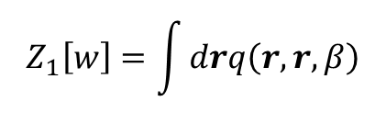
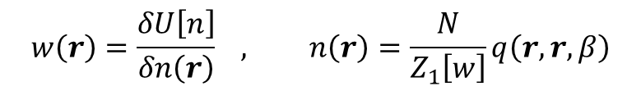
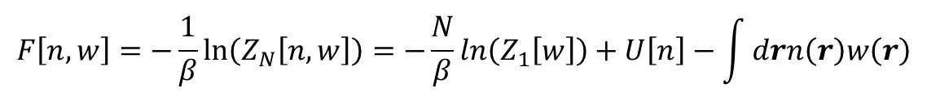

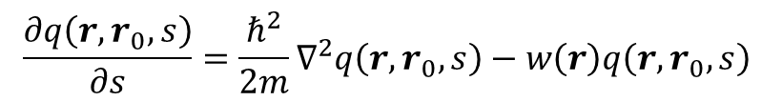
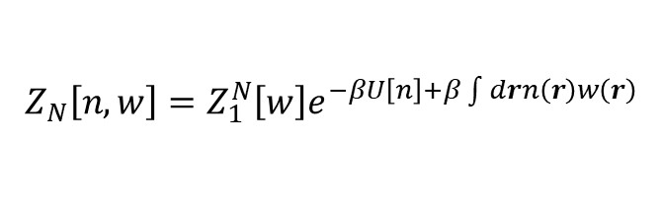
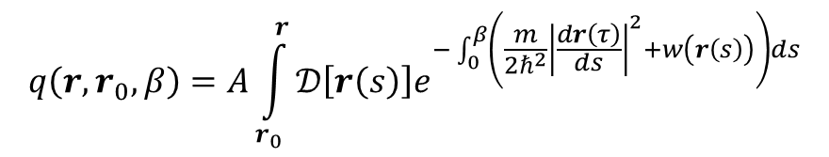
Self-Consistent Field Equations
Transform $N$-coordinate representation of $Z_{N}$ to field representation and perform mean-field saddle expansion of partition function:
$$Z_{N}\left[n, w\right]=Z_{1}^{N}\left[w\right]e^{−βU\left[n\right]+β\int{drn\left(r\right)w\left(r\right)}}$$
$$Z_{1}\left[w\right]=\int{drq\left(r,r,β\right)}$$
where
Single-particle propagator $q\left(r, r_{0}, β\right)$ obeys diffusion equation with initial condition $q\left(r,r_{0},0\right)=δ\left(r−r_{0}\right)$ :
$$q\left(r,r_{0},β\right)=A\int_{r_{0}}^{r}{𝒟\left[r\left(s\right)\right]e^{−\int_{0}^{β}{\left(\frac{m}{2ℏ^{2}}{\left|\frac{dr\left(τ\right)}{ds}\right|}^{2}+w\left(r\left(s\right)\right)\right)ds}}}$$
$$\frac{∂q\left(r,r_{0},s\right)}{∂s}=\frac{ℏ^{2}}{2m}∇^{2}q\left(r,r_{0},s\right)−w\left(r\right)q\left(r,r_{0},s\right)$$
$$→$$
Free energy is then given by:
$$F\left[n,w\right]=−\frac{1}{β}\ln\left(Z_{N}\left[n, w\right]\right)=−\frac{N}{β}ln\left(Z_{1}\left[w\right]\right)+U\left[n\right]−\int{drn\left(r\right)w\left(r\right)}$$
Variational principle involving free energy then gives self-consistent expressions for mean field and density:
$$w\left(r\right)=\frac{δU\left[n\right]}{δn\left(r\right)} , n\left(r\right)=\frac{N}{Z_{1}\left[w\right]}q\left(r,r,β\right)$$
Find more details in J Chem. Phys. 150, 204109 (2019).
Notes:
Hartree independent particle approximation allows us to factor the partition function and identify a single-particle partition function along with a single-particle propagator
Note that we can still consider this partition function to be exact since the contributions from all neglected terms can be packaged into the unknown exchange-correlation functional
The free energy plays the role of the action from the path-integral formalism, so we seek to extremize the free energy in an analogous manner
Briefly explain SCFT procedure here

Slide 4
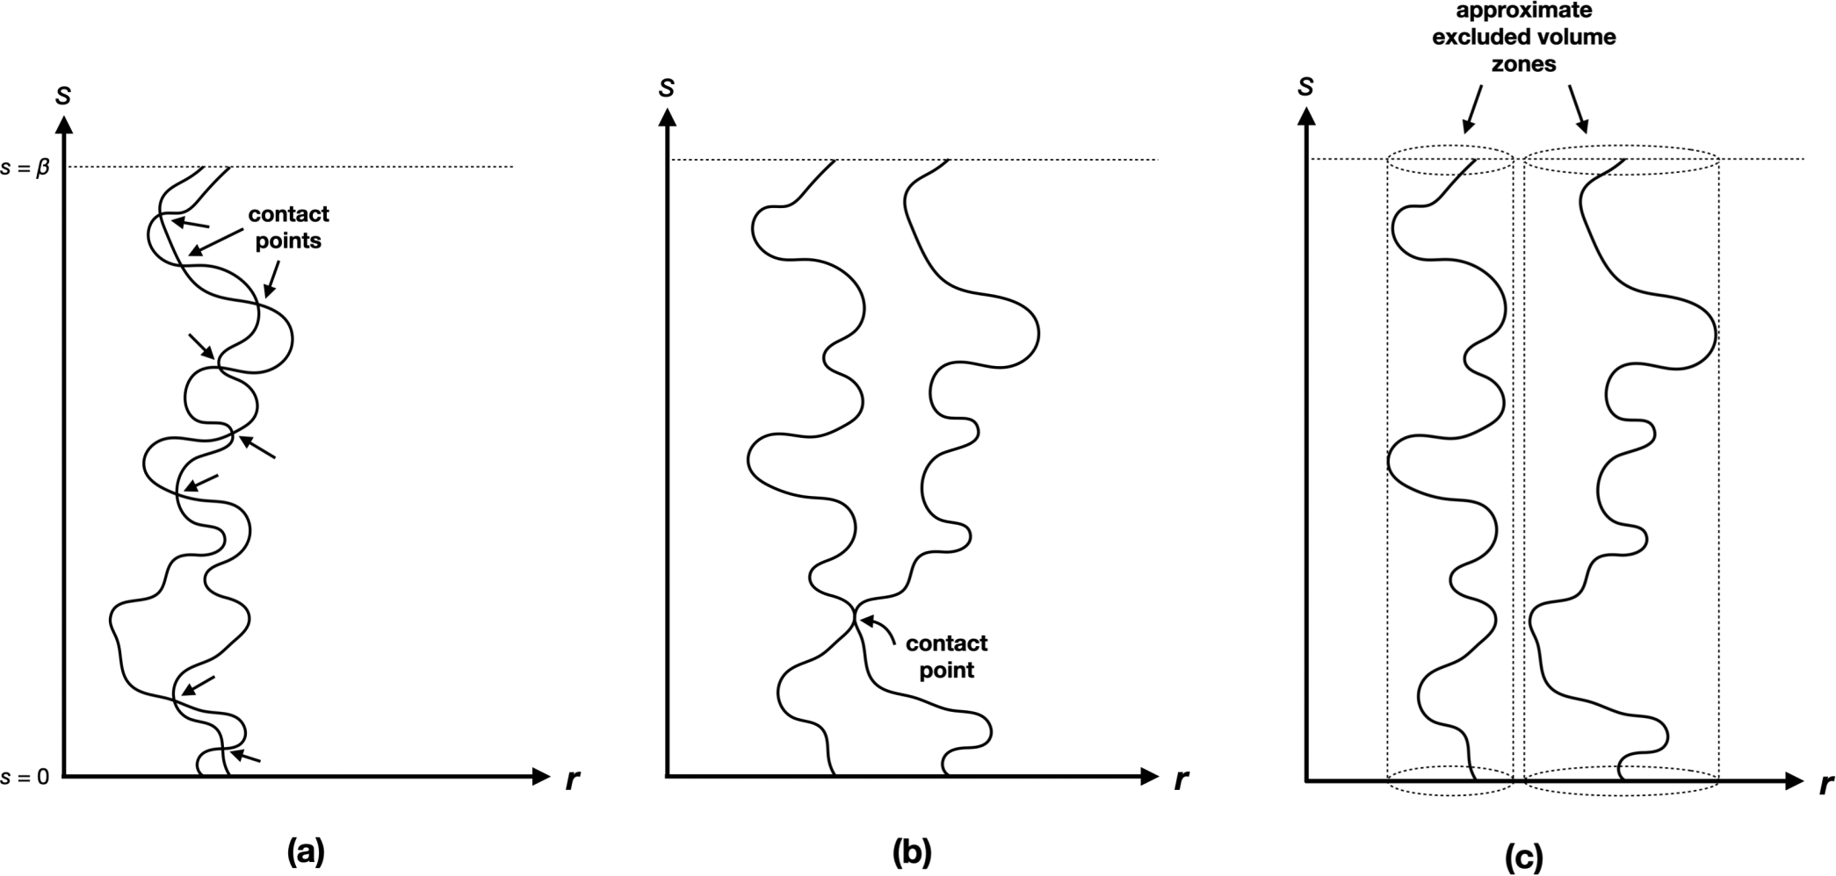

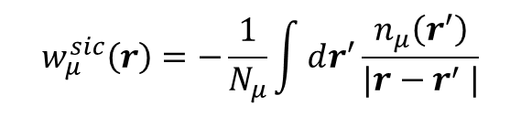

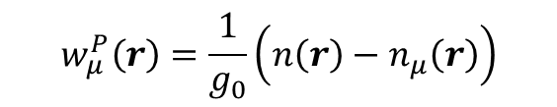
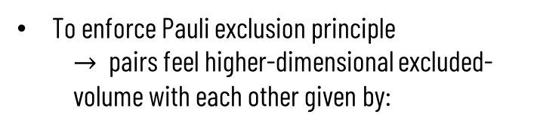
The Model
Fields include standard electron-electron and electron-nucleus interactions in atomic systems
Spin-statistics accounted for by instead postulating that higher-dimensional ring-polymer threads describe “pairs” of distinguishable quantum particles
To enforce Pauli exclusion principle
$→$ pairs feel higher-dimensional excluded-volume with each other given by:
$$w_{μ}^{P}\left(r\right)=\frac{1}{g_{0}}\left(n\left(r\right)−n_{μ}\left(r\right)\right)$$
Fermi-Amaldi-type self-interaction correction acting on all pairs:
Phys. Rev. A 102, 012813 (2020).
$g_{0}$ is free parameter due to 3-D-projection approximation
$$w_{μ}^{sic}\left(r\right)=−\frac{1}{N_{μ}}\int{dr^{′}\frac{n_{μ}\left(r^{′}\right)}{|r−r^{′} |}}$$
$$w_{μ}^{sic}\left(r\right)+w_{μ}^{P}\left(r\right)→$$
Equivalent to Hartree-Fock theory
Notes:
The free energy plays the role of the action from the path-integral formalism, so we seek to extremize the free energy in an analogous manner
The term “pair” means “species” having up to two particles
Hartree-Fock theory models exchange effects exactly
The reason we don’t use the full 4D Pauli exclusion field is because working with it requires us to know the density at every value of the contour, which increases the number of calculation steps substantially due to the nature of the self-consistent method we employ. As will be mentioned near the end, a multi-block calculation would have to be carried out, which entails discretizing the contour values and assigning a density to each value of the contour and then self-consistently solving the system the normal way but this time with a number of extra steps equal to the discretization number of the contour per iteration.
3D-projected Pauli exclusion field overestimates excluded-volume in s space

Slide 5
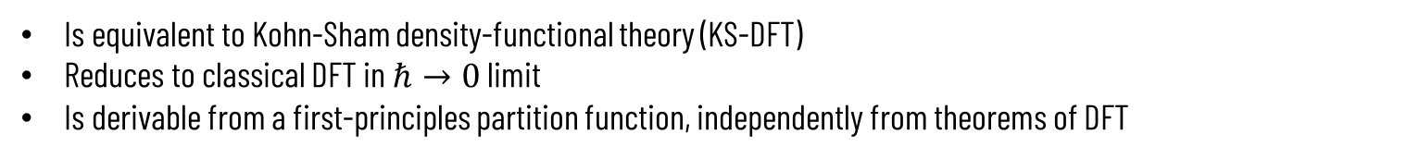
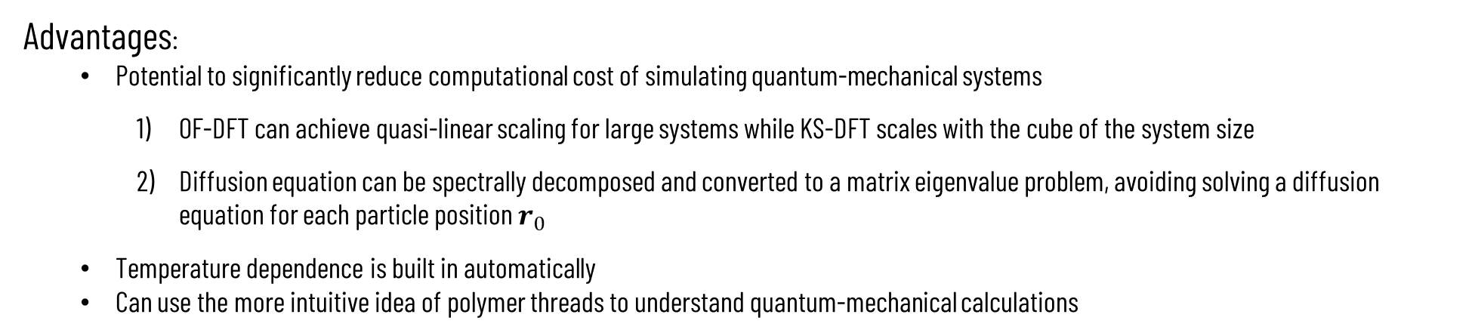
Benefits of Using this Model
Thompson proved the model…
Is equivalent to Kohn-Sham density-functional theory (KS-DFT)
Reduces to classical DFT in $ℏ→0$ limit
Is derivable from a first-principles partition function, independently from theorems of DFT
Advantages:
Potential to significantly reduce computational cost of simulating quantum-mechanical systems
OF-DFT can achieve quasi-linear scaling for large systems while KS-DFT scales with the cube of the system size
Diffusion equation can be spectrally decomposed and converted to a matrix eigenvalue problem, avoiding solving a diffusion equation for each particle position $r_{0}$
Temperature dependence is built in automatically
Can use the more intuitive idea of polymer threads to understand quantum-mechanical calculations
J Chem. Phys. 150, 204109 (2019).
Notes:
Kohn-Sham Hamiltonian appears in our derivation, so we just need to state the existence of the orbitals and solve for them, expand the propagator in terms of them to write the density in terms of them, and then take the 0 temperature limit to recover the standard density formula in KS-DFT
Taking the limit as hbar approaches 0 of our formalism reduces to classical DFT
OF-DFT has to approximate the non-interacting kinetic energy functional, which is exact in KS-DFT, in addition to the exchange correlation functional
The non-interacting kinetic energy functional usually has large contribution to total energy, so approximating it is a significant drawback
Pauli exclusion principle needs to be added to exchange-correlation functional artificially in order for OF-DFT to be valid for Fermions
Write K in spectral form then sub into diffusion equation and use orthogonality relations plus define the matrix A to simplify down to given form
K can be written in final form by a similarity transformation of the matrix exponential $e^{A_{nm}β}$
We choose eigenfunctions and eigenvalues of the Laplacian operator, which is what $f$ and $ε_{i}$ are respectively, so that the diffusion equation reduces to the form of the second equation

Slide 6
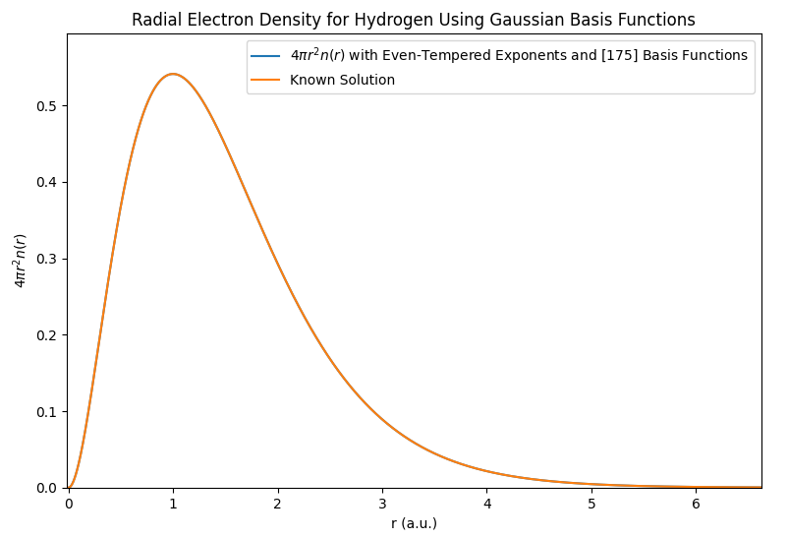
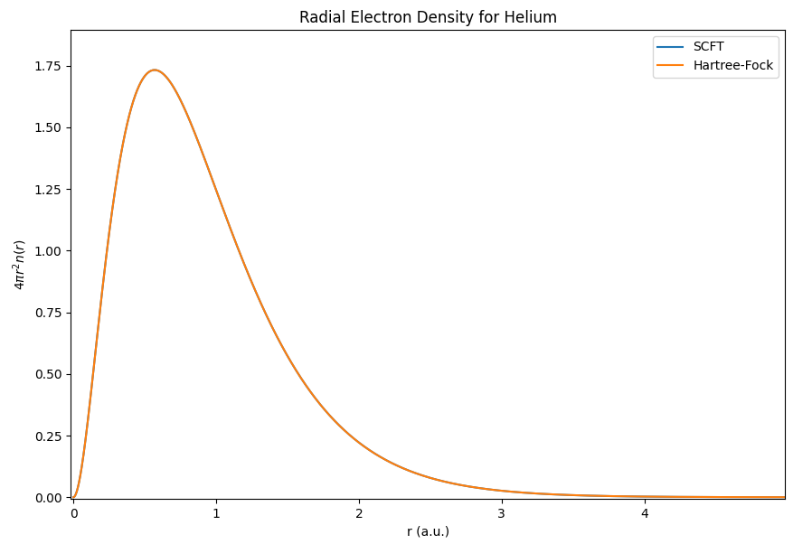

Results – Hydrogen and Helium Radial Electron Densities
Ground-state Hydrogen and Helium are only atoms without Pauli-exclusion effects
suggests that 3D-projected Pauli exclusion field is only physical deviation from Hartree-Fock
$$→$$
All Hartree-Fock plots were generated by functions obtained from J. Chem. Phys. 40, 1686 (1964).
Notes:
Our classical model reproduces the radial electron density of Hydrogen exactly
Helium agrees exactly with Hartree-Fock
For the sake of time and everyone’s attention, I will only present the results up to Krypton. If anyone is interested, I would be happy to send them the results for heavier elements.

Slide 7
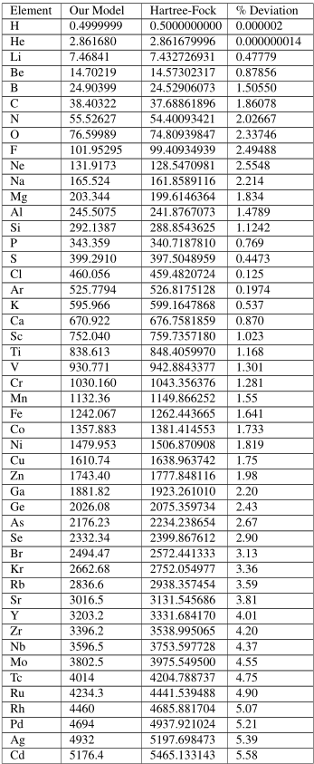
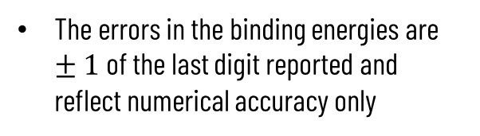
Results – Atomic Binding Energies
The errors in the binding energies are $±1$ of the last digit reported and reflect numerical accuracy only
(All units given in Hartrees)
All Hartree-Fock data are taken from J. Phys. B: At. Mol. Opt. Phys. 29 2973 (1996).
Notes:
For the sake of time and everyone’s attention, I will only present the results up to Cadmium. If anyone is interested, I would be happy to send them the results for heavier elements.
An aspect of the Pauli exclusion field can be seen by looking at the percent deviation column: the deviations after Helium monotonically increase until reaching a shell closure at Neon and then monotonically decrease until the shell closure at Argon, and then promptly increases after that. This gives a clue how the actual Pauli field should behave

Slide 8
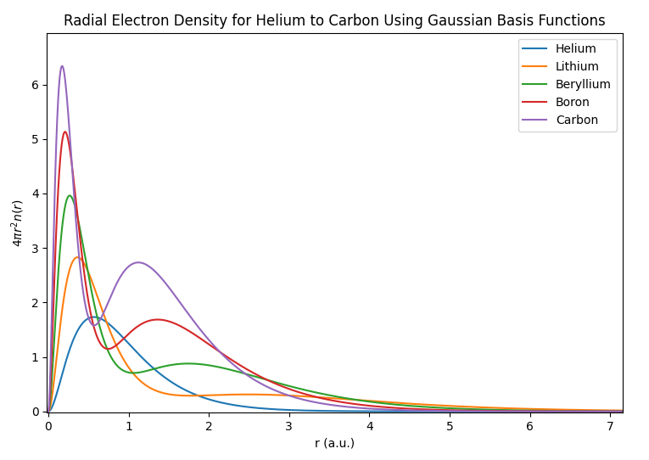
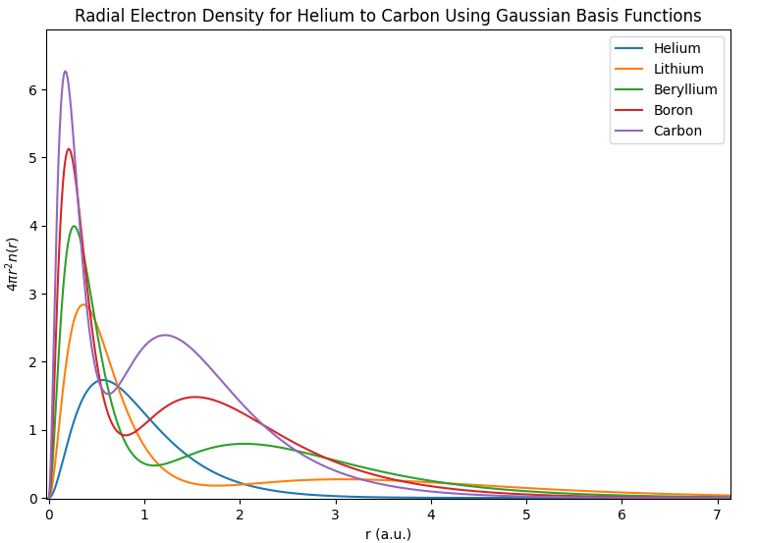
Results – Radial Electron Density
Our Model
Hartree-Fock
All Hartree-Fock plots were generated by functions obtained from J. Chem. Phys. 40, 1686 (1964).
Notes:
Nightmare slide

Slide 9
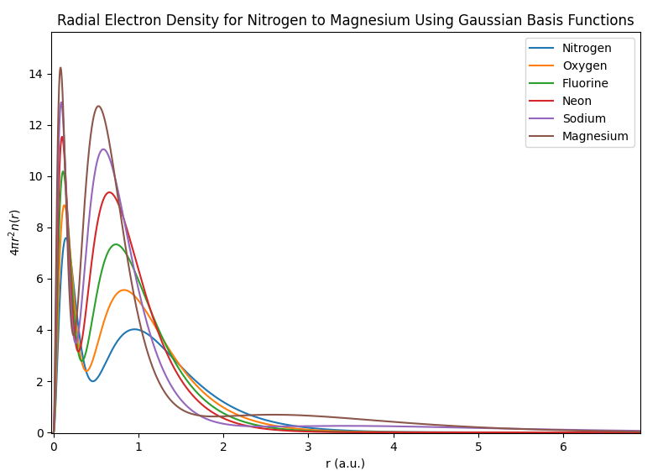
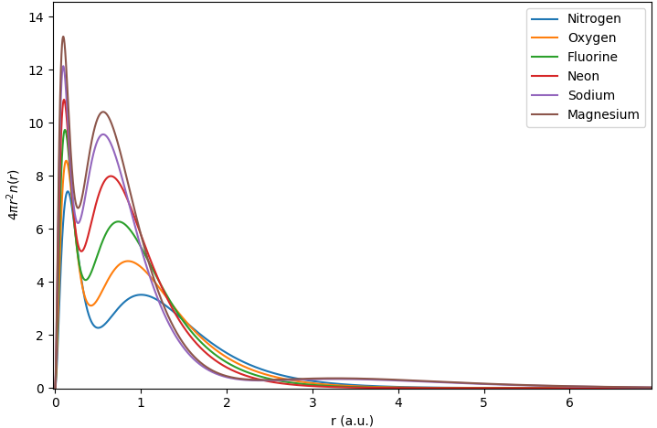
Results – Radial Electron Density
Our Model
Hartree-Fock
All Hartree-Fock plots were generated by functions obtained from J. Chem. Phys. 40, 1686 (1964).
Notes:
Nightmare slide

Slide 10
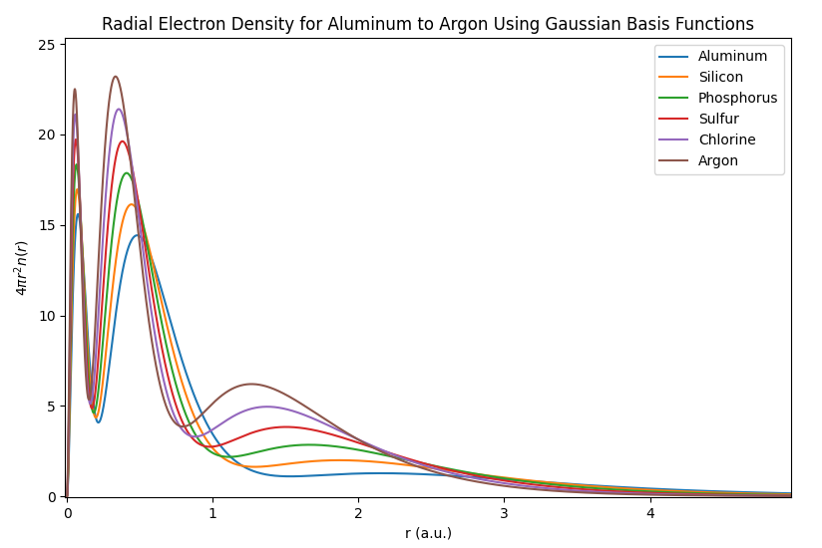
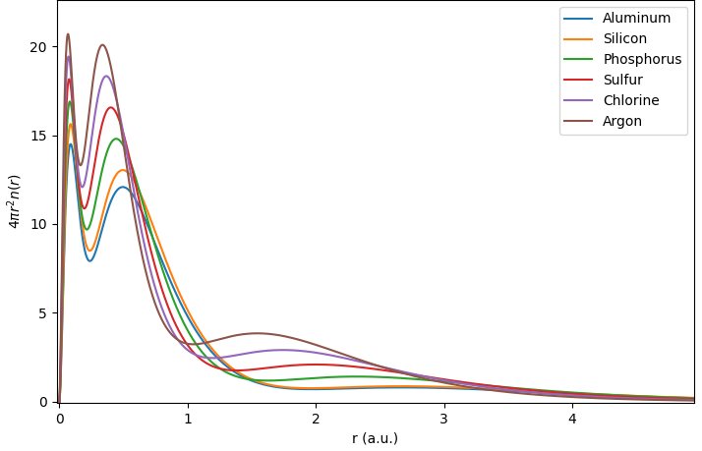
Results – Radial Electron Density
Our Model
Hartree-Fock
All Hartree-Fock plots were generated by functions obtained from J. Chem. Phys. 40, 1686 (1964).
Notes:
The peaks clearly form in the proper position, so we believe the difference in peak height and separation depth is purely due to the repulsion strength of the Pauli field being too strong
Pauli approximation is the only physical obstacle to overcome in order to achieve Hartree-Fock equivalence
Pairs have been populated according to periodic table n-blocks, but that doesn’t imply the model should necessarily reproduce the correct shell structure

Slide 11
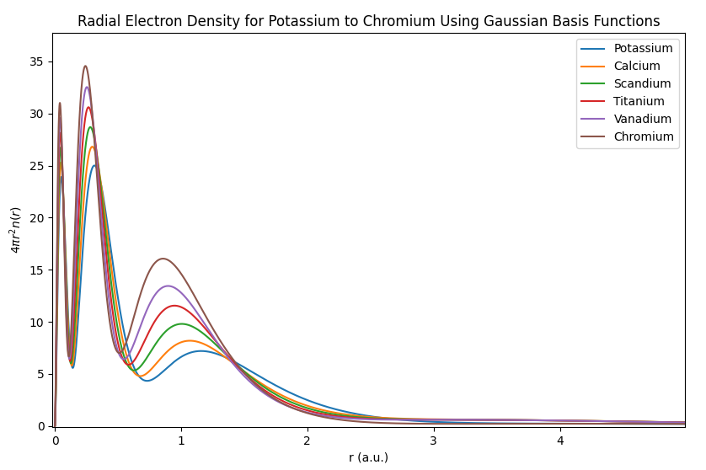
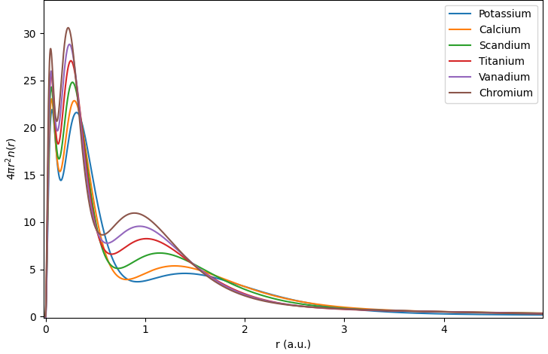
Results – Radial Electron Density
Our Model
Hartree-Fock
All Hartree-Fock plots were generated by functions obtained from J. Chem. Phys. 40, 1686 (1964).
Notes:
Nightmare slide

Slide 12
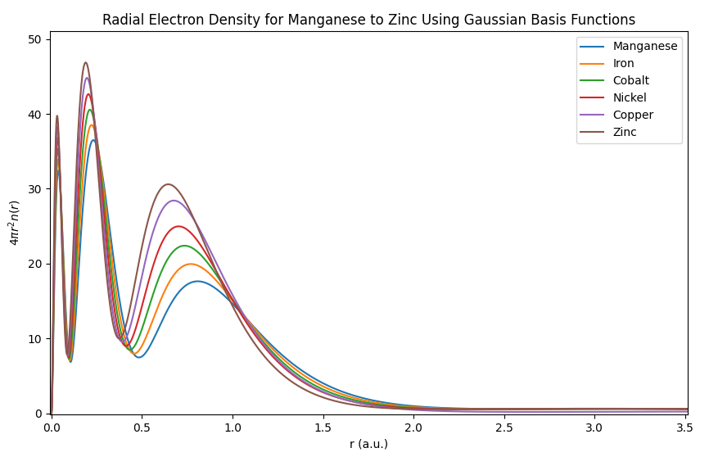
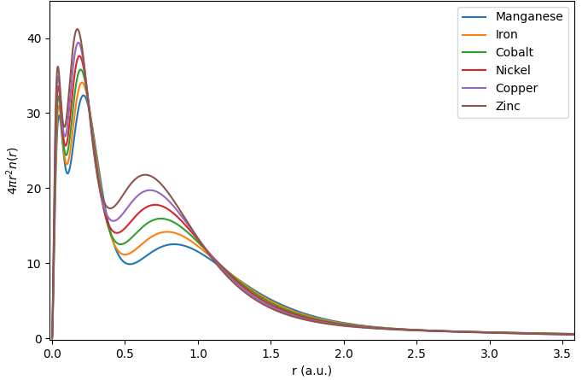
Results – Radial Electron Density
Our Model
Hartree-Fock
All Hartree-Fock plots were generated by functions obtained from J. Chem. Phys. 40, 1686 (1964).
Notes:
Nightmare slide

Slide 13
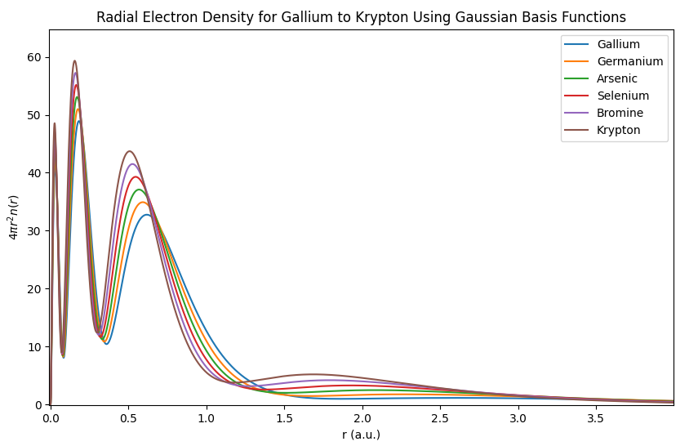
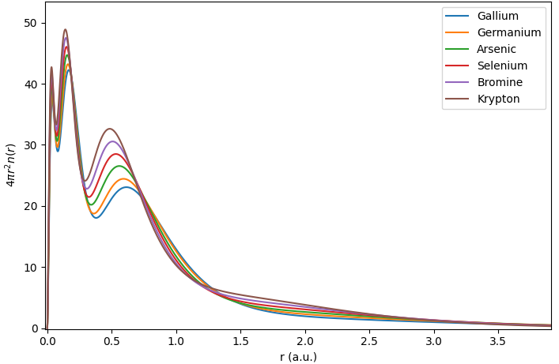
Results – Radial Electron Density
Our Model
Hartree-Fock
All Hartree-Fock plots were generated by functions obtained from J. Chem. Phys. 40, 1686 (1964).

Slide 14
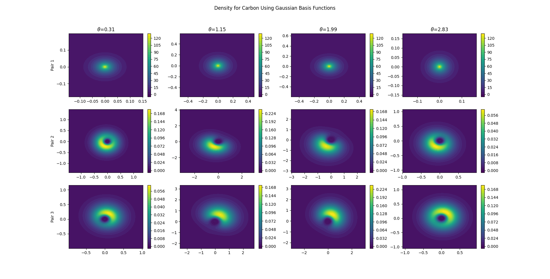
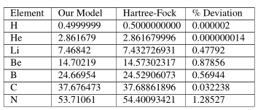

Results – Full Angular Density of Carbon
Spherical symmetry-breaking effect is small and total density looks mostly spherical
Model with Pauli approximation predicts symmetry-breaking at Carbon
Notes:
Angular calculations haven’t been done in previous work due to huge computational effort required, and here we were able to do them de
Pair densities correspond to sums of orbitals
Electron pair densities behave similarly to polymer macrophase separation, where the non-spherical pairs prefer to occupy one of the lobes, but notice that the non-spherical pairs together resemble the 2s + 2p configuration and that the total density looks the same as in other approaches to quantum theory

Slide 15
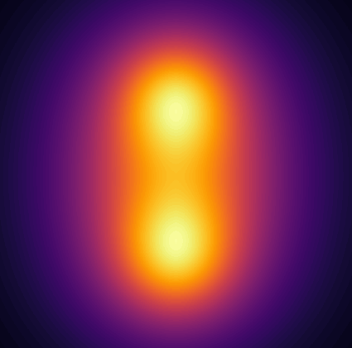
Future Work
Implementing exact 4-D excluded-volume Pauli exclusion field is the next big step, since this is the only approximation preventing full Hartree-Fock equivalence in practice
Adding correlation terms into the model will help account for some of the remaining discrepancies with experimental results
Model infrastructure can be used to extend previous diatomic molecular calculations
Periodic solid-state systems could also be explored using pseudo-potentials
Contour plot of a diatomic molecule from previous work: J. Phys. Chem. A 126(2), 325–332 (2022).
Notes:
Will need to do a multiblock calculation in order to model the exact Pauli potential
This method assigns a density to each polymer contour value and then solves a set of equations for each one
Adding correlation terms will help account for discrepancies with NIST results within nonrelativistic quantum theory
Gaussians can be used for more than just diatomic molecules
Possibly remove third bullet point

Slide 16
Thank you for listening,
are there any questions?

Slide 17
References
Theory of Inhomogeneous Polymers: Fundamentals of the Gaussian Random-Walk Model (E. Helfand)
The Statistical Mechanics of Polymers with Excluded Volume (S. Edwards)
Self-Consistent Field Theory and Its Applications (M. W. Matsen)
Quantum Statistics of Almost Classical Assemblies (J. Kirkwood)
Path Integrals in the Theory of Condensed Helium (D. Ceperley)
Exploiting the Isomorphism Between Quantum Theory and Classical Statistical Mechanics of Polyatomic Fluids (D. Chandler & P. Wolynes)
Density Functional Theory: It’s Origins, Rise to Prominence, and Future (R. Jones)
Density Functional Theory of Atoms and Molecules (R. G. Parr & W. Yang)
Atomic Theory of the Lambda-Transition in Helium (R. P. Feynman)
The Lambda-Transition in Liquid Helium (R. P. Feynman)
Can Orbital-Free Density Functional Theory Simulate Molecules (J. Xia, C. Huang, I. Shin, & E. Carter)
Molecular Bonding in an Orbital-Free-Related Density Functional Theory (S. Sillaste & R. B. Thompson)
An Alternative Derivation to Orbital-Free Density Functional Theory (R. B. Thompson)
Atomic Shell Structure From an Orbital-Free-Related Density-Functional-Theory Pauli Potential (R. B. Thompson)
Moments and Expansion Coefficients of Atomic Electron Momentum Densities: Numerical Hartree-Fock Calculations for Hydrogen to Lawrencium (T. Koga & A. J. Thakker)
Analytical Expressions for the Hartree-Fock Potential of Neutral Atoms and for the Corresponding Scattering Factors for X-Rays and Electrons (T. G. Strand & R. A. Bonham)
Stable and Unstable Phases of a Diblock Copolymer Melt (M. W. Matsen & M. Schick)
Thermal Properties of the Inhomogeneous Electron Gas (N. D. Mermin)
Self-Consistent Equations Including Exchange and Correlation Effects (W. Kohn & L. J. Sham)
Quantum Mechanics and Path Integrals (R. P. Feynman & A. R. Hibbs)
Principles of Quantum Mechanics 2nd Ed. (R. Shankar)
Modern Electronic Structure Theory Chapter 12 (T. Helgaker)
NIST Atomic Spectra Database (A. Kramida et al.)

Slide 18
Benefits of Using this Model
Thompson proved the model…
Is equivalent to Kohn-Sham density-functional theory (KS-DFT)
Reduces to classical DFT in $ℏ→0$ limit
Is derivable from a first-principles partition function, independently from theorems of DFT
Advantages:
Potential to significantly reduce computational cost of simulating quantum-mechanical systems
OF-DFT can achieve quasi-linear scaling for large systems while KS-DFT scales with the cube of the system size
Diffusion equation can be spectrally decomposed and converted to a matrix eigenvalue problem, avoiding solving a diffusion equation for each particle position $r_{0}$
Temperature dependence is built in automatically
Can use the more intuitive idea of polymer threads to understand quantum-mechanical calculations
J Chem. Phys. 150, 204109 (2019).
Notes:
Kohn-Sham Hamiltonian appears in our derivation, so we just need to state the existence of the orbitals and solve for them, expand the propagator in terms of them to write the density in terms of them, and then take the 0 temperature limit to recover the standard density formula in KS-DFT
Taking the limit as hbar approaches 0 of our formalism reduces to classical DFT
OF-DFT has to approximate the non-interacting kinetic energy functional, which is exact in KS-DFT, in addition to the exchange correlation functional
The non-interacting kinetic energy functional usually has large contribution to total energy, so approximating it is a significant drawback
Pauli exclusion principle needs to be added to exchange-correlation functional artificially in order for OF-DFT to be valid for Fermions
Write K in spectral form then sub into diffusion equation and use orthogonality relations plus define the matrix A to simplify down to given form
K can be written in final form by a similarity transformation of the matrix exponential $e^{A_{nm}β}$
We choose eigenfunctions and eigenvalues of the Laplacian operator, which is what $f$ and $ε_{i}$ are respectively, so that the diffusion equation reduces to the form of the second equation

Slide 19
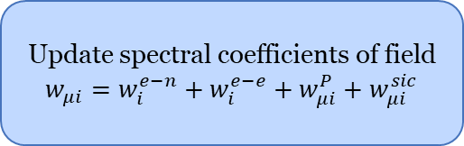
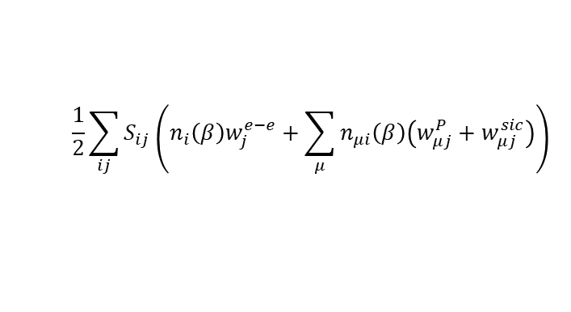
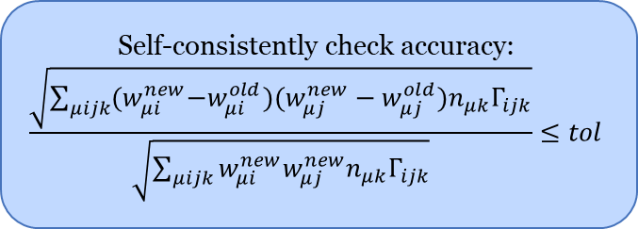
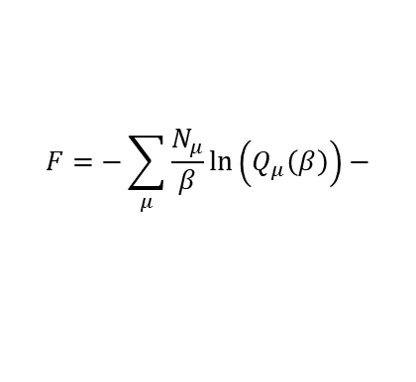
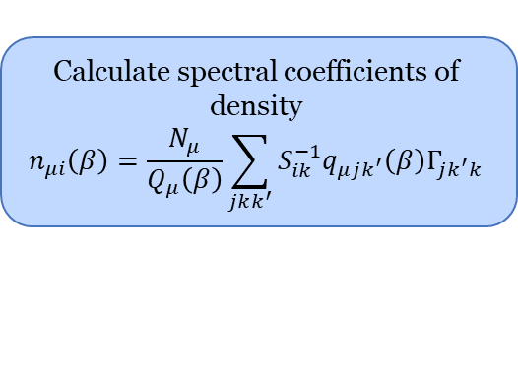
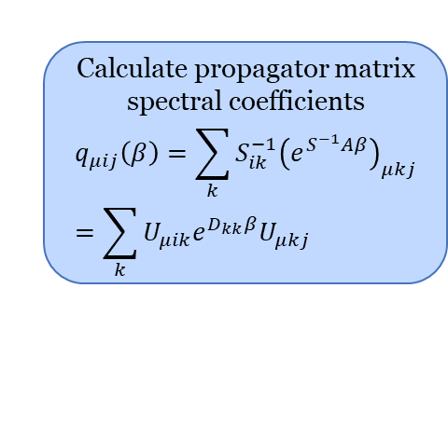
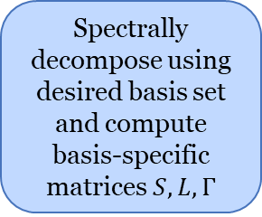
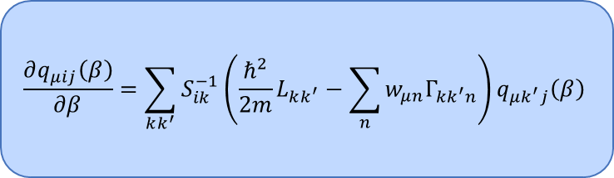
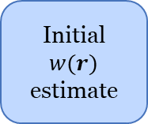
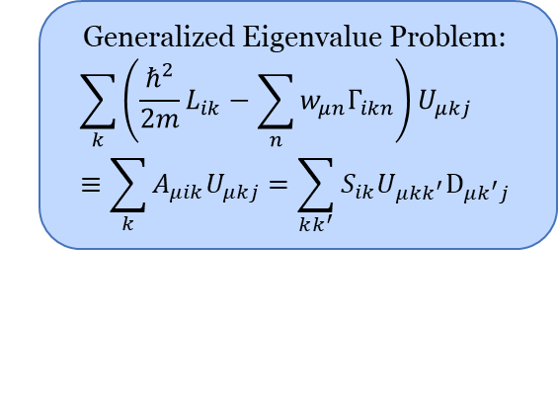
Calculation Process
Spectrally decompose using desired basis set and compute basis-specific matrices $S, L, Γ$
$$\frac{∂q_{μij}\left(β\right)}{∂β}=\sum_{kk^{′}}{S_{ik}^{−1}\left(\frac{ℏ^{2}}{2m}L_{kk^{′}}−\sum_{n}{w_{μn}Γ_{kk^{′}n}}\right)q_{μk^{′}j}\left(β\right)}$$
Generalized Eigenvalue Problem:
$$\sum_{k}{\left(\frac{ℏ^{2}}{2m}L_{ik}−\sum_{n}{w_{μn}Γ_{ikn}}\right)U_{μkj}}≡\sum_{k}{A_{μik}U_{μkj}}=\sum_{kk^{′}}{S_{ik}U_{μkk^{′}}D_{μk^{′}j}}$$
Initial $w(r)$ estimate
Solve
by computing Eigendecomposition
No
Calculate free energy
Calculate propagator matrix spectral coefficients
$$q_{μij}\left(β\right)=\sum_{k}{S_{ik}^{−1}{\left(e^{S^{−1}Aβ}\right)}_{μkj}}=\sum_{k}{U_{μik}e^{D_{kk}β}U_{μkj}}$$
$$F=−\sum_{μ}{\frac{N_{μ}}{β}\ln\left(Q_{μ}\left(β\right)\right)}−$$
Self-consistently check accuracy: $$\frac{\sqrt{\sum_{μijk}{{(w}_{μi}^{new}−w_{μi}^{old})(w_{μj}^{new}−w_{μj}^{old})n_{μk}Γ_{ijk}}}}{\sqrt{\sum_{μijk}{w_{μi}^{new}w_{μj}^{new}n_{μk}Γ_{ijk}}}}≤tol$$
Yes
$$\frac{1}{2}\sum_{ij}{S_{ij}\left(n_{i}\left(β\right)w_{j}^{e−e}+\sum_{μ}{n_{μi}\left(β\right)\left(w_{μj}^{P}+w_{μj}^{sic}\right)}\right)}$$
Convert densities and fields back to real space
Update spectral coefficients of field $w_{μi}=w_{i}^{e−n}+w_{i}^{e−e}+w_{μi}^{P}+w_{μi}^{sic}$
Calculate spectral coefficients of density
$$n_{μi}\left(β\right)=\frac{N_{μ}}{Q_{μ}\left(β\right)}\sum_{jkk^{′}}{S_{ik}^{−1}q_{μjk^{′}}\left(β\right)Γ_{jk^{′}k}}$$

Slide 20

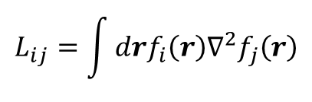
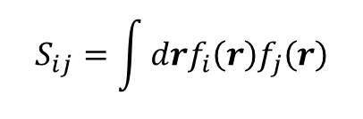
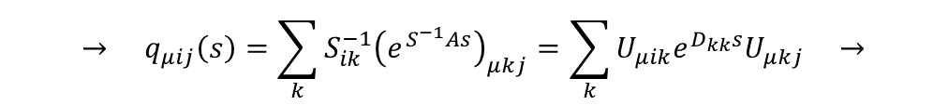

Non-Orthogonal Basis Set Expansions
Translate problem of solving diffusion equation to spectral space using Gaussian basis functions $→$ non-orthogonal spectral expansions
$$f_{i}\left(r\right)=r^{l}e^{−c_{i}r^{2}}Z_{l}^{m}\left(θ,φ\right)$$
We must modify the SCFT equations in spectral space:
$$S_{ij}=\int{drf_{i}\left(r\right)f_{j}\left(r\right)}$$
Overlap integral is no longer diagonal
Basis functions are no longer eigenfunctions of the Laplacian
Generalized eigenvalue problem should be solved when spectrally decomposing the solution for the spectral expansion coefficients of the single-particle propagator to maintain Hermiticity
$$L_{ij}=\int{drf_{i}\left(r\right)∇^{2}f_{j}\left(r\right)}$$
$$\frac{∂q_{μij}\left(s\right)}{∂s}=\sum_{kk^{′}}{S_{ik}^{−1}\left(\frac{ℏ^{2}}{2m}L_{kk^{′}}−\sum_{n}{w_{μn}Γ_{kk^{′}n}}\right)q_{μk^{′}j}\left(s\right)}≡\sum_{kk^{′}}{S_{ik}^{−1}A_{kk^{′}}q_{μk^{′}j}\left(s\right)}$$
$$→ q_{μij}\left(s\right)=\sum_{k}{S_{ik}^{−1}{\left(e^{S^{−1}As}\right)}_{μkj}}=\sum_{k}{U_{μik}e^{D_{kk}s}U_{μkj}} →$$
$$\sum_{k}{A_{μik}U_{μkj}}=\sum_{kk^{′}}{S_{ik}U_{μkk^{′}}D_{μk^{′}j}}$$
Notes:
The equation at the bottom is there to show what I have said in writing, but is for illustrative purposes only. I can go into detail about it later if you have questions

Slide 21

Non-Orthogonal Basis Set Expansions
Gaussian basis sets in spherical coordinates:
Have a very suitable form for atomic systems allowing for relatively good resolution with a modest sized basis
Allow integrals to be evaluated quickly and analytically
Give us the opportunity to explore angular degrees of freedom in atomic systems
New Dangers:
Arbitrary parameters $c_{n}$ have been introduced and we need a way to choose them appropriately so the basis set spans the space well
Nonorthogonality of basis functions can lead to linear dependence errors in calculations
Angular dependence Introduces new term into the gamma tensor: the integral over three real spherical harmonics, also known as the real Gaunt coefficients
Notes:
R is radius of finite spherical box, chosen large enough so that the electron densities go to zero on the boundary
Current research basis functions don’t include the angular components since we would need way more basis sets
Gaussian basis sets are the industry standard in computational chemistry
Modelling simple atomic and molecular systems has the benefit of access to a huge number of prior results to benchmark the theory
Gaussian basis sets are technically overcomplete
We also use Gaussian basis sets to approximate slater orbitals since they are easier to calculate with
We are mostly interested in capturing the qualitative behaviour of these systems since this would indicate that our formalism has the proper structure; better approximations can then be implemented to achieve the desired numerical accuracy

Slide 22



Results – Atomic Binding Energies
The errors in the binding energy values are $±1$ of the last digit reported and reflect numerical accuracy only
(All units given in Hartrees)
All Hartree-Fock data are from (T. Koga & A. J. Thakker, 1996)
Notes:
Helium agrees exactly with Hartree-Fock
For the sake of time and everyone’s attention, I will only present the results up to Krypton. If anyone is interested, I would be happy to send them the results for heavier elements.

Slide 23



NIST Atomic Binding Energies
(All units given in Hartrees)
All NIST data from (A. Kramida et al., 2022)
Notes:
Helium agrees exactly with Hartree-Fock
For the sake of time and everyone’s attention, I will only present the results up to Krypton. If anyone is interested, I would be happy to send them the results for heavier elements.

Slide 24







Equivalence to Kohn-Sham DFT
The pair densities $n_{μ}\left(r\right)$ are related to Kohn-Sham orbitals $φ_{i}\left(r\right)$ through the effective Hamiltonian $ℋ=\frac{ℏ^{2}}{2m}∇^{2}−w\left(r\right)$
Solve eigenvalue problem
Construct propagator
Calculate single-particle partition function
$$q_{μ}\left(r, r^{′},β\right)=\sum_{i}{e^{ε_{i}β}φ_{i}\left(r\right)φ_{i}^{∗}\left(r′\right)}$$
$$Q_{μ}\left[w\right]=\int{dr}q_{μ}\left(r,r,β\right) \\ =\int{dr}\sum_{i}{e^{ε_{i}β}{\left|φ_{i}\left(r\right)\right|}^{2}}=\sum_{i}{e^{ε_{i}β}}$$
$$ℋφ_{i}\left(r\right)=ε_{i}φ_{i}\left(r\right)$$
$$→$$
$$→$$
Density is then
$$n_{μ}\left(r\right)=\frac{N_{μ}}{Q_{μ}\left[w\right]}q_{μ}\left(r,r,β\right)=N_{μ}\frac{\sum_{i}{e^{ε_{i}β}{\left|φ_{i}\left(r\right)\right|}^{2}}}{\sum_{i}{e^{ε_{i}β}}}$$
$$→$$

