Slide 1








A Universal Quantum Computer From Relativistic Motion
Philip A. LeMaitre
March 27, 2026
Phys. Rev. Lett. 134, 190601 (2025)
In collaboration with T. Rick Perche, Marius Krumm, and Hans J. Briegel
Notes:
Hi everyone, thanks for coming to my presentation. My name is Phil and I am a PhD student from the University of Innsbruck in the group of Hans Briegel. Today I will be talking about Multi-Excitation Projective Simulation.

Slide 2
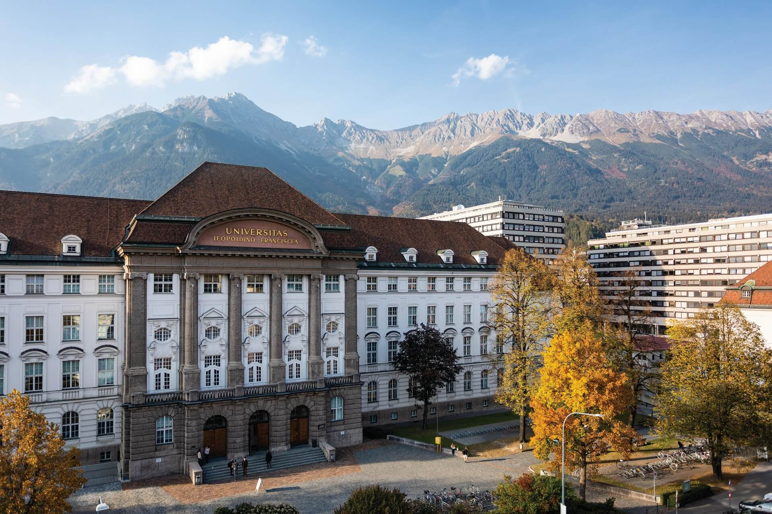






My Journey
Hans Briegel Group
Theoretical Physics Ph.D.
Theoretical Physics B. Sc.
Supervised by Eric Poisson
Russell Thompson Group
Theoretical Physics M. Sc.
Notes:
Why should people care about this work? What is the take home message? Does it address an interesting problem? What has been done before in this area? What did those works struggle with that yours addresses?
The idea of performing some aspects of quantum computing using relativistic motion is not new: Refs. \cite{Layden_Martin-Martinez_Kempf_2016,Martin-Martinez_Aasen_Kempf_2013,Martín-Martínez_Sutherland_2014} constructed 1 and 2-qubit gates in the perturbative regime using coherent field states and Refs. \cite{Bruschi_Dragan_Lee_Fuentes_Louko_2013,Bruschi_Sabín_Kok_Johansson_Delsing_Fuentes_2016,Friis_Bruschi_Louko_Fuentes_2012,AsplingLawler2024} managed the construction for the continuous-variable quantum computing setting. In the former case, we lack analytic expressions for the gates making a full analysis of their properties and any statement of universality seemingly opaque, while in the latter case, the absence of a gate noise analysis (which the authors acknowledge) makes it unclear whether a quantum circuit built from these gates would actually be useful.
We can have the usual universal gate set for quantum algorithms, but we can also have a big unitary that couples every detector
Previous claims of universality did not explicitly show that their gate set could achieve this or claimed it for only a 2-detector setup

Slide 3



Introduction and Motivation
What does a quantum computer look like in RQI?
Some works use relativistic motion of UDW detectors to construct 1 and 2-qubit gates
1. N. Friis, D. E. Bruschi, J. Louko, and I. Fuentes, Motion generates entanglement. Phys. Rev. D 85, 081701 (2012).
2. D. E. Bruschi, A. Dragan, A. R. Lee, I. Fuentes, and J. Louko, Relativistic Motion Generates Quantum Gates and Entanglement Resonances. Phys. Rev. Lett. 111, 090504 (2013).
3. E. Martin-Martinez, D. Aasen, and A. Kempf, Processing quantum information with relativistic motion of atoms, Phys. Rev. Lett. 110, 160501 (2013).
4. E. Martín-Martínez and C. Sutherland, Quantum gates via relativistic remote control. Physics Letters B 739, 74–82 (2014).
5. D. E. Bruschi et al. Towards universal quantum computation through relativistic motion. Sci Rep 6, 18349 (2016).
6. D. Layden, E. Martin-Martinez, and A. Kempf, Universal scheme for indirect quantum control. Phys. Rev. A 93, 040301 (2016).
7. E. Aspling and M. Lawler, Universal Quantum Computing with Field-Mediated Unruh-DeWitt Qubits. arXiv:2402.10173 (2024).
Notes:
Why should people care about this work? What is the take home message? Does it address an interesting problem? What has been done before in this area? What did those works struggle with that yours addresses?
The idea of performing some aspects of quantum computing using relativistic motion is not new: Refs. \cite{Layden_Martin-Martinez_Kempf_2016,Martin-Martinez_Aasen_Kempf_2013,Martín-Martínez_Sutherland_2014} constructed 1 and 2-qubit gates in the perturbative regime using coherent field states and Refs. \cite{Bruschi_Dragan_Lee_Fuentes_Louko_2013,Bruschi_Sabín_Kok_Johansson_Delsing_Fuentes_2016,Friis_Bruschi_Louko_Fuentes_2012,AsplingLawler2024} managed the construction for the continuous-variable quantum computing setting. In the former case, we lack analytic expressions for the gates making a full analysis of their properties and any statement of universality seemingly opaque, while in the latter case, the absence of a gate noise analysis (which the authors acknowledge) makes it unclear whether a quantum circuit built from these gates would actually be useful.
We can have the usual universal gate set for quantum algorithms, but we can also have a big unitary that couples every detector
Previous claims of universality did not explicitly show that their gate set could achieve this or claimed it for only a 2-detector setup

Slide 4
Introduction and Motivation
We also use relativistic motion as part of a specific architecture for a complete, universal quantum computer proposal.
Specifically, we show…
How to execute quantum computation using only detector motion and field-mediated entanglement
Analytic expressions for the gates in general spacetimes
That the noise from the detector-field interaction can be made negligible
That the model is a universal quantum computer
Notes:
Why should people care about this work? What is the take home message? Does it address an interesting problem? What has been done before in this area? What did those works struggle with that yours addresses?
The idea of performing some aspects of quantum computing using relativistic motion is not new: Refs. \cite{Layden_Martin-Martinez_Kempf_2016,Martin-Martinez_Aasen_Kempf_2013,Martín-Martínez_Sutherland_2014} constructed 1 and 2-qubit gates in the perturbative regime using coherent field states and Refs. \cite{Bruschi_Dragan_Lee_Fuentes_Louko_2013,Bruschi_Sabín_Kok_Johansson_Delsing_Fuentes_2016,Friis_Bruschi_Louko_Fuentes_2012,AsplingLawler2024} managed the construction for the continuous-variable quantum computing setting. In the former case, we lack analytic expressions for the gates making a full analysis of their properties and any statement of universality seemingly opaque, while in the latter case, the absence of a gate noise analysis (which the authors acknowledge) makes it unclear whether a quantum circuit built from these gates would actually be useful.
We can have the usual universal gate set for quantum algorithms, but we can also have a big unitary that couples every detector
Previous claims of universality did not explicitly show that their gate set could achieve this or claimed it for only a 2-detector setup

Slide 5
Outline
Variational Quantum Circuits
Unruh-DeWitt Qubits
A Relativistic Quantum Computer
Relativistic Quantum Machine Learning
Extensions
Questions and Outlook
Notes:
Here is how it should go:
Introduce agent definition and general setup
Particularize setup to classical MEPS
Briefly mention inductive bias and its motivation
Show learning results for classical MEPS
Particularize setup to quantum MEPS
Show some preliminary results and describe environment

Slide 6
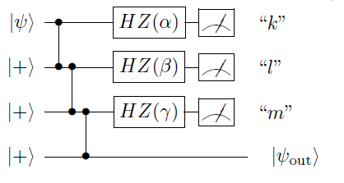








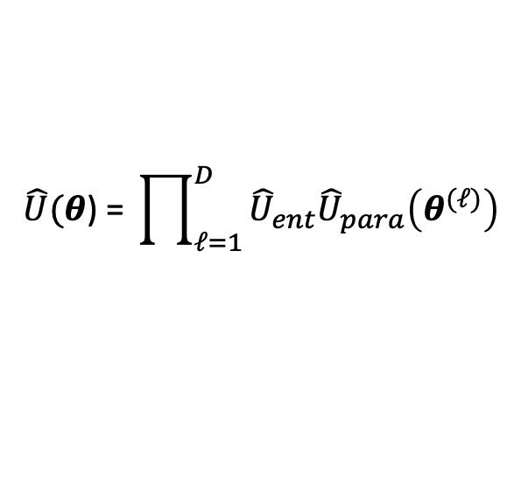








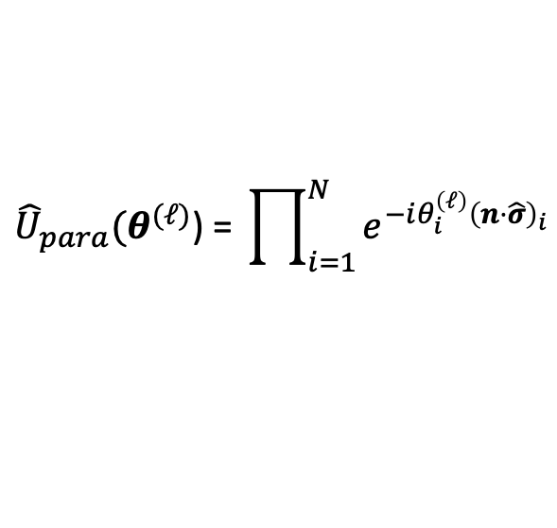

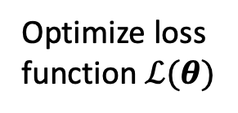





Variational Quantum Computing
$$\hat{U}\text{(}θ\text{) = }\prod_{ℓ=1}^{D}{{\hat{U}}_{ent}{\hat{U}}_{para}\left(θ^{(ℓ)}\right)}$$
$${\hat{U}}_{para}\text{(}θ^{(ℓ)}\text{) = }\prod_{i=1}^{N}{e^{−iθ_{i}^{\left(ℓ\right)}{\left(n⋅\hat{σ}\right)}_{i}}}$$
$n≡$ unit vector, $\hat{σ}≡$ Pauli vector
Initial state
$${\hat{ρ}}_{0}$$
$$⋯$$
$$⋯$$
$$⋯$$
$$⋯$$
$$f_{θ}\left(\hat{O}\right)=Tr\left(\hat{O}\hat{U}\left(θ\right){\hat{ρ}}_{0}{\hat{U}}^{†}(θ)\right)$$
$$\hat{U}\left(θ\right)$$
$$=$$
$$\hat{U}\left(θ^{1}\right)$$
$$\hat{U}\left(θ^{2}\right)$$
$$⋯$$
$$\hat{U}\left(θ^{D}\right)$$
Optimize loss function $ℒ(θ)$
$${\left|ψ\right\rangle }_{1}$$
$${\hat{U}}_{n_{1}}(θ_{1}^{1})$$
Update $θ$
$${\left|ψ\right\rangle }_{2}$$
$${\hat{U}}_{n_{2}}(θ_{2}^{1})$$
$${\hat{U}}_{ent}$$
$$⋯$$
$${\left|ψ\right\rangle }_{N}$$
$${\hat{U}}_{n_{N}}(θ_{N}^{1})$$
M. Cerezo et al. Variational Quantum Algorithms. Nat Rev Phys 3, 625–644 (2021).
Notes:
VQCs have a structure that accommodates UDW time-evolution operators and has the flexibility to allow manipulation of detector trajectories to feature in algorithms; also allows for generalization to QML setting (which we have in mind)
Very clear here how manipulating detector trajectories could be implemented into the computation: as the rotation angles for spacetime rotations of qubits (the rotation part of each VQC layer)
Measure the output of computation with respect to some observable (could just be a Pauli measurement) to get function ansatz (these are called ANN’s in deep learning for example), then input to loss function and optimize; then update parameters and repeat

Slide 7
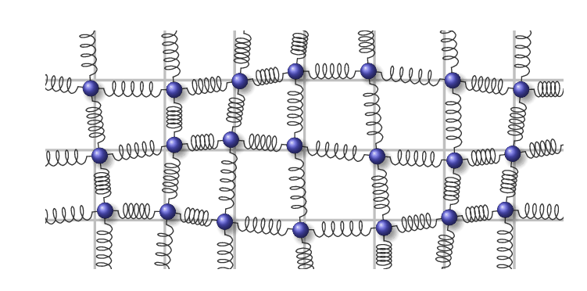
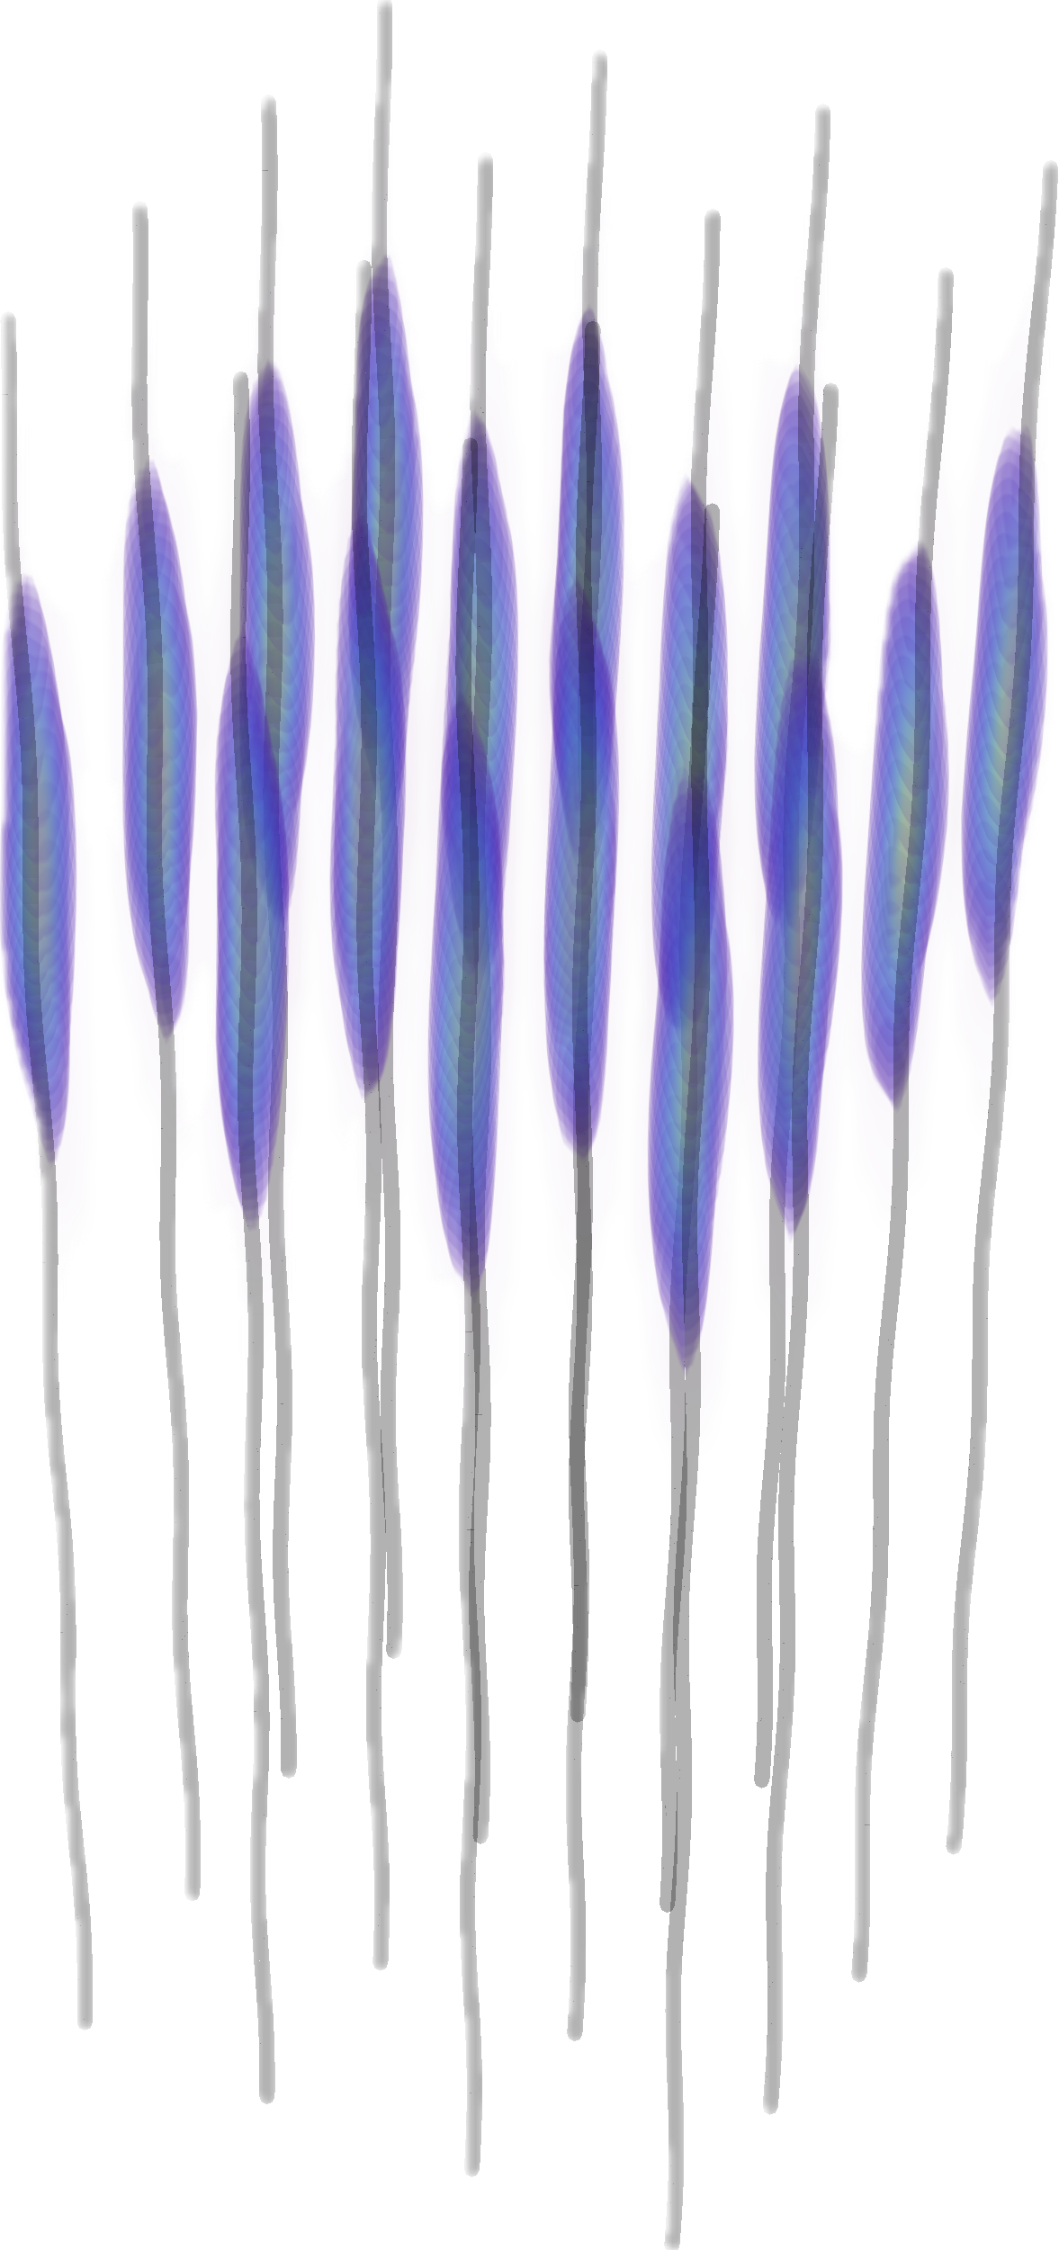
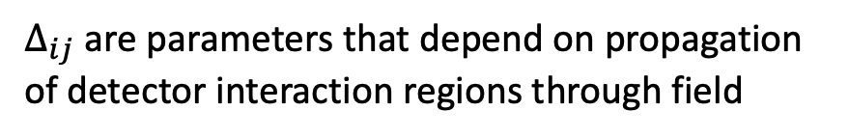
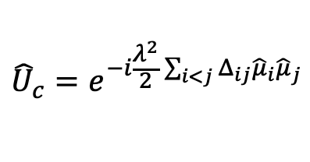




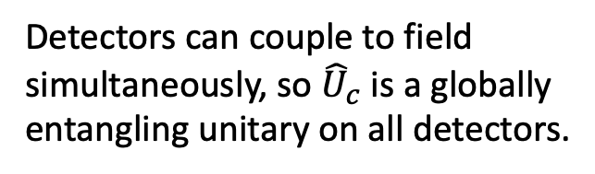


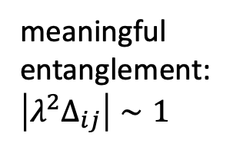
Quantum Fields
Thomas Barthel and Qiang Miao, Scaling functions for eigenstate entanglement crossovers in harmonic lattices. arXiv.1912.10045 (2019).
Consider UDW scalar field interaction Hamiltonian density
$${\hat{h}}_{i}\left(x\right)=λΛ_{i}\left(x\right){\hat{μ}}_{i}⊗\hat{φ}\left(x\right)$$
Time-evolution plus tracing out field results in decohering channel
$$Ω_{i}=0$$
$${\hat{U}}_{c}=e^{−i\frac{λ^{2}}{2}\sum_{i<j}{Δ_{ij}{\hat{μ}}_{i}{\hat{μ}}_{j}}}$$
$$t_{1}<t<t_{2}$$
$$\hat{φ}\left(x\right)$$
$$ℇ\left({\hat{ρ}}_{0}\right)={\hat{U}}_{c}ℇ_{φ}({\hat{ρ}}_{0}){\hat{U}}_{c}^{†}$$
with
$Δ_{ij}$ are parameters that depend on propagation of detector interaction regions through field
Detector-field interaction regions
Detectors can couple to field simultaneously, so ${\hat{U}}_{c}$ is a globally entangling unitary on all detectors.
meaningful entanglement: $\left|λ^{2}Δ_{ij}\right|∼1$
worldlines
$$z_{i}^{μ}(τ_{i})$$
Notes:
Over a proper time interval $\Delta \tau_i$, the local unitary implemented by the internal dynamics of each qubit is simply a Bloch rotation around the $\bm n_i$ axis, which takes the form of each factor in Eq. \ref{Equation:UDWRotate} with parameters $\theta_i = \Omega_i\Delta\tau_i/2$. If we now identify the set $\bm \theta = \{\theta_i, \vartheta_i, \varphi_i\}_i$ as our trainable parameters and define the product of these local unitaries as a trainable layer, we get the first part of a VQC Eq. \ref{Equation:UDWRotate}. Importantly, the $\bm \theta$ depend not only on the internal energy gap of the qubits $\Omega_i$, but also on the proper time difference experienced by each qubit while undergoing its respective trajectory.
Mention that ability to choose Pauli rotation direction is a novel resource that allows us to achieve universality
e.g. circular trajectories in Minkowski $Δτ_{i}=Δt\sqrt{1−R^{2}ω_{i}^{2}}$

Slide 8
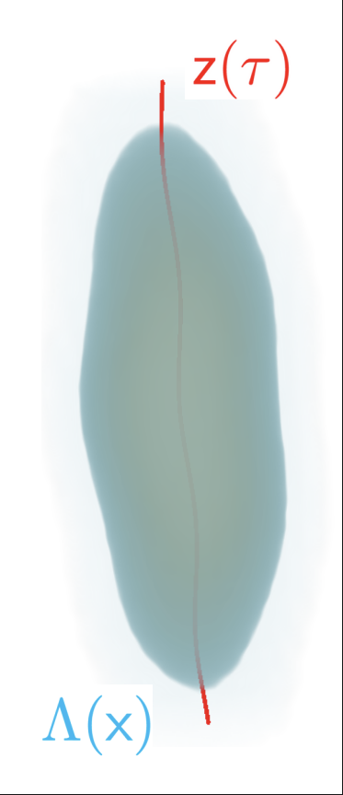



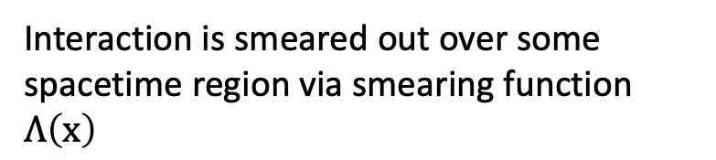


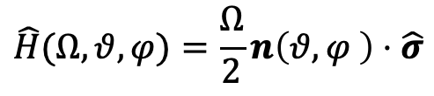

Unruh-DeWitt (UDW) Qubits
Internal dynamics prescribed by free Hamiltonian
Qubit following trajectory through spacetime
$$\hat{H}(Ω,θ,φ)=\frac{Ω}{2}n\left(θ,φ \right)⋅\hat{σ}$$
$$z^{μ}\left(τ\right)=\left(t\left(τ\right),x\left(τ\right)\right)$$
Interacts with quantum field $\hat{φ}\left(x\right)$ via Hamiltonian density
$$\hat{h}\left(x\right)=λΛ\left(x\right)\hat{μ}⊗\hat{φ}\left(x\right)$$
$$\hat{φ}\left(x\right)$$
Interaction is smeared out over some spacetime region via smearing function $Λ\left(x\right)$
$$t$$
$$x$$
Consider UDW scalar field interaction Hamiltonian density
$${\hat{h}}_{i}\left(x\right)=λΛ_{i}\left(x\right){\hat{μ}}_{i}⊗\hat{φ}\left(x\right)$$
Time-evolution plus tracing out field results in decohering channel
$$Ω_{i}=0$$
$${\hat{U}}_{c}=e^{−i\frac{λ^{2}}{2}\sum_{i<j}{Δ_{ij}{\hat{μ}}_{i}{\hat{μ}}_{j}}}$$
$$t_{1}<t<t_{2}$$
$$\hat{φ}\left(x\right)$$
$$ℇ\left({\hat{ρ}}_{0}\right)={\hat{U}}_{c}ℇ_{φ}({\hat{ρ}}_{0}){\hat{U}}_{c}^{†}$$
with
$Δ_{ij}$ are parameters that depend on propagation of detector interaction regions through field
Detector-field interaction regions
Detectors can couple to field simultaneously, so ${\hat{U}}_{c}$ is a globally entangling unitary on all detectors.
meaningful entanglement: $\left|λ^{2}Δ_{ij}\right|∼1$
worldlines
$$z_{i}^{μ}(τ_{i})$$
Notes:
Over a proper time interval $\Delta \tau_i$, the local unitary implemented by the internal dynamics of each qubit is simply a Bloch rotation around the $\bm n_i$ axis, which takes the form of each factor in Eq. \ref{Equation:UDWRotate} with parameters $\theta_i = \Omega_i\Delta\tau_i/2$. If we now identify the set $\bm \theta = \{\theta_i, \vartheta_i, \varphi_i\}_i$ as our trainable parameters and define the product of these local unitaries as a trainable layer, we get the first part of a VQC Eq. \ref{Equation:UDWRotate}. Importantly, the $\bm \theta$ depend not only on the internal energy gap of the qubits $\Omega_i$, but also on the proper time difference experienced by each qubit while undergoing its respective trajectory.
Mention that ability to choose Pauli rotation direction is a novel resource that allows us to achieve universality
e.g. circular trajectories in Minkowski $Δτ_{i}=Δt\sqrt{1−R^{2}ω_{i}^{2}}$

Slide 9
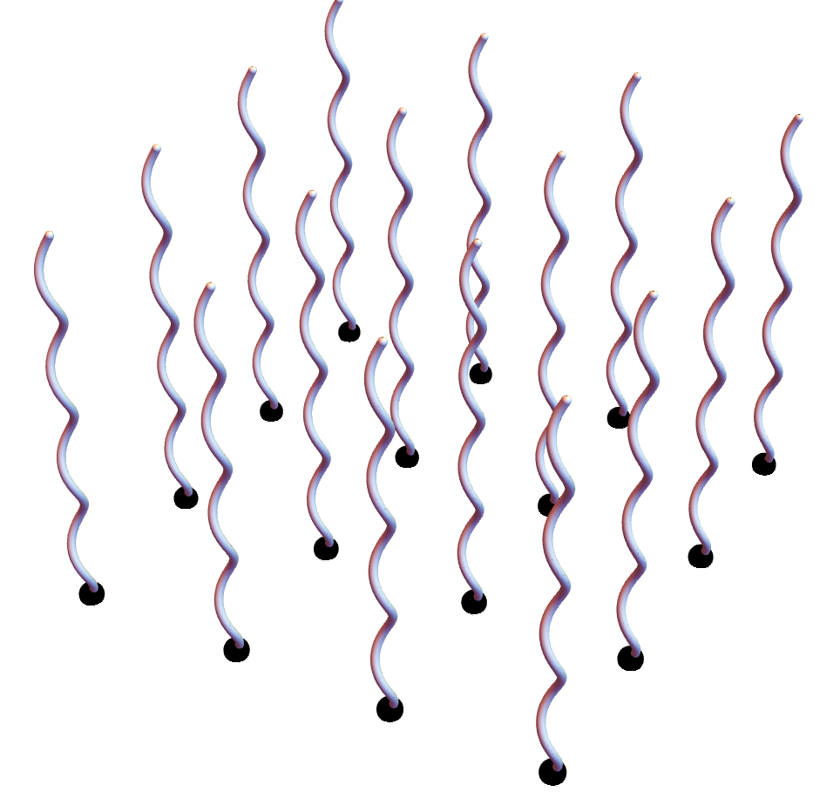
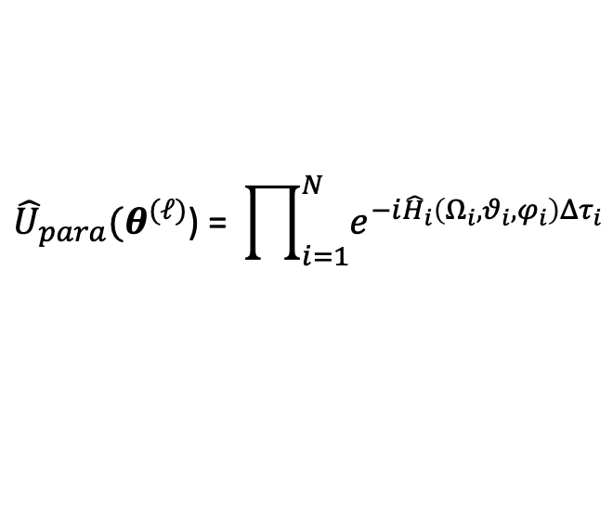
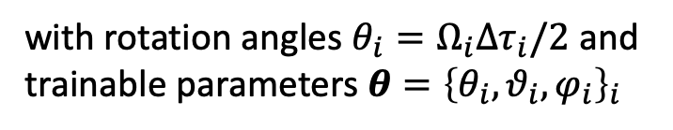

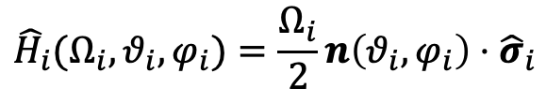

Gate Set – Local Operations
Array of UDW detectors
Internal dynamics prescribed by free Hamiltonian
$${\hat{H}}_{i}(Ω_{i},θ_{i},φ_{i})=\frac{Ω_{i}}{2}n\left(θ_{i},φ_{i}\right)⋅{\hat{σ}}_{i}$$
1-qubit rotation operators
$$t_{0}<t(τ_{i})<t_{1}$$
$${\hat{U}}_{para}\text{(}θ^{(ℓ)}\text{) = }\prod_{i=1}^{N}{e^{−i{\hat{H}}_{i}\left(Ω_{i},θ_{i},φ_{i}\right)Δτ_{i}}}$$
with rotation angles $θ_{i}=Ω_{i}Δτ_{i}/2$ and trainable parameters $θ={\left\{θ_{i},θ_{i},φ_{i}\right\}}_{i}$
worldlines
Rotation angles can be controlled by changing spacetime trajectories of detectors rather than through energy gap.
$$t$$
$$z_{i}^{μ}\left(τ_{i}\right)=\left(t\left(τ_{i}\right),x\left(τ_{i}\right)\right)$$
$$x$$
Notes:
Over a proper time interval $\Delta \tau_i$, the local unitary implemented by the internal dynamics of each qubit is simply a Bloch rotation around the $\bm n_i$ axis, which takes the form of each factor in Eq. \ref{Equation:UDWRotate} with parameters $\theta_i = \Omega_i\Delta\tau_i/2$. If we now identify the set $\bm \theta = \{\theta_i, \vartheta_i, \varphi_i\}_i$ as our trainable parameters and define the product of these local unitaries as a trainable layer, we get the first part of a VQC Eq. \ref{Equation:UDWRotate}. Importantly, the $\bm \theta$ depend not only on the internal energy gap of the qubits $\Omega_i$, but also on the proper time difference experienced by each qubit while undergoing its respective trajectory.
Mention that ability to choose Pauli rotation direction is a novel resource that allows us to achieve universality
e.g. circular trajectories in Minkowski $Δτ_{i}=Δt\sqrt{1−R^{2}ω_{i}^{2}}$

Slide 10
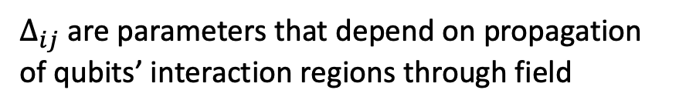
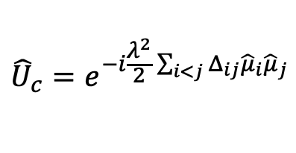




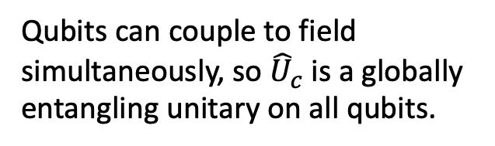

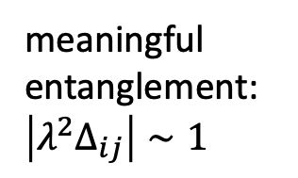
Gate Set – Entangling Operations
Consider UDW scalar field interaction Hamiltonian density
$${\hat{h}}_{i}\left(x\right)=λΛ_{i}\left(x\right){\hat{μ}}_{i}⊗\hat{φ}\left(x\right)$$
Time-evolution plus tracing out field results in decohering channel
$$Ω_{i}=0$$
$${\hat{U}}_{c}=e^{−i\frac{λ^{2}}{2}\sum_{i<j}{Δ_{ij}{\hat{μ}}_{i}{\hat{μ}}_{j}}}$$
$$t_{1}<t<t_{2}$$
$$\hat{φ}\left(x\right)$$
$$ℇ\left({\hat{ρ}}_{0}\right)={\hat{U}}_{c}ℇ_{φ}({\hat{ρ}}_{0}){\hat{U}}_{c}^{†}$$
with
$Δ_{ij}$ are parameters that depend on propagation of qubits’ interaction regions through field
Qubit-field interaction regions
Qubits can couple to field simultaneously, so ${\hat{U}}_{c}$ is a globally entangling unitary on all qubits.
meaningful entanglement: $\left|λ^{2}Δ_{ij}\right|∼1$
worldlines
$$z_{i}^{μ}(τ_{i})$$
Notes:
The entangling channel $\mathcal{E}$ is implemented by allowing the qubits to interact with a quantum field via the UDW detector model. The interaction of a two-level UDW detector with a scalar quantum field $\hat{\phi}(\mf x)$ is often prescribed by the interaction Hamiltonian density~\cite{us,us2,Landulfo,analytical}
\begin{equation}
\hat{h}_i(\mf x) = \lambda \Lambda_i(\mf x) \hat{\mu}_i \hat{\phi}(\mf x),
\end{equation}
where the $\lambda$ are coupling constants, $\hat{\mu}_i$ is an operator acting in the Hilbert space of detector $i$ and $\Lambda_i(\mf x)$ is a spacetime smearing function, which defines the shape of the interaction in spacetime. The idea is that the function $\Lambda_i(\mf x)$ is strongly supported around the detector's trajectory, $\mf z_i(\tau_i)$ and that its spatial extent corresponds to the detector's shape in its own rest space. In our setup, we consider that the support of $\Lambda_i(\mf x)$ is contained in the region $t_1 < t < t_2$, so that the interaction takes place after the local unitaries Eq.~\eqref{Equation:UDWRotate} are applied to the qubits. We assume that while the interactions with the field take place, the detector's internal dynamics are switched off (i.e. $\Omega_i = 0$), so that their evolution is entirely determined by their interaction with the field.
The dynamics of the detectors can be computed by applying the time evolution operator associated with the total interaction Hamiltonian density, $\sum_{i=1}^N \hat{h}_i(\mf x)$ and tracing over the field state. This gives rise to a quantum channel $\mathcal{E}$, which can entangle the qubits with each other (for $\hat{\mu}_i \neq \openone$), but also with the field. For simplicity, we assume the field to be in a quasi-free state\footnote{A quasi-free state is a zero mean Gaussian state. Typical states that satisfy this condition are thermal states and most choices of vacua.} and we compute the channel $\mathcal{E}$ explicitly in Appendix~\ref{Appendix:Calculations}. There we show that it can be decomposed as
\begin{equation}
\E(\hat{\rho}_0) = \hat{U}_\tc{c} \E_\phi(\hat{\rho}_0) \hat{U}_\tc{c}^\dagger\,,
\end{equation}
where $\E_\phi$ is a quantum channel that introduces decoherence due to entanglement between the qubits and the field and $\hat{U}_\tc{c}$ is an entangling unitary that can be written in the form
\begin{equation} \label{Equation:UDWEntangle}
\hat{U}_\tc{c} = e^{- \frac{\ii\lambda^2}{2}\sum_{{i<j}} \Delta_{ij} \hat{\mu}_i \hat{\mu}_j}\,,
\end{equation}
where $\Delta_{ij}$ are parameters that depend on retarded propagation of the qubit interaction regions through the field and usually behave proportionately to the ratio of the interaction time of the qubits with the field and their proper separation. A key assumption for the entangling unitary to act meaningfully between the qubit pairs is that $|\lambda^2 \Delta_{ij}| \sim 1$. This can be accomplished whenever the qubits' interaction regions are in causal contact for enough time, which allows for the field to mediate a sufficient amount of entanglement between the qubits. We emphasize that our calculations allow us to couple detectors simultaneously to the field, meaning that we can get a globally entangling unitary on all detectors. In a way, the unitary $\hat{U}_\tc{c}$ is a weighted version of the M\o lmer-S\o rensen gate in quantum optics.
Detectors are in causal contact for a long time compared to their separation so the notion of simultaneous is somewhat well-defined.
Using a time-independent monopole operator is similar to using gapless detectors, which we assume anyway during the field interaction.

Slide 11








Noise Analysis
Where on the spectrum is our setting?
How bad is the noise from interacting with the field?
1)
$${|λ}^{2}Δ_{ij}| \sim 1$$
Meaningful entanglement
2)
$${N^{2}λ}^{2}𝒲≪1$$
Negligible noise
Channel Fidelity:
$$N^{2}𝒲≪Δ_{ij}$$
$$F\left(ℇ\left(\hat{ρ}\right),{\hat{U}}_{c}\hat{ρ}{\hat{U}}_{c}^{†}\right) ≥Tr({\hat{ρ}}^{2})e^{−2N^{2}λ^{2}𝒲}$$
True for general spacetimes
$Δ_{ij}$ typically scales with interaction times
field-dependent local noise term
Full channel
Unitary-only channel
$$L_{ij}≪T$$
Assume large $T$ to maintain quasi-free state between layers:
$$ω\left(e^{i\hat{φ}\left(g\right)}\right)=e^{−\frac{1}{2}W\left(g,g\right)}$$
Notes:
$𝒲$ is often of order unity when the field is in a state that has a low particle number, as perceived by the detectors (This would not be the case if the field was in a highly excited state, or if the detectors were in extreme states of motion while interacting with the field (such as accelerations high enough so that Unruh-like effects would take place)
Notice that having $N\ll \lambda^{-2} $ does not prevent us from having meaningful entanglement generated by the unitary $\hat{U}_\tc{c}$, provided that $|\lambda^2\Delta_{ij}|\sim 1$. This is a reasonable assumption provided that $T\sim \lambda^{-2} L$, where $T$ is the time duration of the interaction with the field and $L$ is the minimal detector separation between detectors in the setup.}.
Under this assumption, the channel $\mathcal{E}_\phi$ acts as a weakly decohering channel. While the effect may be relatively small, the noise introduced from the interaction with the quantum field is always present regardless of the specifics of the interaction, since the noise terms are present even when the field is in its vacuum state. However, the noise terms are typically negligible in many realistic and experimental scenarios.
where $T$ controls the interaction duration, $\sigma$ is the effective size of the detectors, and $t_\tc{c}$ is the center of the interaction duration in time.
where $\Delta_{ij}$ are parameters that depend on retarded propagation of the qubit interaction regions through the field and usually behave proportionately to the ratio of the interaction time of the qubits with the field and their proper separation. A key assumption for the entangling unitary to act meaningfully between the qubit pairs is that $|\lambda^2 \Delta_{ij}| \sim 1$. This can be accomplished whenever the qubits' interaction regions are in causal contact for enough time, which allows for the field to mediate a sufficient amount of entanglement between the qubits. We emphasize that our calculations allow us to couple detectors simultaneously to the field, meaning that we can get a globally entangling unitary on all detectors.
Pure initial states are very common in typical RQI setups, so this lower bound should be useful

Slide 12
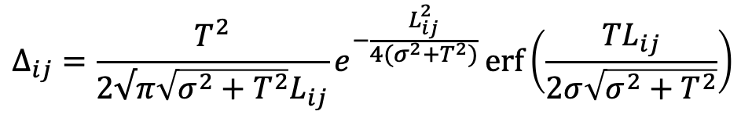
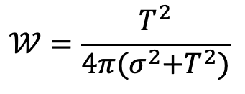

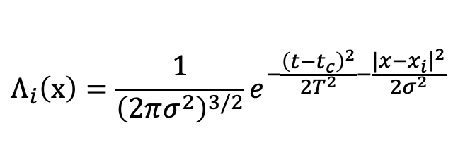





Noise Analysis
Noise Bound:
$$F\left(ℇ\left(\hat{ρ}\right),{\hat{U}}_{c}\hat{ρ}{\hat{U}}_{c}^{†}\right) ≥Tr({\hat{ρ}}^{2})e^{−2N^{2}λ^{2}𝒲}$$
Example: Gaussian smearing in Minkowski
Our Regime:
$N^{2}𝒲≪Δ_{ij}$,
$$L_{ij}≪T$$
$$Λ_{i}\left(x\right)={\frac{1}{{\left(2πσ^{2}\right)}^{3/2}}e}^{−\frac{{\left(t−t_{c}\right)}^{2}}{2T^{2}}−\frac{|{\left.x−x_{i}​\right|}^{2}}{2σ^{2}}}$$
e.g. for $λ\sim {10}^{−4}$ and $N=100$
Per layer: $F ≥99.998\%$
$$𝒲=\frac{T^{2}}{4π{(σ}^{2}+T^{2})}$$
100 layers: $F ≥99.8\%$
$$Δ_{ij}=\frac{T^{2}}{2√π\sqrt{σ^{2}+T^{2}}L_{ij}}e^{−\frac{L_{ij}^{2}}{4(σ^{2}+T^{2})}}\operatorname{erf}\left(\frac{TL_{ij}}{2σ\sqrt{σ^{2}+T^{2}}}\right)$$
Notes:
$𝒲$ is often of order unity when the field is in a state that has a low particle number, as perceived by the detectors (This would not be the case if the field was in a highly excited state, or if the detectors were in extreme states of motion while interacting with the field (such as accelerations high enough so that Unruh-like effects would take place)
Notice that having $N\ll \lambda^{-2} $ does not prevent us from having meaningful entanglement generated by the unitary $\hat{U}_\tc{c}$, provided that $|\lambda^2\Delta_{ij}|\sim 1$. This is a reasonable assumption provided that $T\sim \lambda^{-2} L$, where $T$ is the time duration of the interaction with the field and $L$ is the minimal detector separation between detectors in the setup.}.
Under this assumption, the channel $\mathcal{E}_\phi$ acts as a weakly decohering channel. While the effect may be relatively small, the noise introduced from the interaction with the quantum field is always present regardless of the specifics of the interaction, since the noise terms are present even when the field is in its vacuum state. However, the noise terms are typically negligible in many realistic and experimental scenarios.
where $T$ controls the interaction duration, $\sigma$ is the effective size of the detectors, and $t_\tc{c}$ is the center of the interaction duration in time.
where $\Delta_{ij}$ are parameters that depend on retarded propagation of the qubit interaction regions through the field and usually behave proportionately to the ratio of the interaction time of the qubits with the field and their proper separation. A key assumption for the entangling unitary to act meaningfully between the qubit pairs is that $|\lambda^2 \Delta_{ij}| \sim 1$. This can be accomplished whenever the qubits' interaction regions are in causal contact for enough time, which allows for the field to mediate a sufficient amount of entanglement between the qubits. We emphasize that our calculations allow us to couple detectors simultaneously to the field, meaning that we can get a globally entangling unitary on all detectors.
Pure initial states are very common in typical RQI setups, so this lower bound should be useful

Slide 13
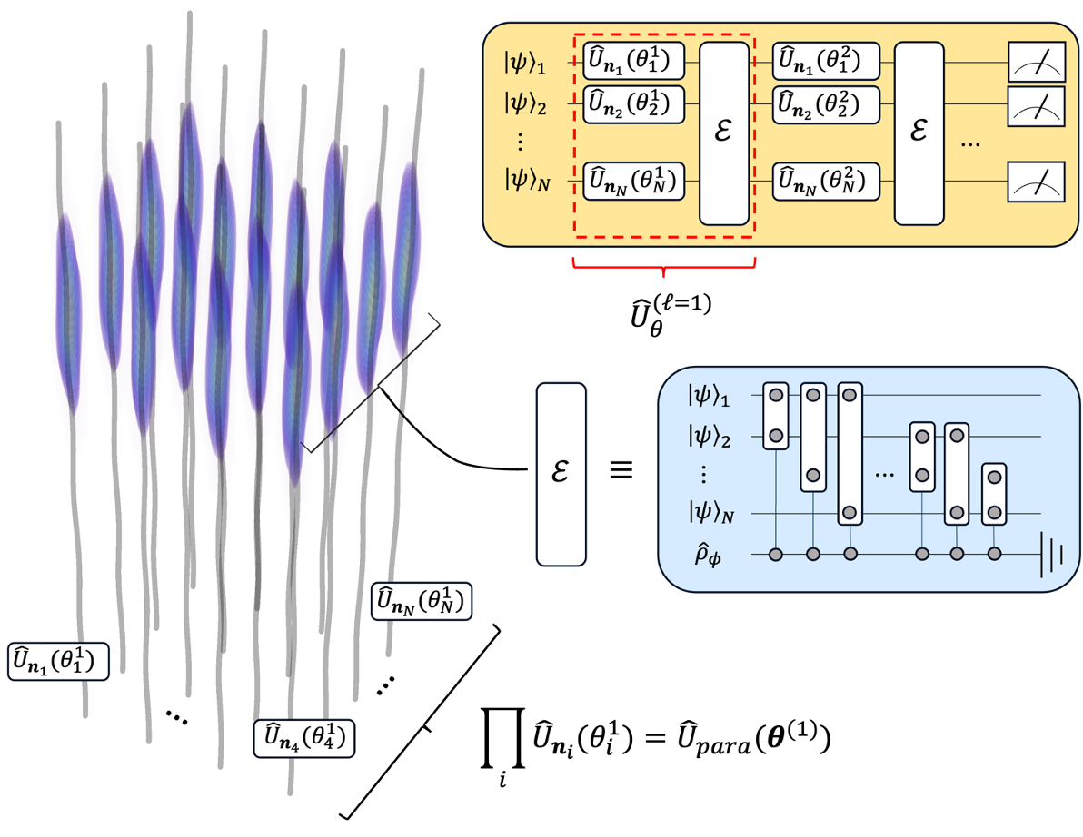


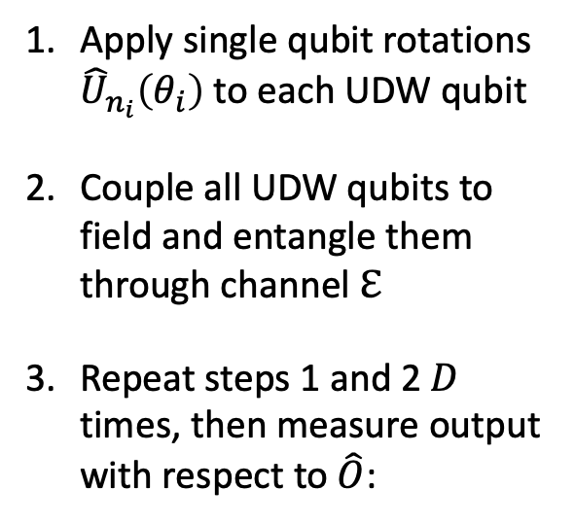


Relativistic Variational Quantum Circuit (RVQC)
System-field interaction regions
Apply single qubit rotations ${\hat{U}}_{n_{i}}\left(θ_{i}\right)$ to each UDW qubit
Couple all UDW qubits to field and entangle them through channel $ℇ$
Repeat steps 1 and 2 $D$ times, then measure output with respect to $\hat{O}$:
$$t$$
$$x$$
Field state
$$f_{θ}\left(\hat{O}\right)=Tr\left(\hat{O}\hat{U}\left(θ\right){\hat{ρ}}_{0}{\hat{U}}^{†}(θ)\right)$$
$$z_{i}^{μ}(τ_{i})$$
worldlines
Notes:
We technically don’t need to do the variational update of the trainable parameters to execute a particular quantum algorithm if we already know what rotation angles will work, but if there is some noise (e.g. externally, detector positions get perturbed, measurements are not performed perfectly, etc. ) preventing us from getting them precisely or measurement is involved in the middle of the algorithm, then the variational scheme is useful. Also, if we want to program the detectors to execute certain trajectories then this is basically like updating the parameters.
When successive applications of the entangling channel $\mathcal E$ are considered, one requires an extra assumption regarding the initial state of the field being quasi-free. After one application of the channel $\mathcal{E}$, the state of the field also evolves due to the interaction with the detectors, and in general the field's final state will not be quasi-free. On the other hand, any effect that the detectors have on the field quickly dissipates away. That is, under the assumption that the time required to implement the free unitaries (when the detectors are not coupled to the field) is large compared to the detector's separation, one can effectively treat the local state of the field probed by the qubits as its previous initial state.
We can just use the U_c entangling gate from now on because we can effectively make the noise zero

Slide 14
RVQC
Key distinctions between typical non-relativistic setups and ours:
Trainable parameters explicitly involve spacetime motion of UDW qubits through their proper time during evolution
Interactions between UDW qubits are entirely mediated through local interactions with quantum field
Presence of noise terms from entanglement between UDW qubits and quantum field
Notes:
Why should people care about this work? What is the take home message? Does it address an interesting problem? What has been done before in this area? What did those works struggle with that yours addresses?
In this work we make an explainable AI model more robust and improve its performance using a quantum-inspired inductive bias, then we outline the quantum version

Slide 15


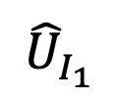
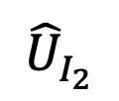
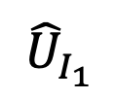


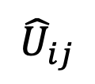





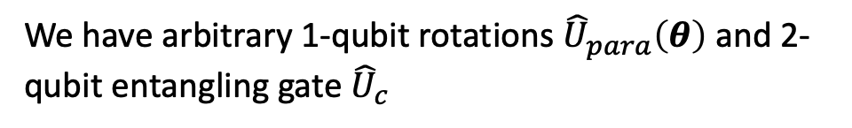


Universality
We have arbitrary 1-qubit rotations ${\hat{U}}_{para}\left(θ\right)$ and 2-qubit entangling gate ${\hat{U}}_{c}$
How do we know it’s universal?
BUT
${\hat{U}}_{c}$ entangles everything: not known to be universal
Consider the following
$${\left|ψ\right\rangle }_{1}$$
$${\hat{X}}_{1}$$
$${\hat{X}}_{1}$$
$${\left|ψ\right\rangle }_{i}$$
$${\left|ψ\right\rangle }_{2}$$
$${\hat{U}}_{I_{1}}$$
$${\hat{U}}_{I_{1}}$$
$${\hat{X}}_{2}$$
$${\hat{U}}_{I_{2}}$$
$${\hat{X}}_{2}$$
$$⋯$$
$${\hat{U}}_{ij}$$
$$⋯$$
$${\left|ψ\right\rangle }_{N}$$
$${\left|ψ\right\rangle }_{j}$$
Notes:
The only obstacle is whether the global entangling unitary Eq. \ref{Equation:UDWEntangle} can be efficiently compiled into entangling gates acting only on pairs of detectors. This obstacle to universality is made even more difficult for detectors interacting with quantum fields, since the field interactions spread entanglement out in all directions in a highly uncontrolled manner, resulting in a fully connected detector configuration that is too entangled to do useful computation. The situation is further complicated by the fact that the inverse of Eq. \ref{Equation:UDWEntangle} is challenging to implement physically.
When successive applications of the entangling channel $\mathcal E$ are considered, one requires an extra assumption regarding the initial state of the field being quasi-free. After one application of the channel $\mathcal{E}$, the state of the field also evolves due to the interaction with the detectors, and in general the field's final state will not be quasi-free. On the other hand, any effect that the detectors have on the field quickly dissipates away. That is, under the assumption that the time required to implement the free unitaries (when the detectors are not coupled to the field) is large compared to the detector's separation, one can effectively treat the local state of the field probed by the qubits as its previous initial state.
The fact that the entangling unitary entangles everything is not useful for proving universality, but that doesn’t mean the VQC cant be universal with the entangling gate in its current form for specific choices of rotation angles and directions, but we do not know what these are analytically (this is a good task for the VQC)

Slide 16
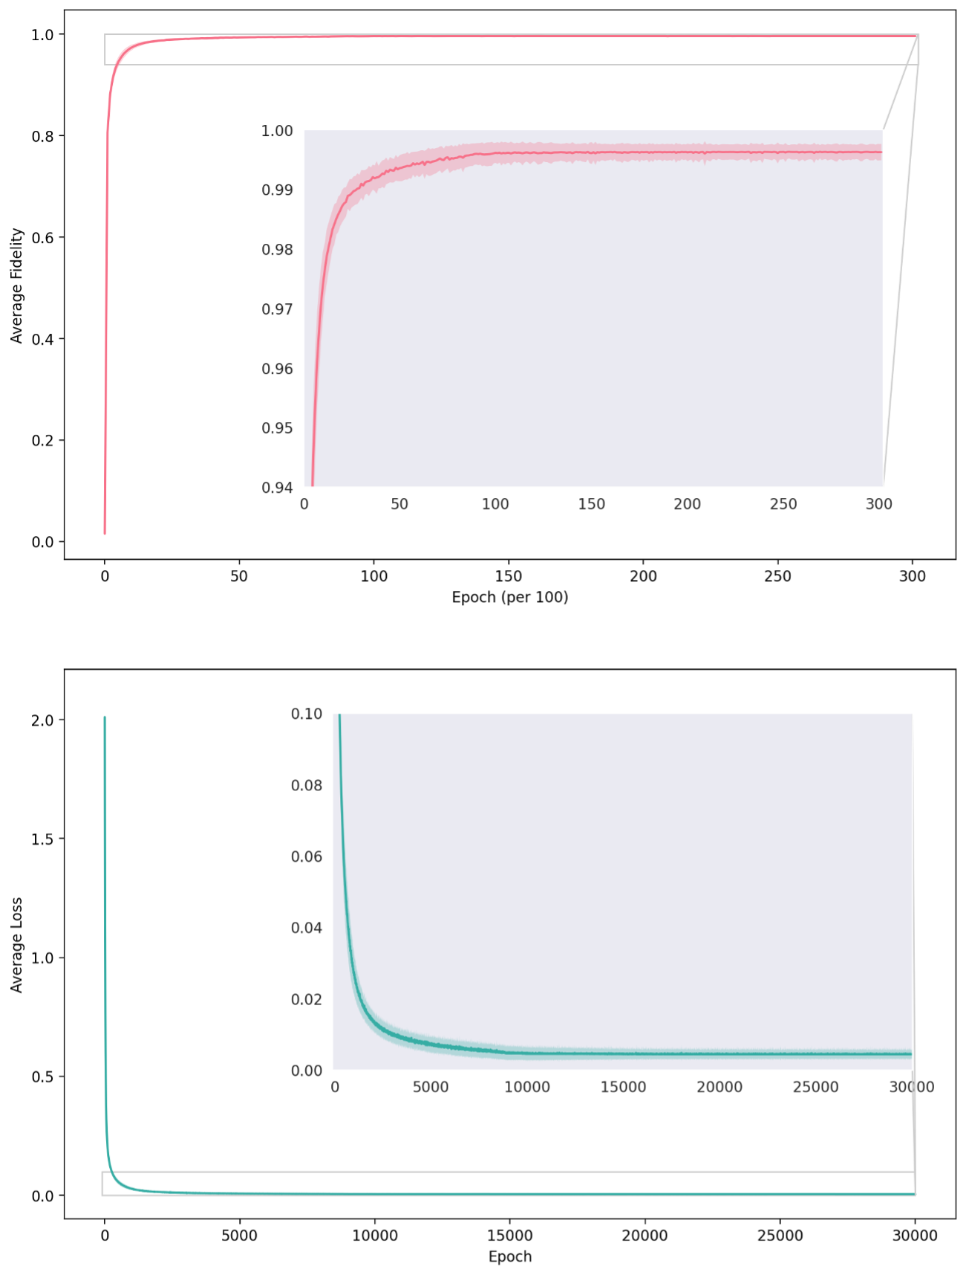








Quantum Fourier Transform Example
$N=6$ qubits
$D=50$layers
with
$T={10}^{8}$,
$λ={10}^{−4}$,
$$σ={10}^{−8}$$
Fix qubit geometry to $3×2$lattice with separations
$$\left(∆x, ∆y\right)=Tλ^{2}(5, 3)$$
and entangling gate operators
$${\hat{μ}}_{i}={\hat{σ}}_{z}$$
Average final precision: $\frac{1}{N}{\left\|{\hat{U}}_{θ}−{\hat{U}}_{QFT}\right\|}_{HS}^{2}=\text{0.00444 ± 0.00138}$
Notes:
The only obstacle is whether the global entangling unitary Eq. \ref{Equation:UDWEntangle} can be efficiently compiled into entangling gates acting only on pairs of detectors. This obstacle to universality is made even more difficult for detectors interacting with quantum fields, since the field interactions spread entanglement out in all directions in a highly uncontrolled manner, resulting in a fully connected detector configuration that is too entangled to do useful computation. The situation is further complicated by the fact that the inverse of Eq. \ref{Equation:UDWEntangle} is challenging to implement physically.
When successive applications of the entangling channel $\mathcal E$ are considered, one requires an extra assumption regarding the initial state of the field being quasi-free. After one application of the channel $\mathcal{E}$, the state of the field also evolves due to the interaction with the detectors, and in general the field's final state will not be quasi-free. On the other hand, any effect that the detectors have on the field quickly dissipates away. That is, under the assumption that the time required to implement the free unitaries (when the detectors are not coupled to the field) is large compared to the detector's separation, one can effectively treat the local state of the field probed by the qubits as its previous initial state.
The fact that the entangling unitary entangles everything is not useful for proving universality, but that doesn’t mean the VQC cant be universal with the entangling gate in its current form for specific choices of rotation angles and directions, but we do not know what these are analytically (this is a good task for the VQC)

Slide 17

Quantum Fourier Transform Example
$N=6$ qubits
$D=50$layers
with
$T={10}^{8}$,
$λ={10}^{−4}$,
$$σ={10}^{−8}$$
Fix qubit geometry to $3×2$lattice with separations
$$\left(∆x, ∆y\right)=Tλ^{2}(5, 3)$$
and entangling gate operators
$${\hat{μ}}_{i}={\hat{σ}}_{z}$$
Average final fidelity: $F=0.9962±0.0014$
Notes:
The only obstacle is whether the global entangling unitary Eq. \ref{Equation:UDWEntangle} can be efficiently compiled into entangling gates acting only on pairs of detectors. This obstacle to universality is made even more difficult for detectors interacting with quantum fields, since the field interactions spread entanglement out in all directions in a highly uncontrolled manner, resulting in a fully connected detector configuration that is too entangled to do useful computation. The situation is further complicated by the fact that the inverse of Eq. \ref{Equation:UDWEntangle} is challenging to implement physically.
When successive applications of the entangling channel $\mathcal E$ are considered, one requires an extra assumption regarding the initial state of the field being quasi-free. After one application of the channel $\mathcal{E}$, the state of the field also evolves due to the interaction with the detectors, and in general the field's final state will not be quasi-free. On the other hand, any effect that the detectors have on the field quickly dissipates away. That is, under the assumption that the time required to implement the free unitaries (when the detectors are not coupled to the field) is large compared to the detector's separation, one can effectively treat the local state of the field probed by the qubits as its previous initial state.
The fact that the entangling unitary entangles everything is not useful for proving universality, but that doesn’t mean the VQC cant be universal with the entangling gate in its current form for specific choices of rotation angles and directions, but we do not know what these are analytically (this is a good task for the VQC)

Slide 18
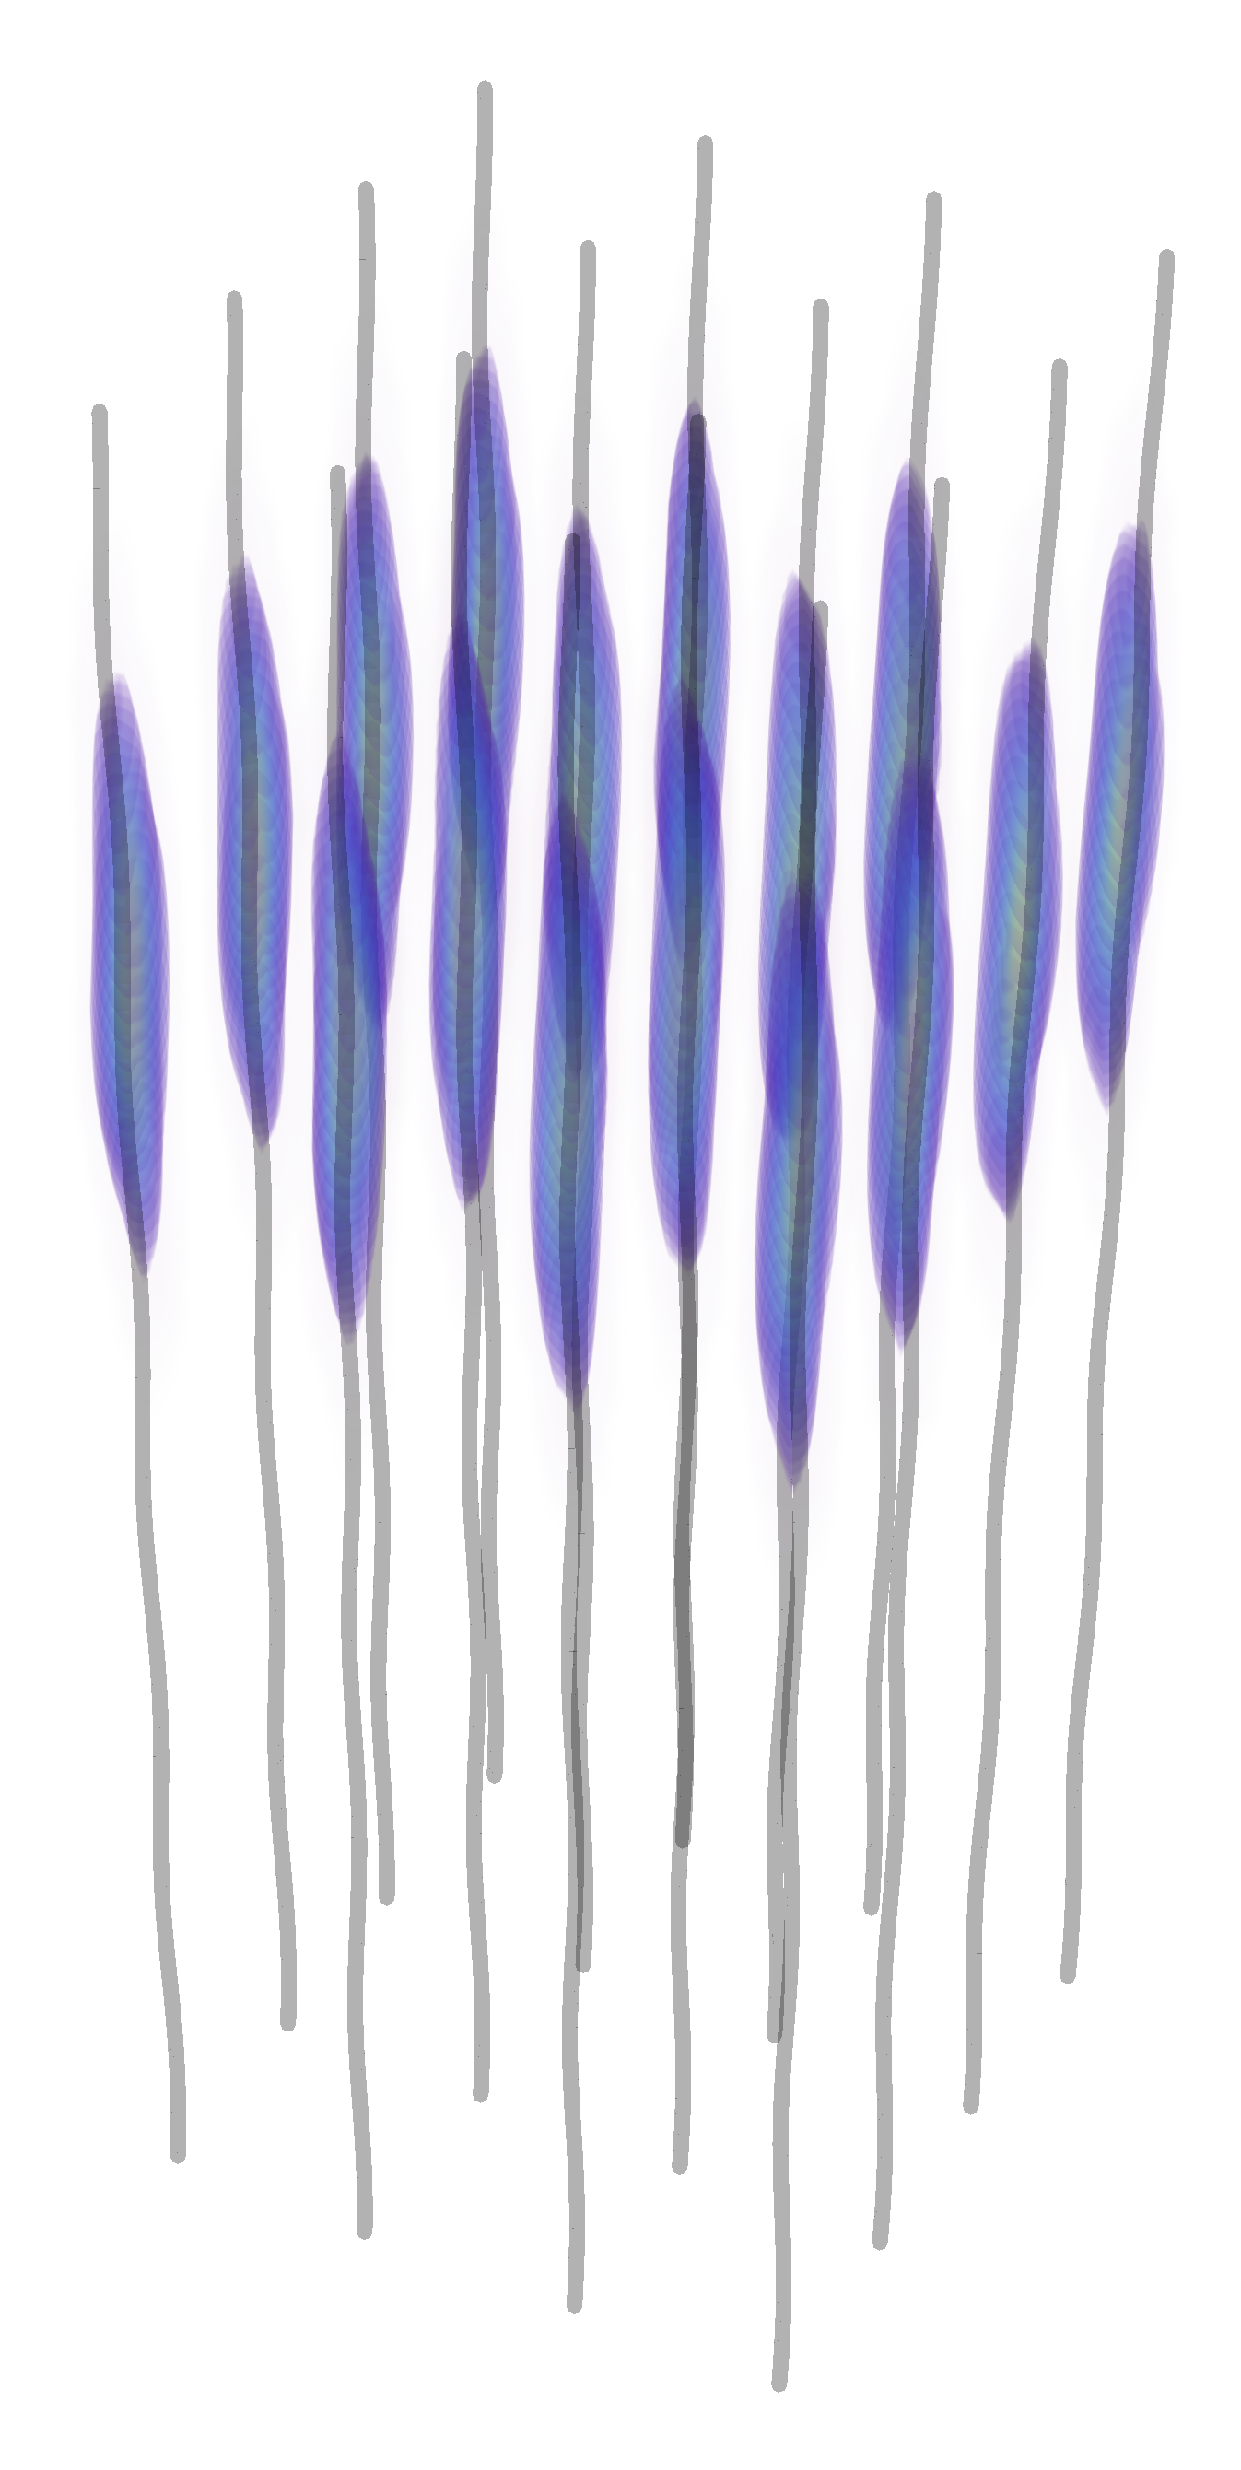
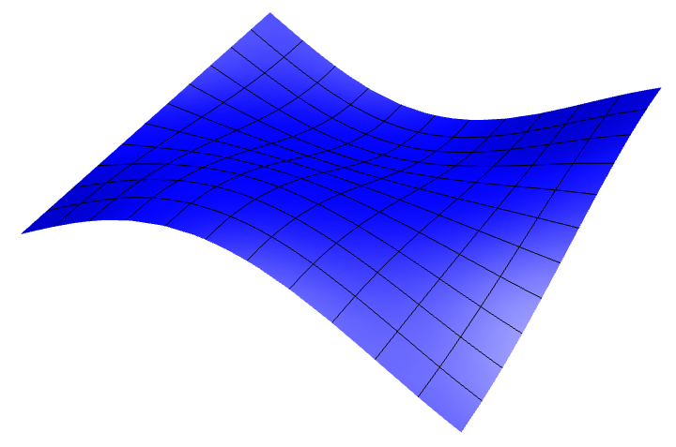



Prospects for Relativistic Quantum Machine Learning (RQML)
Percepts
Spacetime + quantum fields environment
QML Agent
Actions
VQC structure already allows us to implement quantum machine learning algorithms
Just need optimization procedure and learning task
Learning happens through manipulating relativistic motion
Notes:
In the QML setting, the above would constitute one round of training and there would be the additional step of running the parameter optimization routine with respect to some loss function $\mathcal{L}(\bm \theta, \bm x)$ featuring $f_{\bm \theta}(\bm x)$, before the next round.

Slide 19
RQML
Can go in three different directions…
Spacetime distributed learning
Relativity-aware quantum machine learning protocols
Learning quantum field and spacetime properties
Notes:
Why should people care about this work? What is the take home message? Does it address an interesting problem? What has been done before in this area? What did those works struggle with that yours addresses?
In this work we make an explainable AI model more robust and improve its performance using a quantum-inspired inductive bias, then we outline the quantum version

Slide 20
Spacetime Distributed Learning
Agent is spread out over spacetime
= UDW qubit
UDW qubits in local environments are connected through quantum field
What kind of tasks can we envision?
Non-local and distributed reinforcement learning
Distributed quantum cryptography
Distributed graph state preparation
Notes:
Why should people care about this work? What is the take home message? Does it address an interesting problem? What has been done before in this area? What did those works struggle with that yours addresses?
In this work we make an explainable AI model more robust and improve its performance using a quantum-inspired inductive bias, then we outline the quantum version

Slide 21






Relativity-Aware QML Protocols
System-field interaction regions
Can we do better with relativistically-aware gates?
Parameters sensitive to spacetime:
Rotation angles $θ_{i}=Ω_{i}Δτ_{i}/2$
Entangling gate coefficients $Δ_{ij}$
$$t$$
$ℇ_{φ}$ channel coefficients $W_{ij}$
$$x$$
Field state
Gravitation could modulate power of entangling gates
$$z_{i}^{μ}(τ_{i})$$
worldlines
Notes:
- Moving through a gravitational field could naturally alter the entangling gates for different layers as the qubits advance along their trajectories

Slide 22

Learning Quantum Field and Spacetime Properties
We have quantum field 2-point correlation functions in the circuit
These tell us basically everything about the field and spacetime
Spin statistics
Feynman interaction rules
Hilbert space of states
Algebra of field operators
Entanglement structure
Type of field state (e.g. vacuum, thermal, coherent)
Spacetime dimension
Curvature
Metric and causal structure
$$\hat{φ}\left(x\right)$$
Notes:
Why should people care about this work? What is the take home message? Does it address an interesting problem? What has been done before in this area? What did those works struggle with that yours addresses?
In this work we make an explainable AI model more robust and improve its performance using a quantum-inspired inductive bias, then we outline the quantum version

Slide 23

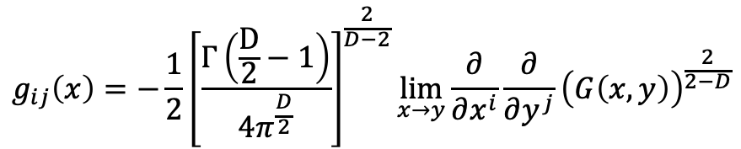
Learning Quantum Field and Spacetime Properties
How can we learn the correlation functions for unknown field and spacetime?
Build tomographic scheme
$$\hat{φ}\left(x\right)$$
Then learn the spacetime metric from the correlation functions:
$$g_{ij}\left(x\right)=−\frac{1}{2}{\left[\frac{Γ\left(\frac{D}{2}−1\right)}{4π^{\frac{D}{2}}}\right]}^{\frac{2}{D−2}}\lim_{x→y}{\frac{∂}{∂x^{i}}\frac{∂}{∂y^{j}}{\left(G\left(x,y\right)\right)}^{\frac{2}{2−D}}}$$
Saravani, M., Aslanbeigi, S. & Kempf, A. Spacetime curvature in terms of scalar field propagators. Phys. Rev. D 93, 045026 (2016).
Notes:
Why should people care about this work? What is the take home message? Does it address an interesting problem? What has been done before in this area? What did those works struggle with that yours addresses?
In this work we make an explainable AI model more robust and improve its performance using a quantum-inspired inductive bias, then we outline the quantum version

Slide 24

What Else?
What about extracting other resources besides entanglement from the field?
Harvesting Contextuality from the Vacuum
Contextuality demarcates boundary between quantum and classical states
Quantum advantage must involve contextuality
Phys. Rev. D. 113, 045001 (2026)
Notes:
Contextuality is failure to find a joint distribution for a family of marginal distributions

Slide 25
Harvesting Contextuality from the Vacuum
Interesting Results:
Single UDW qutrits can become contextual after interaction
Gapless systems can harvest contextuality but not entanglement
Contextuality and entanglement can coexist and influence each other for multiple UDW systems
Phys. Rev. D. 113, 045001 (2026)
Notes:
Contextuality is failure to find a joint distribution for a family of marginal distributions

Slide 26
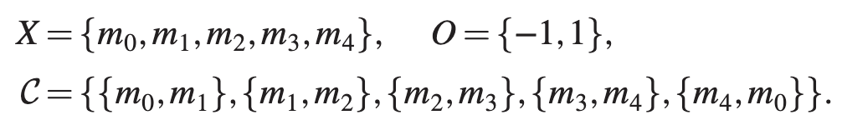
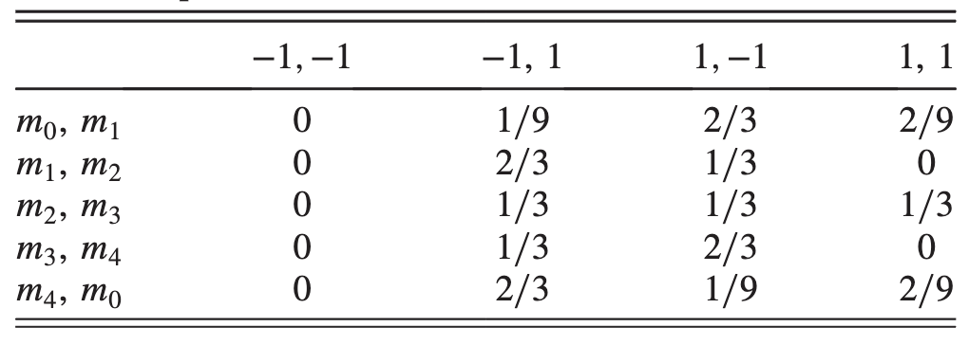
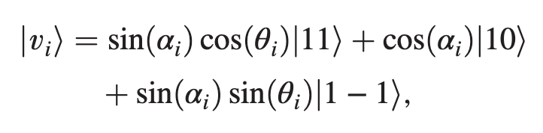





Contextuality
KCBS 5-Cycle Inequality
$$m_{0}$$
$$m_{4}$$
$$m_{1}$$
$$m_{3}$$
$$m_{2}$$
Notes:
Why should people care about this work? What is the take home message? Does it address an interesting problem? What has been done before in this area? What did those works struggle with that yours addresses?
The idea of performing some aspects of quantum computing using relativistic motion is not new: Refs. \cite{Layden_Martin-Martinez_Kempf_2016,Martin-Martinez_Aasen_Kempf_2013,Martín-Martínez_Sutherland_2014} constructed 1 and 2-qubit gates in the perturbative regime using coherent field states and Refs. \cite{Bruschi_Dragan_Lee_Fuentes_Louko_2013,Bruschi_Sabín_Kok_Johansson_Delsing_Fuentes_2016,Friis_Bruschi_Louko_Fuentes_2012,AsplingLawler2024} managed the construction for the continuous-variable quantum computing setting. In the former case, we lack analytic expressions for the gates making a full analysis of their properties and any statement of universality seemingly opaque, while in the latter case, the absence of a gate noise analysis (which the authors acknowledge) makes it unclear whether a quantum circuit built from these gates would actually be useful.
We can have the usual universal gate set for quantum algorithms, but we can also have a big unitary that couples every detector
Previous claims of universality did not explicitly show that their gate set could achieve this or claimed it for only a 2-detector setup

Slide 27
Contextuality and Non-Classicality
Many features of quantum theory are explainable with classical models…
Entanglement
Steering
Superposition
Interference
Spekkens’ toy model!
So what about quantum theory is not classical?
Contextuality/nonlocality cannot be explained classically, so I will take them to be the defining feature of what makes quantum theory non-classical.
Notes:
Why should people care about this work? What is the take home message? Does it address an interesting problem? What has been done before in this area? What did those works struggle with that yours addresses?
The idea of performing some aspects of quantum computing using relativistic motion is not new: Refs. \cite{Layden_Martin-Martinez_Kempf_2016,Martin-Martinez_Aasen_Kempf_2013,Martín-Martínez_Sutherland_2014} constructed 1 and 2-qubit gates in the perturbative regime using coherent field states and Refs. \cite{Bruschi_Dragan_Lee_Fuentes_Louko_2013,Bruschi_Sabín_Kok_Johansson_Delsing_Fuentes_2016,Friis_Bruschi_Louko_Fuentes_2012,AsplingLawler2024} managed the construction for the continuous-variable quantum computing setting. In the former case, we lack analytic expressions for the gates making a full analysis of their properties and any statement of universality seemingly opaque, while in the latter case, the absence of a gate noise analysis (which the authors acknowledge) makes it unclear whether a quantum circuit built from these gates would actually be useful.
We can have the usual universal gate set for quantum algorithms, but we can also have a big unitary that couples every detector
Previous claims of universality did not explicitly show that their gate set could achieve this or claimed it for only a 2-detector setup

Slide 28
Where to Go From Here?
Develop new relativistic quantum machine learning protocols
Relax constraints and extend to fully non-perturbative regime
Fully consistent model of a relativistic agent in curved spacetimes
Models of agents and learning in the quantum gravity regime
Integrate other resources like contextuality into the setup
Notes:
PS has already been successfully applied to modelling animal foraging and behaviour patterns
Flexibility of mePS would be beneficial
Further incorporate many-body features into inductive bias such as Pauli-exclusion
Would also be interesting to explore effect of particle statistics on deliberation
Incorporate more advanced results from hypergraph literature to improve mePS scalability
Explore possible connections with Neuro-Symbolic logic
Further develop quantum mePS and find useful application where quantum advantage can be achieved

Slide 29

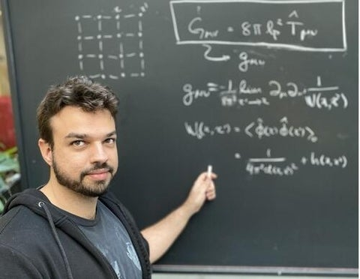

Thank you for your attention!
$$+$$
RVQC:
Contextuality Harvesting:
Phys. Rev. Lett. 134, 190601 (2025)
Phys. Rev. D. 113, 045001 (2026)

Slide 30
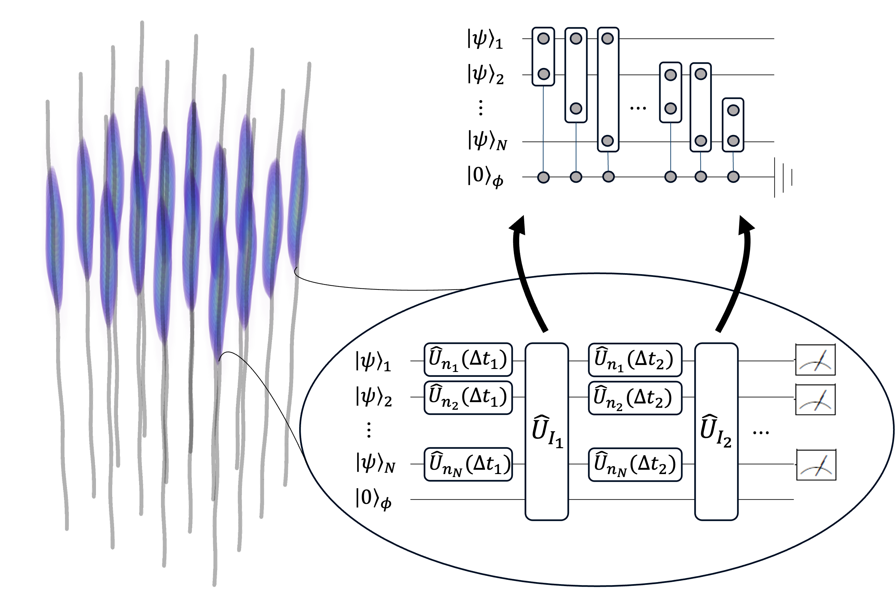
RVQC
Key distinctions between typical non-relativistic setups and ours:
Trainable parameters explicitly involve spacetime motion of detectors through their proper time during evolution
Interactions between detectors are entirely mediated through local interactions with quantum field
Presence of noise terms from entanglement between detectors and quantum field
Notes:
Why should people care about this work? What is the take home message? Does it address an interesting problem? What has been done before in this area? What did those works struggle with that yours addresses?
In this work we make an explainable AI model more robust and improve its performance using a quantum-inspired inductive bias, then we outline the quantum version

Slide 31
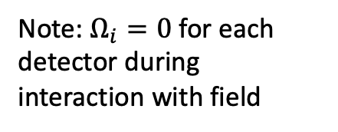
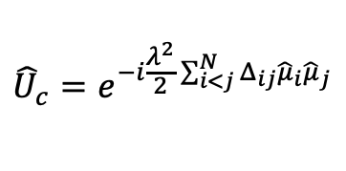
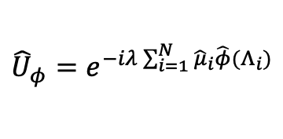

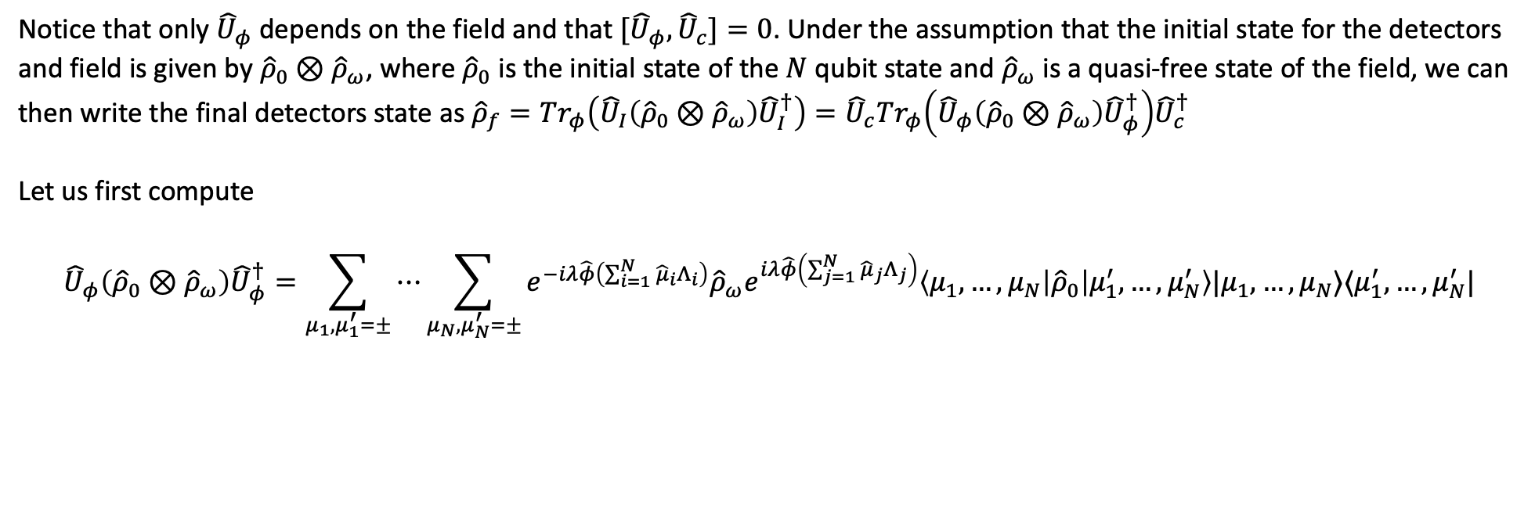
Analytic Expressions
Magnus expansion of UDW interaction time-evolution has only two terms that factor like
$${\hat{U}}_{I}={\hat{U}}_{φ}{\hat{U}}_{c}$$
Note: $Ω_{i}=0$ for each detector during interaction with field
where
$${\hat{U}}_{φ}=e^{−iλ\sum_{i=1}^{N}{{\hat{μ}}_{i}\hat{φ}(Λ_{i})}}$$
and
$${\hat{U}}_{c}=e^{−i\frac{λ^{2}}{2}\sum_{i<j}^{N}{Δ_{ij}{\hat{μ}}_{i}{\hat{μ}}_{j}}}$$
Notice that only ${\hat{U}}_{φ}$depends on the field and that ${[\hat{U}}_{φ},{\hat{U}}_{c}]=0$. Under the assumption that the initial state for the detectors and field is given by ${\hat{ρ}}_{0}⊗{\hat{ρ}}_{ω}$, where ${\hat{ρ}}_{0}$ is the initial state of the $N$ qubit state and ${\hat{ρ}}_{ω}$ is a quasi-free state of the field, we can then write the final detectors state as ${\hat{ρ}}_{f}=Tr_{φ}\left({\hat{U}}_{I}\left({\hat{ρ}}_{0}⊗{\hat{ρ}}_{ω}\right){\hat{U}}_{I}^{†}\right)={\hat{U}}_{c}Tr_{φ}\left({\hat{U}}_{φ}\left({\hat{ρ}}_{0}⊗{\hat{ρ}}_{ω}\right){\hat{U}}_{φ}^{†}\right){\hat{U}}_{c}^{†}$
Let us first compute
$${\hat{U}}_{φ}\left({\hat{ρ}}_{0}⊗{\hat{ρ}}_{ω}\right){\hat{U}}_{φ}^{†}=\sum_{μ_{1},μ_{1}^{′}=±}{⋯}\sum_{μ_{N},μ_{N}^{′}=±}{e^{−iλ\hat{φ}\left(\sum_{i=1}^{N}{{\hat{μ}}_{i}Λ_{i}}\right)}{\hat{ρ}}_{ω}e^{iλ\hat{φ}\left(\sum_{j=1}^{N}{{\hat{μ}}_{j}Λ_{j}}\right)}\left\langle μ_{1},…,μ_{N}\left|{\hat{ρ}}_{0}\right|μ_{1}^{′},…,μ_{N}^{′}\right\rangle |μ_{1},…,μ_{N}⟩⟨μ_{1}^{′},…,μ_{N}^{′}|}$$
Notes:
Why should people care about this work? What is the take home message? Does it address an interesting problem? What has been done before in this area? What did those works struggle with that yours addresses?
In this work we make an explainable AI model more robust and improve its performance using a quantum-inspired inductive bias, then we outline the quantum version

Slide 32
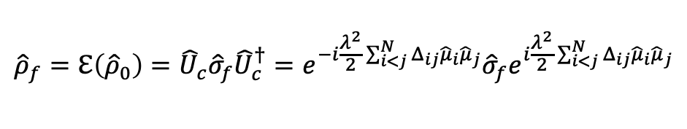


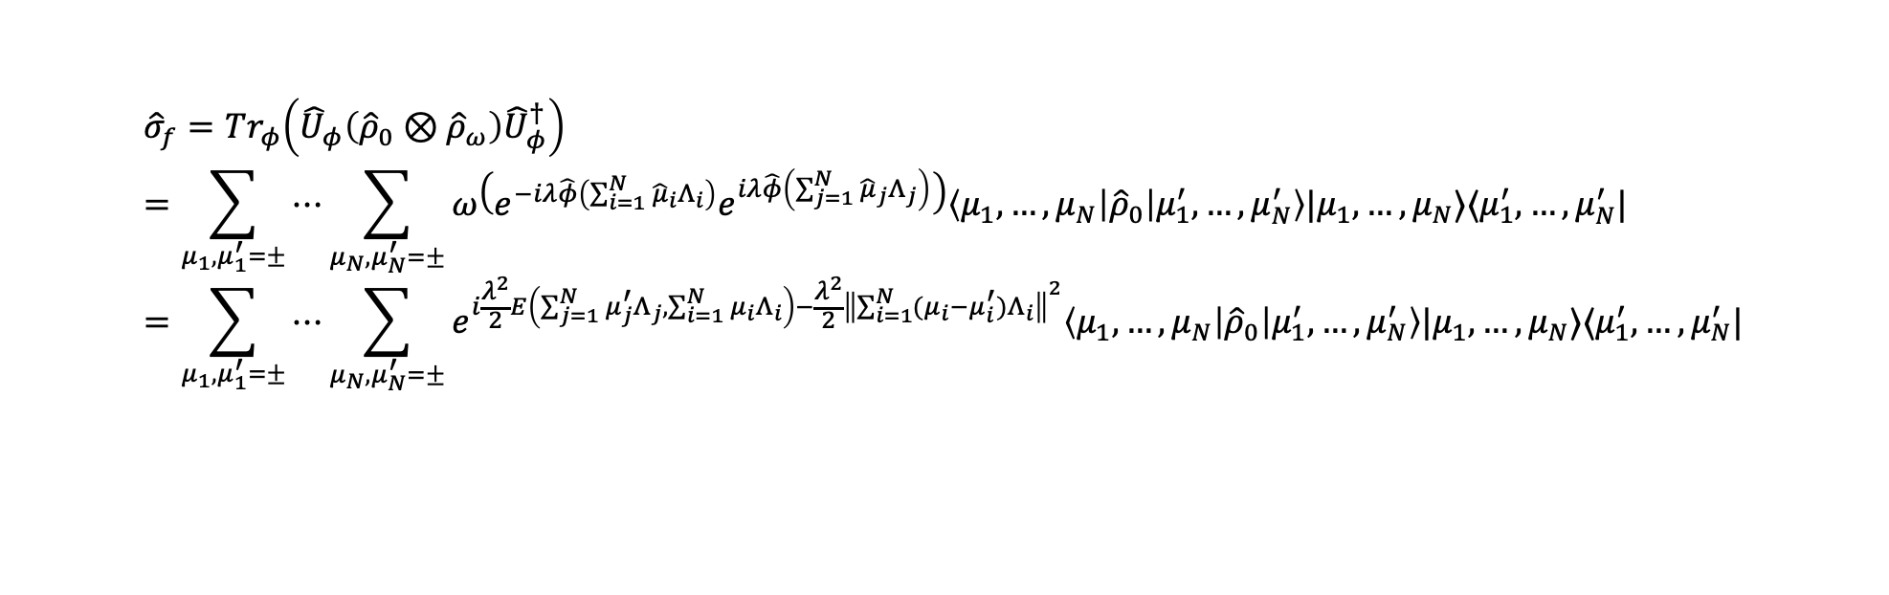
Analytic Expressions
$${\hat{σ}}_{f}=Tr_{φ}\left({\hat{U}}_{φ}\left({\hat{ρ}}_{0}⊗{\hat{ρ}}_{ω}\right){\hat{U}}_{φ}^{†}\right)=\sum_{μ_{1},μ_{1}^{′}=±}{⋯}\sum_{μ_{N},μ_{N}^{′}=±}{ω\left(e^{−iλ\hat{φ}\left(\sum_{i=1}^{N}{{\hat{μ}}_{i}Λ_{i}}\right)}e^{iλ\hat{φ}\left(\sum_{j=1}^{N}{{\hat{μ}}_{j}Λ_{j}}\right)}\right)\left\langle μ_{1},…,μ_{N}\left|{\hat{ρ}}_{0}\right|μ_{1}^{′},…,μ_{N}^{′}\right\rangle |μ_{1},…,μ_{N}⟩⟨μ_{1}^{′},…,μ_{N}^{′}|}=\sum_{μ_{1},μ_{1}^{′}=±}{⋯}\sum_{μ_{N},μ_{N}^{′}=±}{e^{i\frac{λ^{2}}{2}E\left(\sum_{j=1}^{N}{μ_{j}^{′}Λ_{j}}, \sum_{i=1}^{N}{μ_{i}Λ_{i}}\right)−\frac{λ^{2}}{2}{\left\|\sum_{i=1}^{N}{(μ_{i}−μ_{i}^{′})Λ_{i}}\right\|}^{2}}\left\langle μ_{1},…,μ_{N}\left|{\hat{ρ}}_{0}\right|μ_{1}^{′},…,μ_{N}^{′}\right\rangle |μ_{1},…,μ_{N}⟩⟨μ_{1}^{′},…,μ_{N}^{′}|}$$
$$ω\left(e^{−iλ\hat{φ}\left(f\right)}e^{iλ\hat{φ}\left(g\right)}\right)=e^{i\frac{λ^{2}}{2}E\left(f, g\right)−\frac{λ^{2}}{2}W(f+g,f+g)}$$
with
$${\left\|f\right\|}^{2}=W\left(f,f\right)$$
where we used
$${\hat{ρ}}_{f}=ℇ\left({\hat{ρ}}_{0}\right)={\hat{U}}_{c}{\hat{σ}}_{f}{\hat{U}}_{c}^{†}=e^{−i\frac{λ^{2}}{2}\sum_{i<j}^{N}{Δ_{ij}{\hat{μ}}_{i}{\hat{μ}}_{j}}}{\hat{σ}}_{f}e^{i\frac{λ^{2}}{2}\sum_{i<j}^{N}{Δ_{ij}{\hat{μ}}_{i}{\hat{μ}}_{j}}}$$
The final channel is then a combination of multiple commuting entangling unitaries between each qubit and an added quantum channel obtained when one traces over the field. Under the assumption that $E(Λ_{i},Λ_{j}) = 0$(which occurs for symmetric interactions that are only shifted in space), the interaction with the quantum field is merely a decohering channel.
Notes:
Why should people care about this work? What is the take home message? Does it address an interesting problem? What has been done before in this area? What did those works struggle with that yours addresses?
In this work we make an explainable AI model more robust and improve its performance using a quantum-inspired inductive bias, then we outline the quantum version

Slide 33

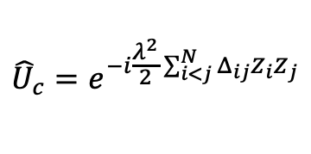
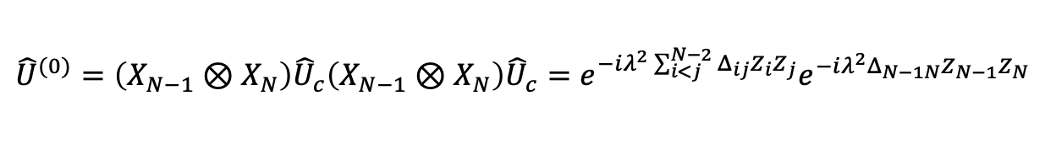

Universality
Since we already have arbitrary local $SU\left(2\right)$rotations, we only have to show that we can transpile ${\hat{U}}_{c}$ and local rotations into two-qubit entangling gates on arbitrary qubit pairs in order to have a universal gate set.
Start with
$${\hat{U}}_{c}=e^{−i\frac{λ^{2}}{2}\sum_{i<j}^{N}{Δ_{ij}Z_{i}Z_{j}}}$$
and note
$$X_{j}e^{iφZ_{1}⊗Z_{2}}X_{j}=e^{−iφZ_{1}⊗Z_{2}}$$
, $X≡{\hat{σ}}_{x}, Z≡{\hat{σ}}_{z}$
Now consider
$${\hat{U}}^{(0)}=\left(X_{N−1}⊗X_{N}\right){\hat{U}}_{c}\left(X_{N−1}⊗X_{N}\right){\hat{U}}_{c}=e^{−iλ^{2}\sum_{i<j}^{N−2}{Δ_{ij}Z_{i}Z_{j}}}e^{−iλ^{2}Δ_{N−1N}Z_{N−1}Z_{N}}$$
Here, the last exponential looks like the expression we want, and we will abbreviate ${\hat{U}}_{pair}=e^{−iλ^{2}Δ_{N−1N}Z_{N−1}Z_{N}}$
Idea is to iterate this operation until we have only a unitary entangling one pair of detectors.
For $J_{1},…,J_{k−1}∈\{𝕀,X\}$, we split the index sets $ℐ_{J_{1},…,J_{k−1}}^{\left(k−1\right)}$into two halves, obtaining $ℐ_{J_{1},…,J_{k−1}𝕀}^{\left(k\right)}$and $ℐ_{J_{1},…,J_{k−1}X}^{\left(k\right)}$. Again, the specific demand for the sizes is $\left|ℐ_{J_{1},…,J_{k−1}X}^{\left(k\right)}\right|=\left\lfloor \frac{\left|ℐ_{J_{1},…,J_{k−1}}^{\left(k−1\right)}\right|}{2}\right\rfloor$.

Slide 34

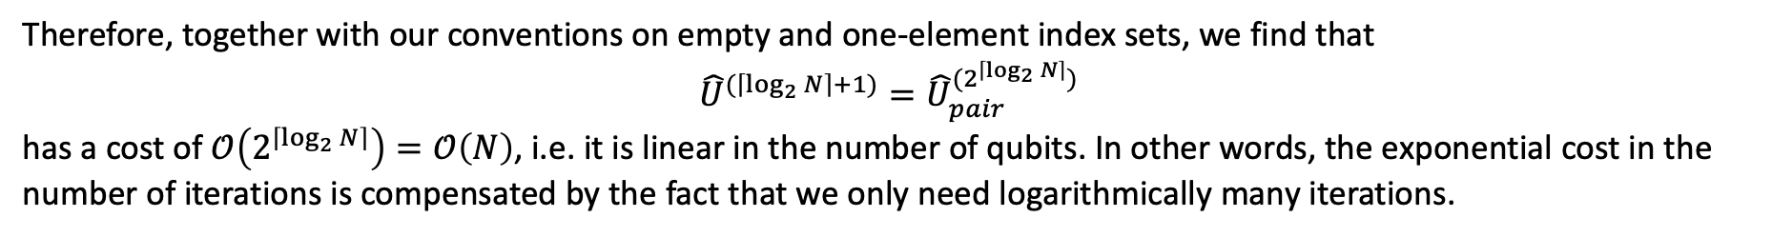




Universality
Then for $k^{th}$ iteration, the next step is
$${\hat{U}}^{(k+1)}=⨂{X_{m}{\hat{U}}^{(k)}}⨂{X_{\overline{m}}{\hat{U}}^{(k)}}=\prod_{J_{1},…,J_{k}∈\{𝕀,X\}}{\exp\left(−i2^{k}λ^{2}\sum_{i<j∈ℐ_{J_{1},…,J_{k}}^{\left(k\right)}}{Δ_{ij}Z_{i}Z_{j}}\right){\hat{U}}_{pair}^{\left(2^{k}\right)}}$$
$$J_{1},…,J_{k−1}∈\{𝕀,X\}$$
$${\overline{J}}_{1},…,{\overline{J}}_{k−1}∈\{𝕀,X\}$$
$$m∈ℐ_{J_{1},…,J_{k−1}X}^{\left(k\right)}$$
$$\overline{m}∈ℐ_{{\overline{J}}_{1},…,{\overline{J}}_{k−1}X}^{\left(k\right)}$$
We have consumed two ${\hat{U}}^{(k)},$each of which costs $2^{k}$ VQC layers, giving a combined cost of $2^{k+1}$ VQC layers.
We recognize that interactions are only present for $i,j$ in the same index set $ℐ_{J_{1},…,J_{k−1}}^{\left(k\right)}$(and $\left\{N−1, N\right\},$of course).
Furthermore, the condition $\left|ℐ_{J_{1},…,J_{k−1}X}^{\left(k\right)}\right|=\left\lfloor \frac{\left|ℐ_{J_{1},…,J_{k−1}}^{\left(k−1\right)}\right|}{2}\right\rfloor$expresses that the index sets are exponentially decreasing in size.
Therefore, together with our conventions on empty and one-element index sets, we find that
$${\hat{U}}^{(\left\lceil \log_{2}{N}\right\rceil +1)}={\hat{U}}_{pair}^{(2^{\left\lceil \log_{2}{N}\right\rceil })}$$
has a cost of $𝒪\left(2^{\left\lceil \log_{2}{N}\right\rceil }\right)=𝒪\left(N\right)$, i.e. it is linear in the number of qubits. In other words, the exponential cost in the number of iterations is compensated by the fact that we only need logarithmically many iterations.

