Slide 1





Harvesting Contextuality from the Vacuum
Philip A. LeMaitre
June 5, 2026
Phys. Rev. D. 113, 045001 (2026)
Notes:
Hi everyone, thanks for coming to my presentation. My name is Phil and I am a PhD student from the University of Innsbruck in the group of Hans Briegel. Today I will be talking about Multi-Excitation Projective Simulation.

Slide 2
Introduction and Motivation
Motivating question: are there other resources besides entanglement we can extract from quantum fields?
Yes, (measurement) contextuality!
Key question: can an initially non-contextual Unruh-DeWitt (UDW) system state become contextual after a local interaction with the vacuum?
Notes:
Why should people care about this work? What is the take home message? Does it address an interesting problem? What has been done before in this area? What did those works struggle with that yours addresses?
The idea of performing some aspects of quantum computing using relativistic motion is not new: Refs. \cite{Layden_Martin-Martinez_Kempf_2016,Martin-Martinez_Aasen_Kempf_2013,Martín-Martínez_Sutherland_2014} constructed 1 and 2-qubit gates in the perturbative regime using coherent field states and Refs. \cite{Bruschi_Dragan_Lee_Fuentes_Louko_2013,Bruschi_Sabín_Kok_Johansson_Delsing_Fuentes_2016,Friis_Bruschi_Louko_Fuentes_2012,AsplingLawler2024} managed the construction for the continuous-variable quantum computing setting. In the former case, we lack analytic expressions for the gates making a full analysis of their properties and any statement of universality seemingly opaque, while in the latter case, the absence of a gate noise analysis (which the authors acknowledge) makes it unclear whether a quantum circuit built from these gates would actually be useful.
We can have the usual universal gate set for quantum algorithms, but we can also have a big unitary that couples every detector
Previous claims of universality did not explicitly show that their gate set could achieve this or claimed it for only a 2-detector setup

Slide 3
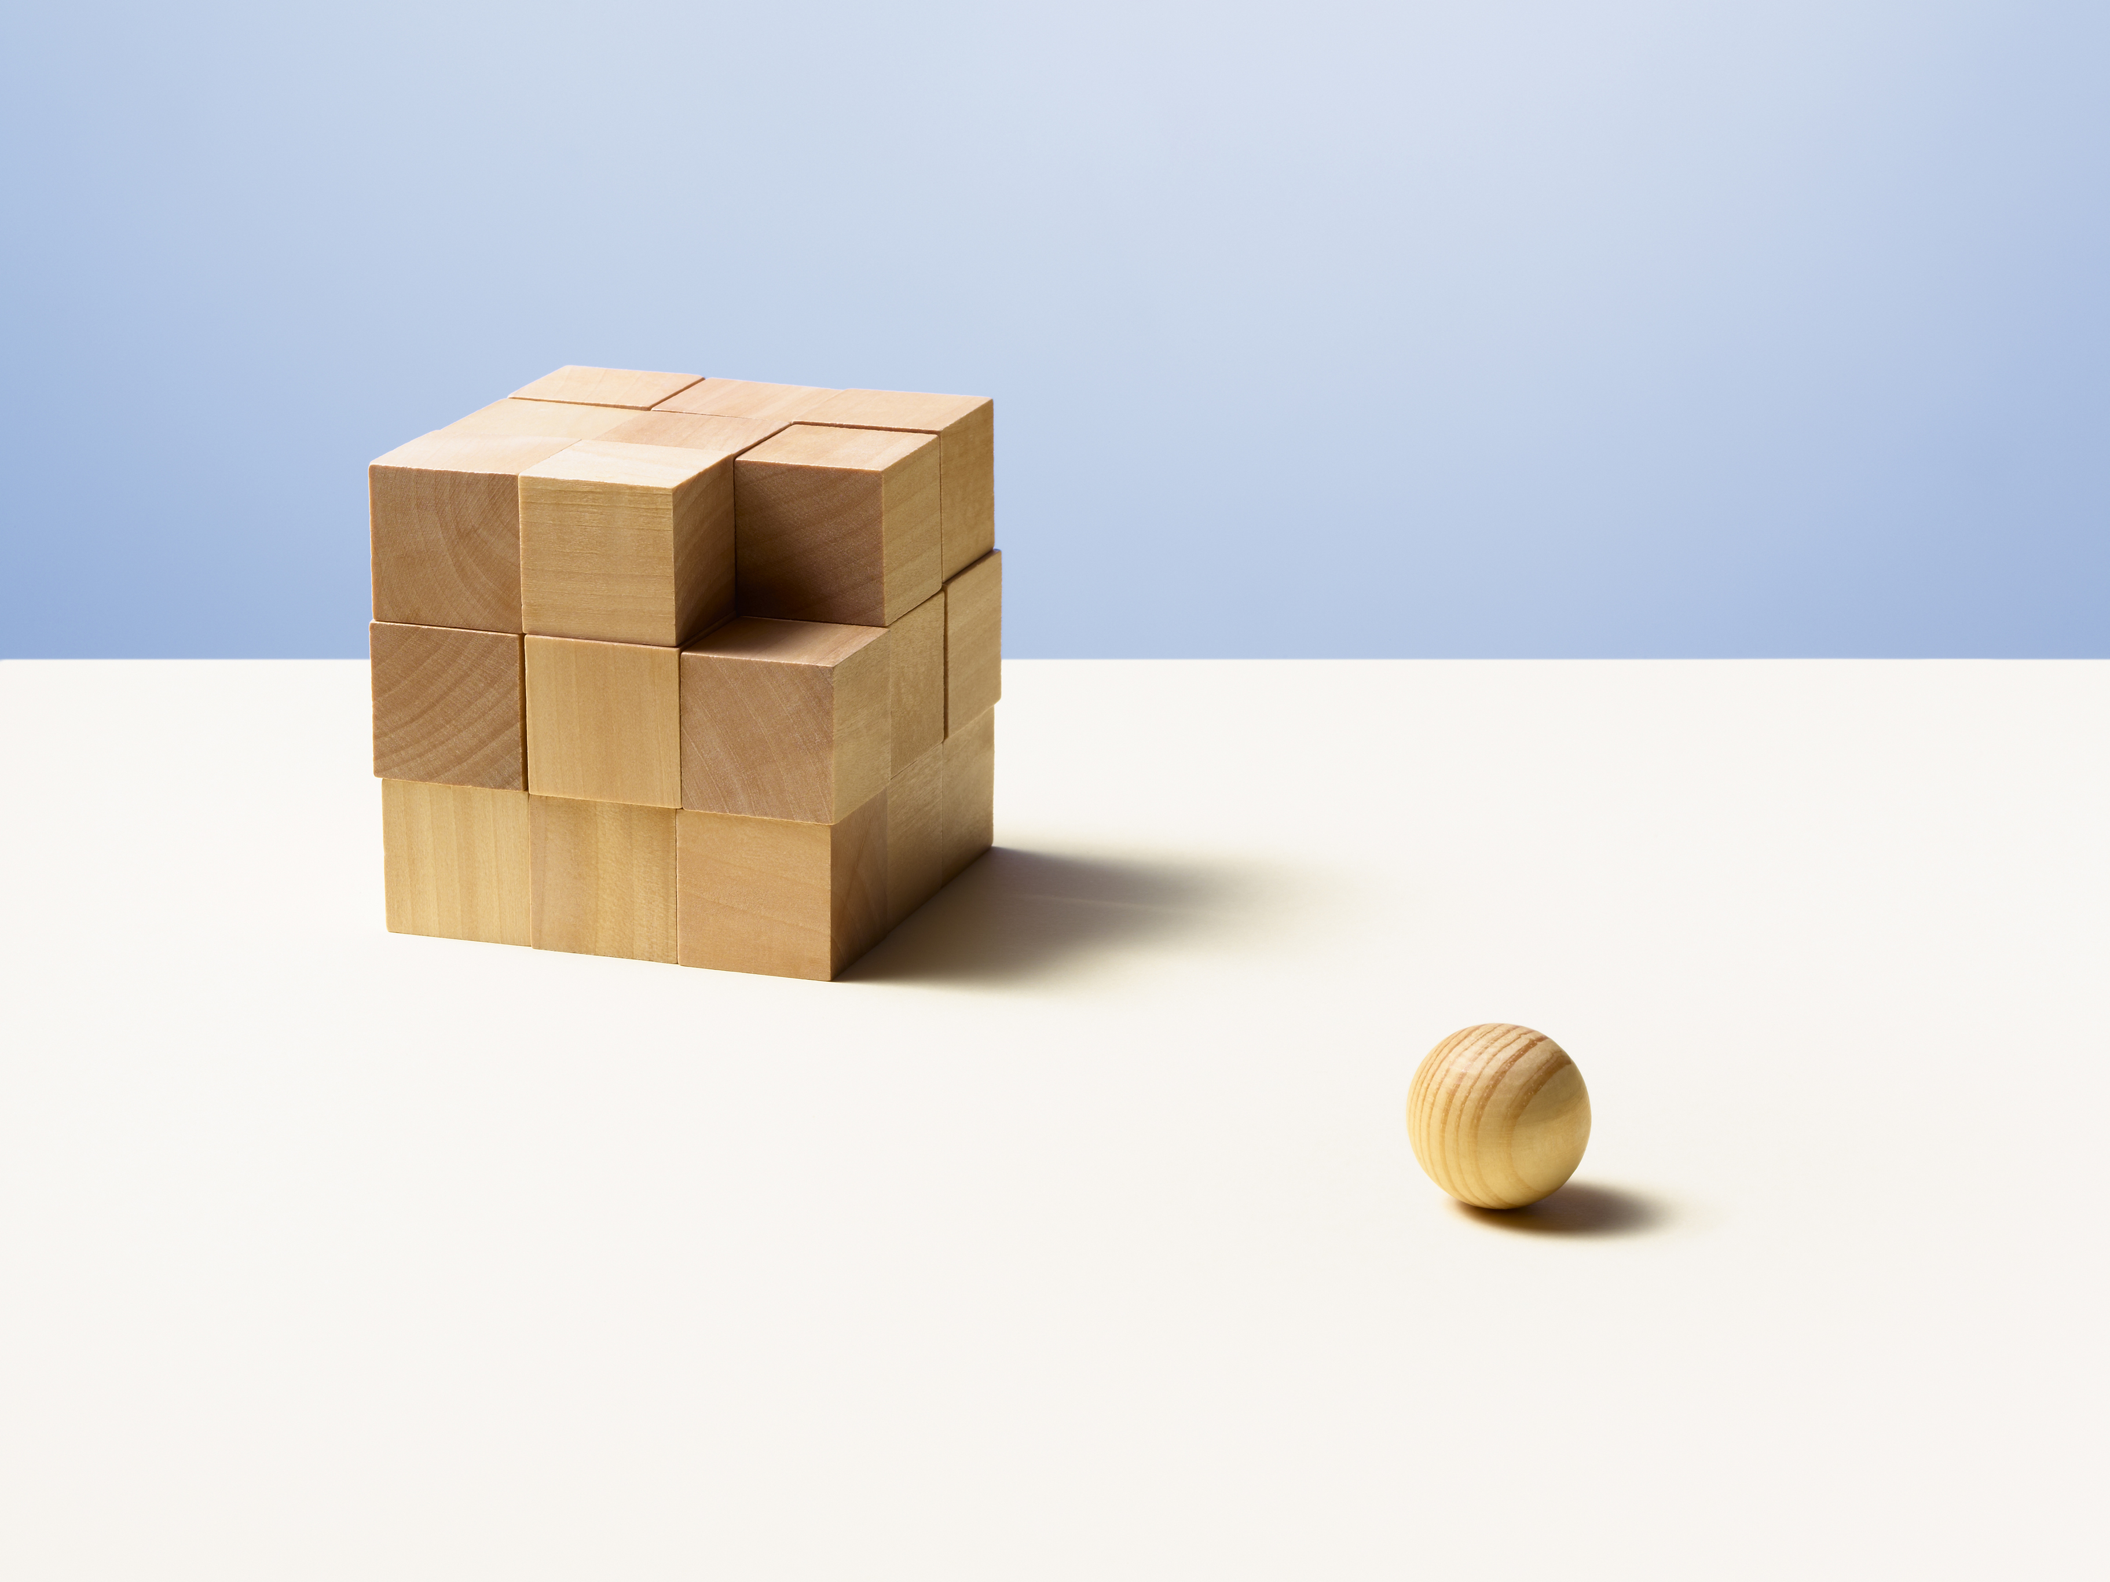
Contextuality
Contextuality asks whether a family of compatible local measurement data admit a single global model independent of context.
Notes:
Why should people care about this work? What is the take home message? Does it address an interesting problem? What has been done before in this area? What did those works struggle with that yours addresses?
The idea of performing some aspects of quantum computing using relativistic motion is not new: Refs. \cite{Layden_Martin-Martinez_Kempf_2016,Martin-Martinez_Aasen_Kempf_2013,Martín-Martínez_Sutherland_2014} constructed 1 and 2-qubit gates in the perturbative regime using coherent field states and Refs. \cite{Bruschi_Dragan_Lee_Fuentes_Louko_2013,Bruschi_Sabín_Kok_Johansson_Delsing_Fuentes_2016,Friis_Bruschi_Louko_Fuentes_2012,AsplingLawler2024} managed the construction for the continuous-variable quantum computing setting. In the former case, we lack analytic expressions for the gates making a full analysis of their properties and any statement of universality seemingly opaque, while in the latter case, the absence of a gate noise analysis (which the authors acknowledge) makes it unclear whether a quantum circuit built from these gates would actually be useful.
We can have the usual universal gate set for quantum algorithms, but we can also have a big unitary that couples every detector
Previous claims of universality did not explicitly show that their gate set could achieve this or claimed it for only a 2-detector setup

Slide 4
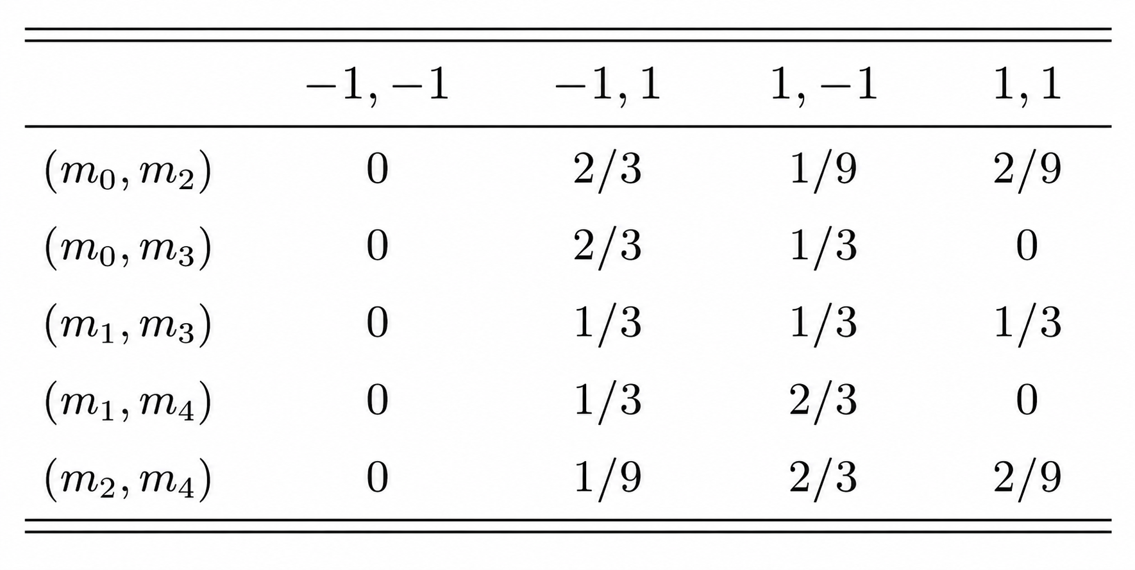



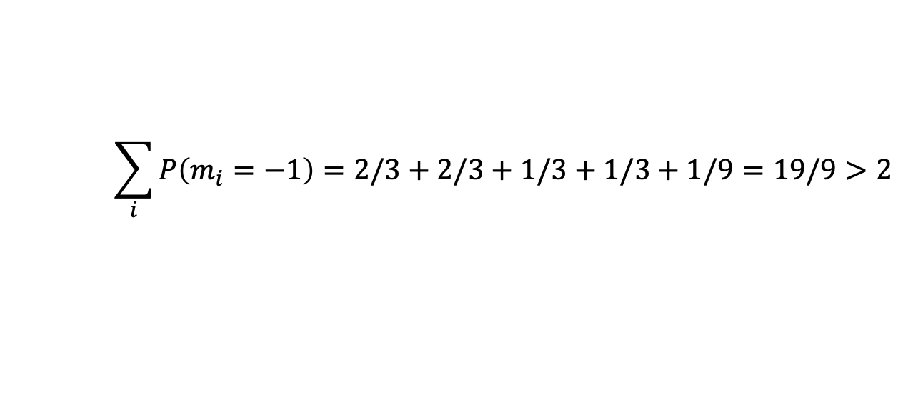


Contextuality
Pentagram Scenario
$$m_{0}$$
$$m_{4}$$
$$m_{1}$$
$$\sum_{i}{P\left(m_{i}=−1\right)}=2/3+2/3+1/3+1/3+1/9=19/9>2$$
$$m_{3}$$
$$m_{2}$$
4
Notes:
Since we have only two possible values and the -1,-1 outcome cant happen, the graph of the projectors associated to -1 should have max independence number equal to 2
Then the expected value of the -1 outcomes with respect to a global distribution should just be the sum of the -1 marginals

Slide 5
Contextuality and Non-Classicality
Many features of quantum theory can be explained with classical models…
Entanglement
Steering
Teleportation
Dense Coding
Interference
… and more!
Spekkens’ toy model!
So what about quantum theory is not classical?
Contextuality/nonlocality resist a classical explanation
R. W. Spekkens, In defense of the epistemic view of quantum states: A toy theory, Phys. Rev. A 75, 032110 (2007).
Notes:
Knowledge balance principle: If one has maximal knowledge, then for every system, at every time, the amount of knowledge one possesses about the ontic state of the system at that time must equal the amount of knowledge one lacks.
Contextuality/nonlocality resist a classical explanation, so I will take them to be the defining feature of what makes quantum theory non-classical.

Slide 6
Contextuality vs. Magic vs. Wigner Negativity
Magic
Contextuality
Bell
nonlocality
Wigner
negativity
M. Howard, J. J. Wallman, V. Veitch, and J. Emerson, Contextuality supplies the magic for quantum computation, Nature (London) 510, 351 (2014).
Notes:
Contextuality generalizes familiar nonclassical resources such as magic and nonlocal entanglement, and is equivalent to Wigner negativity as a measure of non-classicality
Just say which contextuality in particular relates them
Bell non-locality is just contextuality of spatially-separated subsystems via Fine’s theorem
Magic is the contextual non-stabilizer resource (for specific kinds of systems, like qutrits)
Wigner negativity is the same as generalized contextuality since one can either change the basis for the ontological model or allow negative values for the measure

Slide 7
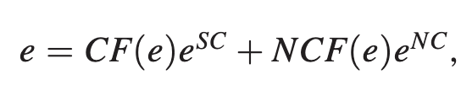
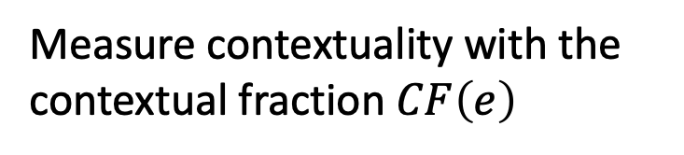
Contextual Fraction
Previous probability table is called an empirical model and can be written as
Contextual part
Non-contextual part
Measure contextuality with the contextual fraction $CF\left(e\right)$
S. Abramsky, R. S. Barbosa, and S. Mansfield, The contextual fraction as a measure of contextuality, Phys. Rev. Lett. 119, 050504 (2017).
Notes:
Why should people care about this work? What is the take home message? Does it address an interesting problem? What has been done before in this area? What did those works struggle with that yours addresses?
The idea of performing some aspects of quantum computing using relativistic motion is not new: Refs. \cite{Layden_Martin-Martinez_Kempf_2016,Martin-Martinez_Aasen_Kempf_2013,Martín-Martínez_Sutherland_2014} constructed 1 and 2-qubit gates in the perturbative regime using coherent field states and Refs. \cite{Bruschi_Dragan_Lee_Fuentes_Louko_2013,Bruschi_Sabín_Kok_Johansson_Delsing_Fuentes_2016,Friis_Bruschi_Louko_Fuentes_2012,AsplingLawler2024} managed the construction for the continuous-variable quantum computing setting. In the former case, we lack analytic expressions for the gates making a full analysis of their properties and any statement of universality seemingly opaque, while in the latter case, the absence of a gate noise analysis (which the authors acknowledge) makes it unclear whether a quantum circuit built from these gates would actually be useful.
We can have the usual universal gate set for quantum algorithms, but we can also have a big unitary that couples every detector
Previous claims of universality did not explicitly show that their gate set could achieve this or claimed it for only a 2-detector setup

Slide 8
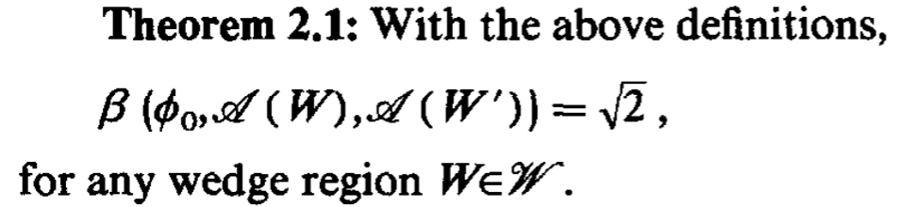
Nonclassicality in Quantum Fields
Summers and Werner showed most field states violate Bell inequalities:
Not dependent on certain types of interactions or preparations
Generic property of fields!
S. J. Summers and R. Werner, Bell’s inequalities and quantum field theory. II. Bell’s inequalities are maximally violated in the vacuum, J. Math. Phys. (N.Y.) 28, 2448 (1987).
Notes:
Why should people care about this work? What is the take home message? Does it address an interesting problem? What has been done before in this area? What did those works struggle with that yours addresses?
The idea of performing some aspects of quantum computing using relativistic motion is not new: Refs. \cite{Layden_Martin-Martinez_Kempf_2016,Martin-Martinez_Aasen_Kempf_2013,Martín-Martínez_Sutherland_2014} constructed 1 and 2-qubit gates in the perturbative regime using coherent field states and Refs. \cite{Bruschi_Dragan_Lee_Fuentes_Louko_2013,Bruschi_Sabín_Kok_Johansson_Delsing_Fuentes_2016,Friis_Bruschi_Louko_Fuentes_2012,AsplingLawler2024} managed the construction for the continuous-variable quantum computing setting. In the former case, we lack analytic expressions for the gates making a full analysis of their properties and any statement of universality seemingly opaque, while in the latter case, the absence of a gate noise analysis (which the authors acknowledge) makes it unclear whether a quantum circuit built from these gates would actually be useful.
We can have the usual universal gate set for quantum algorithms, but we can also have a big unitary that couples every detector
Previous claims of universality did not explicitly show that their gate set could achieve this or claimed it for only a 2-detector setup

Slide 9
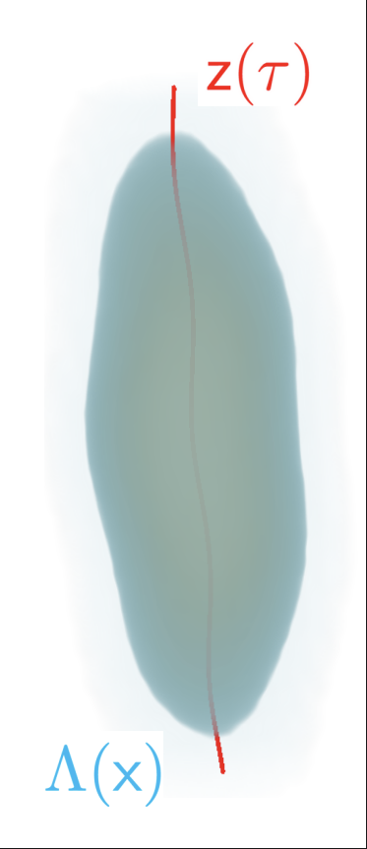





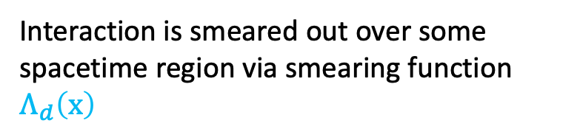



Unruh-DeWitt (UDW) Systems
Internal dynamics prescribed by free Hamiltonian
Qudit following trajectory through spacetime
$$z^{μ}\left(τ\right)=\left(t\left(τ\right),x\left(τ\right)\right)$$
Interacts with quantum field $\hat{φ}\left(x\right)$ via Hamiltonian density
$${\hat{h}}_{d}\left(x\right)=λ_{d}Λ_{d}\left(x\right){\hat{μ}}_{d}(τ)⊗\hat{φ}\left(x\right)$$
$$\hat{φ}\left(x\right)$$
Interaction is smeared out over some spacetime region via smearing function $Λ_{d}\left(x\right)$
$$t$$
$$x$$
Notes:
Why should people care about this work? What is the take home message? Does it address an interesting problem? What has been done before in this area? What did those works struggle with that yours addresses?
The idea of performing some aspects of quantum computing using relativistic motion is not new: Refs. \cite{Layden_Martin-Martinez_Kempf_2016,Martin-Martinez_Aasen_Kempf_2013,Martín-Martínez_Sutherland_2014} constructed 1 and 2-qubit gates in the perturbative regime using coherent field states and Refs. \cite{Bruschi_Dragan_Lee_Fuentes_Louko_2013,Bruschi_Sabín_Kok_Johansson_Delsing_Fuentes_2016,Friis_Bruschi_Louko_Fuentes_2012,AsplingLawler2024} managed the construction for the continuous-variable quantum computing setting. In the former case, we lack analytic expressions for the gates making a full analysis of their properties and any statement of universality seemingly opaque, while in the latter case, the absence of a gate noise analysis (which the authors acknowledge) makes it unclear whether a quantum circuit built from these gates would actually be useful.
We can have the usual universal gate set for quantum algorithms, but we can also have a big unitary that couples every detector
Previous claims of universality did not explicitly show that their gate set could achieve this or claimed it for only a 2-detector setup

Slide 10

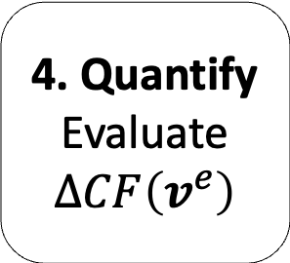
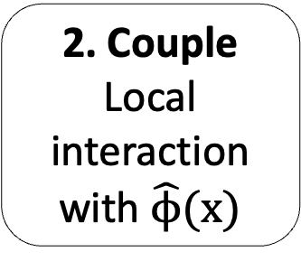
Contextuality Harvesting
Harvested contextuality measured using
The protocol:
1. Prepare
Non-contextual initial system state
2. Couple
Local interaction with $\hat{ϕ}(x)$
3. Reduce
Trace out the field after time evolution
4. Quantify
Evaluate $ΔCF\left(v^{e}\right)$
Notes:
Why should people care about this work? What is the take home message? Does it address an interesting problem? What has been done before in this area? What did those works struggle with that yours addresses?
The idea of performing some aspects of quantum computing using relativistic motion is not new: Refs. \cite{Layden_Martin-Martinez_Kempf_2016,Martin-Martinez_Aasen_Kempf_2013,Martín-Martínez_Sutherland_2014} constructed 1 and 2-qubit gates in the perturbative regime using coherent field states and Refs. \cite{Bruschi_Dragan_Lee_Fuentes_Louko_2013,Bruschi_Sabín_Kok_Johansson_Delsing_Fuentes_2016,Friis_Bruschi_Louko_Fuentes_2012,AsplingLawler2024} managed the construction for the continuous-variable quantum computing setting. In the former case, we lack analytic expressions for the gates making a full analysis of their properties and any statement of universality seemingly opaque, while in the latter case, the absence of a gate noise analysis (which the authors acknowledge) makes it unclear whether a quantum circuit built from these gates would actually be useful.
We can have the usual universal gate set for quantum algorithms, but we can also have a big unitary that couples every detector
Previous claims of universality did not explicitly show that their gate set could achieve this or claimed it for only a 2-detector setup

Slide 11
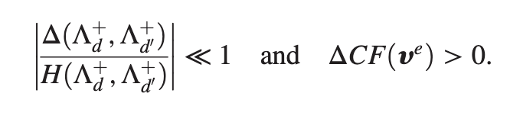
Conditions for Genuine Contextuality Harvesting
Not all harvested contextuality is due to the field
Hadamard function encodes field state-dependence
Symmetric propagator encodes signalling
Quantify:
Genuine harvesting is identified when the Hadamard contribution dominates the signalling term in the relevant peak region
Notes:
Why should people care about this work? What is the take home message? Does it address an interesting problem? What has been done before in this area? What did those works struggle with that yours addresses?
The idea of performing some aspects of quantum computing using relativistic motion is not new: Refs. \cite{Layden_Martin-Martinez_Kempf_2016,Martin-Martinez_Aasen_Kempf_2013,Martín-Martínez_Sutherland_2014} constructed 1 and 2-qubit gates in the perturbative regime using coherent field states and Refs. \cite{Bruschi_Dragan_Lee_Fuentes_Louko_2013,Bruschi_Sabín_Kok_Johansson_Delsing_Fuentes_2016,Friis_Bruschi_Louko_Fuentes_2012,AsplingLawler2024} managed the construction for the continuous-variable quantum computing setting. In the former case, we lack analytic expressions for the gates making a full analysis of their properties and any statement of universality seemingly opaque, while in the latter case, the absence of a gate noise analysis (which the authors acknowledge) makes it unclear whether a quantum circuit built from these gates would actually be useful.
We can have the usual universal gate set for quantum algorithms, but we can also have a big unitary that couples every detector
Previous claims of universality did not explicitly show that their gate set could achieve this or claimed it for only a 2-detector setup

Slide 12
Contextuality Harvesting – An Argument
Can we call it “harvesting?”
Vacuum state is generically highly non-classical
Pre-existing contextuality
1
Use on field and UDW systems to reduce explanation of acquired contextuality to non-classicality of vacuum
Resource theory of contextuality identifies free operations
2
State-dependent portion of vacuum correlations dominates
Specific field state sources non-classicality
3
B. Amaral, Resource theory of contextuality, Phil. Trans. R. Soc. 377, 20190010 (2019).
S. J. Summers and R. Werner, Bell’s inequalities and quantum field theory. II. Bell’s inequalities are maximally violated in the vacuum, J. Math. Phys. (N.Y.) 28, 2448 (1987).
Notes:
Just because a transformation can generate contextuality doesn’t mean it always does,
One can check that the state was part of linearly independent set beforehand and then observe that the field state assignment makes the resulting reduced state contextual, also we know that unitary interactions cannot create preparation/measurement contextuality if there wasn’t any to begin with
Could try out multiple interactions on the vacuum and see that it doesn’t matter what transformation you use.

Slide 13
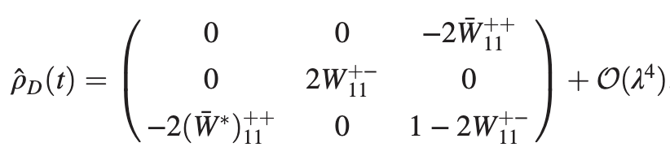



Contextuality Harvesting – Single Qutrit
Why single qutrit?
No subsystem entanglement but still can be non-classical
Vacuum fluctuations transfer contextuality to qutrit
Notes:
Why should people care about this work? What is the take home message? Does it address an interesting problem? What has been done before in this area? What did those works struggle with that yours addresses?
The idea of performing some aspects of quantum computing using relativistic motion is not new: Refs. \cite{Layden_Martin-Martinez_Kempf_2016,Martin-Martinez_Aasen_Kempf_2013,Martín-Martínez_Sutherland_2014} constructed 1 and 2-qubit gates in the perturbative regime using coherent field states and Refs. \cite{Bruschi_Dragan_Lee_Fuentes_Louko_2013,Bruschi_Sabín_Kok_Johansson_Delsing_Fuentes_2016,Friis_Bruschi_Louko_Fuentes_2012,AsplingLawler2024} managed the construction for the continuous-variable quantum computing setting. In the former case, we lack analytic expressions for the gates making a full analysis of their properties and any statement of universality seemingly opaque, while in the latter case, the absence of a gate noise analysis (which the authors acknowledge) makes it unclear whether a quantum circuit built from these gates would actually be useful.
We can have the usual universal gate set for quantum algorithms, but we can also have a big unitary that couples every detector
Previous claims of universality did not explicitly show that their gate set could achieve this or claimed it for only a 2-detector setup

Slide 14
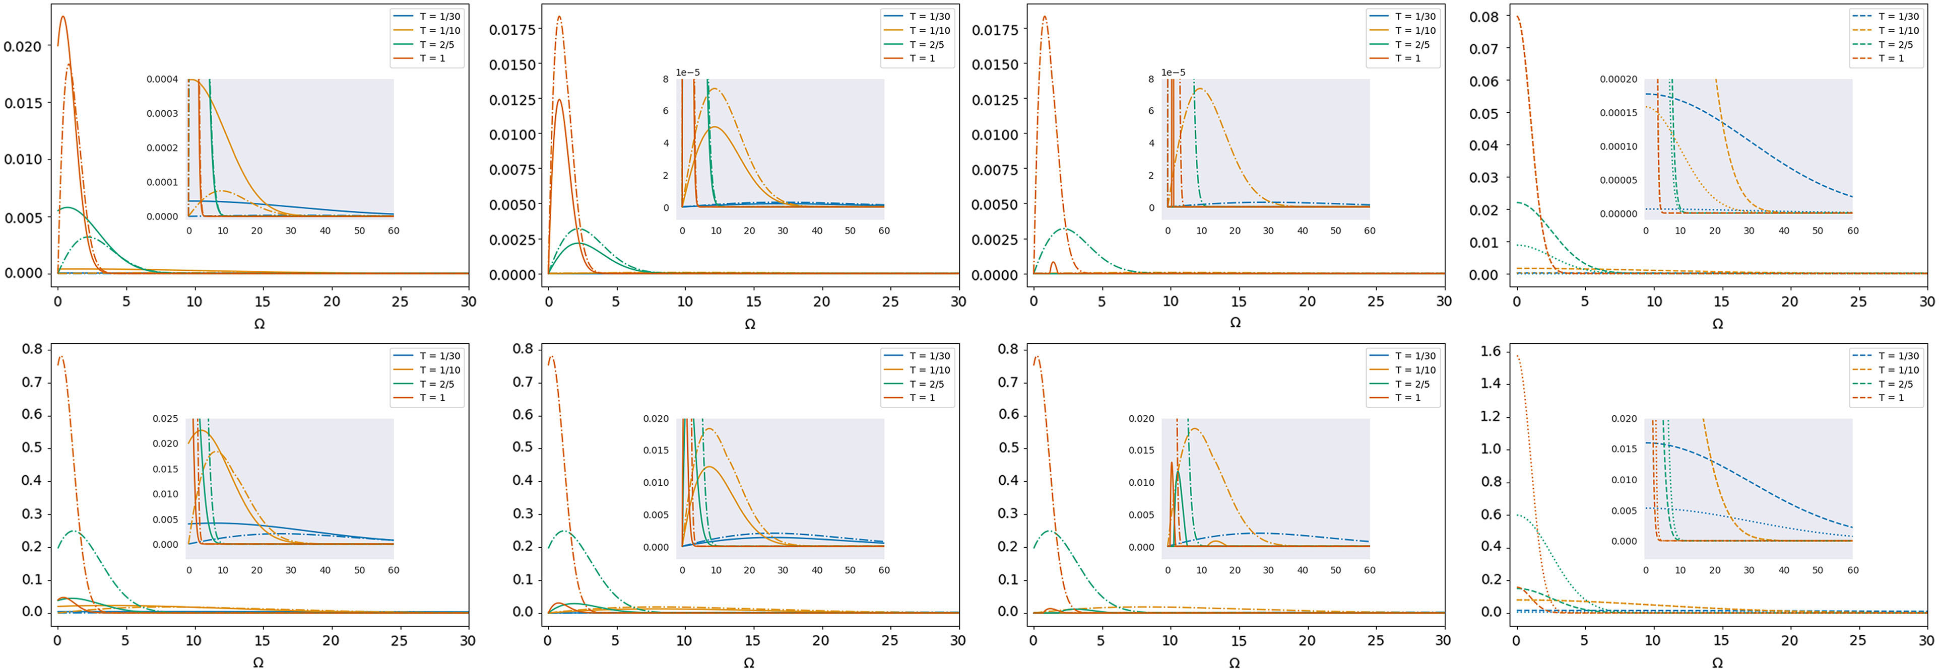
Contextuality Harvesting – Single Qutrit
Longer interactions amplify signalling and can wash out harvested peak
Smaller spatial smearing strengthens harvested contextuality
Harvesting present for gapless systems
Figure 1: single-qutrit contextuality compared with harvested magic and with the genuine-harvesting diagnostic based on the Hadamard and signalling contributions.

Slide 15
Contextuality Harvesting – Single Qutrit
Shifting measurements creates no gapless harvesting
Notes:
Why should people care about this work? What is the take home message? Does it address an interesting problem? What has been done before in this area? What did those works struggle with that yours addresses?
The idea of performing some aspects of quantum computing using relativistic motion is not new: Refs. \cite{Layden_Martin-Martinez_Kempf_2016,Martin-Martinez_Aasen_Kempf_2013,Martín-Martínez_Sutherland_2014} constructed 1 and 2-qubit gates in the perturbative regime using coherent field states and Refs. \cite{Bruschi_Dragan_Lee_Fuentes_Louko_2013,Bruschi_Sabín_Kok_Johansson_Delsing_Fuentes_2016,Friis_Bruschi_Louko_Fuentes_2012,AsplingLawler2024} managed the construction for the continuous-variable quantum computing setting. In the former case, we lack analytic expressions for the gates making a full analysis of their properties and any statement of universality seemingly opaque, while in the latter case, the absence of a gate noise analysis (which the authors acknowledge) makes it unclear whether a quantum circuit built from these gates would actually be useful.
We can have the usual universal gate set for quantum algorithms, but we can also have a big unitary that couples every detector
Previous claims of universality did not explicitly show that their gate set could achieve this or claimed it for only a 2-detector setup

Slide 16
Contextuality Harvesting – Single Qutrit
Additional shift delays harvesting to start at a small gap
Contextuality can persist after harvested magic has already vanished, showing they have different state boundaries
Can harvest contextuality and magic for gapless systems depending on the measurement scenario and smearing profile
R. Nyström, N. Pranzini, and E. Keski-Vakkuri, Harvesting magic from the vacuum, Phys. Rev. Res. 7, 033085 (2025).
Notes:
Can tune measurements to alter harvested amount at zero gap, contextuality can persist after harvested magic has already vanished, showing they have different state boundaries

Slide 17
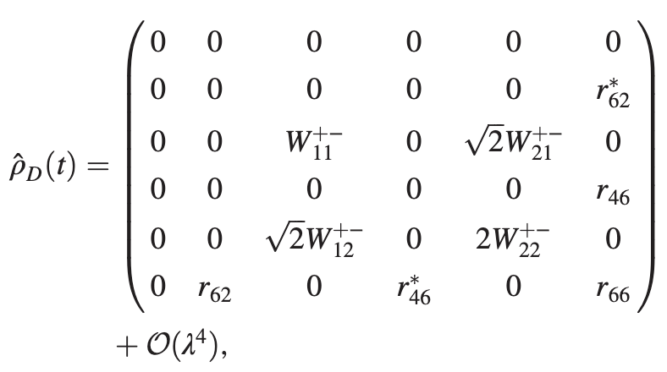

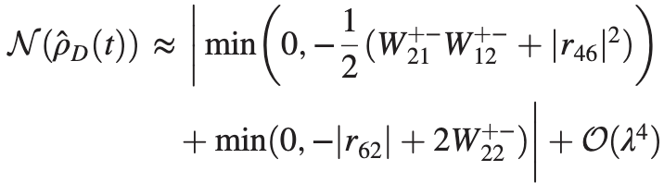
Contextuality Harvesting – Qubit-Qutrit
Vacuum fluctuations transfer contextuality to qutrit
Negativity:
Vacuum fluctuations and field mediation transfer entanglement between qubit and qutrit
Notes:
Why should people care about this work? What is the take home message? Does it address an interesting problem? What has been done before in this area? What did those works struggle with that yours addresses?
The idea of performing some aspects of quantum computing using relativistic motion is not new: Refs. \cite{Layden_Martin-Martinez_Kempf_2016,Martin-Martinez_Aasen_Kempf_2013,Martín-Martínez_Sutherland_2014} constructed 1 and 2-qubit gates in the perturbative regime using coherent field states and Refs. \cite{Bruschi_Dragan_Lee_Fuentes_Louko_2013,Bruschi_Sabín_Kok_Johansson_Delsing_Fuentes_2016,Friis_Bruschi_Louko_Fuentes_2012,AsplingLawler2024} managed the construction for the continuous-variable quantum computing setting. In the former case, we lack analytic expressions for the gates making a full analysis of their properties and any statement of universality seemingly opaque, while in the latter case, the absence of a gate noise analysis (which the authors acknowledge) makes it unclear whether a quantum circuit built from these gates would actually be useful.
We can have the usual universal gate set for quantum algorithms, but we can also have a big unitary that couples every detector
Previous claims of universality did not explicitly show that their gate set could achieve this or claimed it for only a 2-detector setup

Slide 18
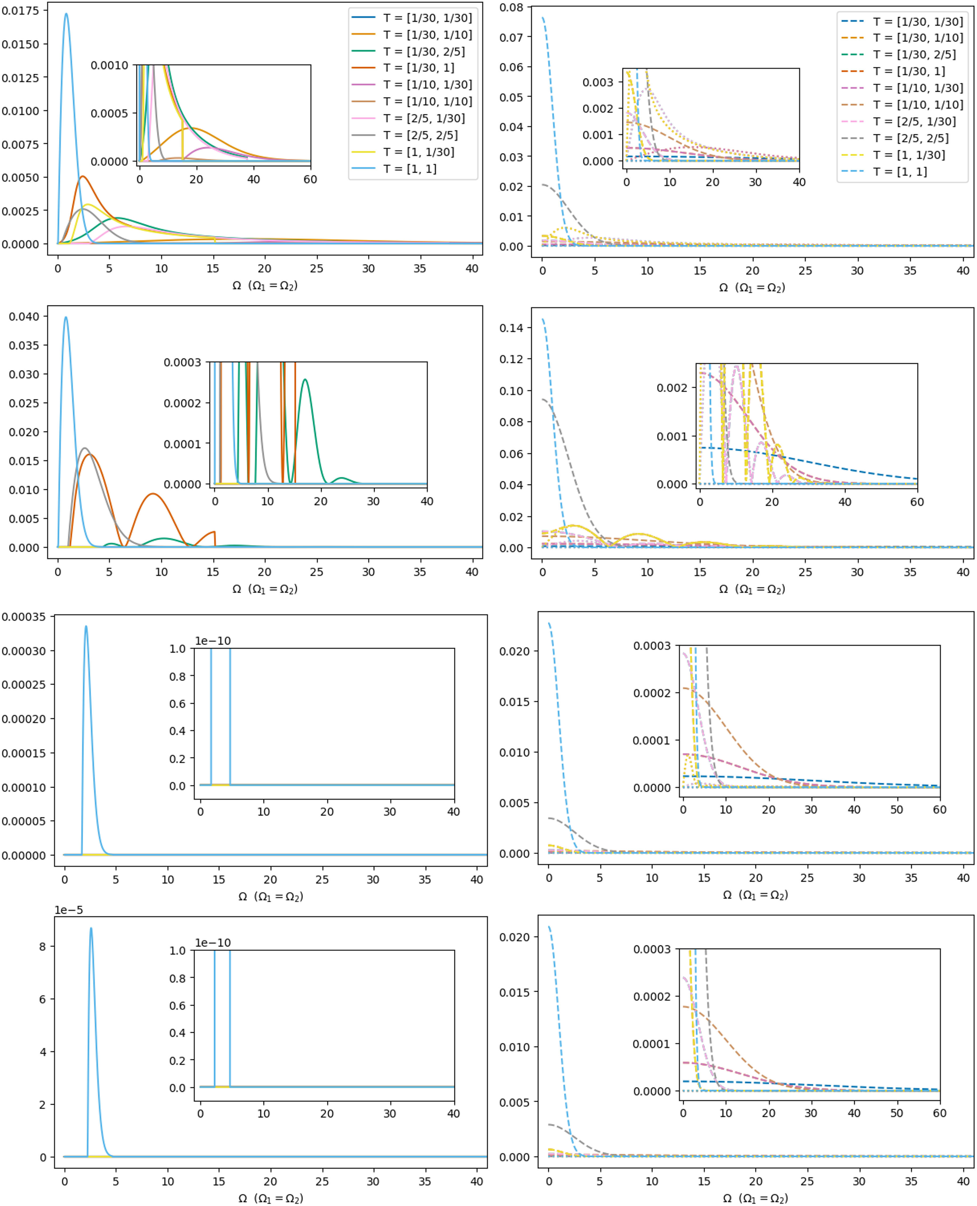
Contextuality Harvesting – Qubit-Qutrit
Smaller system separation
Adding a qubit allows the joint system to harvest negativity while the qutrit still carries local contextuality
The two resource windows need not coincide, so they can compete, align, or separate as the detector profiles and separation are varied
Figure 2: negativity in the qubit-qutrit system as a function of the shared gap, temporal widths, spatial width, and separation.
Notes:
Why should people care about this work? What is the take home message? Does it address an interesting problem? What has been done before in this area? What did those works struggle with that yours addresses?
The idea of performing some aspects of quantum computing using relativistic motion is not new: Refs. \cite{Layden_Martin-Martinez_Kempf_2016,Martin-Martinez_Aasen_Kempf_2013,Martín-Martínez_Sutherland_2014} constructed 1 and 2-qubit gates in the perturbative regime using coherent field states and Refs. \cite{Bruschi_Dragan_Lee_Fuentes_Louko_2013,Bruschi_Sabín_Kok_Johansson_Delsing_Fuentes_2016,Friis_Bruschi_Louko_Fuentes_2012,AsplingLawler2024} managed the construction for the continuous-variable quantum computing setting. In the former case, we lack analytic expressions for the gates making a full analysis of their properties and any statement of universality seemingly opaque, while in the latter case, the absence of a gate noise analysis (which the authors acknowledge) makes it unclear whether a quantum circuit built from these gates would actually be useful.
We can have the usual universal gate set for quantum algorithms, but we can also have a big unitary that couples every detector
Previous claims of universality did not explicitly show that their gate set could achieve this or claimed it for only a 2-detector setup

Slide 19
Contextuality Harvesting – Qubit-Qutrit
Larger system separation
Most entanglement harvesting is destroyed at this distance
Figure 2: negativity in the qubit-qutrit system as a function of the shared gap, temporal widths, spatial width, and separation.
Notes:
Why should people care about this work? What is the take home message? Does it address an interesting problem? What has been done before in this area? What did those works struggle with that yours addresses?
The idea of performing some aspects of quantum computing using relativistic motion is not new: Refs. \cite{Layden_Martin-Martinez_Kempf_2016,Martin-Martinez_Aasen_Kempf_2013,Martín-Martínez_Sutherland_2014} constructed 1 and 2-qubit gates in the perturbative regime using coherent field states and Refs. \cite{Bruschi_Dragan_Lee_Fuentes_Louko_2013,Bruschi_Sabín_Kok_Johansson_Delsing_Fuentes_2016,Friis_Bruschi_Louko_Fuentes_2012,AsplingLawler2024} managed the construction for the continuous-variable quantum computing setting. In the former case, we lack analytic expressions for the gates making a full analysis of their properties and any statement of universality seemingly opaque, while in the latter case, the absence of a gate noise analysis (which the authors acknowledge) makes it unclear whether a quantum circuit built from these gates would actually be useful.
We can have the usual universal gate set for quantum algorithms, but we can also have a big unitary that couples every detector
Previous claims of universality did not explicitly show that their gate set could achieve this or claimed it for only a 2-detector setup

Slide 20
Contextuality Harvesting – Qubit-Qutrit
Harvesting Behaviour
Coexistence Window
Fix the qutrit in a low-gap, high-contextuality regime and widen the qubit temporal profile to pull the negativity peak toward the same region. Both can coexist inside a controllable overlap region.
Energy Gap Ω
Both resources fade for large gaps
Spatial Width σ
Smaller smearing generally amplifies harvesting
Temporal Width T
Controls peak alignment and signalling contamination
Separation L
Nonlocal entanglement dies sooner than local contextuality
Non-classicality remains in the system even at large separation
Figure 2: negativity in the qubit-qutrit system as a function of the shared gap, temporal widths, spatial width, and separation.
Notes:
Why should people care about this work? What is the take home message? Does it address an interesting problem? What has been done before in this area? What did those works struggle with that yours addresses?
The idea of performing some aspects of quantum computing using relativistic motion is not new: Refs. \cite{Layden_Martin-Martinez_Kempf_2016,Martin-Martinez_Aasen_Kempf_2013,Martín-Martínez_Sutherland_2014} constructed 1 and 2-qubit gates in the perturbative regime using coherent field states and Refs. \cite{Bruschi_Dragan_Lee_Fuentes_Louko_2013,Bruschi_Sabín_Kok_Johansson_Delsing_Fuentes_2016,Friis_Bruschi_Louko_Fuentes_2012,AsplingLawler2024} managed the construction for the continuous-variable quantum computing setting. In the former case, we lack analytic expressions for the gates making a full analysis of their properties and any statement of universality seemingly opaque, while in the latter case, the absence of a gate noise analysis (which the authors acknowledge) makes it unclear whether a quantum circuit built from these gates would actually be useful.
We can have the usual universal gate set for quantum algorithms, but we can also have a big unitary that couples every detector
Previous claims of universality did not explicitly show that their gate set could achieve this or claimed it for only a 2-detector setup

Slide 21
Key Takeaways
1
Single qutrits harvest contextuality from vacuum correlations.
2
Gapless systems can harvest contextuality for suitable measurement choices.
3
Qubit–qutrit systems can harvest both negativity and local contextuality, with coexistence and trade-offs.
4
New genuine-harvesting criteria separate vacuum-resource extraction from field-mediated signaling.
Notes:
Gates are derived in a spacetime independent way so we aren’t just limited to Minkowski; we just use it because we know what the expressions for the Wightman function and propagators look like

Slide 22
Outlook
More rigorous proof for genuine contextuality harvesting
Further exploration of the gapless setting
Non-locality-Contextuality tradeoff
How different spacetimes affect harvesting
Notes:
Why should people care about this work? What is the take home message? Does it address an interesting problem? What has been done before in this area? What did those works struggle with that yours addresses?
The idea of performing some aspects of quantum computing using relativistic motion is not new: Refs. \cite{Layden_Martin-Martinez_Kempf_2016,Martin-Martinez_Aasen_Kempf_2013,Martín-Martínez_Sutherland_2014} constructed 1 and 2-qubit gates in the perturbative regime using coherent field states and Refs. \cite{Bruschi_Dragan_Lee_Fuentes_Louko_2013,Bruschi_Sabín_Kok_Johansson_Delsing_Fuentes_2016,Friis_Bruschi_Louko_Fuentes_2012,AsplingLawler2024} managed the construction for the continuous-variable quantum computing setting. In the former case, we lack analytic expressions for the gates making a full analysis of their properties and any statement of universality seemingly opaque, while in the latter case, the absence of a gate noise analysis (which the authors acknowledge) makes it unclear whether a quantum circuit built from these gates would actually be useful.
We can have the usual universal gate set for quantum algorithms, but we can also have a big unitary that couples every detector
Previous claims of universality did not explicitly show that their gate set could achieve this or claimed it for only a 2-detector setup

Slide 23

Thank you for your attention!
Phys. Rev. D. 113, 045001 (2026)

Slide 24
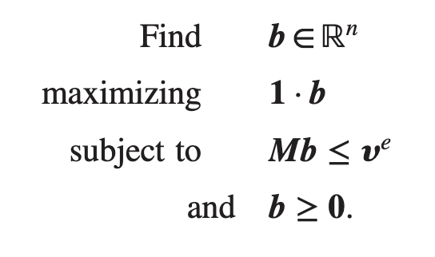

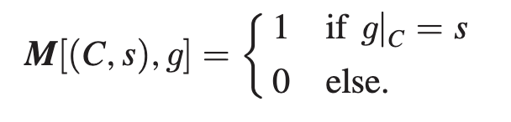

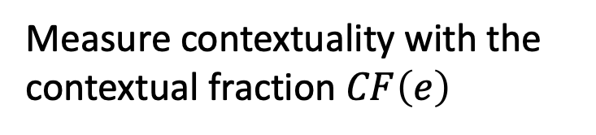
Contextual Fraction
Previous probability table is called an empirical model and can be written as
Can phrase as linear program:
Contextual part
Non-contextual part
Measure contextuality with the contextual fraction $CF\left(e\right)$
$e$ as a vector:
Global assignment matrix:
S. Abramsky, R. S. Barbosa, and S. Mansfield, The contextual fraction as a measure of contextuality, Phys. Rev. Lett. 119, 050504 (2017).
Notes:
Why should people care about this work? What is the take home message? Does it address an interesting problem? What has been done before in this area? What did those works struggle with that yours addresses?
The idea of performing some aspects of quantum computing using relativistic motion is not new: Refs. \cite{Layden_Martin-Martinez_Kempf_2016,Martin-Martinez_Aasen_Kempf_2013,Martín-Martínez_Sutherland_2014} constructed 1 and 2-qubit gates in the perturbative regime using coherent field states and Refs. \cite{Bruschi_Dragan_Lee_Fuentes_Louko_2013,Bruschi_Sabín_Kok_Johansson_Delsing_Fuentes_2016,Friis_Bruschi_Louko_Fuentes_2012,AsplingLawler2024} managed the construction for the continuous-variable quantum computing setting. In the former case, we lack analytic expressions for the gates making a full analysis of their properties and any statement of universality seemingly opaque, while in the latter case, the absence of a gate noise analysis (which the authors acknowledge) makes it unclear whether a quantum circuit built from these gates would actually be useful.
We can have the usual universal gate set for quantum algorithms, but we can also have a big unitary that couples every detector
Previous claims of universality did not explicitly show that their gate set could achieve this or claimed it for only a 2-detector setup

