Slide 1





Harvesting Contextuality from the Vacuum
Philip A. LeMaitre
May 19, 2026
Phys. Rev. D. 113, 045001 (2026)
Notes:
Hi everyone, thanks for coming to my presentation. My name is Phil and I am a PhD student from the University of Innsbruck in the group of Hans Briegel. Today I will be talking about Multi-Excitation Projective Simulation.

Slide 2






My Journey
Hans Briegel Group
Theoretical Physics Ph.D.
Theoretical Physics B. Sc.
Supervised by Eric Poisson
Russell Thompson Group
Theoretical Physics M. Sc.
Notes:
Why should people care about this work? What is the take home message? Does it address an interesting problem? What has been done before in this area? What did those works struggle with that yours addresses?
The idea of performing some aspects of quantum computing using relativistic motion is not new: Refs. \cite{Layden_Martin-Martinez_Kempf_2016,Martin-Martinez_Aasen_Kempf_2013,Martín-Martínez_Sutherland_2014} constructed 1 and 2-qubit gates in the perturbative regime using coherent field states and Refs. \cite{Bruschi_Dragan_Lee_Fuentes_Louko_2013,Bruschi_Sabín_Kok_Johansson_Delsing_Fuentes_2016,Friis_Bruschi_Louko_Fuentes_2012,AsplingLawler2024} managed the construction for the continuous-variable quantum computing setting. In the former case, we lack analytic expressions for the gates making a full analysis of their properties and any statement of universality seemingly opaque, while in the latter case, the absence of a gate noise analysis (which the authors acknowledge) makes it unclear whether a quantum circuit built from these gates would actually be useful.
We can have the usual universal gate set for quantum algorithms, but we can also have a big unitary that couples every detector
Previous claims of universality did not explicitly show that their gate set could achieve this or claimed it for only a 2-detector setup

Slide 3
Introduction and Motivation
Motivating question: are there other resources besides entanglement we can extract from quantum fields?
Yes, (measurement) contextuality!
Key question: can an initially non-contextual Unruh-DeWitt (UDW) system state become contextual after a local interaction with the vacuum?
Notes:
Why should people care about this work? What is the take home message? Does it address an interesting problem? What has been done before in this area? What did those works struggle with that yours addresses?
The idea of performing some aspects of quantum computing using relativistic motion is not new: Refs. \cite{Layden_Martin-Martinez_Kempf_2016,Martin-Martinez_Aasen_Kempf_2013,Martín-Martínez_Sutherland_2014} constructed 1 and 2-qubit gates in the perturbative regime using coherent field states and Refs. \cite{Bruschi_Dragan_Lee_Fuentes_Louko_2013,Bruschi_Sabín_Kok_Johansson_Delsing_Fuentes_2016,Friis_Bruschi_Louko_Fuentes_2012,AsplingLawler2024} managed the construction for the continuous-variable quantum computing setting. In the former case, we lack analytic expressions for the gates making a full analysis of their properties and any statement of universality seemingly opaque, while in the latter case, the absence of a gate noise analysis (which the authors acknowledge) makes it unclear whether a quantum circuit built from these gates would actually be useful.
We can have the usual universal gate set for quantum algorithms, but we can also have a big unitary that couples every detector
Previous claims of universality did not explicitly show that their gate set could achieve this or claimed it for only a 2-detector setup

Slide 4
Outline
Contextuality
Unruh-DeWitt Qudits
Contextuality Harvesting
Qutrit and Qubit-Qutrit Harvesting
Summary and Outlook
Notes:
Why should people care about this work? What is the take home message? Does it address an interesting problem? What has been done before in this area? What did those works struggle with that yours addresses?
The idea of performing some aspects of quantum computing using relativistic motion is not new: Refs. \cite{Layden_Martin-Martinez_Kempf_2016,Martin-Martinez_Aasen_Kempf_2013,Martín-Martínez_Sutherland_2014} constructed 1 and 2-qubit gates in the perturbative regime using coherent field states and Refs. \cite{Bruschi_Dragan_Lee_Fuentes_Louko_2013,Bruschi_Sabín_Kok_Johansson_Delsing_Fuentes_2016,Friis_Bruschi_Louko_Fuentes_2012,AsplingLawler2024} managed the construction for the continuous-variable quantum computing setting. In the former case, we lack analytic expressions for the gates making a full analysis of their properties and any statement of universality seemingly opaque, while in the latter case, the absence of a gate noise analysis (which the authors acknowledge) makes it unclear whether a quantum circuit built from these gates would actually be useful.
We can have the usual universal gate set for quantum algorithms, but we can also have a big unitary that couples every detector
Previous claims of universality did not explicitly show that their gate set could achieve this or claimed it for only a 2-detector setup

Slide 5
I. Contextuality
Notes:
Why should people care about this work? What is the take home message? Does it address an interesting problem? What has been done before in this area? What did those works struggle with that yours addresses?
The idea of performing some aspects of quantum computing using relativistic motion is not new: Refs. \cite{Layden_Martin-Martinez_Kempf_2016,Martin-Martinez_Aasen_Kempf_2013,Martín-Martínez_Sutherland_2014} constructed 1 and 2-qubit gates in the perturbative regime using coherent field states and Refs. \cite{Bruschi_Dragan_Lee_Fuentes_Louko_2013,Bruschi_Sabín_Kok_Johansson_Delsing_Fuentes_2016,Friis_Bruschi_Louko_Fuentes_2012,AsplingLawler2024} managed the construction for the continuous-variable quantum computing setting. In the former case, we lack analytic expressions for the gates making a full analysis of their properties and any statement of universality seemingly opaque, while in the latter case, the absence of a gate noise analysis (which the authors acknowledge) makes it unclear whether a quantum circuit built from these gates would actually be useful.
We can have the usual universal gate set for quantum algorithms, but we can also have a big unitary that couples every detector
Previous claims of universality did not explicitly show that their gate set could achieve this or claimed it for only a 2-detector setup

Slide 6
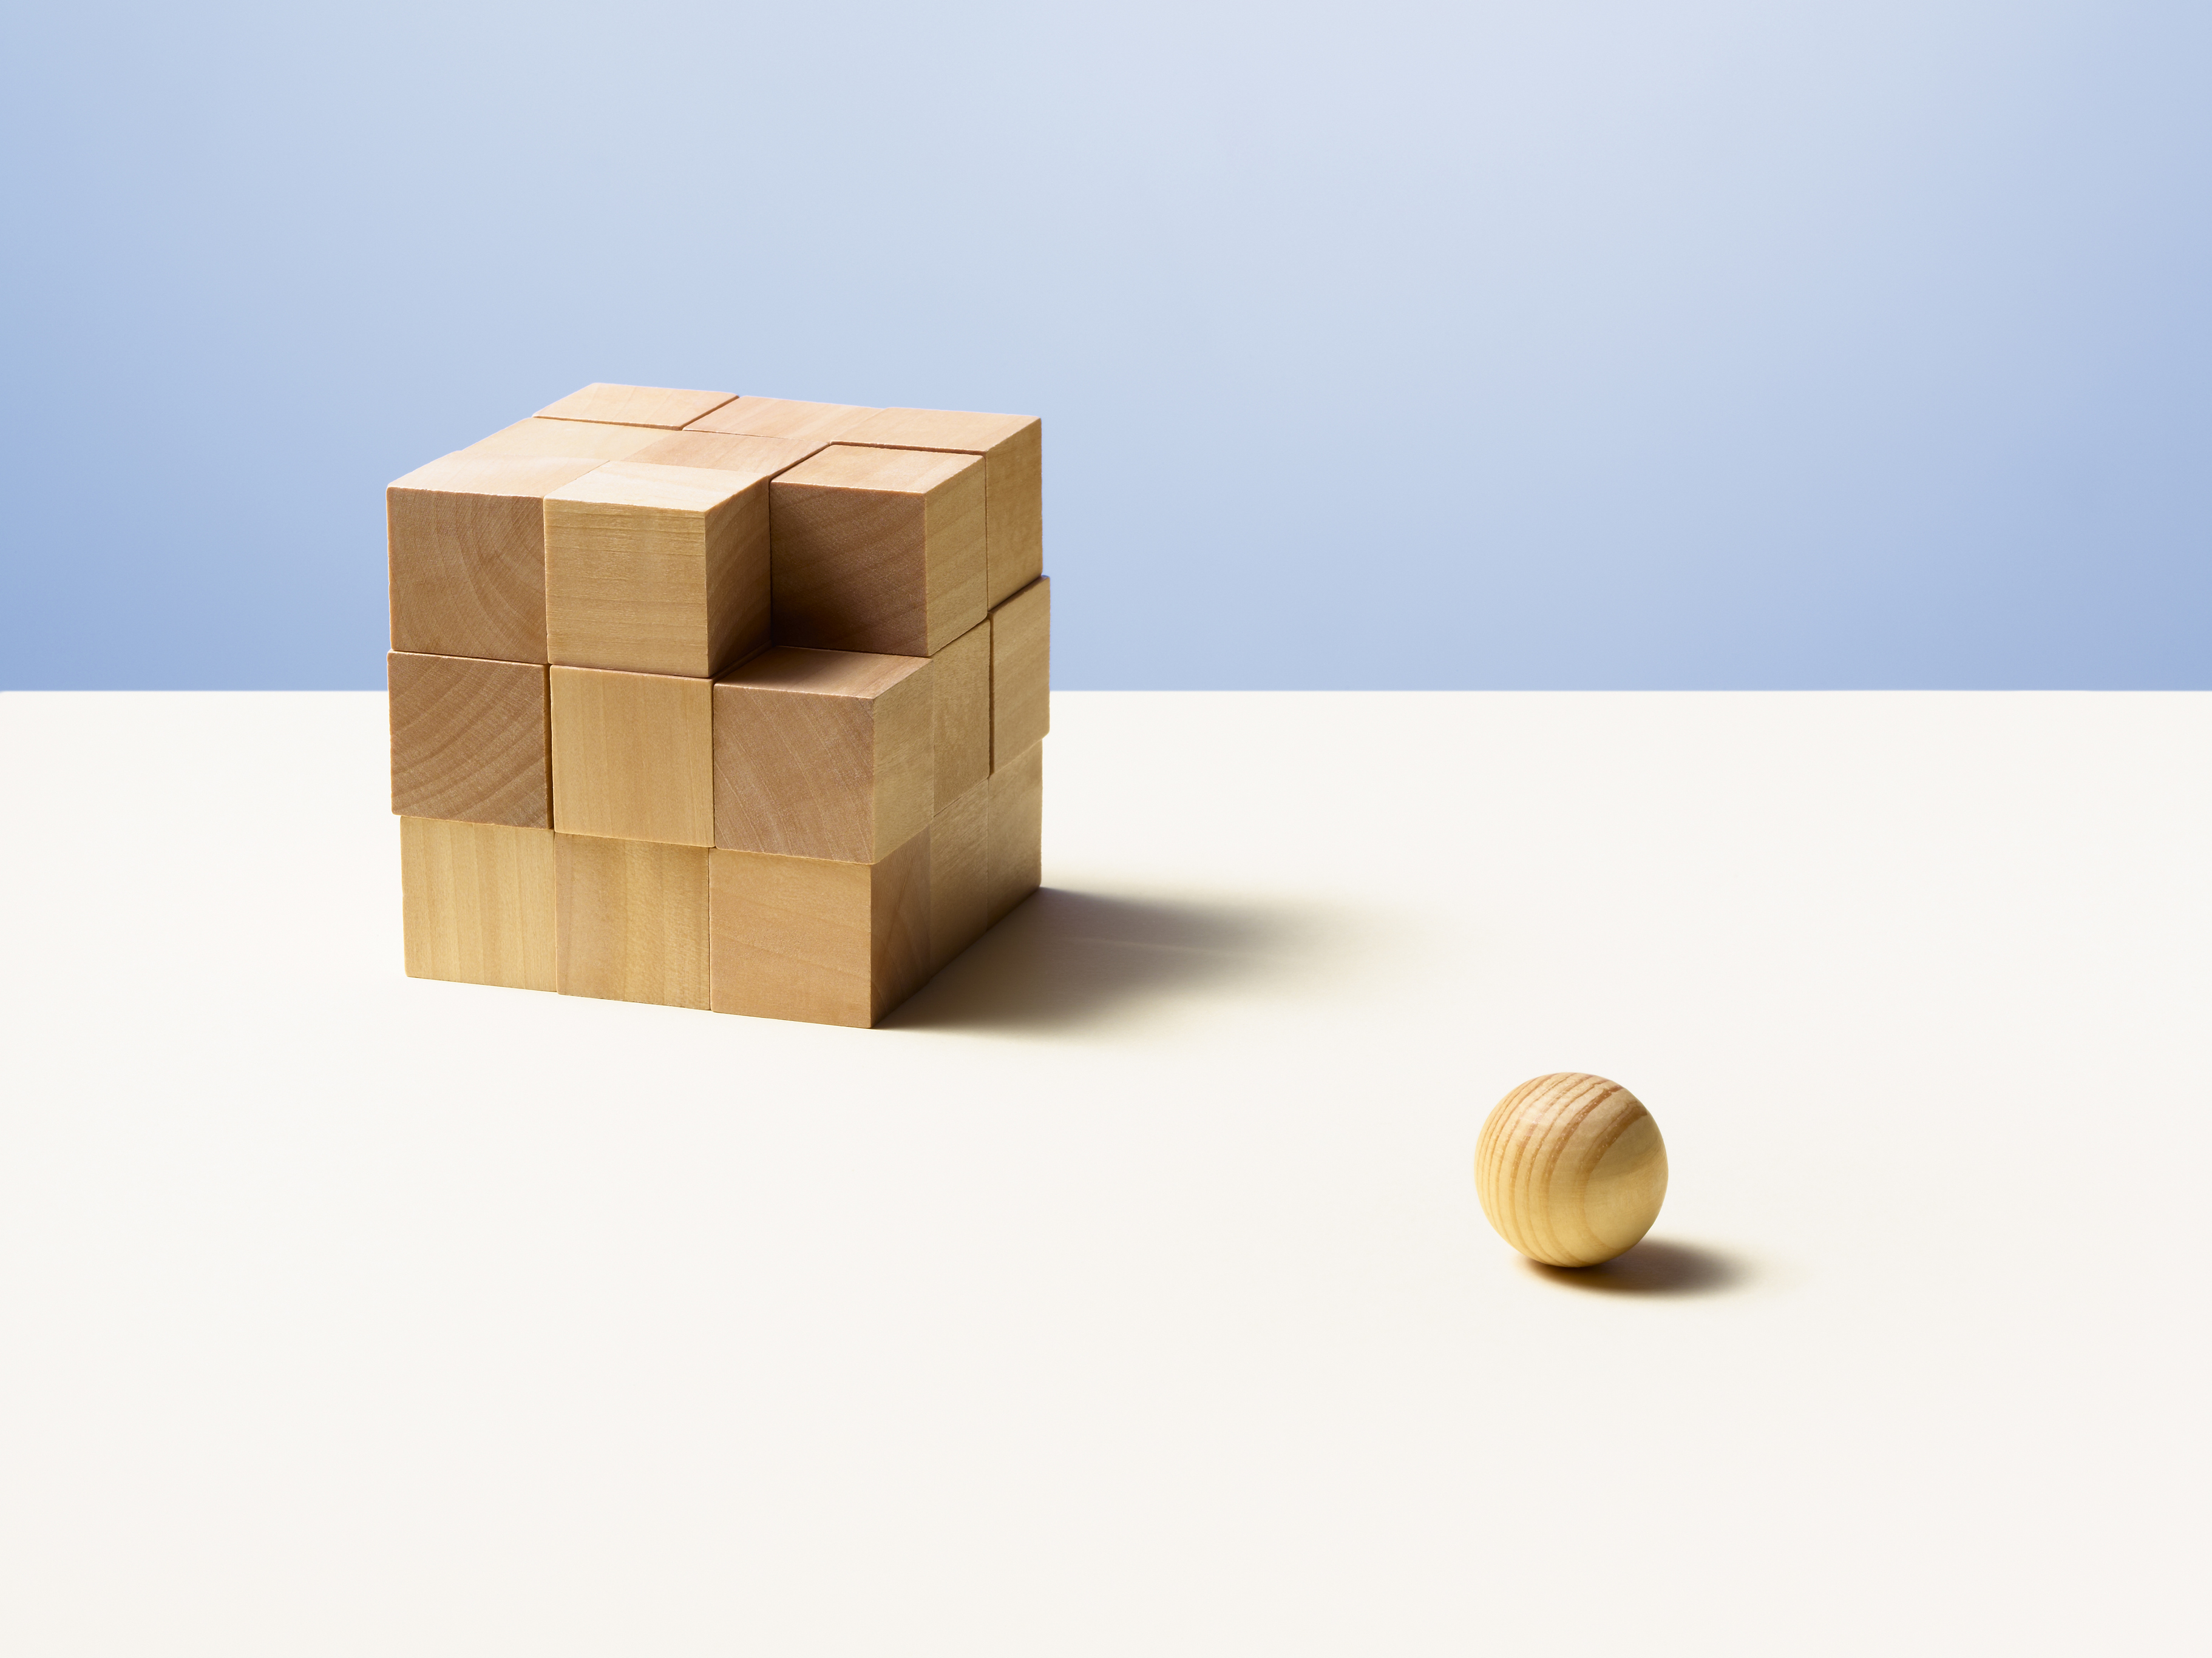
Contextuality
Contextuality asks whether a family of compatible local measurement data admit a single global model independent of context.
Notes:
Why should people care about this work? What is the take home message? Does it address an interesting problem? What has been done before in this area? What did those works struggle with that yours addresses?
The idea of performing some aspects of quantum computing using relativistic motion is not new: Refs. \cite{Layden_Martin-Martinez_Kempf_2016,Martin-Martinez_Aasen_Kempf_2013,Martín-Martínez_Sutherland_2014} constructed 1 and 2-qubit gates in the perturbative regime using coherent field states and Refs. \cite{Bruschi_Dragan_Lee_Fuentes_Louko_2013,Bruschi_Sabín_Kok_Johansson_Delsing_Fuentes_2016,Friis_Bruschi_Louko_Fuentes_2012,AsplingLawler2024} managed the construction for the continuous-variable quantum computing setting. In the former case, we lack analytic expressions for the gates making a full analysis of their properties and any statement of universality seemingly opaque, while in the latter case, the absence of a gate noise analysis (which the authors acknowledge) makes it unclear whether a quantum circuit built from these gates would actually be useful.
We can have the usual universal gate set for quantum algorithms, but we can also have a big unitary that couples every detector
Previous claims of universality did not explicitly show that their gate set could achieve this or claimed it for only a 2-detector setup

Slide 7
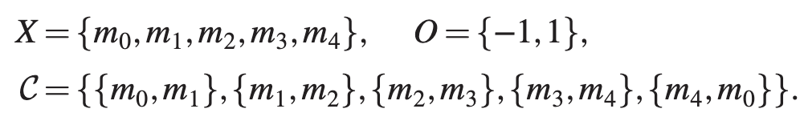
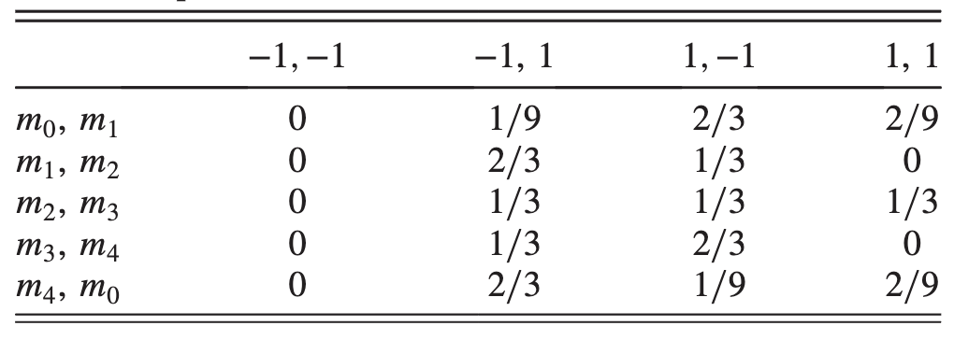
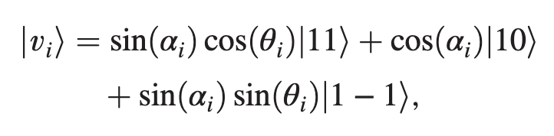





Contextuality
KCBS 5-Cycle Inequality
$$m_{0}$$
$$m_{4}$$
$$m_{1}$$
$$m_{3}$$
$$m_{2}$$
Notes:
Why should people care about this work? What is the take home message? Does it address an interesting problem? What has been done before in this area? What did those works struggle with that yours addresses?
The idea of performing some aspects of quantum computing using relativistic motion is not new: Refs. \cite{Layden_Martin-Martinez_Kempf_2016,Martin-Martinez_Aasen_Kempf_2013,Martín-Martínez_Sutherland_2014} constructed 1 and 2-qubit gates in the perturbative regime using coherent field states and Refs. \cite{Bruschi_Dragan_Lee_Fuentes_Louko_2013,Bruschi_Sabín_Kok_Johansson_Delsing_Fuentes_2016,Friis_Bruschi_Louko_Fuentes_2012,AsplingLawler2024} managed the construction for the continuous-variable quantum computing setting. In the former case, we lack analytic expressions for the gates making a full analysis of their properties and any statement of universality seemingly opaque, while in the latter case, the absence of a gate noise analysis (which the authors acknowledge) makes it unclear whether a quantum circuit built from these gates would actually be useful.
We can have the usual universal gate set for quantum algorithms, but we can also have a big unitary that couples every detector
Previous claims of universality did not explicitly show that their gate set could achieve this or claimed it for only a 2-detector setup

Slide 8
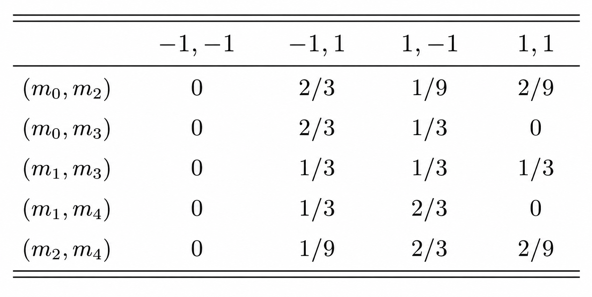







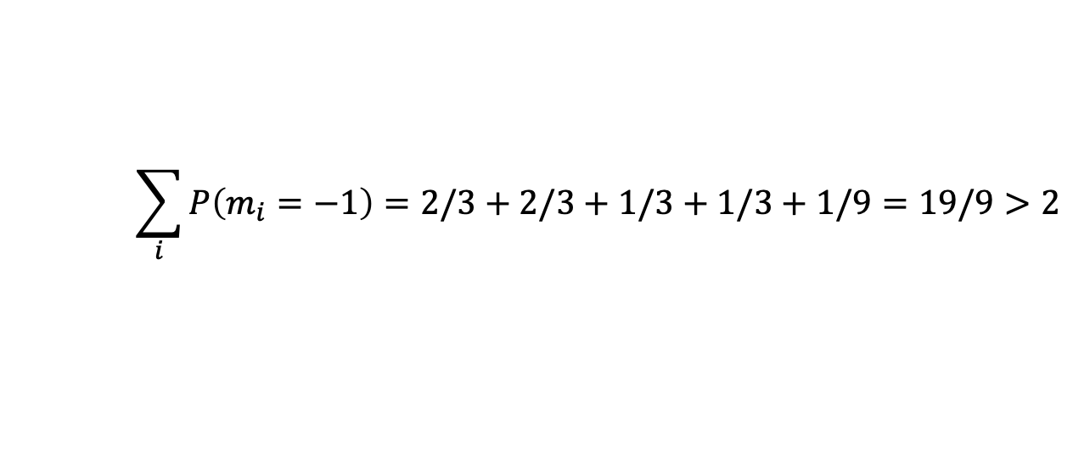
Contextuality
Pentagram Scenario
$$X=\{m_{0},m_{1},m_{2},m_{3},m_{4}\},$$
$$O=\{−1,1\},$$
$$m_{0}$$
$$𝒞=\{\{m_{0},m_{2}\},\{m_{0},m_{3}\},\{m_{1},m_{3}\},\{m_{1},m_{4}\},\{m_{2},m_{4}\}\}$$
$$m_{4}$$
$$m_{1}$$
$$m_{3}$$
$$m_{2}$$
$$\sum_{i}{P\left(m_{i}=−1\right)}=2/3+2/3+1/3+1/3+1/9=19/9>2$$
8
Notes:
Since we have only two possible values and the -1,-1 outcome cant happen, the graph of the projectors associated to -1 should have max independence number equal to 2
Then the expected value of the -1 outcomes with respect to a global distribution should just be the sum of the -1 marginals

Slide 9
Contextuality and Non-Classicality
Many features of quantum theory can be explained with classical models…
Entanglement
Steering
Teleportation
Dense Coding
Interference
… and more!
Spekkens’ toy model!
So what about quantum theory is not classical?
Contextuality/nonlocality resist a classical explanation
R. W. Spekkens, In defense of the epistemic view of quantum states: A toy theory, Phys. Rev. A 75, 032110 (2007).
Notes:
Knowledge balance principle: If one has maximal knowledge, then for every system, at every time, the amount of knowledge one possesses about the ontic state of the system at that time must equal the amount of knowledge one lacks.
Contextuality/nonlocality resist a classical explanation, so I will take them to be the defining feature of what makes quantum theory non-classical.

Slide 10
Contextuality vs. Magic vs. Wigner Negativity
Magic
Contextuality
Bell
nonlocality
Wigner
negativity
M. Howard, J. J. Wallman, V. Veitch, and J. Emerson, Contextuality supplies the magic for quantum computation, Nature (London) 510, 351 (2014).
Notes:
Contextuality generalizes familiar nonclassical resources such as magic and nonlocal entanglement, and is equivalent to Wigner negativity as a measure of non-classicality
Just say which contextuality in particular relates them
Bell non-locality is just contextuality of spatially-separated subsystems via Fine’s theorem
Magic is the contextual non-stabilizer resource (for specific kinds of systems, like qutrits)
Wigner negativity is the same as generalized contextuality since one can either change the basis for the ontological model or allow negative values for the measure

Slide 11
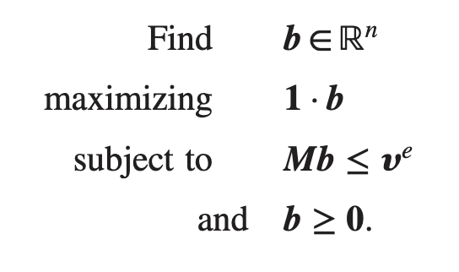
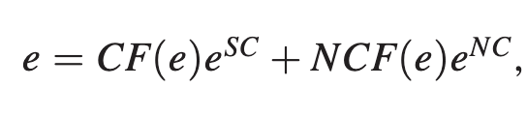

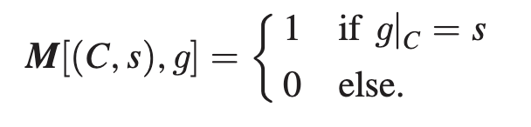

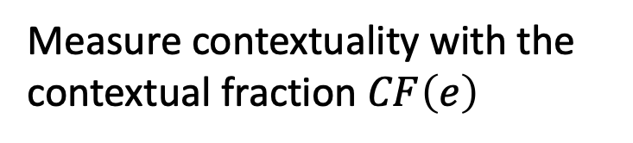
Contextual Fraction
Previous probability table is called an empirical model and can be written as
Can phrase as linear program:
Contextual part
Non-contextual part
Measure contextuality with the contextual fraction $CF\left(e\right)$
$e$ as a vector:
Global assignment matrix:
S. Abramsky, R. S. Barbosa, and S. Mansfield, The contextual fraction as a measure of contextuality, Phys. Rev. Lett. 119, 050504 (2017).
Notes:
Why should people care about this work? What is the take home message? Does it address an interesting problem? What has been done before in this area? What did those works struggle with that yours addresses?
The idea of performing some aspects of quantum computing using relativistic motion is not new: Refs. \cite{Layden_Martin-Martinez_Kempf_2016,Martin-Martinez_Aasen_Kempf_2013,Martín-Martínez_Sutherland_2014} constructed 1 and 2-qubit gates in the perturbative regime using coherent field states and Refs. \cite{Bruschi_Dragan_Lee_Fuentes_Louko_2013,Bruschi_Sabín_Kok_Johansson_Delsing_Fuentes_2016,Friis_Bruschi_Louko_Fuentes_2012,AsplingLawler2024} managed the construction for the continuous-variable quantum computing setting. In the former case, we lack analytic expressions for the gates making a full analysis of their properties and any statement of universality seemingly opaque, while in the latter case, the absence of a gate noise analysis (which the authors acknowledge) makes it unclear whether a quantum circuit built from these gates would actually be useful.
We can have the usual universal gate set for quantum algorithms, but we can also have a big unitary that couples every detector
Previous claims of universality did not explicitly show that their gate set could achieve this or claimed it for only a 2-detector setup

Slide 12
II. Unruh-DeWitt Qudits
Notes:
Why should people care about this work? What is the take home message? Does it address an interesting problem? What has been done before in this area? What did those works struggle with that yours addresses?
The idea of performing some aspects of quantum computing using relativistic motion is not new: Refs. \cite{Layden_Martin-Martinez_Kempf_2016,Martin-Martinez_Aasen_Kempf_2013,Martín-Martínez_Sutherland_2014} constructed 1 and 2-qubit gates in the perturbative regime using coherent field states and Refs. \cite{Bruschi_Dragan_Lee_Fuentes_Louko_2013,Bruschi_Sabín_Kok_Johansson_Delsing_Fuentes_2016,Friis_Bruschi_Louko_Fuentes_2012,AsplingLawler2024} managed the construction for the continuous-variable quantum computing setting. In the former case, we lack analytic expressions for the gates making a full analysis of their properties and any statement of universality seemingly opaque, while in the latter case, the absence of a gate noise analysis (which the authors acknowledge) makes it unclear whether a quantum circuit built from these gates would actually be useful.
We can have the usual universal gate set for quantum algorithms, but we can also have a big unitary that couples every detector
Previous claims of universality did not explicitly show that their gate set could achieve this or claimed it for only a 2-detector setup

Slide 13
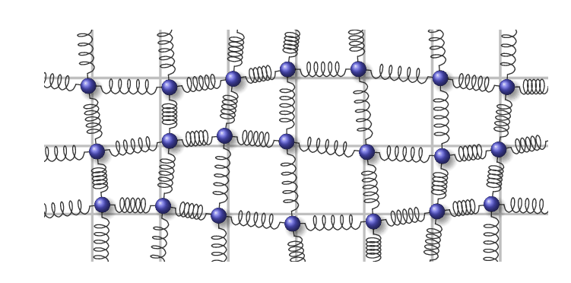
Quantum Fields
Thomas Barthel and Qiang Miao, Scaling functions for eigenstate entanglement crossovers in harmonic lattices. arXiv.1912.10045 (2019).
Notes:
Why should people care about this work? What is the take home message? Does it address an interesting problem? What has been done before in this area? What did those works struggle with that yours addresses?
The idea of performing some aspects of quantum computing using relativistic motion is not new: Refs. \cite{Layden_Martin-Martinez_Kempf_2016,Martin-Martinez_Aasen_Kempf_2013,Martín-Martínez_Sutherland_2014} constructed 1 and 2-qubit gates in the perturbative regime using coherent field states and Refs. \cite{Bruschi_Dragan_Lee_Fuentes_Louko_2013,Bruschi_Sabín_Kok_Johansson_Delsing_Fuentes_2016,Friis_Bruschi_Louko_Fuentes_2012,AsplingLawler2024} managed the construction for the continuous-variable quantum computing setting. In the former case, we lack analytic expressions for the gates making a full analysis of their properties and any statement of universality seemingly opaque, while in the latter case, the absence of a gate noise analysis (which the authors acknowledge) makes it unclear whether a quantum circuit built from these gates would actually be useful.
We can have the usual universal gate set for quantum algorithms, but we can also have a big unitary that couples every detector
Previous claims of universality did not explicitly show that their gate set could achieve this or claimed it for only a 2-detector setup

Slide 14
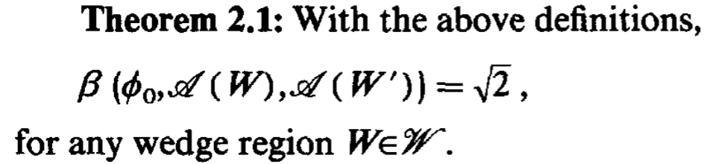
Nonclassicality in Quantum Fields
Summers and Werner showed most field states violate Bell inequalities:
Not dependent on certain types of interactions or preparations
Generic property of fields!
S. J. Summers and R. Werner, Bell’s inequalities and quantum field theory. II. Bell’s inequalities are maximally violated in the vacuum, J. Math. Phys. (N.Y.) 28, 2448 (1987).
Notes:
Why should people care about this work? What is the take home message? Does it address an interesting problem? What has been done before in this area? What did those works struggle with that yours addresses?
The idea of performing some aspects of quantum computing using relativistic motion is not new: Refs. \cite{Layden_Martin-Martinez_Kempf_2016,Martin-Martinez_Aasen_Kempf_2013,Martín-Martínez_Sutherland_2014} constructed 1 and 2-qubit gates in the perturbative regime using coherent field states and Refs. \cite{Bruschi_Dragan_Lee_Fuentes_Louko_2013,Bruschi_Sabín_Kok_Johansson_Delsing_Fuentes_2016,Friis_Bruschi_Louko_Fuentes_2012,AsplingLawler2024} managed the construction for the continuous-variable quantum computing setting. In the former case, we lack analytic expressions for the gates making a full analysis of their properties and any statement of universality seemingly opaque, while in the latter case, the absence of a gate noise analysis (which the authors acknowledge) makes it unclear whether a quantum circuit built from these gates would actually be useful.
We can have the usual universal gate set for quantum algorithms, but we can also have a big unitary that couples every detector
Previous claims of universality did not explicitly show that their gate set could achieve this or claimed it for only a 2-detector setup

Slide 15
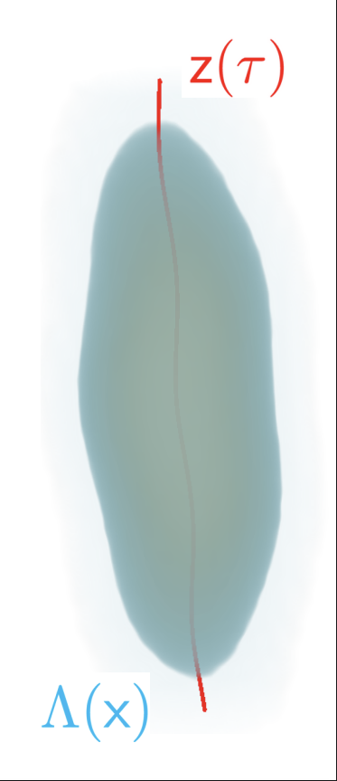





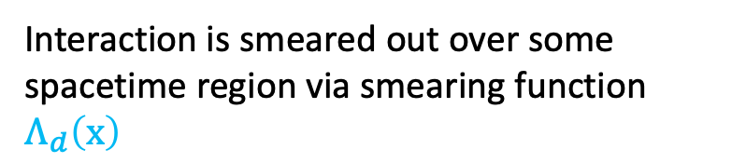



Unruh-DeWitt (UDW) Systems
Internal dynamics prescribed by free Hamiltonian
Qudit following trajectory through spacetime
$$z^{μ}\left(τ\right)=\left(t\left(τ\right),x\left(τ\right)\right)$$
Interacts with quantum field $\hat{φ}\left(x\right)$ via Hamiltonian density
$${\hat{h}}_{d}\left(x\right)=λ_{d}Λ_{d}\left(x\right){\hat{μ}}_{d}(τ)⊗\hat{φ}\left(x\right)$$
$$\hat{φ}\left(x\right)$$
Interaction is smeared out over some spacetime region via smearing function $Λ_{d}\left(x\right)$
$$t$$
$$x$$
Notes:
Why should people care about this work? What is the take home message? Does it address an interesting problem? What has been done before in this area? What did those works struggle with that yours addresses?
The idea of performing some aspects of quantum computing using relativistic motion is not new: Refs. \cite{Layden_Martin-Martinez_Kempf_2016,Martin-Martinez_Aasen_Kempf_2013,Martín-Martínez_Sutherland_2014} constructed 1 and 2-qubit gates in the perturbative regime using coherent field states and Refs. \cite{Bruschi_Dragan_Lee_Fuentes_Louko_2013,Bruschi_Sabín_Kok_Johansson_Delsing_Fuentes_2016,Friis_Bruschi_Louko_Fuentes_2012,AsplingLawler2024} managed the construction for the continuous-variable quantum computing setting. In the former case, we lack analytic expressions for the gates making a full analysis of their properties and any statement of universality seemingly opaque, while in the latter case, the absence of a gate noise analysis (which the authors acknowledge) makes it unclear whether a quantum circuit built from these gates would actually be useful.
We can have the usual universal gate set for quantum algorithms, but we can also have a big unitary that couples every detector
Previous claims of universality did not explicitly show that their gate set could achieve this or claimed it for only a 2-detector setup

Slide 16
III. Contextuality Harvesting
Notes:
Why should people care about this work? What is the take home message? Does it address an interesting problem? What has been done before in this area? What did those works struggle with that yours addresses?
The idea of performing some aspects of quantum computing using relativistic motion is not new: Refs. \cite{Layden_Martin-Martinez_Kempf_2016,Martin-Martinez_Aasen_Kempf_2013,Martín-Martínez_Sutherland_2014} constructed 1 and 2-qubit gates in the perturbative regime using coherent field states and Refs. \cite{Bruschi_Dragan_Lee_Fuentes_Louko_2013,Bruschi_Sabín_Kok_Johansson_Delsing_Fuentes_2016,Friis_Bruschi_Louko_Fuentes_2012,AsplingLawler2024} managed the construction for the continuous-variable quantum computing setting. In the former case, we lack analytic expressions for the gates making a full analysis of their properties and any statement of universality seemingly opaque, while in the latter case, the absence of a gate noise analysis (which the authors acknowledge) makes it unclear whether a quantum circuit built from these gates would actually be useful.
We can have the usual universal gate set for quantum algorithms, but we can also have a big unitary that couples every detector
Previous claims of universality did not explicitly show that their gate set could achieve this or claimed it for only a 2-detector setup

Slide 17

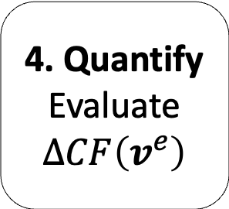
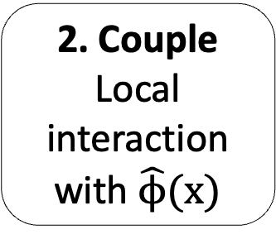
Contextuality Harvesting
Harvested contextuality measured using
The protocol:
1. Prepare
Non-contextual initial system state
2. Couple
Local interaction with $\hat{ϕ}(x)$
3. Reduce
Trace out the field after time evolution
4. Quantify
Evaluate $ΔCF\left(v^{e}\right)$
Notes:
Why should people care about this work? What is the take home message? Does it address an interesting problem? What has been done before in this area? What did those works struggle with that yours addresses?
The idea of performing some aspects of quantum computing using relativistic motion is not new: Refs. \cite{Layden_Martin-Martinez_Kempf_2016,Martin-Martinez_Aasen_Kempf_2013,Martín-Martínez_Sutherland_2014} constructed 1 and 2-qubit gates in the perturbative regime using coherent field states and Refs. \cite{Bruschi_Dragan_Lee_Fuentes_Louko_2013,Bruschi_Sabín_Kok_Johansson_Delsing_Fuentes_2016,Friis_Bruschi_Louko_Fuentes_2012,AsplingLawler2024} managed the construction for the continuous-variable quantum computing setting. In the former case, we lack analytic expressions for the gates making a full analysis of their properties and any statement of universality seemingly opaque, while in the latter case, the absence of a gate noise analysis (which the authors acknowledge) makes it unclear whether a quantum circuit built from these gates would actually be useful.
We can have the usual universal gate set for quantum algorithms, but we can also have a big unitary that couples every detector
Previous claims of universality did not explicitly show that their gate set could achieve this or claimed it for only a 2-detector setup

Slide 18
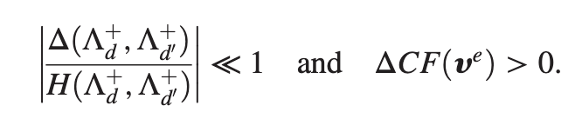
Conditions for Genuine Contextuality Harvesting
Not all harvested contextuality is due to the field
Hadamard function encodes field state-dependence
Symmetric propagator encodes signalling
Quantify:
Genuine harvesting is identified when the Hadamard contribution dominates the signalling term in the relevant peak region
Notes:
Why should people care about this work? What is the take home message? Does it address an interesting problem? What has been done before in this area? What did those works struggle with that yours addresses?
The idea of performing some aspects of quantum computing using relativistic motion is not new: Refs. \cite{Layden_Martin-Martinez_Kempf_2016,Martin-Martinez_Aasen_Kempf_2013,Martín-Martínez_Sutherland_2014} constructed 1 and 2-qubit gates in the perturbative regime using coherent field states and Refs. \cite{Bruschi_Dragan_Lee_Fuentes_Louko_2013,Bruschi_Sabín_Kok_Johansson_Delsing_Fuentes_2016,Friis_Bruschi_Louko_Fuentes_2012,AsplingLawler2024} managed the construction for the continuous-variable quantum computing setting. In the former case, we lack analytic expressions for the gates making a full analysis of their properties and any statement of universality seemingly opaque, while in the latter case, the absence of a gate noise analysis (which the authors acknowledge) makes it unclear whether a quantum circuit built from these gates would actually be useful.
We can have the usual universal gate set for quantum algorithms, but we can also have a big unitary that couples every detector
Previous claims of universality did not explicitly show that their gate set could achieve this or claimed it for only a 2-detector setup

Slide 19
Contextuality Harvesting – An Argument
Can we call it “harvesting?”
Vacuum state is generically highly non-classical
Pre-existing contextuality
1
Use on field and UDW systems to reduce explanation of acquired contextuality to non-classicality of vacuum
Resource theory of contextuality identifies free operations
2
State-dependent portion of vacuum correlations dominates
Specific field state sources non-classicality
3
B. Amaral, Resource theory of contextuality, Phil. Trans. R. Soc. 377, 20190010 (2019).
Notes:
Why should people care about this work? What is the take home message? Does it address an interesting problem? What has been done before in this area? What did those works struggle with that yours addresses?
The idea of performing some aspects of quantum computing using relativistic motion is not new: Refs. \cite{Layden_Martin-Martinez_Kempf_2016,Martin-Martinez_Aasen_Kempf_2013,Martín-Martínez_Sutherland_2014} constructed 1 and 2-qubit gates in the perturbative regime using coherent field states and Refs. \cite{Bruschi_Dragan_Lee_Fuentes_Louko_2013,Bruschi_Sabín_Kok_Johansson_Delsing_Fuentes_2016,Friis_Bruschi_Louko_Fuentes_2012,AsplingLawler2024} managed the construction for the continuous-variable quantum computing setting. In the former case, we lack analytic expressions for the gates making a full analysis of their properties and any statement of universality seemingly opaque, while in the latter case, the absence of a gate noise analysis (which the authors acknowledge) makes it unclear whether a quantum circuit built from these gates would actually be useful.
We can have the usual universal gate set for quantum algorithms, but we can also have a big unitary that couples every detector
Previous claims of universality did not explicitly show that their gate set could achieve this or claimed it for only a 2-detector setup

Slide 20
IV. Qutrit and Qubit-Qutrit Harvesting
Notes:
Why should people care about this work? What is the take home message? Does it address an interesting problem? What has been done before in this area? What did those works struggle with that yours addresses?
The idea of performing some aspects of quantum computing using relativistic motion is not new: Refs. \cite{Layden_Martin-Martinez_Kempf_2016,Martin-Martinez_Aasen_Kempf_2013,Martín-Martínez_Sutherland_2014} constructed 1 and 2-qubit gates in the perturbative regime using coherent field states and Refs. \cite{Bruschi_Dragan_Lee_Fuentes_Louko_2013,Bruschi_Sabín_Kok_Johansson_Delsing_Fuentes_2016,Friis_Bruschi_Louko_Fuentes_2012,AsplingLawler2024} managed the construction for the continuous-variable quantum computing setting. In the former case, we lack analytic expressions for the gates making a full analysis of their properties and any statement of universality seemingly opaque, while in the latter case, the absence of a gate noise analysis (which the authors acknowledge) makes it unclear whether a quantum circuit built from these gates would actually be useful.
We can have the usual universal gate set for quantum algorithms, but we can also have a big unitary that couples every detector
Previous claims of universality did not explicitly show that their gate set could achieve this or claimed it for only a 2-detector setup

Slide 21
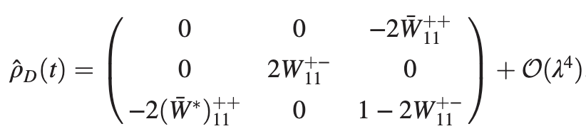



Contextuality Harvesting – Single Qutrit
Why single qutrit?
No subsystem entanglement but still can be non-classical
Vacuum fluctuations transfer contextuality to qutrit
Notes:
Why should people care about this work? What is the take home message? Does it address an interesting problem? What has been done before in this area? What did those works struggle with that yours addresses?
The idea of performing some aspects of quantum computing using relativistic motion is not new: Refs. \cite{Layden_Martin-Martinez_Kempf_2016,Martin-Martinez_Aasen_Kempf_2013,Martín-Martínez_Sutherland_2014} constructed 1 and 2-qubit gates in the perturbative regime using coherent field states and Refs. \cite{Bruschi_Dragan_Lee_Fuentes_Louko_2013,Bruschi_Sabín_Kok_Johansson_Delsing_Fuentes_2016,Friis_Bruschi_Louko_Fuentes_2012,AsplingLawler2024} managed the construction for the continuous-variable quantum computing setting. In the former case, we lack analytic expressions for the gates making a full analysis of their properties and any statement of universality seemingly opaque, while in the latter case, the absence of a gate noise analysis (which the authors acknowledge) makes it unclear whether a quantum circuit built from these gates would actually be useful.
We can have the usual universal gate set for quantum algorithms, but we can also have a big unitary that couples every detector
Previous claims of universality did not explicitly show that their gate set could achieve this or claimed it for only a 2-detector setup

Slide 22
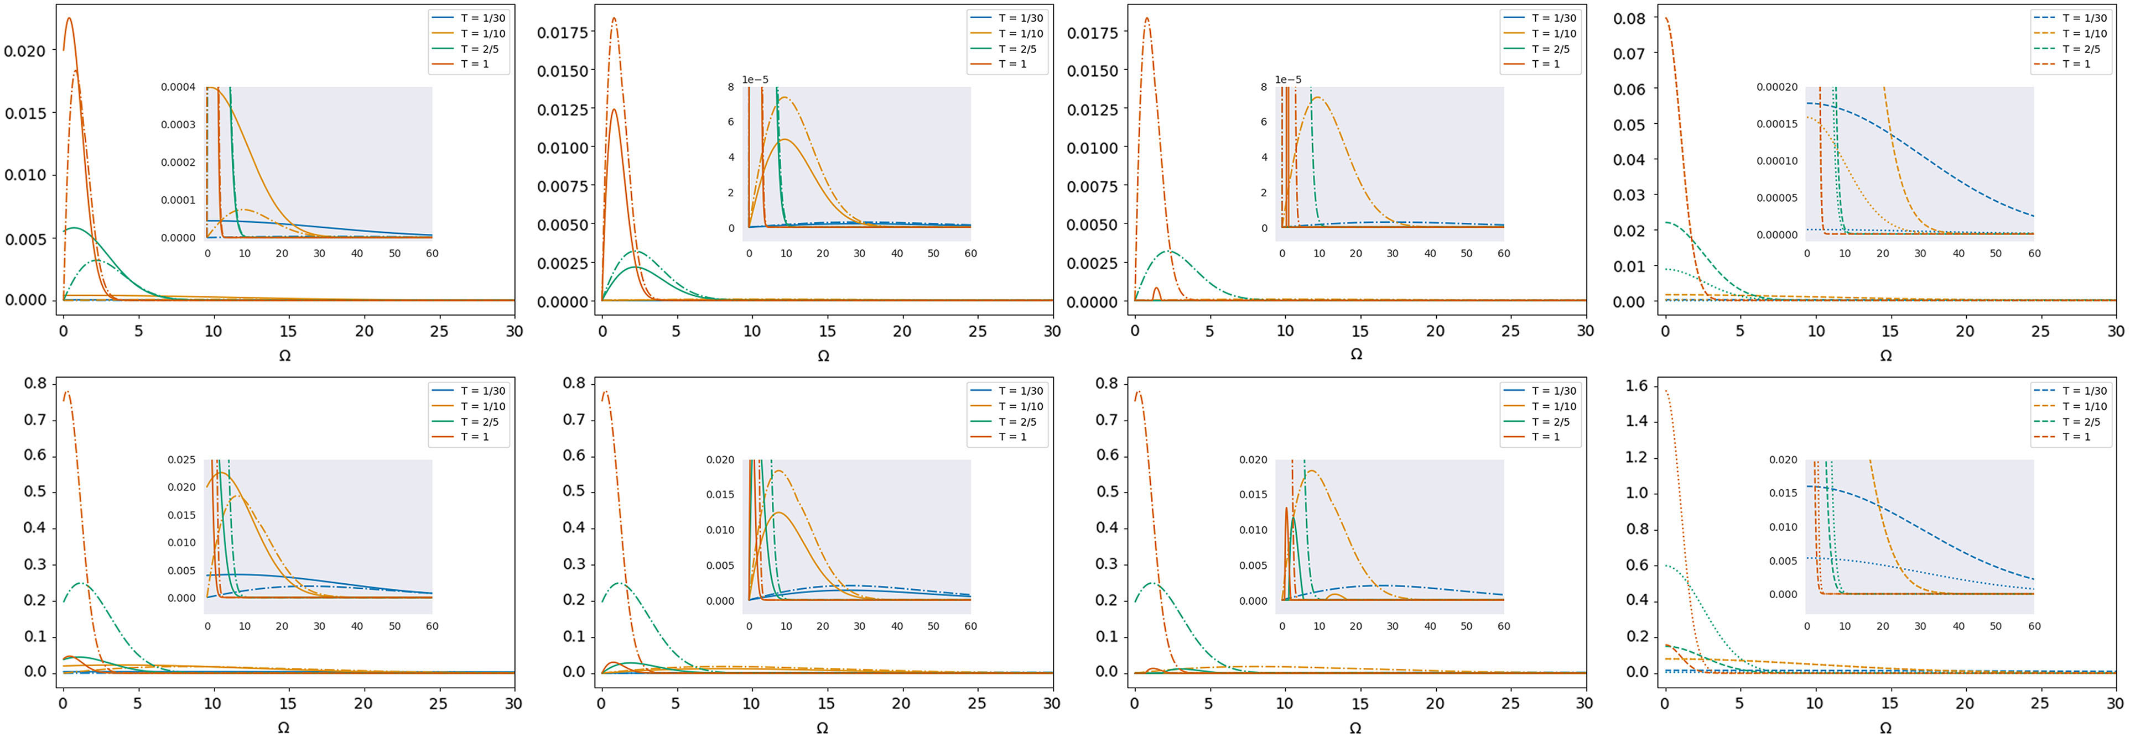
Contextuality Harvesting – Single Qutrit
Sharp temporal profiles preserve genuinely quantum windows
Longer interactions amplify signalling and can wash out harvested peak
Smaller spatial smearing strengthens harvested contextuality
Harvesting present for gapless systems
Figure 1: single-qutrit contextuality compared with harvested magic and with the genuine-harvesting diagnostic based on the Hadamard and signalling contributions.

Slide 23
Contextuality Harvesting – Single Qutrit
Shifting measurements creates no gapless harvesting
Notes:
Why should people care about this work? What is the take home message? Does it address an interesting problem? What has been done before in this area? What did those works struggle with that yours addresses?
The idea of performing some aspects of quantum computing using relativistic motion is not new: Refs. \cite{Layden_Martin-Martinez_Kempf_2016,Martin-Martinez_Aasen_Kempf_2013,Martín-Martínez_Sutherland_2014} constructed 1 and 2-qubit gates in the perturbative regime using coherent field states and Refs. \cite{Bruschi_Dragan_Lee_Fuentes_Louko_2013,Bruschi_Sabín_Kok_Johansson_Delsing_Fuentes_2016,Friis_Bruschi_Louko_Fuentes_2012,AsplingLawler2024} managed the construction for the continuous-variable quantum computing setting. In the former case, we lack analytic expressions for the gates making a full analysis of their properties and any statement of universality seemingly opaque, while in the latter case, the absence of a gate noise analysis (which the authors acknowledge) makes it unclear whether a quantum circuit built from these gates would actually be useful.
We can have the usual universal gate set for quantum algorithms, but we can also have a big unitary that couples every detector
Previous claims of universality did not explicitly show that their gate set could achieve this or claimed it for only a 2-detector setup

Slide 24
Contextuality Harvesting – Single Qutrit
Additional shift delays harvesting to start at a small gap
Contextuality can persist after harvested magic has already vanished, showing they have different state boundaries
Can harvest contextuality and magic for gapless systems depending on the measurement scenario and smearing profile
R. Nyström, N. Pranzini, and E. Keski-Vakkuri, Harvesting magic from the vacuum, Phys. Rev. Res. 7, 033085 (2025).
Notes:
Can tune measurements to alter harvested amount at zero gap, contextuality can persist after harvested magic has already vanished, showing they have different state boundaries

Slide 25
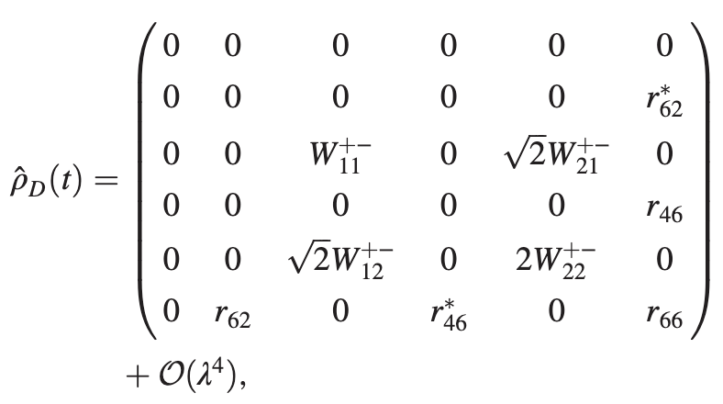

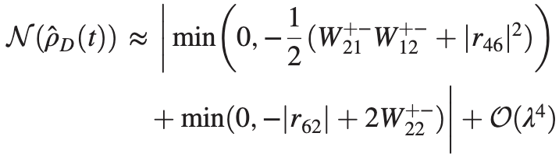
Contextuality Harvesting – Qubit-Qutrit
Vacuum fluctuations transfer contextuality to qutrit
Negativity:
Vacuum fluctuations and field mediation transfer entanglement between qubit and qutrit
Notes:
Why should people care about this work? What is the take home message? Does it address an interesting problem? What has been done before in this area? What did those works struggle with that yours addresses?
The idea of performing some aspects of quantum computing using relativistic motion is not new: Refs. \cite{Layden_Martin-Martinez_Kempf_2016,Martin-Martinez_Aasen_Kempf_2013,Martín-Martínez_Sutherland_2014} constructed 1 and 2-qubit gates in the perturbative regime using coherent field states and Refs. \cite{Bruschi_Dragan_Lee_Fuentes_Louko_2013,Bruschi_Sabín_Kok_Johansson_Delsing_Fuentes_2016,Friis_Bruschi_Louko_Fuentes_2012,AsplingLawler2024} managed the construction for the continuous-variable quantum computing setting. In the former case, we lack analytic expressions for the gates making a full analysis of their properties and any statement of universality seemingly opaque, while in the latter case, the absence of a gate noise analysis (which the authors acknowledge) makes it unclear whether a quantum circuit built from these gates would actually be useful.
We can have the usual universal gate set for quantum algorithms, but we can also have a big unitary that couples every detector
Previous claims of universality did not explicitly show that their gate set could achieve this or claimed it for only a 2-detector setup

Slide 26
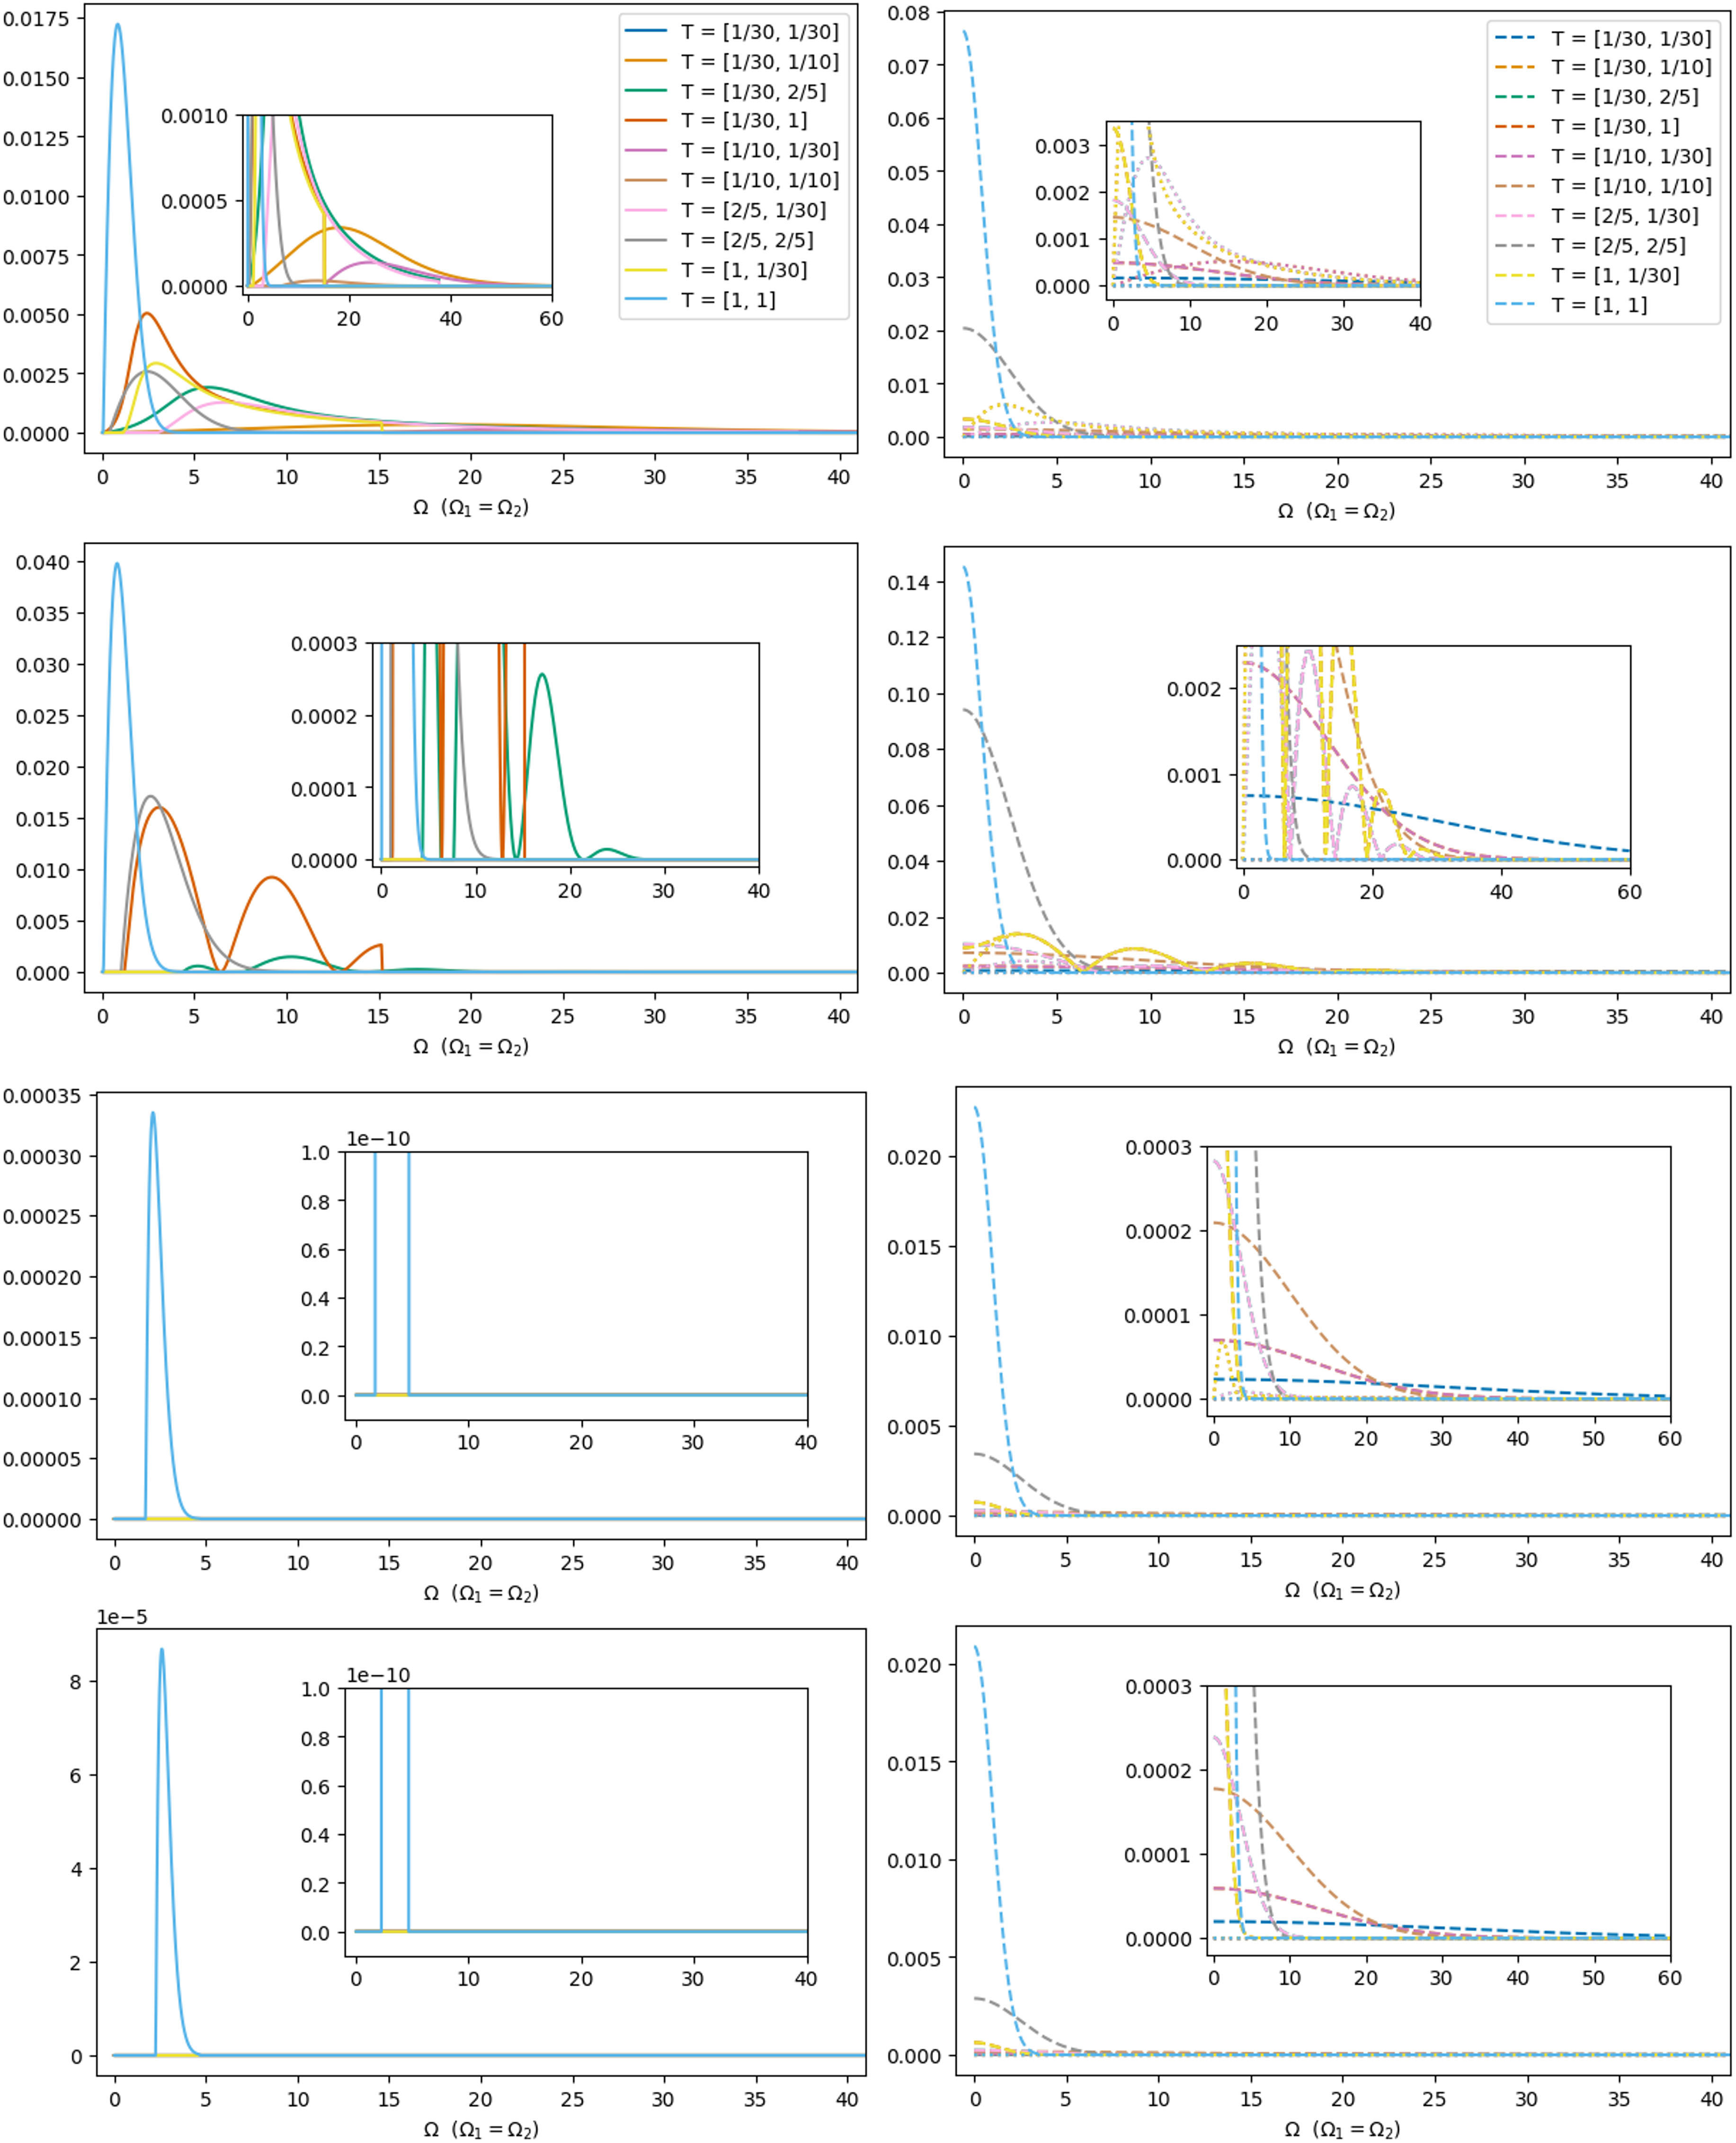
Contextuality Harvesting – Qubit-Qutrit
Smaller system separation
Adding a qubit allows the joint system to harvest negativity while the qutrit still carries local contextuality
The two resource windows need not coincide, so they can compete, align, or separate as the detector profiles and separation are varied
Figure 2: negativity in the qubit-qutrit system as a function of the shared gap, temporal widths, spatial width, and separation.
Notes:
Why should people care about this work? What is the take home message? Does it address an interesting problem? What has been done before in this area? What did those works struggle with that yours addresses?
The idea of performing some aspects of quantum computing using relativistic motion is not new: Refs. \cite{Layden_Martin-Martinez_Kempf_2016,Martin-Martinez_Aasen_Kempf_2013,Martín-Martínez_Sutherland_2014} constructed 1 and 2-qubit gates in the perturbative regime using coherent field states and Refs. \cite{Bruschi_Dragan_Lee_Fuentes_Louko_2013,Bruschi_Sabín_Kok_Johansson_Delsing_Fuentes_2016,Friis_Bruschi_Louko_Fuentes_2012,AsplingLawler2024} managed the construction for the continuous-variable quantum computing setting. In the former case, we lack analytic expressions for the gates making a full analysis of their properties and any statement of universality seemingly opaque, while in the latter case, the absence of a gate noise analysis (which the authors acknowledge) makes it unclear whether a quantum circuit built from these gates would actually be useful.
We can have the usual universal gate set for quantum algorithms, but we can also have a big unitary that couples every detector
Previous claims of universality did not explicitly show that their gate set could achieve this or claimed it for only a 2-detector setup

Slide 27
Contextuality Harvesting – Qubit-Qutrit
Larger system separation
Most entanglement harvesting is destroyed at this distance
Figure 2: negativity in the qubit-qutrit system as a function of the shared gap, temporal widths, spatial width, and separation.
Notes:
Why should people care about this work? What is the take home message? Does it address an interesting problem? What has been done before in this area? What did those works struggle with that yours addresses?
The idea of performing some aspects of quantum computing using relativistic motion is not new: Refs. \cite{Layden_Martin-Martinez_Kempf_2016,Martin-Martinez_Aasen_Kempf_2013,Martín-Martínez_Sutherland_2014} constructed 1 and 2-qubit gates in the perturbative regime using coherent field states and Refs. \cite{Bruschi_Dragan_Lee_Fuentes_Louko_2013,Bruschi_Sabín_Kok_Johansson_Delsing_Fuentes_2016,Friis_Bruschi_Louko_Fuentes_2012,AsplingLawler2024} managed the construction for the continuous-variable quantum computing setting. In the former case, we lack analytic expressions for the gates making a full analysis of their properties and any statement of universality seemingly opaque, while in the latter case, the absence of a gate noise analysis (which the authors acknowledge) makes it unclear whether a quantum circuit built from these gates would actually be useful.
We can have the usual universal gate set for quantum algorithms, but we can also have a big unitary that couples every detector
Previous claims of universality did not explicitly show that their gate set could achieve this or claimed it for only a 2-detector setup

Slide 28
Contextuality Harvesting – Qubit-Qutrit
Harvesting Behaviour
Coexistence Window
Fix the qutrit in a low-gap, high-contextuality regime and widen the qubit temporal profile to pull the negativity peak toward the same region. Both can coexist inside a controllable overlap region.
Energy Gap Ω
Both resources fade for large gaps
Spatial Width σ
Smaller smearing generally amplifies harvesting
Temporal Width T
Controls peak alignment and signalling contamination
Separation L
Nonlocal entanglement dies sooner than local contextuality
Non-classicality remains in the system even at large separation
Figure 2: negativity in the qubit-qutrit system as a function of the shared gap, temporal widths, spatial width, and separation.
Notes:
Why should people care about this work? What is the take home message? Does it address an interesting problem? What has been done before in this area? What did those works struggle with that yours addresses?
The idea of performing some aspects of quantum computing using relativistic motion is not new: Refs. \cite{Layden_Martin-Martinez_Kempf_2016,Martin-Martinez_Aasen_Kempf_2013,Martín-Martínez_Sutherland_2014} constructed 1 and 2-qubit gates in the perturbative regime using coherent field states and Refs. \cite{Bruschi_Dragan_Lee_Fuentes_Louko_2013,Bruschi_Sabín_Kok_Johansson_Delsing_Fuentes_2016,Friis_Bruschi_Louko_Fuentes_2012,AsplingLawler2024} managed the construction for the continuous-variable quantum computing setting. In the former case, we lack analytic expressions for the gates making a full analysis of their properties and any statement of universality seemingly opaque, while in the latter case, the absence of a gate noise analysis (which the authors acknowledge) makes it unclear whether a quantum circuit built from these gates would actually be useful.
We can have the usual universal gate set for quantum algorithms, but we can also have a big unitary that couples every detector
Previous claims of universality did not explicitly show that their gate set could achieve this or claimed it for only a 2-detector setup

Slide 29
Key Takeaways
1
Single qutrits harvest contextuality from vacuum correlations.
2
Gapless systems can harvest contextuality for suitable measurement choices.
3
Qubit–qutrit systems can harvest both negativity and local contextuality, with coexistence and trade-offs.
4
New genuine-harvesting criteria separate vacuum-resource extraction from field-mediated signaling.
Notes:
Gates are derived in a spacetime independent way so we aren’t just limited to Minkowski; we just use it because we know what the expressions for the Wightman function and propagators look like

Slide 30
Outlook
More rigorous proof for genuine contextuality harvesting
Further exploration of the gapless setting
Non-locality-Contextuality tradeoff
How different spacetimes affect harvesting
Notes:
Why should people care about this work? What is the take home message? Does it address an interesting problem? What has been done before in this area? What did those works struggle with that yours addresses?
The idea of performing some aspects of quantum computing using relativistic motion is not new: Refs. \cite{Layden_Martin-Martinez_Kempf_2016,Martin-Martinez_Aasen_Kempf_2013,Martín-Martínez_Sutherland_2014} constructed 1 and 2-qubit gates in the perturbative regime using coherent field states and Refs. \cite{Bruschi_Dragan_Lee_Fuentes_Louko_2013,Bruschi_Sabín_Kok_Johansson_Delsing_Fuentes_2016,Friis_Bruschi_Louko_Fuentes_2012,AsplingLawler2024} managed the construction for the continuous-variable quantum computing setting. In the former case, we lack analytic expressions for the gates making a full analysis of their properties and any statement of universality seemingly opaque, while in the latter case, the absence of a gate noise analysis (which the authors acknowledge) makes it unclear whether a quantum circuit built from these gates would actually be useful.
We can have the usual universal gate set for quantum algorithms, but we can also have a big unitary that couples every detector
Previous claims of universality did not explicitly show that their gate set could achieve this or claimed it for only a 2-detector setup

Slide 31

Thank you for your attention!
Phys. Rev. D. 113, 045001 (2026)

Slide 32

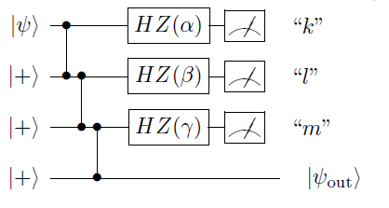






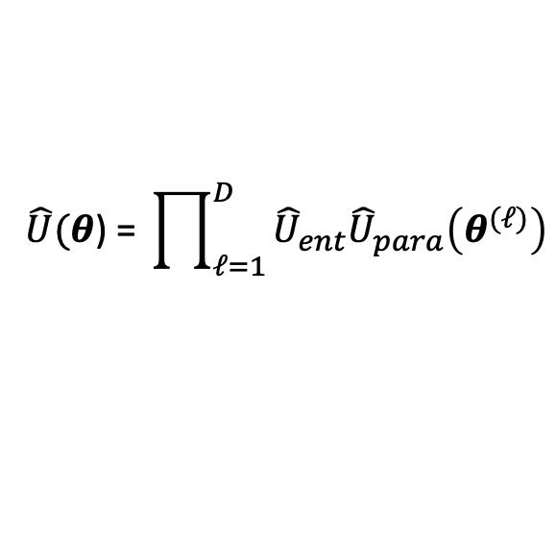







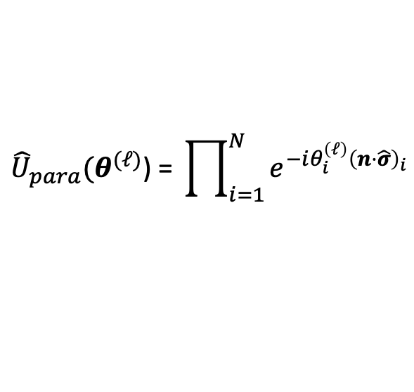

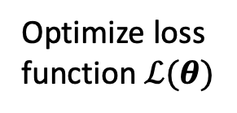





Variational Quantum Computing
$$\hat{U}\text{(}θ\text{) = }\prod_{ℓ=1}^{D}{{\hat{U}}_{ent}{\hat{U}}_{para}\left(θ^{(ℓ)}\right)}$$
$${\hat{U}}_{para}\text{(}θ^{(ℓ)}\text{) = }\prod_{i=1}^{N}{e^{−iθ_{i}^{\left(ℓ\right)}{\left(n⋅\hat{σ}\right)}_{i}}}$$
$n≡$ unit vector, $\hat{σ}≡$ Pauli vector
Initial state
$${\hat{ρ}}_{0}$$
$$⋯$$
$$⋯$$
$$⋯$$
$$⋯$$
$$f_{θ}\left(\hat{O}\right)=Tr\left(\hat{O}\hat{U}\left(θ\right){\hat{ρ}}_{0}{\hat{U}}^{†}(θ)\right)$$
$$\hat{U}\left(θ\right)$$
$$=$$
$$\hat{U}\left(θ^{1}\right)$$
$$\hat{U}\left(θ^{2}\right)$$
$$⋯$$
$$\hat{U}\left(θ^{D}\right)$$
Optimize loss function $ℒ(θ)$
$${\left|ψ\right\rangle }_{1}$$
$${\hat{U}}_{n_{1}}(θ_{1}^{1})$$
Update $θ$
$${\left|ψ\right\rangle }_{2}$$
$${\hat{U}}_{n_{2}}(θ_{2}^{1})$$
$${\hat{U}}_{ent}$$
$$⋯$$
$${\left|ψ\right\rangle }_{N}$$
$${\hat{U}}_{n_{N}}(θ_{N}^{1})$$
M. Cerezo et al. Variational Quantum Algorithms. Nat Rev Phys 3, 625–644 (2021).
Notes:
VQCs have a structure that accommodates UDW time-evolution operators and has the flexibility to allow manipulation of detector trajectories to feature in algorithms; also allows for generalization to QML setting (which we have in mind)
Very clear here how manipulating detector trajectories could be implemented into the computation: as the rotation angles for spacetime rotations of qubits (the rotation part of each VQC layer)
Measure the output of computation with respect to some observable (could just be a Pauli measurement) to get function ansatz (these are called ANN’s in deep learning for example), then input to loss function and optimize; then update parameters and repeat

Slide 33

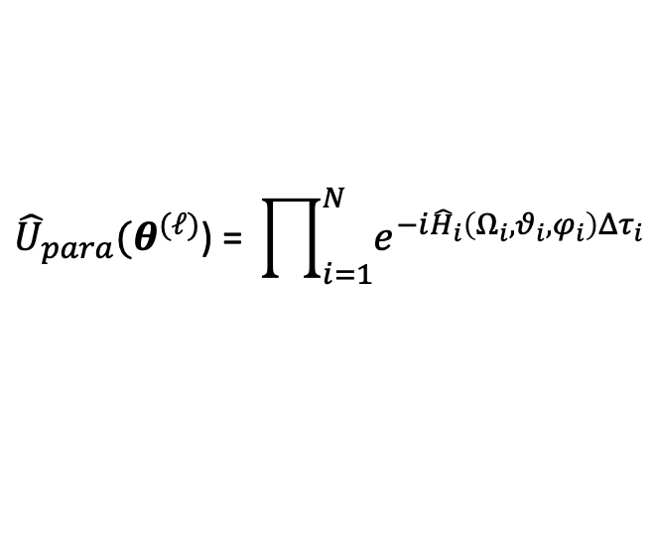
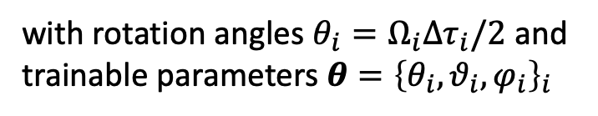

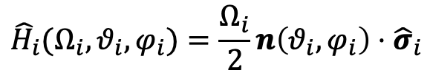



Gate Set – Local Operations
Array of UDW detectors
Internal dynamics prescribed by free Hamiltonian
$${\hat{H}}_{i}(Ω_{i},θ_{i},φ_{i})=\frac{Ω_{i}}{2}n\left(θ_{i},φ_{i}\right)⋅{\hat{σ}}_{i}$$
1-qubit rotation operators
$$t_{0}<t(τ_{i})<t_{1}$$
$${\hat{U}}_{para}\text{(}θ^{(ℓ)}\text{) = }\prod_{i=1}^{N}{e^{−i{\hat{H}}_{i}\left(Ω_{i},θ_{i},φ_{i}\right)Δτ_{i}}}$$
with rotation angles $θ_{i}=Ω_{i}Δτ_{i}/2$ and trainable parameters $θ={\left\{θ_{i},θ_{i},φ_{i}\right\}}_{i}$
worldlines
Rotation angles can be controlled by changing spacetime trajectories of detectors rather than through energy gap.
$$t$$
$$z_{i}^{μ}\left(τ_{i}\right)=\left(t\left(τ_{i}\right),x\left(τ_{i}\right)\right)$$
$$x$$
Notes:
Over a proper time interval $\Delta \tau_i$, the local unitary implemented by the internal dynamics of each qubit is simply a Bloch rotation around the $\bm n_i$ axis, which takes the form of each factor in Eq. \ref{Equation:UDWRotate} with parameters $\theta_i = \Omega_i\Delta\tau_i/2$. If we now identify the set $\bm \theta = \{\theta_i, \vartheta_i, \varphi_i\}_i$ as our trainable parameters and define the product of these local unitaries as a trainable layer, we get the first part of a VQC Eq. \ref{Equation:UDWRotate}. Importantly, the $\bm \theta$ depend not only on the internal energy gap of the qubits $\Omega_i$, but also on the proper time difference experienced by each qubit while undergoing its respective trajectory.
Mention that ability to choose Pauli rotation direction is a novel resource that allows us to achieve universality
e.g. circular trajectories in Minkowski $Δτ_{i}=Δt\sqrt{1−R^{2}ω_{i}^{2}}$

Slide 34
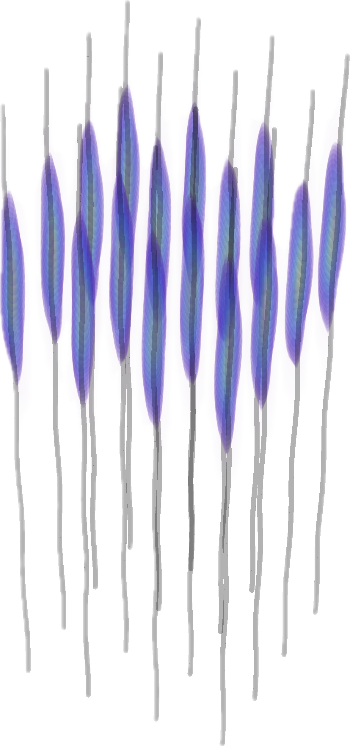
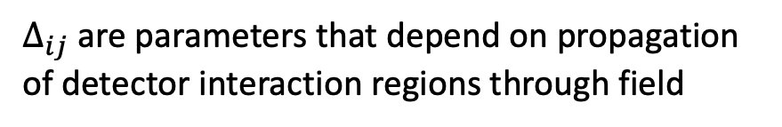
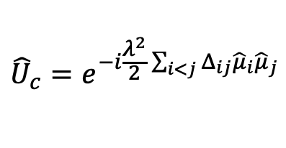




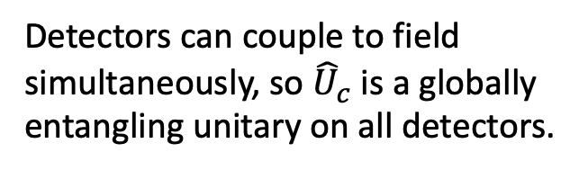


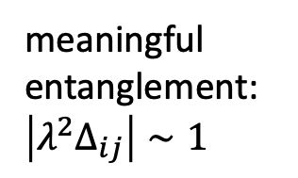
Gate Set – Entangling Operations
Consider UDW scalar field interaction Hamiltonian density
$${\hat{h}}_{i}\left(x\right)=λΛ_{i}\left(x\right){\hat{μ}}_{i}⊗\hat{φ}\left(x\right)$$
Time-evolution plus tracing out field results in decohering channel
$$Ω_{i}=0$$
$${\hat{U}}_{c}=e^{−i\frac{λ^{2}}{2}\sum_{i<j}{Δ_{ij}{\hat{μ}}_{i}{\hat{μ}}_{j}}}$$
$$t_{1}<t<t_{2}$$
$$\hat{φ}\left(x\right)$$
$$ℇ\left({\hat{ρ}}_{0}\right)={\hat{U}}_{c}ℇ_{φ}({\hat{ρ}}_{0}){\hat{U}}_{c}^{†}$$
with
$Δ_{ij}$ are parameters that depend on propagation of detector interaction regions through field
Detector-field interaction regions
Detectors can couple to field simultaneously, so ${\hat{U}}_{c}$ is a globally entangling unitary on all detectors.
meaningful entanglement: $\left|λ^{2}Δ_{ij}\right|∼1$
worldlines
$$z_{i}^{μ}(τ_{i})$$
Notes:
The entangling channel $\mathcal{E}$ is implemented by allowing the qubits to interact with a quantum field via the UDW detector model. The interaction of a two-level UDW detector with a scalar quantum field $\hat{\phi}(\mf x)$ is often prescribed by the interaction Hamiltonian density~\cite{us,us2,Landulfo,analytical}
\begin{equation}
\hat{h}_i(\mf x) = \lambda \Lambda_i(\mf x) \hat{\mu}_i \hat{\phi}(\mf x),
\end{equation}
where the $\lambda$ are coupling constants, $\hat{\mu}_i$ is an operator acting in the Hilbert space of detector $i$ and $\Lambda_i(\mf x)$ is a spacetime smearing function, which defines the shape of the interaction in spacetime. The idea is that the function $\Lambda_i(\mf x)$ is strongly supported around the detector's trajectory, $\mf z_i(\tau_i)$ and that its spatial extent corresponds to the detector's shape in its own rest space. In our setup, we consider that the support of $\Lambda_i(\mf x)$ is contained in the region $t_1 < t < t_2$, so that the interaction takes place after the local unitaries Eq.~\eqref{Equation:UDWRotate} are applied to the qubits. We assume that while the interactions with the field take place, the detector's internal dynamics are switched off (i.e. $\Omega_i = 0$), so that their evolution is entirely determined by their interaction with the field.
The dynamics of the detectors can be computed by applying the time evolution operator associated with the total interaction Hamiltonian density, $\sum_{i=1}^N \hat{h}_i(\mf x)$ and tracing over the field state. This gives rise to a quantum channel $\mathcal{E}$, which can entangle the qubits with each other (for $\hat{\mu}_i \neq \openone$), but also with the field. For simplicity, we assume the field to be in a quasi-free state\footnote{A quasi-free state is a zero mean Gaussian state. Typical states that satisfy this condition are thermal states and most choices of vacua.} and we compute the channel $\mathcal{E}$ explicitly in Appendix~\ref{Appendix:Calculations}. There we show that it can be decomposed as
\begin{equation}
\E(\hat{\rho}_0) = \hat{U}_\tc{c} \E_\phi(\hat{\rho}_0) \hat{U}_\tc{c}^\dagger\,,
\end{equation}
where $\E_\phi$ is a quantum channel that introduces decoherence due to entanglement between the qubits and the field and $\hat{U}_\tc{c}$ is an entangling unitary that can be written in the form
\begin{equation} \label{Equation:UDWEntangle}
\hat{U}_\tc{c} = e^{- \frac{\ii\lambda^2}{2}\sum_{{i<j}} \Delta_{ij} \hat{\mu}_i \hat{\mu}_j}\,,
\end{equation}
where $\Delta_{ij}$ are parameters that depend on retarded propagation of the qubit interaction regions through the field and usually behave proportionately to the ratio of the interaction time of the qubits with the field and their proper separation. A key assumption for the entangling unitary to act meaningfully between the qubit pairs is that $|\lambda^2 \Delta_{ij}| \sim 1$. This can be accomplished whenever the qubits' interaction regions are in causal contact for enough time, which allows for the field to mediate a sufficient amount of entanglement between the qubits. We emphasize that our calculations allow us to couple detectors simultaneously to the field, meaning that we can get a globally entangling unitary on all detectors. In a way, the unitary $\hat{U}_\tc{c}$ is a weighted version of the M\o lmer-S\o rensen gate in quantum optics.
Detectors are in causal contact for a long time compared to their separation so the notion of simultaneous is somewhat well-defined.
Using a time-independent monopole operator is similar to using gapless detectors, which we assume anyway during the field interaction.

Slide 35



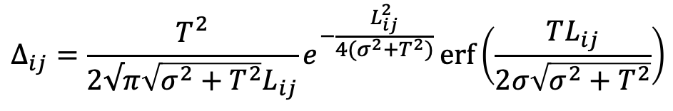

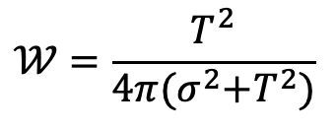


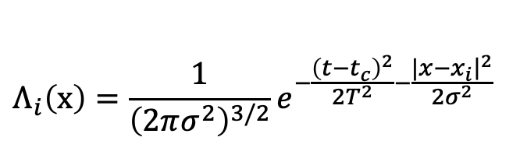



Noise Analysis
How bad is the noise from interacting with the field?
Where on the spectrum is our setting?
Channel Fidelity:
1)
Meaningful entanglement
$$F\left(ℇ\left(\hat{ρ}\right),{\hat{U}}_{c}\hat{ρ}{\hat{U}}_{c}^{†}\right) ≥Tr({\hat{ρ}}^{2})e^{−2N^{2}λ^{2}𝒲}$$
$${|λ}^{2}Δ_{ij}| \sim 1$$
2)
$${N^{2}λ}^{2}𝒲≪1$$
Negligible noise
field-dependent local noise term
$$N^{2}𝒲≪Δ_{ij}$$
Example: Gaussian smearing in Minkowski
True for general spacetimes
$$Λ_{i}\left(x\right)={\frac{1}{{\left(2πσ^{2}\right)}^{3/2}}e}^{−\frac{{\left(t−t_{c}\right)}^{2}}{2T^{2}}−\frac{|{\left.x−x_{i}​\right|}^{2}}{2σ^{2}}}$$
$Δ_{ij}$ typically scales with interaction times
$$𝒲=\frac{T^{2}}{4π{(σ}^{2}+T^{2})}$$
$$L_{ij}≪T$$
e.g. for $λ\sim {10}^{−4}$ and $N=100$
$$Δ_{ij}=\frac{T^{2}}{2√π\sqrt{σ^{2}+T^{2}}L_{ij}}e^{−\frac{L_{ij}^{2}}{4(σ^{2}+T^{2})}}\operatorname{erf}\left(\frac{TL_{ij}}{2σ\sqrt{σ^{2}+T^{2}}}\right)$$
Per layer: $F ≥99.998\%$
100 layers: $F ≥99.8\%$
Notes:
$𝒲$ is often of order unity when the field is in a state that has a low particle number, as perceived by the detectors (This would not be the case if the field was in a highly excited state, or if the detectors were in extreme states of motion while interacting with the field (such as accelerations high enough so that Unruh-like effects would take place)
Notice that having $N\ll \lambda^{-2} $ does not prevent us from having meaningful entanglement generated by the unitary $\hat{U}_\tc{c}$, provided that $|\lambda^2\Delta_{ij}|\sim 1$. This is a reasonable assumption provided that $T\sim \lambda^{-2} L$, where $T$ is the time duration of the interaction with the field and $L$ is the minimal detector separation between detectors in the setup.}.
Under this assumption, the channel $\mathcal{E}_\phi$ acts as a weakly decohering channel. While the effect may be relatively small, the noise introduced from the interaction with the quantum field is always present regardless of the specifics of the interaction, since the noise terms are present even when the field is in its vacuum state. However, the noise terms are typically negligible in many realistic and experimental scenarios.
where $T$ controls the interaction duration, $\sigma$ is the effective size of the detectors, and $t_\tc{c}$ is the center of the interaction duration in time.
where $\Delta_{ij}$ are parameters that depend on retarded propagation of the qubit interaction regions through the field and usually behave proportionately to the ratio of the interaction time of the qubits with the field and their proper separation. A key assumption for the entangling unitary to act meaningfully between the qubit pairs is that $|\lambda^2 \Delta_{ij}| \sim 1$. This can be accomplished whenever the qubits' interaction regions are in causal contact for enough time, which allows for the field to mediate a sufficient amount of entanglement between the qubits. We emphasize that our calculations allow us to couple detectors simultaneously to the field, meaning that we can get a globally entangling unitary on all detectors.
Pure initial states are very common in typical RQI setups, so this lower bound should be useful

Slide 36
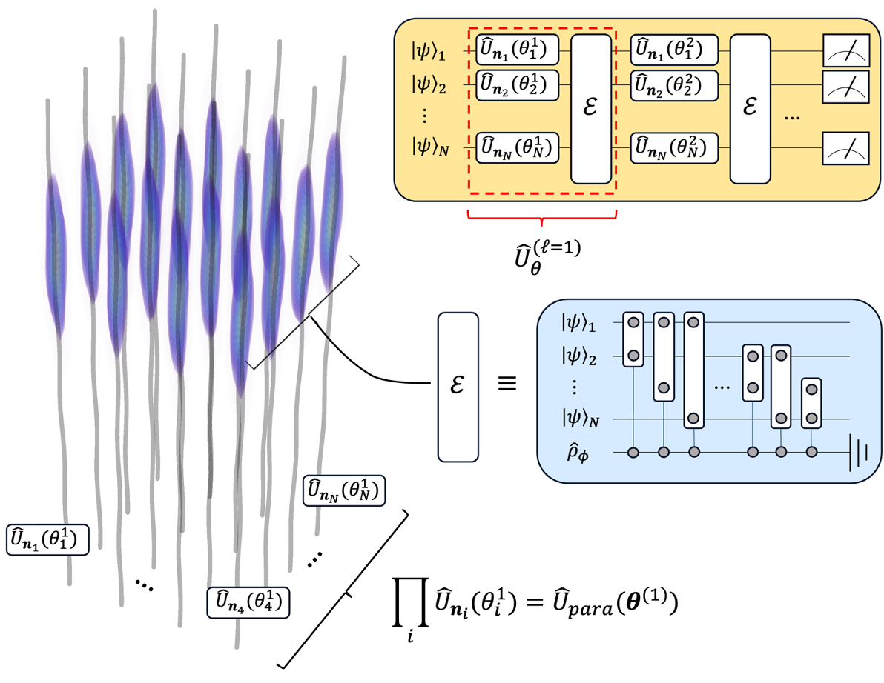


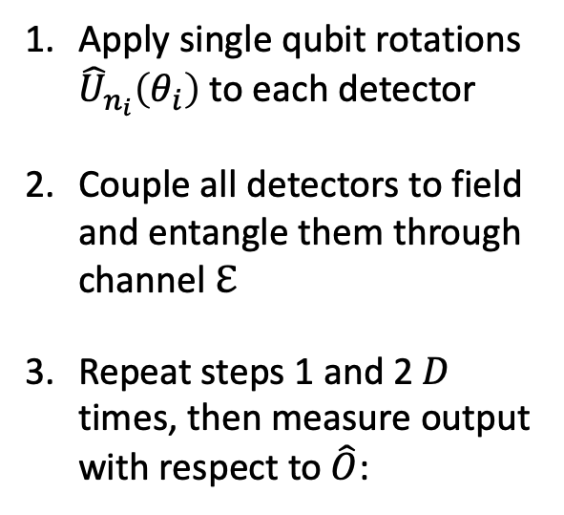


Relativistic Variational Quantum Circuit (RVQC)
System-field interaction regions
Apply single qubit rotations ${\hat{U}}_{n_{i}}\left(θ_{i}\right)$ to each detector
Couple all detectors to field and entangle them through channel $ℇ$
Repeat steps 1 and 2 $D$ times, then measure output with respect to $\hat{O}$:
$$t$$
$$x$$
Field state
$$f_{θ}\left(\hat{O}\right)=Tr\left(\hat{O}\hat{U}\left(θ\right){\hat{ρ}}_{0}{\hat{U}}^{†}(θ)\right)$$
$$z_{i}^{μ}(τ_{i})$$
worldlines
Notes:
We technically don’t need to do the variational update of the trainable parameters to execute a particular quantum algorithm if we already know what rotation angles will work, but if there is some noise (e.g. externally, detector positions get perturbed, measurements are not performed perfectly, etc. ) preventing us from getting them precisely or measurement is involved in the middle of the algorithm, then the variational scheme is useful. Also, if we want to program the detectors to execute certain trajectories then this is basically like updating the parameters.
When successive applications of the entangling channel $\mathcal E$ are considered, one requires an extra assumption regarding the initial state of the field being quasi-free. After one application of the channel $\mathcal{E}$, the state of the field also evolves due to the interaction with the detectors, and in general the field's final state will not be quasi-free. On the other hand, any effect that the detectors have on the field quickly dissipates away. That is, under the assumption that the time required to implement the free unitaries (when the detectors are not coupled to the field) is large compared to the detector's separation, one can effectively treat the local state of the field probed by the qubits as its previous initial state.
We can just use the U_c entangling gate from now on because we can effectively make the noise zero

