Slide 1
Offline caching in web applications for AntidoteDB
Department of Computer Science
Software Engineering
Presenter: Server Khalilov
Leader: Prof. Dr. Arnd Poetzsch-Heffter
Supervisor: Dr. rer. nat. Annette Bieniusa
11th January 2019

Slide 2
Outline
Introduction
Main Concepts
Protocol
Key Technologies
Implementation
Evaluation
Related Work
Summary

Slide 3
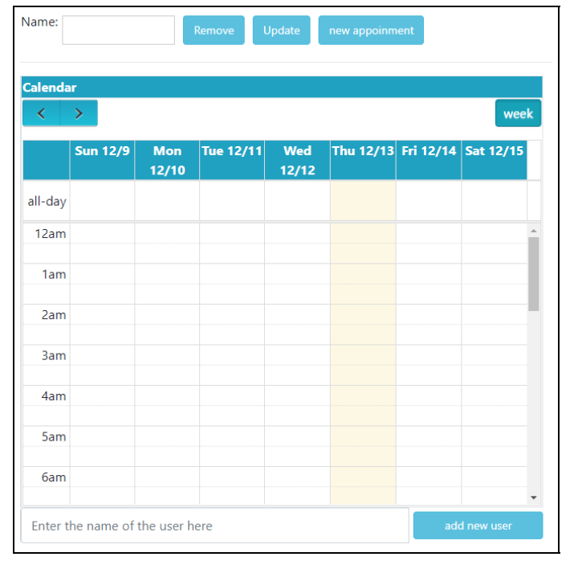
Introduction
To be available in offline periods, the system should replicate its data on the client machine.
Having the data locally allows to work on it while being offline or under poor network conditions.
Local updates should be sent back to the server for further synchronization.
All of it is possible with WebCure.
A view at the interface of the Calendar App.
Notes:
- Users tend to seek more comfortable experience of working with web applications nowadays.

Slide 4
Main concepts
Geo-distributed database - a database, which is spread across two or more geographically distinct locations.
Transaction - a basic unit of computing, which consists of a sequence of operations that are applied on a database independently. A correct transaction obeys rules, specified on the database.
Notes:
Transactions transform a consistent database state to
another consistent database state.
A transaction is considered to be correct
if it obeys the rules, specified on the database. As long as each transaction
is correct, a database guarantees that concurrent execution of user
transactions will not violate database consistency [2]. Consistency requires
transactions to change the data only according to the specified rules. An
example of a consistency rule can be the following: imagine that in a bank
database the bank account number should only consist of integer numbers.
If an employee tries to create an account that contains something
5
2 Theoretical background
other than integer numbers in it, then the database consistency rule will
disallow it. Consistency rules are important as they control the incoming
data and reject the information, which does not fit.

Slide 5
Main concepts – Consistency
As long as transaction is correct, a database guarantees that concurrent execution of transactions guarantees database consistency.
Consistency requires transactions to change the data only according to the specified rules.
Notes:
An example of a consistency rule can be the following: imagine that in a bank
database the bank account number should only consist of integer numbers.
If an employee tries to create an account that contains something other than integer numbers in it, then the database consistency rule will
disallow it. Consistency rules are important as they control the incoming
data and reject the information, which does not fit.

Slide 6
Main concepts – Consistency Models
Strong consistency: there is a total order of update and every read returns the latest data.
Causal consistency: every process observes a monotonically non-decreasing set of updates in an order that respects the causality between operations.
Notes:
STRONG CONSISTENCY:
The advantage of strong consistency is that the
database is always in a consistent state and to disadvantages, we can add
low latency, as there is a delay for making sure that all the replicas are in a
consistent state before any other read / write requests could be processed
CAUSAL CONSISTENCY:
As the causal ordering is respected,
it makes it easier for programmers to reason, as it gives the guarantee
that related events are visible in the order of occurrence, while the
events, which have no relation to each other, can be in a different order
in different replicas

Slide 7
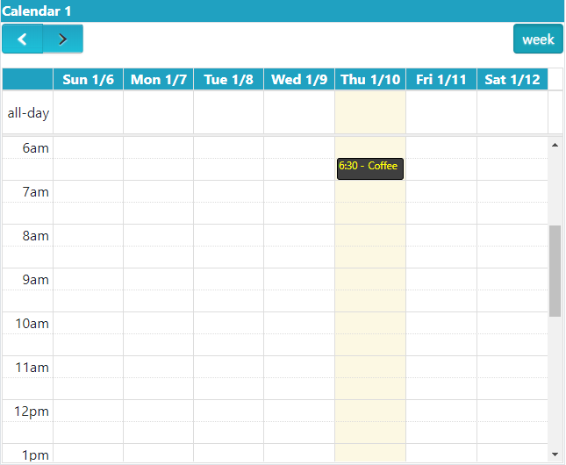
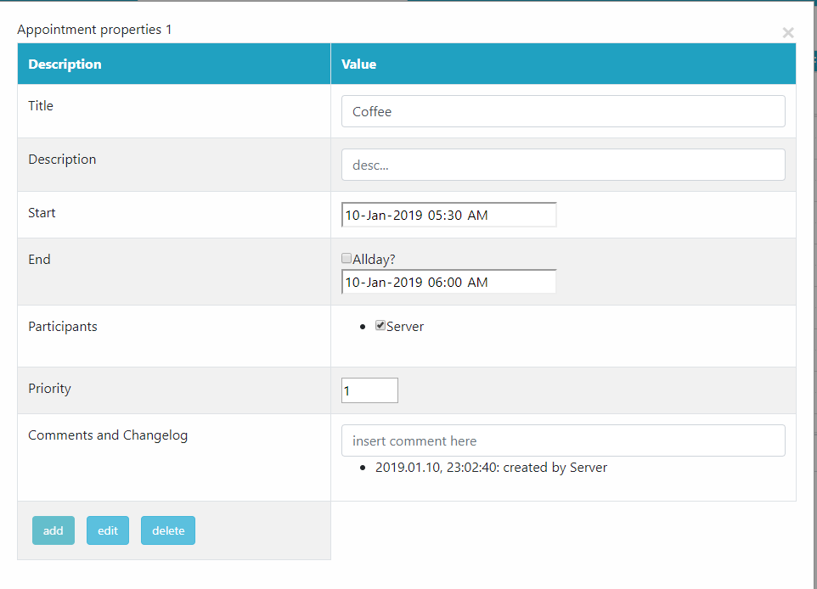
Main concepts – Example of Causal consistency
An example of causal consistency.
An appointment can be edited only after it was created.
Notes:
There, a reply to a wall post happens after the original
post is published. Thus, users should not see the reply before the original
post is observable. This type of guarantees is provided by causal consistency.
Looking at Figure 2.1 we can see that on the left subfigure, the user
can see the original wall post as well as the reply, while on the right subfigure,
without causal consistency, the user sees only the reply, while the
original wall post is missing. Such kind of behaviour in social networks
might create misunderstanding between people.
creating an appointment → editing the appointment. Not vice versa!

Slide 8

Main concepts – AntidoteDB
One of the core parts of WebCure is AntidoteDB database. It is:
Geo-distributed;
groups operations into independent transactions;
delivers updates in a causal order and merges concurrent operations (which is possible due to CRDTs).
To ensure the guarantees it offers, AntidoteDB uses timestamps, indicating
the time after the transaction.
Notes:
Timestamps are considered to be unique,
totally ordered, and consistent with causal order, which means that if
operation 1 happened before operation 2, then the timestamp related to the
operation 2 is greater than the one related to the operation 1[

Slide 9
Main concepts – CRDTs
CRDT is an abstract data type, which possesses the properties:
The data at any replica can be modified independently of other replicas;
Replicas deterministically converge to the same state when they received the same updates.
Notes:
Timestamps are considered to be unique,
totally ordered, and consistent with causal order, which means that if
operation 1 happened before operation 2, then the timestamp related to the
operation 2 is greater than the one related to the operation 1[

Slide 10
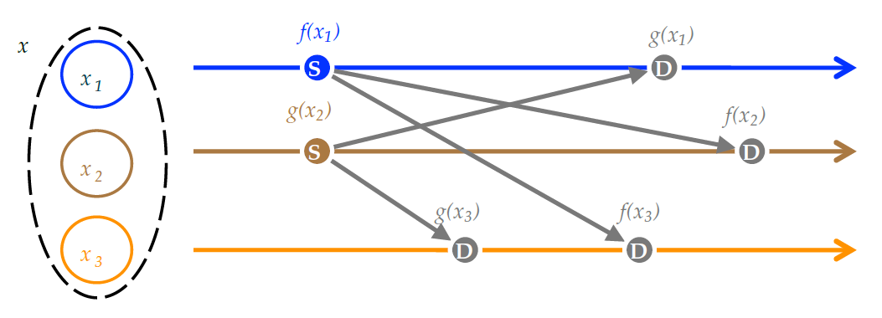
Main concepts – Operation-based approach of replication
Replicas converge by propagating operations to every other replica.
Once an operation is received in a replica, it is applied locally. Afterwards, all replicas would possess all of the updates.
«S» stands for source replicas
and «D» for downstream replicas.
Notes:
This replication approach infers that replicas do not exchange full states
with each other, which is a positive concerning efficiency. Not always,
though, as it depends on the task. Sometimes, applying multiple operations
at every replica could be costly, and this is where state-based replication
approach is beneficial.

Slide 11
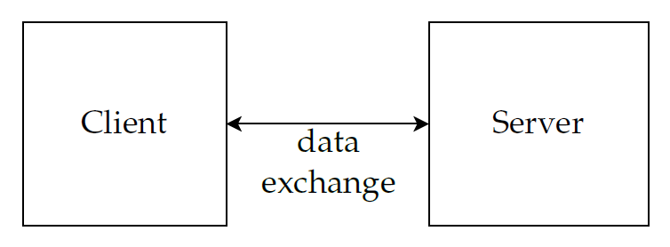
Protocol
Initially, we consider a server and a client as black boxes.
Notes:
In other words, to calculate
the state of the Counter, it is needed to count the number of increments
and subtract the number of decrements.

Slide 12
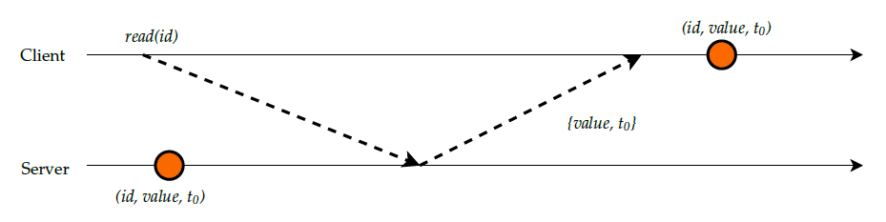
Protocol – A Client receives an update from the server
The communication between a client and a server for the read function.

Slide 13
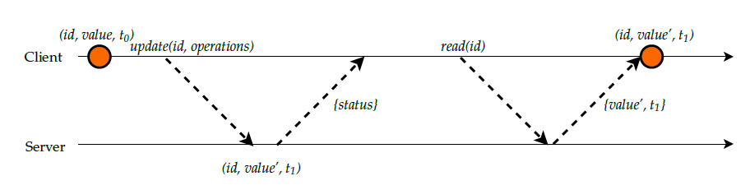
Protocol – A client sends an update to the server
The communication between a client and a server for the update function.

Slide 14
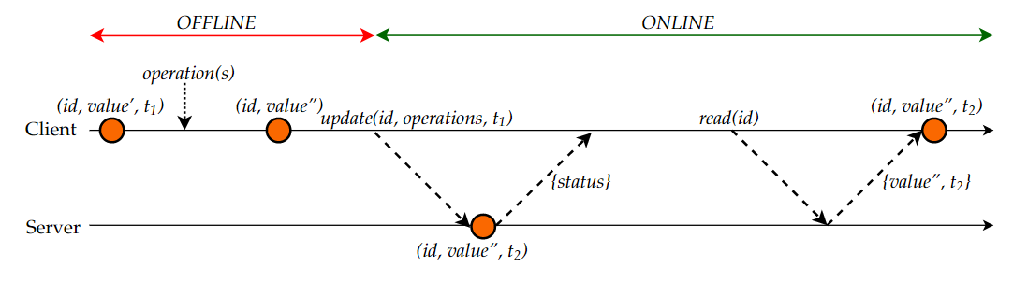
Protocol – Offline work
The communication between a client and a server while offline with a transition to online.

Slide 15
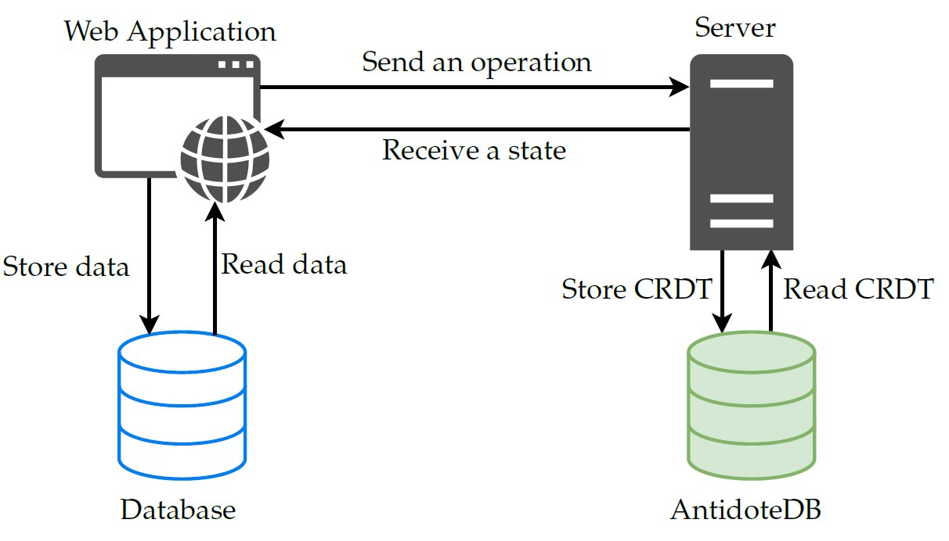
Protocol – Main Components of the system
Notes:
We introduced a client and a server as black boxes, without
really explaining their internal structure. However, we have a clear
picture of what the system and its main components will look like.
3 TIER ACRCHITECTURE
Its principal distinction is that it has a clear separation between the presentation,
application, and data layers, as we can spot in Figure 5.3, where we also
sketch how each JavaScript file of WebCure relates to these layers. Each
layer is responsible for its tasks.
A presentation layer is implemented on a client side and is responsible for
presenting the information to the users, while it can also accept requests
from them. An application layer is based on a server’s side, implements
the algorithmic part of the system and answers the operations requested
by the client. The last one, a data layer, manages and implements the data
sources of the system. The advantages of a 3-tier architecture style are the
scalability and portability it provides. However, a disadvantage could be
a communication overhead between the layers[36].

Slide 16
Key Technologies
Service worker, in order to manage requests coming from the client;
Cache API to store HTML, CSS, JavaScript files, and any static files[18] to make the application available offline;
Database to store the data locally;
Background Sync for deferring the actions conducted offline until the connection is stable

Slide 17
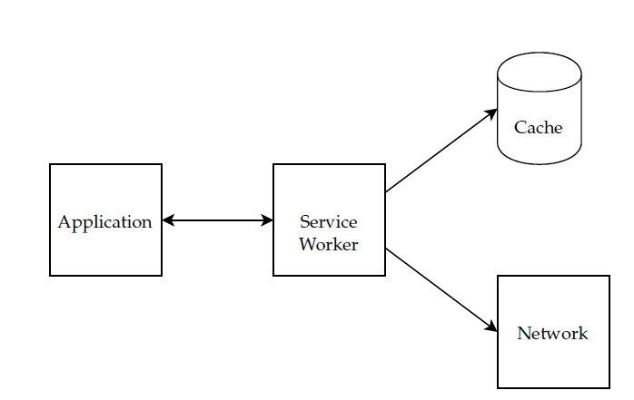
Key Technologies – Service Worker
Service worker is a JavaScript file, which serves as a proxy.

Slide 18
Key Technologies – Cache API
For the best offline experience, the web application should store somewhere HTML, CSS, JavaScript code, as well as images, fonts. That is what Cache API used for.

Slide 19
Key Technologies – IndexedDB
It is database, which lets us store any data in the user’s browser.
Each IndexedDB database contains Object stores. Those object stores, in its turn, are similar to tables in traditional databases
Usually, the practice is to have one object store for each type of data. This data could be anything: custom objects, strings, numbers, arrays, and other.
All read and write operations in IndexedDB should be wrapped into a transaction. if one operation within a transaction fails, then none of the other operations are going to be applied.

Slide 20
Key Technologies – Background Sync
This feature is beneficial for the use case, when the offline work should be immediately sent to the server, once the connection is established again.
In our case, in WebCure we are going to use it for sending the operations conducted offline back to the AntidoteDB server for further synchronisation.
Notes:
The reality is that it is not always possible to be online all the time, even if
someone wanted to. Sometimes, there is no network connection at all, or
it could be that abysmal that it would be hard to do anything under such
conditions.

Slide 21
Protocol – Main Components of the system
Cache API
Service Worker + background sync
Service worker
IndexedDB
Notes:
We introduced a client and a server as black boxes, without
really explaining their internal structure. However, we have a clear
picture of what the system and its main components will look like.
3 TIER ACRCHITECTURE
Its principal distinction is that it has a clear separation between the presentation,
application, and data layers, as we can spot in Figure 5.3, where we also
sketch how each JavaScript file of WebCure relates to these layers. Each
layer is responsible for its tasks.
A presentation layer is implemented on a client side and is responsible for
presenting the information to the users, while it can also accept requests
from them. An application layer is based on a server’s side, implements
the algorithmic part of the system and answers the operations requested
by the client. The last one, a data layer, manages and implements the data
sources of the system. The advantages of a 3-tier architecture style are the
scalability and portability it provides. However, a disadvantage could be
a communication overhead between the layers[36].

Slide 22
Implementation
To demonstrate the functionality of WebCure, we implemented three different types of CRDTs used in AntidoteDB: a counter, a set and a multi-value-register.

Slide 23
Implementation – Database
This layer includes an AntidoteDB database, which is used to store and handle CRDT-objects.
To be able to work with the database, we are going to use a JavaScript Client for AntidoteDB.

Slide 24
Implementation – Server
To implement a server we used a Node.js framework called Express.
Taking Set CRDT as an example, we will now discuss the methods the server implements:
• Sending back either the latest state of a set CRDT or, if a timestamp was provided, then the state at a specific timestamp;
• Adding/removing elements from a set CRDT;
• Applying a list of operations, which were performed at the client while offline.

Slide 25
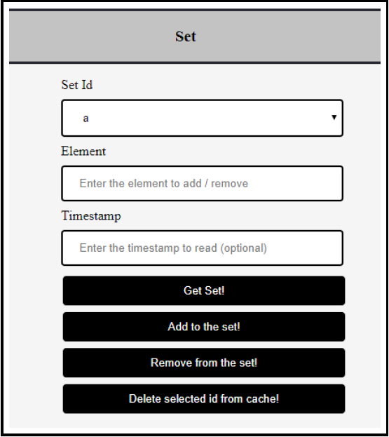
Implementation – Client
A presentation app runs in the web-browser, supports various commands from the user and sits on top of the local database layer.
Notes:
On the screen you can see the demonstration application that we implemented.

Slide 26
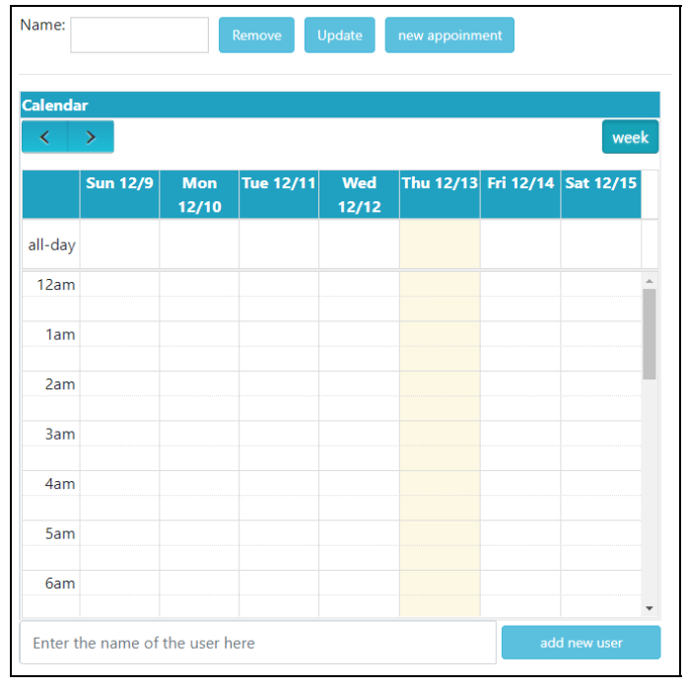
Evaluation
It is time to demonstrate the applicability of WebCure.
For that, we are going to take the Calender App designed and built in the work of Tim Dellmann.
In the implementation of the Calendar App, the next types of CRDTs were used: maps, multi-value registers and sets.
A view at the interface of the Calendar App
Notes:
3 point is possible due to AntidoteDB, which is a database the Calendar App is built on.

Slide 27
Evaluation – Calendar based on WebCure
We restructured the Calendar App, so the integration with WebCure would be possible.
In the original Calendar App, the feature of having users was implemented with set CRDTs. Therefore, we extended the application to have our abstract SetCRDT class on a client side, while also making the additional features of the application to work offline.
Notes:
3 point is possible due to AntidoteDB, which is a database the Calendar App is built on.

Slide 28
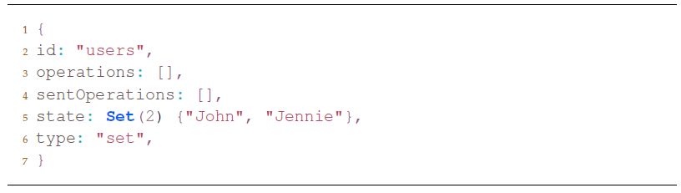
Evaluation – Calendar based on WebCure
Consider a situation where we added two users with names John and Jennie to the first Calendar App:
Notes:
3 point is possible due to AntidoteDB, which is a database the Calendar App is built on.

Slide 29
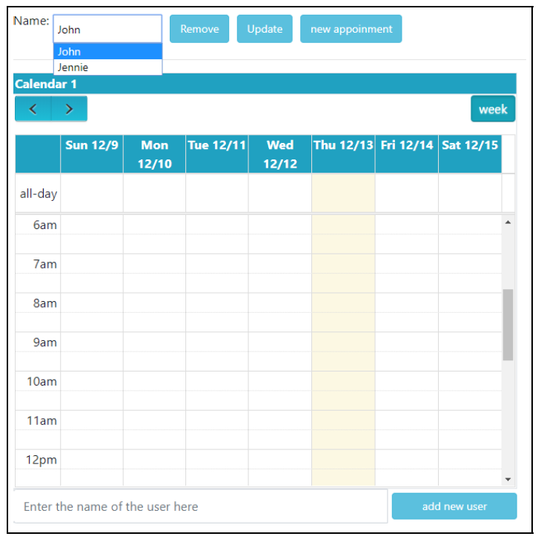
Evaluation – Calendar based on WebCure
A view reflecting the addition of two users: John, Jennie.
Notes:
3 point is possible due to AntidoteDB, which is a database the Calendar App is built on.

Slide 30
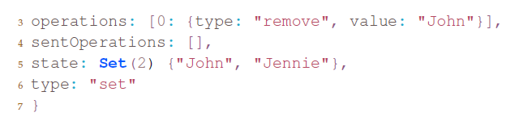
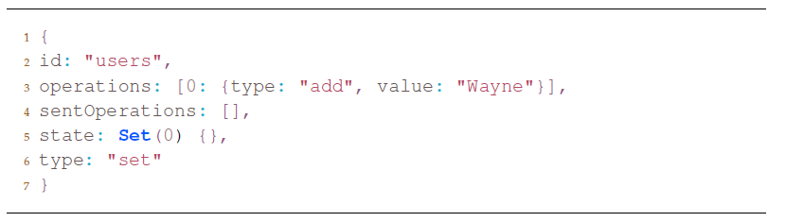
Evaluation – Calendar based on WebCure
Next, we turn off the network for both calendar applications.
Then, we firstly locally remove the user John through the interface of the first Calendar App and, afterwards, we add a user Wayne at the second Calendar App.
Notes:
3 point is possible due to AntidoteDB, which is a database the Calendar App is built on.

Slide 31
Evaluation – Calendar based on WebCure
As we are working offline, the changes will be applied straight away.
After we turn the connection back on, all the offline performed operations are sent to the server immediately.
Notes:
3 point is possible due to AntidoteDB, which is a database the Calendar App is built on.

Slide 32
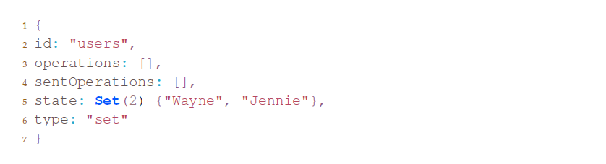
Evaluation – Calendar based on WebCure
Finally, both calendars will reach the same state, as the servers converged having applied all the provided operations.
Notes:
3 point is possible due to AntidoteDB, which is a database the Calendar App is built on.

Slide 33
Evaluation – Summary
 | Calendar | Calendar + WebCure
Response time (N=20) | 316.35ms | 2.06ms (+ 300ms once for the initial load)
Size | - | > 400 KB
Respose time indicates the time needed until the main page of the application loads, as well as all the styles, images, and JavaScript libraries.
N – number of trials.
Notes:
As we can see, this comparison answers our research question RQ3, as caching already
makes a huge difference regarding the performance and, therefore, the
user experience as well.

Slide 34
Evaluation – Summary
The extended version of the Calendar works offline and online;
WebCure enables the extended version of the application to have the logic only on a client-side, which allows avoiding the replication of logic.
The extended version of the Calendar is more efficient.
Notes:
FIRST POINT:
That makes it harder to
break the causality rules, as operations performed offline on a client are
going to be applied on the server according to their specific timestamp,
cached on a client
The extended version proved to be available and functional offline and
online, while partially replicating the data at a client side, which lets
users continue working with their data. This example proves the point
that WebCure allows to build web applications, which outperform their
normal versions while keeping their functionality and giving users the
opportunity to work on their data while offline.

Slide 35
Evaluation – Related Work / Competitor Products
Feature | WebCure | CouchDB | Realm Mobile
Concurrent updates | + | - | -
Consistency Model | Causal Consistency | Eventual Consistency | Eventual Consistency
Offline experience | + | + | +
Notes:
Eventual consistency is a consistency model that guarantees that, if no new updates are made to a given object, eventually all accesses to that object will return the last updated value.

Slide 36
Summary
Designed a stable protocol for the communication between a client with a local storage and a server, and supporting the offline work.
Made a research on available technologies, which allowed us to implement the design.
Developed a presentation application for Counters, Sets, Multi-Value Registers, which demonstrates the work of WebCure.
Extended the Calendar application with WebCure and proved its efficiency.
Notes:
That would allow the user for offline operation at times, when there is
no internet connection available, or when it is poor. Moreover, there are
requirements for the system such as the possibility to maintain the data
at client side as well, and synchronise it with a cloud storage server,
when the mode of the client switches from offline to online. Additionally,
after the system was designed, it was needed to be implemented, and its
feasibility and performance should have been evaluated

Slide 37
Summary
Thank you for your attention!
Any questions?

Slide 38
Appendix
CRDTs: Counter
CRDTs: Add-wins Set
CRDTs: Multi-value register

Slide 39
Main concepts – CRDTs: Counter
Counter is a CRDT, which keeps track on its state, which is an integer
number.
Operations:
Inc() – increases the state by one unit.
Dec() – decreases the state by one unit.
The concurrency semantics for this data type is that a final state of the object
reflects all the performed operations on it.
Notes:
In other words, to calculate
the state of the Counter, it is needed to count the number of increments
and subtract the number of decrements.

Slide 40
Main concepts – CRDTs: Add-wins Set
Add-wins Set represents a collection of objects with a specific handling of concurrent updates performed over them.
Operations:
add() – adds an element to the set.
remove() – removes an element from the set.
Example:
{} // A: add(a); B: remove(a);
{a}
Notes:
In other words, to calculate
the state of the Counter, it is needed to count the number of increments
and subtract the number of decrements.

Slide 41
Main concepts – CRDTs: Multi-value Register
This data type maintains a value and provides a write operation of updating that value.
Operations:
read() – returns the state of the Multi-value register.
write(x) – changes the state of it, by adding an element x.
reset() – resets the state of the register.
The concurrency semantics for this data type is that the register will consist of all the concurrently written updates for further processing. However, any write operation overwrites the previous state of the register.
Notes:
In other words, to calculate
the state of the Counter, it is needed to count the number of increments
and subtract the number of decrements.

