Slide 1
Evaluation of a genetic algorithm based image approximation method
Gergely Vakulya

Slide 2
Overview
Genetic algorithms
The proposed genetic algorithm
  Chromosome representation
  Genetic operations
Test images
Test results
Comparison to compression algorithms

Slide 3
The proposed genetic algorithm
Basic principle:
  Approximate a black and white image with k triangles
  The number of triangles is limited (kmax)
  The chromosomes store the k, the 3 coordinate pairs and the color of the triangles
  Mutation operator can add, remove or modify triangles
  Crossover generates new specimen from the triangle set of the parents
  Both operators have tunable probability
  Selection operator with moderate elitism

Slide 4
Chromosome representation

Slide 5

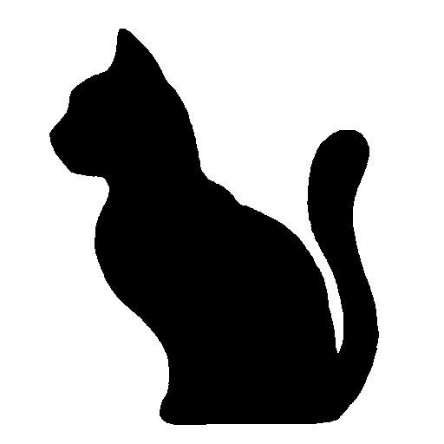
Test images
Two images were selected
Black and white bitmaps
512x512 pixels resolution
Moderate complexity

Slide 6
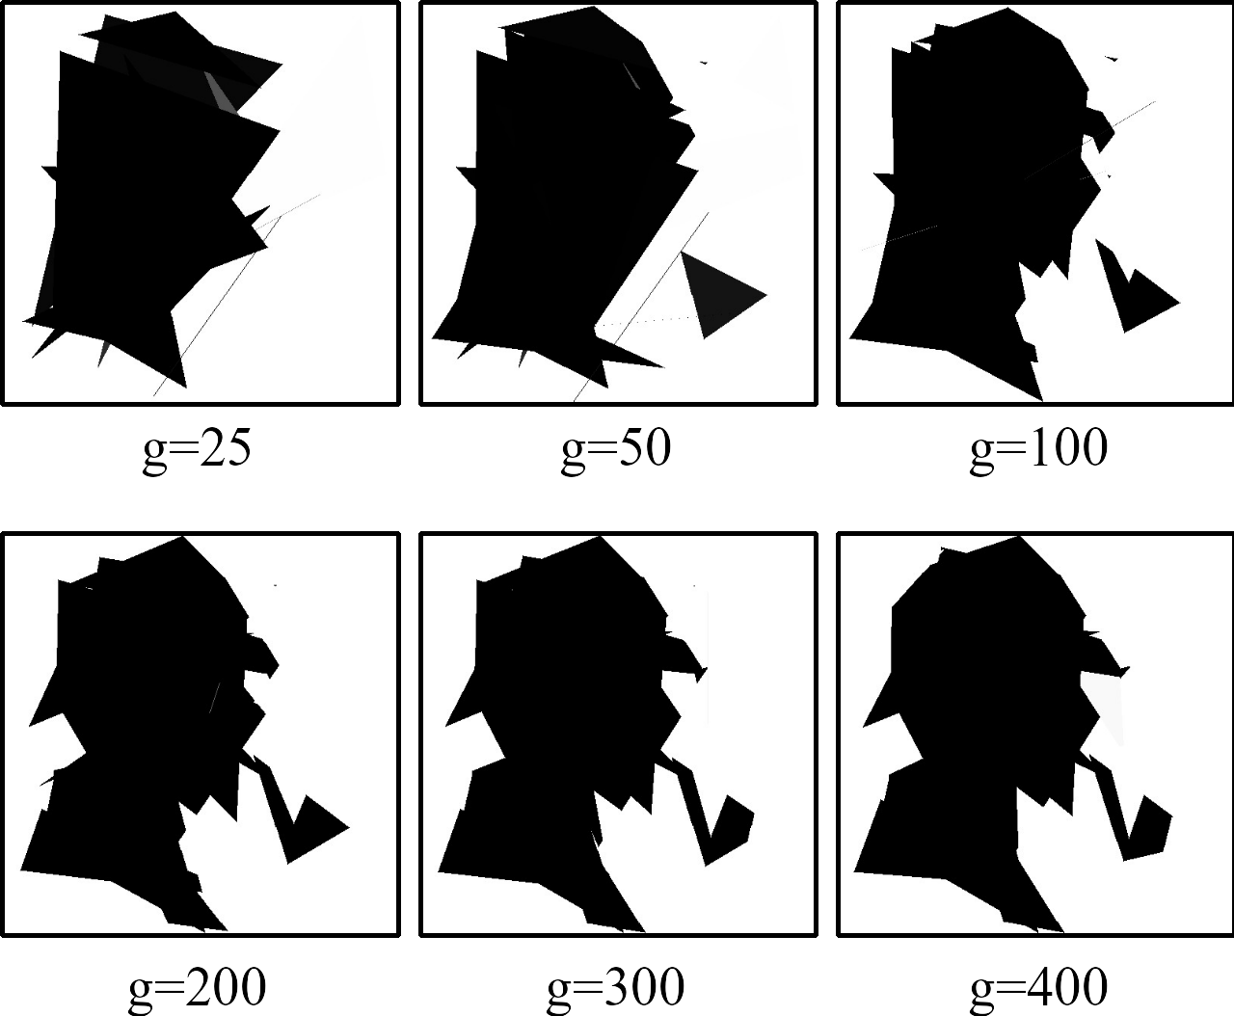
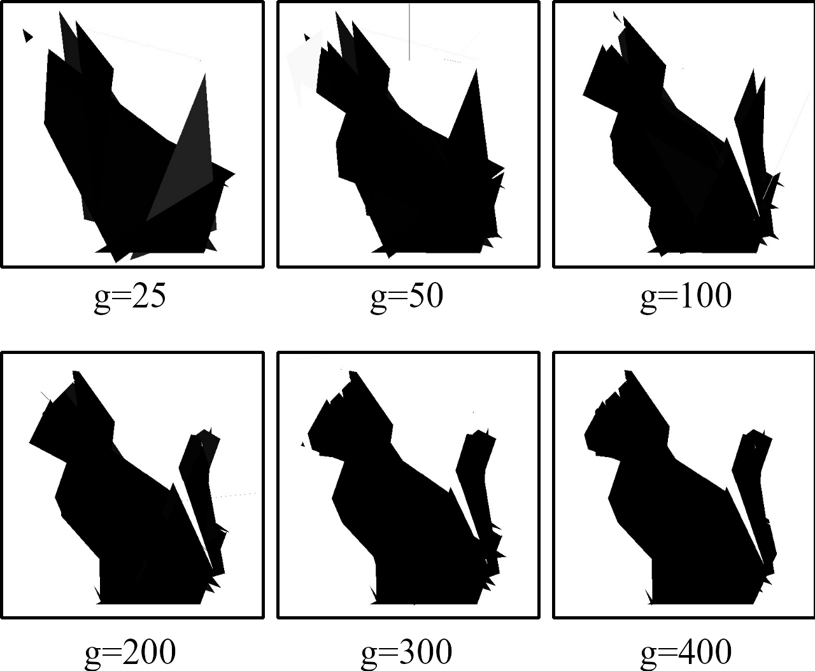
Results
For each image kmax=20 was set.
The best matching image was saved after 20, 50, 100, 200, 300 and 400 generations.
The algorithms generates a recognizable image after 200 generations.
The next 200 generations give a slight improvement.

Slide 7
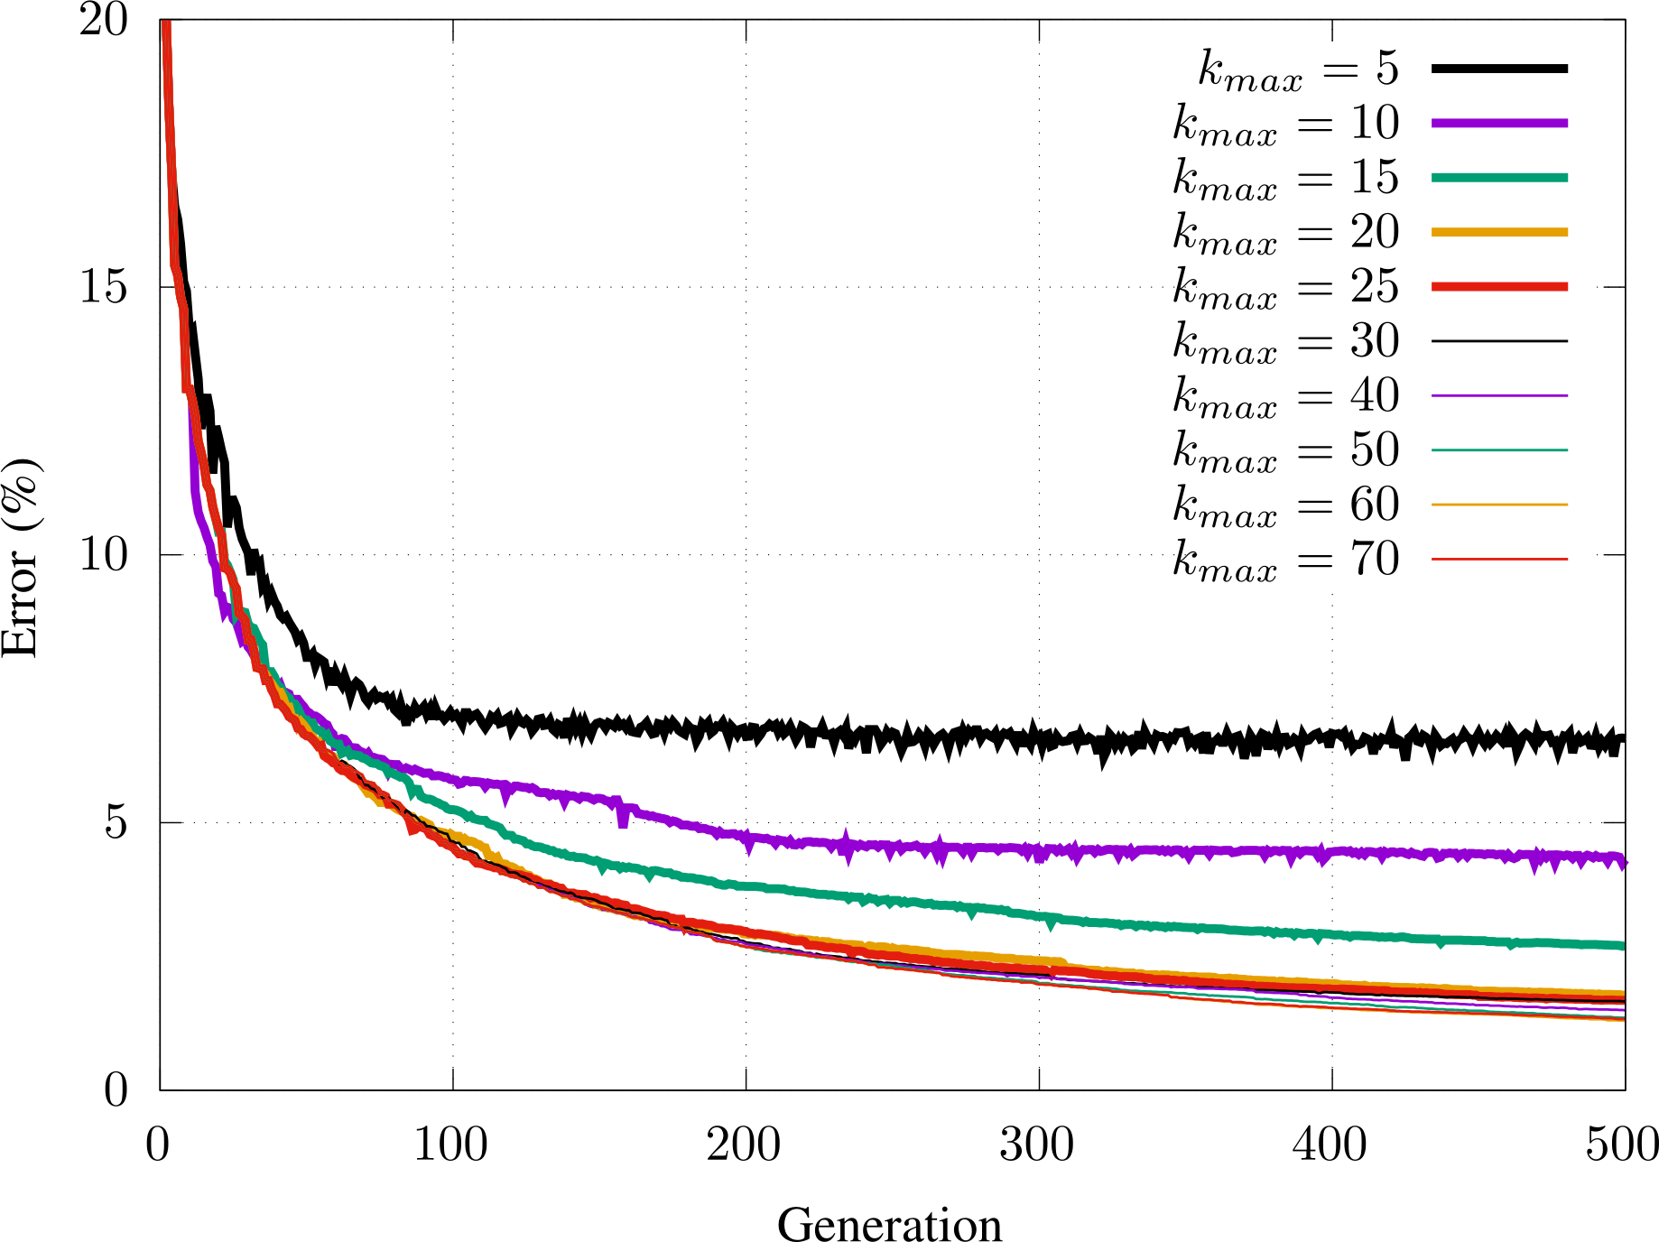
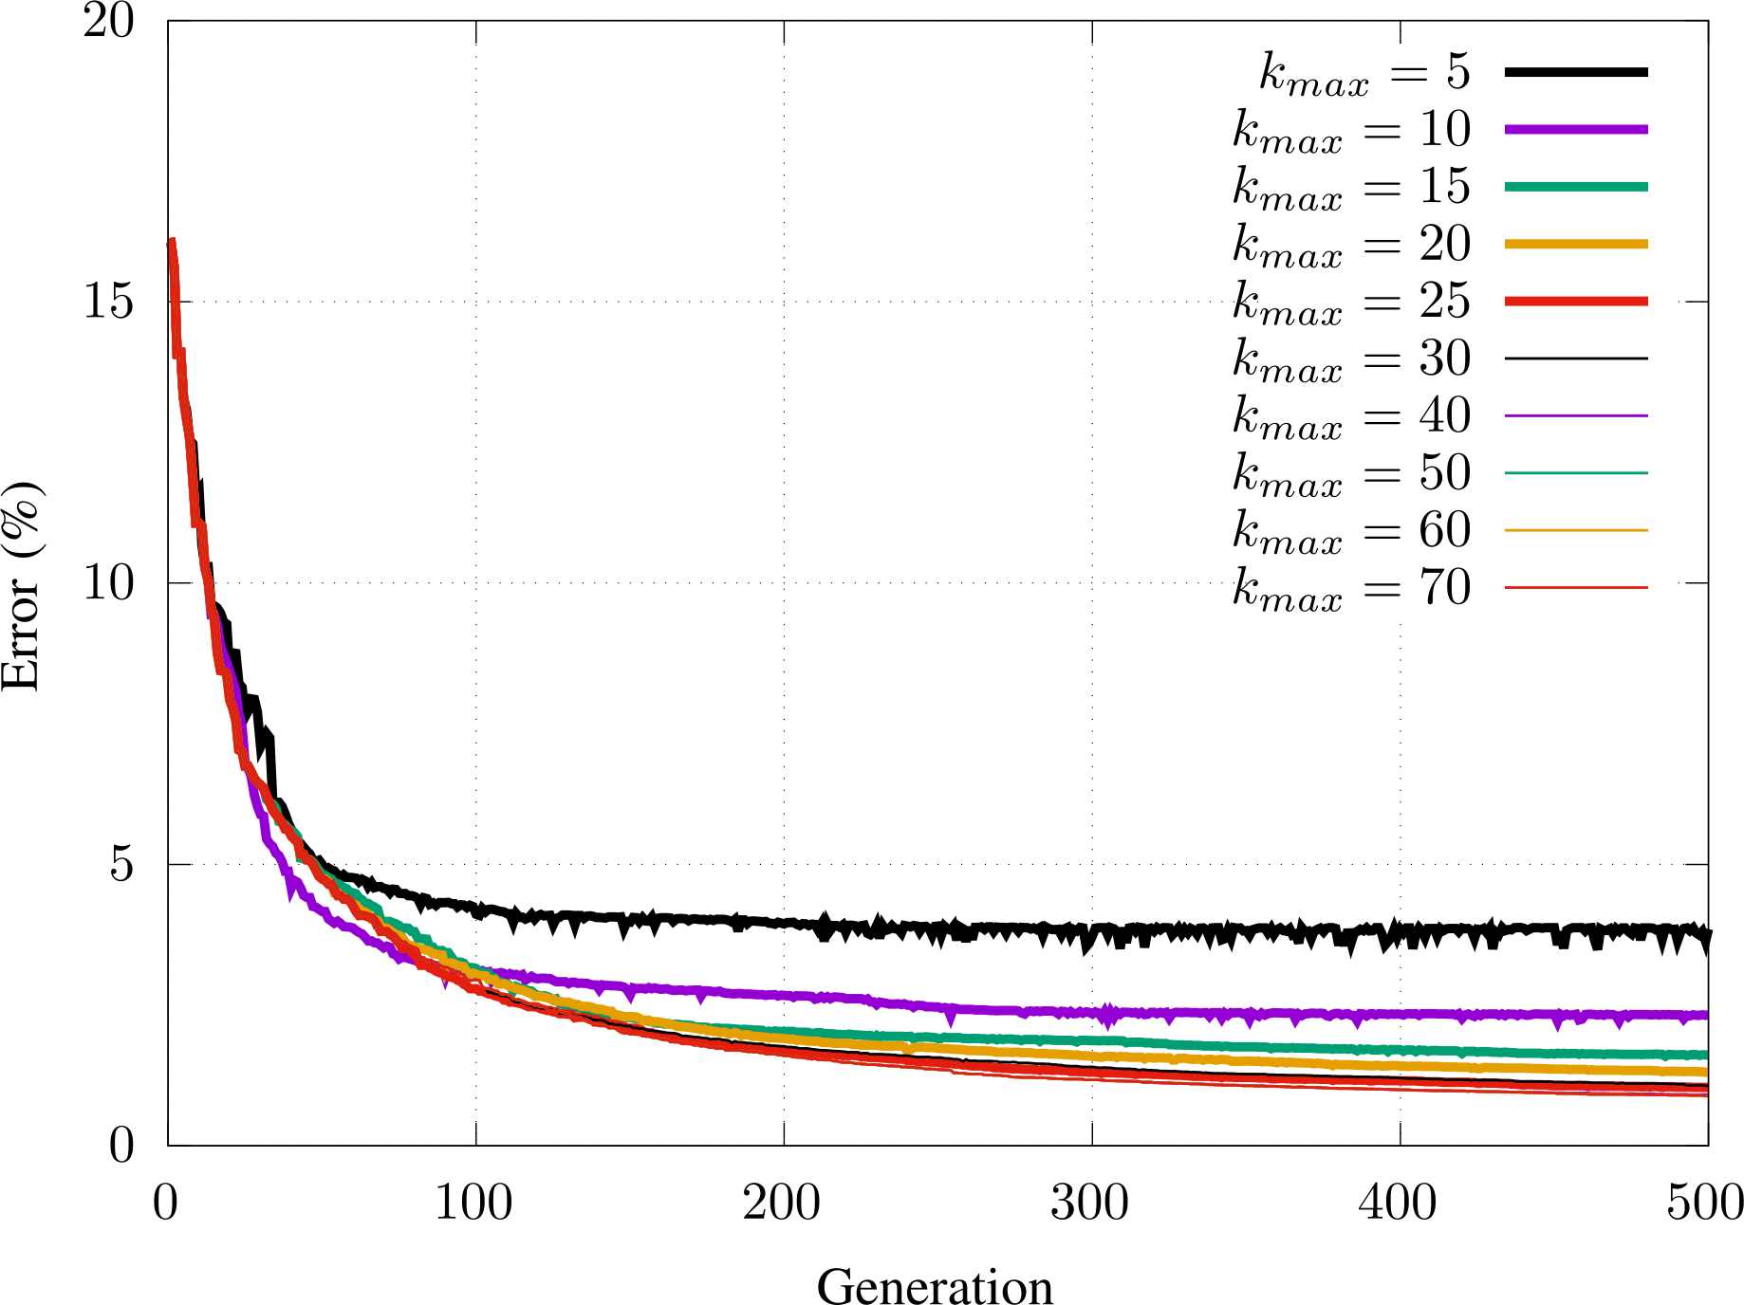
Results
The image approximation algorithm was run for both test images with several kmax settings
The approximation error of the best image is plotted for each generation
kmax=20 is a big barrier
After 400 generations no further improvement is observable

Slide 8
Comparison to compression algorithms
The two test images were approximated with moderate and fine settings
The efficiency of the image compression was compared to
  lossy/lossless image compression methods
  General purpose file compression programs
Achieved gain is approx. 1 order of magnitude
Comp. method | Size (bytes)
 | Sherlock | Cat
JPEG | 2443 | 2521
PNG | 2688 | 2247
rar | 2059 | 1553
bzip2 | 1859 | 1690
GA (kmax=20) | 139 | 139
GA (kmax=50) | 345 | 345

Slide 9
Summary

Slide 10
Thank you for your attention!

