Slide 1



Use of Deep Learning methods and land cover/use data to improve the spatial resolution of Numerical Weather Prediction (NWP) simulations
MSc in Data Science
Thesis Presentation
1 October 2025
Student: Antigoni Moira
Supervisor: Theodoros Giannakopoulos
Co-supervisor: Stelios Karozis

Slide 2
Contents
Background
Weather forecast models
Weather forecast trade-offs
Motivation / Problem statement
Methodology
Approach
Dataset & Data pre-processing
Metrics
Training & validation strategy
Work strategy & Results
Baseline Selection
DL Model Architecture Selection
Seasonal vs Universal models
1-step vs 2-steps downscaling
DEM data incorporation methods
Conclusions
Future work
References

Slide 3
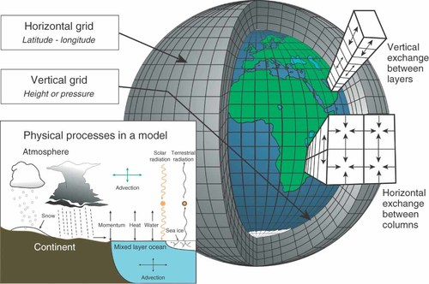
Background | Weather forecast models
Numerical Weather Prediction (NWP) Models :
Deterministic modeling
Solve differential equations to simulate atmospheric processes
Rely on real-time observations and supercomputers
Statistical or Empirical Models:
Use historical weather data and statistical relationships rather than physical equations
Cannot replace NWP
Excellent for bias correction
Hybrid / Data-Driven Models :
Combine NWP physics with statistics
Cutting-edge research
Comparable to NWP at global scale (GraphCast 2023 ²)
Schematic representation of the grid of a weather model ¹
Notes:
To obtain weather forecasts, a numerical weather model divides the Earth's atmosphere into smaller volumes (three-dimensional grid). For any grid cell, we assume that the atmosphere here is the same. For each grid point, relevant atmospheric parameters (such as temperature, humidity, wind speed, and pressure) are calculated at various altitudes and at fixed time intervals.
For each cell, the model solves a set of “governing equations” based on physics. These equations ensure the conservation of momentum, mass, and energy, essentially describing how air moves, heats, and interacts with itself and the Earth. For example, if air flows into a grid cell, an equal amount must flow out elsewhere, and changes in density or pressure must be accounted for. The most challenging part is solving the momentum equations, known as the Navier-Stokes equations, which describe fluid motion. These equations are highly nonlinear and computationally intensive, requiring supercomputers to simulate even relatively short-term forecasts.
Beyond simulating the movement of the atmosphere, NWP models include numerous physical modules that handle other essential processes. The microphysics module calculates how air becomes saturated, forms clouds, and produces different types of precipitation. Radiation modules account for the absorption, reflection, and emission of shortwave (solar) and longwave (infrared) radiation, affecting temperature and atmospheric stability. Surface interaction modules simulate how the atmosphere exchanges heat, moisture, and momentum with the land, snow, and vegetation. Each of these modules communicates with the others to maintain a physically consistent forecast, ensuring that wind, temperature, moisture, and precipitation evolve in a realistic way across space and time.

Slide 4
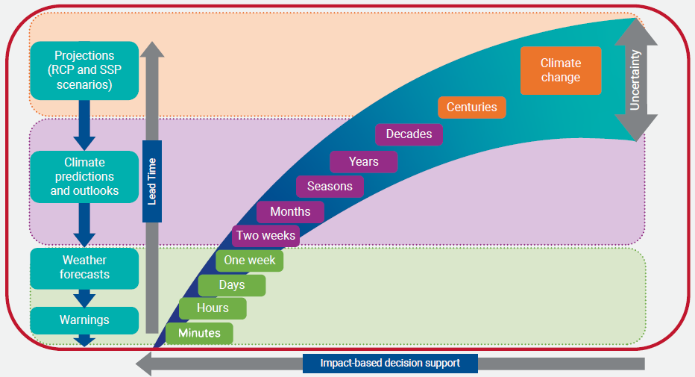
Background | Weather forecast trade-offs
Time Range vs. Accuracy
Spatial Resolution vs. Forecast Range
Update Frequency vs. Cost
Complex Physics vs. Speed
Deterministic vs. Probabilistic (Ensemble)
Global vs. Regional Focus
Observational Density vs. Real-time Delivery
Timescales of weather and climate information ³
Notes:
Time Range vs. Accuracy: Longer lead times → lower accuracy | Chaos theory: small initial errors grow with time (atmospheric predictability limit ≈ 2 weeks).
Spatial Resolution vs. Forecast Range: Higher resolution → shorter range | Finer grids require smaller time steps → far more computing power → usually run only for short-range forecasts.
Update Frequency vs. Cost: More frequent model runs → higher computational expense | Each model cycle (data assimilation + forecast) consumes supercomputer time and energy.
Complex Physics vs. Speed: More detailed physical schemes (cloud microphysics, aerosols, ocean coupling) → slower model runtime | Must simplify or parameterize processes to meet operational deadlines.
Deterministic vs. Probabilistic (Ensemble): Ensemble forecasts give probabilities and uncertainty but require multiple runs | Single deterministic run is faster but offers no measure of confidence.
Global vs. Regional Focus: Global models give boundary conditions but coarse detail | Regional models give local detail but depend on global model boundaries.
Observational Density vs. Real-time Delivery: Assimilating every available observation can delay forecast issuance | Centers balance data volume with operational timeliness.

Slide 5
Motivation / Problem statement
“High resolution is crucial for guiding more confident decision-making.”
Short Term:
Agriculture
Energy
Transportation
Construction
Tourism and Entertainment
Environment and Disaster Management
Medium-Long Term:
Agriculture
Insurance
Real Estate
Urban Planning
Tourism
Public Health

Slide 6
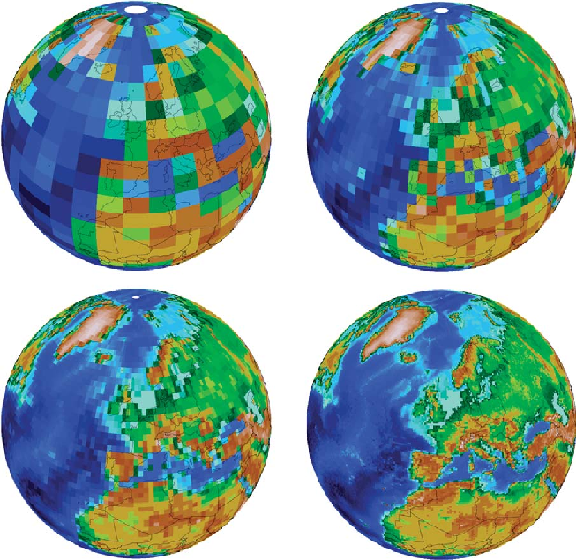
Motivation / Problem statement
When Forecast Models Use Low Spatial Resolution
Global Weather Models
Cover the entire Earth
Typical resolution: 10–50 km grid spacing
Climate Models
Forecast decades to centuries ahead
Typical resolution: 50–200 km grid spacing
Solutions
Dynamical Downscaling
Statistical Downscaling
Deep Learning Downscaling
Spatial Resolution ⁴

Slide 7
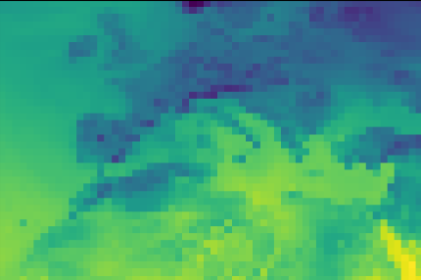
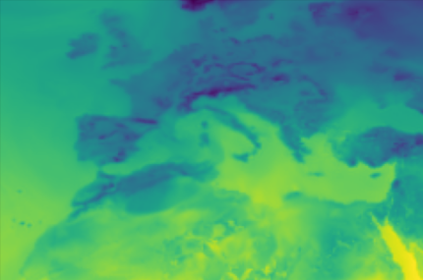
Methodology | Approach
“Deep Learning Downscaling as Single-Image Super-Resolution (SISR)”
Interpolation-Based
Bicubic Interpolation
Lanczos resampling
…
Reconstruction-Based
Total Variation (TV) regularization
Gradient Profile Prior
…
Deep Learning-Based
Convolutional Neural Networks (CNNs)
Generative Adversarial Networks (GANs)
Transformer
…
1° × 1° ( ≈ 100km x 100 km)
0.25° × 0.25° ( ≈ 25km x 25 km)
CNN-based DL model

Slide 8
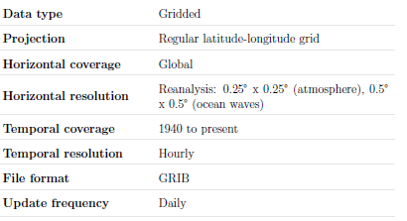
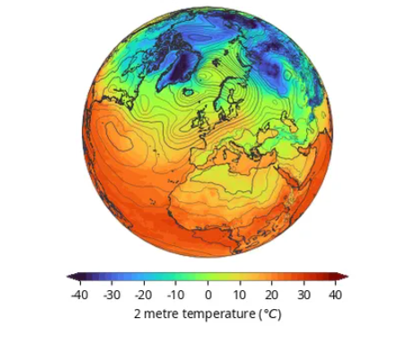
Methodology | Dataset & Data pre-processing
Pre-Processing Steps
Upscaling: Bicubic interpolation to match target resolution
Normalization: Z-score standardization
Shuffling: Randomize data order to remove temporal bias
Splitting: 70% training, 15% validation, 15% testing
ERA5 reanalysis Data description ⁵
Variable: 2-meter air temperature (T2m)
Period: 2000 – 2020
Temporal resolution: 6-hourly (00:00, 06:00, 12:00, 18:00 UTC)
Spatial domain: Latitude 80° N to 0°, Longitude 60° W to 85° E
“A model-agnostic input approach with no model or temporal bias.”

Slide 9





Methodology | Metrics
Mean Squared Error (MSE)
Mean Absolute Error (MAE)
Peak Signal-to-Noise Ratio (PSNR)
Structural Similarity Index Measure (SSIM)
Land MAE
Land MAE in °C

Slide 10
Methodology | Training & validation strategy
Validation Metrics:
MSE, MAE, PSNR, SSIM
Loss function:
MAE (L1 loss) → less sensitive to outliers, reflects average deviation in original units
Optimizer & Learning Rate:
Adam optimizer
ReduceLROnPlateau schedule
Training Details:
Batch Size: 128 (1° → 0.5°), 64 (0.5° → 0.25°)
Epochs: 200 for architecture selection, 1000 for other trainings
Early Stopping: 50 epochs for architecture selection, 150 for other trainings

Slide 11
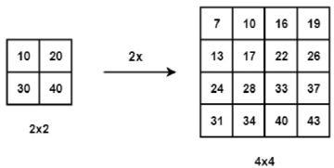
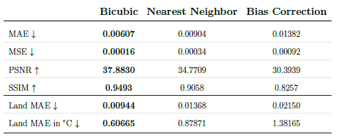
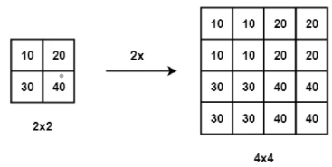
Work strategy & Results | Baseline Selection
Bicubic interpolation⁶
Bias-corrected nearest neighbor interpolation
Perform nearest neighbor interpolation
Compute mean error grid from training set
Use error grid to correct test set interpolation
Nearest-neighbor interpolation⁶

Slide 12
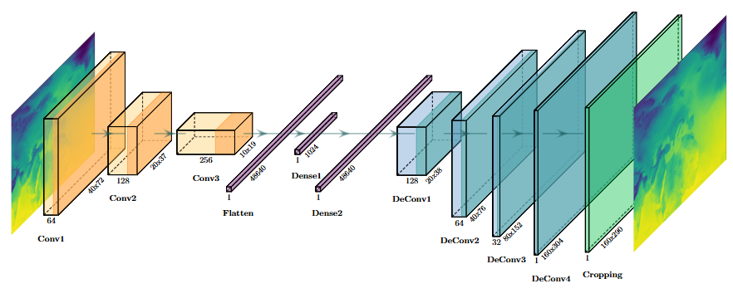
Work strategy & Results | DL Model Architecture Selection
Convolutional Auto-Encoder (CAE)
Encoder | Latent Space | Decoder

Slide 13
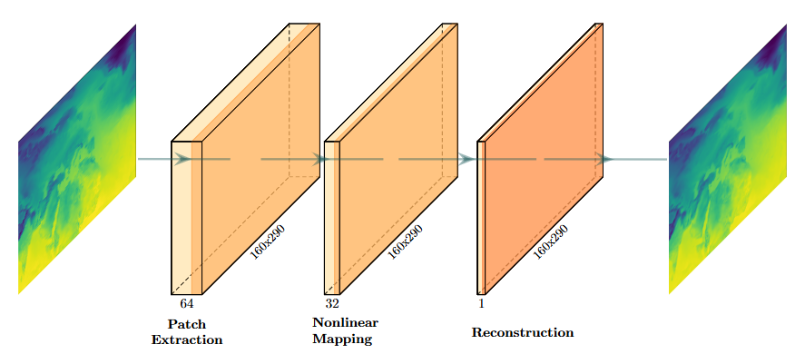
Work strategy & Results | DL Model Architecture Selection
Super-Resolution Convolutional Neural Network (SRCNN)

Slide 14
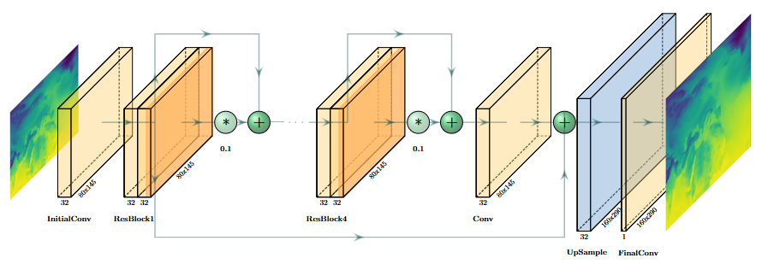
Work strategy & Results |DL Model Architecture Selection
Enhanced Deep Super-Resolution Network (EDSR)

Slide 15
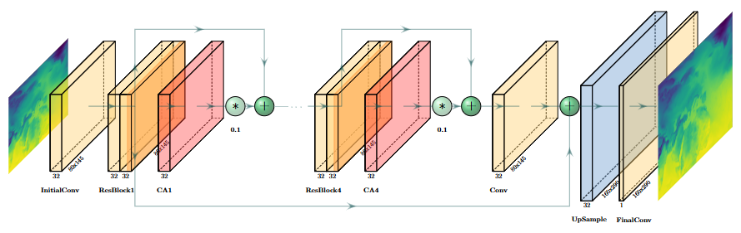
Work strategy & Results | DL Model Architecture Selection
Residual Channel Attention Network (RCAN)

Slide 16
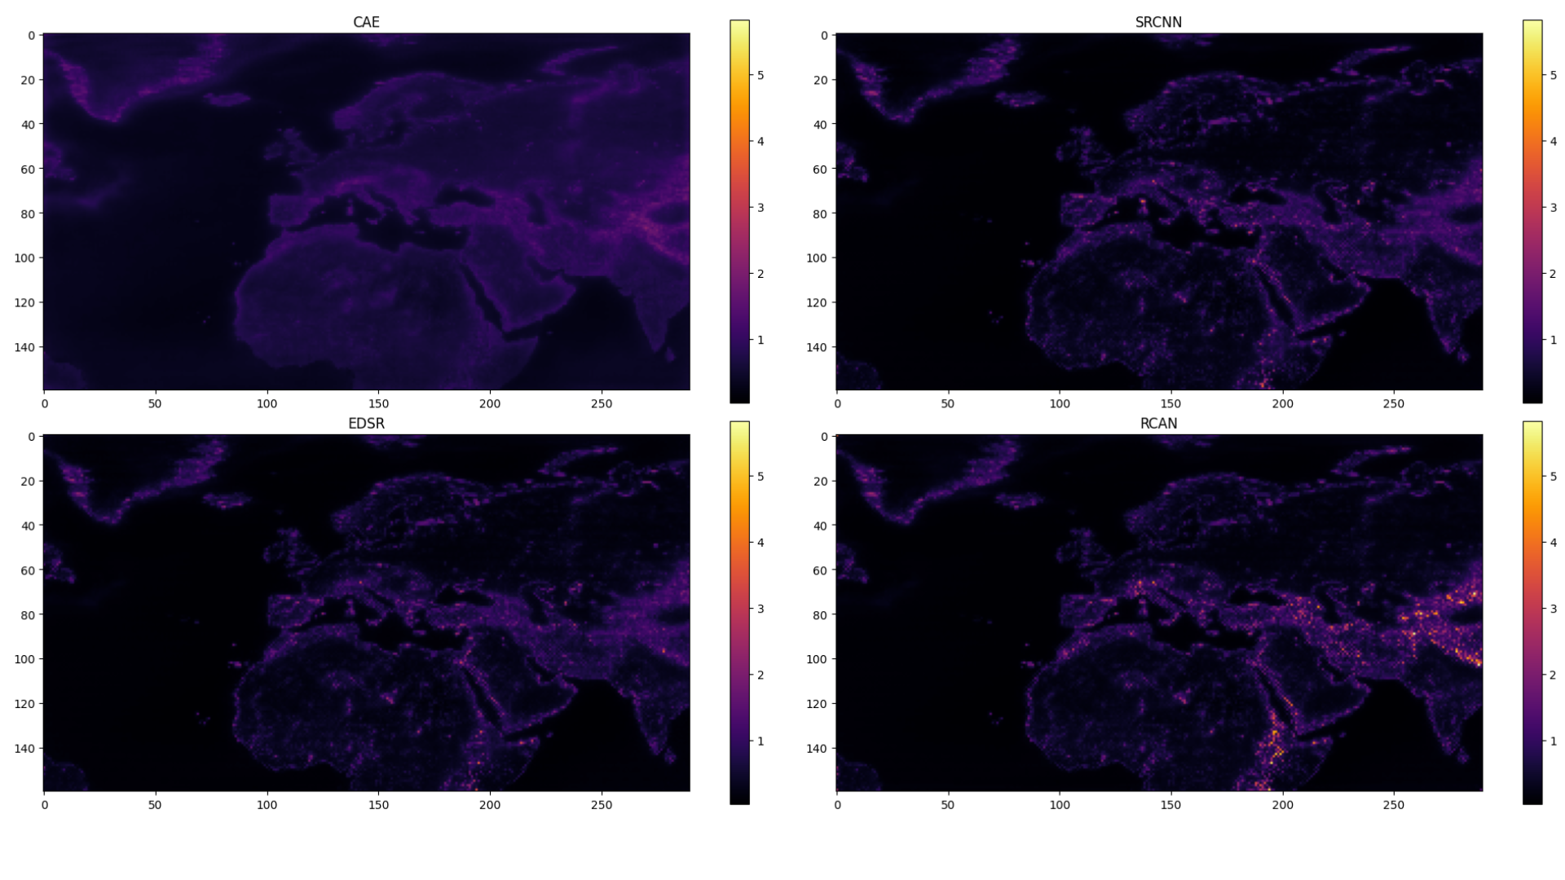
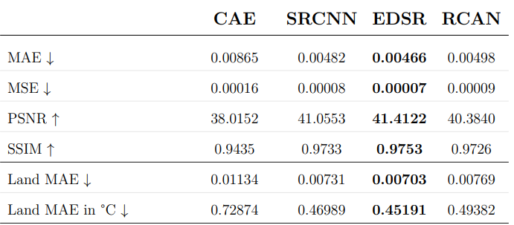
Work strategy & Results | DL Model Architecture Selection
EDSR achieves higher performance compared to the others

Slide 17
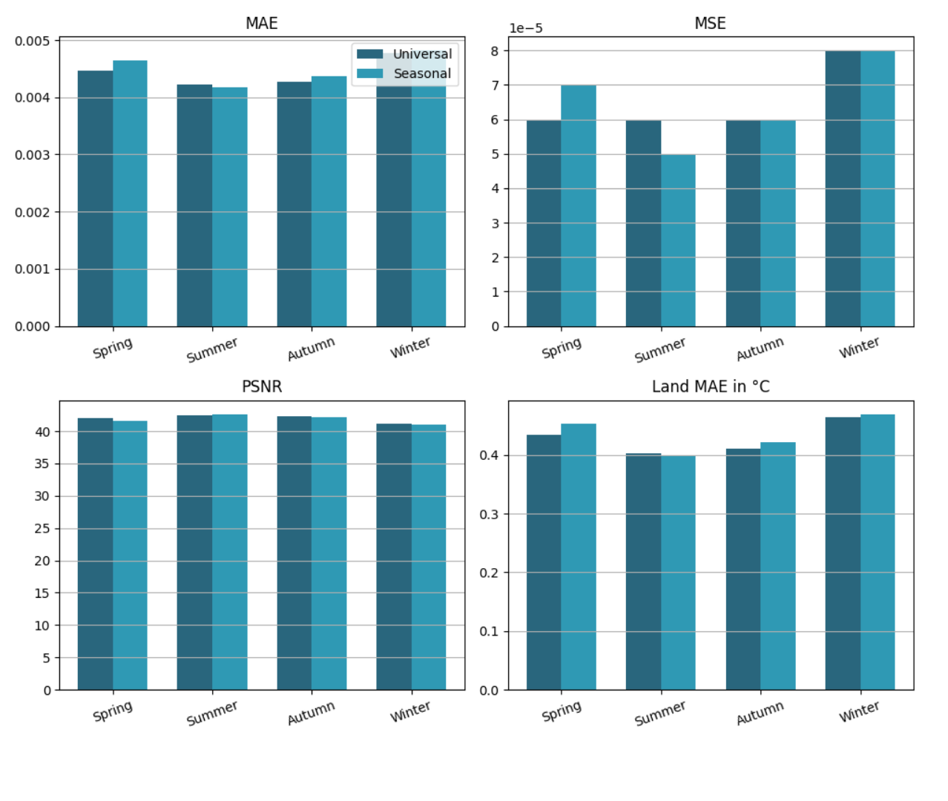
Work strategy & Results | Seasonal vs Universal models
“Training seasonal models adds unnecessary complexity without offering a meaningful improvement in performance.”
Notes:
This approach might be more appropriate if the spatial domain were limited to a smaller, more climatically homogeneous
area, where seasonal definitions are more relevant and consistent across the grid.

Slide 18
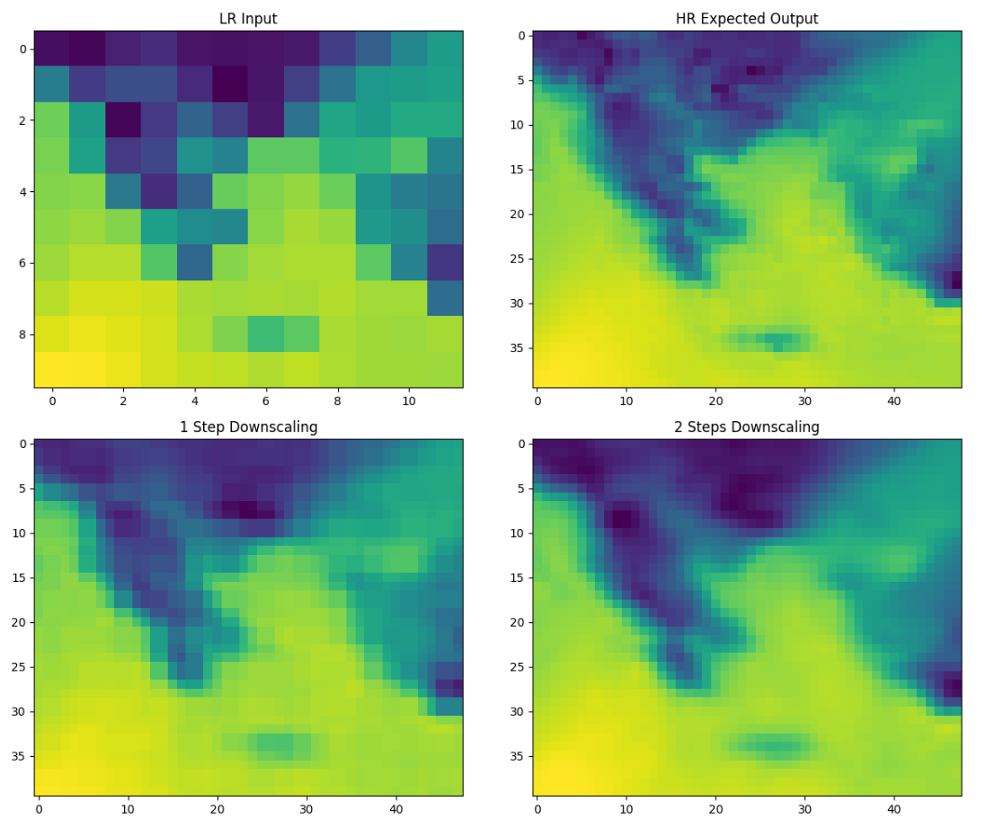
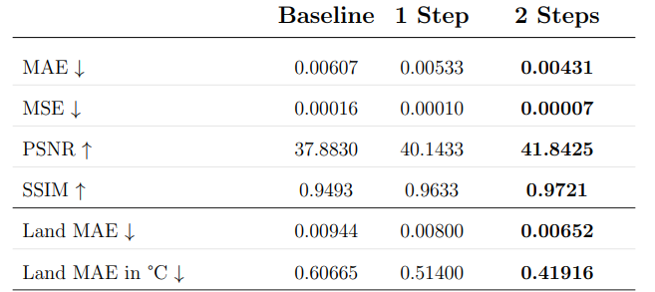
Work strategy & Results | 1-step vs 2-steps downscaling
The gradual, 2-steps downscaling approach outperforms direct downscaling
Notes:
This is likely because it allows the model to better capture and adapt to the different physical processes and influencing factors present at each intermediate spatial scale.

Slide 19
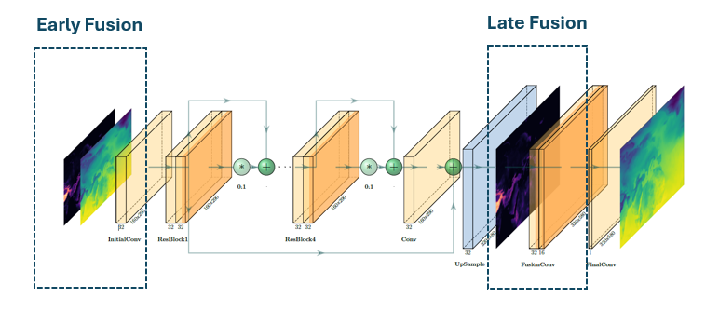
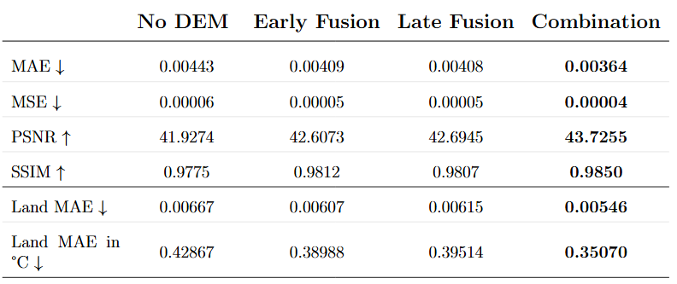
Work strategy & Results | DEM data incorporation methods
Combination of Early & Late Fusion elevation data integration gave the best results

Slide 20
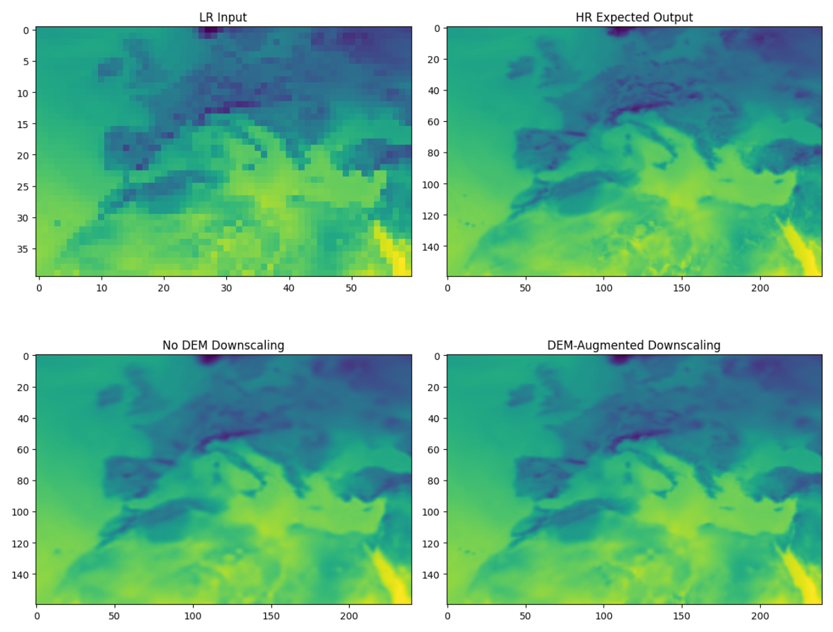
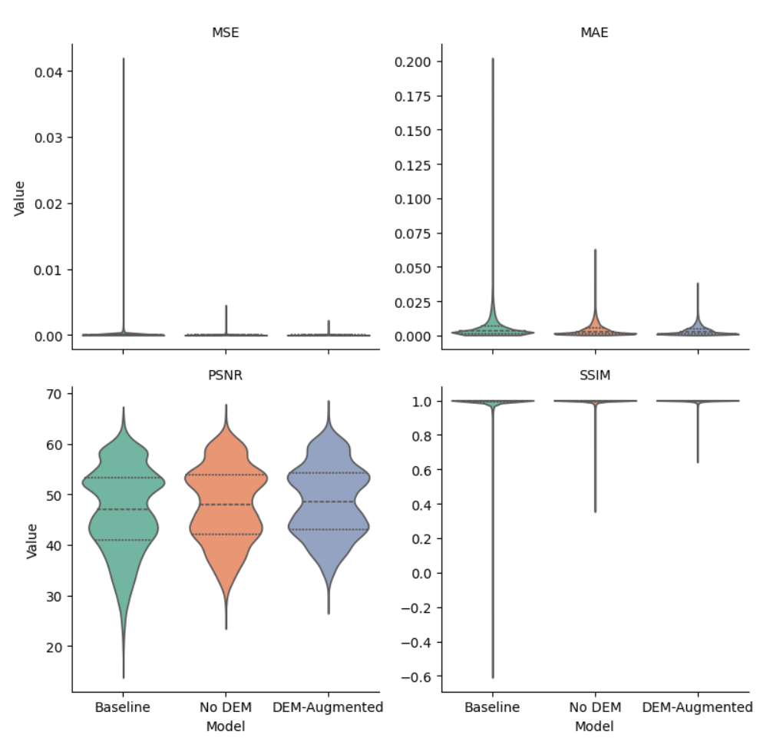
Work strategy & Results | Final Results

Slide 21
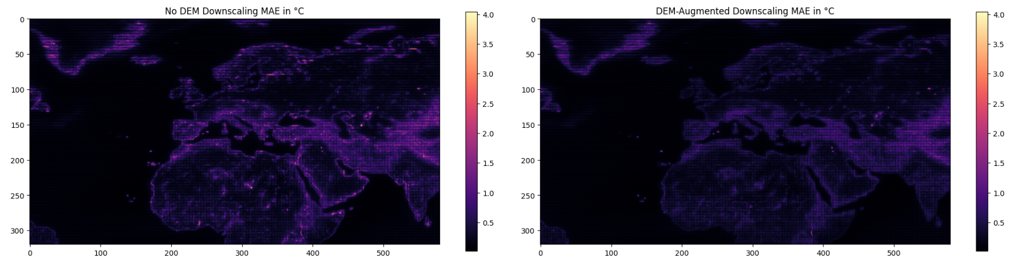
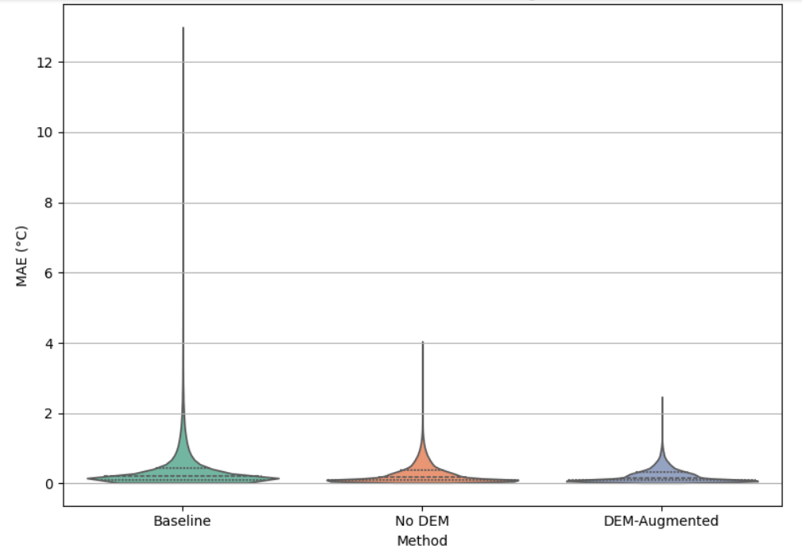
Work strategy & Results | Final Results

Slide 22
Conclusions
Developed an effective and lightweight method for downscaling T2m data
Achieved improvement of spatial resolution with low average error (~0.2°C per cell)
Implemented complementary enhancements:
Gradual two-step downscaling
Integration of geospatial information (e.g., elevation)
Shifted from generic SISR to domain-informed climate application
Benefits:
Improved accuracy, especially in complex terrains
Increased physical interpretability of results
Developed a model-agnostic approach, using only reanalysis data and independent of temporal sequence

Slide 23
Future work
Extension to Other Climate Variables
Precipitation
Wind
Multi-variable modeling (simultaneous downscaling of multiple variables)
Use of data cubes for efficient multi-dimensional processing
Finer-scale downscaling using higher-resolution reanalysis datasets
ERA5-Land (9km)
CERRA-Land (5.5km)
Predictor Exploration at Each Downscaling Level
For example:
100 km → 50 km: Climate zones
50 km → 25 km: Elevation and derived features (aspect, slope)
<25 km: Land use data
Model Architecture & Training Optimizations
Deeper EDSR models
Explore GAN-based architectures

Slide 24
References
Edwards, P. N. (2010). History of climate modeling. WIREs Climate Change, 2(1), 128–139. https://doi.org/10.1002/wcc.95
Lam et al. (2022). GraphCast: Learning skillful medium-range global weather forecasting (Version 2). https://doi.org/10.48550/ARXIV.2212.12794
UNDRR and WMO (2023), Technical guidance on application of climate information for comprehensive risk management, United Nations Office for Disaster Risk Reduction and World Meteorological Organization.
Washington et al.(2008). The computational future for climate and Earth system models: on the path to petaflop and beyond. https://doi.org/10.1098/rsta.2008.0219
C3S. (2018). ERA5 hourly data on single levels from 1940 to present [Dataset]. Copernicus Climate Change Service (C3S) Climate Data Store (CDS). https://doi.org/10.24381/CDS.ADBB2D47
O.S. Ci. Image super resolution: A comparison between interpolation & deep learning-based techniques. https://shorturl.at/ucUMU
GitHub Repository

Slide 25

Thank you
Any questions?

