Slide 1


Elevation Data Integration Approaches for Deep
Learning-Based 2-m Temperature Downscaling
Antigoni Moira¹, Stelios Karozis¹, Theodoros Giannakopoulos², Effrosyni Karakitsou¹,
Nikolaos Gounaris¹ and Athanasios Sfetsos¹
¹Environmental Research Laboratory, Institute of Nuclear & Radiological Sciences & Technology, Energy & Safety, NCSR “Demokritos”, Greece
²Computational Intelligence Laboratory, Institute of Informatics and Telecommunications, NCSR “Demokritos”, Greece
Workshop on AI-driven Data Engineering and Reusability for
Earth and Space Sciences (DARES’25)

Slide 2
Contents
Background → Weather forecast |Problem statement | Previous work
Methodology → Integration strategies | Elevation–derived features
Experimental Setup → Dataset & pre-processing | Training & validation
Results → Integration strategies | Elevation-derived features | Summary
Conclusions
Future work
References
Antigoni Moira et al. | Presentation for DARES’25, Bologna, Italy | 25.10.2025

Slide 3
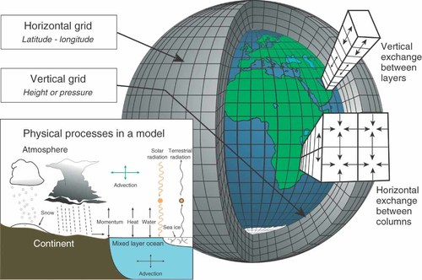
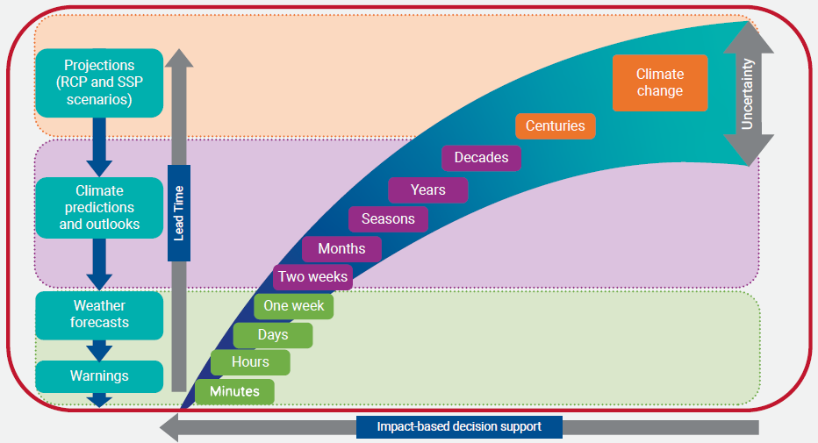
Background → Weather Forecast
Numerical Weather Prediction (NWP) Models
Deterministic modeling
Solve differential equations to simulate atmospheric processes
Rely on real-time observations and supercomputers
Weather forecast trade-offs
Time Range vs. Accuracy
Global vs. Regional Focus
Spatial Resolution vs. Forecast Range
Fig. 1 [1]
Fig. 2 [2]
Antigoni Moira et al. | Presentation for DARES’25, Bologna, Italy | 25.10.2025

Slide 4
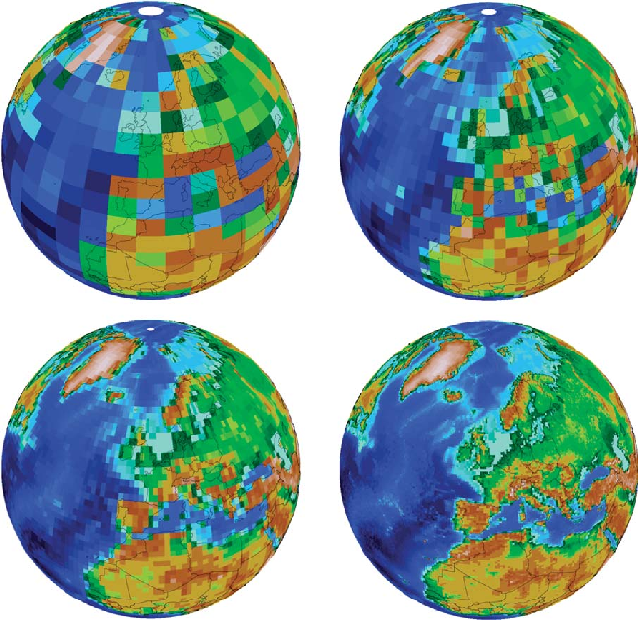
Background → Problem Statement
When Forecast Models Use Low Spatial Resolution?
Global Weather Models
Cover the entire Earth
Typical resolution: 10–50 km grid spacing
Climate Models
Forecast decades to centuries ahead
Typical resolution: 50–200 km grid spacing
Why High Spatial Resolution is important?
Could guide more confident decision-making in sectors like:
Agriculture
Energy
Transportation
Environment and Disaster Management
Etc
Fig. 3 [3]
Antigoni Moira et al. | Presentation for DARES’25, Bologna, Italy | 25.10.2025

Slide 5
Background → Previous work
Publication: A deep learning approach for spatial error correction of numerical seasonal weather prediction simulation data [4]
Seasonal predictions
CAE with Evidence transfer
MSc Thesis: Use of Deep Learning methods and land cover/use data to improve the spatial resolution of Numerical Weather Prediction (NWP) simulations
Comparison of CNN-based models
Gradual downscaling
Integration of elevation
EU Project Nevermore: Development of models and tools for simulating and assessing the impacts and risks of climate change
Antigoni Moira et al. | Presentation for DARES’25, Bologna, Italy | 25.10.2025

Slide 6
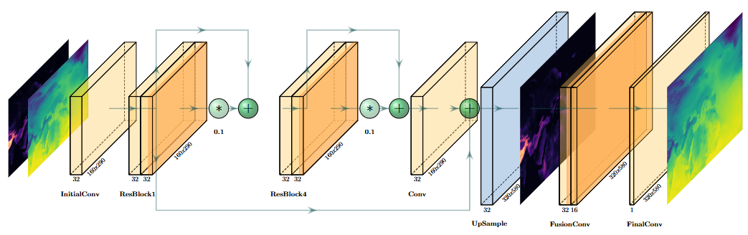
Methodology → Integration strategies
Enhanced Deep Super-Resolution Network (EDSR)
Early Fusion
Late Fusion
Fig. 4
Antigoni Moira et al. | Presentation for DARES’25, Bologna, Italy | 25.10.2025

Slide 7
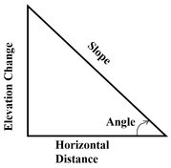
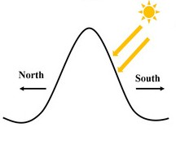
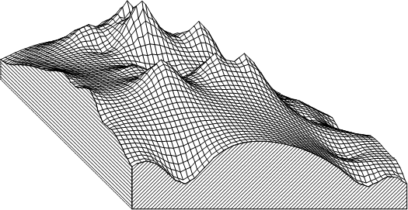
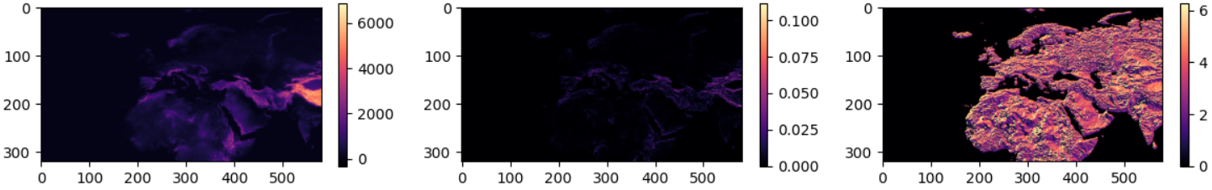
Methodology → Elevation-derived features
Elevation
Slope
Aspect
Fig. 5 [5]
Fig. 6 [6]
Fig. 7 [6]
Fig. 8
Antigoni Moira et al. | Presentation for DARES’25, Bologna, Italy | 25.10.2025

Slide 8
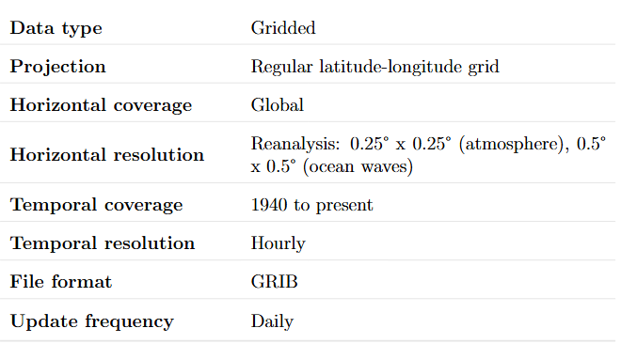
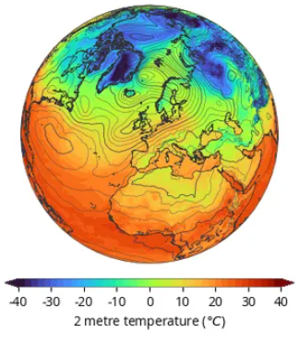
Experimental Setup → Dataset & pre-processing
ERA5 reanalysis Dataset [7]
Pre-Processing Steps
Upscaling: Bicubic interpolation to match target resolution (from 0.25 ° x 0.25 ° to 0.5 ° x 0.5 °)
Normalization: Z-score standardization
Shuffling: Randomize data order to remove temporal bias
Splitting: 70% training, 15% validation, 15% testing
Variable: 2-meter air temperature (T2m)
Period: 2000 – 2020
Temporal resolution: 6-hourly (00:00, 06:00, 12:00, 18:00 UTC)
Spatial domain: Latitude 80° N to 0°, Longitude 60° W to 85° E
A model-agnostic input approach with no model or temporal bias
& elevation data from the U.S. Geological Survey 3D Elevation Program DEM [8]
Antigoni Moira et al. | Presentation for DARES’25, Bologna, Italy | 25.10.2025

Slide 9
Experimental Setup → Training & validation
Validation Metrics:
Mean Squared Error (MSE)
Mean Absolute Error (MAE)
Peak Signal-to-Noise Ratio (PSNR)
Structural Similarity Index Measure (SSIM)
Loss function:
MAE (L1 loss) → less sensitive to outliers, reflects average deviation in original units
Optimizer & Learning Rate:
Adam optimizer
ReduceLROnPlateau schedule (70 epochs)
Training Details:
Batch Size: 32
Training: 250 epochs
Early Stopping: 100 epochs
Antigoni Moira et al. | Presentation for DARES’25, Bologna, Italy | 25.10.2025

Slide 10
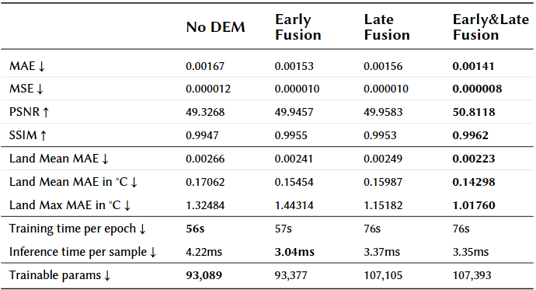
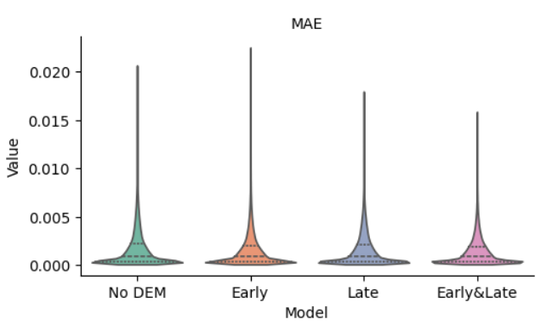
Results → Integration strategies
Combination of Early & Late Fusion elevation data integration gave the best results
The Early & Late Fusion exhibits the smallest variability in MAE
Fig. 9
Antigoni Moira et al. | Presentation for DARES’25, Bologna, Italy | 25.10.2025

Slide 11
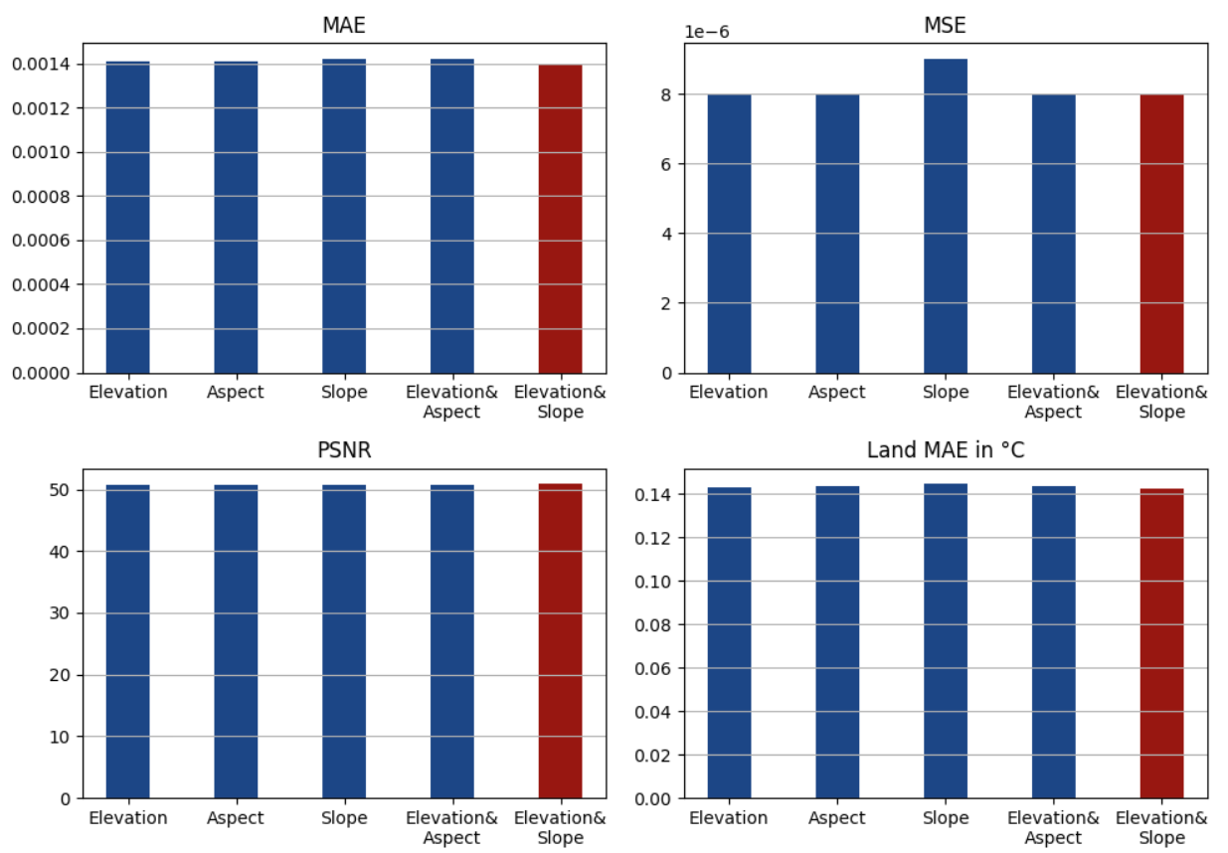
Results → Elevation-derived features
Differences between approaches are minimal across metrics.
The Elevation & Slope combination yields slight improvements over using elevation alone and is recommended as the most effective approach.
Antigoni Moira et al. | Presentation for DARES’25, Bologna, Italy | 25.10.2025

Slide 12
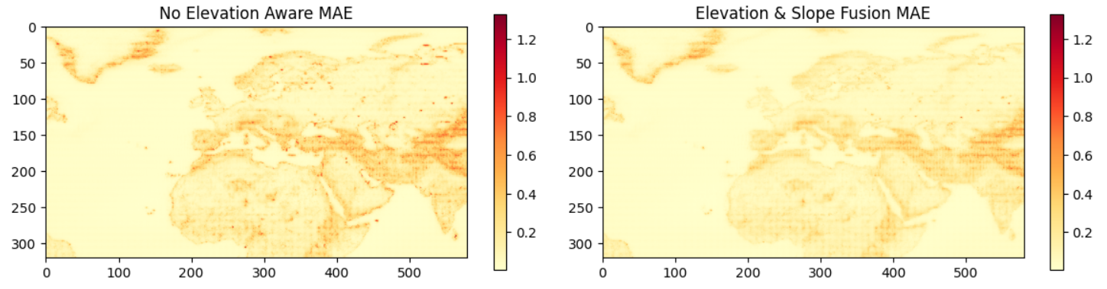
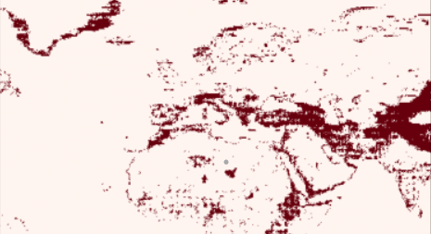
Results → Summary
Upper 10th percentile of MAE
Mean MAE in those pixels: 0.3877 ° C
Mean MAE in those pixels: 0.2925 ° C
Fig. 10
Antigoni Moira et al. | Presentation for DARES’25, Bologna, Italy | 25.10.2025

Slide 13
Conclusions
Developed an input model–agnostic method for downscaling T2m, capable of doubling spatial resolution (from 0.5°×0.5° to 0.25°×0.25° grids)
Achieved a low average error of approximately 0.14 °C per cell
Delivered a 16% reduction in MAE across the entire domain through integration of geospatial information
Improved performance in complex terrains, with ~0.1 °C lower error in the most challenging areas
Antigoni Moira et al. | Presentation for DARES’25, Bologna, Italy | 25.10.2025

Slide 14
Future work
Extension to Other Climate Variables
Precipitation
Wind
Multi-variable modeling (simultaneous downscaling of multiple variables)
Use of data cubes for efficient multi-dimensional processing
Finer-scale downscaling using higher-resolution reanalysis datasets
ERA5-Land (9km)
CERRA-Land (5.5km)
Predictor Exploration at Each Downscaling Level
For example:
100 km → 50 km: Climate zones
50 km → 25 km: Elevation and derived features (aspect, slope)
<25 km: Land use data
Model Architecture & Training Optimizations
Deeper EDSR models
Explore GAN-based architectures
Use of temporal models
ConvLSTMs
Antigoni Moira et al. | Presentation for DARES’25, Bologna, Italy | 25.10.2025

Slide 15
References
Edwards, P. N. (2010). History of climate modeling. WIREs Climate Change, 2(1), 128–139. https://doi.org/10.1002/wcc.95
UNDRR and WMO (2023), Technical guidance on application of climate information for comprehensive risk management, United Nations Office for Disaster Risk Reduction and World Meteorological Organization.
Washington et al.(2008). The computational future for climate and Earth system models: on the path to petaflop and beyond. https://doi.org/10.1098/rsta.2008.0219
Karozis, S., Klampanos, I. A., Sfetsos, A., & Vlachogiannis, D. (2023). A deep learning approach for spatial error correction of numerical seasonal weather prediction simulation data. Big Earth Data, 7(2), 231–250. https://doi.org/10.1080/20964471.2023.2172820
Digital Elevation Model (DEM). Geoportal.gov.pl. https://www.geoportal.gov.pl/en/data/digital-elevation-model-dem/
Bhakare, S., et al. (2024). Intercomparison of Machine Learning Models for Spatial Downscaling of Daily Mean Temperature in Complex Terrain. Atmosphere, 15(9), 1085. https://doi.org/10.3390/atmos15091085
C3S. (2018). ERA5 hourly data on single levels from 1940 to present [Dataset]. Copernicus Climate Change Service (C3S) Climate Data Store (CDS). https://doi.org/10.24381/CDS.ADBB2D47
U.S. Geological Survey, The 3d elevation program (3dep). (2023) https://www.usgs.gov/core-science-systems/ngp/3dep
Antigoni Moira et al. | Presentation for DARES’25, Bologna, Italy | 25.10.2025

Slide 16
Thank you!
Questions?

Slide 17
Bonus slides

Slide 18





Bonus slides → Metrics
Mean Squared Error (MSE)
Mean Absolute Error (MAE)
Peak Signal-to-Noise Ratio (PSNR)
Structural Similarity Index Measure (SSIM)
Land MAE
Land MAE in °C
Antigoni Moira et al. | Presentation for DARES’25, Bologna, Italy | 25.10.2025

Slide 19
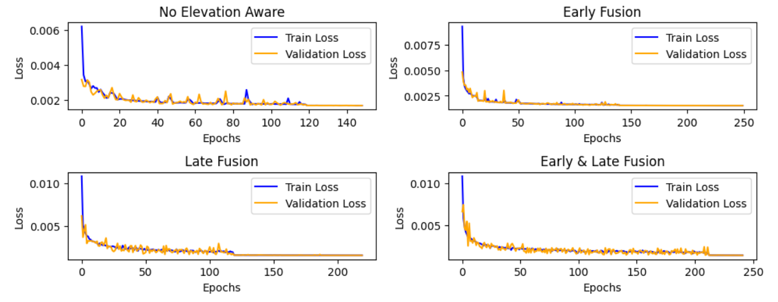
Bonus slides → Integration strategies training history
Antigoni Moira et al. | Presentation for DARES’25, Bologna, Italy | 25.10.2025

Slide 20
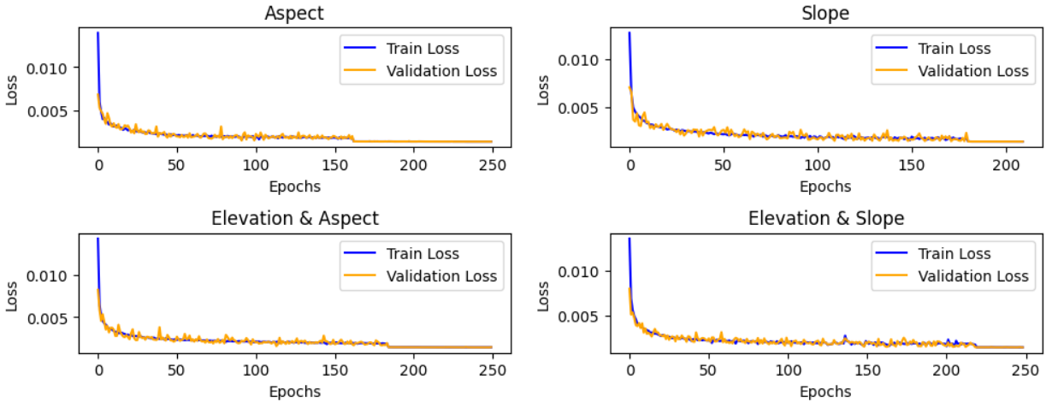
Bonus slides → Elevation-derived features training history
Antigoni Moira et al. | Presentation for DARES’25, Bologna, Italy | 25.10.2025

Slide 21
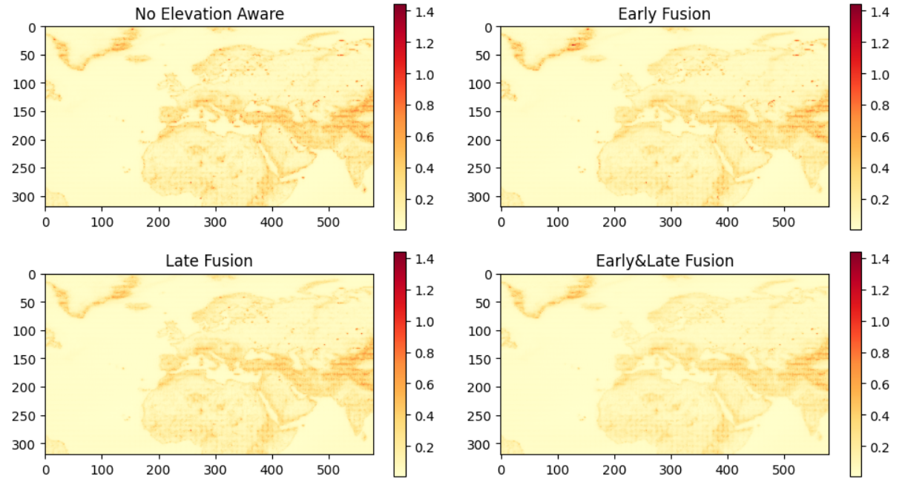
Bonus slides → Integration strategies MAE comparison
Antigoni Moira et al. | Presentation for DARES’25, Bologna, Italy | 25.10.2025

Slide 22
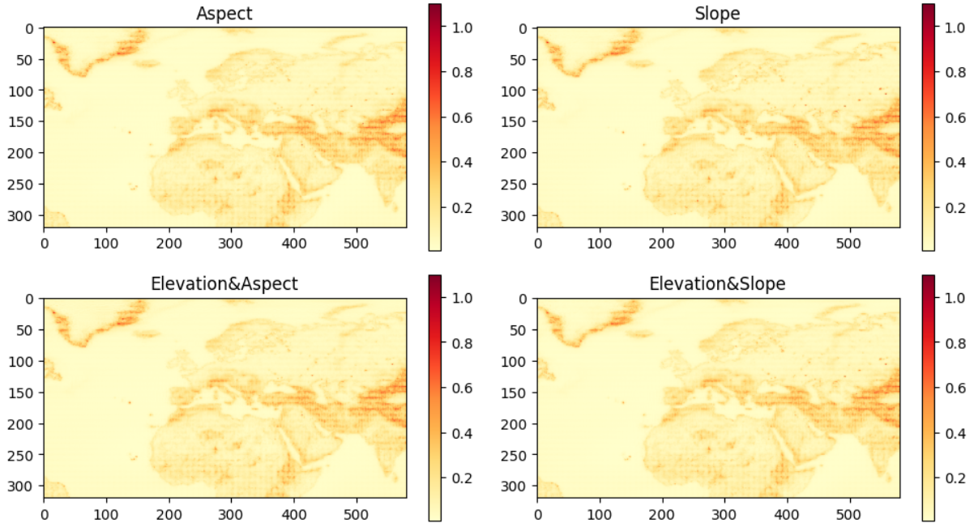
Bonus slides → Elevation-derived features MAE comparison
Antigoni Moira et al. | Presentation for DARES’25, Bologna, Italy | 25.10.2025

Slide 23
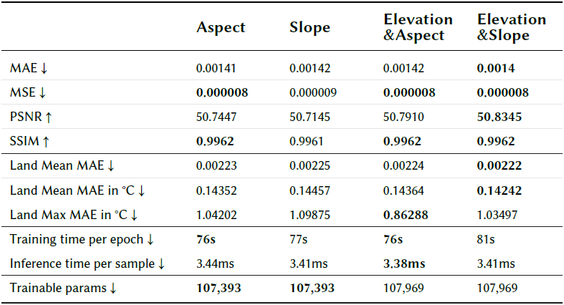
Bonus slides → Elevation-derived features metrics table
Antigoni Moira et al. | Presentation for DARES’25, Bologna, Italy | 25.10.2025

Slide 24
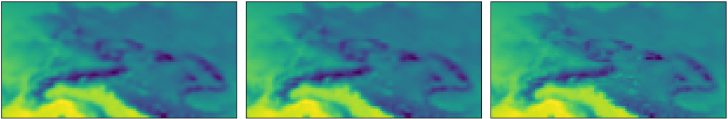
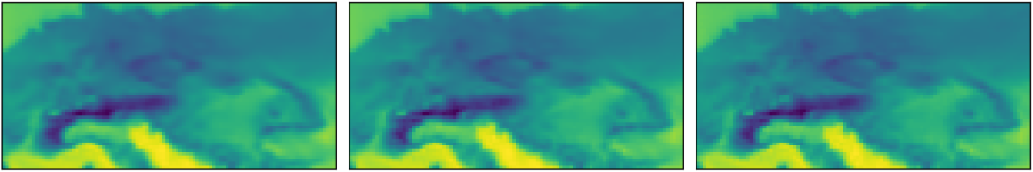
Bonus slides → Outputs “Central Europe” (1)
No DEM
Elevation & Slope
Original High-Resolution
04/04/2015 00:00
21/09/2006 06:00
Antigoni Moira et al. | Presentation for DARES’25, Bologna, Italy | 25.10.2025

Slide 25
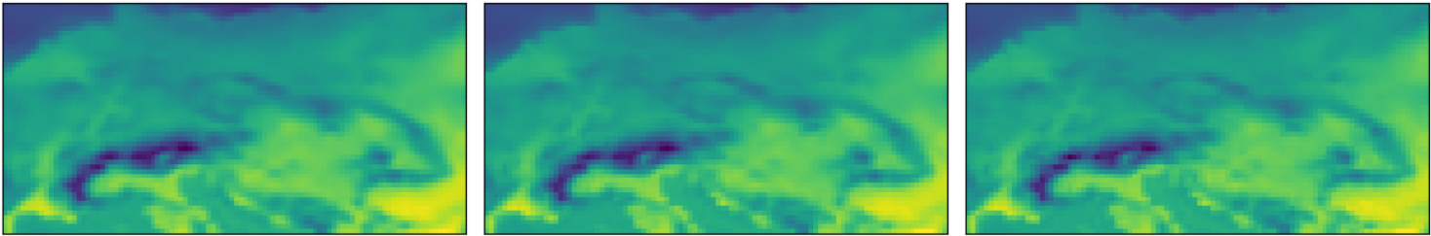
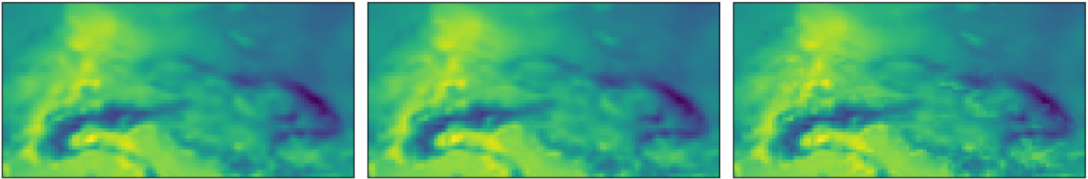
Bonus slides → Outputs “Central Europe” (2)
No DEM
Elevation & Slope
Original High-Resolution
29/05/2010 12:00
06/09/2013 18:00
Antigoni Moira et al. | Presentation for DARES’25, Bologna, Italy | 25.10.2025

Slide 26
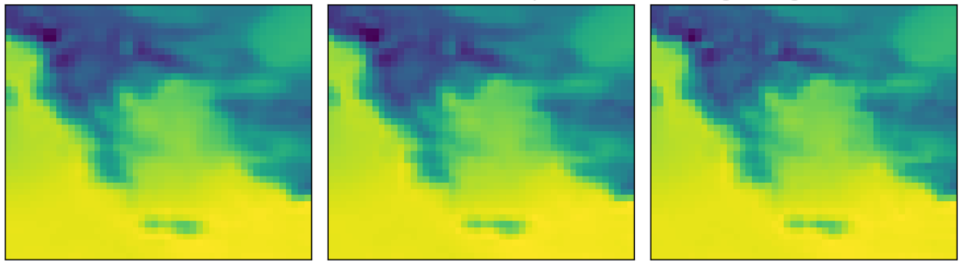
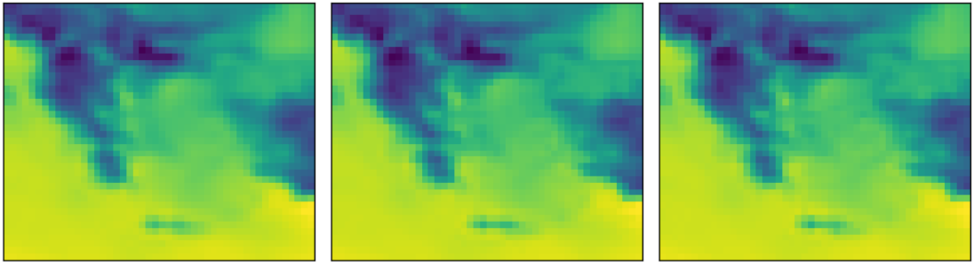
Bonus slides → Outputs “Greece” (1)
No DEM
Elevation & Slope
Original High-Resolution
04/04/2015 00:00
21/09/2006 06:00
Antigoni Moira et al. | Presentation for DARES’25, Bologna, Italy | 25.10.2025

Slide 27
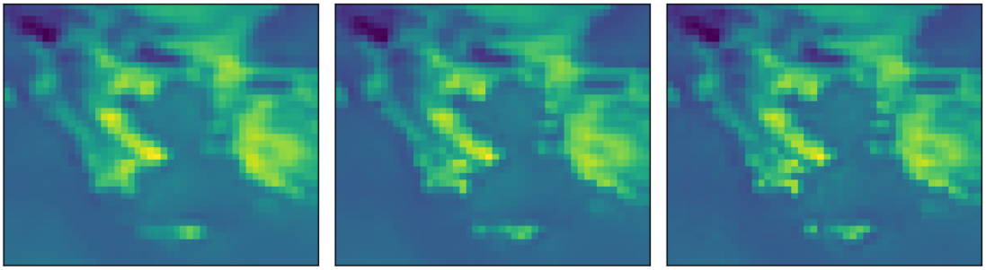
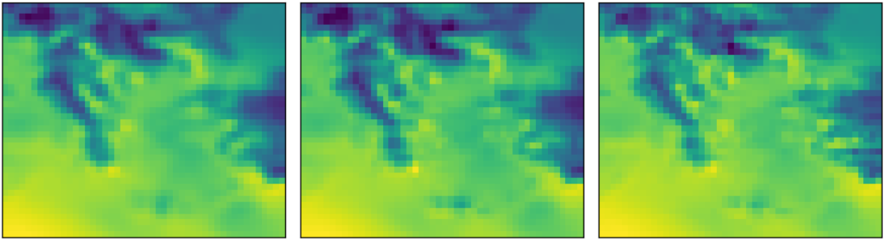
Bonus slides → Outputs “Greece” (2)
No DEM
Elevation & Slope
Original High-Resolution
29/05/2010 12:00
06/09/2013 18:00
Antigoni Moira et al. | Presentation for DARES’25, Bologna, Italy | 25.10.2025

Slide 28
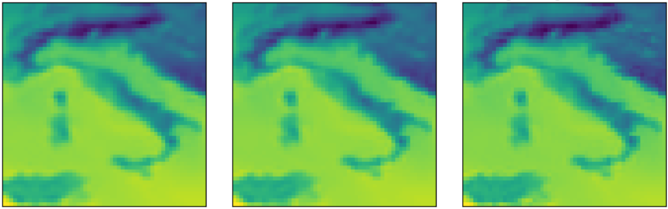
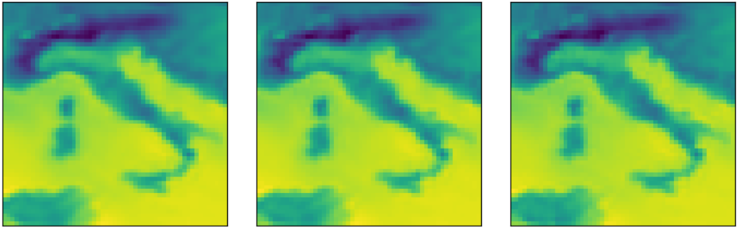
Bonus slides → Outputs “Italy” (1)
No DEM
Elevation & Slope
Original High-Resolution
04/04/2015 00:00
21/09/2006 06:00
Antigoni Moira et al. | Presentation for DARES’25, Bologna, Italy | 25.10.2025

Slide 29
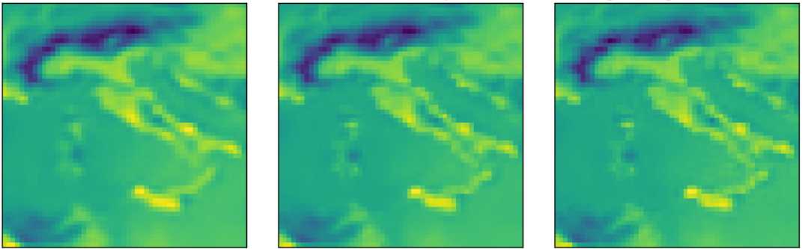
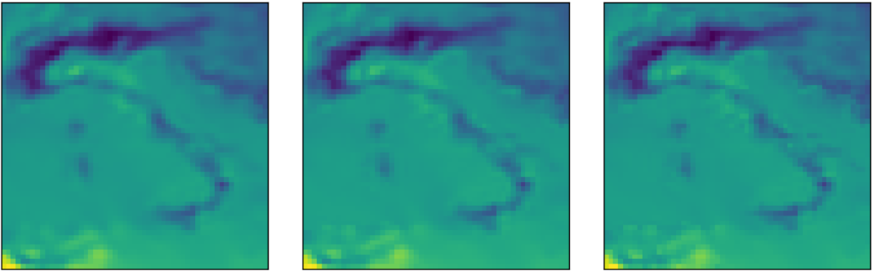
Bonus slides → Outputs “Italy” (2)
No DEM
Elevation & Slope
Original High-Resolution
29/05/2010 12:00
06/09/2013 18:00
Antigoni Moira et al. | Presentation for DARES’25, Bologna, Italy | 25.10.2025

Slide 30
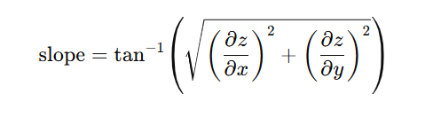

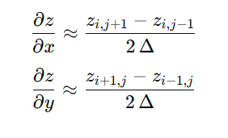
Bonus slides →Slope and Aspect Equations
Antigoni Moira et al. | Presentation for DARES’25, Bologna, Italy | 25.10.2025

