Slide 1
Four-Round
Secure Computation without Setup
TCC 2017
Zvika Brakerski (Weizmann Institute of Science)
Shai Halevi (IBM)
Antigoni Polychroniadou (Cornell Tech)

Slide 2


Secure Multi-Party Computation (MPC)
f(x₁, x₂, x₃, x₄) = (y_{1,} y₂ ,y₃ ,y₄ )
x₁
x₁
x₁
y₄
y₁
x₄
Goal:
Correctness: Everyone computes f(x₁,…,x₄)
Security: Nothing else but the output is revealed
Adversary
PPT
Malicious
Static
x₂
y₂
y₃
x₃

Slide 3

Motivating Question?
f(x₁, x₂, x₃, x₄) = (y_{1,} y₂ ,y₃ ,y₄ )
Can we construct
Secure MPC protocols with
optimal
Round
Complexity?
x₁
x₁
x₁
y₄
y₁
x₄
Goal:
Correctness: Everyone computes f(x₁,…,x₄)
Security: Nothing else but the output is revealed
Adversary
PPT
Malicious
Static
x₂
y₂
y₃
x₃

Slide 4
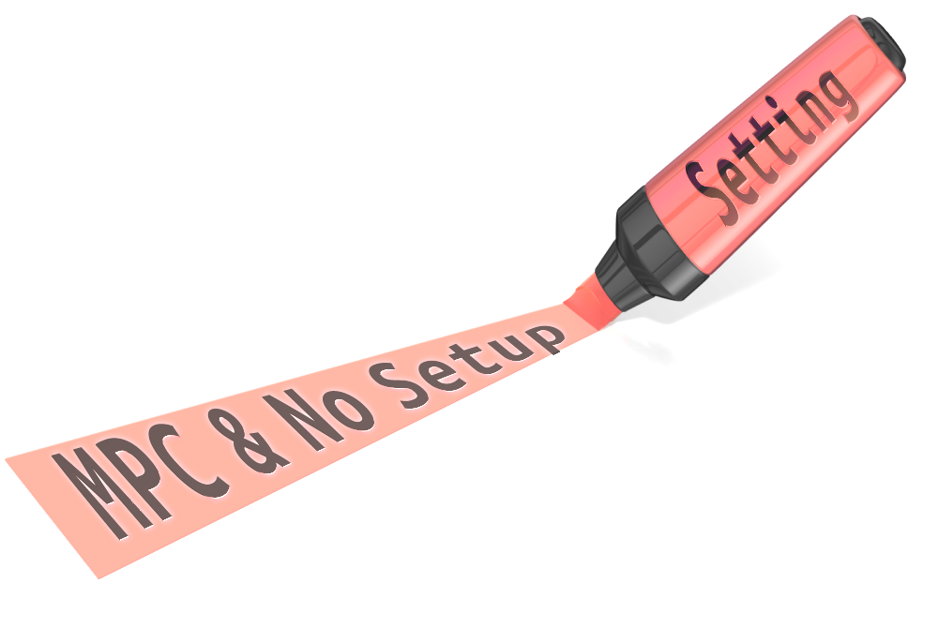
State-of-the-Art: Computational Setting
O(1)-round protocols*
6-round
protocol
4-round
protocol
[KOS03,
Pas04,DI05,DI06,
IPS08,Wee10,
Goy11,LP11,
GLOV12]
1st O(1)-round
protocol
[GMPP]
This work
O(d_{F})-round
protocol
[BMR]
2016
2017
[GMW]
1990
2003-2012
Lower Bound:
4 rounds for simultaneous- message
MPC and 2PC
1987
Lower Bound:
5 rounds for sequential 2PC
[KO04,ORS15]
*20-30 rounds

Slide 5
Target - This slide is linked to slide 2
4-round Protocols
2PC
4-round 2PC from sub-exponential assumptions [GMPP16]
4-round 2PC from polynomial assumptions [COSV17] (next talk)
MCF
MPC
4-round MPC [This work]
Concurrent work of [ACJ17]
4-round MCF from sub-exponential assumptions
[GMPP16]
4-round MCF from polynomial assumptions
[COSV17] (next talk)

Slide 6
Our Results
Theorem 1. (informal) LWE ➔ 3-round semi-malicious MPC
Our MPC results are based on FHE techniques
Instantiations:
[PPV08]: adaptive PRGs
[LPS17]: sub-exp. time-lock puzzles
([GMPP16] can also be based on [LPS17])
Theorem 2. (informal)
Adaptive Commitments + sub-exp. LWE ➔ 4-round malicious MPC

Slide 7







Homomorphic Encryption
$$sk,pk$$
$$c←Enc_{pk}\left(x\right)$$
  $$c^{∗}$$
  $$c^{∗}←Eval_{pk}(f, c)$$
  $$Dec_{sk}\left(c^{∗}\right)=f(x)$$

Slide 8





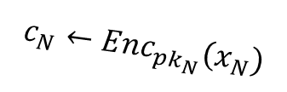





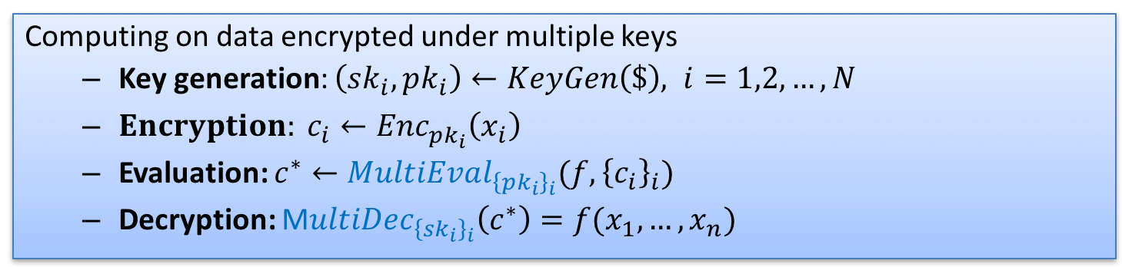

Multi-Key Homomorphic Encryption
$$sk_{1},pk_{1}$$
$$sk_{2},pk_{2}$$
$$c_{1}←Enc_{pk_{1}}\left(x_{1}\right)$$
$$c_{2}←Enc_{pk_{2}}\left(x_{2}\right)$$
  $$c^{∗}$$
  $$c^{∗}$$
…
  $$c^{∗}←MultiEval_{{\left\{pk_{i}\right\}}_{i}}(f, {\left\{c_{i}\right\}}_{i})$$
$$c_{N}←Enc_{pk_{N}}\left(x_{N}\right)$$
$$sk_{N},pk_{N}$$
  M$ultiDec_{{\left\{sk_{i}\right\}}_{i}}\left(c^{∗}\right)=f(x_{1},…,x_{n})$
  $$c^{∗}$$
Computing on data encrypted under multiple keys
  Key generation: $\left(sk_{i},pk_{i}\right)←KeyGen\left(\$\right), i=1,2, …,N$
  ${Encryption: c}_{i}←Enc_{pk_{i}}\left(x_{i}\right)$
  Evaluation: $c^{∗}←MultiEval_{{\left\{pk_{i}\right\}}_{i}}(f, {\left\{c_{i}\right\}}_{i})$
  Decryption: M$ultiDec_{{\left\{sk_{i}\right\}}_{i}}\left(c^{∗}\right)=f(x_{1},…,x_{n})$
[Lopez-AltTromerVaikuntanathan12] from NTRU (also from (R)LWE for few players)
  [ClearMcGoldrick14, MukherjeeWichs15] LWE-based for poly # of players

Slide 9


Previous Approach
With Setup
Without Setup
[MW16]:
[GMPP16]:
[GentrySahaiWaters13] FHE
2-round MPC in the CRS model [MW16]
Multi-Key FHE
4-round Multi-party coin flipping [GMPP16]
2-round MPC in the CRS model
6-round MPC

Slide 10
Our Approach
04
STEP
4-round malicious MPC
Compile Semi-malicious to malicious
Prove correctness of decryption:
using 4-round ZK proofs
Prove correctness of encryption:
3-round ZK proofs impossible [GoldreichKrawczyk96]
Use 3-round WI proofs + adaptive commitments to build 3-round non-malleable ‘ZK-like’ proofs
3-round Semi-malicious MPC:
Use
Leakage resilience
of dual-Regev
02
STEP
03
STEP
3-round Semi-malicious MPC
Distributed key gen. (malicious)
Encryption (semi-malicious)
Decryption (semi-malicious)
Using Regev FHE
dual-Regev FHE
01
STEP
Multi-Key FHE [CM15,MW16]

Slide 11
Our Approach for semi-malicious MPC
2-round semi-malicious MPC in the CRS model [MW16]
Replace CRS with a 1-round malicious distributed key generation step
3-round semi-malicious MPC

Slide 12



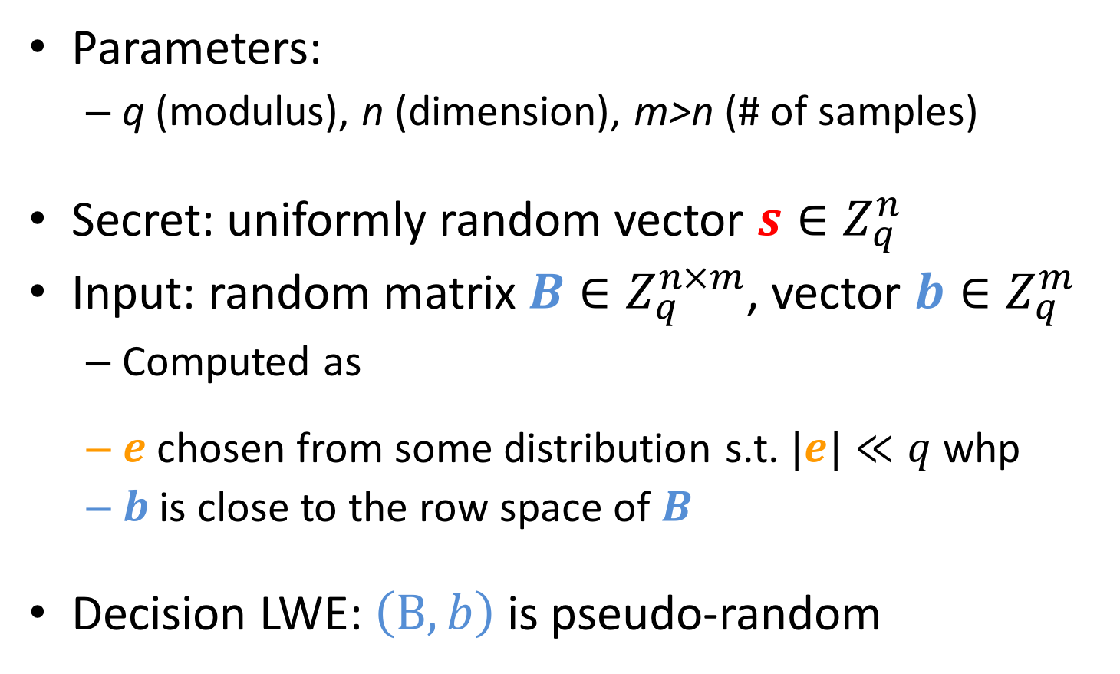
Learning with Errors (LWE) [R’05]
Parameters:
  q (modulus), n (dimension), m>n (# of samples)
Secret: uniformly random vector $s∈Z_{q}^{n}$
Input: random matrix $B∈Z_{q}^{n×m}$, vector $b∈Z_{q}^{m}$
  Computed as
  $e$ chosen from some distribution s.t. $|e|≪q$ whp
  $b$ is close to the row space of $B$
Decision LWE: $\left(B,b\right)$ is pseudo-random
$$=$$
$$+$$
$$(mod q)$$
b
s
B
e

Slide 13
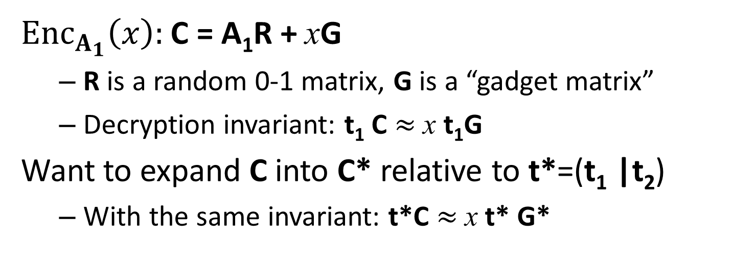
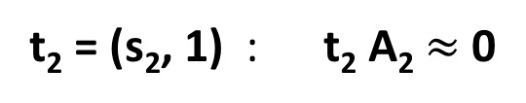
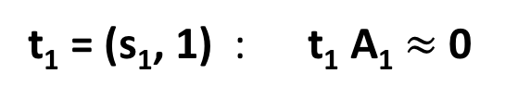
Multi-Key FHE [CM’15,MW’16]
Special case for N=2
B
B acts as CRS
B
A₁ =
A₂ =
b₁ = -s₁B-e₁
b₂ = -s₂B-e₂
t₁ = (s₁, 1) : t₁ A₁ $≈$ 0
t₂ = (s₂, 1) : t₂ A₂ $≈$ 0
$Enc_{A_{1}}\left(x\right):$C = A₁R + xG
  R is a random 0-1 matrix, G is a “gadget matrix”
  Decryption invariant: t₁ C $≈$ x t₁G
Want to expand C into C* relative to t*=(t₁ |t₂)
  With the same invariant: t*C $≈$ x t* G*

Slide 14
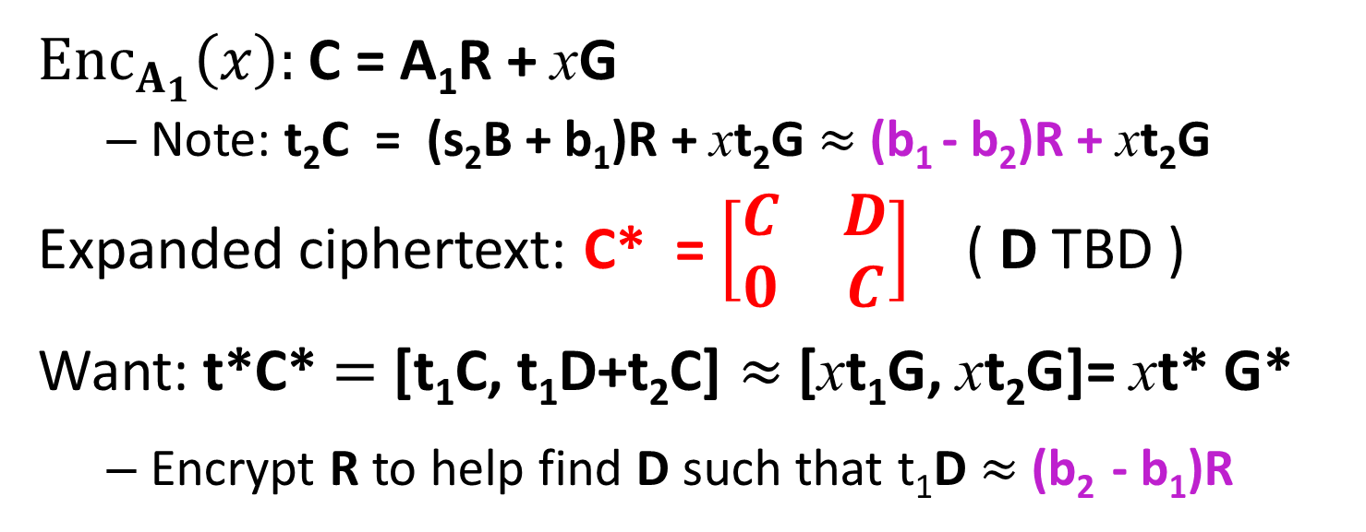
Multi-Key FHE [CM’15,MW’16]
Special case for N=2
B
B acts as CRS
B
A₁ =
A₂ =
b₁ = -s₁B-e₁
b₂ = -s₂B-e₂
t₁ = (s₁, 1) : t₁ A₁ $≈$ 0
t₂ = (s₂, 1) : t₂ A₂ $≈$ 0
$Enc_{A_{1}}\left(x\right):$C = A₁R + xG
  Note: t₂C = (s₂B + b₁)R + xt₂G $≈$(b₁ - b₂)R + xt₂G
Expanded ciphertext: C* = $\left[\begin{matrix}C & D \\ 0 & C\end{matrix}\right]$ ( D TBD )
Want: t*C* $=$ [t₁C, t₁D+t₂C] $≈$ [xt₁G, xt₂G]= xt* G*
  Encrypt R to help find D such that t₁D $≈$ (b₂ - b₁)R

Slide 15
CRS-Free Variant, 1st Try
Special case for N=2
B₁
Each party chooses own B_{i}
B₂
A₁ =
A₂ =
b_{1,1} = -s₁B₁-e₁
b_{2,2} = -s₂B₂-e₂
(B₁, b_{1,1})
(B₂, b_{2,2})
b_{1,2}= -s₁B₂-e’₁
b_{2,1}= -s₂B₁-e’₂
B₁
B₂
=B
b₁ = b_{1,1}|b_{1,2}
b₂ = b_{2,1}|b_{2,2}

Slide 16
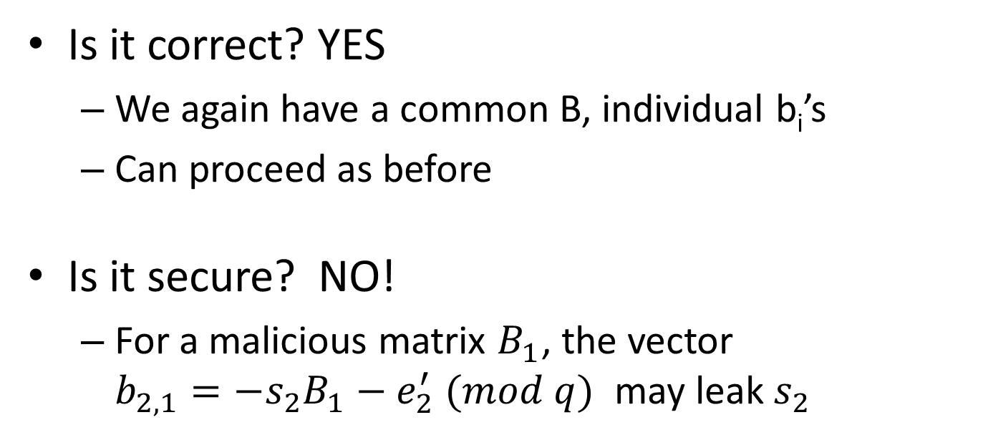
CRS-Free Variant, 1st Try
B₁
B₂
=B
b₁ = b_{1,1}|b_{1,2}
b₂ = b_{2,1}|b_{2,2}
Is it correct? YES
  We again have a common B, individual b_{i}’s
  Can proceed as before
Is it secure? NO!
  For a malicious matrix $B_{1}$, the vector ${b_{2,1}=−s}_{2}B_{1}−e_{2}^{′} (mod q)$ may leak $s_{2}$

Slide 17
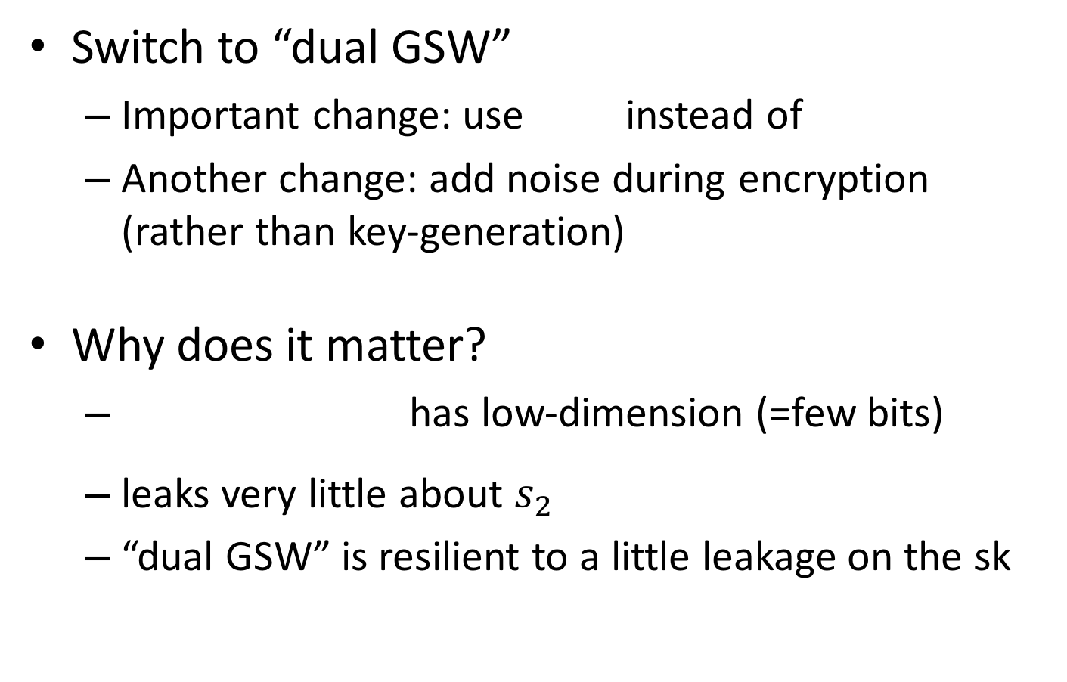

CRS-Free Variant, 2nd Try
Switch to “dual GSW”
  Important change: use instead of
  Another change: add noise during encryption (rather than key-generation)
Why does it matter?
  has low-dimension (=few bits)
  leaks very little about $s_{2}$
  “dual GSW” is resilient to a little leakage on the sk
B_{i}
B_{i}
B₁
$$b_{2,1}$$
=
s₂

Slide 18
CRS-Free Variant, 2nd Try
Special case for N=2
B₁
B₂
Each party chooses own B_{i}
A₁ =
A₂ =
b_{1,1} =
-s₁B₁
b_{2,2} =
-s₂B₂
(B₁, b_{1,1})
(B₂, b_{2,2})
b_{1,2}= -s₁B₂
b_{2,1}= -s₂B₁
B₁
B₂
=B
b₁ =
b_{1,1}|b_{1,2}
b₂ =
b_{2,1}|b_{2,2}

Slide 19
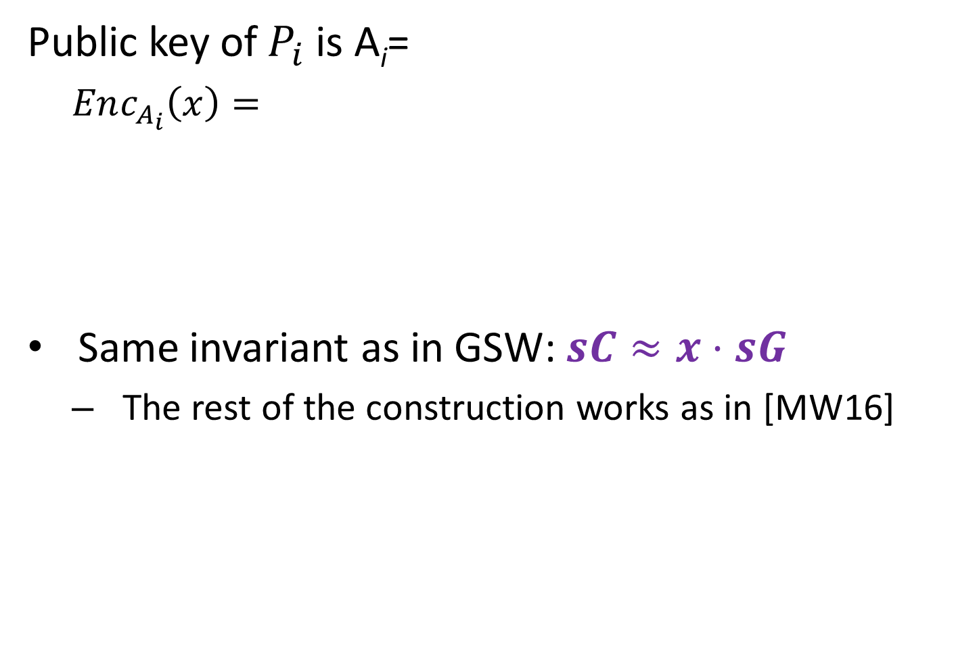



CRS-Free Variant, 2nd Try
B
Public key of $P_{i}$ is A_{i}=
  $Enc_{A_{i}}\left(x\right)=$
Same invariant as in GSW: $sC≈x⋅sG$
  The rest of the construction works as in [MW16]
b_{i}
C
A_{i}
R
E
G
=
$$×$$
$$+$$
$$+ x$$

Slide 20
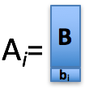
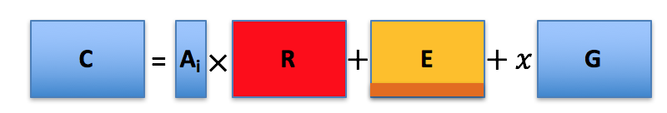
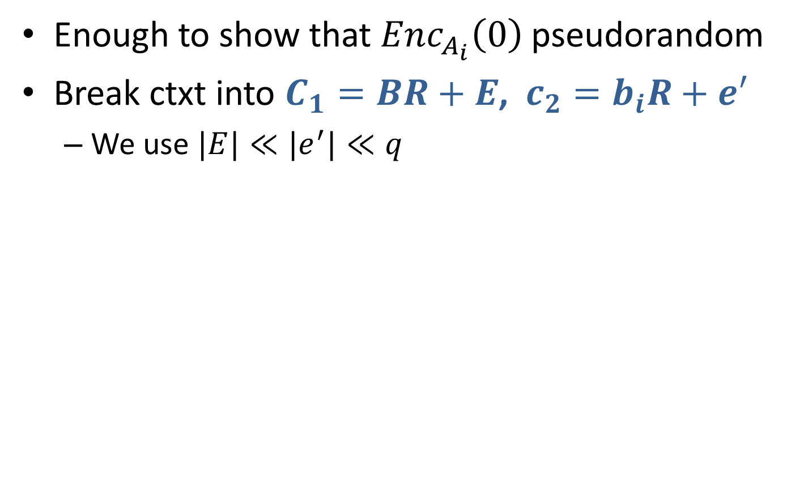
Security
Enough to show that $Enc_{A_{i}}\left(0\right)$ pseudorandom
Break ctxt into $C_{1}=BR+E$, $c_{2}=b_{i}R+e′$
  We use $|E|≪|e^{′}|≪q$
C
C₁
c₂

Slide 21
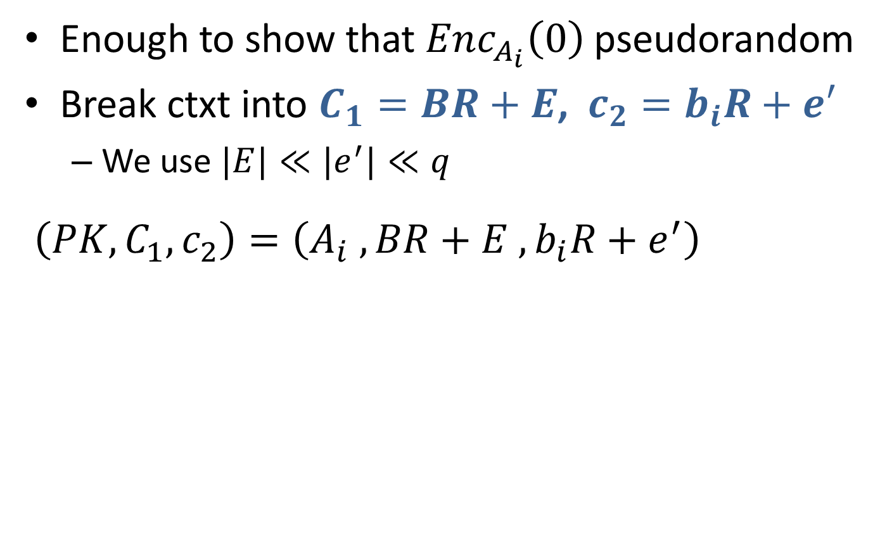
Security
Enough to show that $Enc_{A_{i}}\left(0\right)$ pseudorandom
Break ctxt into $C_{1}=BR+E$, $c_{2}=b_{i}R+e′$
  We use $|E|≪|e^{′}|≪q$
$\left(PK, C_{1},c_{2}\right)=\left(A_{i} , BR+E , b_{i}R+e^{′}\right)$
C
C₁
c₂

Slide 22
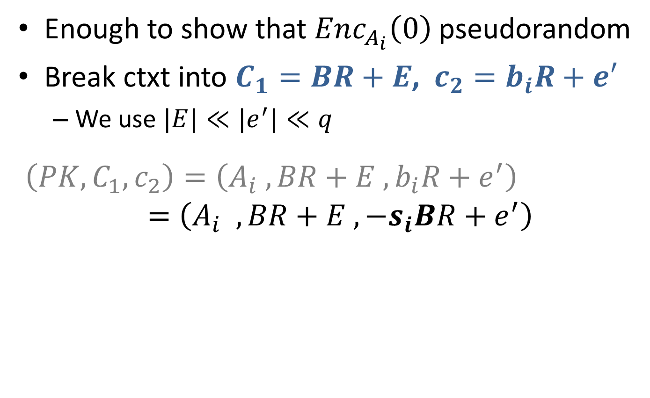
Security
Enough to show that $Enc_{A_{i}}\left(0\right)$ pseudorandom
Break ctxt into $C_{1}=BR+E$, $c_{2}=b_{i}R+e′$
  We use $|E|≪|e^{′}|≪q$
$\left(PK, C_{1},c_{2}\right)=\left(A_{i} , BR+E , b_{i}R+e^{′}\right)$
$$=\left(A_{i} , BR+E , −s_{i}BR+e^{′}\right)$$
C
C₁
c₂

Slide 23

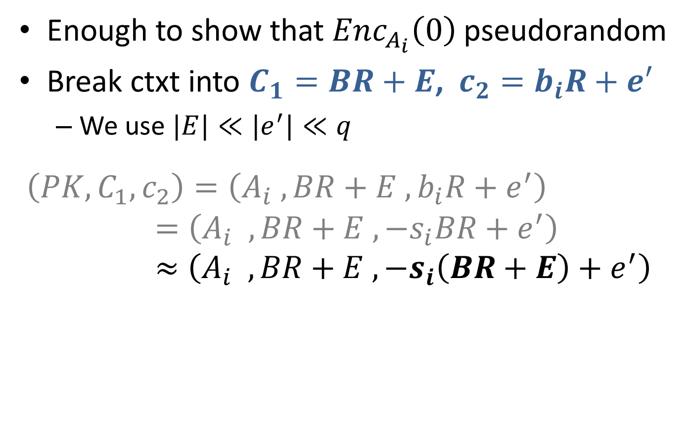
Security
Enough to show that $Enc_{A_{i}}\left(0\right)$ pseudorandom
Break ctxt into $C_{1}=BR+E$, $c_{2}=b_{i}R+e′$
  We use $|E|≪|e^{′}|≪q$
$\left(PK, C_{1},c_{2}\right)=\left(A_{i} , BR+E , b_{i}R+e^{′}\right)$
$$=\left(A_{i} , BR+E , −s_{i}BR+e^{′}\right) \\ ≈\left(A_{i} , BR+E , −s_{i}\left(BR+E\right)+e^{′}\right)$$
C
C₁
c₂
$$e^{′}≈e^{′}−s_{i}E$$

Slide 24
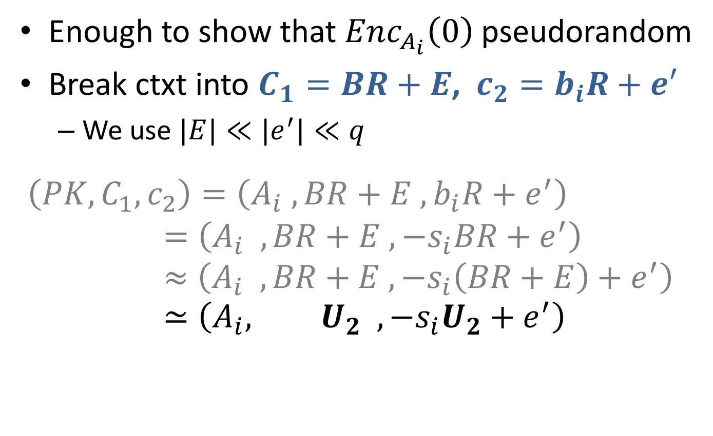
Security
Enough to show that $Enc_{A_{i}}\left(0\right)$ pseudorandom
Break ctxt into $C_{1}=BR+E$, $c_{2}=b_{i}R+e′$
  We use $|E|≪|e^{′}|≪q$
$\left(PK, C_{1},c_{2}\right)=\left(A_{i} , BR+E , b_{i}R+e^{′}\right)$
$$=\left(A_{i} , BR+E , −s_{i}BR+e^{′}\right) \\ ≈\left(A_{i} , BR+E , −s_{i}\left(BR+E\right)+e^{′}\right) \\ ≃\left(A_{i}, U_{2} , −s_{i}U_{2}+e^{′}\right)$$
C
C₁
c₂
$$e^{′}≈e^{′}−s_{i}E$$
LWE

Slide 25
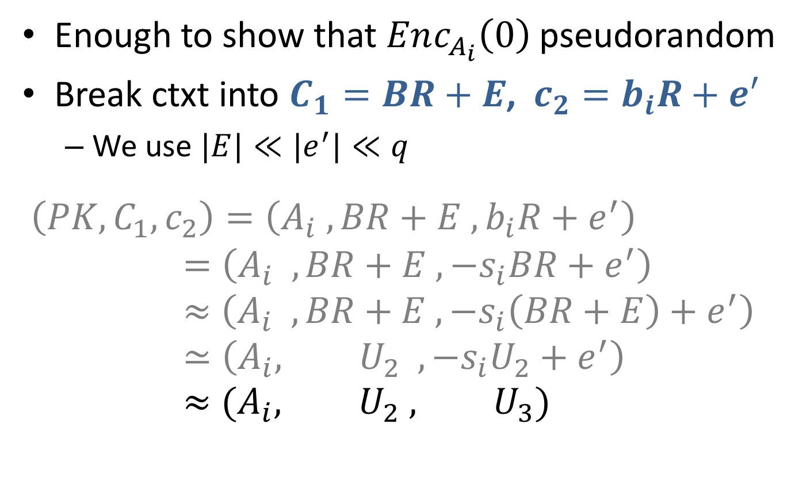
Security
Enough to show that $Enc_{A_{i}}\left(0\right)$ pseudorandom
Break ctxt into $C_{1}=BR+E$, $c_{2}=b_{i}R+e′$
  We use $|E|≪|e^{′}|≪q$
$\left(PK, C_{1},c_{2}\right)=\left(A_{i} , BR+E , b_{i}R+e^{′}\right)$
$$=\left(A_{i} , BR+E , −s_{i}BR+e^{′}\right) \\ ≈\left(A_{i} , BR+E , −s_{i}\left(BR+E\right)+e^{′}\right) \\ ≃\left(A_{i}, U_{2} , −s_{i}U_{2}+e^{′}\right) \\ ≈(A_{i}, U_{2} , U_{3})$$
C
C₁
c₂
$$e^{′}≈e^{′}−s_{i}E$$
LWE
LHL

Slide 26
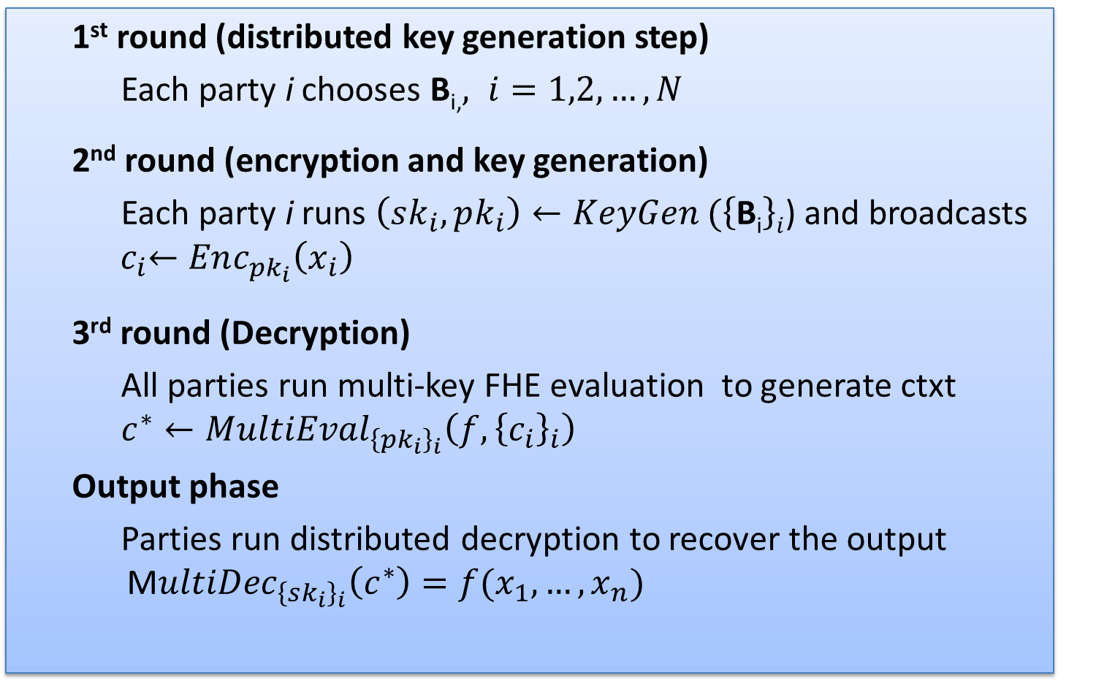
3-round Semi-malicious MPC
  1st round (distributed key generation step)
  Each party i chooses B_{i,}$, i=1,2, …,N$
  2nd round (encryption and key generation)
  Each party i runs $\left(sk_{i},pk_{i}\right)←KeyGen (\left\{\text{B}\text{i}\right\}i$) and broadcasts ${ c}_{i}←Enc_{pk_{i}}\left(x_{i}\right)$
  3rd round (Decryption)
  All parties run multi-key FHE evaluation to generate ctxt
  $c^{∗}←MultiEval_{{\left\{pk_{i}\right\}}_{i}}\left(f, {\left\{c_{i}\right\}}_{i}\right)$
  Output phase
  Parties run distributed decryption to recover the output M$ultiDec_{{\left\{sk_{i}\right\}}_{i}}\left(c^{∗}\right)=f(x_{1},…,x_{n})$

Slide 27
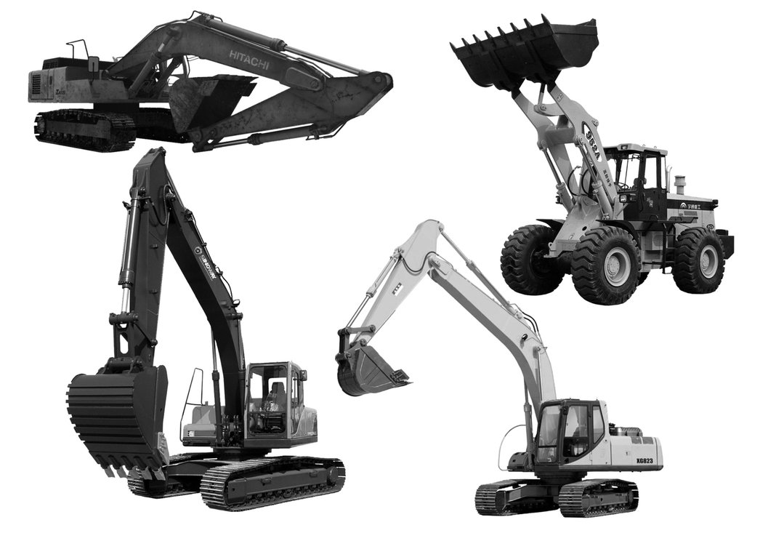
Getting Malicious Security
Proof of correct decryption in four rounds
  Using more or less standard techniques
Proof of correct encryption in three rounds, using heavy tools:
  Adaptive commitments
  Sprinkle complexity leveraging
  as needed
This Photo by Unknown Author is licensed under CC BY-NC-ND

Slide 28
Our Results
Theorem 1. (Informal) LWE ➔ 3-round semi-malicious MPC
Instantiations:
[LPS17]: sub-exp. time-lock puzzles
Theorem 2. (Informal)
Adaptive Commitments + sub-exp. LWE ➔ 4-round malicious MPC
2PC
MCF
First 4-round MPC protocol
from sub-exponential assumptions
MPC

Slide 29
Thank you!

