Slide 1
Efficient Leakage Resilient Circuit Compilers
Marcin Andrychowicz, Warsaw University, Poland
Ivan Damgård, Aarhus University, Denmark
Stefan Dziembowski, Warsaw University, Poland
Sebastian Faust, EPFL, Switzerland
Antigoni Polychroniadou, Aarhus University, Denmark

Slide 2



Theory
Cryptographic Algorithms are often modeled as ‘black boxes’
E.g. Internal computation is opaque to external adversaries.
Security is proven under various hardness assumptions.

Slide 3
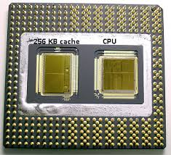
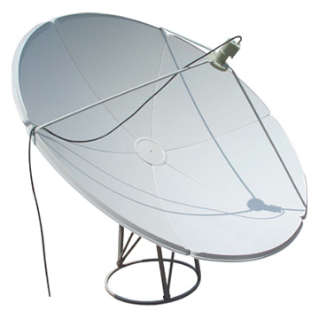
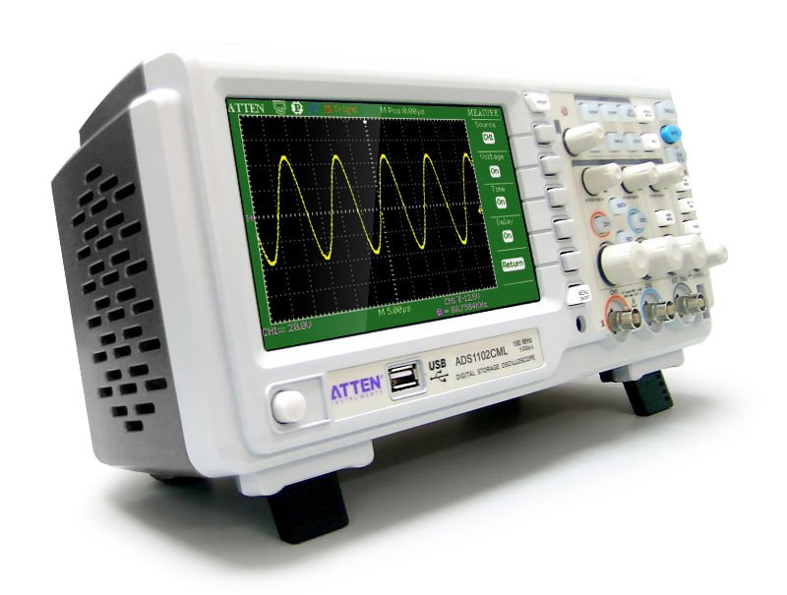
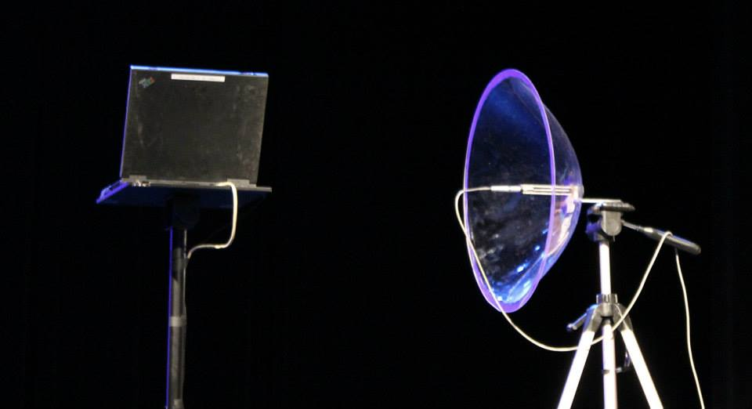


Reality
Computation Internals Leak
Cache
EM Radiation
Power
Consumption
Acoustic
Timing
Probing

Slide 4
Motivation
Many provably secure cryptosystems can be broken by side-channel attacks

Slide 5
Two Paradigms to Fight Leakage Attacks
Consider Leakage at design level
Only security of specific schemes
How to securely implement any scheme?
Wanted:
Leakage resilient Compiler
Transform any circuit to a leakage resilient circuit secure in a strong black-box sense.
Notes:
As a general comment about leakage resilient cryptography, there are works, that take leakage into account at design time. More specifically, given a cryptographic primitive and a specific security requirement, then these works try to design an algorithm that maintains security and is resilient to 'some' leakage attacks. So this means that whenever one wants leakage resilience against a different task, we need to design a new leakage-resilient algorithm. The solutions to the above situation are the so-called leakage resilient compilers, which transform any circuit to a leakage resilient circuit secure in a strong black-box sense. There is a nice article about the above arguments here http://windowsontheory.org/2012/08/09/on-leakage-resilient-cryptography/

Slide 6

Def: Circuit Compilers
Circuit Compiler

Slide 7

Def: Circuit Compilers
C
C′
…
+
+
…
Encoder
x
Circuit Compiler
…
-
x
Decoder
…
…
Encoder
-
Notes:
In this paper, we revisit the problem of constructing general leakage resilient compilers that can transform any (Boolean) circuit C into a protected circuit C′ computing the same functionality as C, which additionally is resilient to certain classes of leakage functions.

Slide 8

Def: Circuit Compilers
C
C′
…
+
+
…
Encoder
x
Circuit Compiler
…
-
x
Decoder
…
…
Encoder
-
Indistinguishable
Even given leakage,
execution “looks like”
black-box access to C(.)
Notes:
In this paper, we revisit the problem of constructing general leakage resilient compilers that can transform any (Boolean) circuit C into a protected circuit C′ computing the same functionality as C, which additionally is resilient to certain classes of leakage functions.

Slide 9
Def: Circuit Compilers
C
C′
…
+
+
…
Encoder
x
Circuit Compiler
…
-
x
Decoder
…
…
Encoder
-
Goal:
Reduce the overhead
induced by the compiler
Indistinguishable
Even given leakage,
execution “looks like”
black-box access to C(.)
Notes:
In this paper, we revisit the problem of constructing general leakage resilient compilers that can transform any (Boolean) circuit C into a protected circuit C′ computing the same functionality as C, which additionally is resilient to certain classes of leakage functions.

Slide 10
Def: Circuit Compilers
C
C′
In all previous works the transformed circuit C′ has size at least O(k²), where k is the security parameter.
…
+
+
…
Encoder
x
Circuit Compiler
…
-
x
Decoder
…
…
Encoder
-
Goal:
Reduce the overhead
induced by the compiler
Indistinguishable
Even given leakage,
execution “looks like”
black-box access to C(.)
Notes:
In this paper, we revisit the problem of constructing general leakage resilient compilers that can transform any (Boolean) circuit C into a protected circuit C′ computing the same functionality as C, which additionally is resilient to certain classes of leakage functions.

Slide 11
Our Goal
Build Efficient Leakage Resilient Compilers

Slide 12
Is it possible to construct leakage resilient compilers with at most linear overhead?
All previous works introduce at least quadratic overhead.

Slide 13
Prior Work on General Compilers
Three Leakage Models:
‘Local’ bounded Wire-Probing: [ISW03,…]
‘Local’ Only Computation (OC) Leakage/ Split state model:
[MR04,…]
‘Global’ computational continuous weak Leakage i.e. AC⁰
leakage Functions [FRRTV10,…]

Slide 14
Our Results
Using Techniques from secure MPC
Efficient Compliers:
‘Local’ Wire-Probing: O(polylog(k) ·|C|log |C|)
Previous Best Overhead: O(k²|C|) by [ISW03]
‘Local’ OC Leakage : O(k log k log log k)
Previous Best Overhead: Ω(k⁴) by [DF12] and Ω(k³) by [GR12]
This talk
‘Global’ computational weak Leakage: O(k·|C|log|C|)
Previous Best Overhead: O(k²) by [FRRTV10] and O(k³) by [R13]

Slide 15
Our result on global computational weak Leakage
Informal Theorem : A compiler that makes any circuit resilient to computationally weak leakages. The compiler increases the circuit size by a factor of O(k).
Global adaptive leakage
Arbitrary total leakage
However we must assume something [MR04]:
Leakage function is computationally weak
Simple opaque gates.
Notes:
May depend on whole state and intermediate results, and chosen adaptively by the adversary.
(Bounded just per observation)

Slide 16
The Compiler
C′
…
+
…
Encoder
…
x
Decoder
…
…
Encoder
-

Slide 17
The Compiler:
From wires to wire bundles
C′
…
+
…
Encoder
…
x
Decoder
…
…
Encoder
-

Slide 18
Packed Secret Sharing (PSS)
PSS is a central tool in information theoretic secure MPC protocols.
f
Standard Secret Sharing :
P₁
P₂
P₃
P₄
P₅
P₆
P₇
Degree of f denoted by d

Slide 19
Packed Secret Sharing (PSS)
PSS is a central tool in information theoretic secure MPC protocols.
f
Packed Secret Sharing (PSS) :
l=3
Transform circuit to work
on PSS with O(log|C|)
overhead [DIK10]*
P₁
P₂
P₃
P₄
P₅
P₆
P₇
*Introduces Permutation gates.

Slide 20
Every wire is encoded with PSS.
Inputs are encoded; outputs are decoded.
C
C′
…
+
+
…
Encoder
x
…
-
x
Decoder
…
…
Encoder
-
Wire bundle that carries the encoding of w, e.g. k shares of w. Notation: (w₁,…,w_{k})=[w]_{d}
Each wire w

Slide 21
PSS is is secure against AC⁰ leakages
A function is in AC⁰ if it can be computed by a poly-size O(1) depth boolean circuit with unbounded fan-in AND, OR (and NOT) gates.
PSS Encoding is AC⁰ indistinguishable, i.e.
Inner product hard to compute in AC⁰.

Slide 22
The Compiler:
From gates to gadgets
C′
…
+
…
Encoder
…
x
Decoder
…
…
Encoder
-

Slide 23
Every gate is replaced by a gadget operating on encoded PSS bundles
C
C′
…
+
+
…
Encoder
x
…
-
x
Decoder
…
…
Encoder
-
Gadgets: built from normal gates and opaque gates and operate on encodings
Gates

Slide 24
Opaque Gates
  [G89,GoldOstr95]…Leak-free processor: oblivious RAM
  [MR04], [DP08], [GKR08], [DF12]…Leak-free memory: “only computation leaks”, one-time programs
  [FRRTV10],… Opaque Gates
  [GR12],[R13]… Ciphertext banks
  Opaque Gates: simple gates that sample from a fixed distribution
  e.g: securely draw strings with inner product 0.
  Stateless: No secrets are stored
  Small and simple
  Computation independent: No inputs, so can be pre-computed

Slide 25
The Compiler:
Addition & Subtraction gadgets
C′
…
+
…
Encoder
…
x
Decoder
…
…
Encoder
-

Slide 26
The Compiler:
Addition & Subtraction gadgets
C′
…
+
…
Encoder
…
x
Decoder
…
…
Encoder
-

Slide 27
The Compiler:
Addition & Subtraction gadgets
Goal : c=a+b⇒[a+b]_{d} ←[a]_{d} +[b]_{d}
[0]_{d}← Opaque gate
[a+b]_{d} = [a]_{d}+[b]_{d}+[0]_{d} OR [a-b]_{d} = [a]_{d}-[b]_{d}+[0]_{d}

Slide 28
The Compiler:
Multiplication gadgets
C′
…
+
…
Encoder
…
x
Decoder
…
…
Encoder
-

Slide 29
The Compiler:
Multiplication gadgets
C′
…
+
…
Encoder
…
x
Decoder
…
…
Encoder
-

Slide 30
The Compiler:
Multiplication gadgets
Goal: c = ab ⇒ [ab]_{d} ← [a]_{d}[b]_{d}
[r]_{d},[r]_{2d} ← Opaque gate
[ab]_{2d} = [a]_{d}[b]_{d}
[ab +r]_{2d} =[ab]_{2d} +[r]_{2d}
(ab+r) ← Decode([ab+r]_{2d})
[ab+r] _{d} ←Encode (ab+r)
[ab]_{d} = [ab+r]_{d} − [r]_{d}
Permutation gadget follow the same approach

Slide 31
Compiler: High-Level
Circuit topology is preserved.
Every wire is encoded; Inputs are encoded; outputs are decoded.
Every gate is converted into a gadget operating on encodings.

Slide 32
Security of the Compiled Circuit
Prove security via ‘swallow’ reconstractors per gadget (technique introduced in [FRRTV10])
Reconstractor: on input the inputs and outputs of a gadget and is able to simulate its internals in a way that looks indistinguishable for leakages from AC⁰.

Slide 33
Conclusion
Three efficient circuit compilers ….
compile any circuit
‘Local’ Wire-Probing
‘Local’ OC Leakage
‘Global’ Computational weak Leakage
Question
Connection to Obfuscation
Notes:
‘Local’ Wire-Probing
‘Local’ OC Leakage :
‘Global’ Computational weak Leakage:

Slide 34
Thank you!

