Slide 1
Composable Security in the
Tamper-Proof Hardware Model under
Minimal Complexity
TCC 2016-B
Carmit Hazay Bar-Ilan University, Israel
Antigoni Ourania Polychroniadou (Aarhus University, Denmark )
Muthuramakrishnan Venkitasubramaniam (University of Rochester, New York)

Slide 2
Introduction of Secure MPC
[Yao82,GMW87,BGW88, CCD88]

Slide 3
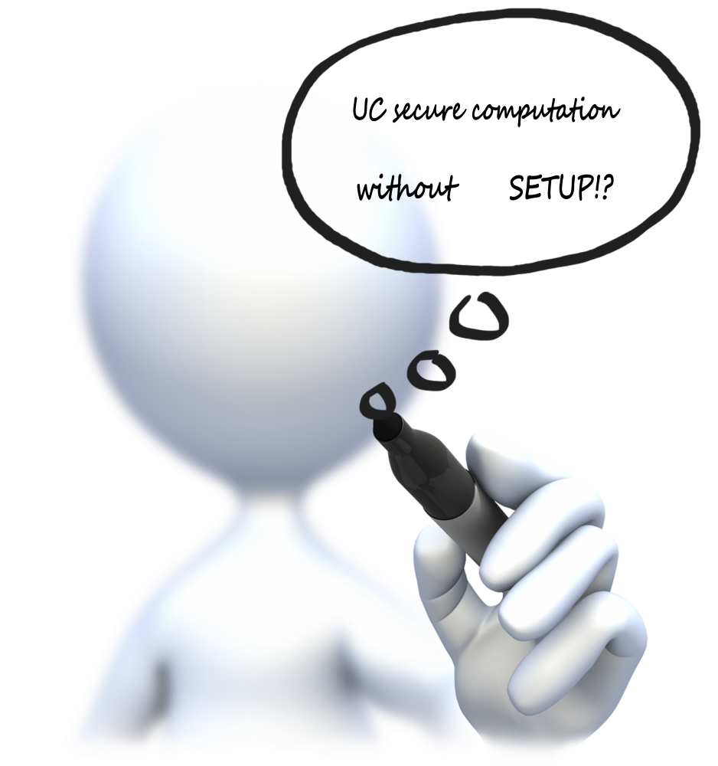



Secure Multi-Party Computation
UC
f(x₁, x₂, x₃, x₄) = (y_{1,} y₂ ,y₃ ,y₄ )
x₁
x₁
x₁
y₄
y₁
x₄
Goal:
Correctness: Everyone computes f(x₁,…,x₄)
Security: Nothing else but the output is revealed
Adversary
PPT
Malicious
Static
x₂
y₂
y₃
x₃

Slide 4
Bypass Impossibility for UC security
Possible: with “trusted help”
E.g. Common Reference String (CRS) model [CLOS02]
Motivation: Can we “eliminate” trust?

Slide 5
Quality of UC
Composition
Round Efficient
Assumptions
Usability
5
Model
4
3
4
2
1

Slide 6
Quality of UC
Composition
Our result in a nutshell:
2-round 2PC using stateless tokens from OWFs with GUC-security
Round Efficient
UC
Assumptions
2 rounds
Semi-honest
OT
G
(this work)
Usability
UC
Model
Central Trust
2 rounds
(this work)
5
OWFs
(this work)
Common Reference String (CRS)
4
Decentralized
“SGX”?
3
Tamper Proof Hardware Tokens
4
2
1

Slide 7



Hardware Token Model
1
Stateless Tokens
Stateful Tokens
x
c
b₀,b₁
f
f(x)
b_{c}
GOOD
NOT SO GOOD
Requires non-volatile memory

Slide 8


Hardware Token Model
1
Attacker capability
x
f
f(x)
Transfer Tokens
Inject malicious code

Slide 9
Prior Works
3
[K07]
[CGS09]
[GISVW10]
[CKSYZ14]
This Work
Model
Stateful
Stateless
Stateful
Stateless
Stateless
Assumption
DDH
ETDP
-------
CRHF
OWFs
Rounds
O(1)
O(n)
O(d_{F})
O(1)
2
UC
UC
UC
UC
G
UC
Composition
MPC
no
no
no
no
YES
(ETDP
& 3rnd)

Slide 10
Composibility in[Katz07] Framework
4
Does not provide adequate composability guarantees.
Does not allow for transferability of tokens
Does not implement multi-versions* of UC
Do not achieve UC-MPC
This Work: A new way to model Tamper-Proof Model as a Global Functionality F_{global}
Prove security in the Global Universal Composability (GUC [CDPW07]) Framework
Concurrent work [MMN16]: model token-based protocols in GUC.

Slide 11
Z
TS
Z
P₁
P₂
P₁
P₂
UC
A
𝝅
S
𝝅
P₃
P₄
P₃
P₄
F
REAL WORLD
IDEAL WORLD
Z
GS
Z
GS
P₁
P₂
P₁
P₂
GUC
A
𝝅
S
𝝅
P₃
P₄
P₃
P₄
F

Slide 12
Our Results
Theorem 1 [2PC]
Assuming OWFs, realize any (well-formed) two-party f via
two-rnd blackbox cons. with GUC-security f in the F_{global}-hybrid.
Corollary 1 [Thm1+IPS08]:
Assuming OWFs, realize any (well-formed) multiparty f via
O(1)-round blackbox cons. with GUC-security f in the F_{global}-hybrid.
Theorem 2 [MPC]
Assuming OWFs and ETDPs, realize any (well-formed) multiparty f via
three-rnd construction with GUC-security f in the F_{global}-hybrid.

Slide 13
Tamper Proof hardware as Global Functionality§
F_{global} functionality
Transfer*
Create
Retrieve:
Execute

Slide 14
Issue with Transfers
Malleability
Transfer to honest parties
Transfer to dishonest parties
Honest party encodes sid into tokens
Answer only if session id = sid
Lose
extractability
Track illegitimate queries [CJS15]

Slide 15
Product Piece 1 – Do not delete this text box - used for hyperlinks
Tamper Proof hardware as Global Functionality
Create:
Every party can create a token and send to another party
Encode sid and answer only if prefix of query = sid
sid
Execute:
If a party owns a token it can execute it on any input.
If an ``illegal query’’ is made then record in Q_{sid}
Transfer:
Adversary can transfer token from one session to another
Retrieve:
Every legitimate query for the current session can be retrieved. Return Q_{sid}

Slide 16

Extractable Commitment from Tokens
[GoyalIshaiShaiVenkatesanWadia10]
C
R
P
Extract by
observing query
P
P
USE RETRIEVE !

Slide 17

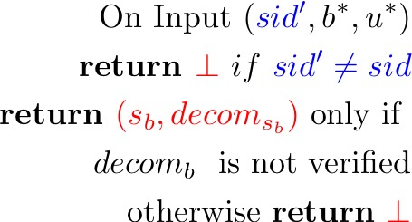
UC Oblivious Transfer from Tokens
F_{B}
B
A
F_{A}
Vulnerable to input-dependent abort
Token aborts based on b*

Slide 18
UC Oblivious Transfer from Tokens
F_{B}
B
A
F_{A}
Solve input-dependent abort:
use verification checks to ensure that
B’s inputs can be verified [ORS15].

Slide 19
MPC with tamper proof tokens
Two ingredients:
Embed next message function in token [a la GGHR14]
Design a commit-and-prove protocol using tokens
Easy
Issues:
Commit and prove needs to be black-box in the commitment scheme
Next-message token cannot issue token-based commitments
(tokens cannot invoke tokens)
Design special-purpose 3-round input-delayed black-box commit and prove protocol ([HV16] gave a 6-round protocol)

Slide 20

Summary
Designed two party protocols with stateless tokens
  OWFs (minimal [GISVW10])
  Two rounds (minimal)
  Black-box
  GUC security
Designed three-round MPC protocols with stateless tokens
  Used OWFs and ETDPs
  Better alternative to CRS based constructions (LWE/IO)?
[HPV16]: Constant-round Adaptive GUC in the tamper-proof model from OWFs

Slide 21
Thank you!

