Slide 1

Uber Ride Booking Dashboard – NCR Region
Data-Driven Insights from Customer, Driver, and Booking Behavior Analysis

Slide 2
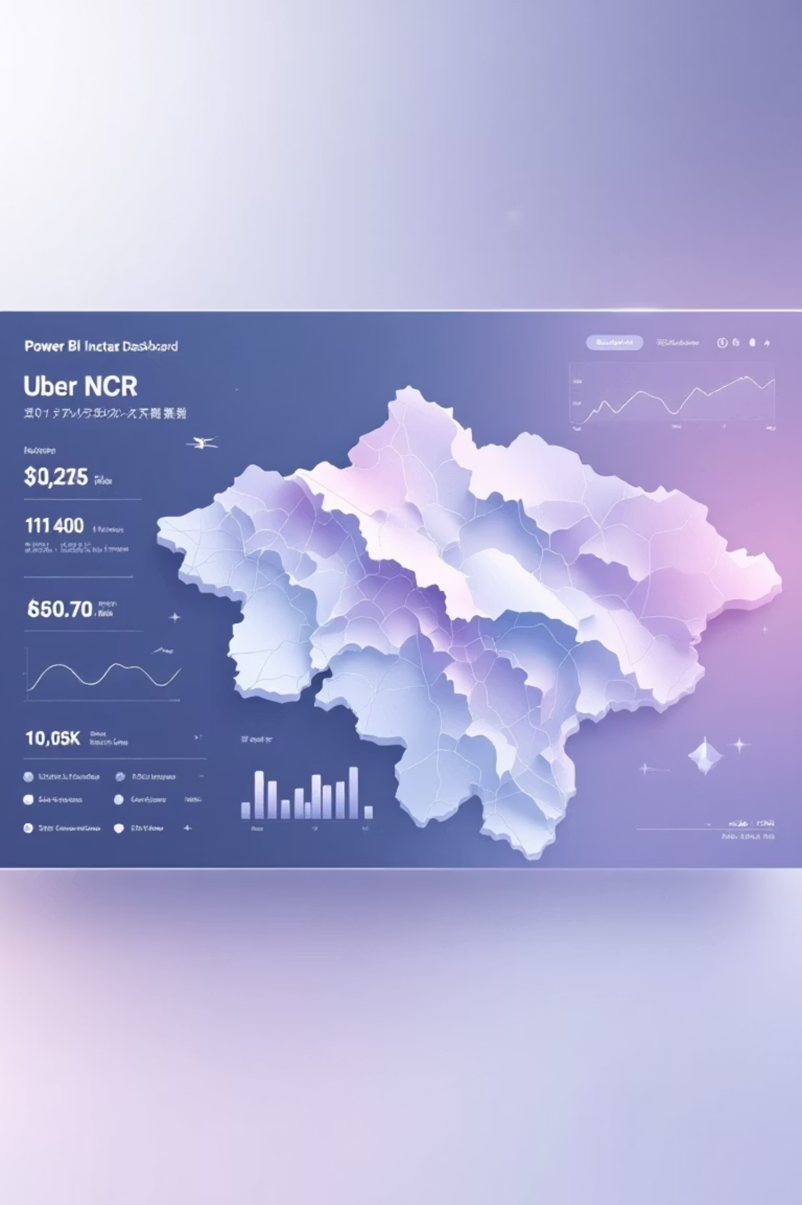
Project Overview: Unveiling Uber's NCR Dynamics
Regional Focus
Tooling
Analyzed extensive Uber ride booking data specifically for the National Capital Region (NCR) to uncover localized trends.
Dashboard developed and visualized using the robust capabilities of Microsoft Power BI, ensuring interactive and dynamic insights.
Core Analysis Pillars
Booking Trends & Patterns
Revenue & Distance Metrics
Customer Behavior Profiling
Driver Performance Evaluation
In-depth Cancellation Analysis

Slide 3
Overall Business Performance at a Glance
150K
72M
478.12
3.65M
Total Bookings
Total Revenue
Avg. Booking Value
Total Ride Distance
A substantial volume indicating high demand and market penetration in the NCR region.
Significant revenue generated, reflecting the economic impact and success of Uber's operations.
Average value per booking, showcasing consistent customer spending patterns.
Cumulative distance covered, highlighting the extensive reach and operational scale.
9K
Incomplete Rides
A relatively low number, suggesting efficient dispatch and service delivery.
Insight: High booking volume paired with robust revenue generation and a minimal rate of incomplete rides underscores a strong operational foundation.

Slide 4
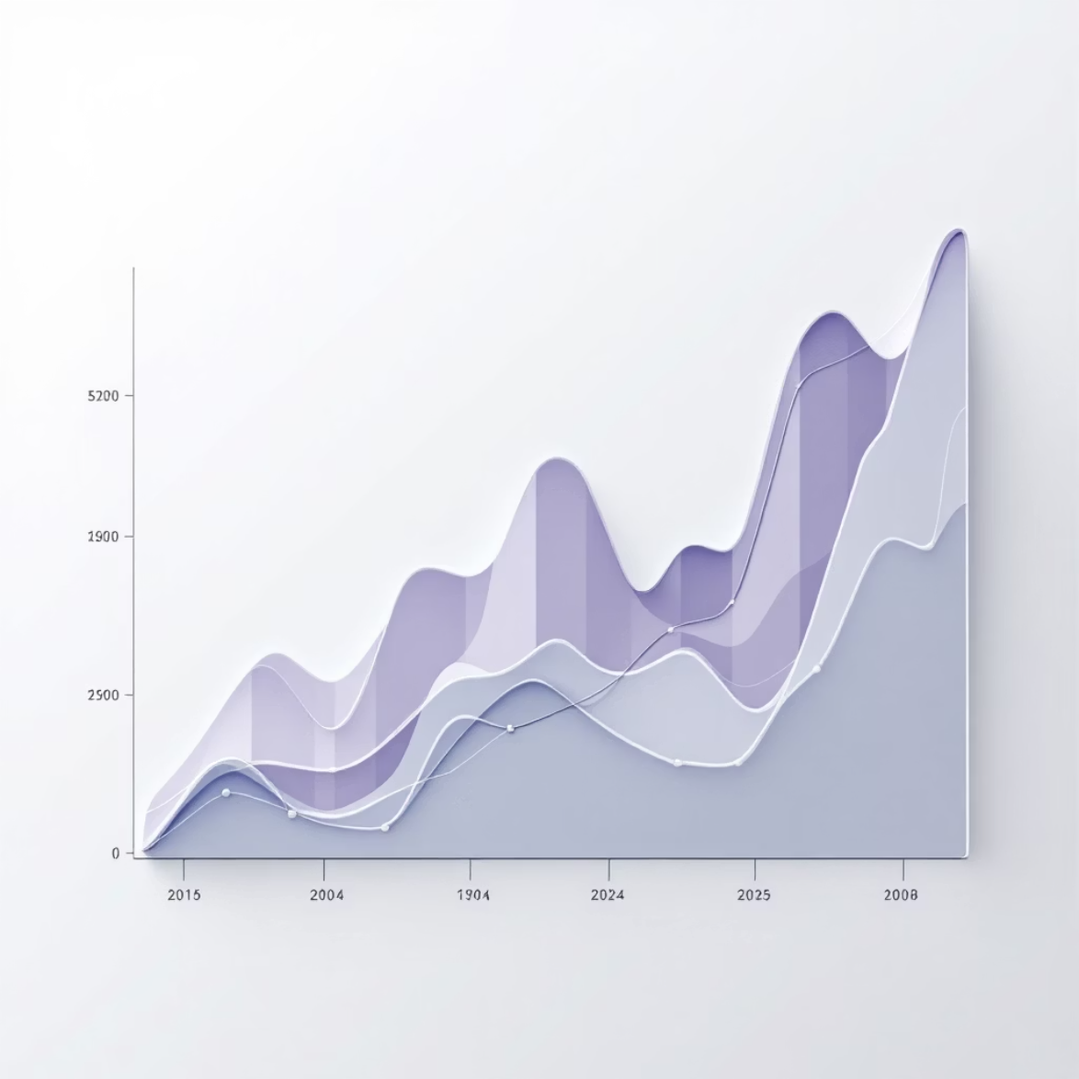



Booking Trends & Status Analysis
2
1
3
1
Completed
93K (62%)
The majority of rides are successfully completed, indicating effective service execution.
2
Cancelled
37.5K (25%)
Monthly Booking Stability
A notable percentage, highlighting an area requiring focused intervention and strategy.
Analysis of monthly booking trends reveals a generally stable demand across the year, suggesting consistent user engagement.
3
Incomplete
19.5K (13%)
While smaller, incomplete rides still impact user experience and operational efficiency.
Insight: While most rides are successfully completed, the significant volume of cancellations represents a critical area for operational improvement and customer retention strategies.

Slide 5




Preferred Payment Methods in NCR
94K
25K
12K
UPI
Cash
Uber Wallet
Dominant choice, reflecting the widespread adoption of digital payments.
Still a significant payment option for a segment of users.
Growing preference for in-app payment solutions.
10K
8K
Credit Card
Debit Card
Consistent usage among card-holding customers.
Another digital alternative for secure transactions.
Insight: Digital payments overwhelmingly dominate the NCR region, with UPI emerging as the most preferred method, indicating a strong trend towards cashless transactions.

Slide 6








Customer Dashboard: Key Engagement Metrics
Total Customers
Cust. Cancellation Rate
148.788K
0.07
A vast user base demonstrating Uber's extensive reach in the NCR market.
A low rate, suggesting overall satisfaction with the booking process and service.
Avg. Customer Rating
Avg. Booking Value
4.24
478.12
High average rating, reflecting positive experiences and service quality.
Consistent average spend per customer, supporting revenue stability.
Insight: Customers exhibit high satisfaction, as evidenced by strong average ratings and a commendably low cancellation rate, pointing to a generally positive user experience.

Slide 7

Customer Behavior: Diving Deeper into Cancellations
Payment Type Split
Top Cancellation Reasons
Digital: 124.63K (83.09%)
Wrong Address – 2.4K bookings
Cash: 25.37K (16.91%)
Change of Plans – 2.4K bookings
Reinforces the preference for digital transactions among customers.
Driver Not Moving – 2.3K bookings
Driver Asked to Cancel – 2.3K bookings
AC Not Working – 1.2K bookings
These reasons highlight critical areas for improving the booking and ride experience.
Insight: The data strongly suggests that both address accuracy during booking and driver conduct during the ride are direct and significant factors influencing ride cancellations.

Slide 8






Customer Satisfaction: Rating Distribution
Rating 4
48K bookings
Rating 3
4K bookings
Rating 5
41K bookings
Insight: A significant majority of customers consistently provide ratings of 4 or 5, underscoring widespread positive ride experiences and satisfaction with Uber's service.

Slide 9


Driver Dashboard: Performance & Efficiency
Avg. VTAT
Driver Cancellation Rate
8.46
0.18
Average Vehicle Turnaround Time, a key metric for driver efficiency.
Percentage of rides drivers cancel, warranting closer examination.
Avg. Driver Rating
Avg. Ride Distance
4.11
24.34
Reflects overall customer perception of driver service quality.
Average kilometers covered per ride, indicating typical trip lengths.
Insight: While average driver ratings remain strong, the driver cancellation rate presents a critical area for monitoring and targeted intervention to maintain service reliability.

Slide 10

Optimizing Driver Performance & Customer Experience
Bookings by Driver Rating
Driver Cancellation Reasons
Rating 3: 7K bookings
Customer related issues – 6.8K
Rating 4: 63K bookings
Customer coughing/sick – 6.8K
Rating 5: 23K bookings
Personal & car related issues – 6.7K
Drivers rated 4 are the backbone of booking fulfillment, underscoring the importance of their consistent performance.
Too many passengers – 6.7K
Understanding these reasons can lead to proactive measures to reduce driver-initiated cancellations and improve the overall ride ecosystem.
Insight: The majority of bookings are successfully facilitated by drivers with a 4-star rating, while health and passenger-related issues emerge as primary drivers for driver cancellations.

