Slide 1
Parallel Acceleration of Convolution Operation of Any Shape
Project of High Performance Calculation (HPC-101) Course
Notes:
Very relevant to this article

Slide 2
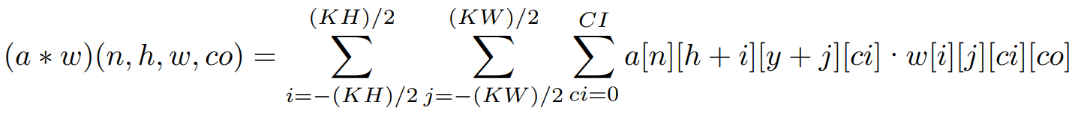

0. Overall Target
Using Nvidia GPU and CUDA Runtime API (CUDA C++), construct customized kernel functions for acceleration of CNN convolution operation of tensors of any shape. API of CUDA deep neural network operator library (cuDNN) is not allowed.
1. Restatement of the Problem
Assume we have a 4-dimention tensor a representing a batched images input. The shape of a is [B, H, W, CI], where B is batch size, H is the height of the image, W is the width, and CI is the number of channels of each input image. All of the 4 parameters are adjustable.
We also have a 4-dimention tensor w representing the convolution kernels. The shape of w is [KH, KW, CI, CO], where KH and KW represents the height and width of convolution kernels, respectively, and CO is the output channels of the convolution operation. All of the 4 parameters are adjustable.
Define the convolution operation of a and w as:
* Note that the batch dimension [B] is not shown in this figure.
Notes:
Building serving system based on the characteristic of the task, gaining more acceleration.

Slide 3
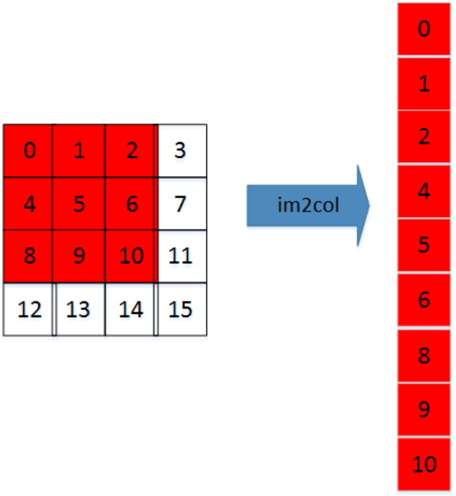

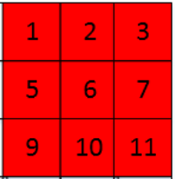
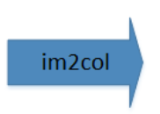
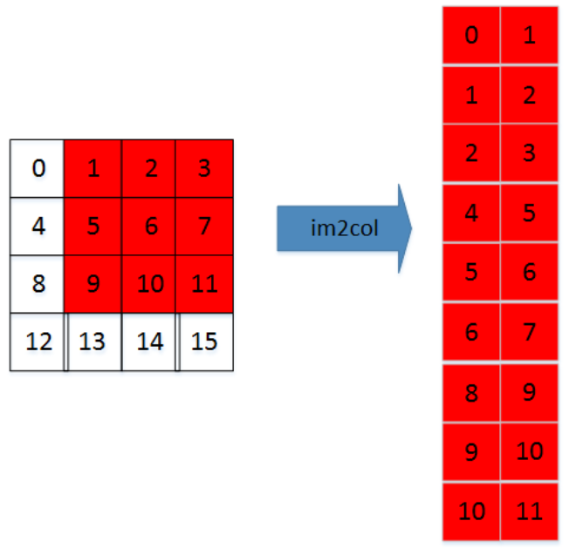
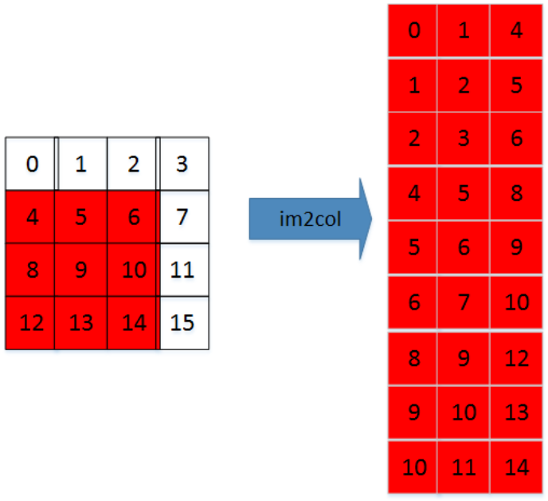
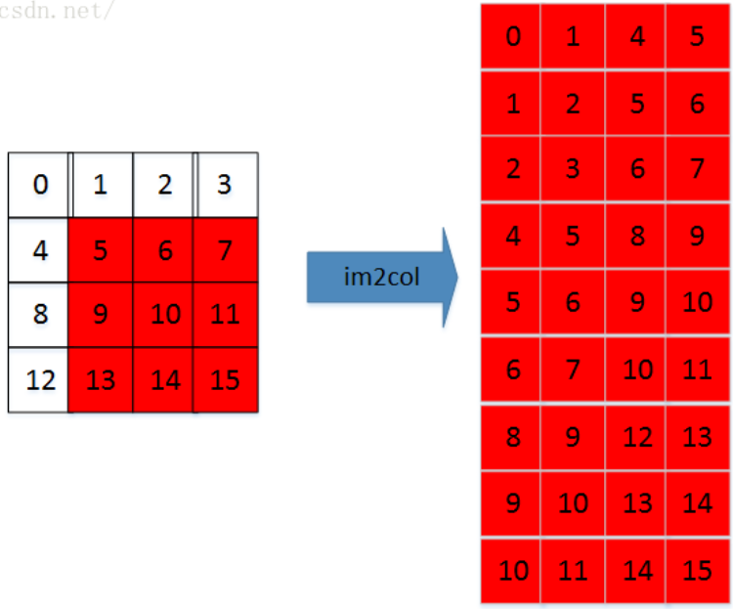
2. im2col Algorithm: Converting Convolution to GEMM
First consider convolution of 2-dimention tensors. That is, a 1-channel image [H, W] and one kernel [KH, KW].
(P1) Single convolution operation is the inner product of two matrices in essence.
(P2) Single calculation of a matrix multiplication product is also the inner product of a row and a column of two input matrices, respectively.
(C1) Derived from (P1) and (P2), we can reshape the matrices of a single convolution operation into row and column vector, a and w respectively. As shown in the figure below:
(P3) Convolution operation is sliding window. Each window of the image can be reshape as a row vector a_{i} .
(C2) Derived from (C1) and (P3), if the vector of each window a_{i} concatenate in column axis, we can get a reshaped matrix A. The multiplication between A and w is the same as the convolution operation between the original image.
image a
kernel w
multiplication = convolution
image a
image a
image a
kernel w
Notes:
For simplicity's sake

Slide 4
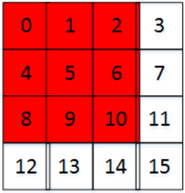
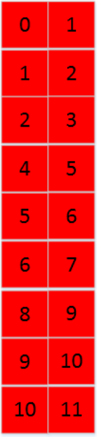
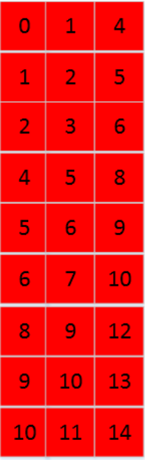
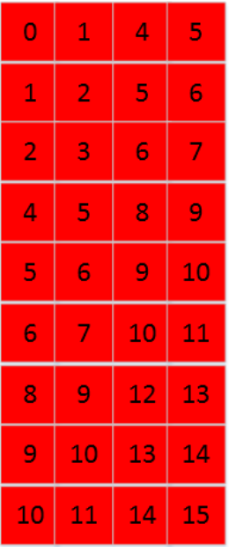
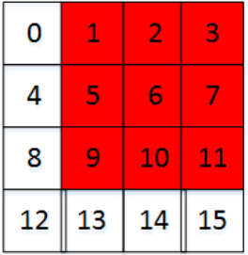
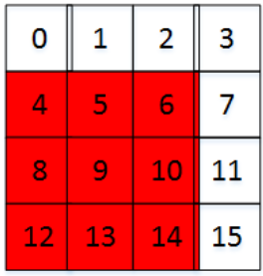
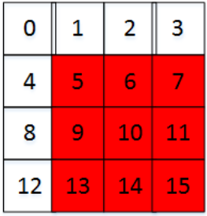
2. im2col Algorithm: Converting Convolution to GEMM
(2) Expand to 3-dimention tensors. That is, a CI-channel image [H, W, CI] and one kernel [KH, KW, CI].
(P4) There is no essential difference between 2-dimention conv and 3-dimention conv. The single operation of 3-dimention convolution is a inner product of 2 cubic matrices.
(C3) The cubic matrices in (P4) can also be reshaped to row vector and column vector. After reshaping, the matrix multiplication is the same as 2-dimention conditions as discussed above.
image a
kernel w
multiplication = convolution
image a
image a
image a
kernel w
Notes:
Building serving system based on the characteristic of the task, gaining more acceleration.

Slide 5
2. im2col Algorithm: Converting Convolution to GEMM
(3) Expand to 4-dimention tensors. That is, a batched CI-channel image [B, H, W, CI] and CO kernels [KH, KW, CI, CO].
(C4) This expand can be transform to GEMM by concatenate the batch dimension [B] to the volume axis of image matrix, and concatenate the output channel dimension to the row axis of kernel matrix.
CO kernels w
batched image a
multiplication = convolution
Now we have converted 4-dimension convolution operation to General Matrix Multiplication (GEMM).
Notes:
Building serving system based on the characteristic of the task, gaining more acceleration.

Slide 6
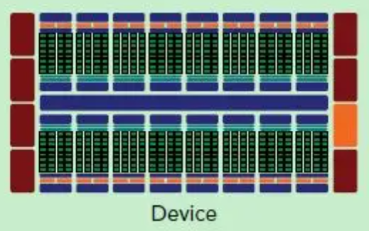
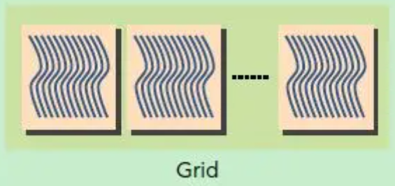
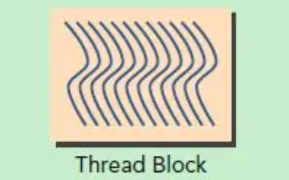
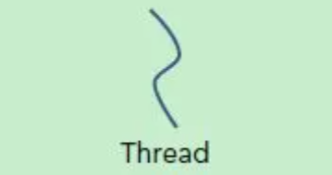
3. Parallel Optimization of GEMM
The Hierarchical Structure of Nvidia GPU Cores
The Hierarchical Structure of Nvidia GPU Memories
CUDA Memory
CUDA Memory can be accessed by every Threads.
Slowest
Shared Memory can only be accessed by Threads on the same Block.
Medium Speed
Shared Memory
Register
Register can only be accessed by one Thread.
Fastest
Notes:
Building serving system based on the characteristic of the task, gaining more acceleration.

Slide 7
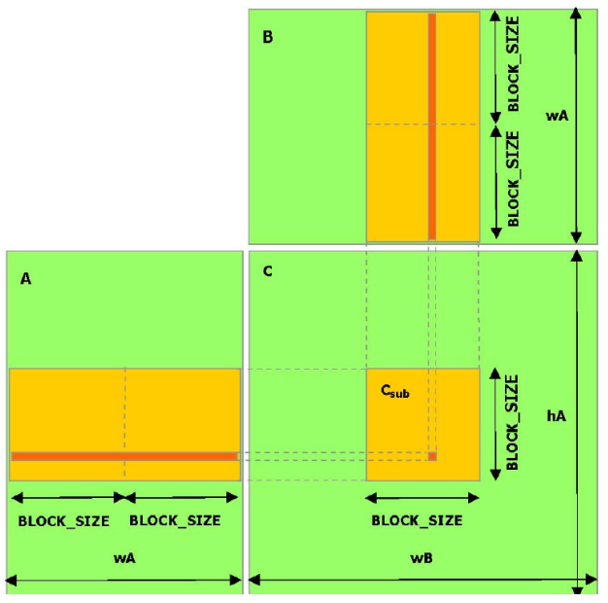
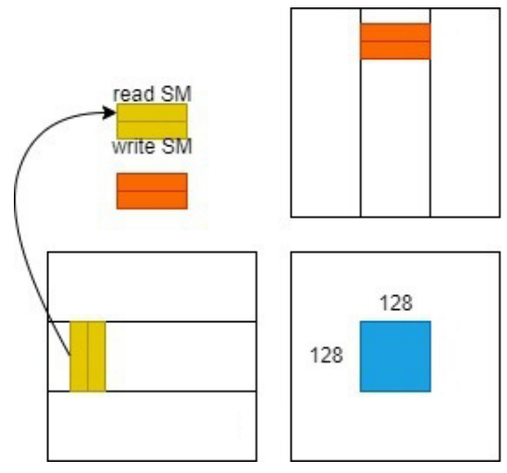
3. Parallel Optimization of GEMM
3.1. Matrix Splitting and Thread Allocation
Based on the computing resources of the target GPU (RTX 2080Ti), divide the result matrix into 128×128 small chunks, each Block calculates one of them. Similar to the partition of a Block, each Thread inside the Block calculates a 16×16 sub-chunk in the chunk. There are 64 Threads per Block.
3.2. Accelerate Memory Access Speed Using Shared Memory
Shared Memory is much faster than CUDA Memory and can be shared across the entire Block. Since data will be accessed multiple times, using Shared Memory can decrease the total memory time.
Shared Memory’s capacity is too small to store all the data required for calculations at once. As shown in the figure left, data is read into shared memory in multiple rounds and batches. The final result can be obtained by accumulating the corresponding results for each round.
Notes:
Building serving system based on the characteristic of the task, gaining more acceleration.

Slide 8
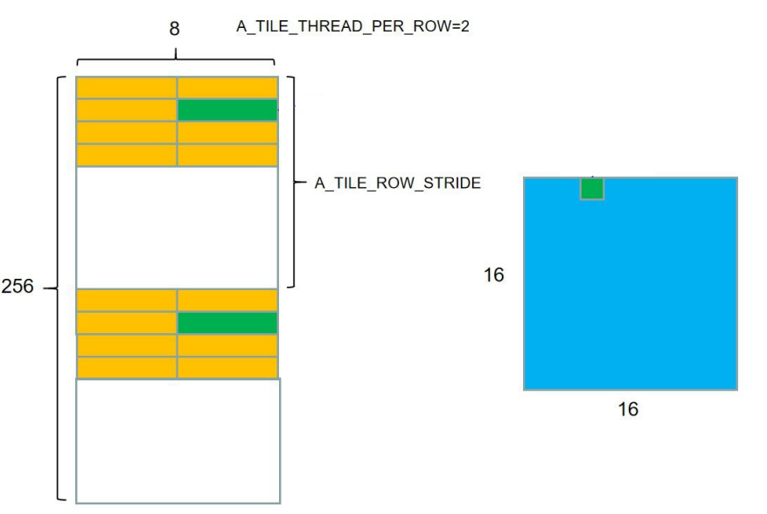
3. Parallel Optimization of GEMM
3.3. Accelerate Memory Access Speed Using Registers
Compared to Shared Memory, Registers have a faster speed but much smaller capacity, and can only be accessed by one Thread.
We can still continue the above approach, since data will be accessed multiple times, using Registers can decrease the total memory time.
As shown in the following figure. Each Thread reads a part of the data it needs from the Shared Memory in batches to the Register for multiple times, and then accumulates the calculation results of each batch to obtain the final result.
Notes:
Building serving system based on the characteristic of the task, gaining more acceleration.

Slide 9
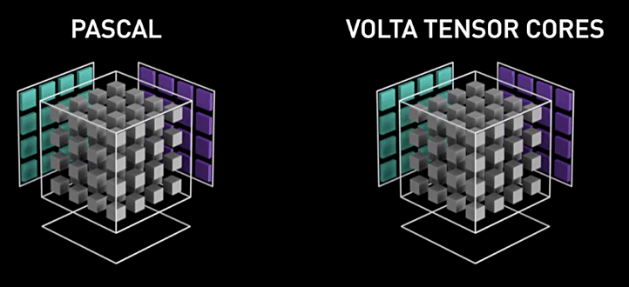

3. Parallel Optimization of GEMM
3.3. Hide Memory Access Latency by reading in Shared Memory and Register Asynchronously
When the Thread is busy on calculating the sub-result of the i-th batch, we can read the data of (i+1)-th batch at the same time (DMA).
In this way, when then calculation of i-th batch is finished, the data of (i+1)-th batch has already prepared. Threads can continue to calculate without any idle.
3.4. Using Vector Data Type to Read 128 bits in One Clock Cycle
Data type Float4 provided by CUDA C++ operates 128 bits in one clock cycle.
Transmit 16 uint8_t variables from CUDA memory to Shared Memory, or from Shared Memory to Registers.
3.5. Tensor Core
Tensor Core is a vector ALU of Nvidia GPUs.
Calculate equation (1) of 128×128 bits matrices in one clock cycle.
(1)
Notes:
Building serving system based on the characteristic of the task, gaining more acceleration.

Slide 10
4. Result
Naïve time: 82,999.985 ms
CUDA time: 199.512 ms
Im2col time: 60.020 ms
accelerate ratio: 416.015 (Ranks 1st among all the course takers.)
5. Conclusions & Insights
Elaborate data preparation takes extra time, but it provides convenience for subsequent steps, and the extra time can be covered by the acceleration of following steps.
im2col.
Shared Memory and Registers.
Data padding for full parallelism of LLM serve.
(2) Hotter data, which is frequently accessed, should be put in faster memories.
Shared Memory and Registers.
Cached tokens of LLM serve.
(3) Faster heterogeneous devices have more restrictions
Speed: Tensor Core > CUDA Core > CPUs.
Restrictions: Tensor Core > CUDA Core > CPUs.
(4) Never left any device in idle.
Using DMA to copy data between CUDA Memory, Shared Memory and Registers, when the Threads is busy in calculation.
Notes:
Building serving system based on the characteristic of the task, gaining more acceleration.

