Slide 1
Introduction to Routing
COSC264
Introduction to Computer Networks and the Internet
Dr Barry Wu
Wireless Research Centre (WRC)
University of Canterbury
Barry.wu@canterbury.ac.nz

Slide 2
Learning Objectives
At the end of the lectures, you will be able to:
Define the term routing
Describe the term autonomous system
Understand the difference between forwarding and routing
Understand the principal routing strategies
Discuss approaches to routing
Compare and contrast the two representative routing algorithms

Slide 3
Outline
Routing overview
Link state routing (Dijkstra’s algorithm)
Distance vector routing (Bellman-Ford algorithm)
Summary
Notes:
Two classes of algorithms

Slide 4
Routing Overview

Slide 5
What is routing?
A famous quotation from RFC 791 Internet Protocol
“A name indicates what we seek. An address indicates where it is. A route indicates how we get there.” -- Jon Postel
Routing refers to the network-wide process that determines the end-to-end paths that packets take from source to destination.
Source: https://en.wikipedia.org/wiki/Routing
Notes:
Routing is the main function of the network layer in the OSI model.
RFC: a formal document from the Internet Engineering Task Force (IETF) that contains specifications about the internet and computer networking topics.
Jon Postel was an American computer scientist who made many significant contributions to the development of the Internet, particularly with respect to standards.

Slide 6
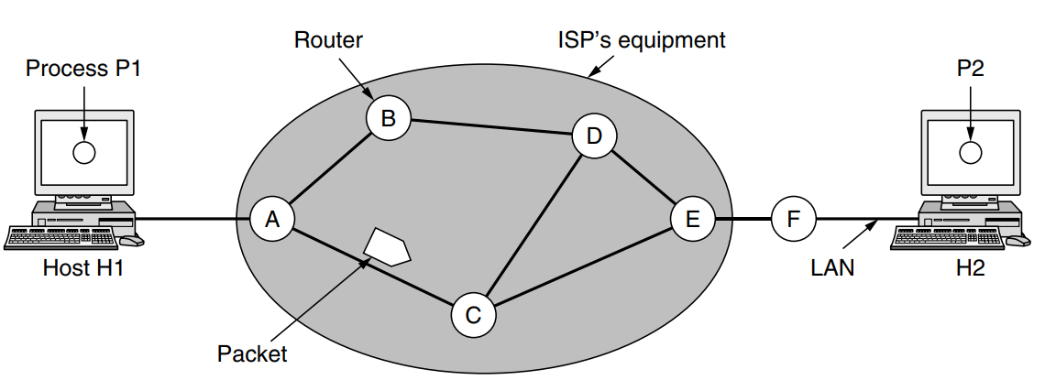
How does routing occur?
The environment of the network layer protocols
Source: Andrew S. Tanenbaum & David J. Wetherall, Computer Networks, 5th edition, 2010, Figure 5-1.
Notes:
The context in which the network layer protocols operate
The major components of the network are the ISP’s equipment (routers connected by transmission lines)
A host sends a packet to the nearest router, either on its own LAN or over a point-to-point link to the ISP.
Then it is forwarded to the next router along the path until it reaches the destination host, where it is delivered.

Slide 7
Why does routing matter?
The network needs to work out the path from the sender to the receiver automatically in a dynamic environment.
Notes:
More precisely, from the sending router to the receiving router!!
End-to-end performance
• Quality of the path affects user performance
• Propagation delay and throughput
Use of network resources
• Balance of the traffic over the routers and links
• Avoiding congestion by directing traffic to lightly loaded links
Transient disruptions during changes
• Router failures and maintenance
• Limiting packet loss during changes
Efficient routing minimises delays, reduces congestion, and ensures that data packets are delivered efficiently.

Slide 8
Autonomous System (AS)
An AS exhibits the following characteristics:
is a set of routers and networks managed by a single organisation
typically consists of a group of routers exchanging information via a common routing protocol
is connected, except in times of failure
Notes:
To proceed with our discussion of routing protocols, we need to introduce the concept of an AS.
3. Except in times of failure, an AS is connected (in a graph-theoretic sense);
that is, there is a path between any pair of nodes.

Slide 9
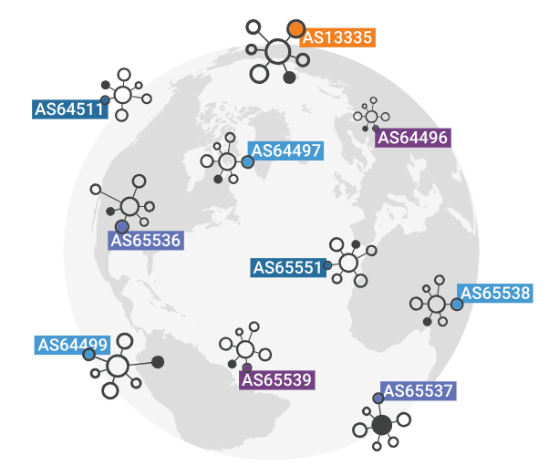
AS Examples
Each AS is assigned an autonomous system number (ASN)
Typically each Internet Service Provider (ISP) is an AS
Other AS examples: corporations, universities​
Source: https://www.cloudflare.com/learning/network-layer/what-is-an-autonomous-system/
Notes:
The Internet can be viewed as a collection of networks or ASs that are interconnected.
Google operates its own AS (AS15169) to manage its extensive network infrastructure and ensure efficient routing of data across its global data centres.
Amazon: Amazon has its own AS (AS16509) for Amazon Web Services (AWS) and other network operations, managing traffic for its cloud services and e-commerce platforms.

Slide 10
Common Types of ASs
ASs are categorised depending on the way they are connected.
Stub AS
is only connected to another AS
e.g., AS1, AS5
Multi-homed AS
has more than one connection to other ASs, but does not allow traffic to pass through
e.g., AS2
Transit AS
is connected to more than one AS and allows the traffic to pass through
e.g., AS3, AS4
Source: https://en.wikipedia.org/wiki/Autonomous_system_(Internet)

Slide 11
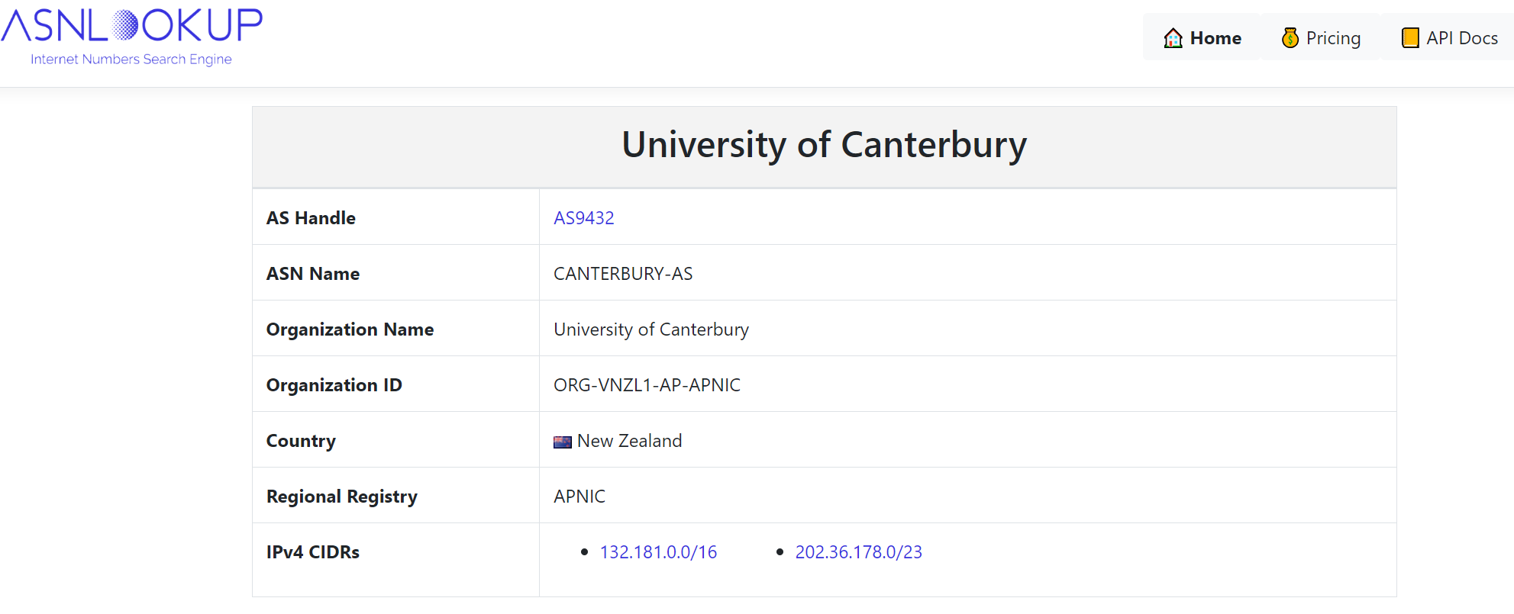
ASN Lookup
Source: https://asnlookup.com/asn/AS9432/
Notes:
AS handle is the unique identifier.
There are five Regional Internet Registries (RIRs) for different service regions.
APNIC is the Asia Pacific Regional Internet Registry for the Asia-Pacific region.
Classless Inter-Domain Routing (CIDR) is an IP address allocation method that improves data routing efficiency on the internet.

Slide 12
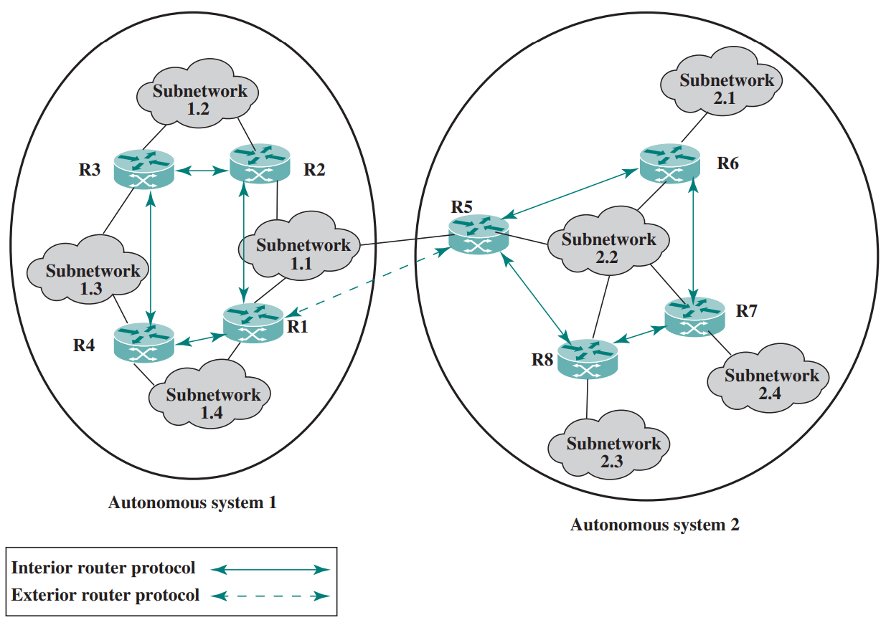
Exterior and Interior Routing Protocols
Interior router protocol within AS
Exterior router protocol for AS-to-AS routing
Source: William Stallings, Data and Computer Communications, 10th edition, 2013, Figure 19.9.
Notes:
IRP: pass routing information between routers within an AS.
The protocol used within the AS does not need to be implemented outside of the system.
This flexibility allows IRPs to be custom tailored to specific applications and requirements.
ERP: pass routing information between routers in different ASs.
The routing algorithms and information in routing tables used by routers in different ASs may differ.
Route redistribution for different routing protocols within the same AS and between ASs
- share routing information between different routing protocols within a network

Slide 13
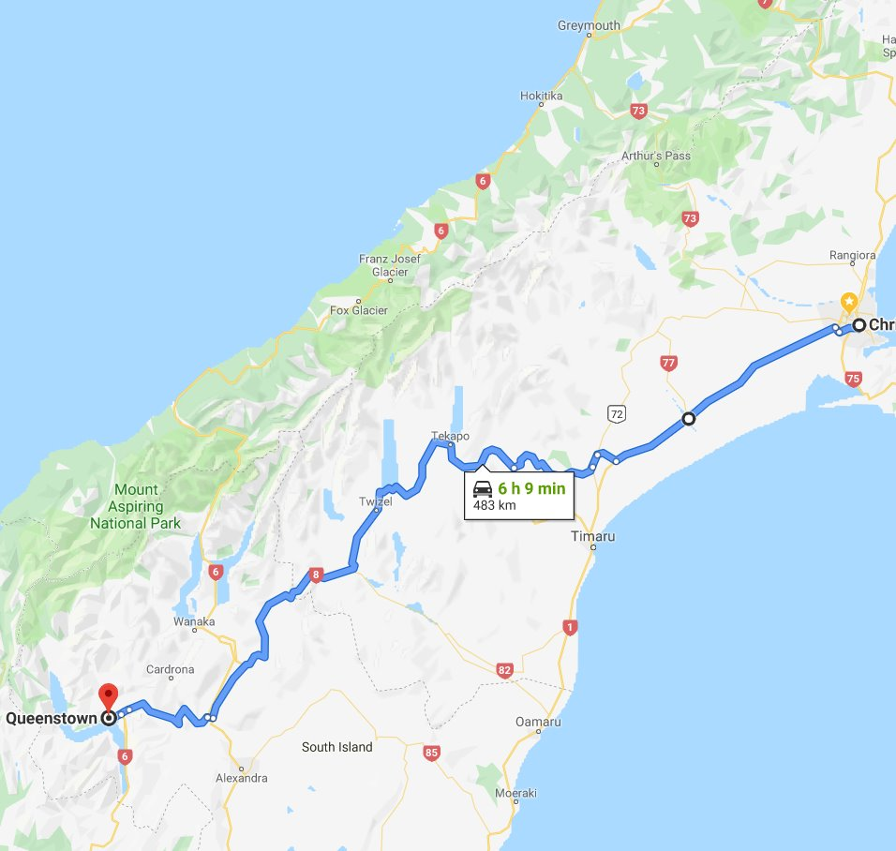
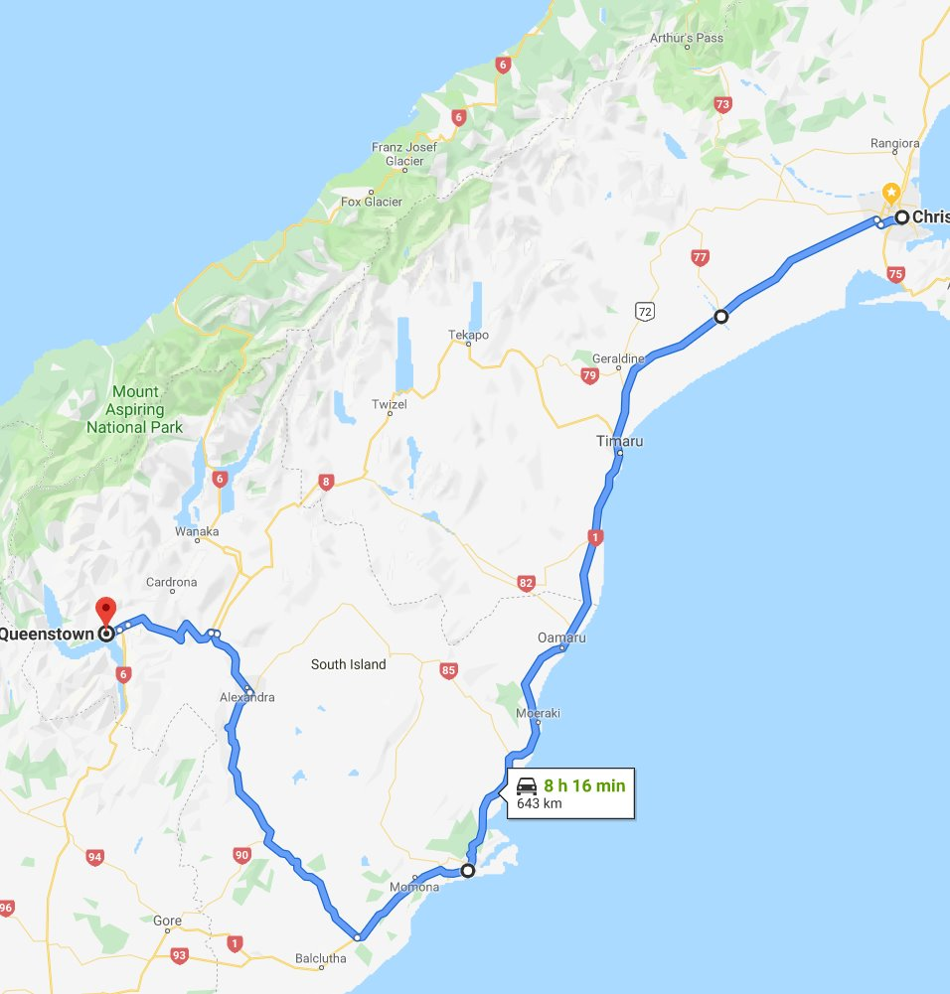
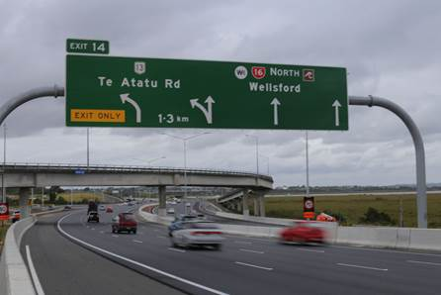
Routing vs. Forwarding
Routing: determine which paths to use
Routing algorithms calculate these paths
Forwarding: handle each packet as it arrives
The router consults a forwarding table to decide which output link to send the packet
Notes:
To move packets from a sending host to a receiving host, two important network-layer functions can be identified.
Routing: planning trip from source to destination
Forwarding is per-packet decision
Forwarding: determining which exits to take on a motor way

Slide 14
Routing vs. Forwarding (cont.)
Routing: computing paths the packets will follow
routers talking amongst themselves and jointly creating forwarding tables
non-real time: latency up to 2 minutes
Forwarding: directing every data packet to an outgoing link
individual router using a forwarding table
real time; may be implemented in specialised hardware
Notes:
normally only between routers
To achieve the required speed and efficiency, packet forwarding is often implemented in specialised hardware (custom-design or reconfigurable chips).

Slide 15
Forwarding Table
A forwarding table:
results from the execution of the routing protocol (dynamic routing, or static / preconfigured routing)
is consulted for every packet
is changed on relatively large timescales, e.g., upon topology changes, load changes or changes in metrics
At minimum, this contains the interface identifier and next hop information for each reachable destination network prefix.
Source: https://datatracker.ietf.org/doc/html/rfc3222#section-5.3
Notes:
Forwarding table entries are often populated by routing.
Topology Changes: links going up or down, routers may need to update their forwarding tables to reflect the new paths available for packet forwarding.
Load Changes: Changes in network traffic patterns or congestion levels may require routers to adjust their forwarding decisions to optimise traffic flow and balance load across network links.
Metric Changes: link bandwidth, delay, or cost to calculate the best paths to network destinations.
If these metrics change (e.g., due to link upgrades or failures), routers may need to update their forwarding tables accordingly.

Slide 16
Routing and Forwarding
Routing algorithm
Replaced by CIDR IP address
(e.g., 200.23.16.0/24)
Local forwarding table
header value
output link
Next-hop | flags
0100
0101
0111
1001
3
2
2
1
Value in arriving
packet’s header
0111
1
3
2
Notes:
Every router has a forwarding table.
A router forwards a packet by examining the value of a field in the arriving packet's header and then using this header value to index into the router's forwarding table.
The header value
- Indicate the router's outgoing link interface to which that packet is to be forwarded
- Represent the destination network
Classless Inter-Domain Routing is a method for allocating IP addresses for IP routing.

Slide 17
Q: What is the difference between routing algorithms and routing protocols?

Slide 18
Routing Algorithms and Routing Protocols
A routing algorithm solves a routing problem with ideal assumptions.
A routing protocol
embeds a routing algorithm into a real networking context:
It operates in a distributed environment
It incorporates explicit information exchange among nodes
Information exchange takes time and might fail, the protocol must consider these possibilities
Notes:
Distributed: each router independently determines the best paths based on routing information it receives from its neighbours.

Slide 19
Routing Strategies
Fixed/static routing
A single, permanent route is configured for each source-destination pair of nodes in the network.
The routes are fixed, or at least only change when there is a change in the topology of the network.
Flooding
A packet is sent by a source node to every one of its neighbours.
At each node, an incoming packet is retransmitted on all outgoing links except for the link on which it arrived.
Adaptive/dynamic routing
Routing decisions change as conditions on the network change, such as failure or congestion.
Information about the state of the network must be exchanged among the nodes.
Random routing
A node selects only one outgoing path for retransmission of an incoming packet.
The outgoing link is chosen at random, excluding the link on which the packet arrived.
Notes:
Fixed: simple, low overhead on the routers; manual updates of the routes
Flooding: broadcast or distribute some advertisement to all nodes in a network.
In virtually all packet-switching networks, some sort of adaptive routing technique is used.
Failure: if a node or link fails, it can no longer be used as part of a route.
Congestion: if a particular portion of the network is heavily congested, it is desirable to route packets around rather than through the area of congestion.
Drawbacks:
The routing decision is more complex; therefore, the processing burden on network nodes increases.
Trade-off between the quality of the information and the amount of overhead
Random routing: implemented in telecommunication networks (Valiant load balancing) to improve load distribution

Slide 20
Approaches to Routing
Distance-vector routing
Each router maintains a vector giving the best-known distance to each destination and which link to use to get there.
These vectors are updated by exchanging information with the neighbours.
Each router builds up a routing database based on neighbour updates.
Link-state routing
When a router is initialised, it determines the link cost on each of its network interfaces.
The router advertises this set of link costs to all other routers in the internet topology.
Each router builds up the complete topology of the configuration and then performs a routing calculation.
Notes:
Internet routing protocols employ some approaches to gathering and using routing information.
DV:
Each router exchanges information with its neighbouring nodes.
Require the transmission of a considerable amount of information by each router.
When there is a significant change in a link cost or when a link is unavailable, it may take a considerable amount of time for this information to propagate through the network.

Slide 21
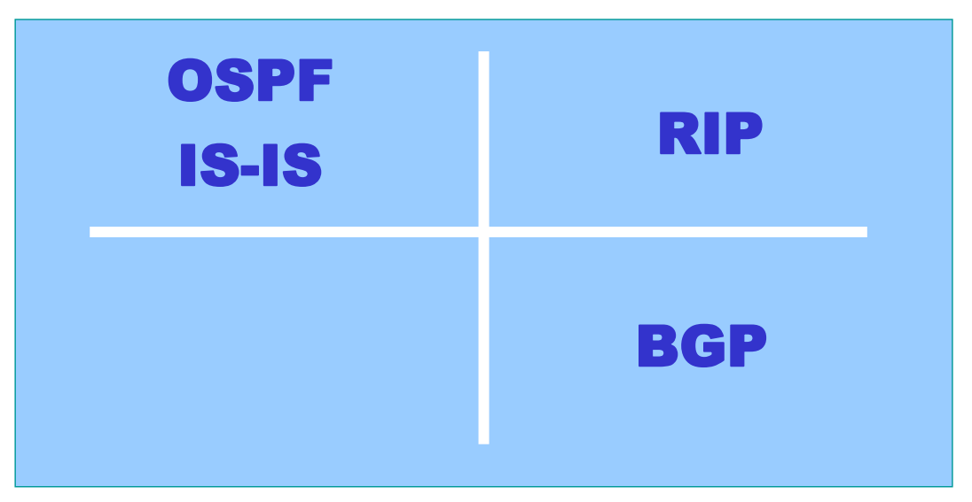
Common Routing Protocols
Link-state routing
Vector routing (distance or path)
Interior router protocol
Exterior router protocol
Open Shortest Path First (OSPF)
Intermediate System – Intermediate System (IS-IS)
Routing Information Protocol (RIP)
Border Gateway Protocol (BGP)
Notes:
Path-vector routing: a path vector lists the ASs that a packet must traverse if it follows this
Provide information about which networks can be reached by a given router and the ASs that must be crossed to get there.

Slide 22
Modelling a Network
Modelled as a graph
Routers ⇒ vertices
Links ⇒ edges
Edge labels (called metrics) can be interpreted differently
as costs, such as the value that is inversely related to the data rate, the current queuing delay
5
3
2
4
2
5
1
2
1
6
3
1
2
3
5
1
An example network graph
Notes:
The higher the data rate on a link, the lower the assigned cost of the link
Weighted graph

Slide 23
Least-Cost Routing Algorithms
Find a path with the least cost
5
1
3
2
1
4
2
4
1
2
5
1
1
2
1
6
1
1
1
6
3
1
1
1
1
3
2
3
5
5
1
1
Notes:
Virtually all packet-switching networks base their routing decision on some form of least-cost criterion.
Given a network of nodes connected by bidirectional links, where each link has a cost associated with it in each direction, define the cost of a path between two nodes as the sum of the costs of the links traversed.
For each pair of nodes, find a path with the least cost.
If the criterion is to minimise the number of hops, each link has a value of 1.
Note that the cost of a link may differ in its two directions.
Link capacities in each direction
Service agreements for incoming and outgoing traffic

Slide 24
Link State Routing (Dijkstra’s Algorithm)

Slide 25
Link State Routing
Each router has the complete network picture
Topology
Link costs
How does each router get the global state?
Discover its neighbours and learn their network addresses.
Set the distance or cost metric to each of its neighbours.
Construct a packet telling all it has just learned.
Send this packet to and receive packets from all other routers.
Notes:
1. Beaconing: periodic “hello” messages in both directions
2. The cost to reach neighbours can be set automatically or configured by the network operator.
A common choice is to make the cost inversely proportional to the bandwidth of the link.
This makes higher-capacity paths better choices.

Slide 26
Link State Routing: Control Traffic
Each router reliably floods information about its neighbours to every other router
Host C
Host A
Host D
N1
N2
N3
N5
Host B
N4
Host E
N6
N7
Notes:
Distributing the link state packets
Flooding is used in computer network routing algorithms in which every incoming packet is sent through every outgoing link except the one it arrived on.
Ensure all nodes receive link-state information
Broadcast storm: when there is an excessive amount of broadcast traffic on a network, which can overwhelm network resources and degrade performance.
Spanning Tree Protocol

Slide 27
Link State Routing: Node State
A
C
Host C
A
C
D
D
A
C
D
Host A
Host D
B
E
B
E
B
E
N1
N2
A
C
D
N3
A
C
D
B
N5
E
C
A
D
B
E
A
C
D
Host B
B
N4
Host E
E
N6
B
E
N7
Notes:
Each node ends up knowing the entire network topology.

Slide 28
Link State Routing: Computing the New Routes
Each router independently calculates the shortest path from itself to every other router
Using, for example, Dijkstra’s Algorithm
Each router constructs a forwarding table for all destinations
u
Destination | Next hop
u | x
v | y
… | …
x
w
y
v

Slide 29
Dijkstra’s Algorithm
Basic idea: find the shortest paths from a given source node to all other nodes by developing the paths in order of increasing path length.
Source: E. W. Dijkstra (1959). A note on two problems in connexion with graphs. Numerische Mathematik, vol. 1, pp. 269-271.
Notes:
We want to find the least-cost path from u to all the remaining nodes:
We find the least-cost path from u to its direct neighbor x.
If we can find a better path from u to any node via x; we record this path.

Slide 30
Dijkstra’s Algorithm (cont.)
INPUT:
Network topology (graph), with link costs
OUTPUT:
Least cost paths from one node to all other nodes

Slide 31
Dijkstra’s Algorithm (cont.)
S: nodes whose least-cost paths already known
Initially, S = {u} where u is the source node
c(i,j): link cost from node i to j; cost infinite if not direct neighbors; ≥ 0
D(v): cost of the least-cost path from source u to node v
p(v): predecessor node along the path from source u to v, that is next to v
5
B
3
C
2
5
A
2
1
F
3
1
2
D
E
1

Slide 32
Dijkstra’s Algorithm (cont.)
1 Initialisation:
2 S = {u} /* u is the source*/
3 for all nodes v
4 if v is adjacent to u
5 D(v) = c(u,v) /* cost of neighbours known*/
6 else D(v) = ∞ /* cost of others unknown*/
7
8 Loop:
9 find w not in S with the smallest D(w)
10 add w to S
11 update D(v) for all v adjacent to w and not in S:
if D(w) + c(w,v) < D(v) then
D(v) = D(w) + c(w,v); p(v) = w;
/* new cost to v is either old cost to v or known
shortest path cost to w plus cost from w to v */
13 until all nodes in S
Notes:
D(v): cost of the least-cost path
Iterative algorithms use loops to repeatedly execute a set of operations.

Slide 33
Example: Dijkstra’s Algorithm
Step
0
1
2
3
4
5
start S
A
D(B),p(B)
2,A
D(C),p(C)
5,A
D(D),p(D)
1,A
D(E),p(E)
D(F),p(F)
5
1 Initialisation:
2 S = {A};
3 for all nodes v
4 if v is adjacent to A
5 then D(v) = c(A,v);
6 else D(v) = ;
…
B
3
C
2
5
A
2
1
F
3
1
2
D
E
1

Slide 34
Example: Dijkstra’s Algorithm (cont.)
Step
0
1
2
3
4
5
start S
A
D(B),p(B)
2,A
D(C),p(C)
5,A
D(D),p(D)
1,A
D(E),p(E)
D(F),p(F)
…
8 Loop
9 find w not in S s.t. D(w) is a minimum;
10 add w to S;
update D(v) for all v adjacent
to w and not in S:
if D(w) + c(w,v) < D(v) then
D(v) = D(w) + c(w,v); p(v) = w;
13 until all nodes in S;
5
B
3
C
2
5
A
2
1
F
3
1
2
D
E
1
Notes:
D(v): cost of the least-cost path from source u to node v

Slide 35
Example: Dijkstra’s Algorithm (cont.)
Step
0
1
2
3
4
5
start S
A
AD
D(B),p(B)
2,A
D(C),p(C)
5,A
D(D),p(D)
1,A
D(E),p(E)
D(F),p(F)
…
8 Loop
9 find w not in S s.t. D(w) is a minimum;
10 add w to S;
update D(v) for all v adjacent
to w and not in S:
if D(w) + c(w,v) < D(v) then
D(v) = D(w) + c(w,v); p(v) = w;
13 until all nodes in S;
5
B
3
C
2
5
A
2
1
F
3
1
2
D
E
1

Slide 36
Example: Dijkstra’s Algorithm (cont.)
Step
0
1
2
3
4
5
start S
A
AD
D(B),p(B)
2,A
D(C),p(C)
5,A
4,D
D(D),p(D)
1,A
D(E),p(E)
2,D
D(F),p(F)
…
8 Loop
9 find w not in S s.t. D(w) is a minimum;
10 add w to S;
update D(v) for all v adjacent
to w and not in S:
if D(w) + c(w,v) < D(v) then
D(v) = D(w) + c(w,v); p(v) = w;
13 until all nodes in S;
5
B
3
C
2
5
A
2
1
F
3
1
2
D
E
1
Notes:
D(D) + c(D,B) = 1 + 2 = 3
D(D) + c(D,C) = 1 + 3 = 4
D(D) + c(D,E) = 1 + 1 = 2

Slide 37
Example: Dijkstra’s Algorithm (cont.)
Step
0
1
2
3
4
5
start S
A
AD
ADE
D(B),p(B)
2,A
D(C),p(C)
5,A
4,D
3,E
D(D),p(D)
1,A
D(E),p(E)
2,D
D(F),p(F)
4,E
…
8 Loop
9 find w not in S s.t. D(w) is a minimum;
10 add w to S;
update D(v) for all v adjacent
to w and not in S:
if D(w) + c(w,v) < D(v) then
D(v) = D(w) + c(w,v); p(v) = w;
13 until all nodes in S;
5
B
3
C
2
5
A
2
1
F
3
1
2
D
E
1
Notes:
D(C) = 4
D(E) + c(E,C) = 3
D(F)
D(E) + c(E,F) = 4
Random selection
Priority queue
All nodes will eventually be processed, and the least cost paths will be correctly computed.

Slide 38
Example: Dijkstra’s Algorithm (cont.)
Step
0
1
2
3
4
5
start S
A
AD
ADE
ADEB
D(B),p(B)
2,A
D(C),p(C)
5,A
4,D
3,E
D(D),p(D)
1,A
D(E),p(E)
2,D
D(F),p(F)
4,E
…
8 Loop
9 find w not in S s.t. D(w) is a minimum;
10 add w to S;
update D(v) for all v adjacent
to w and not in S:
if D(w) + c(w,v) < D(v) then
D(v) = D(w) + c(w,v); p(v) = w;
13 until all nodes in S;
5
B
3
C
2
5
A
2
1
F
1
3
D
E
2
1
Notes:
D(C) = 3
D(B) + c(B,C) = 5

Slide 39
Example: Dijkstra’s Algorithm (cont.)
Step
0
1
2
3
4
5
start S
A
AD
ADE
ADEB
ADEBC
D(B),p(B)
2,A
D(C),p(C)
5,A
4,D
3,E
D(D),p(D)
1,A
D(E),p(E)
2,D
D(F),p(F)
4,E
…
8 Loop
9 find w not in S s.t. D(w) is a minimum;
10 add w to S;
update D(v) for all v adjacent
to w and not in S:
if D(w) + c(w,v) < D(v) then
D(v) = D(w) + c(w,v); p(v) = w;
13 until all nodes in S;
5
B
3
C
2
5
A
2
1
F
3
1
2
D
E
1
Notes:
D(F) = 4
D(C) + c(C,F) = 3 + 5 = 8

Slide 40
Example: Dijkstra’s Algorithm (cont.)
Step
0
1
2
3
4
5
start S
A
AD
ADE
ADEB
ADEBC
ADEBCF
D(B),p(B)
2,A
D(C),p(C)
5,A
4,D
3,E
D(D),p(D)
1,A
D(E),p(E)
2,D
D(F),p(F)
4,E
…
8 Loop
9 find w not in S s.t. D(w) is a minimum;
10 add w to S;
update D(v) for all v adjacent
to w and not in S:
if D(w) + c(w,v) < D(v) then
D(v) = D(w) + c(w,v); p(v) = w;
13 until all nodes in S;
5
B
3
C
2
5
A
2
1
F
3
1
2
D
E
1

Slide 41
Example: Dijkstra’s Algorithm (cont.)
Step
0
1
2
3
4
5
start S
A
AD
ADE
ADEB
ADEBC
ADEBCF
D(B),p(B)
2,A
D(C),p(C)
5,A
4,D
3,E
D(D),p(D)
1,A
D(E),p(E)
2,D
D(F),p(F)
4,E
…
8 Loop
9 find w not in S s.t. D(w) is a minimum;
10 add w to S;
update D(v) for all v adjacent
to w and not in S:
if D(w) + c(w,v) < D(v) then
D(v) = D(w) + c(w,v); p(v) = w;
13 until all nodes in S;
5
B
3
C
2
5
A
2
1
F
3
1
2
D
E
1
Notes:
To determine path A -> F, work backward

Slide 42
The Forwarding Table
Running Dijkstra at node A gives the shortest path from A to all destinations
We then construct the forwarding table
Destination | Next hop
B | B
C | D
D | D
E | D
F | D
5
B
3
C
2
5
A
2
1
F
3
1
2
D
E
1

Slide 43
When to initiate flooding?
Topology change
Link or node failure
Link or node recovery
Configuration change
Link cost change
Periodically
Typically, 30 minutes
Corrects for possible corruption of the data
Notes:
New nodes or links
Periodic:
Refresh the link-state information to avoid stale information.
Software bugs during LSA generation
Transmission errors due to physical issues on the network links
Memory corruption in storage of the database
This ensures that corrupted or lost data can be corrected and that all routers maintain an accurate view of the network.

Slide 44
Convergence
Consistent routing information to all nodes
All nodes have the same link-state database
Consistent forwarding after convergence
All nodes have the same link-state database
All nodes forward packets on shortest paths
Notes:
An iterative algorithm is said to converge when as the iterations proceed the output gets closer and closer to a specific value.
Specific value: could be a fixed point, or optimal solution.

Slide 45
Transient Disruptions
Detection delay
A node does not detect a failed link immediately and forwards data packets into a “blackhole”
Depends on timeout for detecting lost “hellos”
Inconsistent link-state database
Some routers know about failure before others
The shortest paths are no longer consistent
Notes:
Transient disruption: temporary interruptions or inconsistencies in the forwarding of packets across a network.
10 seconds, 60 seconds, 5 seconds
Timeout: detect a failure after a few missed “hellos”
40 seconds, 60 seconds, 15 seconds
Faster detection
- Smaller hello timers
- Link-layer technologies that can detect failures
Faster flooding
- Flooding immediately
- Sending link-state packets with high-priority

Slide 46
Oscillation with Link State Routing
w
w
1+e
0
1
2+e
x
1
z
x
1
1
z
1
1
0
0
1+e
0
y
e
0
y
0
e
e
a. Initial routing
b. Recompute
w
w
2+e
0
0
2+e
1
z
x
1
1
z
x
1
0
0
1+e
1
1
y
1+e
0
y
0
e
e
c. Recompute
d. Recompute
Notes:
Routing tables continuously change and fluctuate.
This can lead to instability in the network and inefficient routing.
If there are frequent changes in link costs (congestion or delay-based metrics), it can cause routers to recalculate and oscillate between different routing paths.
Assume link cost = amount of carried traffic on the link
a. All traffic sent to w
b. x, y detect better path to w, clockwise
c. x, y, z detect a zero-cost path to w, counterclockwise, route their traffic to the counterclockwise routes
d. x, y, z detect a zero-cost path to w, clockwise
Traditional Internet routing protocols (RIP, OSPF, and BGP) are load-insensitive.​
Link costs don’t change dynamically based on the current network load or congestion.
Advanced routing protocols like MPLS and Segment Routing, and enhancements to BGP are helping to address the need for more dynamic and load-aware routing solutions.
Better performance during high-traffic periods, reducing congestion
More responsive to congestion
More efficient use of network resources.

Slide 47
Distance Vector Routing (Bellman-Ford Algorithm)
Notes:
The distance vector routing algorithm is sometimes called by other names, most commonly the distributed Bellman-Ford routing algorithm.

Slide 48

Bellman-Ford Equation
Define
d_{x}(y) := cost of least-cost path from x to y
Then
d_{x}(y) = $\min_{v}${c(x,v) + d_{v}(y) }
where $min$ is taken over all neighbors of x.
“After travelling from x to v, if we then take the least-cost path from v to y, the path cost is c(x,v)+ d_{v}(y). Since we must begin by travelling to some neighbor v, the least-cost from x to y is the minimum of c(x,v)+ d_{v}(y) taken over all neighbors v.” from [KR3]
Notes:
y in RIP is a destination subnet;

Slide 49
Bellman-Ford example
To calculate d_{u}(z), according to B-F equation:
5
3
d_{u}(z) = min { c(u,v) + d_{v}(z),
c(u,x) + d_{x}(z),
c(u,w) + d_{w}(z) }
= min {2 + 5,
1 + 3,
5 + 3} = 4
v
w
2
5
u
2
1
z
3
1
2
x
y
1
Clearly, d_{v}(z) = 5, d_{x}(z) = 3, d_{w}(z) = 3
Node that achieves minimum is the next
hop in shortest path.

Slide 50
Distance Vector Algorithm
Estimates:
D_{x}(y) = estimate of least cost from x to y
Distance vector: D_{x} = [D_{x}(y): y є N ]
Each node x:
Node x knows cost to each neighbor v: c(x,v)
Node x maintains D_{x} = [D_{x}(y): y є N ]
Node x also maintains its neighbors’ distance vectors
For each neighbor v, x maintains D_{v} = [D_{v}(y): y є N ]

Slide 51
An illustration
Distance vectors at node u
u
v
D_{u}
D_{v}
x
w
D_{x}

Slide 52
Distance vector algorithm
Basic idea:
Each node periodically sends its own distance vector estimate to neighbours
When a node x receives new DV estimate from neighbor, it updates its own DV using B-F equation:
D_{x}(y) ← min_{v}{c(x,v) + D_{v}(y)} for each node y ∊ N
Amazingly, as long as all the nodes continue to exchange their distance vectors in an asynchronous fashion, the estimate D_{x}(y) converges to the actual least cost d_{x}(y)

Slide 53
Distance Vector Algorithm
Iterative, asynchronous: each local iteration caused by:
local link cost change
DV update message from neighbour
Distributed:
each node notifies neighbours only when its DV changes
neighbours then notify their neighbours if necessary
Each node:
wait for (change in local link cost or msg from neighbor)
recompute estimates
if DV to any dest has changed, notify neighbors

Slide 54
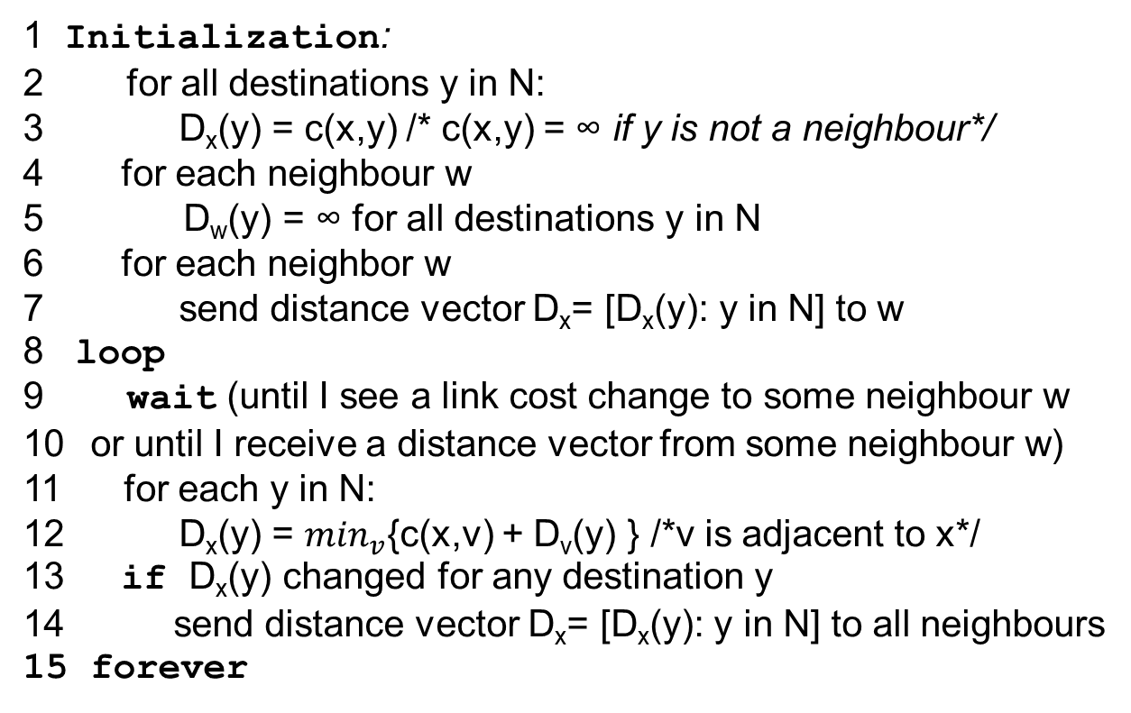
Distance Vector Algorithm
At each node, x:
1 Initialization:
2 for all destinations y in N:
3 D_{x}(y) = c(x,y) /* c(x,y) = ∞ if y is not a neighbour*/
for each neighbour w
D_{w}(y) = ∞ for all destinations y in N
for each neighbor w
7 send distance vector D_{x}= [D_{x}(y): y in N] to w
8 loop
9 wait (until I see a link cost change to some neighbour w
or until I receive a distance vector from some neighbour w)
11 for each y in N:
12 D_{x}(y) = $\min_{v}${c(x,v) + D_{v}(y) } /*v is adjacent to x*/
if D_{x}(y) changed for any destination y
send distance vector D_{x}= [D_{x}(y): y in N] to all neighbours
forever
Notes:
Min_v is necessary because the new dv may bring bigger values. You still need to enumerate all possible neighbours.

Slide 55
D_{x}(y) = min{c(x,y) + D_{y}(y), c(x,z) + D_{z}(y)} = min{2+0 , 7+1} = 2
D_{x}(z) = min{c(x,y) + D_{y}(z), c(x,z) + D_{z}(z)}
= min{2+1 , 7+0} = 3
node x table
cost to
cost to
cost to
x y z
x y z
x y z
x
0 2 7
x
0 2 3
x
0 2 3
y
y
from
∞
∞
∞
from
2 0 1
y
from
2 0 1
z
∞
∞
∞
z
7 1 0
z
3 1 0
node y table
cost to
cost to
cost to
x y z
x y z
x y z
y
2
1
x
∞
∞
x
0 2 7
∞
2 0 1
x
0 2 3
x
z
y
y
from
from
2 0 1
y
2 0 1
7
from
z
∞
∞
∞
z
7 1 0
z
3 1 0
node z table
cost to
cost to
cost to
x y z
x y z
x y z
x
∞ ∞ ∞
x
0 2 7
x
0 2 3
y
y
2 0 1
y
from
2 0 1
from
from
∞
∞
∞
z
z
3 1 0
z
3 1 0
7
1
0
time
Notes:
In RIP, routing table is used and it combines the forwarding table and distance vector.

Slide 56
Distance Vector: link cost changes
D_{y}(x) =min{c(y,x)+ D_{x}(x), c(y,z)+ D_{z}(x)} = min{1+0, 1+5} = 1;
Link cost changes:
node detects local link cost change
updates routing info, recalculates distance vector
if DV changes, notify neighbors
We consider y and z’s DVs only here.
1
y
4
1
x
z
50
At time t₀, y detects the link-cost change (4 → 1), updates its DV,
and informs its neighbors.
At time t₁, z receives the update from y and updates its table.
It computes a new least cost to x (5 →2) and sends its neighbors its DV.
At time t₂, y receives z’s update and updates its distance table.
y’s least costs do not change and hence y does not send any
message to z.
“good
news
travels
fast”

Slide 57
Distance Vector: link cost changes
Link cost changes:
Before the link cost changes
D_{y}(x) = 4, D_{z}(x) = 5 (only y, z’s DV entry to dest. x ）
At time t0, y detects the link-cost
change and re-computes its DV
D_{y}(x) = min{c(y,x)+ D_{x}(x), c(y,z)+ D_{z}(x)} = min {60+0, 1+5} = 6;
The assumption is that y stores its own DV and its neighbours’ (and its own link costs to its neighbours).
60
y
4
1
x
z
50
y’s DV table | y | x | z
y | 0 | 4 | 1
x | 4 | 0 | 5
z | 1 | 5 (via y) | 0
False
→ 6 (via z)
y’s forwarding table
z’s forwarding table
Dest. | Next-hop
x | z
z | z
Dest. | Next-hop
x | y
y | y

Slide 58
Distance Vector: link cost changes
Link cost changes:
Before the link cost changes
D_{y}(x) = 4, D_{z}(x) = 5 (y, z’s DV entries）
At time t0, y detects the link-cost
change and re-compute its DV
D_{y}(x) = min{c(y,x)+ D_{x}(x), c(y,z)+ D_{z}(x)} = min {60+0, 1+5} = 6;
At time t1, y sends its new dv to z; after z receives y’s new dv; z can update
D_{z}(x) = min{c(z,y)+ D_{y}(x), c(z,x)+ D_{x}(x)} = min {1+6, 50+0} = 7;
bad news travels slow - “count to infinity” problem!
60
y
4
1
x
z
50
z’s DV table | y | x | z
y | 0 | 6 | 1
x | 51 | 0 | 50
z | 1 | 5 | 0
(via z)
→ 7 (via y)
y’s forwarding table
z’s forwarding table
Dest. | Next-hop
x | z
z | z
Dest. | Next-hop
x | y
y | y

Slide 59
Distance Vector: link cost changes
60
Link cost changes:
Before the link cost changes
D_{y}(x) = 4, D_{z}(x) = 5 (y, z’s DV entries）
At time t0, y detects the link-cost
change and re-computes its DV
D_{y}(x) = min{c(y,x)+ D_{x}(x), c(y,z)+ D_{z}(x)} = min {60+0, 1+5} = 6;
At time t1, y sends its new dv to z; after z receives y’s new dv; z can update
D_{z}(x) = min{c(z,y)+ D_{y}(x), c(z,x)+ D_{x}(x)} = min {1+6, 50+0} = 7;
At time t2, z sends its new dv to y; similarly y can update
D_{y}(x) = min{c(y,x)+ D_{x}(x), c(y,z)+ D_{z}(x)} = min {60+0, 1+7} = 8;
Then D_{z}(x) = min{c(z,y)+ D_{y}(x), c(z,x)+ D_{x}(x)} = min {1+8, 50+0} = 9;
D_{y}(x) = min{c(y,x)+ D_{x}(x), c(y,z)+ D_{z}(x)} = min {60+0, 1+9} = 10;
…
D_{y}(x) = … = 50;
D_{z}(x) = min{c(z,y)+ D_{y}(x), c(z,x)+ D_{x}(x)} = min {1+50, 50+0} = 50;
D_{y}(x) = min{c(y,x)+ D_{x}(x), c(y,z)+ D_{z}(x)} = min {60+0, 1+50} = 51;
D_{z}(x) = min{c(z,y)+ D_{y}(x), c(z,x)+ D_{x}(x)} = min {1+51, 50+0} = 50;
bad news travels slow - “count to infinity” problem!
y
4
1
x
z
50
60
y
1
x
z
50
Next-hop changes!
Converged!
The bad news about the increase in link cost has travelled slowly!
Count-to-infinity problem!

Slide 60
Distance Vector: link cost changes
10,000
Link cost changes:
Before the link cost changes
D_{y}(x) = 4, D_{z}(x) = 5
At time t0, y detects the link-cost
Change and re-compute its DV
D_{y}(x): 4 → 6 → 8 → 10, …, → 9998;
D_{z}(x): 5 → 7 → 9 → 11, …, → 9999; (causing a routing loop!)
D_{z}(x) = min{c(z,y)+ D_{y}(x), c(z,x)+ D_{x}(x)} = min {1+9998, 9999+0} = 9999;
D_{y}(x) = min{c(y,x)+ D_{x}(x), c(y,z)+ D_{z}(x)} = min {10000+0, 1+9999} = 10000;
D_{z}(x) = min{c(z,y)+ D_{y}(x), c(z,x)+ D_{x}(x)} = min {1+10000, 9999+0} = 9999;
bad news travels slow - “count to infinity” problem!
y
4
1
x
z
9,999
Neighbours exchange distance vectors only!
Distance vectors provide limited information!
z tells y: “I have a path to x with a cost of 7.”
It does NOT tell y that this path goes through y!
Notes:
The back-and-forth process will continue until after z computes the cost of its path via y to be greater than 9,999.
In every iteration, Dz(x) increases by 2.

Slide 61
Distance Vector: link cost changes
60
Link cost changes:
Before the link cost changes
D_{y}(x) = 4, D_{z}(x) = 5 (y, z’s DV entries）
At time t0, y detects the link-cost
change and re-compute its DV
D_{y}(x) = min{c(y,x)+ D_{x}(x), c(y,z)+ D_{z}(x)} = min {60+0, 1+5} = 6;
The assumption is that y stores its own DV and its neighbours’ (and its link costs to its neighbours).
y
4
1
x
z
50
y’s DV table | y | x | z
y | 0 | 4 | 1
x | 4 | 0 | 5
z | 1 | 5 (via y) | 0
False
→ 6 (via z)
y’s forwarding table
z’s forwarding table
Dest. | Next-hop
x | z
z | z
Dest. | Next-hop
x | y
y | y

Slide 62
Distance Vector: link cost changes
Poisoned reverse (aka “split horizon with poisoned reverse”):
If z routes through y to get to x :
z tells y its (z’s) distance to x is infinite (so y won’t route to x via z)
60
y
4
1
x
z
50
Before the link cost changes
D_{y}(x) = 4, D_{z}(x) = 5, but z will lie to y saying “D_{z}(x) = ∞” (poisoned reverse)
y’s DV table | y | x | z
y | 0 | 4 | 1
x | 4 | 0 | ∞
z | 1 | ∞ | 0

Slide 63
Distance Vector: link cost changes
Poisoned reverse:
If z routes through y to get to x :
z tells y its (z’s) distance to x is infinite (so y won’t route to x via z)
60
y
4
1
x
z
50
Before the link cost changes
D_{y}(x) = 4, D_{z}(x) = 5, but z will lie to y saying “D_{z}(x) = ∞” (poisoned reverse)
At time t0, y detects the link-cost
change and re-compute its dv
D_{y}(x) = min{c(y,x)+ D_{x}(x), c(y,z)+ D_{z}(x)} = min {60+0, 1+ ∞} = 60;
y’s DV table | y | x | z
y | 0 | 4 | 1
x | 4 | 0 | ∞
z | 1 | ∞ | 0
→ 60 (via x)

Slide 64
Distance Vector: link cost changes
Poisoned reverse:
If z routes through y to get to x :
z tells y its (z’s) distance to x is infinite (so y won’t route to x via z)
60
y
4
1
x
z
50
Before the link cost changes
D_{y}(x) = 4, D_{z}(x) = 5, but z will lie to y saying “D_{z}(x) = ∞” (poisoned reverse)
At time t0, y detects the link-cost
change and re-compute its dv
D_{y}(x) = min{c(y,x)+ D_{x}(x), c(y,z)+ D_{z}(x)} = min {60+0, 1+ ∞} = 60;
Now y sends data directly to x;
At time t1, y sends its new dv to z; after z receives y’s new dv; z can update
D_{z}(x) = min{c(z,y)+ D_{y}(x), c(z,x)+ D_{x}(x)} = min {1+60, 50+0} = 50;
z’s DV table | y | x | z
y | 0 | 60 | ∞
x | ∞ | 0 | ∞
z | 1 | 50 (via x) | 0

Slide 65
Distance Vector: link cost changes
Poisoned reverse:
If z routes through y to get to x :
z tells y its (z’s) distance to x is infinite (so y won’t route to x via z)
60
y
4
1
x
z
50
Before the link cost changes
D_{y}(x) = 4, D_{z}(x) = 5, but z will lie to y saying “D_{z}(x) = ∞” (poisoned reverse)
At time t0, y detects the link-cost
change and re-compute its dv
D_{y}(x) = min{c(y,x)+ D_{x}(x), c(y,z)+ D_{z}(x)} = min {60+0, 1+ ∞} = 60;
Now y sends data directly to x;
At time t1, y sends its new dv to z; after z receives y’s new dv; z can update
D_{z}(x) = min{c(z,y)+ D_{y}(x), c(z,x)+ D_{x}(x)} = min {1+60, 50+0} = 50;
At time t2, z sends its new dv to y without lying since it will not route through y; similarly y can update
D_{y}(x) = min{c(y,x)+ D_{x}(x), c(y,z)+ D_{z}(x)} = min {60+0, 1+50} = 51;
Then D_{z}(x) = min{c(z,y)+ D_{y}(x), c(z,x)+ D_{x}(x)} = min {1+ ∞, 50+0} = 50; y lies to z this time because it routes through z;
60
y
1
x
z
50

Slide 66
It seems to be effective!
y uses z as its next-hop and will lie to z by saying that “I have a path to x with a cost of infinity.”
(Do not count on me to route your traffic to x, --poisoned reverse.)
60
y
1
x
z
50
Poisoned reverse does not solve the general count-to-infinity problem.
Loops involving three or more nodes (rather than simply two immediately neighbouring nodes) will not be detected by the poisoned reverse technique.

Slide 67
A loop involving 3 nodes
Consider y,z,w distance table entries to
x only. Using poisoned reverse,
z (tells) → w, D_{z}(x) = ∞; z → y D_{z}(x) = 6 (not lying);
w → y, D_{w}(x) = ∞; w → z D_{w}(x) = 5 (not lying);
y → w, D_{y}(x) = 4 (not lying); y → z D_{y}(x) = 4 (not lying);
Then there is link-cost change (4→60);
60
1
y
w
4
3
1
x
z
50

Slide 68
A loop involving 3 nodes
Consider y,z,w distance table entries to
x only. Using poisoned reverse,
z (tells) → w, D_{z}(x) = ∞; z → y D_{z}(x) = 6 (not lying);
w → y, D_{w}(x) = ∞; w → z D_{w}(x) = 5 (not lying);
y → w, D_{y}(x) = 4 (not lying); y → z D_{y}(x) = 4 (not lying);
Then there is link-cost change (4→60);
At t1, y updates its D_{y}(x) = 9 (via z, z did not lie:);
Now y notifies w and z; y → w, D_{y}(x) = 9; y → z D_{y}(x) = ∞;
D_{y}(x) = min{c(y,z)+D_{z}(x), c(y,w) + D_{w}(x), c(y,x) + D_{x}(x) } = min{3+6, 1+ ∞, 60+0} = 9 (via z)
60
1
y
w
4
3
1
x
z
50

Slide 69
A loop involving 3 nodes
Consider y,z,w distance table entries to
x only. Using poisoned reverse,
z → w, D_{z}(x) = ∞; z → y D_{z}(x) = 6 (not lying);
w → y, D_{w}(x) = ∞; w → z D_{w}(x) = 5 (not lying);
y → w, D_{y}(x) = 4 (not lying); y → z D_{y}(x) = 4 (not lying);
Then there is link-cost change (4→60);
At t1, y updates its D_{y}(x) = 9 (via z, z did not lie:);
Now y notifies w and z; y → w, D_{y}(x) = 9; y → z D_{y}(x) = ∞;
D_{y}(x) = min{c(y,z)+D_{z}(x), c(y,w) + D_{w}(x), c(y,x) + D_{x}(x) } = min{3+6, 1+ ∞, 60+0} = 9 (via z)
60
1
y
w
4
3
1
x
z
50
w re-computes:
D_{w}(x)=min{c(w,y)+ D_{y}(x) , c(w,z)+ D_{z}(x)} = min{1+9,1+ ∞}= 10 (via y);
w notifies y and z; →y D_{w}(x) = ∞ (lying); →z D_{w}(x) = 10 (telling truth);

Slide 70
A loop involving 3 nodes
Consider y,z,w distance table entries to
x only. Using poisoned reverse,
z → w, D_{z}(x) = ∞; z → y D_{z}(x) = 6 (not lying);
w → y, D_{w}(x) = ∞; w → z D_{w}(x) = 5 (not lying);
y → w, D_{y}(x) = 4 (not lying); y → z D_{y}(x) = 4 (not lying);
Then there is link-cost change (4→60);
At t1, y updates its D_{y}(x) = 9 (via z, z did not lie:);
Now y notifies w and z; y → w, D_{y}(x) = 9; y → z D_{y}(x) = ∞;
D_{y}(x) = min{c(y,z)+D_{z}(x), c(y,w) + D_{w}(x), c(y,x) + D_{x}(x) } = min{3+6, 1+ ∞, 60+0} = 9 (via z)
60
1
y
w
4
3
1
x
z
50
w re-computes:
D_{w}(x)=min{c(w,y)+ D_{y}(x) , c(w,z)+ D_{z}(x)} = min{1+9,1+ ∞}= 10 (via y);
w notifies y and z; →y D_{w}(x) = ∞ (lying); →z D_{w}(x) = 10 (telling truth);
z re-computes:
D_{z}(x)=min{c(z,w)+ D_{w}(x), c(z,y)+ D_{y}(x),
c(z,x)+D_{x}(x)} = min{1+10, 3+ ∞, 50}= 11 (via w);
z notifies w and y; →w D_{z}(x) = ∞ (lying); →y D_{z}(x) = 11 (telling truth);

Slide 71
A loop involving 3 nodes
y re-computes:
D_{y}(x)=min{c(y,z)+ D_{z}(x), c(y,w)+ D_{w}(x),
c(y,x)+ D_{x}(x)} = min{3+11, 1+ ∞, 60}= 14 (via z);
y notifies z and w; →z D_{y}(x) = ∞ (lying); →w D_{y}(x) = 14 (telling truth);
Consider y,z,w distance table entries to
x only. Using poisoned reverse,
z → w, D_{z}(x) = ∞; z → y D_{z}(x) = 6 (not lying);
w → y, D_{w}(x) = ∞; w → z D_{w}(x) = 5 (not lying);
y → w, D_{y}(x) = 4 (not lying); y → z D_{y}(x) = 4 (not lying);
Then there is link-cost change (4→60);
At t1, y updates its D_{y}(x) = 9 (via z, z did not lie:);
Now y notifies w and z; y → w, D_{y}(x) = 9; y → z D_{y}(x) = ∞;
D_{y}(x) = min{c(y,z)+D_{z}(x), c(y,w) + D_{w}(x), c(y,x) + D_{x}(x) } = min{3+6, 1+ ∞, 60+0} = 9 (via z)
60
1
y
w
4
3
1
x
z
50
w re-computes:
D_{w}(x)=min{c(w,y)+ D_{y}(x) , c(w,z)+ D_{z}(x)} = min{1+9,1+ ∞}= 10 (via y);
w notifies y and z; →y D_{w}(x) = ∞ (lying); →z D_{w}(x) = 10 (telling truth);
z re-computes:
D_{z}(x)=min{c(z,w)+ D_{w}(x), c(z,y)+ D_{y}(x),
c(z,x)+D_{x}(x)} = min{1+10, 3+ ∞, 50}= 11 (via w);
z notifies w and y; →w D_{z}(x) = ∞ (lying); →y D_{z}(x) = 11 (telling truth);

Slide 72
A loop involving 3 nodes
Consider y,z,w distance table entries to
x only. Using poisoned reverse,
z → w, D_{z}(x) = ∞; z → y D_{z}(x) = 6 (not lying);
w → y, D_{w}(x) = ∞; w → z D_{w}(x) = 5 (not lying);
y → w, D_{y}(x) = 4 (not lying); y → z D_{y}(x) = 4 (not lying);
Then there is link-cost change (4→60);
At t1, y updates its D_{y}(x) = 9 (via z, z did not lie:);
Now y notifies w and z; y → w, D_{y}(x) = 9; y → z D_{y}(x) = ∞;
D_{y}(x) = min{c(y,z)+D_{z}(x), c(y,w) + D_{w}(x), c(y,x) + D_{x}(x) } = min{3+6, 1+ ∞, 60+0} = 9 (via z)
60
1
y
w
4
3
1
x
z
50
 | t0 | t1 | t2 | t3 | t4
z | w, D_{z}(x) = ∞; y, D_{z}(x) = 6; |  |  | w, D_{z}(x) = ∞; → y, D_{z}(x) = 11;
w | y, D_{w}(x) = ∞; z D_{w}(x) = 5; |  | y, D_{w}(x) = ∞; → z, D_{w}(x) = 10;
y | w, D_{y}(x) = 4; z, D_{y}(x) = 4; | w, D_{y}(x) = 9; → z, D_{y}(x) = ∞; |  |  | w, D_{y}(x) = 14; → z D_{y}(x) = ∞;
This sequence (y-w-z) repeats and a routing loop exits.

Slide 73
Distance Vector Algorithm
Iterative, asynchronous: each local iteration caused by:
local link cost change
DV update message from neighbour
Distributed:
each node notifies neighbours only when its DV changes
neighbours then notify their neighbours if necessary
Each node:
wait for (change in local link cost or msg from neighbor)
recompute estimates
if DV to any dest has changed, notify neighbors
DV has the count-to-infinity problem and poisoned reverse does not solve it. In RIP the maximum cost of a path is limited to 15.

Slide 74
Summary

Slide 75
LS vs DV
Classification of routing algorithms
LS
a global routing algorithm
compute the least-cost path between a source and destination using complete and global knowledge about the network
DV
a decentralised routing algorithm
calculate the least-cost path in an iterative and distributed manner
Both
dynamic routing algorithms
more responsive to network changes but more susceptible to problems such as routing loops and oscillation in routes
Notes:
LS: the algorithm has complete information about connectivity and link costs.

Slide 76
LS vs DV
Message complexity
LS: O(nm) with n nodes and m links
DV: message exchange between neighbours only at each iteration
Speed of convergence
LS: O(n²)
DV: convergence time varies; the count-to-infinity problem
Notes:
Big O evaluates how well an algorithm will perform as the problem size increases.
LS requires each node to know the cost of each link in the network.
Each link (there are m links in total) must carry LSAs for all routers.
LS: flooding + Dijkstra
The flooding of LSAs across the network can have a time complexity of O(n^2), where n is the number of routers.
This is because each router might send LSAs to every other router, and each LSA needs to be processed by every router in the network.
Dijkstra’s algorithm computes the shortest path from a single source node to all other nodes.
In the first iteration, search through all n nodes to determine the node, w, not in N that has the minimum cost.
In the second iteration, check n - 1 nodes to determine the minimum cost.
In the third iteration n - 2 nodes, and so on.
Comparisons: O(n2)​
DV: the time needed to converge can depend on many factors.
When link costs change, the DV algorithm will propagate the results of the changed link cost only if the new link cost results in a changed least-cost path for one of the nodes attached to that link.
The DV algorithm can converge slowly and can have routing loops while the algorithm is converging.
DV also suffers from the count-to-infinity problem.

Slide 77
LS vs DV
Robustness: what happens if router malfunctions?
LS
a node can advertise incorrect link cost
each node computes only its own table
DV
a node can advertise incorrect path cost
each node’s distance vector is used by others
error propagates through the entire network
Notes:
LS:
A router could broadcast an incorrect cost for one of its attached links (but no others). A router could also corrupt or drop any packets it received as part of an LS broadcast.
This means route calculations are somewhat separated under LS, providing a degree of robustness.
DV:
A node’s calculation in DV is passed on to its neighbour and then indirectly to its neighbour’s neighbour on the next iteration.
In this sense, an incorrect node calculation can be diffused through the entire network under DV.

Slide 78
Routing Algorithms and Routing Protocols in the Internet
Intra-AS Routing
Routing Protocols | Routing Algorithms
RIP | Bellman-Ford (Distance-vector) Algorithm
OSPF | Dijkstra’s Algorithm
BGP | A variant of Bellman-Ford Algorithm (path-vector)
Inter-AS Routing

Slide 79
References
William Stallings, Data and Computer Communications, Pearson, 10th edition, 2013.
Chapter 19 Routing (19.1, 19.3, 19.4)
Andrew S. Tanenbaum & David J. Wetherall, Computer Networks, Prentice Hall, 5th edition, 2010.
Chapter 5 The Network Layer (5.1, 5.2)
James F. Kurose & Keith W. Ross, Computer networking: a top-down approach featuring the Internet, Addison Wesley, 3rd edition, 2005. ​
Chapter 4 The Network Layer (4.5)

Slide 80
Acknowledgements
Lecture notes are developed based on slides from the following three sources:
Dr Mengmeng Ge’s lecture notes for COSC264, University of Canterbury, 2023
Assoc Prof Dan Kim’s lecture notes for COSC264, University of Canterbury, 2017
Prof Aleksandar Kuzmanovic’s lecture notes for CS340, Northwestern University, 2005, https://users.cs.northwestern.edu/~akuzma/classes/CS340-w05/lecture_notes.htm

