Slide 1
The Network Layer in the Internet
COSC264
Introduction to Computer Networks and the Internet
Dr Barry Wu
WRC
University of Canterbury
Barry.wu@canterbury.ac.nz

Slide 2
Learning Objectives
At the end of the lectures, you will be able to:
Describe and compare the three routing protocols, including BGP, RIP, and OSPF
Understand the network address translation
Understand the IP version 6
Understand address aggregation
Notes:
With the exponential growth of internet-connected devices, this pool of addresses has nearly been exhausted.
Two approaches to mitigate this problem

Slide 3
Outline
Routing in the Internet
BGP
RIP
OSPF
NAT
IPv6
Address aggregation

Slide 4
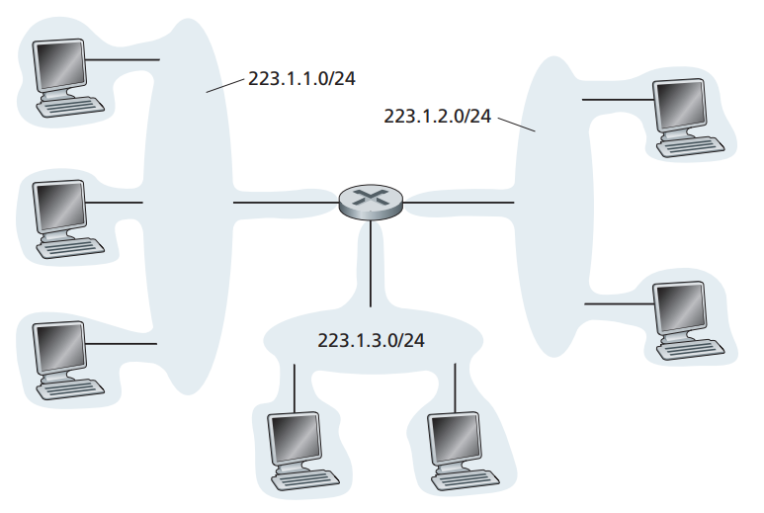
Subnets
To determine the subnets, detach each interface from its host or router, creating islands of isolated networks, with interfaces terminating the end points of the isolated networks. Each of these isolated networks is called a subnet.
Source: James F. Kurose & Keith W. Ross, Computer networking: a top-down approach featuring the Internet, 3rd edition, 2005, Figure 4.16.
Notes:
A subnet is also called an IP network: a logically segmented portion of a larger network
IP addressing assigns an address to this subnet.

Slide 5
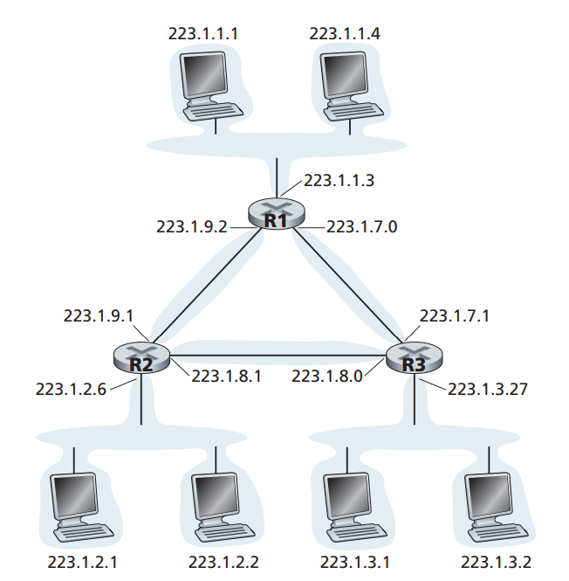
Subnets (cont.)
6 subnets!
Source: James F. Kurose & Keith W. Ross, Computer networking: a top-down approach featuring the Internet, 3rd edition, 2005, Figure 4.17.

Slide 6
Interconnected Autonomous Systems
3c
3a
2c
3b
2a
AS3
2b
1c
AS2
1a
1b
1d
AS1
Intra-AS
routing
algorithm
Inter-AS
routing
algorithm
Forwarding
table
How does a router know how to route a packet to a destination that is outside the AS?
Notes:
For each AS, each router is either a gateway router or an internal router.
A gateway router is a router on the edge of an AS that directly connects to one or more routers in other ASs.
An internal router connects only to hosts and routers within its own AS.
Routers within the same AS are under the same administrative control.
Forwarding table is configured by both intra- and inter-AS routing algorithm​s.
Intra-AS sets entries for internal dests​
Inter-AS sets entries for external dests ​

Slide 7
Case 1: Only one gateway router to only one other AS
3c
3a
2c
3b
2a
AS3
2b
1c
AS2
1a
1b
1d
AS1
Router 2a (as the gateway router): I will take care of this!
Notes:
Intra-AS algorithm: helps to decide the least-cost path (from each internal router to the gateway router) inside AS.
The gateway router forwards the packet on the one link that leads outside the AS.
The AS on the other side of the link will then take over the routing of the packet to the destination.

Slide 8
Case 2: Two or more links to the other ASs
3c
3a
2c
3b
2a
AS3
2b
1c
AS2
1a
1b
1d
AS1
Handled by the inter-AS routing protocol
Routers 1b and 1c:
obtain the reachability information from the neighbouring ASs
propagate the reachability information to all routers inside the AS
Notes:
Two gateway routers in AS1
Which destinations are reachable via AS2 or AS3

Slide 9
Case 2: Two or more links to the other ASs (cont.)
Router 1c: Subnet x is reachable from me.
3c
3a
2c
3b
2a
AS3
2b
1c
AS2
1a
1b
1d
AS1
Router 1d:
(1) Determine the router interface on the least-cost path to gateway router 1c from the intra-AS routing protocol
(2) Add an entry (x, I) into its forwarding table
Notes:
AS1 learns from the inter-AS routing protocol that subnet x is reachable from AS3 and propagates this to all routers.

Slide 10
Case 2: Two or more links to the other ASs (cont.)
1c: Subnet x is reachable from me.
3c
3a
2c
3b
2a
AS3
2b
1c
AS2
1a
1b
1d
AS1
1b: Subnet x is reachable from me.
1d: Which way to go? Hot-potato routing – using the intra-routing to choose the nearest gateway router
Notes:
Hot-potato: get rid of the packet ASAP by having a router send the packet to the gateway router that has the smallest router-to-gateway cost among all gateways with a path to the destination.

Slide 11
Main steps in adding an outside-AS destination in a router’s forwarding table
Learn from inter-AS routing protocol that subnet x is reachable via multiple gateways.
Use routing info from intra-AS routing protocol to determine costs of least-cost paths to each of the gateways.
Hot-potato routing: Choose the least-cost gateway from intra-AS routing protocol.
Determine from intra-AS routing protocol the router interface I that leads to least-cost gateway. Enter (x,I) in forwarding table.
Notes:
The gateway router that has the smallest router-to-gateway cost

Slide 12
Inter-Autonomous System Routing

Slide 13
Border Gateway Protocol (BGP)
The de facto exterior router protocol for the Internet
Allow routers/gateways in different autonomous systems (ASs) to cooperate in the exchange of routing information
Use a modified distance vector algorithm, referred to as a “Path Vector” algorithm
The current version of BGP known as BGP-4 (RFC 4271)
Source: https://datatracker.ietf.org/doc/html/rfc4274
Notes:
BGP4: de facto standard inter-AS routing protocol
This algorithm uses path information.

Slide 14
BGP Basics
BGP provides each AS a means to:
Obtain the subnet reachability information from neighbouring ASs
Propagate the reachability information to all routers internal to the AS
Determine “good” routes to subnets based on the reachability information and AS policy

Slide 15
BGP Basics (cont.)
Pairs of routers (BGP peers) exchange routing information over TCP connections.
The TCP connection along with all the BGP messages sent over the connection is a BGP session.
Destinations are CIDRised prefixes, with each prefix representing a subnet or a collection of subnets.
3c
3a
2c
3b
2a
AS3
2b
1c
AS2
1a
1b
AS1
1d
eBGP session
iBGP session
Notes:
A TCP connection is a reliable, connection-oriented communication channel between two devices over a network.
A BGP session that spans two ASs is called an external BGP (eBGP) session.
A BGP session between routers in the same AS is called an internal BGP (iBGP) session.

Slide 16
Functional Procedures
Neighbour acquisition
Two neighbouring routers in different autonomous systems agree to exchange routing information regularly.
Open messages: open a neighbour relationship with another router
Keepalive messages: acknowledge an Open message
3c
3a
2c
3b
2a
AS3
2b
1c
AS2
1a
1b
AS1
1d
eBGP session
iBGP session
Notes:
To acquire a neighbour, a router first opens a TCP connection to the neighbour router of interest.
Two routers send Open messages to each other after a TCP connection is established.
Header: marker for compatibility, type, length,
Data: AS of the router, BGP identifier
If each router accepts the request, it returns a Keepalive message in response.
- Header

Slide 17
Functional Procedures (cont.)
Neighbour reachability
Each partner needs to be assured that the other partner still exists and is still engaged in the neighbour relationship.
Keepalive messages: periodically confirm the neighbour relationship
3c
3a
2c
3b
2a
AS3
2b
1c
AS2
1a
1b
AS1
1d
eBGP session
iBGP session

Slide 18
Functional Procedures (cont.)
Network reachability
Each router maintains a database of the networks that it can reach and the preferred route for reaching each network.
Update messages: transmit information about a single route and/or list multiple routes to be withdrawn
3c
3a
2c
3b
2a
AS3
2b
1c
AS2
1a
1b
AS1
1d
eBGP session
iBGP session
Notes:
Routes are advertised between BGP peers in UPDATE messages.
When a change is made to this database, the router issues an Update message.
Data: path attributes, withdrawn routes, network layer reachability information (list of networks/subnets that can be reached)

Slide 19
Path Attributes
When a router advertises a prefix, it includes with the prefix a number of BGP attributes.
Two important attributes:
AS_Path: contains the ASs through which the advertisement for the prefix passed; if a router sees its AS is contained in the path list, it rejects the advertisement (to avoid loop).
Next_Hop: indicates the specific gateway router of the AS (which sends the advertisement).
When a gateway router receives a router advertisement, it uses its import policy to decide whether to accept or filter the route.

Slide 20
BGP Routing Information Exchange - Example
Router 3a in AS3 can issue an Update message to router 1c in AS1.
UPDATE msg received by 1c:
AS_Path: {AS3}
Next_Hop: IP address of 3a
NLRI (Network Layer Reachability Information): a list of identifiers of networks in AS3, such as a prefix 1.44.24.0/21
3c
3a
2c
3b
2a
AS3
2b
1c
AS2
1a
1b
AS1
1d
eBGP session
iBGP session
Notes:
AS3 advertises a prefix to AS1
AS3 can aggregate prefixes in its advertisement

Slide 21
BGP Routing Information Exchange – Example (cont.)
Router 1c can use iBGP sessions to distribute this new reachability information to all routers in AS1.
Router 1b can then advertise the new reachability information to AS2 (using eBGP sessions).
When router 2a learns about a new prefix, it creates an entry for the prefix in its forwarding table.
UPDATE MSG received by 2a:
AS_Path: {AS1, AS3}
Next_Hop: IP address of 1b
NLRI (Network Layer Reachability Information): a list of identifiers of networks in AS3, such as a prefix 1.44.24.0/21
3c
3a
2c
3b
2a
AS3
2b
1c
AS2
1a
1b
AS1
1d
eBGP session
iBGP session
Notes:
AS path, that the route has followed (given in reverse order).

Slide 22
BGP Route Selection
Each BGP router may learn about more than one route to any one prefix and must select one of the possible routes.
Elimination rules:
Highest local preference value (assigned as an attribute)
Shortest AS-PATH
Closest NEXT-HOP router​ (hot-potato routing)
Additional criteria
Notes:
1. A route is assigned a local preference value as one of its attributes (in addition to the AS-PATH and NEXT-HOP attributes).
The local preference of a route could have been set by the router or could have been learned from another router in the same AS.
The value of the local preference attribute is a policy decision that is left entirely up to the AS’s network administrator.
2. Route with the shortest path
3. The router for which the cost of the least-cost path is smallest – determined by the intra-AS routing algorithm (hot-potato routing)
4. BGP identifier: 4-octet unsigned integer that indicates the BGP Identifier of the sender of BGP messages.
Lowest identifier

Slide 23
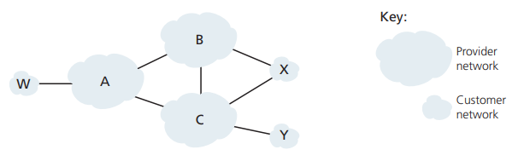
BGP Routing Policy (cont.)
A advertises to B a path AW; B advertises to X the path BAW
Should B advertise to C the path BAW?
If yes, B gets no “revenue” for routing YCBAW since neither W nor Y is B’s customer. (free riding!)
B may force C to route to/from A’s customers via a direct connection between A and C.
Rule of thumb (typically for tier-3 and many tier-2 ISPs) – Any traffic flowing across an ISP’s backbone network must have either a source or a destination (or both) in a network that is a customer of that ISP.
Notes:
No standards that govern how ISPs route among themselves.
Peering agreements negotiated between pairs of ISPs: specify how traffic is exchanged and how costs are shared
Settlement free
Paid – imbalanced traffic

Slide 24
BGP Routing Policy
X is dual-homed (multi-homed)
How will X be prevented from forwarding traffic between B and C?
X functions as a stub network and advertises that it has no paths to any other destinations except itself
Selective routing advertisement policy
Notes:
BGP can enforce policy decisions at the AS level.
Provider network: ISPs
Stub network: traffic entering the stub destined for that network; traffic leaving the stub originated in that network.

Slide 25
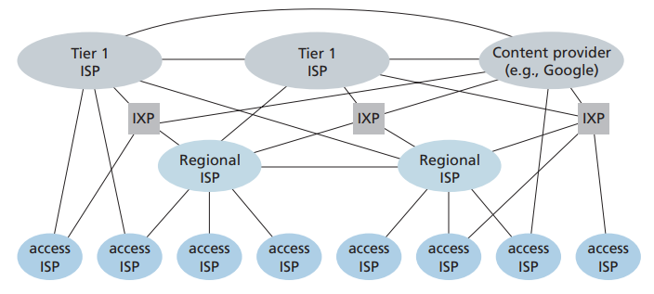
ISP Hierarchy (Optional Content)
Source: James F. Kurose & Keith W. Ross, Computer networking: a top-down approach featuring the Internet, 8th edition (global edition), 2022, Figure 1.15.
Notes:
Tier 1: global connectivity and transit
The lower-tier ISPs connect to the higher-tier ISPs, and the higher-tier ISPs interconnect with one another
Internet Exchange Point (IXP): a meeting point where multiple ISPs can peer together.
CDN: content delivery network is a distributed group of servers that caches content near end users.
NZ largest ISP: Spark
- extensive peering and relationships with content providers and global Tier 1 carriers

Slide 26
Intra-Autonomous System Routing

Slide 27
Intra-AS Routing
Also known as Interior Router Protocols
Most common Intra-AS routing protocols
RIP: Routing Information Protocol
OSPF: Open Shortest Path First
IS-IS: Intermediate System to Intermediate System (OSPF’s closely related cousin)
IGRP: Interior Gateway Routing Protocol (Cisco proprietary)
Notes:
IS-IS: link state: an ISO-based protocol (not IP-specific) and operates using CLNS (Connectionless Network Service) – a network layer protocol in OSI.
IGRP: distance vector; main goal is to improve upon the limitations of earlier routing protocols like RIP by supporting larger, more complex networks.

Slide 28
Routing Information Protocol (RIP)
One of the oldest distance vector routing protocols
Based on the Bellman-Ford algorithm
Use the hop count as the distance metric
The current version of RIP known as RIP version 2 (RFC 2453)
Source: https://datatracker.ietf.org/doc/html/rfc2453
Notes:
Still in use today

Slide 29
RIP Basics
A Request message is used to ask for a response containing all or part of a router’s RIP table.
RIP table, known as a routing table, includes both the router’s distance vector and its forwarding table
A Response message (also known as a RIP advertisement) is for one of several different reasons:
Response to a specific query
Regular update (unsolicited response)
Triggered update caused by a route change
Source: https://datatracker.ietf.org/doc/html/rfc2453
Notes:
Each router maintains a RIP table known as a routing table.
Header: command (specify the purpose of this message) and version
Data: RIP entries (e.g., destination IPv4, metric - the cost to reach that destination)

Slide 30
RIP Basics (cont.)
Distance metric: # of hops (max = 15 hops)
# of hops: # of subnets traversed along the shortest path from the source router to the destination subnet, including the destination subnet (e.g., source = A)
u
v
destination hops
u 1
v 2
w 2
x 3
y 3
z 2
A
B
w
x
z
C
D
y

Slide 31
RIP Basics (cont.)
RIP is a UDP-based protocol (port number 520)
RIP is typically implemented as an application-layer process
routed
routed
Transprt
(UDP)
Transprt
(UDP)
Network Forwarding
(IP) table
Network
(IP)
Forwarding
table
Data link
Data link
Physical
Physical
Notes:
Each router sends and receives RIP requests and responses over UDP using port number 520.
A process called route-d (daemon) executes RIP
A daemon is a background process in Unix and Unix-like operating systems that runs continuously and handles system or service requests.

Slide 32
RIP Basics (cont.)
Each router sends its advertisement every 30 seconds (or whenever its RIP table changes) to all its neighbours via a Response Message.
Each response message contains a list of up to 25 destination subnets within the AS and the sender’s distance to each of those subnets.
The route is considered to have expired upon the timeout (180 seconds).
The route is removed from the RIP table upon expiration of the garbage-collection timer (120 seconds).
Notes:
The timeout is initialised when a route is established, and any time an update message is received for the route.
However, it is retained in the routing table for a short time so that neighbours can be notified that the route has been dropped.
RIP allows for potential fluctuations in the network or temporary outages to be resolved before the route is permanently discarded.
This period helps to accommodate transient network issues and ensures that routes are only permanently removed if they have truly become obsolete.
Deletions can occur for one of two reasons: the timeout expires, or the metric is set to 16 because of an update received from the current router
Until the garbage-collection timer expires, the route is included in all updates sent by this router.
When the garbage-collection timer expires, the route is deleted from the routing table

Slide 33
RIP Solutions to the Count-to-Infinity Problem
Count-to-16
Split horizon
Don’t send a neighbour the routing information learned from this neighbour ​
Split horizon with poison reverse
Send the routing information learned from this neighbour but set their metrics to infinity​
Maximum number of hops bounded to 15
A metric of infinity is set to 16
Notes:
Routing loops: when X tells Y that it has a path somewhere, Y has no way of knowing whether itself is on the path.
This limits the convergence time
All implementation of RIP must use split horizon and should also use split horizon with poisoned reverse.

Slide 34
Open Shortest Path First (OSPF)
Open: published in the open literature
Use the link-state routing algorithm
Advertisements disseminated to the entire AS (via broadcasting)​ and carried directly by IP
The current version of OSPF known as OSPF version 2 (RFC 2328)
Notes:
RIP works well in small systems, but less well as networks get larger.
It has slower convergence.
Broadcasting: transmit data packets from one source to all devices within a specific network segment or broadcast domain
OSPF must itself implement functionality such as reliable message transfer and link-state broadcast.
OSPF is typically deployed large and complex networks due to its scalability and efficiency.

Slide 35
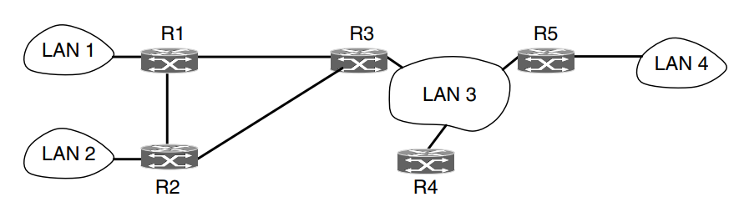
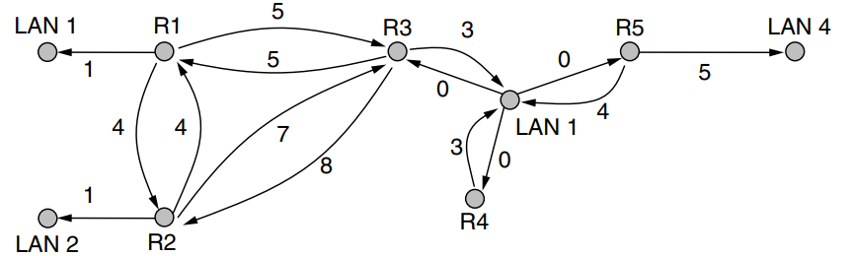

OSFP Basics
Each router maintains a database that reflects the known topology of the autonomous system of which it is a part.
An AS
A graph representation of the AS
Source: Andrew S. Tanenbaum & David J. Wetherall, Computer Networks, 5th edition, 2010, Figure 5-64.
Notes:
OSPF operates by abstracting the collection of actual networks, routers, and links into a directed graph.
Each edge is assigned a weight.
LAN: a network that connects computers and other devices within a limited geographical area, such as a home, office, or building.
1. Each router broadcasts routing information to all other routers in the AS.
2. Each router locally runs Dijkstra’s shortest-path algorithm to determine a shortest-path tree to all subnets, with itself as the root node.
3. Each router constructs a complete topological map of the entire autonomous system.

Slide 36
OSPF Basics (cont.)
Security
All OSPF protocol exchanges are authenticated.
Equal-cost multipath (ECMP)
OSPF remembers the set of shortest paths and splits the traffic across them during packet forwarding to balance load.
Traffic engineering
OSPF computes a route through the internet that incurs the least cost based on a user-configurable metric of cost.
Area routing
OSPF allows an AS to be divided into numbered areas.
Source: https://info.support.huawei.com/info-finder/encyclopedia/en/OSPF.html
Notes:
Security: only trusted routers can participate; by default, packets are not authenticated.
Two types: 64-bit authentication field in the header as a password; crypto (shared secret key by routers, used to generate message digest, append to the end of the packet)
ECMP: multiple paths may be found that are equally short.
Traffic engineering: the process of optimising a network's performance by controlling traffic flow across the network
This cost is configurable by the system administrator.
Bandwidth

Slide 37
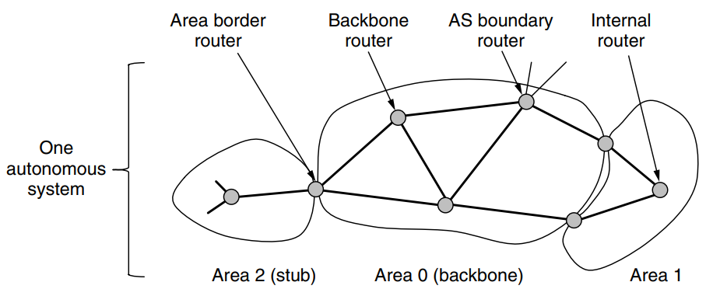
Hierarchical OSPF
An area is a network or a set of contiguous networks.
Each area runs a separate copy of the OSPF algorithm.
Source: Andrew S. Tanenbaum & David J. Wetherall, Computer Networks, 5th edition, 2010, Figure 5-65.
Notes:
Each router within an area has the same link state database and runs the same shortest path algorithm.
Every AS has a backbone area, called area 0.
- The routers in this area are called backbone routers.
- All areas are connected to the backbone.
- Two-level hierarchy: backbone area, non-backbone area
Area border router: belong to an area and the backbone
It must also be part of the backbone.
Inter-area routing within the AS is done with the help of area border routers.
An area border router needs the databases for all the areas to which it is connected and must run the shortest path algorithm for each area separately.
Area border routers condense the topological information of their attached areas for distribution to the backbone. The backbone in turn distributes the information to the other areas.
Internal routers: lie within an area.
AS boundary router: it injects routes to external destinations on other ASs into the area.
- May use BGP to perform inter-AS routing.

Slide 38
Hierarchical OSPF (cont.)
There can be multiple AS boundary routers in an AS.
AS boundary routers may be internal or area border routers and may or may not participate in the backbone.
Notes:
When routing a packet between two non-backbone areas the backbone is used.

Slide 39
IP Addresses

Slide 40
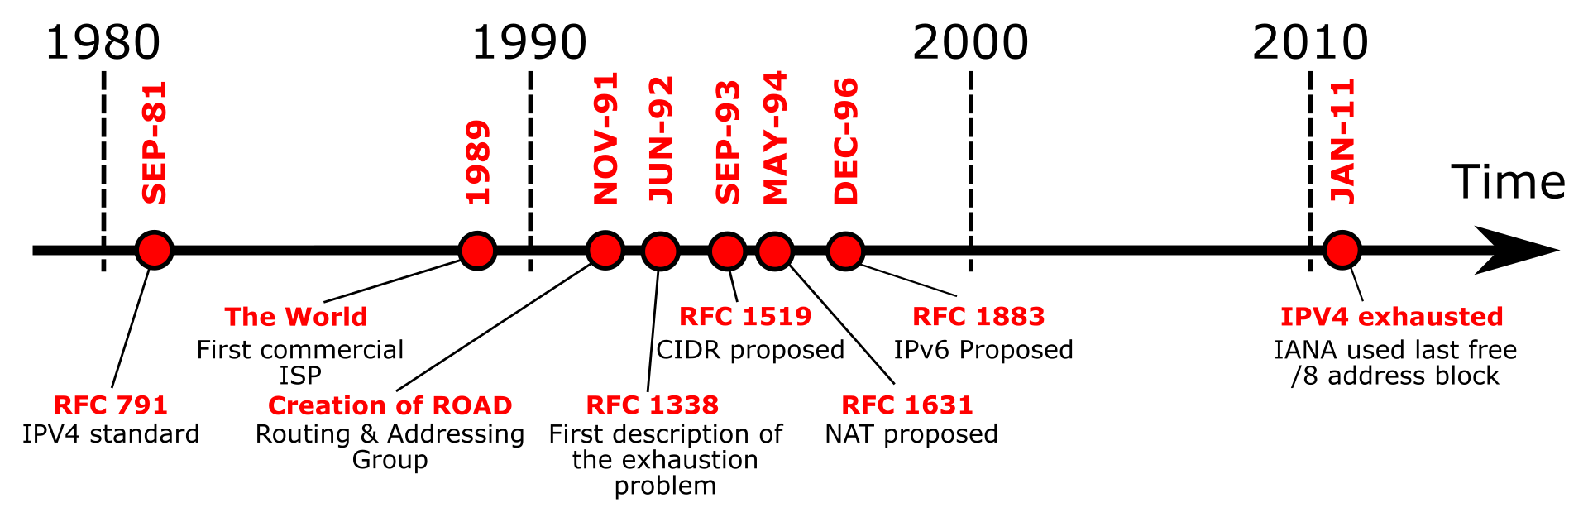
IP addresses are scarce
IPv4 address exhaustion timeline
Source: https://en.wikipedia.org/wiki/IPv4_address_exhaustion
Notes:
IPv4 address exhaustion is the depletion of the pool of unallocated IPv4 addresses.
IPv4 addresses are 32-bit numbers, providing about 4.3 billion unique addresses.
Depletion has been anticipated since the late 1980s when the Internet started experiencing dramatic growth.
Several new technologies.
- CIDR: Classless Inter-Domain Routing; efficient address allocation
The IP address space is managed globally by the Internet Assigned Numbers Authority (IANA), and by five regional Internet registries (RIRs).
All RIRs have exhausted their address pools.

Slide 41
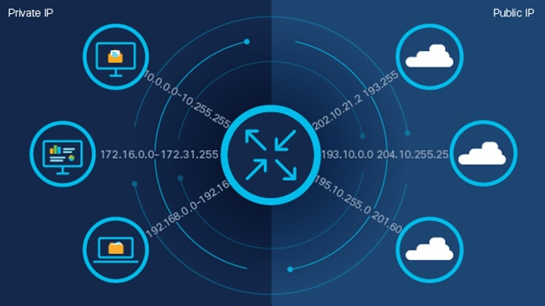
Network Address Translation (NAT)
The ISP assigns each home or business a single IP address (or at most, a small number of them) for Internet traffic.
Source: https://www.cisco.com/c/en/us/products/routers/network-address-translation.html
Notes:
Within the local network, every computer gets a unique IP address.
Before a packet exits the customer network and goes to the ISP, an address translation takes place.
This translation makes use of three ranges of IP addresses that have been declared as private.
10.0.0.0 – 10.255.255.255/8 (16,777,216 hosts)
172.16.0.0 – 172.31.255.255/12 (1,048,576 hosts)
192.168.0.0 – 192.168.255.255/16 (65,536 hosts)

Slide 42
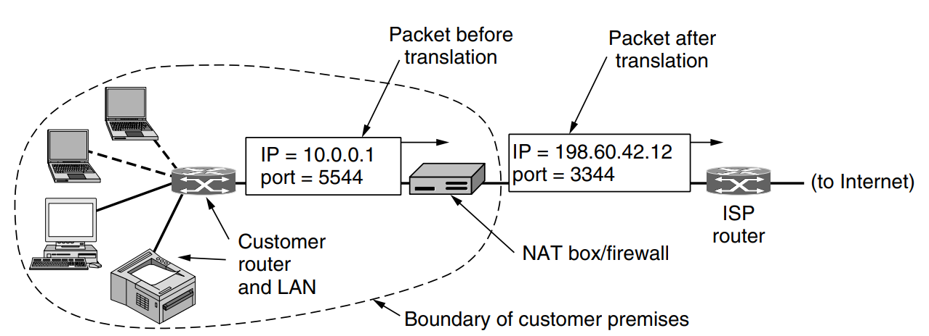
The Operation of NAT
Before a packet exits the local network and goes to the ISP, an address translation from the unique internal IP address to the shared public IP address takes place.
How does the NAT box know which internal address to replace it with?
Every host gets a unique IP address through DHCP
(Dynamic Host Configuration Protocol).
Source: Andrew S. Tanenbaum & David J. Wetherall, Computer Networks, 5th edition, 2010, Figure 5-55.
Notes:
Routers or dedicated servers can run DHCP server.
The NAT box is often combined in a single device with a firewall, which provides security by carefully controlling what goes into the customer network and what comes out of it.
Port # is used by sockets to identify processes on hosts.

Slide 43
The Operation of NAT (cont.)
NAT translation table
WAN side addr. LAN side addr.
2: NAT box changes the
source addr. and port number from
10.0.0.1, 3345 to
138.76.29.7, 5001 and adds an entry
into the table
1: Host 10.0.0.1
sends a packet to a web server (128.119.40.186, 80)
138.76.29.7, 5001 10.0.0.1, 3345
…… ……
S: 10.0.0.1, 3345
D: 128.119.40.186, 80
10.0.0.1
1
2
S: 138.76.29.7, 5001
D: 128.119.40.186, 80
10.0.0.4
10.0.0.2
138.76.29.7
S: 128.119.40.186, 80
D: 10.0.0.1, 3345
4
S: 128.119.40.186, 80
D: 138.76.29.7, 5001
3
4: NAT box changes the destination addr. and port number from 138.76.29.7, 5001 to 10.0.0.1, 3345
10.0.0.3
3: When a reply arrives, NAT box indexes the NAT translation table using the destination addr. and port number
Notes:
An IPv4 address refers to an end host.
A port number refers to a particular application / server software running in that end host.
Through these port numbers, there can be many simultaneous “conversations” going on between the same two hosts.
1. The host selects an unused TCP port on its machine and supplies a destination port to tell who to give the packets to on the remote side.
Ports 0–1023 are reserved for well-known services.

Slide 44
Motivations of NAT
The local network uses just one IP address as far as the outside world is concerned
no need to be allocated a range of addresses from the ISP
can change addresses of devices in the local network without notifying the outside world
can change the ISP without changing addresses of devices in the local network
devices inside the local network not explicitly addressable, visible by the outside world

Slide 45
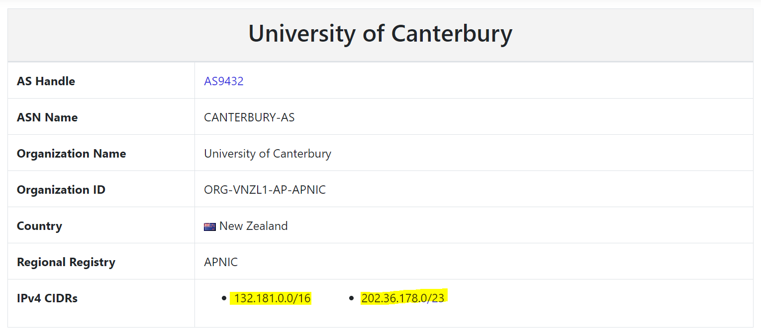
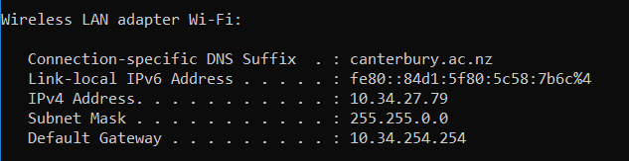
An Example
Notes:
ipconfig - windows

Slide 46
NAT is controversial
NAT violates the architectural model of IP.
NAT breaks the end-to-end connectivity model of the Internet.
Some processes on the Internet are not required to use TCP or UDP.
NAT violates the most fundamental rule of protocol layering.
The port-number is a 16-bit field.
Notes:
1. Every IP address uniquely identifies a single machine worldwide.
Port numbers are meant to be used for addressing processes, not for addressing hosts.
2. Any host can send a packet to any other host at any time (without a middleman). The mapping in the NAT box is set up by outgoing packets.
In practice, a home user with NAT can make TCP/IP connections to a remote Web server, but a remote user cannot make connections to a game server on the home network.
3. If a user on machine A decides to use some new transport protocol to talk to a user on machine B, introduction of a NAT box will cause the application to fail because the NAT box will not be able to locate the TCP source port correctly.
4. Ensure that changes in one layer do not require changes in other layers.
NAT destroys this independence.
5. At most 65,536 processes can be mapped onto a public IP address.

Slide 47
CGNAT (Optional Content)
Carrier-grade NAT, known as large-scale NAT
Used by ISPs to manage the shortage of public IPv4 addresses
An ISP assigns private IP addresses (in the 100.64.0.0/10 range, as per RFC 6598) to multiple customers.
All customers behind the CGNAT share a smaller pool of public IP addresses.
Notes:
When traffic leaves the ISP’s network and reaches the public internet, the private IP addresses along with port numbers are translated into a single or a small number of public IP addresses along with different port numbers to keep connections separate.
Real world examples
- Mobile networks
- Broadband ISPs to home broadband users

Slide 48
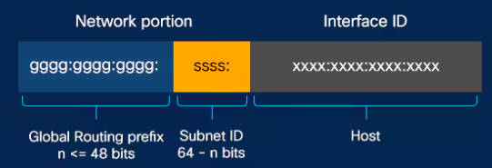
IPv6 at a glance
Longer addresses (128 bits long)
Simplification of the header (8 fields) for faster packet processing
Better support for options through extension headers
Improved QoS
Source: https://www.cisco.com/c/en/us/solutions/ipv6/overview.html#~addressing-structure
Notes:
Global routing prefix identifies the network or organisation.
used by internet routers to forward packets toward the destination.
the first 48 bits of the IPv6 address
Subnet: 16 bits
Host: 64 bits
In IPv4, options were added directly into the IP header
variable header length: increasing the complexity of packet processing.
performance impact: routers and devices had to inspect the entire header to find any options, slowing down packet forwarding

Slide 49
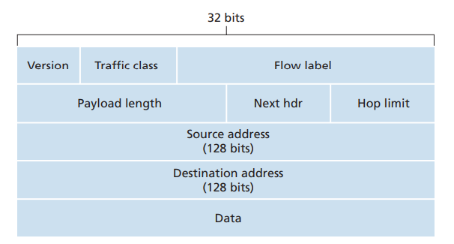
IPv6 Header Format
Flow Label: mark groups of packets
Next header: identify the type of header immediately following the IPv6 header
Source: James F. Kurose & Keith W. Ross, Computer networking: a top-down approach featuring the Internet, Addison Wesley, 3rd edition, 2005, Figure 4.22
Notes:
40-byte header
The IPv6 header is aligned with 32-bit boundaries for efficient processing.
- modern processors and network hardware are often optimised for handling 32-bit and 64-bit data efficiently.
Version: 4-bit
Traffic class (8-bit): give priority to certain datagrams within a flow, or from certain applications
Flow (20-bit): label traffic belonging to specific flows for special handling, such as audio and video transmission; process packets more efficiently.
Hop limit: decremented by one by each router that forwards the packet; discard when zero

Slide 50
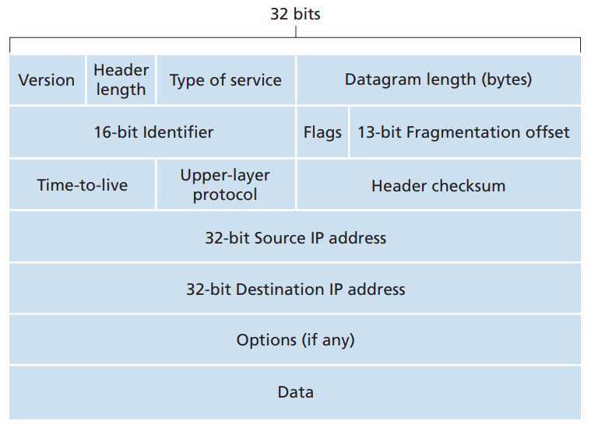
IPv4 vs. IPv6
Facilitate QoS
IPv4: header + data
IPv6: data only
A field that is decremented on each hop
IPv4: the upper-layer protocol
IPv6: the upper-layer protocol or extension header
Source: James F. Kurose & Keith W. Ross, Computer networking: a top-down approach featuring the Internet, Addison Wesley, 3rd edition, 2005, Figure 4.13 & 4.22.
Notes:
Fragment: a different approach to fragmentation.
IPv4: break down larger packets into smaller fragments (smaller MTU of the original packets)
IPv6 does not allow for fragmentation and reassembly at intermediate routers; these operations can be performed only by the source and destination.
- A router receives a packet that is too large to send over the outgoing link, drop the packet and send back ICMP error message (network diagnostic and error reporting).
Checksum: removed entirely to reduce the processing time at each hop
IPv6 relies on end-to-end error detection mechanisms provided by higher-layer protocols.
Options: allowed, but outside of header, indicated by “Next Header” field.

Slide 51
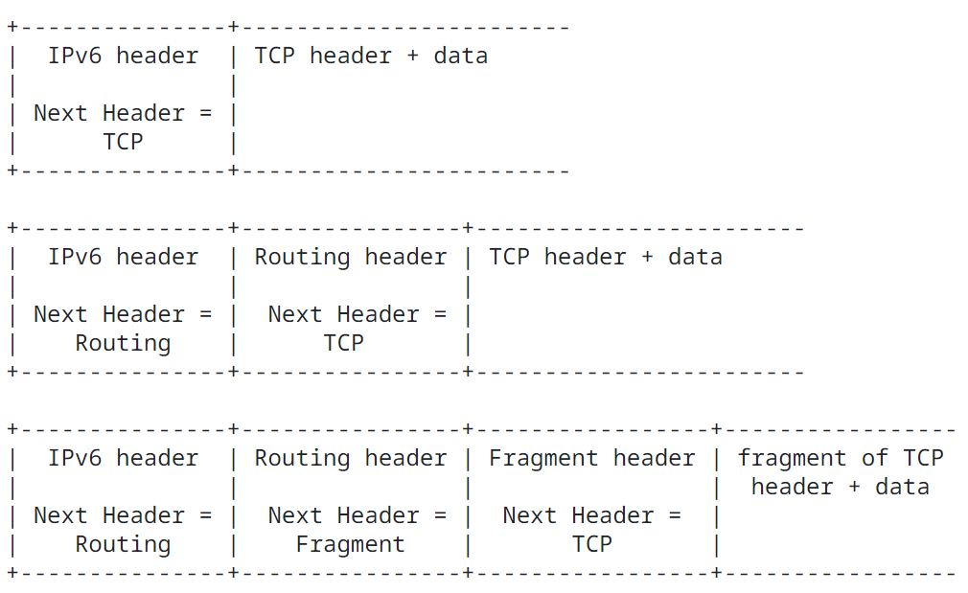
Some Examples
Source: https://datatracker.ietf.org/doc/html/rfc8200#section-4
Notes:
carry zero, one, or more extension headers, each identified by the Next Header field of the preceding header
Routing header: used by an IPv6 source to list one or more intermediate nodes to be "visited" on the way to a packet's destination.
Fragment: send a packet larger than would fit in the path MTU to its destination.

Slide 52
Transition From IPv4 To IPv6
How will the network operate with mixed IPv4 and IPv6 routers?
New devices are IPv4 and IPv6 capable; but old ones only supports IPv4.
Not all routers can be upgraded.
Source: https://datatracker.ietf.org/doc/html/rfc2893
Notes:
Adoption of IPv6 is slow.

Slide 53
Dual-Stack Approach
All IPv6 nodes also have a complete IPv4 implementation.
conversion
IPv6
IPv6
IPv4
IPv4
IPv6
IPv6
A
B
C
D
E
F
Essentially only IPv4 datagrams can be exchanged.
Information in some IPv6-specific fields will be lost.
Notes:
IPv6 nodes have a complete IPv4 implementation.
Fields that do not have any counterpart in IPv4, such as flow field.

Slide 54
Tunnelling
A
B
tunnel
E
F
Logical view:
IPv6
IPv6
IPv6
IPv6
A
B
C
D
E
F
Physical view:
IPv6
IPv6
IPv4
IPv4
IPv6
IPv6
Flow: X
Src: A
Dest: F
data
Src: B
Dest: E
Src:B
Dest: E
Flow: X
Src: A
Dest: F
data
Flow: X
Src: A
Dest: F
data
Flow: X
Src: A
Dest: F
data
A-to-B:
IPv6
B-to-C:
IPv6 as payload inside IPv4
D-to-E:
IPv6 as payload inside IPv4
E-to-F:
IPv6
Notes:
Take the entire IPv6 datagram and put it in the data (payload) field of an IPv4 datagram.

Slide 55
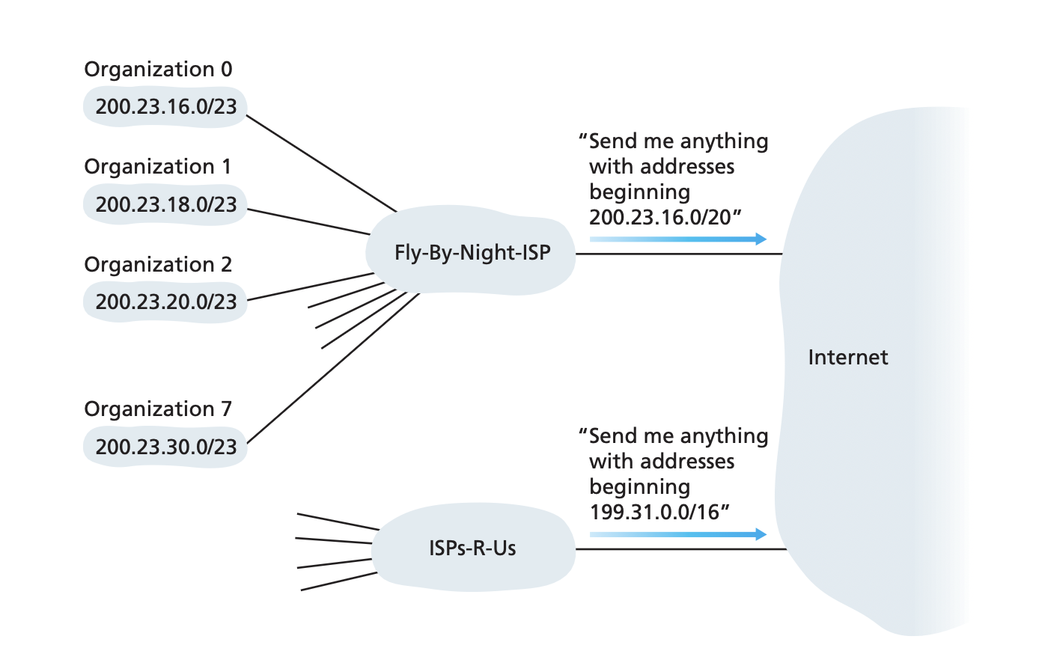
Address aggregation
Source: [Kurose & Ross]
Notes:
Fig. 4.18
This example of an ISP that connects eight organizations to the Internet nicely illustrates
how carefully allocated CIDRized addresses facilitate routing. Suppose, as shown in above Figure,
that the ISP (which we’ll call Fly-By-Night-ISP) advertises to the outside world that it
should be sent any datagrams whose first 20 address bits match 200.23.16.0/20. The
rest of the world need not know that within the address block 200.23.16.0/20 there are
in fact eight other organizations, each with its own subnets. This ability to use a single pre-
fix to advertise multiple networks is often referred to as address aggregation (also
route aggregation or route summarization).

Slide 56
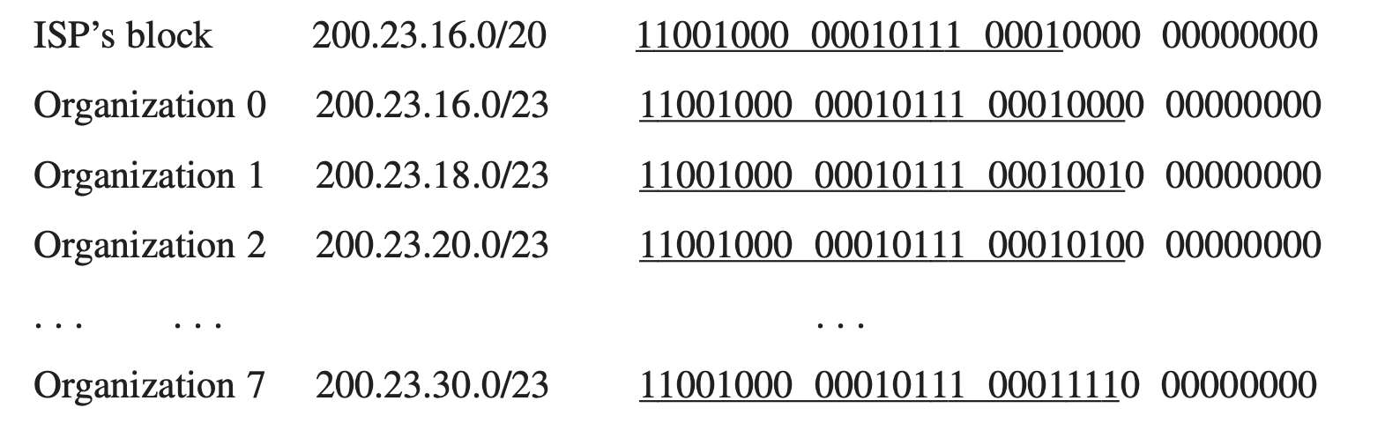
Address aggregation
Source: [Kurose & Ross]
Notes:
Address aggregation works extremely well when addresses are allocated in blocks to
ISPs and then from ISPs to client organizations.

Slide 57
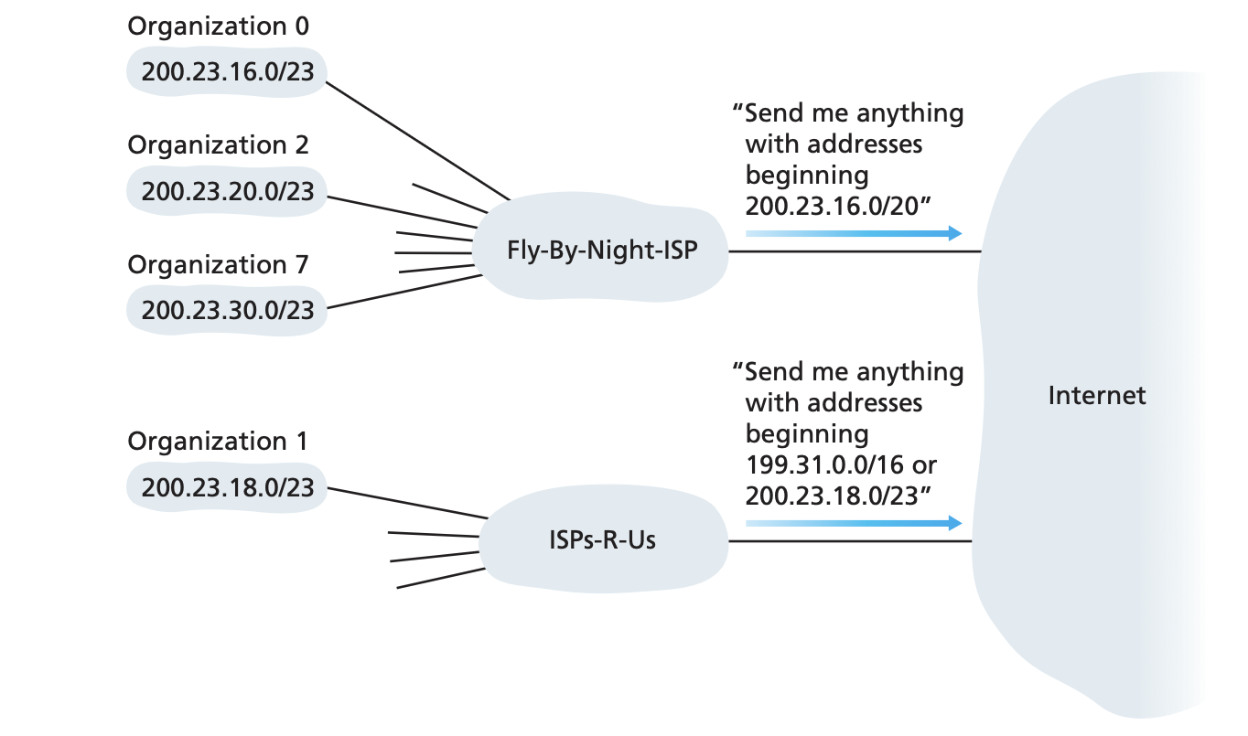
Address aggregation
Apply longest address prefix match if there are multiple matches in the forwarding table.
Source: [Kurose & Ross]
Notes:
Fig. 4.19
But what happens when addresses are
not allocated in such a hierarchical manner? What would happen, for example, if Fly-By-
Night-ISP acquires ISPs-R-Us and then has Organization 1 connect to the Internet through
its subsidiary ISPs-R-Us?
As shown in Figure 4.18, the subsidiary ISPs-R-Us owns the
address block 199.31.0.0/16, but Organization 1’s IP addresses are unfortunately out-
side of this address block. What should be done here? Certainly, Organization 1 could
renumber all of its routers and hosts to have addresses within the ISPs-R-Us address
block. But this is a costly solution, and Organization 1 might well be reassigned to
another subsidiary in the future. The solution typically adopted is for Organization 1
to keep its IP addresses in 200.23.18.0/23. In this case, as shown in Figure 4.19,
Fly-By-Night-ISP continues to advertise the address block 200.23.16.0/20 and ISPs-R-Us
continues to advertise 199.31.0.0/16. However, ISPs-R-Us now also advertises the block
of addresses for Organization 1, 200.23.18.0/23. When other routers in the larger
Internet see the address blocks 200.23.16.0/20 (from Fly-By-Night-ISP) and
200.23.18.0/23 (from ISPs-R-Us) and want to route to an address in the block
200.23.18.0/23, they will use longest prefix matching (see Section 4.2.2), and route
toward ISPs-R-Us, as it advertises the longest (most specific) address prefix that matches
the destination address.

Slide 58
Obtaining addresses
An organization can obtain a block of IP addresses from its ISP;
ISP obtains addresses from Internet registries (local: ARIN, RIPE, APNIC, LACNIC; or global: ICANN)
A host typically obtains its IP address from a DHCP server or by manual configuration.

Slide 59
References
William Stallings, Data and Computer Communications, Pearson, 10th edition, 2013.
Chapter 19 Routing (19.3)
Andrew S. Tanenbaum & David J. Wetherall, Computer Networks, Prentice Hall, 5th edition, 2010.
Chapter 5 The Network Layer (5.6)
James F. Kurose & Keith W. Ross, Computer networking: a top-down approach featuring the Internet, Addison Wesley, 3rd edition, 2005. ​
Chapter 4 The Network Layer (4.6)

Slide 60
Acknowledgements
Lecture notes are developed based on slides from the following three sources:
Dr Mengmeng Ge’s lecture notes for COSC264, University of Canterbury, 2023
Assoc Prof Dan Kim’s lecture notes for COSC264, University of Canterbury, 2017
Prof Aleksandar Kuzmanovic’s lecture notes for CS340, Northwestern University, 2005, https://users.cs.northwestern.edu/~akuzma/classes/CS340-w05/lecture_notes.htm

