Slide 1
Reliable Data Transfer: Error Detection and Correction
COSC264
Introduction to Computer Networks and the Internet
Dr Barry Wu
WRC
University of Canterbury
Barry.wu@canterbury.ac.nz

Slide 2
Learning Objectives
At the end of the lectures, you will be able to:
Explain the basic mechanism for the use of error-detecting codes
Present an overview of the Internet checksum
Understand the operation of the cyclic redundancy check
Define Hamming distance
Explain the basic principles for forward error correction using a block code

Slide 3
Outline
Error Detection
Parity check
Internet checksum
Cyclic Redundancy Check (CRC)
Forward Error Correction
Block Code Principles

Slide 4
The Journey of a Packet
Regardless of the design of the transmission system, there will be errors, such as bit errors, lost packets, and out-of-order packets.
Notes:
Bit errors occur when a bit or multiple bits in a data stream are altered during the transmission process.
Wireless links are prone to high error rates
Low bit-error links: including fibre optic cables, and many twisted-pair copper cables
Fibre optics: use light, not affected by electromagnetic interference from nearby devices or cables.
The twisting of the pairs of wires helps cancel out EMI and cross-talk between adjacent pairs.

Slide 5
The Journal of a Packet (cont.)
Problems​ | Approaches​
Bit errors​ | Error detection and correction​ techniques
Lost packet​s | ARQ protocols
Out of order​ packets | ARQ protocols
Notes:
The first approach uses redundancy - additional bits appended to the data bits by the sender.
Many link-layer protocols provide a mechanism to detect bit errors.
The Internet’s transport layer and network layer also provide a limited form of error detection.
ARQ (automatic repeat request): acks, retransmissions, timer, sequence number.

Slide 6
Some Causes for Transmission Errors
Thermal noise
Weak signal strength, interference, deliberate jamming, jitter, etc.
A crashing router / switch / station loses all packets currently in its memory
Packets
are routed in the wrong direction
are dropped because of congestion
are dropped because of insufficient resources at the receiver
Transmission errors present a design challenge for a network and a distributed application.
Notes:
Thermal noise: electronic noise present in all electrical circuits and transmission systems; introduce random fluctuations in the signal, which can distort the transmitted data, especially over long distances or at high data rates.
Weak signal strength: the transmitted signal loses energy as it travels through a medium; due to large distances, or transmission through materials that absorb or scatter the signal.
Interference: external signals from other devices (e.g., electrical equipment, other communication channels) overlap with the transmitted signal.
Jamming: intentional interference with a communication signal by an external source, typically for malicious purpose.
Jitter: small but rapid variations in the timing of signal pulses due to network congestion or variations in the transmission medium; can lead to out-of-sequence packet delivery or packet loss.

Slide 7
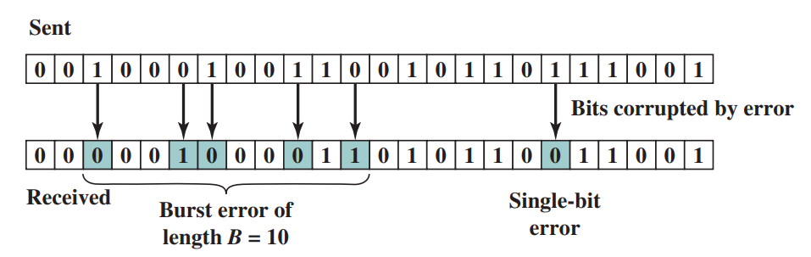
Types of Bit Errors
An error occurs when a bit is altered between transmission and reception.
Source: William Stallings, Data and Computer Communications, 10th edition, 2013, Figure 6.1.
Notes:
A single-bit error is an isolated error condition that alters one bit but does not affect nearby bits.
A burst error of length B is a contiguous sequence of B bits in which the first and last bits and any number of intermediate bits are received in error.

Slide 8
Error Detection

Slide 9
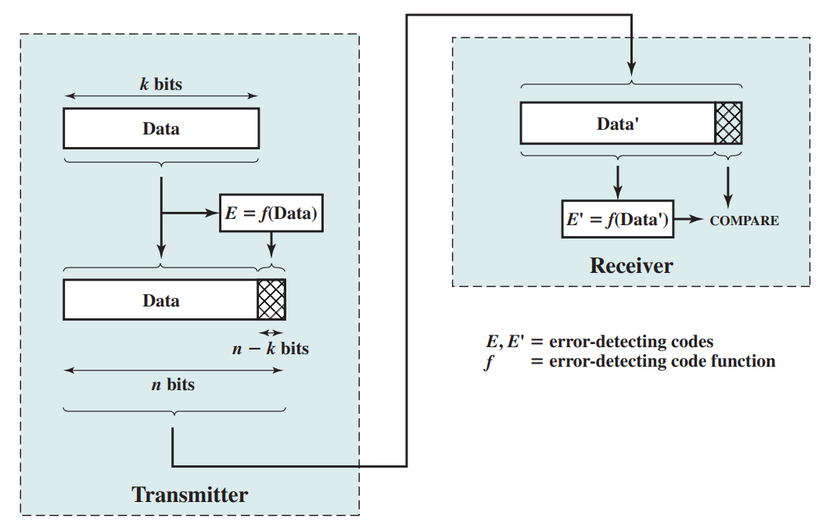
Error Detection Process
Additional bits that constitute an error-detecting code are added by the transmitter.
Whether an error is detected, not whether an error has occurred!
Source: William Stallings, Data and Computer Communications, 10th edition, 2013, Figure 6.2.
Notes:
Sender:
- This code is calculated as a function of the other transmitted bits.
- The error-detecting code is appended to the data block to produce a frame of n bits, which is then transmitted.
Receiver:
separate the incoming frame into data and the error-detecting code.
perform the same error-detecting calculation on the data bits
compare this value with the value of the incoming error-detecting code.
Some errors occur but they are not detected.

Slide 10
Parity Check
The simplest error detecting scheme is to append a parity bit to the end of a block of data
Even parity – use parity bit to make the number of 1’s (including the
parity bit) an even number.
Odd parity – use parity bit to make the number of 1’s (including the
parity bit) an odd number.
Parity bit
Odd # of 1s --Error detected!
10000101
1
10010101
1
Parity bit
Even # of 1s --Error detected!
10010101
1
10000101
1

Slide 11
Parity Check (cont.)
If any even number of bits are flipped due to error, an undetected error occurs
Parity bit
10000101
1
Even # of 1s – No error detected!
10010001
1
We need a more robust error-detection scheme!

Slide 12
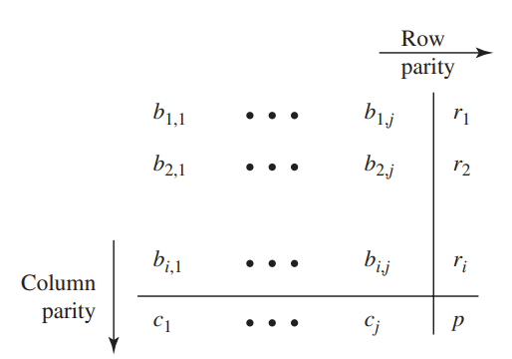
2-Dimensional Parity Check
A parity bit r_{i} is appended to each row i.
A parity bit c_{j} is appended to each column j.
An overall parity bit p completes the matrix.
Source: William Stallings, Data and Computer Communications, 10th edition, 2013, Figure 6.3.
Notes:
The error-detecting code consists of i + j + 1 parity bits.
The receiver can detect the fact that a single bit error has occurred, and use the column and row indices of the column and row with parity errors to identify the bit that was corrupted and correct that error.
Matrix dimensions for a 2D parity check, consider factors such as data size, transmission protocols, etc.

Slide 13
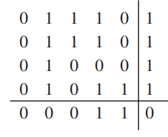
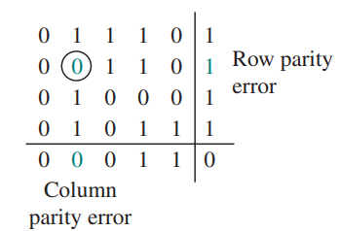
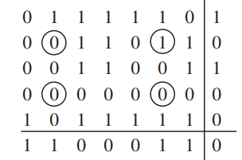
2-Dimensional Even Parity Example
No errors
Correctable single-bit error
Undetectable error pattern
Source: William Stallings, Data and Computer Communications, 10th edition, 2013, Figure 6.3.
Notes:
20 data bits arranged in a 4 * 5 array, with the parity bits calculated, to form a 5 * 6 array.
When a single-bit error occurs, both the corresponding row and column parity bits now indicate an error.
The error can be determined to be at the intersection of that row and column.
It is possible to not only detect but also correct the bit error.
It can only correct single-bit errors.
If an even number of errors occur in a row, the errors are detected by the column parity bits.
If an even number of errors occur in a column, the errors are detected by the row parity bits.
Any pattern of four errors forming a rectangle is undetectable.
If the four circled bits change value, the corresponding row and column parity bits do not change value.
2D parity checks are used in real-world applications but have become less common.

Slide 14
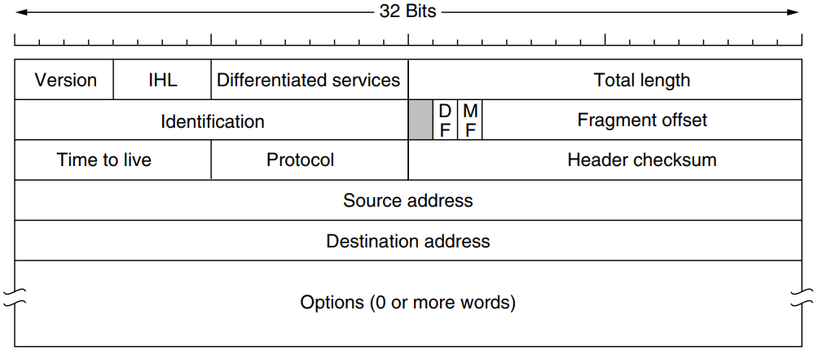
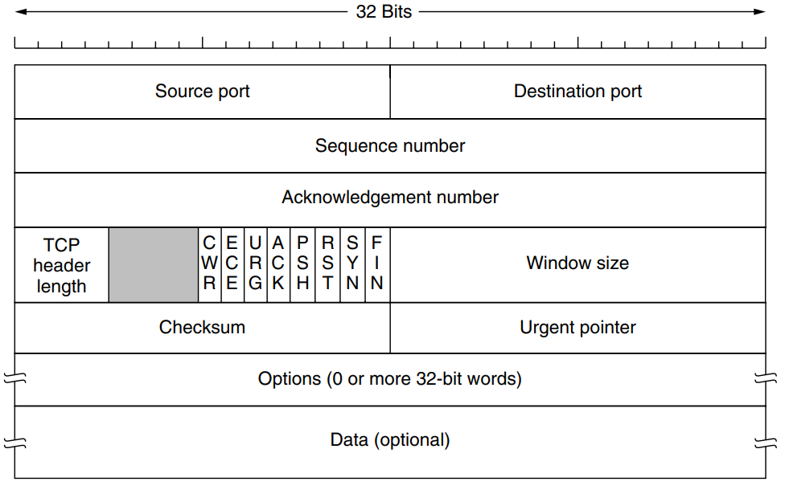
Internet Checksum
An error-detecting code
Used in many Internet standard protocols, including IP, TCP, and UDP
IPv4 header
TCP header
Source: Andrew S. Tanenbaum & David J. Wetherall, Computer Networks, 5th edition, 2010, Figure 5-46 & 6-63.

Slide 15
Why do we need checksums at IP and TCP/UDP?​
IPv4 checksum is computed over the IP header while TCP/UDP checksum is computed over the entire segment.
TCP/UDP and IP can belong to different protocol stacks.​ ​
TCP can run over a different protocol.
IP can carry data that will not be passed to TCP/UDP.
TCP/UDP error detection is on an end-to-end basis. ​
Notes:
TCP over ATM
TCP over IPv6
The checksum is calculated by the sender and verified by the receiver, ensuring that any errors introduced during the entire path of transmission (across various routers, switches, and links) are detected at the final destination.
The IP checksum only covers the IP header, not the data payload.

Slide 16
Internet Checksum (cont.)
The calculation makes use of:
One’s complement arithmetic (addition)
The two numbers are treated as unsigned binary integers and added
If there is a carry out of the leftmost bit, add 1 to the sum (end-around carry)
One’s complement operation on a set of binary digits
Replace 0 digits with 1 digits and 1 digits with 0 digits
ex2.
1101
+ 1011
---------
11000
+ 1 -------------
1001
ex1.
0011
+1100
---------
1111

Slide 17
Internet Checksum (cont.)
Goal: detect errors (e.g., flipped bits) in the IP packet header
Sender to compute the checksum
The checksum field is set to all zeros.
The checksum is calculated by performing the one’s-complement addition of all the words in the header, and then taking the ones-complement operation of the result.
This result is placed in the checksum field.
Receiver to verify a checksum
The one’s-complement sum is computed over the same set of octets, including the checksum field.
The check succeeds if the result is all 1 bits.
The header is treated as a sequence of 16-bit integers​.
Notes:
Word: 2 bytes
Octet: 8 bits
Since some header fields change, this is recomputed and verified at each point that the internet header is processed.
- a reduction of the time to live, additions or changes to internet options, or due to fragmentation

Slide 18
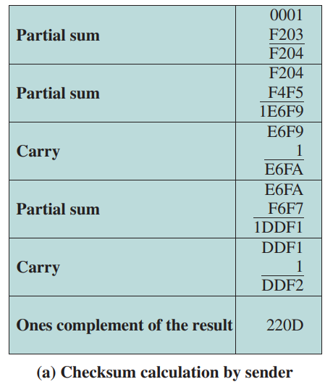
Internet Checksum (cont.)
Consider a header that consists of 10 octets.
00 01 F2 03 F4 F5 F6 F7 00 00
hexadecimal: binary (decimal)
A:1010 (10)
B:1011 (11)
C:1100 (12)
D:1101 (13)
E:1110 (14)
F:1111 (15)
One’s complement in hexadecimal:
F→0
E→1
D→2
C→3
B→4
A→5
9→6
8→7
Source: William Stallings, Data and Computer Communications, 10th edition, 2013, Figure 6.4.
Notes:
Hexadecimal: 0 – F
Subtract from FFFF

Slide 19
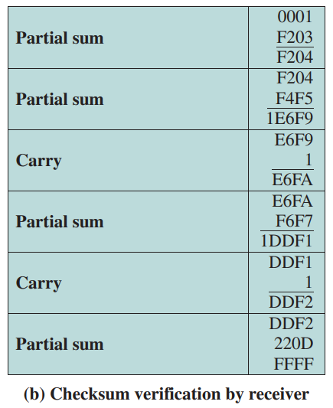
Internet Checksum (cont.)
Consider a header that consists of 10 octets.
00 01 F2 03 F4 F5 F6 F7 22 0D
hexadecimal: binary (decimal)
A:1010 (10)
B:1011 (11)
C:1100 (12)
D:1101 (13)
E:1110 (14)
F:1111 (15)
One’s complement in hexadecimal:
F→0
E→1
D→2
C→3
B→4
A→5
9→6
8→7
Source: William Stallings, Data and Computer Communications, 10th edition, 2013, Figure 6.4.
Notes:
in hexadecimal

Slide 20
Internet Checksum (cont.)
The primary reason for its adoption in Internet protocols is efficiency.
Most of these protocols are implemented in software
The Internet checksum, involving simple operations, causes very little overhead.
It is assumed that
At the lower link level, a strong error-detection code such as CRC is used.
The Internet checksum is an additional check for errors.
It is considerably less effective than the cyclic redundancy check (CRC).
Notes:
Not robust: errors where the sum of bits results in no change in checksum
The simplicity of the checksum algorithm allows for rapid calculation with limited processing power.

Slide 21
Cyclic Redundancy Check (CRC)
One of the most common and powerful error-detecting codes
Typically used in the data link layer
Given a k-bit block of bits, or message
Transmitter
Generate an (n - k)-bit sequence, known as a frame check sequence (FCS), such that the resulting frame, consisting of n bits, is exactly divisible by some predetermined number
Receiver
Divide the incoming frame by that number and, if there is no remainder, assume there was no error
Notes:
One of the most common and powerful error-detecting codes
CRC is related to cyclic codes.

Slide 22
CRC – Notations
Define
D = k-bit block of data
F = (n-k)-bit FCS
P = pattern of n-k+1 bits (the predetermined divisor)
T = n-bit frame to be transmitted
We would like T to be divisible by P (using modulo-2 arithmetic).
F = remainder of (D*2^{n-k} )/P
k-bit
n-k bit
D
F
T: n-bit
Notes:
The sender and receiver agree on a certain fixed polynomial called the Generator polynomial.

Slide 23
CRC – Notations (cont.)
How to choose the pattern P?
The pattern P is chosen to be one bit longer than the desired FCS.
The exact bit pattern chosen depends on the type of errors expected.
It is required that the highest-order bit = 1;
It is optional but common that the lowest-order bit = 1.
Notes:
The extra bit in p: ensure that the division produces the correct length for the remainder (FCS).
High order bit: ensure that the generator polynomial has the proper degree
- act as lower-degree polynomial
- inaccurate FCS
Low order bit: detect odd-numbered bit errors

Slide 24
CRC – Modulo-2 Arithmetic
To calculate FCS is like doing long division in regular arithmetic, but with differences.
Modulo-2 arithmetic
Addition and subtraction: use binary addition with no carries, just XOR
Multiplication and division: the same as in base-2 arithmetic but addition or subtraction is done without carries or borrows (XOR)
11001
x 11 --------
11001
110011
--------
101011
1111
+1010 --------
0101
1111
-0101 --------
1010
Notes:
XOR: produce a 1 if either of its inputs is 1 and will produce a 0 output if both of its inputs are 0 or 1.

Slide 25
CRC – An Example
Message D = 1010001101 (10 bits)
Pattern P = 110101 (6 bits)
FCS F = to be calculated (5 bits)
Thus, n=15, k=10, and (n-k) =5
k-bit
n-k bit
D
F
T: n-bit

Slide 26
CRC – An Example (cont.)
P, as divisor
1 1 0 1 0 1 0 1 1 0
Quotient, not used
1 1 0 1 0 1
1 0 1 0 0 0 1 1 0 1 0 0 0 0 0
D*2^{n-k},as dividend
1 1 0 1 0 1
A divisor is said “to go into” a dividend if the dividend has equal number of bits as the divisor! (heading zeros not counted)
1 1 1 0 1 1
1 1 0 1 0 1
1 1 1 0 1 0
1 1 0 1 0 1
1 1 1 1 1 0
1 1 0 1 0 1
1 0 1 1 0 0
1 1 0 1 0 1
1 1 0 0 1 0
1 1 0 1 0 1
1 1 1 0
Remainder
The remainder is added to D*2^{n-k} to give T= 101000110101110
Notes:
XOR: produce a 1 if either of its inputs is 1 and will produce a 0 output if both of its inputs are 0 or 1.
Steps and Terms in the Division Process
Align the Divisor:
Line up the leftmost 1 of the divisor with the leftmost 1 of the current dividend segment.
Subtract (XOR):
Subtract the divisor from the dividend segment using bitwise XOR (since we’re in modulo-2 arithmetic).
Bring Down the Next Bit:
Move to the next bit in the dividend and repeat the process.
Repeat:
Continue until you’ve processed all bits of the dividend.
Remainder:
The bits left after the last subtraction/XOR are the CRC.

Slide 27
CRC – An Example (cont.)
1 1 0 1 0 1 0 1 1 0
P
1 1 0 1 0 1
1 0 1 0 0 0 1 1 0 1 0 1 1 1 0
T
1 1 0 1 0 1
1 1 1 0 1 1
1 1 0 1 0 1
1 1 1 0 1 0
1 1 0 1 0 1
1 1 1 1 1 0
1 1 0 1 0 1
1 0 1 1 1 1
1 1 0 1 0 1
1 1 0 1 0 1
1 1 0 1 0 1
0
Remainder
Because there is no remainder, it is assumed that there have been no errors.
Notes:
XOR: produce a 1 if either of its inputs is 1 and will produce a 0 output if both of its inputs are 0 or 1.
An error will only be undetectable if the frame is divisible by the pattern.

Slide 28
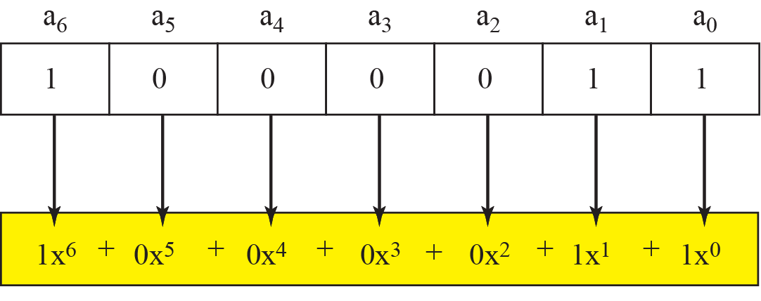
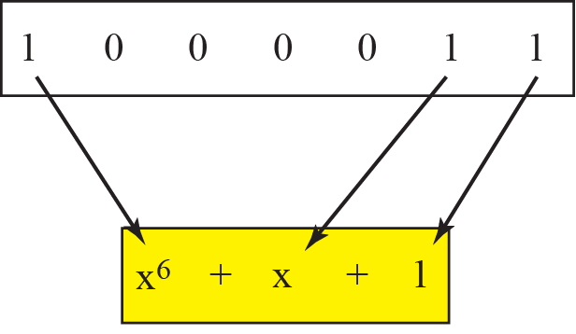
CRC, also known as polynomial codes
Express all values as polynomials in a dummy variable X, with binary coefficients.
The power of each term shows the position of the bit.
The coefficient shows the value of the bit.
Notes:
CRC (Cyclic Redundancy Check) is called a polynomial code because the process of generating and checking CRCs is based on treating binary data as polynomials over the finite field GF(2) (i.e., modulo-2 arithmetic).

Slide 29
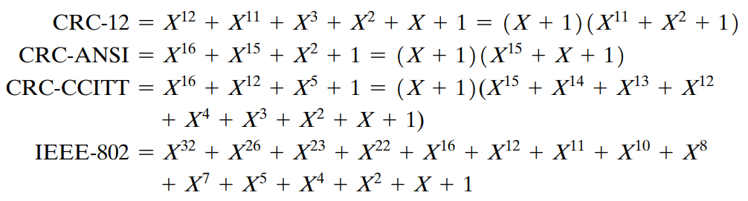
CRC – Some Standard Polynomials
Four versions of P(X) are widely used.
CRC-12: transmissions of streams of 6-bit characters
CRC-16/CRC-ANSI: various communication protocols, including serial communication standards like Modbus
CRC-CCITT: telecommunications applications
CRC-32/IEEE-802: network protocols, such as Ethernet, ZIP file compression, PNG image format, and other file transfer protocols
Notes:
Specification of a CRC code requires definition of a so-called generator polynomial.
This polynomial becomes the divisor in a polynomial long division, which takes the message as the dividend and in which the quotient is discarded, and the remainder becomes the result.
The CRC-12 system is used for transmission of streams of 6-bit characters and generates a 12-bit FCS.
Both CRC-16 and CRC-CCITT are popular for 8-bit characters in the United States and Europe, respectively, and both result in a 16-bit FCS.
CRC-32 is specified as an option in some point-to-point synchronous transmission standards and is used in IEEE 802 LAN standards.
A polynomial of degree r typically detects all burst errors of length r or less.

Slide 30
Error Correction

Slide 31
Forward Error Correction (FEC)
Typically, retransmission is needed when there are bit errors
Not good enough for wireless applications:
High bit error rate (BER) on a wireless link
Long propagation delay on satellite links
Need to correct errors on the basis of the bits received
Notes:
Some channels, like optical fibre in telecommunications networks, have tiny error rates so that transmission errors are a rare occurrence.
Other channels, especially wireless links, have high error rates - transmission errors are the norm.
FEC is critical, particularly where reliable data transmission is needed in environments with high latency, noise, or where retransmissions are impractical.

Slide 32
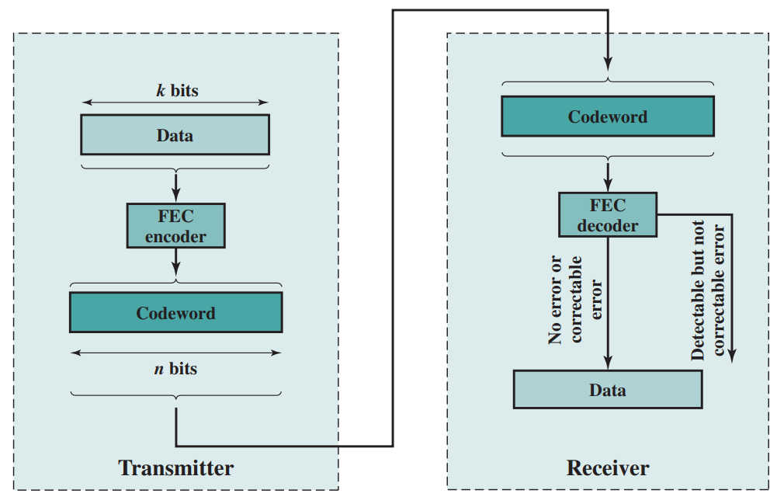
FEC Process
A message is divided into blocks (block coding), every k bits, called a data block.
FEC encoder encodes the data block; the resulting n-bit block is called a codeword.
Source: William Stallings, Data and Computer Communications, 10th edition, 2013, Figure 6.8.
Notes:
No errors: the input to the FEC decoder is identical to the original codeword, and the decoder produces the original data block as output.
Detectable, correctable errors: For certain error patterns, it is possible for the decoder to detect and correct those errors. The FEC decoder is able to map the block into the original data block.
Detectable, not correctable errors: For certain error patterns, the decoder can detect but not correct the errors. The decoder simply reports an uncorrectable error.
Undetectable errors: For certain, typically rare, error patterns, the decoder does not detect the error and maps the incoming n-bit data block into a different k-bit block.

Slide 33
An Example
Let us assume that k = 2 and n = 3.
Data block | Codeword
00 | 000
01 | 011
10 | 101
11 | 110
Case 1 (no errors): 000 is received given data block = 00; → extract 00.
Case 2 (detectable errors): 111 is received given data block = 11; → bit error detected
Case 3 (undetectable errors): 110 is received given data block = 10;
→ extract 11, no bit error detected.
Where is the ability to correct errors?
Notes:
In essence, error correction works by adding sufficient redundancy to the transmitted message.
The redundancy makes it possible for the receiver to deduce what the original message was, even in the face of a certain level of error rate.

Slide 34
Block Code Principles
Hamming distance
d(v₁, v₂) between two n-bit binary sequences v₁ and v₂ is the number of bits in which v₁ and v₂ disagree.
Example: v₁=011011, v₂=110001, d(v₁,v₂) = 3

Slide 35
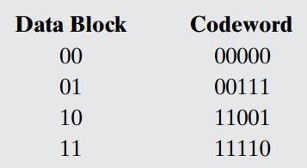
Block Code Principles (cont.)
Example: for k = 2 and n = 5
A codeword block is received with the bit pattern 00100
Codeword
00000
00111
11001
11110
Data block
00
01
10
11
00100
Single bit change
00100
Two-bit change
00100
Four-bit change
Three-bit change
00100
Notes:
This is not a valid codeword, and so the receiver has detected an error.
We can deduce that the most likely codeword that was sent was 00000 and that therefore the desired data block is 00.

Slide 36
Block Code Principles (cont.)
If an invalid codeword is received, the valid codeword that is closest to it (minimum distance) is selected.
This will only work if there is a unique valid codeword at a minimum distance from each invalid codeword.
For 2-bit data blocks to be encoded into 5-bit codewords, there are 2⁵ = 32 possible codewords.
4 out of these 32 codewords are valid, leaving 28 invalid codewords.

Slide 37
Block Code Principles (cont.)
Equal distance to codeword1 and codeword2; error detected but NOT corrected even with minimum-distance decoding
codeword2
Invalid codeword1
Invalid codeword1
codeword3
codeword1
Error detected and corrected if we apply minimum-distance decoding
codeword4
Notes:
A unique valid codeword at a minimum distance from this invalid codeword.

Slide 38
An Example of Invalid Codewords
Invalid Codeword | Minimum Distance | Valid Codeword | Invalid Codeword | Minimum Distance | Valid Codeword
00001 | 1 | 00000 | 10000 | 1 | 00000
00010 | 1 | 00000 | 10001 | 1 | 11001
00011 | 1 | 00111 | 10010 | 2 | 00000 or 11110
00100 | 1 | 00000 | 10011 | 2 | 00111 or 11001
00101 | 1 | 00111 | 10100 | 2 | 00111 or 11001
00110 | 1 | 00111 | 10101 | 2 | 00111 or 11001
01000 | 1 | 00000 | 10110 | 1 | 11110
01001 | 1 | 11001 | 10111 | 1 | 00111
01010 | 2 | 00000 or 11110 | 11000 | 1 | 11001
01011 | 2 | 00111 or 11001 | 11010 | 1 | 11110
01100 | 2 | 00000 or 11110 | 11011 | 1 | 11001
01101 | 2 | 00111 or 11001 | 11100 | 1 | 11110
01110 | 1 | 11110 | 11101 | 1 | 11001
01111 | 1 | 00111 | 11111 | 1 | 11110
Notes:
28 invalid codewords
There are 8 cases in which an invalid codeword is at a distance 2 from two different valid codewords.
Thus, if one such invalid codeword is received, and error in 2 bits could have caused it and the receiver has no way to choose between the two alternatives.
This code is capable of correcting all single-bit errors but cannot correct double-bit errors.

Slide 39
Pairwise Distances between Valid Codewords
00111
2-bit error
Not correctable!
1-bit error
1-bit error
d(00000,00111) = 3;
d(00000,11001) = 3;
d(00000,11110) = 4;
d(00111,11001) = 4;
d(00111,11110) = 3;
d(11001,11110) = 3;
11001
00000
The error-correction ability is related to the minimum Hamming distance of the codewords.
11110
Notes:
The minimum distance between valid codewords is 3.
A single-bit error will result in an invalid codeword that is a distance 1 from the original valid codeword but a distance at least 2 from all other valid codewords.
As a result, the code can always correct a single-bit error.
The code will always detect a double-bit error.
For given values of n and k, we would like the largest possible value of dmin.
The code should be relatively easy to encode and decode, requiring minimal memory and processing time.
The number of extra bits n - k to be small, to reduce bandwidth.
The number of extra bits n - k to be large, to reduce error rate.

Slide 40
Summary
CRC and FEC (the data link layer)
IPv4 header checksum (the network layer)
TCP/UDP checksum (the transport layer)
Notes:
CRC at the data link layer provides strong error detection for physical transmission.
hardware implementations of CRC are generally much faster than software implementations because they can perform operations in parallel and are optimised for specific tasks.
Checksums at the IP and TCP/UDP layers offer error detection focused on the integrity of headers and application data.
hop to hop and end to end

Slide 41
References
James F. Kurose & Keith W. Ross, Computer networking: a top-down approach featuring the Internet, Addison Wesley, 3rd edition, 2005. ​​
Chapter 5 The Link Layer and Local Area Network (5.2)​
William Stallings, Data and Computer Communications, Pearson, 10th edition, 2013.
Chapter 6 Error Detection and Correction
Andrew S. Tanenbaum & David J. Wetherall, Computer Networks, Prentice Hall, 5th edition, 2010.
Chapter 3 The Data Link Layer (3.2)

Slide 42
Acknowledgements
Lecture notes are developed based on slides from the following three sources:
Dr Mengmeng Ge’s lecture notes for COSC264, University of Canterbury, 2023
Assoc Prof Dan Kim’s lecture notes for COSC264, University of Canterbury, 2017
Prof Aleksandar Kuzmanovic’s lecture notes for CS340, Northwestern University, 2005, https://users.cs.northwestern.edu/~akuzma/classes/CS340-w05/lecture_notes.htm

