Slide 1
Reliable Data Transfer: ARQ Protocols
COSC264
Introduction to Computer Networks and the Internet
Dr Barry Wu
WRC
University of Canterbury
Barry.wu@canterbury.ac.nz

Slide 2
Learning Objectives
At the end of the lectures, you will be able to:
Understand the need for reliable data transfer
Present an overview of the basic mechanisms of stop-and-wait ARQ, go-back-N ARQ, and selective repeat/reject* ARQ
Selective reject is used in Data and Computer Communications by William Stallings
Selective repeat is used in Computer networking: a top-down approach featuring the Internet by James F. Kurose & Keith W. Ross and Computer Networks by Andrew S. Tanenbaum & David J. Wetherall
Notes:
Consider the problem of reliable data transfer in a general context
Implementing reliable data transfer can occur at the transport layer or the data link layer.

Slide 3
Outline
Reliable data transfer (RDT) protocols
rdt 1.0: over a perfectly reliable channel
rdt 2.0: over a channel with bit errors
rdt 3.0: over a lossy channel with bit errors
Pipelined reliable data transfer protocols
Notes:
Lost frame: a frame fails to arrive at the other side.
Damaged frame: some of the bits are in error (have been altered during transmission).

Slide 4
ARQ (Automatic Repeat reQuest)
Reliable data transfer protocols based on retransmission are known as ARQ (Automatic Repeat reQuest) protocols.
Stop-and-wait ARQ
Go-back-N ARQ
Selective repeat/reject ARQ
Notes:
Common techniques for error control, such as error detection, acks, retransmissions.
Collectively, these mechanisms are all referred to as automatic repeat request (ARQ).
The effect of ARQ is to turn a potentially unreliable data link into a reliable one.
Three versions of ARQ have been standardised.

Slide 5
Reliable data transfer over a perfectly reliable channel

Slide 6
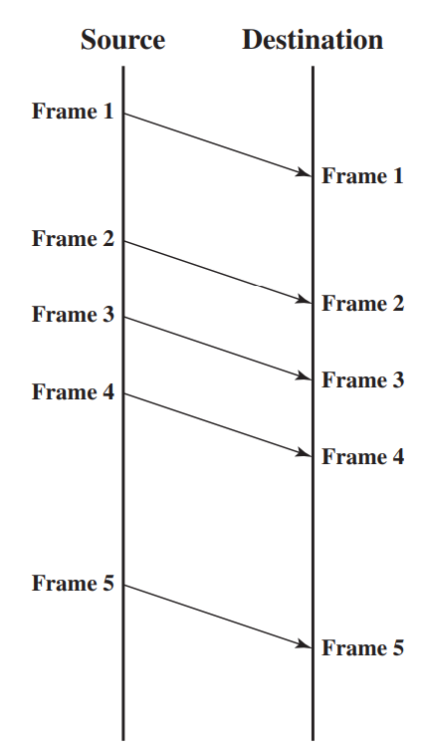
Error-Free Transmission: rdt 1.0
A perfectly reliable channel
no bit errors
no out-of-order frames
no frame loss
The sender sends data whenever data is available; the receiver receives data and delivers data to its upper-layer protocol.
Source: William Stallings, Data and Computer Communications, 10th edition, 2013, Figure 7.1.
Notes:
We assume that all frames that are transmitted are successfully received; no frames are lost, and none arrive with errors.
Frames arrive in the same order in which they are sent.
However, each transmitted frame suffers an arbitrary and variable amount of delay before reception.

Slide 7
Reliable data transfer over a lossless channel with bit errors

Slide 8
A channel with only bit errors
Hello
Yes (ACK)
Checksum/CRC for error detection
Positive acknowledgements (ACKs)
Negative acknowledgements (NAKs)
Can we meet at @#%& (bit errors)
Pardon? (NAK, negative ACK)
Can we meet at the library? (retransmission)
Notes:
Bits in a packet can be corrupted.
We’ll continue to assume that all transmitted packets are received in the order in which they were sent.
Error detection
Receiver feedback
Retransmissions: a packet that is received in error at the receiver will be retransmitted by the sender.

Slide 9
Stop-and-Wait Protocols: rdt 2.0
Sender
When the packet is ready, sends it and waits for ACK/NAK
If NAK is received, retransmits the last packet and waits for ACK/NAK
If ACK is received, waits for the next packet to be ready
Receiver
If the packet is received without error, sends ACK
If the packet is received with error, sends NAK
Notes:
This is also known as stop-and-wait protocol because the sender waits for ACK to send data again.

Slide 10
rdt 2.0: FSM (Finite-state machine)
Sends packet
Sender
Wait for call from above
Wait for ACK/NAK
Receives NAK
& Retransmits
Receives ACK
Receiver
Wait for call from below
Received correct packet
& Sends ACK
Receives corrupted packet
& Sends NAK
Notes:
FSM: a computational model used to represent and control the execution flow of a system.
a finite number of states
transitions between those states
actions that occur based on certain inputs
input: the external information or event that triggers a transition between states
Sender
the send-side protocol is waiting for data to be passed down from the upper layer.
the sender protocol is waiting for an ACK or a NAK packet from the receiver.
when the sender is in the wait-for-ACK-or-NAK state, it cannot get more data from the upper layer.
Receiver
On packet arrival, the receiver replies with either an ACK or a NAK, depending on whether or not the received packet is corrupted.

Slide 11
rdt 2.0: A Fatal Flaw
Hello
Yes (ACK)
Can we meet at @#%& (bit errors)
Pardon? (NAK)
Can we meet at the library? (retransmission)
ACK/NAK can be corrupted!
Notes:
One approach: add checksum bits to ACK/NAK packets in order to detect such errors.
The more difficult question is how the protocol should recover from errors in ACK or NAK packets.
If an ACK or NAK is corrupted, the sender has no way of knowing whether or not the receiver has correctly received the last piece of transmitted data.

Slide 12
rdt 2.0: Corrupted ACK/NAK
Hello
Y#% (corrupted ACK)
The receiver does not know whether the data is new or a retransmission!
Resend the data!
Hello
Yes (ACK)
Can we meet at the library?
####
Can we meet at the library?
Notes:
One approach is for the sender to simply resend the current data packet when it receives a garbled ACK or NAK packet.

Slide 13
rdt 2.0: Corrupted ACK/NAK (cont.)
Zak is his
Yes (ACK)
new or a retransmission?!
great
####
great
Yes (ACK)
grandson

Slide 14
How to handle corrupted ACK/NAK: rdt 2.1
For this simple case of a stop-and-wait protocol, add a new field (1-bit sequence number)
retransmission (same as previous)
new (different from previous)
Hello, 0
Y#% (corrupted ACK)
Hello, 0
Yes (ACK)
Can we meet at the library?, 1
The receiver will not be confused!
####
Can we meet at the library?, 1
Notes:
Add a new field to the data packet and have the sender number its data packets by putting a sequence number into this field
A 1-bit sequence number will suffice, as it will allow the receiver to know whether the sender is resending
the previously transmitted packet (the sequence number of the received packet has the same sequence number as the most recently received packet)
or a new packet (the sequence number changes)

Slide 15
How to handle corrupted ACK/NAK: rdt 2.1 (cont.)
Zak is his, 0
Yes (ACK)
great,1
####
Zak is his great grandson
great,1 (retrans.)
Yes (ACK)
grandson,0
Notes:
the receiver will not be confused

Slide 16
How to handle corrupted ACK/NAK: rdt 2.1 (cont.)
Zak is his, 0
Yes (ACK)
great,1
Yes (ACK)
Zak is his great great grandson
great,0 (new)
Yes (ACK)
grandson,1

Slide 17
How to handle corrupted ACK/NAK: rdt 2.2
NAK-free data transfer: use duplicate ACKs with the sequence number to replace NAK
Hello, 0
Yes, 0 (ACK, 0)
Can we meet at @#%& (bit errors)
Yes, 0 (ACK, 0)
Can we meet at the library?, 1 (retransmission)
Notes:
Protocol rdt2.1 uses both positive and negative acknowledgments from the receiver to the sender.
When an out-of-order packet is received, the receiver sends a positive ack for the packet it has received.
When a corrupted packet is received, the receiver sends a nak.
A sender that receives two ACKs for the same packet (i.e., receives duplicate ACKs) knows that the receiver did not correctly receive the packet following the packet that is being ACKed twice.

Slide 18
How to handle corrupted ACK/NAK: rdt 2.2 (cont.)
Hello, 0
Yes, 0 (ACK, 0)
Can we meet at the library?, 1 (no bit errors)
Yes, 1 (ACK, 1)
The receiver uses ACKs with the sequence number.

Slide 19
Reliable data transfer over a lossy channel with bit errors
Notes:
how to detect packet loss and what to do when packet loss occurs.
checksum, sequence numbers, ACK packets, and retransmissions

Slide 20
Data Loss
Hello, 0
My “Hello” gets lost?

Slide 21
ACK Loss
Hello, 0
Yes, 0 (ACK, 0)
My “Hello” gets lost?

Slide 22
Data Delayed
My “Hello” gets lost?
Hello, 0

Slide 23
ACK Delayed
Hello, 0
My “Hello” gets lost?
Yes, 0 (ACK, 0)

Slide 24
How to detect the packet loss?
Wait, wait and wait!
How long should the sender wait?
Too short → duplicate data packets
Too long → decreased performance
The solution: to judiciously choose a time value

Slide 25
Example: Data Loss
Hello, 0
Timeout
Hello, 0
Use timeout to detect packet loss
Use retransmission to recover from packet loss
Notes:
From the sender’s viewpoint: retransmission
Implementing a time-based retransmission mechanism requires a countdown timer that can interrupt the sender after a given amount of time has expired.
The sender will
start the timer each time a packet (either a first-time packet or a retransmission) is sent
respond to a timer interrupt (taking appropriate actions)
stop the timer

Slide 26
Example: ACK Loss
Hello, 0
Yes, 0 (ACK 0)
Timeout
Hello, 0

Slide 27
Example: Data Delayed
Hello, 0
Timeout
Hello, 0

Slide 28
Example: ACK Delayed
Hello, 0
Timeout
Yes, 0 (ACK 0)
Hello, 0

Slide 29
How to detect the packet loss? (cont.)
Use timeout to detect packet loss (choose a time value wisely)
Use retransmission to recover from packet loss (duplicate data packets – use seq#)

Slide 30
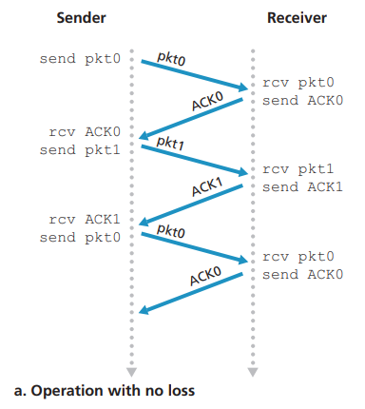
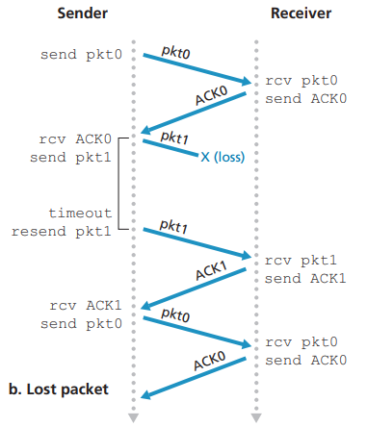
Alternating Bit Protocols: rdt 3.0
Source: James F. Kurose & Keith W. Ross, Computer networking: a top-down approach featuring the Internet, 3rd edition, 2005, Figure 3.16.

Slide 31
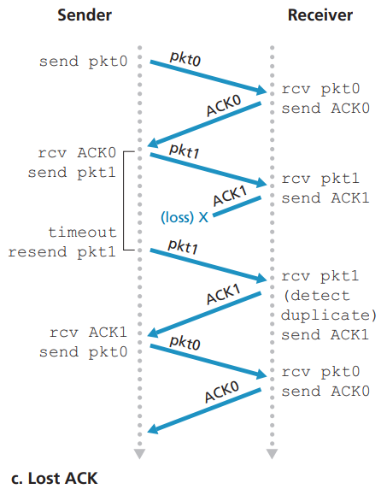
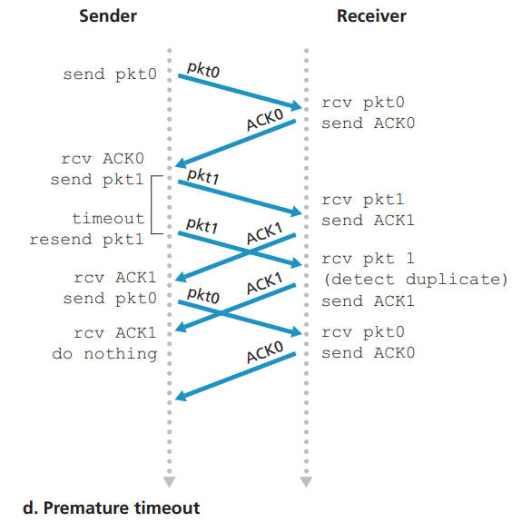
Alternating Bit Protocols: rdt 3.0 (cont.)
Source: James F. Kurose & Keith W. Ross, Computer networking: a top-down approach featuring the Internet, 3rd edition, 2005, Figure 3.16.
Notes:
Premature timeout: it occurs when a sender mistakenly assumes that the acknowledgment (ACK) for a sent data packet has been lost or delayed.
Network delays: leading the sender to falsely assume it has been lost.

Slide 32

The Performance Problem of Alternating Bit Protocols
It is essentially a stop-and-wait protocol.
The first bit of the first packet
is transmitted, t = 0
Sender
Receiver
The last bit of the first packet
is transmitted, t = L/R
The first packet bit arrives
RTT
The last packet bit arrives
ACK arrives, next packet
Is sent, t = RTT + L / R
RTT – Round Trip Time
L – Packet Size
R – Transmission Rate
Utilisation of the sender: $U_{sender}=\frac{L/R}{RTT+L/R}$
Notes:
Bit rate is the number of bits that are conveyed or processed per unit of time.
The fraction of time the sender is busy sending bits.

Slide 33

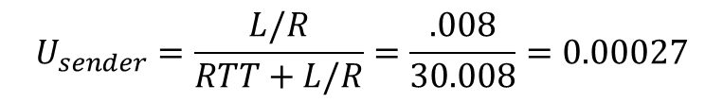
The Performance Problem of Alternating Bit Protocols (cont.)
An example: transmission rate of 1 Gbps, RTT of 30 milliseconds , packet size of 1KB
$t_{trans}=\frac{L}{R}$ $=\frac{8kb/pkt}{{10}^{9}bits/sec}=8 microseconds$
$$U_{sender}=\frac{L/R}{RTT+L/R}=\frac{.008}{30.008}=0.00027$$
The sender is idle in most time – very low utilisation!
Not to mention we have neglected the lower layer protocol processing time at the sender and receiver, and processing and queuing delays at intermediate routers.

Slide 34
Pipelined reliable data transfer protocols

Slide 35
Pipelining
s
r
s
r
Notes:
The sender is allowed to send multiple packets without waiting for acknowledgements.
Since the many in-transit sender-to-receiver packets can be visualised as filling a pipeline, this technique is known as pipelining.

Slide 36
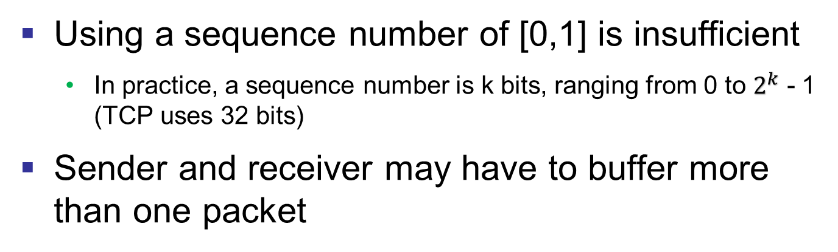
Pipelining (cont.)
1
0
s
r
0
1
Using a sequence number of [0,1] is insufficient
In practice, a sequence number is k bits, ranging from 0 to $2^{k}$ - 1 (TCP uses 32 bits)
Sender and receiver may have to buffer more than one packet
Notes:
Minimally, the sender will have to buffer packets that have been transmitted but not yet acknowledged.
The range of sequence numbers needed, and the buffering requirements will depend on the manner in which a data transfer protocol responds to lost, corrupted, and overly delayed packets.
Two basic approaches toward pipelined error recovery can be identified: Go-Back-N and selective repeat.

Slide 37
Go-Back-N Protocol (Sliding-Window Protocol)
The sender is allowed to send multiple packets without waiting for an acknowledgement but is constrained to have no more than N unacknowledged packets in the pipeline.
base: seq# of the oldest unACK’d pkt
nextseqnum: the smallest unused seq#
ACK’d seq#
Sent seq#, not yet ACK’d
Usable seq#, not yet sent
Window of size N
Not usable seq#
Older packets
Notes:
Sender cannot send too fast.
The window size is related to flow control and congestion control: utilisation

Slide 38
Go-Back-N: Invocation from Above (Sender)
Window of size N
Older packets
ACK’d seq#
Usable seq#, not yet sent
Sent seq#, not yet ACK’d
Not usable seq#
Notes:
The sender first checks to see if the window is full – N unacked packets.
If not, create and send a packet.
If full, return the data back to the upper layer and an indication that the window is full.
In practice, the sender can buffer this data.

Slide 39
Go-Back-N: Receipt of an ACK (Sender)
base
nextseqnum
Window of size N
Older packets
ACK’d seq#
Usable seq#, not yet sent
Sent seq#, not yet ACK’d
Not usable seq#
Notes:
base: seq# of the oldest unACK’d pkt

Slide 40
Go-Back-N: Cumulative ACK (Sender)
base
nextseqnum
Window of size N
Older packets
ACK’d seq#
Usable seq#, not yet sent
Sent seq#, not yet ACK’d
Not usable seq#
Notes:
An ack for packet sequence number n
All packets up to and including n have been received at the receiver side

Slide 41
Go-Back-N: Cumulative ACK (Sender) (cont.)
An ACK with seq# n means that all packets with a seq# up to (and including) n have been correctly received at the receiver.
Data 1
ACK 1
Data 2
ACK 2
I know Data 1, 2, and 3 are all received correctly☺
Data 3
ACK 3
Notes:
If a packet with sequence number n is received correctly and is in order, the receiver sends an ACK for packet n and delivers the data portion of the packet to the upper layer.

Slide 42
Go-Back-N: Cumulative ACK (Receiver)
Data 1
ACK 1
Data 2
I am expecting Data 2 and will discard Data 3 and still ACK 1.
Data 3
ACK 1
Rule for Receiver: I’m always expecting the next in-order pkt; if unexpected pkt comes, I always discard them and resend an ACK for the latest correctly received in-order pkt.
Notes:
The receiver discards out-of-order packets.
The disadvantage of throwing away a correctly received packet is that the subsequent retransmission of that packet might be lost or garbled and thus even more retransmissions would be required.

Slide 43
Go-Back-N: Timeout (Sender)
base
nextseqnum
When there is a timeout: resend all not yet ACK’d pkts.
Window of size N
Older packets
ACK’d seq#
Usable seq#, not yet sent
Sent seq#, not yet ACK’d
Not usable seq#
Notes:
If a timeout occurs, the sender resends all packets that have been previously sent but that have not yet been acknowledged.
Our sender uses only a single timer, which can be thought of as a timer for the oldest transmitted but not yet acknowledged packet.
If an ACK is received but there are still additional transmitted but not yet acknowledged packets, the timer is restarted.
If there are no outstanding, unacknowledged packets, the timer is stopped.

Slide 44
Go-Back-N: Rules for the Receiver Side
Initially, expecting packet 0
0
1
2
2^k -1
When packet 0 arrives uncorrupted:
Deliver data to above;
Send ACK 0;
Now expecting packet 1.
1
2
3
2^k -1
0
Then packet 2 (out-of-order)
arrives uncorrupted or a corrupted packet arrives:
Discard it;
Still send ACK 0;
Still expecting packet 1.
1
2
3
2^k -1
0
The receiver could have buffered pkt 2 for later delivery; but if pkt 1 is lost, pkts 1 & 2 will be retransmitted later. For simplicity!
Then packet 1 arrives uncorrupted:
Deliver data to above;
Send ACK 1;
Now expecting packet 2.
2
3
4
2^k -1
0
1
The receiver only needs to keep track of the expectedseqnum.
Notes:
Receiver protocol:
If it receives an in-order packet; sends an ACK, delivers the packet, and expects the next in-order one;
otherwise, it discards the received packet (out-of-order/corrupted); sends an ACK.

Slide 45
Go-Back-N: Extended FSM​ Descriptions
Extended FSM of the sender
Extended FSM of the receiver
Source: James F. Kurose & Keith W. Ross, Computer networking: a top-down approach featuring the Internet, 3rd edition, 2005, Figure 3.20 & 3.21.

Slide 46
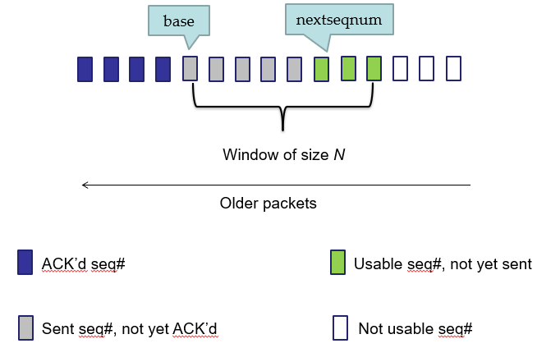
Go-Back-N: Extended FSM​ of Sender
rdt_send(data)
if (nextseqnum < base+N) { /*If we are allowed to send packets*/
sndpkt[nextseqnum] = make_pkt(nextseqnum,data,chksum)
udt_send(sndpkt[nextseqnum])
if (base == nextseqnum) /*If there are no previous packets in flight*/
start_timer /*Start timer for the just-sent packet*/
nextseqnum++ /*Move to the next smallest unused sequence#*/
}
else
refuse_data(data)
Λ
base=1
nextseqnum=1
timeout
Wait
(re)start_timer
/*Resend all previously sent unACK’ed packets*/
udt_send(sndpkt[base])
udt_send(sndpkt[base+1])
…
udt_send(sndpkt[nextseqnum-1])
rdt_rcv(rcvpkt)
&& corrupt(rcvpkt)
Go back
Λ
rdt_rcv(rcvpkt) &&
notcorrupt(rcvpkt)
base = getacknum(rcvpkt)+1 /*Slide the window to its right*/
If (base == nextseqnum) /*If there are no packets in flight*/
stop_timer /* Stop timer because there are not outstanding packet*/
else
(re)start_timer /*Start timer for the oldest transmitted but not ACKed packet*/
Notes:
A single timer for the oldest transmitted but not yet acknowledged packet
Timeout:
If an ACK is received but there are still additional transmitted but not yet acknowledged packets, the timer is restarted.
If there are no outstanding, unacknowledged packets, the timer is stopped.
Corrupted packet: no explicit action; the sender passively waits for either a valid ack or a timeout to trigger retransmission.

Slide 47
Go-Back-N: Extended FSM​ of Receiver
default /*Other cases other than receiving in-order packets*/
udt_send(sndpkt)
/*Send an ACK for the most recently received in-order packet*/
rdt_rcv(rcvpkt) /*Receive in-order packets*/
&& notcurrupt(rcvpkt)
&& hasseqnum(rcvpkt,expectedseqnum)
Λ
Wait
expectedseqnum=1
sndpkt =
make_pkt(0,ACK,checksum)
extract(rcvpkt,data)
deliver_data(data)
sndpkt = make_pkt(expectedseqnum,ACK,checksum)
udt_send(sndpkt)
expectedseqnum++
Receiver protocol:
If it receives an in-order packet; sends an ACK, delivers the packet, and expects the next in-order one;
otherwise, it discards the received packet (out-of-order/corrupted); sends an ACK.
Notes:
hasseqnum(rcvpkt, expectedseqnum): check if the sequence# of the received packet matches the expected sequence number.
Udt_send (unreliable data transfer)

Slide 48
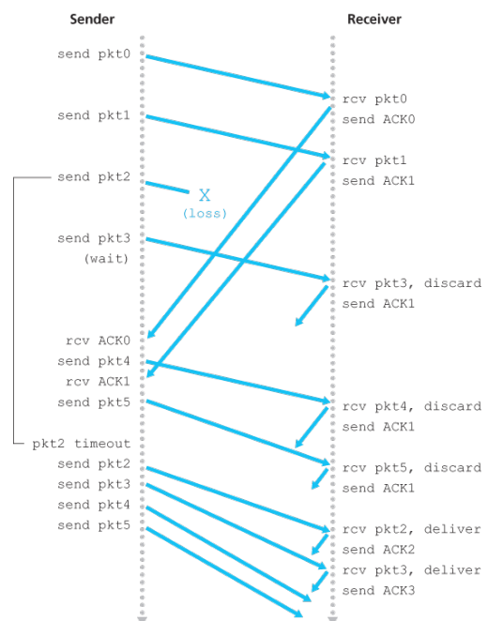
Go-Back-N Operation
When there is a time-out caused by a single packet error, all unacknowledged packets will be resent!
Source: James F. Kurose & Keith W. Ross, Computer networking: a top-down approach featuring the Internet, 3rd edition, 2005, Figure 3.22.
Notes:
Window size: 4
Because of this window size limitation, the sender sends packets 0 through 3 but then must wait for one or more of these packets to be acknowledged before proceeding.
As each successive ACK is received, the window slides forward and the sender can transmit one new packet (pkt4 and pkt5, respectively).
On the receiver side, packet 2 is lost and thus packets 3, 4, and 5 are found to be out of order and are discarded.
When the window size and bandwidth-delay product are both large, many packets can be in the pipeline.
A single packet error can thus cause GBN to retransmit a large number of packets.

Slide 49
Selective Repeat/Reject (SR)
receiver individually acknowledges all correctly received pkts
buffers pkts, as needed, for eventual in-order delivery to upper layer
sender only resends pkts for which ACK not received
sender has timer for each unACKed pkt
sender window
N consecutive seq #’s
again limits seq #s of sent, unACKed pkts
Receiver window
N consecutive seq #’s
defines the range of sequence numbers that the receiver is currently willing to accept and buffer.
Notes:
SR – Friday;

Slide 50
SR: Sender window
send_base
nextseqnum
ACK’d seq#
Usable seq#, not yet sent
Window of size N
Sent seq#, not yet ACK’d
Not usable seq#
Older packets

Slide 51
SR: Receiver window
Rcv_base
Rcv_base + N-1
ACK’d seq#; out-of-order
Buffered;
Acceptable seq#
Window of size N
Not usable seq#
Expected seq#, not yet received
Older packets

Slide 52
SR: Sender Window – Receipt of an ACK
send_base
nextseqnum
ACK’d
Window of size N
Older packets
ACK’d seq#
Usable seq#, not yet sent
Sent seq#, not yet ACK’d
Not usable seq#
Notes:
ACK received with seq# in [send_base, send_base+N-1]
mark the packet as received

Slide 53
SR: Sender Window – Receipt of an ACK (cont.)
send_base
nextseqnum
ACK’d
Window of size N
Older packets
ACK’d seq#
Usable seq#, not yet sent
Sent seq#, not yet ACK’d
Not usable seq#
Notes:
if the seq# = send_base, advance the window base to next unACK’d seq#

Slide 54
SR: Sender Window – Timeout
send_base
nextseqnum
Timeout for pkt with this seq#; resend this pkt only and restart timer.
Window of size N
Older packets
ACK’d seq#
Usable seq#, not yet sent
Sent seq#, not yet ACK’d
Not usable seq#
Notes:
each packet has its own timer
resend the packet and restart the timer

Slide 55
SR: Sender Side
Sender
Data received from above
if the next available seq# is in the window, send the packet
Timeout
each packet has its own timer
resend the packet and restart the timer
ACK received with seq# in [send_base, send_base+N-1]
mark the packet as received
if the seq# = send_base, advance the window base to next unACK’d seq#
The only case when the sender window moves.

Slide 56
SR: Receiver Window – Expected Packet
rcv_base
This packet is delivered to the upper layer!
Window of size N
Older packets
Out-of-order buffered but ACK’d seq#
Acceptable seq#
Expected not yet received seq#
Not usable seq#
Notes:
if seq# = rcv_base, the packet and any buffered, in-order packets are delivered, advance the window by the number of packets delivered

Slide 57
SR: Receiver Window – Expected Packet (cont.)
Receiver receives an expected packet; it will send a selective ACK; deliver buffered and consecutively numbered packets to above.
rcv_base
These 3 will be delivered to the upper layer!
Window of size N
Older packets
Out-of-order buffered but ACK’d seq#
Acceptable seq#
Expected not yet received seq#
Not usable seq#

Slide 58
SR: Receiver Window – New Out-of-Order Packet
Receiver receives a new packet; buffer it and send a selective ACK.
rcv_base
Window of size N
Older packets
Out-of-order buffered but ACK’d seq#
Acceptable seq#
Expected not yet received seq#
Not usable seq#

Slide 59
SR: Receiver Window – Old Packet
Receiver receives an old packet (retransmission); ignore it and send a selective ACK again.
rcv_base
Window of size N
Older packets
Out-of-order buffered but ACK’d seq#
Acceptable seq#
Expected not yet received seq#
Not usable seq#

Slide 60
SR: Receiver window – a delivered pkt - seq# in [rcv_base-N, rcvbase-1]
S: 0 1 2 3 4 5 6 7 8 9
R: 0 1 2 3 4 5 6 7 8 9
Rcv_base
Receiver receives a delivered pkt; it will send an ACK (sender might be waiting for this ACK).
Window of size N
ACK’d seq#; out-of-order
Buffered;
acceptable seq#
Not usable seq#
expected seq#, not yet received

Slide 61
SR: Receiver Side
Receiver
Packet with seq# in [rcv_base, rcv_base+N-1]
send a selective ACK
out-of-order: the packet is buffered
if seq# = rcv_base, the packet and any buffered, in-order packets are delivered, advance the window by the number of packets delivered
Packet with seq# in [rcv_base-N, rcv_base-1]
send ACK even if the receiver has previously acknowledged
Otherwise
ignore the packet
Notes:
Sender is retransmitting the packet – it has not received ACK; resend it to make sender’s window move

Slide 62
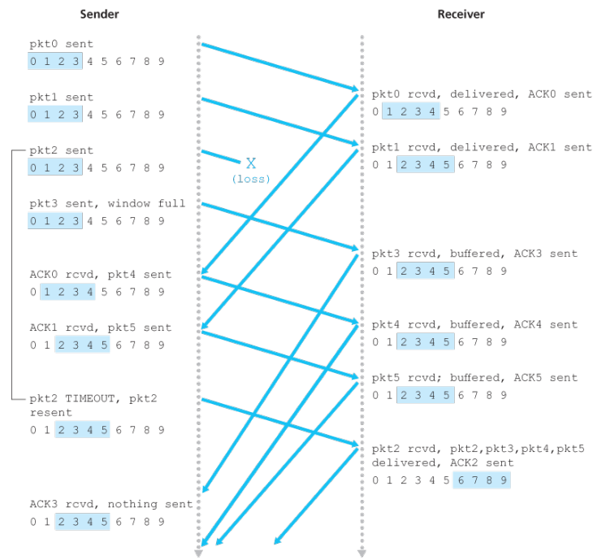
SR Operation
Source: James F. Kurose & Keith W. Ross, Computer networking: a top-down approach featuring the Internet, 3rd edition, 2005, Figure 3.26.
Notes:
Sender and receiver might have different view of what has been received correctly.
The receiver initially buffers packets 3, 4, and 5, and delivers them together with packet 2 to the upper layer when packet 2 is finally received.

Slide 63
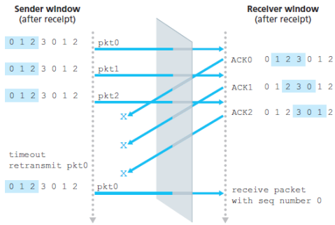
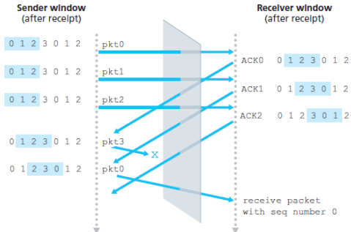
SR: Receiver Dilemma with Too Large Windows
Example:
seq#: 0, 1, 2, 3
window size = 3
A retransmission with seq# 0
A new transmission with seq# 0
Source: James F. Kurose & Keith W. Ross, Computer networking: a top-down approach featuring the Internet, 3rd edition, 2005, Figure 3.26.
Notes:
Suppose packets 0 through 2 are transmitted and correctly received and acknowledged at the receiver.
ACKs for the first three packets are lost and the sender retransmits these packets.
ACKs for the first three packets are all delivered correctly. The sender moves its window forward and sends packets 3, 0, and 1. The packet with sequence number 3 is lost, but the packet with sequence number 0 arrives - a packet containing new data.
Receiver sees no difference in two scenarios!

Slide 64
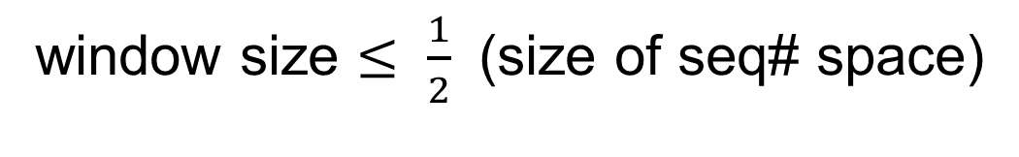
What is the relationship between the window size and seq# space?
window size $≤ \frac{1}{2}$ (size of seq# space)
Notes:
We use an 8-bit field for seq#, the window size should be no greater than 2^8/2 = 2^7 = 128.
We use a window of size 4, we should at least use a 3-bit seq# field.

Slide 65
Summary
Mechanism | Use, Comments
Checksum | To detect bit errors
Timer | To timeout/retransmit a packet (lost/premature packet)
Sequence number | To detect a lost packet (gap in seq#) To detect a duplicate packet (duplicate seq#)
Acknowledgement | To notify the successful receipt of packets (individual/cumulative)
Negative ACK | To notify the unsuccessful receipt of packets
Window, pipelining | To improve sender utilisation
Source: James F. Kurose & Keith W. Ross, Computer networking: a top-down approach featuring the Internet, 3rd edition, 2005, Table 3.1.
Notes:
By allowing multiple packets to be transmitted but not yet acknowledged, sender utilisation can be increased over a stop-and-wait mode of operation.

Slide 66
References
James F. Kurose & Keith W. Ross, Computer networking: a top-down approach featuring the Internet, Addison Wesley, 3rd edition, 2005. ​
Chapter 3 Transport Layer (3.4)
William Stallings, Data and Computer Communications, Pearson, 10th edition, 2013.
Chapter 7 Data Link Control Protocols
Andrew S. Tanenbaum & David J. Wetherall, Computer Networks, Prentice Hall, 5th edition, 2010.
Chapter 3 The Data Link Layer (3.3, 3.4)

Slide 67
Acknowledgements
Lecture notes are developed based on slides from the following three sources:
Dr Mengmeng Ge’s lecture notes for COSC264, University of Canterbury, 2024
Assoc Prof Dan Kim’s lecture notes for COSC264, University of Canterbury, 2017
Prof Aleksandar Kuzmanovic’s lecture notes for CS340, Northwestern University, 2005, https://users.cs.northwestern.edu/~akuzma/classes/CS340-w05/lecture_notes.htm

