Slide 1
Transport Layer Protocols
COSC264
Introduction to Computer Networks and the Internet
Dr Barry Wu
WRC
University of Canterbury
Barry.wu@canterbury.ac.nz

Slide 2
Learning Objectives
At the end of the lectures, you will be able to:
Describe transport-layer services
Explain the concept of multiplexing and demultiplexing
Present an overview of the UDP services
Explain the TCP connection management
Understand how TCP provides reliable data transfer, flow control, and congestion control

Slide 3
Outline
Transport-layer services
Multiplexing and demultiplexing
Connectionless transport: UDP
Connection-oriented transport: TCP

Slide 4
Introduction to transport-layer services

Slide 5

Transport Protocols
Provide logical communication between application processes running on different hosts
Run on end hosts
Sender: the transport layer converts the message from a sending application into transport-layer segments and passes them to the network layer
Receiver: the transport layer receives segments from below and processes them, making available the data in the segments to the receiving application
Multiple transport protocols available to applications
Internet: mainly TCP and UDP
application
transport
network
data link
physical
network
data link
physical
network
data link
physical
logical end-to-end transport
network
data link
physical
network
data link
physical
network
data link
physical
network
data link
physical
application
transport
network
data link
physical
Notes:
Transport layer protocols implemented in the end systems not in network routers.
Sender: break the message into smaller chunks and add header to each chunk to create the segment

Slide 6
Services provided by the Internet Transport Layer
Integrity/error checking (TCP and UDP)
Extending host-to-host delivery to process-to-process delivery (TCP and UDP);
Transport-layer multiplexing and demultiplexing
Reliable data transfer (TCP)
Flow control (TCP)
Congestion control (TCP)
Notes:
IP service model is a best-effort delivery service – unreliable.
Extending host-to-host delivery to process-to-process delivery.
Error detection fields in the segment header.
Congestion control: TCP connections equally share a bandwidth when traversing a congested network link.

Slide 7
Popular Internet applications and their underlying transport protocols​
Application​ | Application-layer protocol​ | Underlying transport protocol​
Email​ | SMTP​ | TCP​
Web​ | HTTP​ | Typically TCP​
File transfer | FTP | TCP
Name translation​ | DNS​ | Typically UDP​
Network management | SNMP | Typically UDP
Streaming multimedia​ | Typically proprietary​ | UDP​ or TCP
Internet telephony​ | Typically proprietary​ | UDP​ or TCP

Slide 8
Multiplexing and demultiplexing

Slide 9
Definition
Multiplexing
To create segments and pass them to the network layer
Demultiplexing
To deliver the data in a transport-layer segment to the correct socket
P1
P2
P3
P1
P2
P3
transport
transport
Multiplexing
Demultiplexing
network
network
link
link
physical
physical
Process
Socket
9
Notes:
Gather data chunks at the source host from different sockets, encapsulate each data chunk with header information.
Examine header fields to identify the receiving socket and direct the segment to that socket.

Slide 10
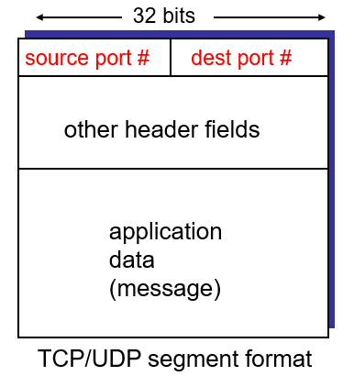
How demultiplexing works
The host receives IP datagrams
Each datagram has source and destination IP addresses
Each datagram carries 1 transport-layer segment
Each segment has source and destination port numbers
The host uses IP addresses & port numbers to direct a segment to the appropriate socket
Notes:
Each socket is assigned a port number to help identify specific services on a host.

Slide 11
Connectionless Demultiplexing
A UDP socket is identified by a two-tuple
Destination IP address
Destination port number
When a host receives a UDP segment
checks the destination port number in the segment
directs the UDP segment to the socket with that port number
Packets with different source IP addresses and/or source port numbers, but with the same destination IP and port number, will be directed to the same socket.
Notes:
Socket has two perspectives:
Facing the application programmer – a socket is a high-level abstraction that allows them to establish communication between different networked applications;
Facing the system programmer who implements the OS – a socket is a mechanism that manages the actual data transmission across the network.

Slide 12
Connectionless Demultiplexing (cont.)
Port# 46428
Port# 19157
Port# 42345
P1
D-IP: A
D-IP: B
D-P: 46428
D-P: 42345
Client
IP: A
D-IP: C
Server
IP: C
D-IP: C
Client
IP: B
D-P: 19157
D-P: 19157
The source port serves as part of a “return address”.

Slide 13
Connection-Oriented Demultiplexing
A TCP socket is identified by a 4-tuple
Source IP address
Source port number
Destination IP address
Destination port number
The server host may support many simultaneous TCP sockets
Each socket is attached to a process
Each socket is identified by its own 4-tuple
Notes:
Web servers have different sockets for each connecting client.

Slide 14
Connection-Oriented Demultiplexing (cont.)
P1
S-P: 19157
S-P: 5775
D-P: 80
D-P: 80
S-IP: A
S-IP: B
D-IP: C
D-IP: C
Client
IP: A
Server
IP: C
Client
IP: B
S-P: 19157
D-P: 80
S-IP: B
D-IP: C
The same Web server has different sockets for different processes at clients.
Notes:
A chooses source port numbers independently of B.
Server will correctly demultiplex two connections with the same source port number.

Slide 15
Connectionless transport: UDP

Slide 16
UDP (User Datagram Protocol) [RFC 768]
A “no-frills, bare-bones” transport protocol
Multiplexing/demultiplexing function and error checking
Provide a connectionless service for application-level processes
No handshaking between sending and receiving transport-layer entities before sending a segment
An unreliable service
UDP segments may be lost​ or delivered out of order​
Notes:
Each UDP segment handled independently of others​

Slide 17
UDP Segment Format
The source and destination ports add a port addressing capability to IP.
The length field contains the length of the entire UDP segment, including header and data.
An optional checksum applies to the entire UDP segment plus a conceptual IP pseudoheader.
32 bits
Source port
Destination port
Length
Checksum
Application data
(message)
UDP segment format
Notes:
The UDP length field includes the 8-byte header and the data.
The minimum length is 8 bytes, to cover the header.
The maximum length is 65,515 bytes, which is lower than the largest number that will fit in 16 bits because of the size limit on IP packets.
An optional Checksum is also provided for extra reliability.
If it is not used, it is set to zero.
IP pseudoheader: provide additional error-checking for key parts of the IP header.

Slide 18
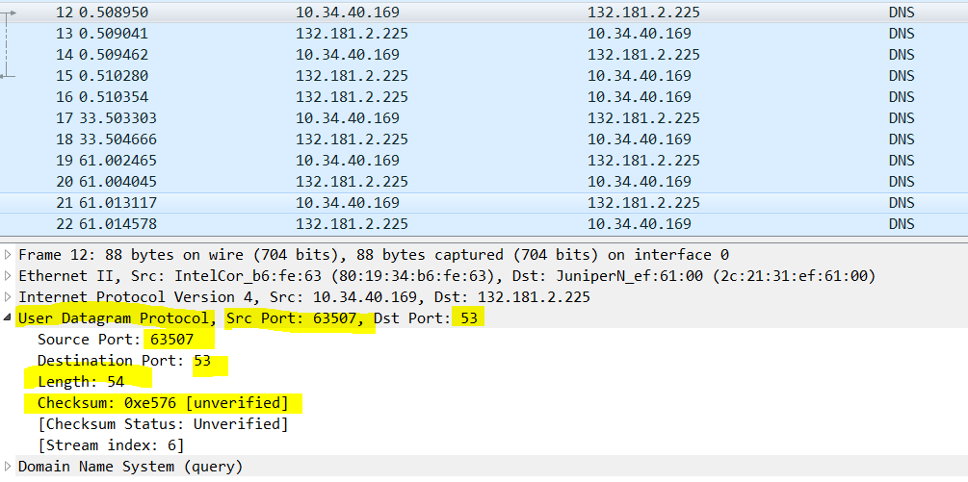
A UDP segment captured by Wireshark

Slide 19
Why using UDP
No connection establishment (which can add delay)
No connection state (no allocation of buffers, parameters, sequence numbers, etc.)
Small segment header overhead (8 bytes)
Finer application-level control over what data is sent, and when (no congestion control)
Notes:
UDP does not introduce any delay to establish a connection
probably the principal reason why DNS runs over UDP rather than TCP
Under UDP, as soon as an application process passes data to UDP, UDP will package the data inside a UDP segment and immediately pass the segment to the network layer.
Since real-time applications often require a minimum sending rate, do not want to overly delay segment transmission, and can tolerate some data loss, TCP’s service model is not particularly well matched to these applications’ need.

Slide 20
Connection-oriented transport: TCP

Slide 21
TCP: Overview RFCs: 793, 1122, 1323, 2018, 2581
point-to-point:
one sender, one receiver
reliable, in-order byte stream:
no (app. layer) “message boundaries”
pipelined:
TCP congestion and flow control set window size
full duplex data:
bi-directional data flow in same connection
MSS: maximum segment size
connection-oriented:
handshaking (exchange of control msgs) init’s sender, receiver state before data exchange
Notes:
TCP does not make any attempt to preserve application message boundaries -- it's just a stream of bytes in each direction. Message boundaries in this context is simply the start & end of the message/packet.

Slide 22
TCP segment structure
32 bits
URG: urgent data
(generally not used)
counting
by bytes
of data
(not segments!)
source port #
dest port #
sequence number
ACK: ACK #
valid
acknowledgement number
head
len
not
used
U
Receive window
A
P
R
S
PSH: pass data now
(generally not used)
F
# bytes
rcvr willing
to accept
checksum
Urg data pnter
RST, SYN, FIN:
connection estab
(setup, teardown
commands)
Options (variable length)
application
data
(variable length)
Internet
checksum
(as in UDP)
Notes:
1. UDP is connectionless, but TCP is connection-oriented. Thus, TCP has fields used for connection maintenance, specifically the flags. UDP does not.
2. Both protocols have the same port number fields, and they are used the same way in each protocol.
3. TCP uses acknowledgements to provide reliable transport, whereas UDP does not provide reliable transport. So TCP needs a sequence number and acknowledgement number, but UDP does not.
4. Because of the options, TCP header lengths vary. Thus, TCP needs the header length field to allow the receiver to separate the end of the header from the data. UDP has no options, no need for a length field, and no need to pad the options field out to a multiple of 32 bits in size.
5. TCP supports flow control, but UDP does not. TCP's window size field (rwnd in the text, or Window in the original specification) is used for this. UDP has no analog.
6. Both protocols use checksum in like manners, and so both have identical checksum fields.
7. UDP's length field is necessary in order for the receiving process to have access to the size of the incoming datagram. TCP is a byte-stream protocol, and all bytes are the same length, so a length field is unnecessary.
From other sources:
a UDP packet is the entire message. Each UDP packet is self contained. TCP packets are part of a stream, a fragment of the whole stream. So nobody knows how long the stream is.
“Because a UDP packet is not "complete" unless it has all the payload. If a UDP packet arrives, and the length says 10-octets, but there were only 9, throw the packet away”

Slide 23
TCP 3-way handshaking
Client host
Server host
Connection request
SYN = 1, seq#=client_isn
Connection granted
SYN = 1, seq# = server_isn
Ack# = client_isn+1, ACK = 1
Ack# = client_isn +1, acknowledging the SYN segment. Referred to as SYNACK seg;
ACK
SYN = 0, seq# = client_isn+1
Ack# = server_isn+1, ACK =1
Connection established
time
time
Notes:
https://www.linkedin.com/pulse/we-need-talk-what-communicated-during-tcpip-3-way-gonzalo-murillo/
ACKs:
seq # of next byte expected from the other side

Slide 24
TCP Connection Management – Three-way Handshake
Step 1: client host sends TCP SYN segment (SYN bit is set to 1) to server
specifies initial seq # (randomly chosen), client_isn;
no data
Step 2: server host receives SYN, replies with SYNACK segment
specifies server initial seq. # (randomly chosen), server_isn;
SYN = 1; ACK# = client_isn +1; ACK = 1; seq# = server_isn;
Step 3: client receives SYNACK; replies with ACK segment, which may contain data;
SYN = 0; ACK = 1; ACK# = server_isn + 1; seq# = client_isn + 1;

Slide 25
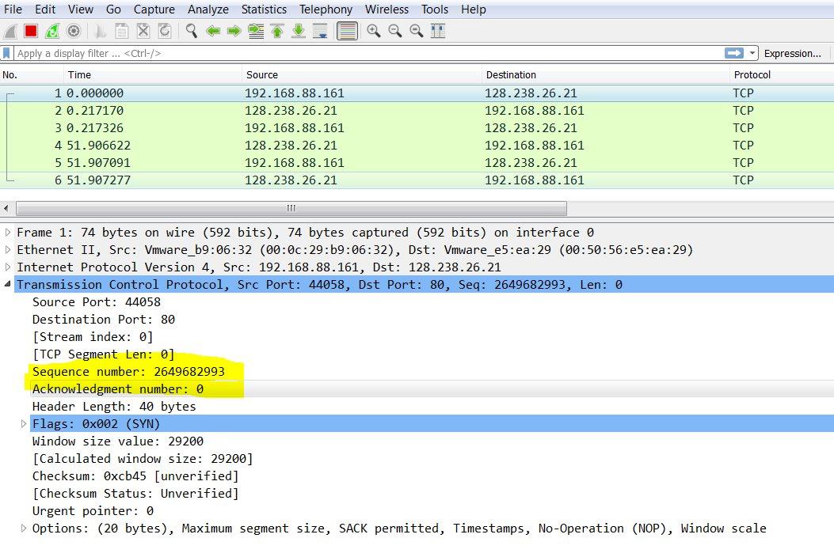
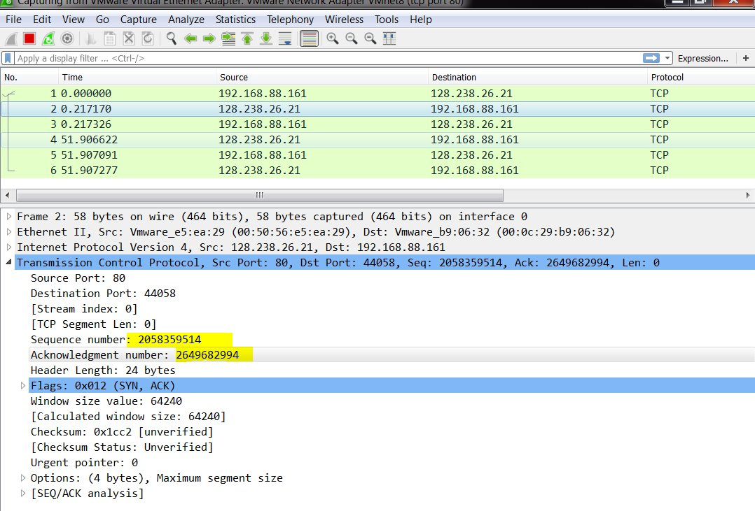
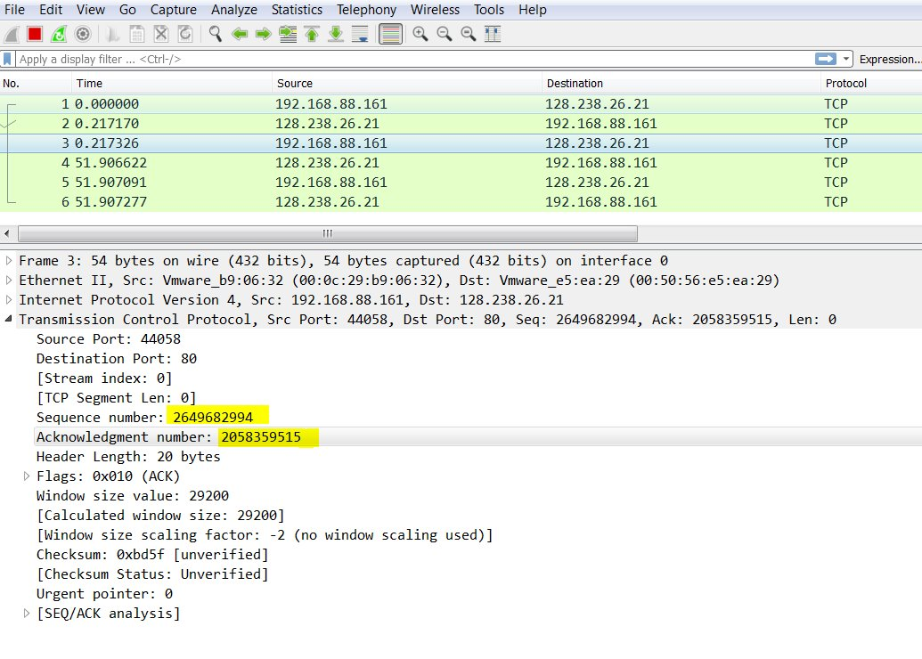

Slide 26
TCP Connection Management – Close a Connection
Normal closing:
Step 1: the client sends a TCP FIN control segment to the server.
Step 2: the server receives the FIN segment and replies with ACK; sends a FIN segment.
Step 3: the client receives the FIN segment and replies with ACK.
Step 4: the server receives ACK. Connection closed.
Client host
Server host
Close
FIN
ACK
FIN
Close
ACK
Timed wait
closed
Notes:
Either can end the connection.
Why there is a waiting time?
The TIME_WAIT state ensures that all packets related to the connection are handled correctly.
This is particularly important because TCP packets can be delayed or lost in the network.

Slide 27
TCP Reliable Data Transfer: An Overview
TCP creates RDT service on top of IP’s unreliable service
Pipelined segments
Cumulative ACKs
TCP uses single retransmission timer
Retransmissions are triggered by:
timeout events
duplicate ACKs (fast retransmit)

Slide 28
TCP Segments and Sequence Numbers
Seq. #’s:
usually the byte-stream “number” of the first byte in segment’s data
Total 500,000 bytes
Data for 1st segment
Data for 2nd segment
0
1
999
1000
1999
499,999
Seq # for the 1st segment
Seq # for the 2nd segment
In practice, a random seq # is used as the initial seq #, not a zero.
Notes:
TCP views data as an order stream of bytes.
Sequence # for a segment is the byte-stream number of the first byte in the segment.
As data is transmitted, the sequence number is incremented by the number of bytes of data sent in each TCP segment.

Slide 29
TCP ACK Number
ACKs:
seq # of next byte expected from the other side
ACK(seq #) means “all bytes up to (seq# -1) are received correctly”
Cumulative ACK (like Go-Back-N)

Slide 30
An Example
Host A
Host B
User types ‘C’
seq#=42, ack#=79, data = ‘C’
Host ACKs receipt of ‘C’ and echoes
back ‘C’
seq#=79, ack#=43, data = ‘C’
Host ACKs receipt of echoed ‘C’
seq#=43, ack#=80
Sequence and acknowledgment numbers for a simple Telnet application over TCP
Notes:
Each character typed by the user will be sent to the remote host.
The remote host will send back a copy of each character, which will be displayed on the Telnet user’s screen.
- Echo back for immediate feedback and input verification
The starting sequence numbers are 42 and 79 for the client and server.
Seq#: usually the byte-stream “number” of first byte in segment’s data
ACK: seq# of next byte expected from the other side

Slide 31
TCP RDT Sender Events:
data rcvd from app:
Create segment with seq #
start timer if not already running
timeout:
retransmit segment with the smallest seq#;
restart timer
Ack rcvd:
Cumulative ACK;
Slide window;
… (later);

Slide 32
TCP RDT – Cumulative ACK
Host A
Host B
seq#=92, 8 bytes data
ack#=100
seq#=100, 20 bytes data
X
seq#=92 timeout
(loss)
ack#=120
Cumulative ACK: all bytes up to (120-1) are received!
Notes:
Whenever the timeout event occurs, TCP retransmits the not-yet-acknowledged segment with the smallest sequence number.
(new) TimoutInterval =2* (previous) TimeoutInterval
Motivation: no packet was received for the last timeout period; could be a congestion, trying to slow down the sending process.

Slide 33
TCP RDT - Timeout
Host A
Host B
seq#=92, 8 bytes data
I have received all bytes up to 99.
Timeout
ack#=100
X
(loss)
seq#=92, 8 bytes data
ack#=100
Retransmission due to a lost acknowledgment
Notes:
When a segment is sent, a retransmission timer is started. If the segment is acknowledged before the timer expires, the timer is stopped. If, on the other hand, the timer goes off before the acknowledgement comes in, the segment is retransmitted (and the timer os started again).

Slide 34
TCP RDT – Timeout (cont.)
Host A
Host B
seq#=92, 8 bytes data
seq#=100, 20 bytes data
seq#=92 timeout
ack#=100
ack#=120
seq#=92, 8 bytes data
Retransmission of one segment only.
(different from Go-Back-N)
Notes:
As long as the ACK for the second segment arrives before the new timeout, the second segment will not be retransmitted.

Slide 35
Some Refinement
timeout:
When timeout expires after TimoutInterval;
Retransmits the unAck’d segment with smallest seq#; (not all of the unAck’d pkts, different from Go-Back-N)
(new) TimoutInterval =2* (previous) TimeoutInterval
Motivation: no packet was received for the last timeout period
Could be a congestion… trying to slow down the sending process;
TimoutInterval uses initial value (calculated based on most recent EstimatedRTT and DevRTT, to be discussed later) when timer is started in events “data rcvd from app” or “Ack rcvd” is activated;

Slide 36
Fast Retransmit
If sender receives 3 duplicated ACKs for the same data, it supposes that segment after the ACK’d data was lost:
fast retransmit: resend segment before timer expires
Time-out period is often relatively long:
long delay before resending lost packet
Detect lost segments via duplicate ACKs.
Sender often sends many segments back-to-back
If segment is lost, there will likely be many duplicate ACKs.

Slide 37
Without fast retransmit:
Host A
Host B
Seq=80, 12 bytes data
ACK=92
Seq=92, 8 bytes data
X
Seq=100, 20 bytes data
Seq=120, 10 bytes data
Seq=130, 20 bytes data
ACK=92
ACK=92
Seq=92 timeout
ACK=92
The sender might have to wait for a timeout to resend the segment!
time
Seq=92, 8 bytes data
Notes:
First seg seq# = 80, 12 bytes; this one arrives correctly; but its ACK gets lost;

Slide 38
Host A
Host B
With fast retransmit:
Seq=80, 12 bytes data
ACK=92
Seq=92, 8 bytes data
X
Seq=100, 20 bytes data
Seq=120, 10 bytes data
Seq=130, 20 bytes data
Buffered!
ACK=92
ACK=92
Seq=92 timeout
ACK=92
Seq=92, 8 bytes data
time
Fast retransmit: sender retransmits before timeout if it receives 3 duplicated ACKs!
Notes:
First seg seq# = 80, 12 bytes; this one arrives correctly; but its ACK gets lost;

Slide 39
TCP Reliable Data Transfer
Go-Back-N or Selective Repeat/Reject?
Cumulative ACKs (similar to GBN)
Many TCP implementations buffer correctly received but out-of-order segments (similar to SR)
When there is timeout, sender retransmits the unAck’d segment with the smallest seq# only
Notes:
Go-back-N: acks are cumulative and re-send all unACKed segments if there's a timeout.
SR: receiver individually acknowledges all correctly received packets​; sender only resends the oldest packet for which ACK is not received​.
Selective ACK:
Allow a TCP receiver to acknowledge out-of-order segments selectively rather than just cumulatively acknowledging the last correctly received, in-order segment.
When combined with selective retransmission – skipping the retransmission of segments that have already been selectively acknowledged by the receiver – TCP looks a lot like the generic SR protocol.

Slide 40
TCP Reliable Data Transfer
There are further recommendations for ACK generation at the TCP receiver side.
To avoid sending two many ACKs
RFC 1122, RFC 2581
TCP can use selective ACK options [RFC 2018].
Notes:
Go-back-N: acks are cumulative and re-send all unACKed segments if there's a timeout.
SR: receiver individually acknowledges all correctly received packets​; sender only resends the oldest packet for which ACK is not received​.
Selective ACK:
Allow a TCP receiver to acknowledge out-of-order segments selectively rather than just cumulatively acknowledging the last correctly received, in-order segment.
When combined with selective retransmission – skipping the retransmission of segments that have already been selectively acknowledged by the receiver – TCP looks a lot like the generic SR protocol.

Slide 41
How Long Should the Sender Wait?

Slide 42
TCP Round-Trip Time and Timeout
If the timeout value is too small, the sender will time out too fast resulting in unnecessary retransmissions.
If the timeout value is too large, the sender will take too long to recover from errors (i.e. excessive delays when packets are lost).
TCP sets timeout as a function of the RTT (Round-Trip Time).

Slide 43
TCP Round Trip Time and Timeout
Q: how to estimate RTT?
SampleRTT: measured time from segment transmission until ACK receipt
ignore retransmissions (do not sample retransmitted segments);
SampleRTT will vary, want estimated RTT “typical”
average several recent measurements
Notes:
Why not use retransmitted segments?

Slide 44
TCP Round-Trip Time and Timeout (cont.)
EstimatedRTT = (1 - α) * EstimatedRTT + α * SampleRTT
Exponential weighted moving average (EWMA)
The weighted average puts more weight on recent samples which better reflect the current congestion in the network
The weight of a given SampleRTT decays exponentially fast as the updates proceed.
Typical value: α = 0.125

Slide 45
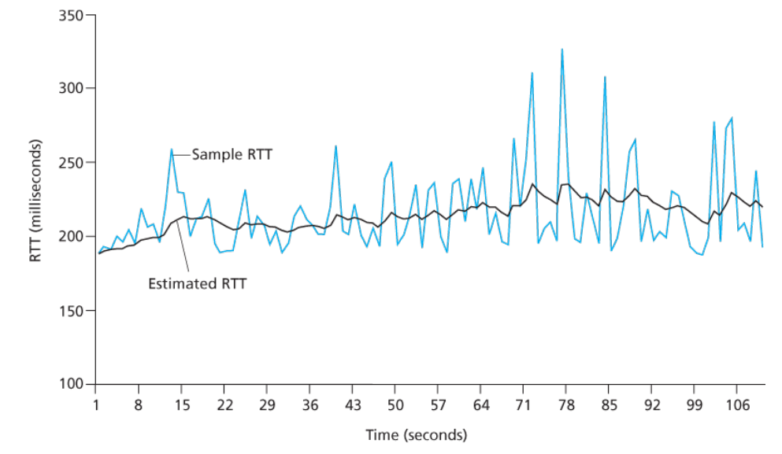
TCP Round-Trip Time and Timeout (cont.)
Source: James F. Kurose & Keith W. Ross, Computer networking: a top-down approach featuring the Internet, 3rd edition, 2005, Figure 3.32.

Slide 46
TCP Round-Trip Time and Timeout (cont.)
Setting the timeout
Measure the variability of the RTT as an estimate of how much SampleRTT deviates from EstimatedRTT
DevRTT = (1 - β) * DevRTT +
β * |SampleRTT-EstimatedRTT|
(typically, β = 0.25)
TimeoutInterval = EstimatedRTT + 4 * DevRTT
Notes:
DevRTT refers to the deviation of the Round-Trip Time (RTT).

Slide 47
TCP Flow Control and Congestion Control

Slide 48
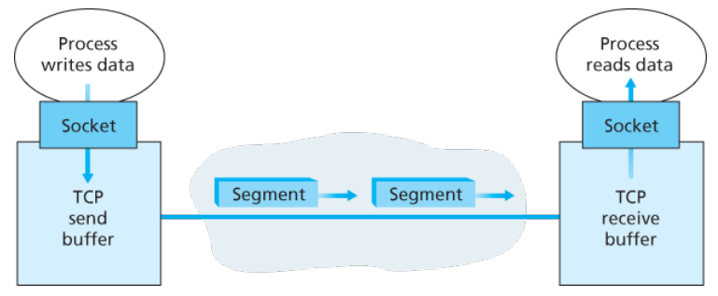
TCP Flow Control
Flow control is a speed-matching service
Match the rate at which the sender is sending against the rate at which the receiver is reading.
Source: James F. Kurose & Keith W. Ross, Computer networking: a top-down approach featuring the Internet, 3rd edition, 2005, Figure 3.28.
Notes:
When TCP receives a segment at the other end, the segment's data is placed in the TCP connection's receive buffer. The application reads the stream of data from this buffer. Each side of the connection has its own send buffer and its own receive buffer.

Slide 49
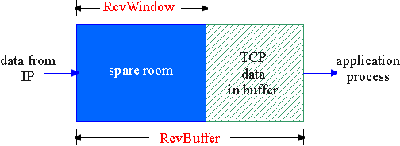
TCP Flow Control: How It Works
LastByteRcvd
LastByteRead
Spare room in buffer = RcvWindow
= RcvBuffer - [LastByteRcvd - LastByteRead]
Question: How does the connection use the variable RcvWindow to provide the flow control service?
Notes:
LastByteRead = the number of the last byte in the data stream read from the buffer by the application process in B.
LastByteRcvd = the number of the last byte in the data stream that has arrived from the network and has been placed in the receive buffer at B.

Slide 50
TCP Segment Structure
32 bits
URG: urgent data
(generally not used)
counting
by bytes
of data
(not segments!)
source port #
dest port #
sequence number
ACK: ACK #
valid
acknowledgement number
head
len
not
used
U
Receive window
A
P
R
S
PSH: push data now
(generally not used)
F
# bytes
rcvr willing
to accept
checksum
Urg data pnter
RST, SYN, FIN:
connection estab
(setup, teardown
commands)
Options (variable length)
application
data
(variable length)
Internet
checksum
(as in UDP)

Slide 51
TCP Flow Control: How It Works (cont.)
Suppose that host A is sending a large file to host B over a TCP connection.
Host B places its current value of RcvWindow in the window field of every segment it sends to A.
Initially, host B sets RcvWindow = RcvBuffer.
Host A keeps track of two variables, LastByteSent and LastByteAcked, and makes sure that LastByteSent - LastByteAcked <= RcvWindow.
Notes:
LastByteSent - LastByteAcked, is the number of unacknowledged data that A has sent

Slide 52
Pathological Scenario
Host A
Host B
RcvWindow = 0
Buffer emptied
RcvWindow > 0
No way of being informed
if B has no data to send to A!
time

Slide 53
Solution – Continue to Send Small Segments to B
Host A
Host B
RcvWindow = 0
Buffer emptied
RcvWindow > 0
1 byte data
ACK, RcvWindow = 8194
time

Slide 54
Flow Control vs Congestion Control
Transport-layer flow control to avoid buffer overflow at the receiver
Host A
Host C
Flow Control
Host B
Unlimited shared output link buffers
Shared outgoing link
Host D
Congestion control to avoid buffer overflow at the router caused by congestion in the network
Notes:
Congestion control is not so much a service provided to the invoking application; it is a service to the network as a whole. ​

Slide 55
Principles of Congestion Control
Congestion
Informally: “too many sources attempting to send data at too high a rate”
Manifestations (symptoms)
lost packets (buffer overflow at routers)
long delays (queueing in router buffers)
Notes:
packet loss typically results from overflowing router buffers as the network becomes congested; congestion control treats the cause of packet loss.

Slide 56
Approaches to Congestion Control
Network-assisted congestion control
Routers provide feedback to the end systems, such as a single bit indicating congestion at a link, the explicit transmission rate supported on an outgoing link
End-to-end congestion control
No explicit support from the network layer
Congestion inferred by the end-systems based on observed packet loss and delay

Slide 57
TCP Congestion Control
Use end-to-end congestion control (no network assistance)
Keep track of the congestion window that limits the sending rate
LastByteSent-LastByteAcked
≤ min{CongWin, RcvWindow}
Notes:
The constraint above limits the amount of unacknowledged data at the sender and therefore indirectly limits the sender’s send rate.

Slide 58
TCP Congestion Control (cont.)
Roughly at the beginning of every RTT, the constraint permits the sender to send at most CongWin bytes.
By adjusting CongWin according to network congestion, the sender can adjust its rate at which it sends data into its connection.
CongWin
Sending rate =
bytes/sec
RTT
Notes:
The constraint above limits the amount of unacknowledged data at the sender and therefore indirectly limits the sender’s send rate.

Slide 59

TCP Congestion Control (cont.)
How does a TCP sender detect congestion?
Loss event = timeout or 3 duplicate ACKs
The TCP sender reduces the send rate after a loss event
Notes:
Fast retransmit is not in conflict with congestion avoidance.
It can be done at the same time: first (fast) retransmit the missing segment, and then decrease CongWin.
The latter is about rate; the former is about which segment to be retransmitted!
https://tools.ietf.org/html/rfc2001
When there is excessive congestion, then one (or more) router buffers along the path overflows, causing a datagram (containing a TCP segment) to be dropped.
The dropped datagram, in turn, results in a loss event at the sender—either a timeout or the receipt of three duplicate ACKs

Slide 60
TCP Congestion Control (cont.)
How does a TCP sender adjust CongWin?
ACKs indicate a congestion-free path and loss events indicate a congested path
If ACKs (for previously unacknowledged segments) arrive, increase CongWin
If there is a timeout or duplicate ACKs, decrease CongWin
Notes:
How do the TCP senders determine their sending rates such that they don’t congest the network but at the same time make use of all the available bandwidth?
TCP’s strategy for adjusting its transmission rate is to increase its rate in response to arriving ACKs until a loss event occurs, at which point, the transmission rate is decreased. T

Slide 61
The celebrated TCP Congestion-Control Algorithm
Slow start
Additive-Increase, Multiplicative-Decrease (AIMD)
Reaction to timeout events
Notes:
Used by a TCP sender to control the amount of outstanding data being injected into the network
Used by a TCP sender to detect and repair loss

Slide 62
TCP Slow Start
When a connection begins
CongWin = 1 MSS (Maximum Segment Size)
Initial sending rate = MSS/RTT
Double CongWin every RTT
CongWin increases by 1 MSS every time a transmitted segment is first acknowledged
Summary: the TCP sending rate starts slow but grows exponentially during the slow start phase
Host A
Host B
one segment (1MSS)
RTT
two segments (2 MSS)
four segments (4MSS)
time
Notes:
The maximum segment size (MSS) is a parameter of the Options field of the TCP header that specifies the largest amount of data, specified in bytes.
Example: MSS = 500 bytes & RTT = 200 msec The initial rate is about 20 kbps (bits per second)
Since the available bandwidth to the TCP sender may be much larger than MSS/RTT, the TCP sender would like to find the amount of available bandwidth quickly.

Slide 63
TCP AIMD (Saw-toothed Pattern)
Additive increase: increase CongWin by 1 MSS every RTT
Multiplicative decrease: cut CongWin in half when a loss event occurs
The linear increase phase is known as congestion avoidance.
Additive increase
Loss event
Multiplicative decrease
Source: James F. Kurose & Keith W. Ross, Computer networking: a top-down approach featuring the Internet, 3rd edition, 2005, Figure 3.50.
Notes:
Long-lived TCP connections

Slide 64
TCP AIMD
Increase CongWin by a single MSS every RTT
An example
Initial CongWin = 1 MSS
After sending one segment and receiving one ACK within one RTT, CongWin = 1 MSS + 1 MSS = 2 MSS
After sending two segments and receiving two ACKs within one RTT, CongWin = 2 MSS+ 1 MSS = 3 MSS
Continue, CongWin = 3 MSS+ 1 MSS = 4 MSS

Slide 65
Tricks so far
Congestion avoidance
Loss event happens
Slow start
Typically 1 MSS
AIMD
TCP has some refined actions towards a loss event, depending on whether it is a timeout or 3 dup-ACKs.
3 dup ACKs indicates network is still capable of delivering some segments
timeout is “more alarming”;

Slide 66
Refinement – Reaction to Timeout
After 3 dup ACKs:
ssthresh = CongWin/2
CongWin = CongWin/2 + 3 MSS
window then grows linearly for each additional duplicate ACK
CongWin = ssthresh if a new ACK arrives and window grows linearly again.
But after timeout event:
CongWin is set to 1 MSS;
ssthresh = CongWin/2
window then grows exponentially to a threshold (ssthresh), then grows linearly
66

Slide 67
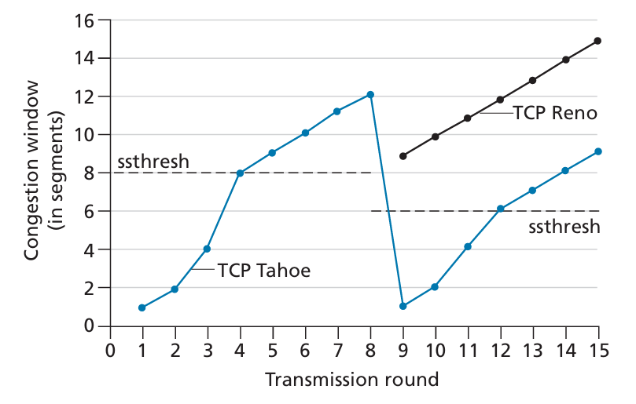
TCP Tahoe vs TCP Reno
3 duplicated ACKs
Source: James F. Kurose & Keith W. Ross, Computer networking: a top-down approach featuring the Internet, 8th edition, 2021, Figure 3.52.
Notes:
The TCP Tahoe and Reno algorithms are named after versions of the 4.3BSD operating system where they were first implemented, and these versions were named after geographical locations.
An early version of TCP, known as TCP Tahoe, unconditionally cut its congestion window to 1 MSS and entered the slow-start phase after either a timeout-indicated or triple-duplicate-ACK-indicated loss event.
The newer version of TCP, TCP Reno, incorporated fast recovery.
The threshold is initially equal to 8 MSS.
For the first eight transmission rounds, Tahoe and Reno take identical actions. The congestion window climbs exponentially fast during slow start and hits the threshold at the fourth round of transmission.
The congestion window then climbs linearly until a triple duplicate- ACK event occurs, just after transmission round 8.
Note that the congestion window is when this loss event occurs.
The value of ssthresh is then set to CongWin/2.
Under TCP Reno, the congestion window is set to ssthresh+3 and then grows linearly.
Under TCP Tahoe, the congestion window is set to 1 MSS and grows exponentially until it reaches the value of ssthresh , at which point it grows linearly.

Slide 68
References
James F. Kurose & Keith W. Ross, Computer networking: a top-down approach featuring the Internet, Addison Wesley, 3rd edition, 2005. ​
Chapter 3 Transport Layer (3.1 – 3.3, 3.5 – 3.7)
William Stallings, Data and Computer Communications, Pearson, 10th edition, 2013.
Chapter 15 Transport Protocols
Andrew S. Tanenbaum & David J. Wetherall, Computer Networks, Prentice Hall, 5th edition, 2010.
Chapter 6 The Transport Layer (6.2, 6.3, 6.5)

Slide 69
Acknowledgements
Lecture notes are developed based on slides from the following three sources:
Dr Mengmeng Ge’s lecture notes for COSC264, University of Canterbury, 2024
Assoc Prof Dan Kim’s lecture notes for COSC264, University of Canterbury, 2017
Prof Aleksandar Kuzmanovic’s lecture notes for CS340, Northwestern University, 2005, https://users.cs.northwestern.edu/~akuzma/classes/CS340-w05/lecture_notes.htm

