Slide 1
Application Protocols: Introduction to the Web and HTTP
COSC264
Introduction to Computer Networks and the Internet
Dr Barry Wu
WRC
University of Canterbury
Barry.wu@canterbury.ac.nz

Slide 2
Learning Objectives
At the end of the lectures, you will be able to:
Understand the concept of network applications
Explain the role of HTTP in the operation of the Web
Describe the HTTP message format
Explain the difference between non-persistent and persistent connections
Explain cookies
Explain caching

Slide 3
Outline
Network applications
The Web
HTTP
Non-persistent and persistent connections
Messages
Cookies
Web caching

Slide 4
Network Applications

Slide 5
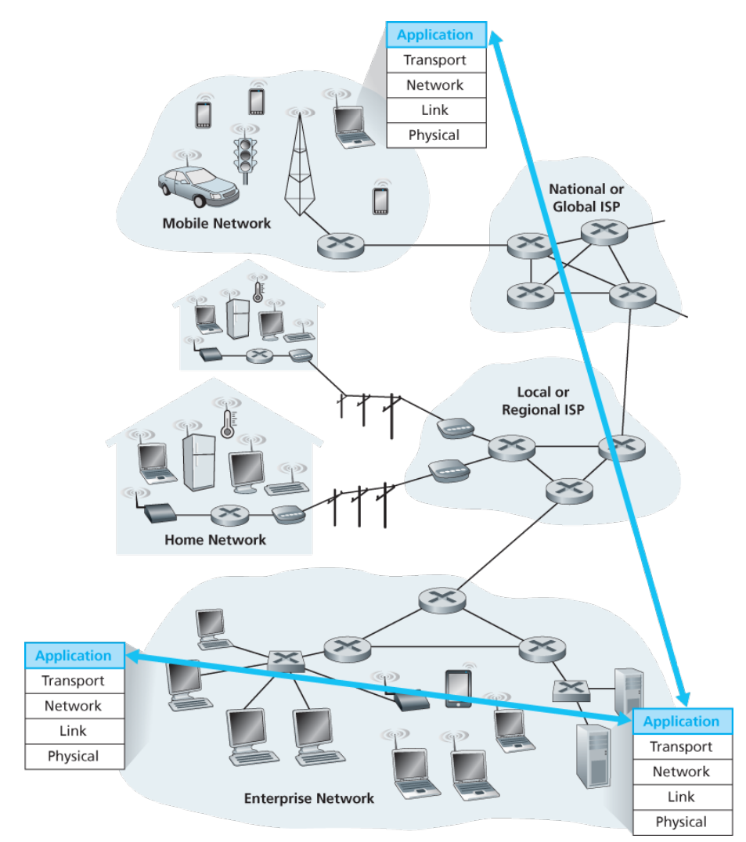
What is a network application?
Programs that run on different end systems and communicate with each other over the network
Source: James F. Kurose & Keith W. Ross, Computer networking: a top-down approach featuring the Internet, 3rd edition, 2005, Figure 2.1.
Notes:
At the core of network application development is writing programs that run on different end systems and communicate with each other over the network
Communication for a network application takes place between end systems at the application layer.

Slide 6
Some Popular Network Applications
Web browsing
Google Chrome, Mozilla Firefox, Microsoft Edge
Email
Gmail, Outlook
Remote access
PuTTY, Remote Desktop
Instant messaging
Slack, Microsoft Teams
Streaming services
Netflix, Spotify, YouTube
File transfer
FileZilla, WinSCP
Notes:
Email: SMTP, IMAP
Remote access: SSH, RDP

Slide 7
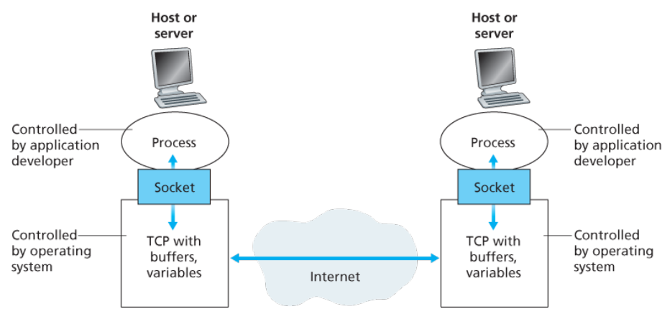
Application processes, sockets, and underlying transport protocol
Source: James F. Kurose & Keith W. Ross, Computer networking: a top-down approach featuring the Internet, 3rd edition, 2005, Figure 2.3.
Notes:
Most applications consist of pairs of communicating processes, with the two processes in each pair sending messages to each other.
A process sends messages into, and receives messages from, the network through a software interface called a socket.
In this figure, a socket is the interface between the application layer and the transport layer within a host. It is also referred to as the Application Programming Interface (API) between the application and the network, since the socket is the programming interface with which network applications are built.

Slide 8
Application-Layer Protocols
An application-layer protocol defines how an application’s processes, running on different end systems, pass messages to each other.
An application-layer protocol is only one piece (a big piece) of a network application.​
Network application | Application protocol
Web application | HTTP
Email | SMTP

Slide 9
Services an Application Needs from a Transport-Layer Protocol
Reliable data transfer
Applications that require reliable data transfer
Email, instant messaging, file transfer, financial applications, etc.
Applications that are loss-tolerant
Multimedia applications, etc.
Notes:
most notably multimedia applications such as conversational audio/video that can tolerate some amount of data loss.

Slide 10
Services an Application Needs from a Transport-Layer Protocol (cont.)
Bandwidth
Bandwidth-sensitive applications
Internet telephony applications, multimedia applications, etc.
Elastic applications
Email, file transfer, etc.
Notes:
Transmit data at a certain rate
Elastic applications can make use of as much, or as little bandwidth as happens to be available.

Slide 11
Services an Application Needs from a Transport-Layer Protocol (cont.)
Timing
End-to-end delays
Time-sensitive applications
Interactive real-time applications, such as Internet telephony, virtual environments, teleconferencing, multiplayer games, etc.
Non time-sensitive applications
Email, file transfer, etc.
Notes:
Tight constraint is placed on the end-to-end delays.

Slide 12
Services Provided by the Internet Transport Protocols
TCP​ | UDP​
Connection-oriented service​ | Connectionless service​
Reliable transport service​ | Unreliable data transfer service ​
Congestion control | No congestion control​
Flow control​ | No flow control​
No guarantee on the rate of delivery No guarantee on the delays
The Internet has been hosting time-sensitive applications for many years!
Notes:
TCP does not guarantee a minimum transmission rate.
Sending rate is regulated by TCP congestion control.
TCP does not provide any delay guarantee.
UDP does not include a congestion-control mechanism, so the sending side of UDP can pump data into the network layer at any rate it pleases.
UDP allows for rapid data transmission, it does not guarantee that data will be delivered at a specific rate or even reliably at all.

Slide 13
The Web and HTTP

Slide 14
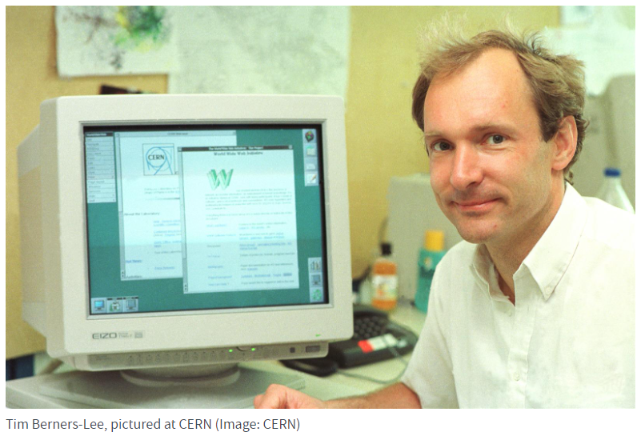
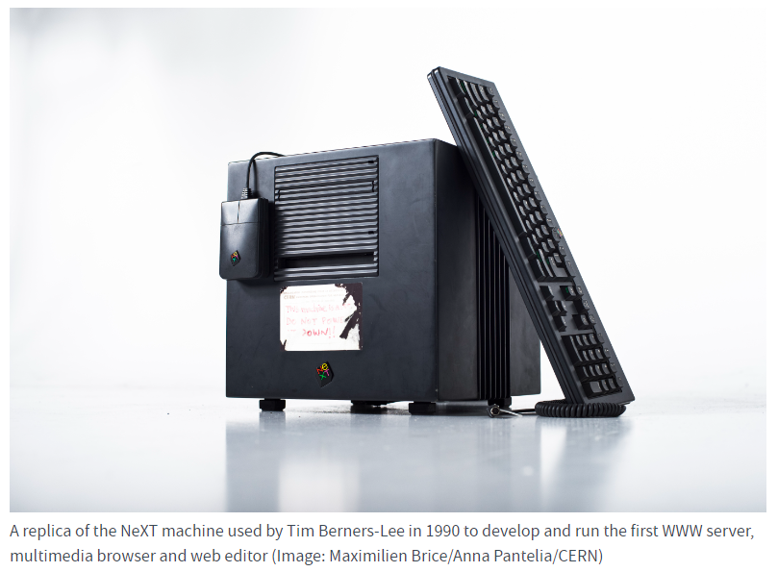
World Wide Web
The World Wide Web, commonly known as the Web, is a global collection of documents and other resources to be shared over the Internet.
Tim Berners-Lee, a British scientist, invented the World Wide Web (WWW) in 1989.
Source: https://home.cern/science/computing/birth-web/short-history-web
Notes:
The Internet is a global system of computer networks interconnected through telecommunications and optical networking.
The Web was originally conceived and developed to meet the demand for automated information-sharing between scientists in universities and institutes around the world.
He developed the first web server, the first web browser, and a document formatting protocol, called Hypertext Markup Language (HTML). After publishing the markup language in 1991 and releasing the browser source code for public use in 1993.
Websites for use by the general public began to emerge in 1993-94.
The World Wide Web is one common area for information exchange, facilitated by global computer networks - or the Internet.
You connect to this Internet to access the Web.

Slide 15
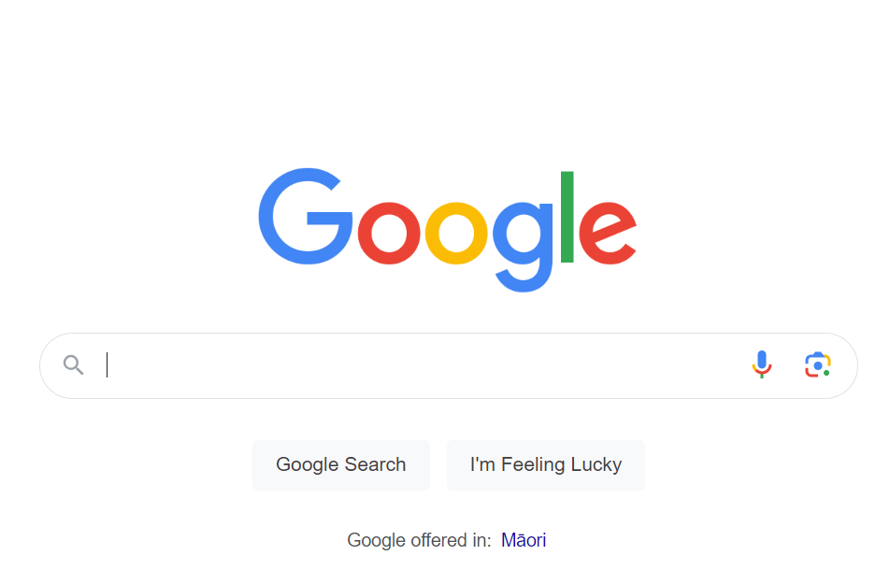
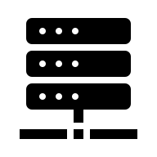


World Wide Web (cont.)
Architecture of the Web
Web page
Web server
HTTP request
HTTP response
www.google.com
Web browser
www.canterbury.ac.nz
Notes:
Web resources are made available to the network through web servers and can be accessed by programs such as web browsers.
The information in the Web is transferred across the Internet using HTTP/HTTPS.

Slide 16
HTTP Overview
The Hypertext Transfer Protocol (HTTP) is the foundation protocol of the Web
Protocol​ | Published​ | Status​ | RFC
HTTP/1.0​ | 1996 | Obsolete​ | RFC 1945
HTTP/1.1 | 1997 | Standard | RFC 2068, 2616, 7230-7235
HTTP/2 | 2015 | Standard | RFC 7540
HTTP/3 | 2022 | Standard | RFC 9114
Source: https://en.wikipedia.org/wiki/HTTP
Notes:
Web’s application layer protocol
HTTP/1.1 has been the dominant version for many years due to its widespread adoption and compatibility with existing web infrastructure.
Adoption of HTTP/2 has been increasing steadily, especially with the growing importance of performance optimization in web development.
HTTP/3 is also gaining traction as support for the QUIC protocol becomes more widespread.

Slide 17
HTTP Overview (cont.)
A Web page consists of objects
An object is a file (e.g., an HTML file, a JPEG image)
Most Web pages consist of a base HTML file and several referenced objects
Each object is addressable by a URL
http://www.someschool.edu/someDept/pic.gif
host name
path name
Notes:
The base HTML file references the other objects in the page with the objects' URLs.

Slide 18
HTTP Overview (cont.)
Client/server model
Client: Web browser that requests, receives, and displays Web objects
Server: Web server that sends objects in response to requests
HTTP request
PC running
Edge
HTTP response
HTTP request
Server
running
Apache Web
server
HTTP response
PC running
Chrome
Source: James F. Kurose & Keith W. Ross, Computer networking: a top-down approach featuring the Internet, 3rd edition, 2005, Figure 2.6.
Notes:
HTTP defines how Web clients request Web pages from Web servers and how servers transfer Web pages to clients.

Slide 19
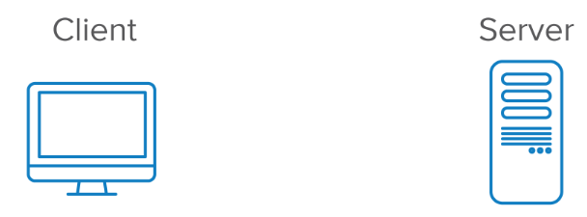
HTTP Overview (cont.)
HTTP is stateless
An HTTP server can work without maintaining any information about past client requests.​
HTTP uses TCP (HTTP/3 is an exception)
Step 1
Establish a TCP connection
Step 2
Exchange HTTP messages
Notes:
HTTP State Management Mechanism: HTTP Cookie and Set-Cookie header fields can be used by HTTP servers to store state (called cookies) at HTTP user agents, letting the servers maintain a stateful session over the mostly stateless HTTP protocol.
To provide reliability, HTTP makes use of TCP
The HTTP client first initiates a TCP connection with the server over port 80.
The server accepts the connection from the client.
Once the connection is established, the browser and the server processes exchange HTTP messages through their TCP socket interfaces.

Slide 20
HTTP Connections
Non-persistent HTTP
At most one object is sent over a TCP connection.
HTTP/1.0 uses nonpersistent HTTP.
Persistent HTTP
Multiple objects can be sent over a TCP connection.
HTTP/1.1, HTTP/2, and HTTP/3 use persistent HTTP.

Slide 21
HTTP with Non-Persistent Connections
Suppose user enters the URL www.someSchool.edu/someDepartment/home.index​
The HTTP client initiates a TCP connection to the server www.someSchool.edu on port number 80
The HTTP client sends an HTTP request message to the server via its socket. The request message includes the path name /someDepartment/home.index
The HTTP server receives the request message via its socket, retrieves the object from its storage, encapsulates the object in an HTTP response message, and sends the response to the client via its socket
The HTTP server tells TCP to close the TCP connection
The HTTP client receives the response message. The TCP connection terminates. The client extracts the file from the response message, examines the HTML file, and finds references to the 10 JPEG objects.
Repeat for each referenced JPEG object
Notes:
The page consists of a base HTML file and 10 JPEG images, and that all 11 of these objects reside on the same server.
TCP doesn’t actually terminate the connection until it knows that the client has received the response message intact.

Slide 22
Response Time Modeling
Definition of RTT (Round Trip Time)
time to send a small packet to travel from the client to the server and back to the client
Response time
one RTT to initiate a TCP connection
one RTT for HTTP request and response
file transmission time
Initiate a TCP
connection
RTT
Request
file
RTT
Time to
transmit
the file
File
received
time
time
Source: James F. Kurose & Keith W. Ross, Computer networking: a top-down approach featuring the Internet, 3rd edition, 2005, Figure 2.7.

Slide 23
Persistent HTTP
Non-persistent HTTP
require 2 RTTs per object
resources are allocated for each TCP connection – a burden for the server especially.
Persistent HTTP
the server leaves connection open after sending a response
subsequent HTTP messages between the same client and server are sent over the same connection
TCP connection
TCP connection
TCP connection
Notes:
the HTTP server closes a connection when it isn’t used for a certain time

Slide 24
Persistent HTTP (cont.)
Persistent without pipelining
the client issues new request only when previous response has been received
one RTT for each referenced object
Persistent with pipelining
default in HTTP/1.1
the client sends requests as soon as it encounters a referenced object
TCP connection
TCP connection
Notes:
These requests for objects can be made back-to-back, without waiting for replies to pending requests (pipelining).
Pipelining allows a client to make multiple requests without waiting for each response, allowing a single TCP connection to be used much more efficiently, with much lower elapsed time.
as little as one RTT for all the referenced objects

Slide 25
HTTP request message
HTTP request message:
URL field
HTTP version field
request line
(GET, POST,
HEAD commands)
GET /somedir/page.html HTTP/1.1
Host: www.someschool.edu
User-agent: Mozilla/4.0
Connection: close
Accept-language:fr
(Entity body)
header
lines
Nonpersistent connections
Carriage return,
blank line
Notes:
Language part; weight (q-factor weight “;q-”
The order in which header fields with differing field names are received is not significant. However, it is "good practice" to send general-header fields first, followed by request-header or response- header fields, and ending with the entity-header fields.
Multiple message-header fields with the same field-name MAY be present in a message if and only if the entire field-value for that header field is defined as a comma-separated list [i.e., #(values)]. It MUST be possible to combine the multiple header fields into one "field-name: field-value" pair, without changing the semantics of the message, by appending each subsequent field-value to the first, each separated by a comma. The order in which header fields with the same field-name are received is therefore significant to the interpretation of the combined field value, and thus a proxy MUST NOT change the order of these field values when a message is forwarded.

Slide 26
HTTP Request Message - Accept-Language Header
Accept-Language: <language-range>[;q=<weight>], <language-range>[;q=<weight>], ...
Each language-range MAY be given an associated quality value which represents an estimate of the user's preference for the languages specified by that range. The quality value defaults to "q=1".
For example,
Accept-Language: da, en-gb;q=0.8, en;q=0.7
would mean: "I prefer Danish, but will accept British English and other types of English."

Slide 27
General format of a request message
Request line
method
sp
URL
sp
Version
cr
lf
Header field name:
sp
value
cr
lf
Order is not significant, but it is good to send fields containing control data first.
Header lines
Header lines
Header field name:
sp
value
cr
lf
cr
lf
Blank line
Entity body
An empty line to indicate the end of the header section
Empty for GET but it is used with POST (filling a form);
Notes:
A client sends an HTTP request to a server in the form of a request message, beginning with a request-line that includes a method, URI, and protocol version (Section 3.1.1), followed by header fields containing request modifiers, client information, and representation metadata (Section 3.2), an empty line to indicate the end of the header section, and finally a message body containing the payload body (if any, Section 3.3).
A line feed means moving one line forward. The code is \n. A carriage return means moving the cursor to the beginning of the line. The code is \r.
Windows editors often still use the combination of both as \r\n in text files. Unix uses mostly only the \n.
The separation comes from typewriter times, when you turned the wheel to move the paper to change the line and moved the carriage to restart typing on the beginning of a line. This was two steps.

Slide 28
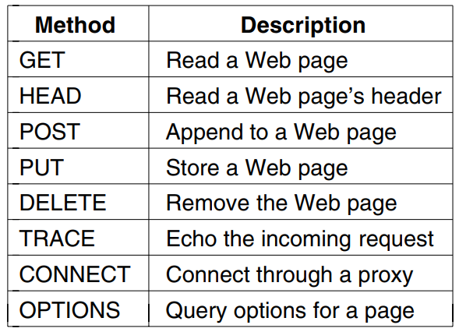
HTTP Request Message – Request Methods
Some built-in HTTP request methods
Source: Andrew S. Tanenbaum & David J. Wetherall, Computer Networks, 5th edition, 2010, Figure 7-37.
Notes:
HTTP 1.1
An HTTP client often uses the POST method when the user fills out a form.
Example: when a user provides search words to a search engine. With a POST message, the user is still requesting a Web page from the server, the specific contents of the Web page depend on what the user entered into the form fields.

Slide 29
HTTP response message
status line
(protocol ver,
status code,
status msg.)
HTTP/1.1 200 OK
Connection close
Date: Thu, 06 Aug 1998 12:00:15 GMT
Server: Apache/1.3.0 (Unix)
Last-Modified: Mon, 22 Jun 1998 …...
Content-Length: 6821
Content-Type: text/html
data data data data data ...
header
lines
data, e.g.,
requested
HTML file

Slide 30
General format of a response message
Status line
version
sp
Status code
sp
phrase
cr
lf
Header field name:
sp
value
cr
lf
Header lines
Header field name:
sp
value
cr
lf
cr
lf
Blank line
Entity body

Slide 31
HTTP Response Status Codes
200 OK
request succeeded and requested object is returned in the response
301 Moved Permanently
requested object has been permanently moved; the new location is specified in the response message (Location:)
400 Bad Request
request not understood by the server
404 Not Found
requested document not found on the server
505 HTTP Version Not Supported
requested HTTP protocol version is not supported by the server

Slide 32

User-Server Interaction: Cookies [RFC 2109]
Many major Web sites use cookies to identify users
Online shopping
Four components
a cookie header line in the HTTP response message
a cookie header line in the HTTP request message
a cookie file kept on the user’s end system and managed by the user’s browser
a back-end database at the Web site
Notes:
These are best known for allowing you to keep items in a shopping cart even after clicking on a different page.

Slide 33
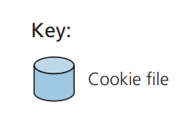
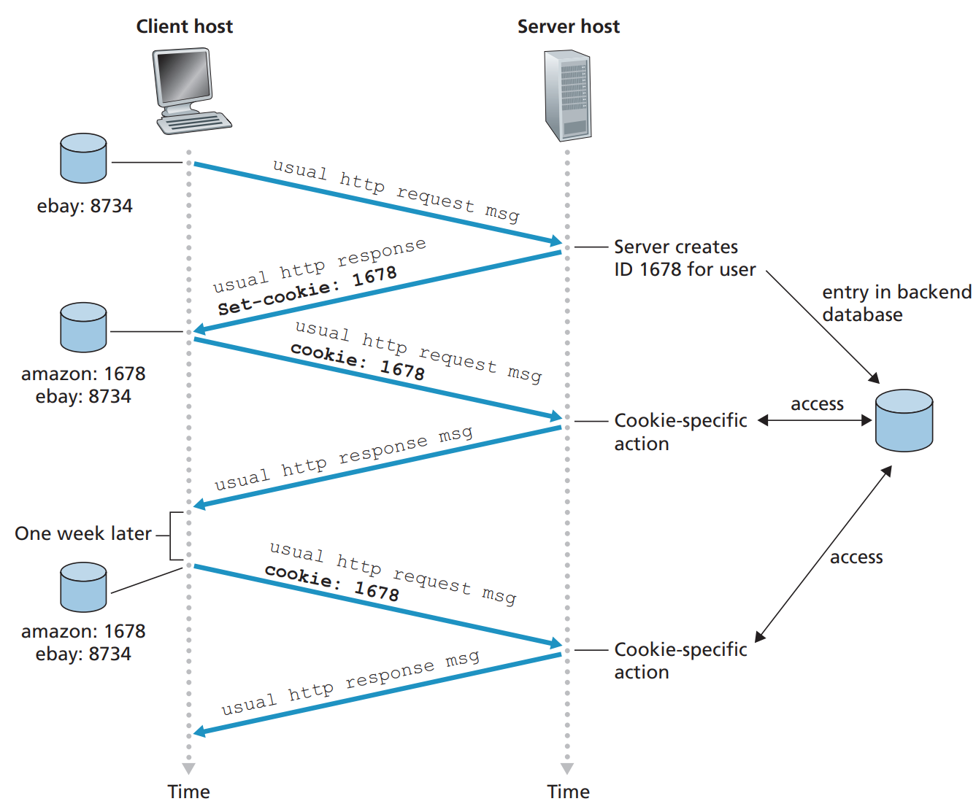
User-Server Interaction: Cookies (cont.)
Source: James F. Kurose & Keith W. Ross, Computer networking: a top-down approach featuring the Internet, , 8th edition, 2021, Figure 2.10
Notes:
HTTP State Management Mechanism: define the HTTP Cookie and Set-Cookie header fields.
These header fields can be used by HTTP servers to store state (called cookies) at HTTP user agents, letting the servers maintain a stateful session over the mostly stateless HTTP protocol.
A session can be created with the help of cookie.
A session ID is a unique number that a Web site's server assigns a specific user for the duration of that user's visit (session). The session ID can be stored as a cookie, form field, or URL (Uniform Resource Locator). Some Web servers generate session IDs by simply incrementing static numbers.​

Slide 34
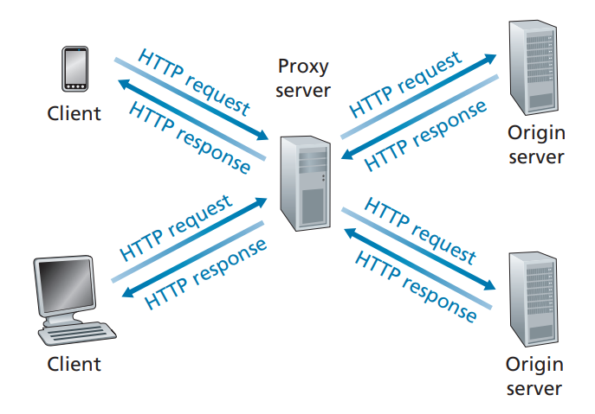
Caching
A Web cache, also called a proxy server, is a network entity that satisfies HTTP requests on behalf of an origin Web server.
A cache is both a server and a client at the same time.
When it receives requests from and sends responses to a browser, it is a server.
When it sends requests to and receives responses from an origin server, it is a client.
Source: James F. Kurose & Keith W. Ross, Computer networking: a top-down approach featuring the Internet, 3rd edition, 2005, Figure 2.10.
Notes:
Satisfy client request without involving the origin server
The browser establishes a TCP connection to the Web cache and sends an HTTP request for the object to the Web cache.
The Web cache checks to see if it has a copy of the object stored locally. If it does, the Web cache returns the object within an HTTP response message to the client browser.
If the Web cache does not have the object, the Web cache opens a TCP connection to the origin server.
When the Web cache receives the object, it stores a copy in its local storage and sends a copy, within an HTTP response message, to the client browser.

Slide 35
Caching (cont.)
Why caching?
Reduce the response time for a client request
Reduce traffic on an institution’s access link to the Internet
Lower bandwidth costs
Origin servers
Internet
Institutional
network
Institutional cache
Source: James F. Kurose & Keith W. Ross, Computer networking: a top-down approach featuring the Internet, 3rd edition, 2005, Figure 2.12.
Notes:
Typically cache is installed by ISP (university, company, residential ISP)

Slide 36
Conditional GET
cache
server
Goal: don’t send object if cache has up-to-date cached version
cache: specify date of cached copy in HTTP request
If-modified-since: <date>
server: response contains no object if cached copy is up-to-date:
HTTP/1.0 304 Not Modified
HTTP request msg
If-modified-since: <date>
object
not
modified
HTTP response
HTTP/1.0
304 Not Modified
HTTP request msg
If-modified-since: <date>
object
modified
HTTP response
HTTP/1.0 200 OK
<data>
Notes:
Use GET;
Includes an If-Modified-Since: header line;
A request asking for something not in the cache;
Cache gets it from the server and stores it;
One week later, another request comes for the same object; and the object is still in the cache.
Now cache can use conditional get!

Slide 37
References
James F. Kurose & Keith W. Ross, Computer networking: a top-down approach featuring the Internet, Addison Wesley, 3rd edition, 2005. ​
Chapter 2 Application Layer (2.1, 2.2)
William Stallings, Data and Computer Communications, Pearson, 10th edition, 2013.
Chapter 24 Electronic Mail, DNS, and HTTP (24.3)
Andrew S. Tanenbaum & David J. Wetherall, Computer Networks, Prentice Hall, 5th edition, 2010.
Chapter 7 The Application Layer (7.3)

Slide 38
Acknowledgements
Lecture notes are developed based on slides from the following three sources:
Dr Mengmeng Ge’s lecture notes for COSC264, University of Canterbury, 2023
Assoc Prof Dan Kim’s lecture notes for COSC264, University of Canterbury, 2017
Prof Aleksandar Kuzmanovic’s lecture notes for CS340, Northwestern University, 2005, https://users.cs.northwestern.edu/~akuzma/classes/CS340-w05/lecture_notes.htm

