Slide 1
Application Protocols: Introduction to Email and DNS
COSC264
Introduction to Computer Networks and the Internet
Dr Barry Wu
WRC
University of Canterbury
Barry.wu@canterbury.ac.nz

Slide 2
Learning Objectives
At the end of the lectures, you will be able to:
Discuss the applications for emails
Explain that basic functionality of SMTP
Explain the basic function of mail access protocols, including POP3 and IMAP
Describe the key elements of MIME
Explain Internet domains and domain names
Discuss the operation of the Domain Name System

Slide 3
Outline
Electronic Mail (Email)
SMTP, POP3, IMAP
MIME
Domain Name System (DNS)
3

Slide 4
Email
4

Slide 5
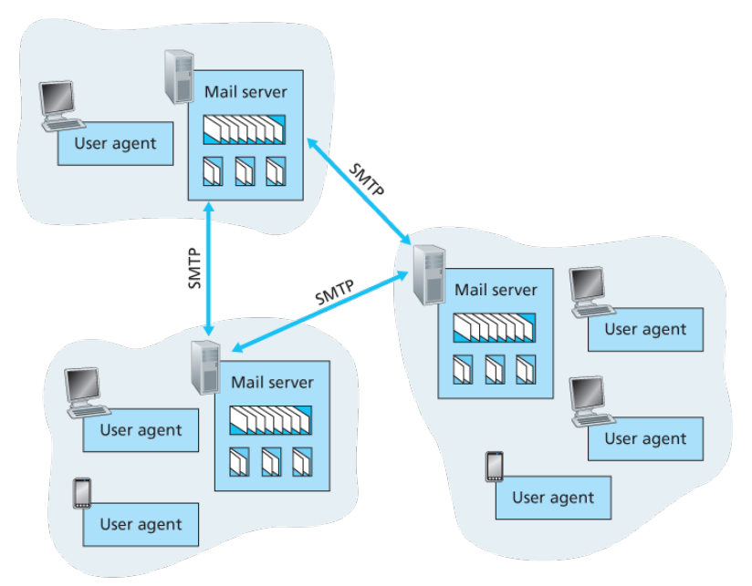

Email Overview
A high-level view of the Internet email system
Mail server
A mailbox for each recipient that manages and maintains incoming messages
A message queue of outgoing messages
User agent
Allow users to read, reply to, forward, save, and compose messages
Example: Outlook
Simple Mail Transfer Protocol (SMTP)
Source: James F. Kurose & Keith W. Ross, Computer networking: a top-down approach featuring the Internet, 3rd edition, 2005, Figure 2.15.
Notes:
One of the Internet’s most important applications to date.

Slide 6
Simple Mail Transfer Protocol (SMTP)
SMTP is a mail transport and delivery protocol
Also used as a “mail submission” protocol
SMTP has two sides
A client side executes on the sender’s mail server.
A server side executes on the recipient’s mail server.
Both the client and server sides of SMTP run on every mail server
When a mail server sends mail to other mail servers, it acts as an SMTP client.
When a mail server receives mail from other mail servers, it acts as an SMTP server.
Notes:
SMTP is at the heart of Internet email.
SMTP: protocol between mail servers to send email messages

Slide 7
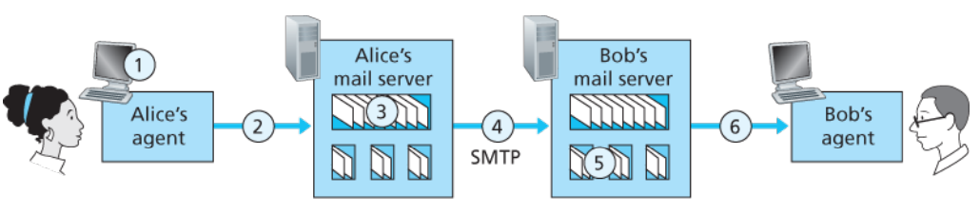
Basic Operation of SMTP
3. The SMTP client opens a TCP connection to an SMTP server on Bob’s mail server
5. The SMTP server receives the message; Bob’s mail server places the message in Bob’s mailbox.
1. Alice uses her UA to compose the message
2. Alice’s UA sends the message to her mail server
4. The SMTP client sends Alice’s message over the TCP connection
6. Bob invokes his UA to read message
Source: James F. Kurose & Keith W. Ross, Computer networking: a top-down approach featuring the Internet, 3rd edition, 2005, Figure 2.16.
Notes:
SMTP is used to transfer a message from the SMTP sender to the SMTP receiver over a TCP connection.

Slide 8
SMTP vs. HTTP
Common characteristics
Transfer files from one host to another
Persistent connections
Differences
HTTP
Pull protocol
Synchronous communication
SMTP
Push protocol
Asynchronous communication
Store-and-forward architecture
Direct request-response model
based on 7-bits ASCII
8

Slide 9
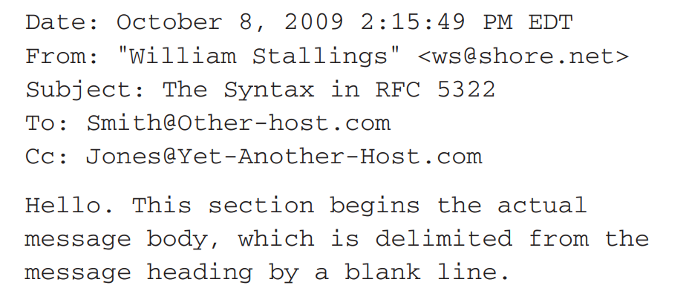
An Example of Internet Message Format
A message consists of header fields followed, optionally, by a body
A message is ASCII text
Header lines
Body
Notes:
The overall structure of a message that conforms to RFC 5322 is very simple.
ASCII, in full American Standard Code for Information Interchange, a standard data-encoding format for electronic communication between computers.
The most frequently used keywords are From, To, Subject, and Date.
The header lines and the body of the message are separated by a blank line.

Slide 10
Multipurpose Internet Mail Extensions (MIME) for None-ASCII Data
An extension to the RFC 5322
The specification is provided in RFCs 2045 through 2049
From: alice@crepes.fr
To: bob@hamburger.edu
Subject: Picture of yummy crepe.
MIME-Version: 1.0
Content-Transfer-Encoding: base64
Content-Type: image/jpeg
(base64 encoded data ……
……base64 encoded data)
Encode binary data as printable text
Notes:
Emails were all texts but there was a demand to send richer contents.
Alice's user agent encoded the JPEG image using base64 encoding.
Content-Transfer-Encoding: Indicates the type of transformation that has been used to represent the body of the message in a way that is acceptable for mail transport.
When the receiving user agent encounters image/jpeg, it knows that it should decode the image and then display it.

Slide 11
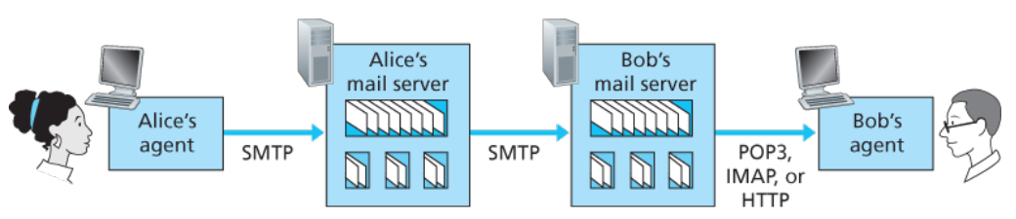
Mail Access Protocols
Email retrieval from the recipient’s mail server to the recipient’s user agent
POP3: Post Office Protocol version 3 [RFC 1939]
IMAP: Internet Mail Access Protocol version 4 [RFC 3501]
HTTP for web-based email
Source: James F. Kurose & Keith W. Ross, Computer networking: a top-down approach featuring the Internet, 3rd edition, 2005, Figure 2.17.
Notes:
SMTP: delivers message from sender’s mail server to receiver’s mail server; also used to transfer mail from sender’s user agent to the sender’s mail server.
With this service, the user agent is an ordinary Web browser, and the user communicates with its remote mailbox via HTTP.

Slide 12
POP3
Connection establishment
The user agent establishes a TCP connection to the mail server on port 110.
Authentication state
The user agent sends a username and a password (cleartext) to authenticate the user.
Transaction state
The user agent retrieves messages.
The user agent can mark messages for deletion, remove marks, and obtain mail statistics.
Update state
The mail server deletes the messages that were marked for deletion and closes the connection.
Notes:
Once the server successfully authenticates the client, the client can access the mailbox to retrieve and delete messages.
Update occurs after the client has issued the quit command

Slide 13
POP3 (cont.)
What are some notable issues with POP3?
POP3 does not synchronise emails across multiple devices
POP3 does not support server-side folder management, so users can’t organise emails into folders on the server
Notes:
Once an email is downloaded to one device, it is typically deleted from the server, making it inaccessible from other devices.
POP3 clients may be configured to allow the server to continue storing copies of the downloaded messages.

Slide 14
IMAP
IMAP keeps messages on the server and replicates copies to the clients.
Users can organise messages in folders.
IMAP maintains user state information across sessions.
IMAP4 allows a user agent to obtain components of messages.
Notes:
An IMAP server associates each message with a folder (e.g., INBOX).
Users can move messages into the folders they create, delete messages, mark messages as important, etc.
such as names of the folders and which messages are associated with which folders.
Useful for a low-bandwidth connection.

Slide 15
Web-based Email
Web-based email is accessed through a web browser
HTTP for communication between the user's browser and the mail server
Web-based email services
Outlook
Gmail

Slide 16
DNS
16

Slide 17

Domain Name System (DNS)
The IP address provides a way of uniquely identifying devices on the Internet.
The number scheme is effective for computer processing but is not convenient for users.

Slide 18
DNS Overview [RFC 1034, 1035]
A directory lookup service
Provide a mapping between the name of a host on the Internet and its numerical address
A distributed database
Implemented in a hierarchy of DNS servers
An application-layer protocol (over UDP on port 53)
Allow hosts to query the distributed database

Slide 19
DNS Services
Hostname to IP address translation
Commonly employed by HTTP, SMTP, etc.
Host aliasing
Canonical and alias names
Example: relay1.west-coast.enterprise.com could have two aliases such as enterprise.com and www.enterprise.com
Mail server aliasing
Example: Bob’s email address might be bob@outlook.com; the canonical hostname might be relay1.west-coast.outlook.com
Notes:
DNS can be invoked by a mail application to obtain the canonical hostname for a supplied alias hostname as well as the IP address of the host.

Slide 20
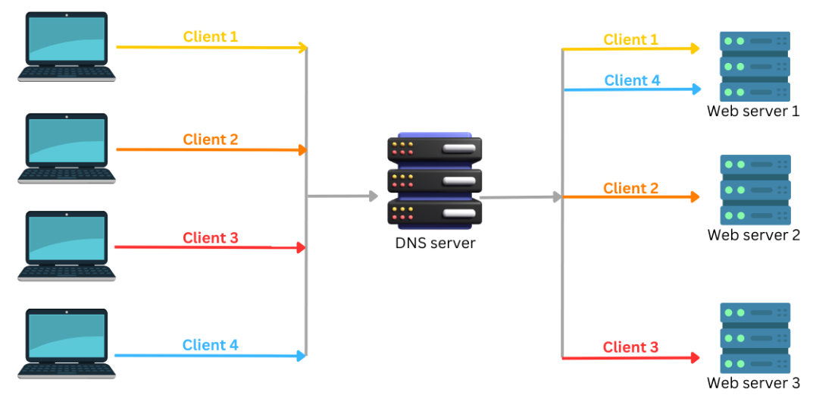
DNS Services (cont.)
Load distribution
Perform load distribution among replicated servers
Example: round-robin DNS
Source: https://www.cloudns.net/wiki/article/182/
Notes:
Rotate the IP addresses of the servers in a circular order.
So, whenever a client requests a domain name, the DNS server responds with a list of IP addresses for that domain name, each time returning the IP addresses in a different order.
Because a client typically sends its HTTP request message to the IP address that is listed first in the set, DNS rotation distributes the traffic among the replicated servers.

Slide 21
Why not centralised DNS?

Slide 22
Problems with a centralised design
Single point of failure
Traffic volume
Distant centralised database
Maintenance
A centralised DNS doesn’t scale!
Notes:
A single DNS server would have to handle all DNS queries.
A single DNS server cannot be “close to” all the querying clients – delays.

Slide 23
A Distributed, Hierarchical Database
Root DNS Servers
com DNS servers
org DNS servers
edu DNS servers
yahoo.com
DNS servers
amazon.com
DNS servers
pbs.org
DNS servers
poly.edu
DNS servers
umass.edu
DNS servers
Source: https://www.iana.org/domains/root/servers
Notes:
No single DNS server has all the mappings for all of the hosts in the Internet.
Root servers are configured in the DNS root zone as 13 named authorities.
The top-level domains come in two flavours: generic and country domains, such as au, nz.
Every organisation with publicly accessible hosts (such as Web servers and mail servers) on the Internet must provide publicly accessible DNS records that map the names of those hosts to IP addresses.
Either implement its own authoritative DNS server
Or store them in an authoritative DNS server of some service provider

Slide 24
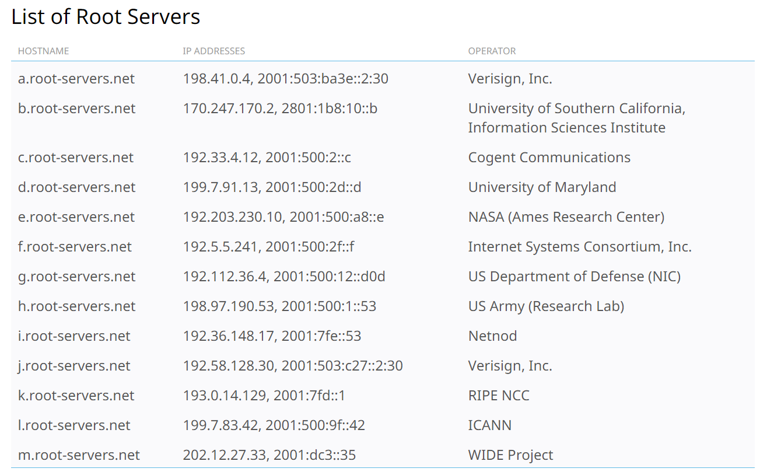
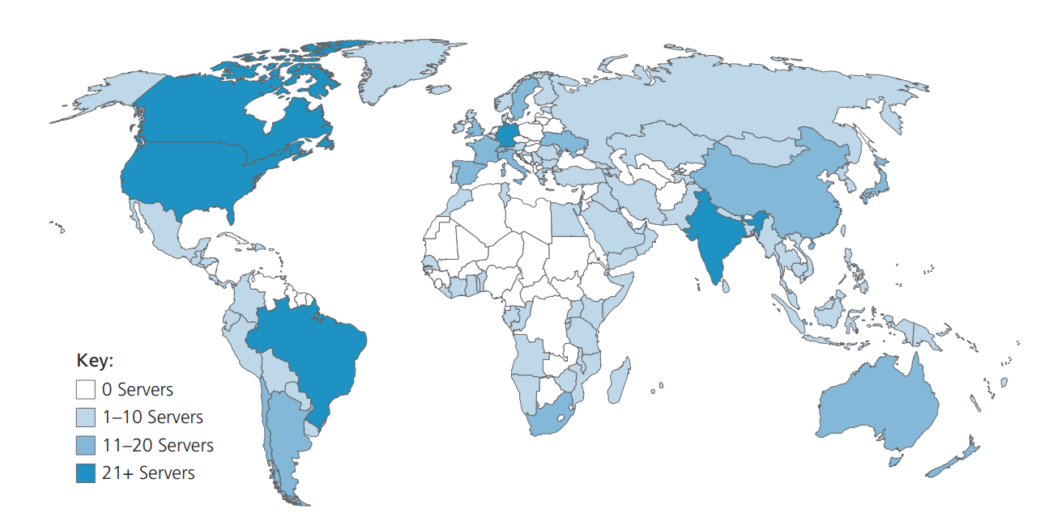
Root DNS Servers
13 root DNS servers in the Internet
Each server is a cluster of replicated servers
More than 1000 root server instances scattered all over the world​
Source: https://www.iana.org/domains/root/servers
Source: James F. Kurose & Keith W. Ross, Computer networking: a top-down approach featuring the Internet, , 8th edition, 2021, Figure 2.18

Slide 25
TLD DNS Servers and Authoritative DNS Servers
TLD (Top-Level Domain) Servers for top-level and country top-level domains
Root DNS Servers
com DNS servers
org DNS servers
edu DNS servers
yahoo.com
DNS servers
amazon.com
DNS servers
pbs.org
DNS servers
poly.edu
DNS servers
umass.edu
DNS servers
Authoritative DNS Servers (organisation’s DNS servers)
Source: https://www.iana.org/domains/root/servers
Notes:
No single DNS server has all the mappings for all of the hosts in the Internet.
Root servers are configured in the DNS root zone as 13 named authorities.
The top-level domains come in two flavours: generic and country domains, such as au, nz.
Every organisation with publicly accessible hosts (such as Web servers and mail servers) on the Internet must provide publicly accessible DNS records that map the names of those hosts to IP addresses.
Either implement its own authoritative DNS server
Or store them in an authoritative DNS server of some service provider

Slide 26
Local DNS Servers
A local DNS server does not strictly belong to the hierarchy (but is central to the DNS architecture)​.
Each ISP (residential or institutional) has a local DNS server (a default name server).
When a host makes a DNS query, the query is sent to its local DNS server which​ forwards the query into the hierarchy.​
Notes:
Act as a proxy

Slide 27
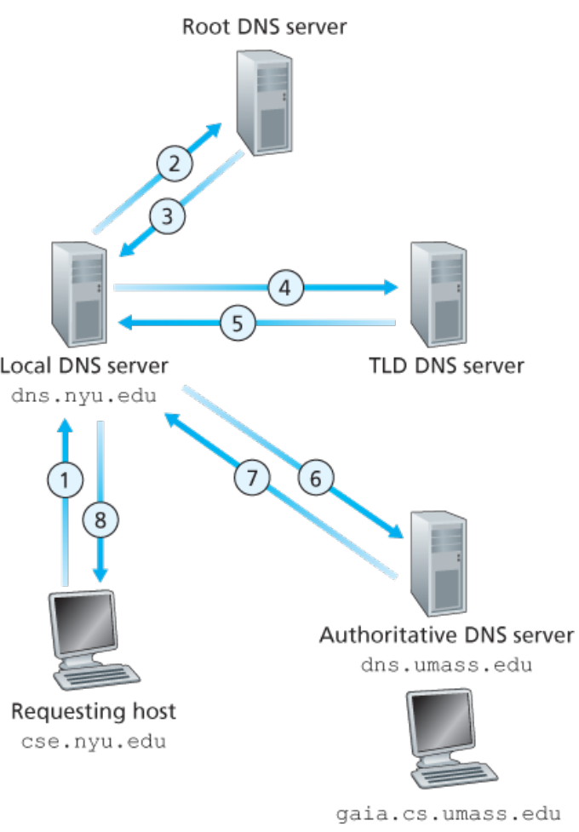
Interaction of the various DNS servers
DNS name resolution
Host at cse.nyu.edu wants to find the IP address of gaia.cs.umass.edu
2, 4, 6: iterative queries
1: recursive query
Source: James F. Kurose & Keith W. Ross, Computer networking: a top-down approach featuring the Internet, 3rd edition, 2005, Figure 2.20.
Notes:
Recursive and iterative queries
The host cse.nyu.edu wants to find the IP of gaia.cs.umass.edu at University of Massachusetts.
1. It sends a DNS query message to its local DNS server, dns.nyu.edu.
2-3. The local DNS server forwards the query message to a root DNS server. The root DNS server takes note of the edu suffix and returns a list of IP addresses for TLD servers responsible for edu . Local DNS servers (recursive resolvers) come pre-configured with the IP addresses of all 13 root DNS server systems. This is essential for the DNS system to work.
4-5. The local DNS server then resends the query message to one of these TLD servers. The TLD server takes note of the umass.edu suffix and responds with the IP address of the authoritative DNS server for dns.umass.edu.
6-7. The local DNS server resends the query message directly to dns.umass.edu, which responds with the IP address of gaia.cs.umass.edu.
8 messages (4 queries + 4 replies) are sent.

Slide 28
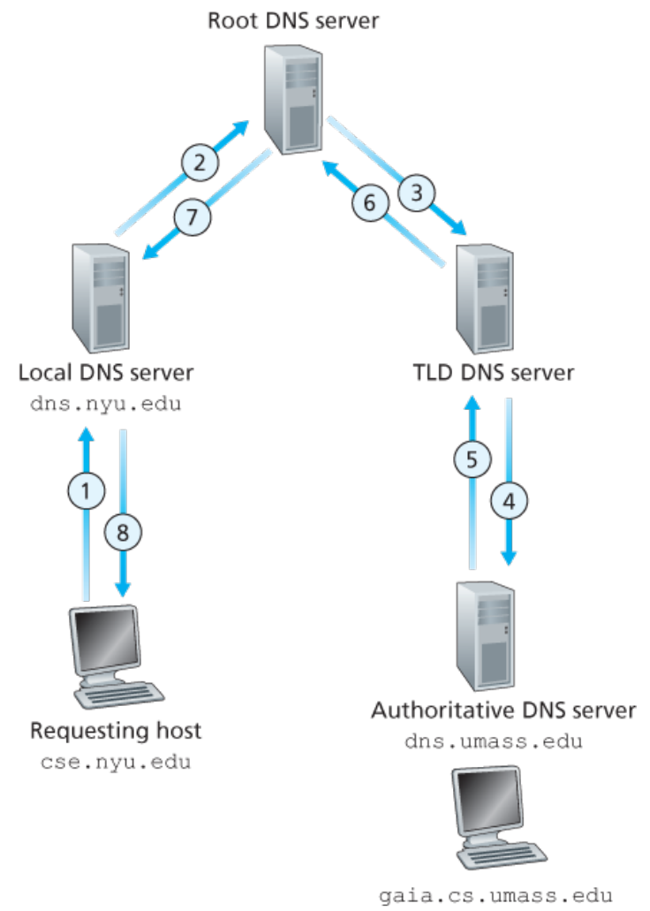
Recursive Queries in DNS
DNS name resolution
Host at cse.nyu.edu wants to find the IP address of gaia.cs.umass.edu
Put burden of name resolution on the contacted name server
Source: James F. Kurose & Keith W. Ross, Computer networking: a top-down approach featuring the Internet, 3rd edition, 2005, Figure 2.21.
Notes:
A recursive query may always seem preferable, but many name servers (especially the root) will not handle them. They are too busy.
Iterative queries put the burden on the originator.

Slide 29
DNS Caching
A DNS server can cache the mapping in its local memory when it receives a DNS reply.
Cache entries timeout after some time.
IP addresses of TLD servers are typically cached in local name servers.
Bypass the root DNS servers
Local DNS server
dns.nyu.edu
Request the IP address for
gaia.cs.umass.edu
Reply cached answer for
gaia.cs.umass.edu
Another requesting host
apricot.nyu.edu
Notes:
Cached answers are not authoritative, since changes will not be propagated to all the caches in the world that may know about it
Using cached answers greatly reduces the steps in a query and improves performance.

Slide 30
DNS records
DNS: distributed db storing resource records (RR)
RR format: (name, value, type, ttl)
Type=A
name is a hostname
value is the IP address
Type=CNAME
name is alias name for some “canonical” (the real) hostname
www.ibm.com is really
servereast.backup2.ibm.com
value is canonical name
Type=NS
name is a domain (e.g. foo.com)
value is the hostname of authoritative name server that knows how to get the IP addrs. for hosts in the domain.
Type=MX
value is canonical name of a mail server associated with an alias hostname name
There are other types: AAAA, PTR, SRV, TXT, etc.

Slide 31
A toy example
name | value | type | TTL
canterbury.ac.nz | web.canterbury.ac.nz | CNAME | XXXX
www.canterbury.ac.nz | web.canterbury.ac.nz | CNAME | XXXX
web.canterbury.ac.nz | 132.181.106.9 | A | XXXX
canterbury.ac.nz | itdns.canterbury.ac.nz | NS | XXXX
canterbury.ac.nz | mail.canterbury.ac.nz | MX | XXXX
www.google.co.nz | 172.217.167.99 | A | 86400
itdns.canterbury.ac.nz | 132.181.2.225 | A | XXXX
mail.canterbury.ac.nz | 132.181.3.225 | A | XXXX
Notes:
86400
24 hours

Slide 32
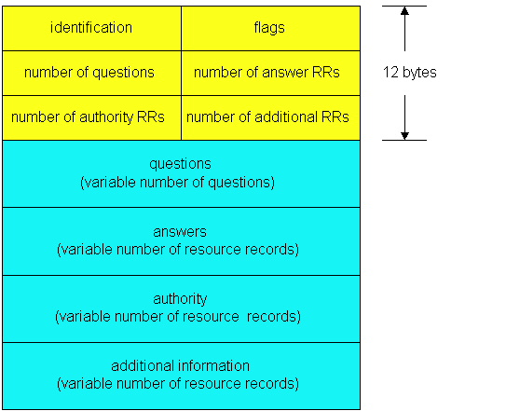
DNS protocol, messages
DNS protocol : query and reply messages, both with same message format
msg header
identification: 16 bit # for query, reply to query uses same #
flags:
Query (0) or reply (1)
recursion desired (in a query)
recursion available (in a reply)
reply is authoritative (in a reply)

Slide 33
DNS protocol, messages
Name, type fields
for a query
(Name, Type)
e.g., (ibm.com, CNAME)
RRs in reponse
to query
(Type, Value, TTL)
(CNAME, serv.bckup.ibm.com,5)
records for
authoritative servers
Multiple RRs possible for the same name!
additional “helpful”
info that may be used
e.g., (serv.bckup.ibm.com, 254.24.54.42,A)

Slide 34
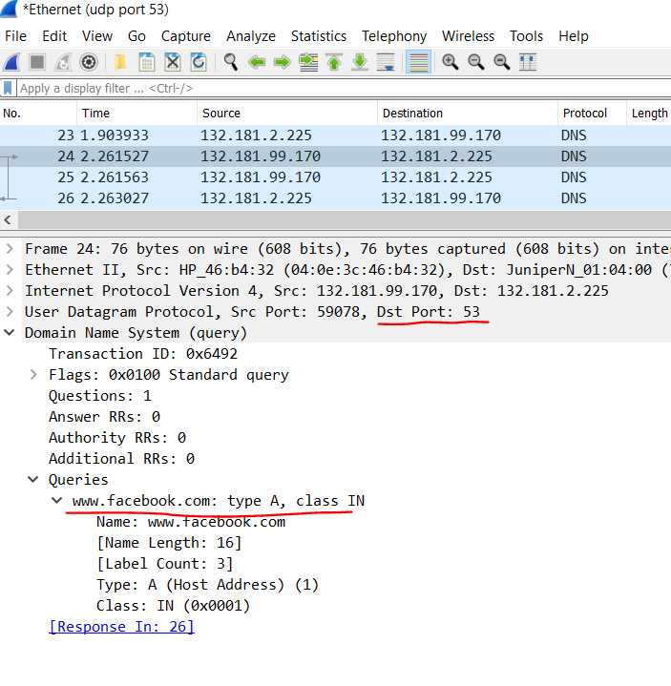
A Query Example

Slide 35
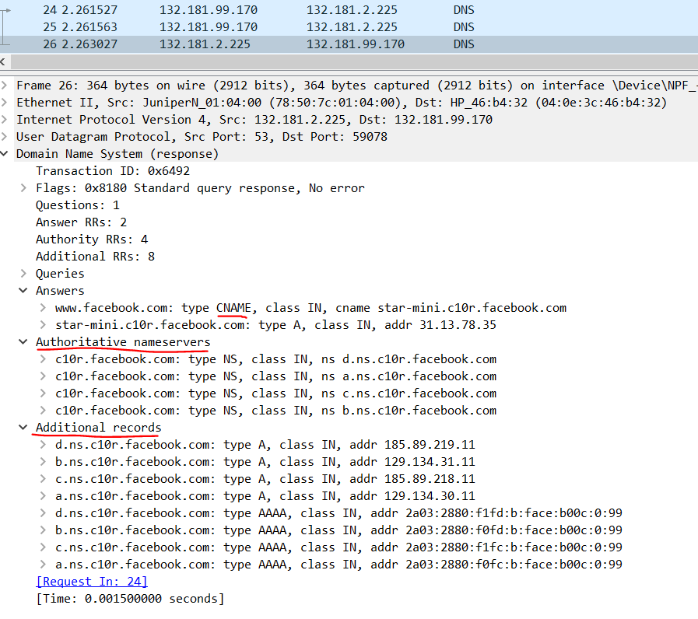
A Response Example

Slide 36
References
James F. Kurose & Keith W. Ross, Computer networking: a top-down approach featuring the Internet, Addison Wesley, 3rd edition, 2005. ​
Chapter 2 Application Layer (2.3, 2.4)
William Stallings, Data and Computer Communications, Pearson, 10th edition, 2013.
Chapter 24 Electronic Mail, DNS, and HTTP (24.1, 24.2)
Andrew S. Tanenbaum & David J. Wetherall, Computer Networks, Prentice Hall, 5th edition, 2010.
Chapter 7 The Application Layer (7.1, 7.2)

Slide 37
Acknowledgements
Lecture notes are developed based on slides from the following three sources:
Dr Mengmeng Ge’s lecture notes for COSC264, University of Canterbury, 2024
Assoc Prof Dan Kim’s lecture notes for COSC264, University of Canterbury, 2017
Prof Aleksandar Kuzmanovic’s lecture notes for CS340, Northwestern University, 2005, https://users.cs.northwestern.edu/~akuzma/classes/CS340-w05/lecture_notes.htm

