Slide 1
BENJAMIN MUTIE CHARLES
Web Tech Summer 2025 Final Exams

Slide 2
Benjamin is developing a data-powered website to help students and alumni from Nyumba Ya Watoto(an orphanage in Kenya) solve career gap problems in the students through mentorship from alumni.

Slide 3
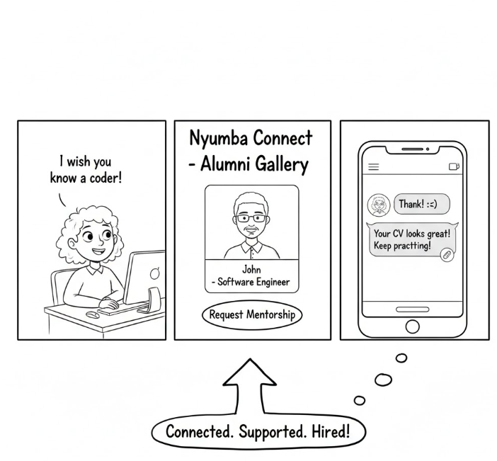
Nyumba Connect
ddd
From "Searching" to "Belonging": Instead of feeling like they are entering the job market alone, students now have a dedicated community that wants them to succeed because they are part of the same "family."
1.Students(Mentees)- Young people currently at Nyumba ya Watoto.. They are looking for guidance on "what comes next" after school.
2. The Alumni (Mentors): Former residents of Nyumba ya Watoto who have successfully transitioned into adulthood and professional life.. They provide the "social proof" that success is possible.
The Administrators: Staff members who oversee the platform, approve opportunities, and ensure the environment remains safe and productive for the children.
.
The "Network Gap." Children in institutional care often lack the organic professional networks (the "who you know") that children in traditional families have.
Isolation: Without a bridge, students may not know how to apply their skills in the real world.
Fragmented Information: Opportunities (jobs/internships) and resources are often scattered; this platform centralizes them.
PROBLEM:What is the problem the website will solve
PAYOFF: What is a simple drawn screen that is illustrative of something the website shows that helps solve the problem. It is likely a report or some results of data entered by the participants. This is the most important square
PERSONA(s) who are the people involved in using the website and what are their background
FINISH: Why are the users better off with the website than before.

Slide 4
User / Customer
Nyumba ya Watoto is a children’s home dedicated to the care and development of children. The Nyumba Connect website serves as a comprehensive mentorship and career development platform that bridges the gap between current children at the orphanage and the alumni network. Its purpose is to foster community growth by providing a secure environment for career guidance, sharing professional opportunities, and offering well-being support through shared lived experiences. Learn more about the orphanage here fondazionechincherini.it
User Roles:
The website utilizes a role-based authentication system to manage access and functionality:
Students: They browse the alumni gallery to request mentorship, message mentors for guidance, and apply for posted career opportunities using their uploaded CVs.
Alumni: They serve as mentors by responding to student requests, sharing career advice through real-time messaging, and posting job or internship opportunities.
Admins: They manage the platform by overseeing user accounts, approving or rejecting opportunity postings, and managing the library of career resources.

Slide 5
Main Functions of the Website
Main Functions to Solve the Problem
Mentorship Management System: This allows students to search for and connect with specific alumni mentors based on their career interests, bridging the "network gap" through formal request and acceptance workflows.
Integrated Messaging Platform: A secure, private communication tool that enables real-time guidance and professional dialogue between mentors and students once a connection is established.
Opportunity & Job Board: A centralized hub where alumni can post internships and job openings specifically for Nyumba students, ensuring that users have direct access to "hidden" career paths.
Resource & CV Library: A digital repository where students can access career guides and manage their CVs, allowing for professional preparation and seamless application to posted opportunities.

Slide 6
Architecture
Presentation Tier (Frontend) | HTML5, CSS3, JavaScript, Bootstrap 5 | Provides a responsive, mobile-friendly interface so students can access mentorship resources from any device.
Application Tier (Backend) | PHP | A reliable server-side language that handles the core business logic, such as processing mentorship requests and managing messaging sessions.
Data Tier (Database) | MySQL | A relational database management system (RDBMS) used to securely store complex relationships between users, messages, and job applications.
Image of 3 tier architecture and how they connect, programing languages for each tier and why, other technologies (frameworks, etc).

