Slide 1


Slide 2
Feature register
Save register data to database
Create access token
2s
Send welcome email
3s
Create sendgrid user
Time consumed: 5.5s

Slide 3
Feature register
Save register data to database
Create access token
Send welcome email
Create sendgrid user
Time consumed: 0.5s

Slide 4
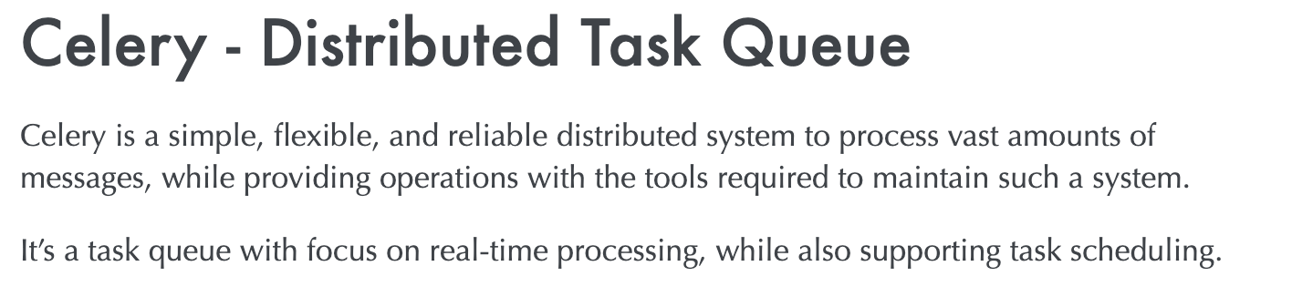

Slide 5
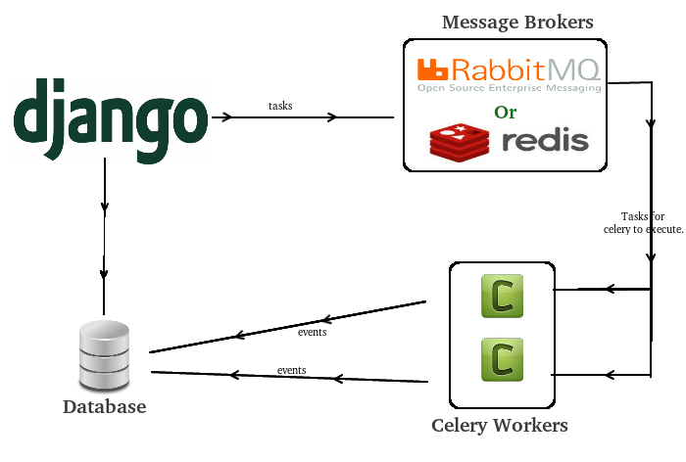

Slide 6
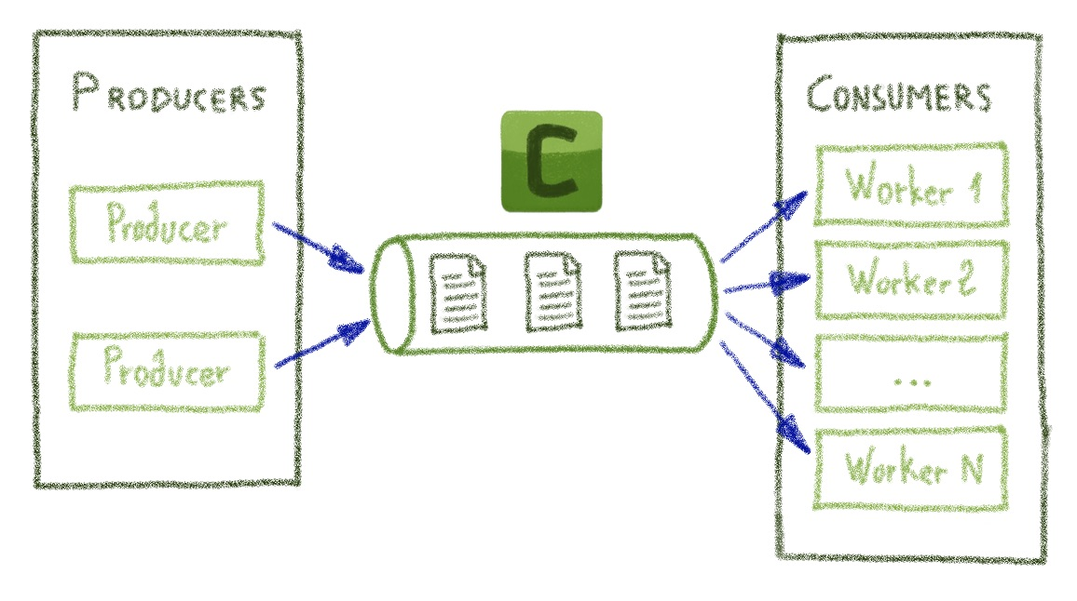

Slide 7
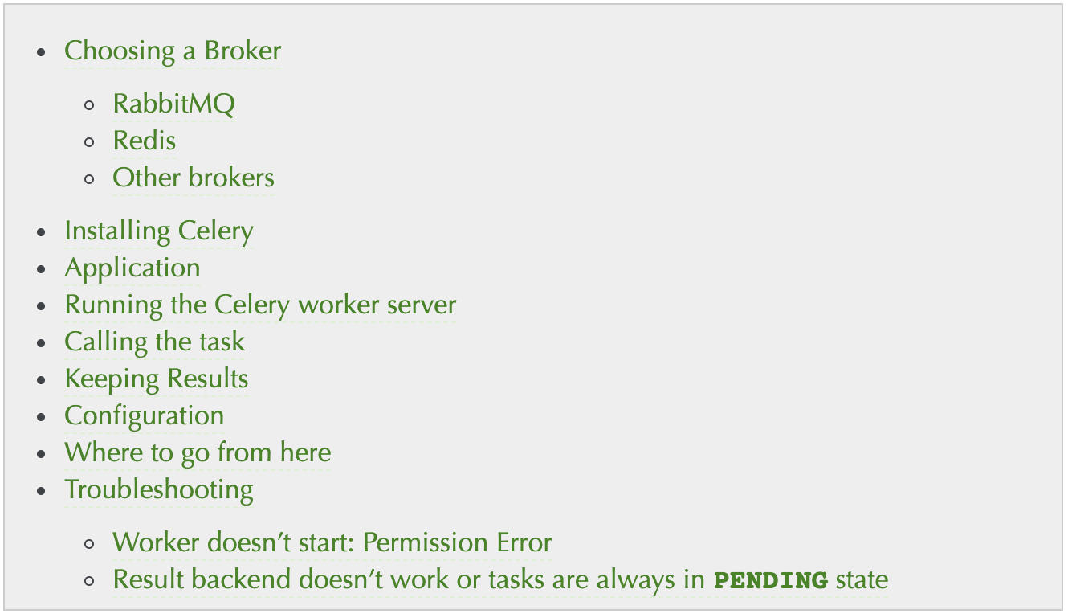

Slide 8
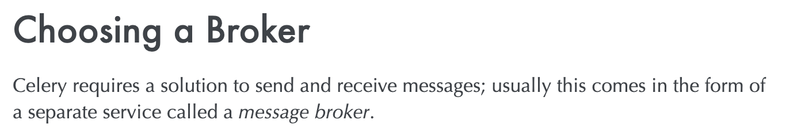

Slide 9
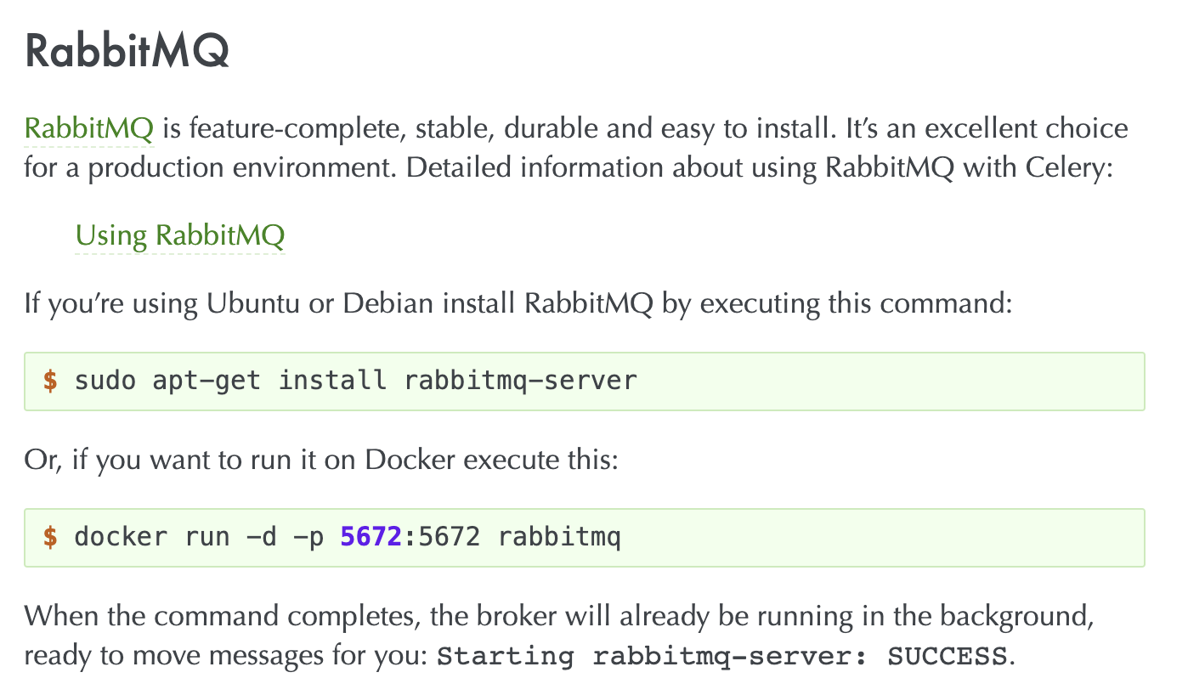

Slide 10
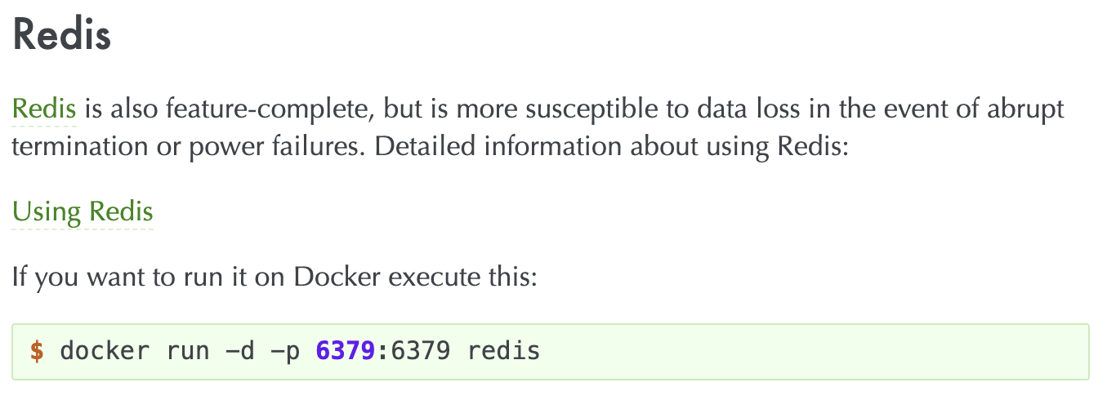

Slide 11
What we need
Pipenv
Application -> Django
Messaging Queue
Celery

Slide 12
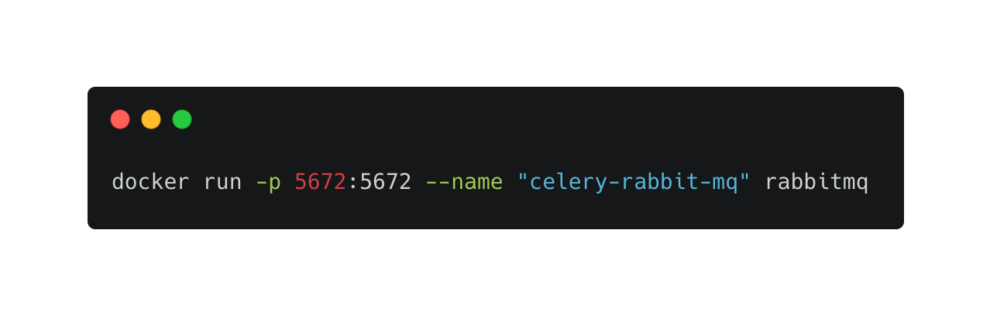
Install & Run RabbitMQ
docker run -p 5672:5672 --name "celery-rabbit-mq" rabbitmq

Slide 13
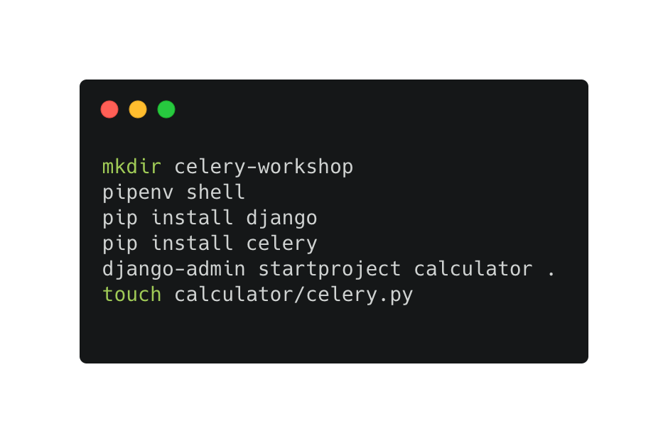
Create Django Project
mkdir celery-workshop
pipenv shell
pip install django
pip install celery
django-admin startproject calculator .
touch calculator/celery.py

Slide 14
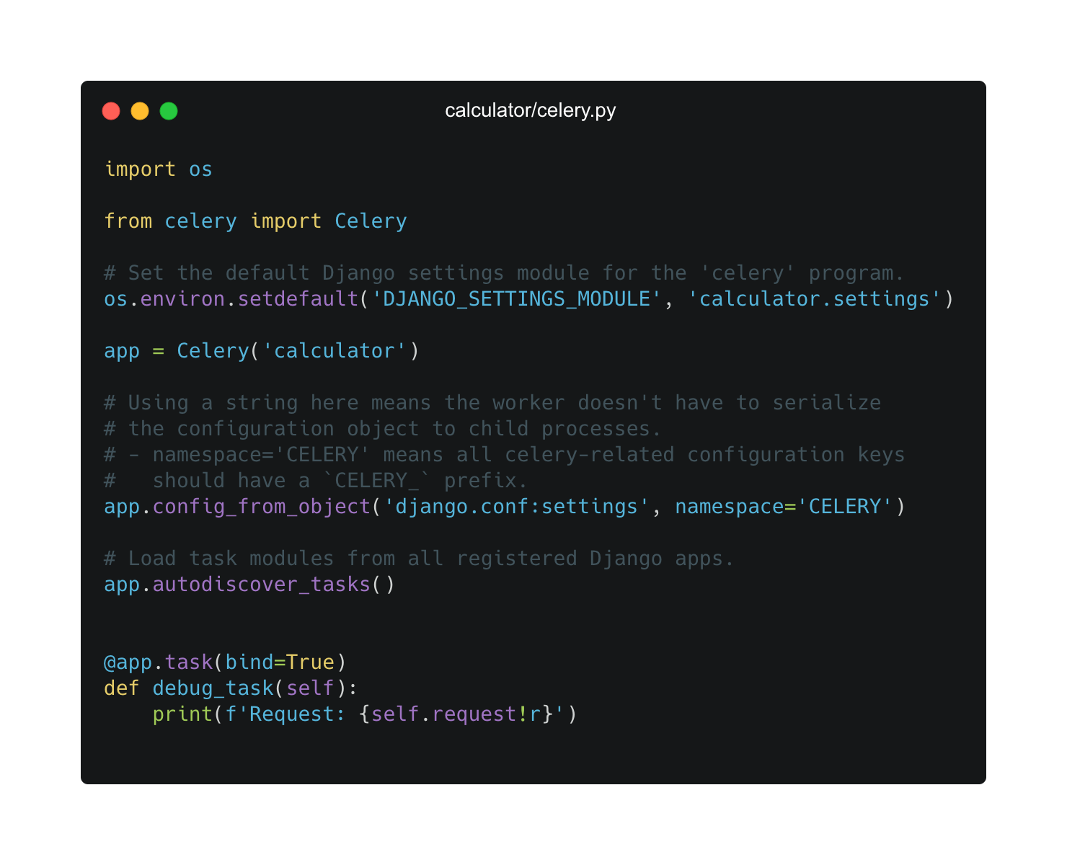
Setup Celery Instance

Slide 15
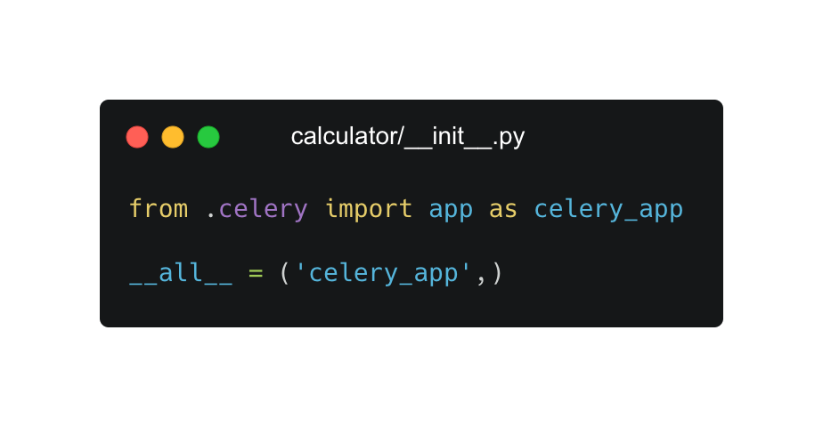
Always run celery when application start

Slide 16
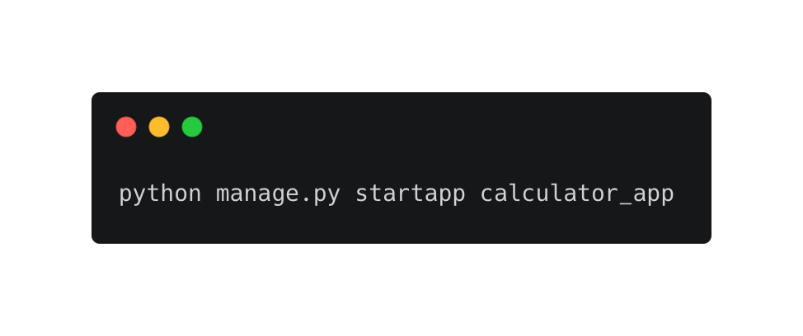
Create New App

Slide 17
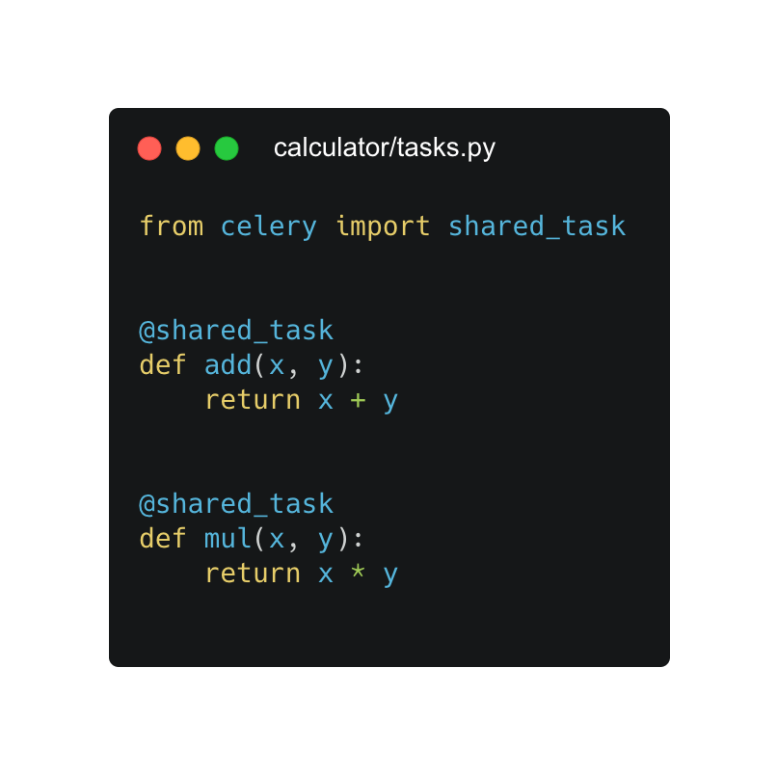
Create Task

Slide 18
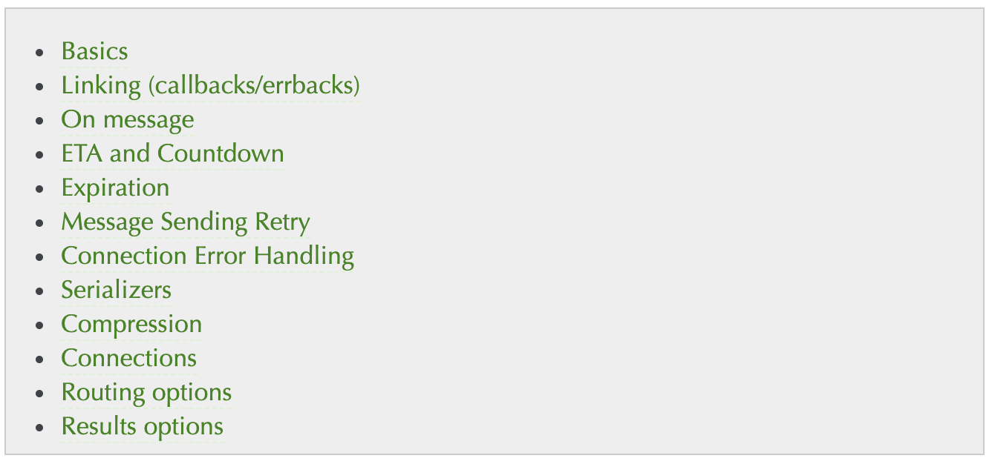
Calling a Task
Calling Tasks — Celery 5.1.0 documentation (celeryproject.org)

Slide 19
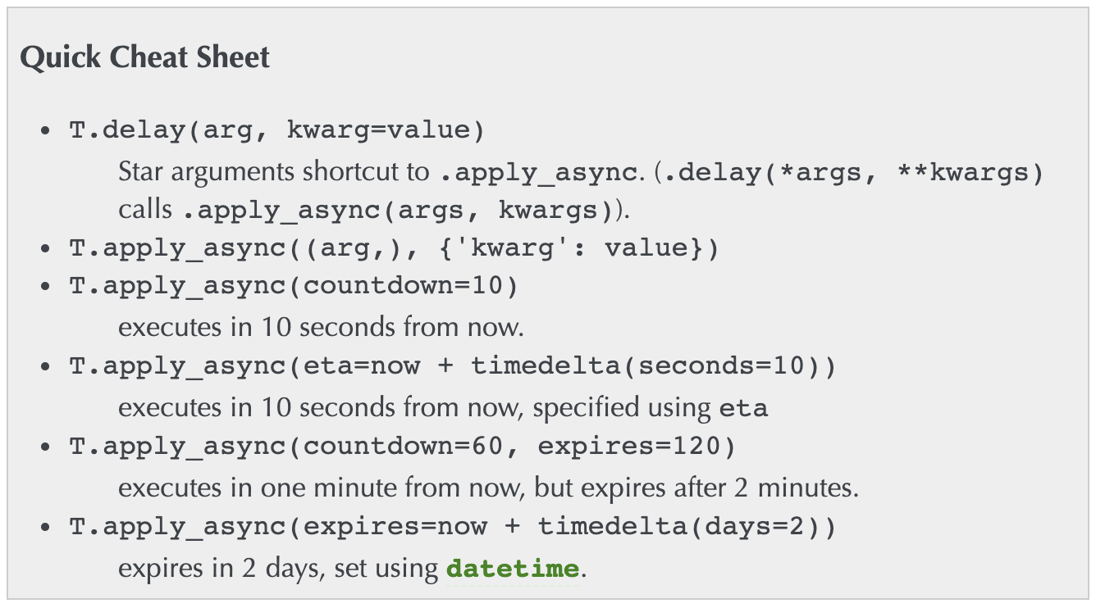

Slide 20
Run command
celery -A calculator worker -l INFO
python manage.py runserver

Slide 21
Monitoring

Slide 22
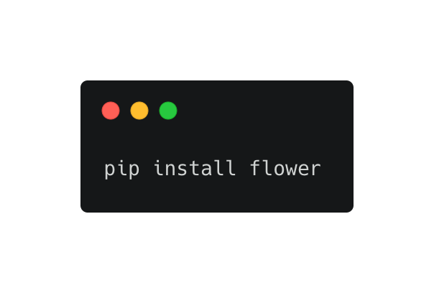
Install Flower
Monitoring and Management Guide — Celery 5.1.0 documentation (celeryproject.org)

Slide 23
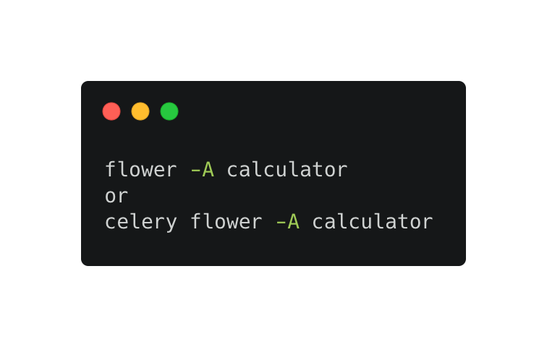
Start flower
Installation — Flower 1.0.0 documentation

Slide 24
Let try
Start flower
Run any task
See the result
Stop flower
Start flower

Slide 25
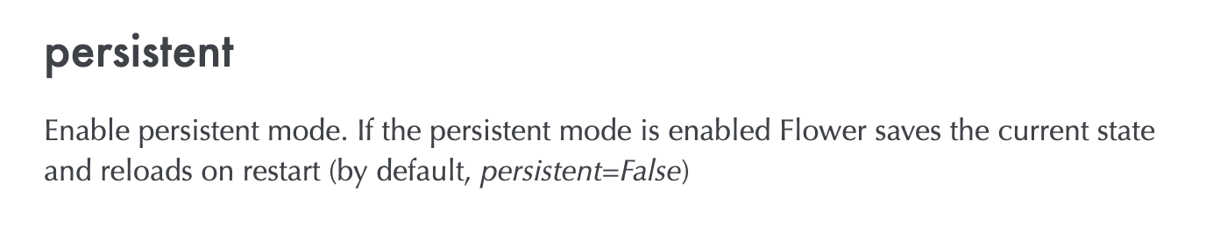

Slide 26
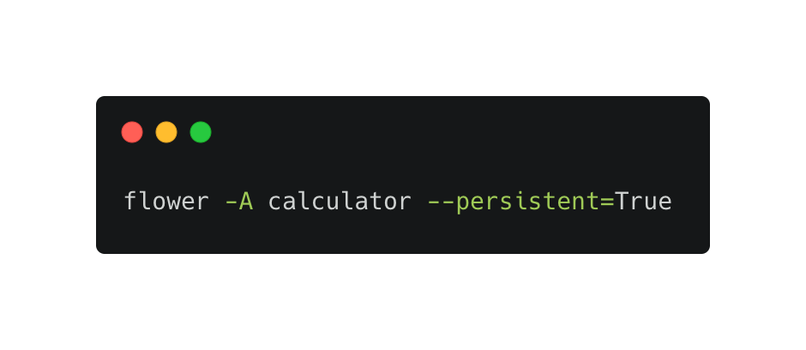
Start flower with persistent flag

Slide 27
Let try
Start flower
Run any task
See the result
Stop flower
Start flower

Slide 28
First steps with Django — Celery 5.1.0 documentation (celeryproject.org)
Introducing Director – a tool to build your Celery workflows | OVHcloud Blog
celery/examples/django at master · celery/celery (github.com)
rabbitmq - celery flower does not show previously run tasks after restart - Stack Overflow

