Slide 1
Image Classification
Using Deep Learning & Streamlit for Real-Time Image Classification
Developer : Aditya Wagh

Slide 2
Introduction
Image Classification Using CNN: The project utilizes a Convolutional Neural Network (CNN) to classify images from the CIFAR-10 dataset into 10 categories such as airplanes, cars, and animals.
Web-Based Application: Built with Streamlit, the application allows users to upload images and receive real-time predictions, making it easy to interact with the model.
User-Friendly Interface: The purpose is to provide an accessible and visually appealing platform for users to explore image classification without needing deep technical knowledge.

Slide 3
Objective
Easy Image Classification: Provide a simple platform where users can upload images and get instant predictions using a Convolutional Neural Network (CNN).
Accessible to Everyone: Make advanced image classification available to non-technical users through a user-friendly interface built with Streamlit.
Real-Time Interaction: Allow users to experience real-time image classification with minimal effort, making it both interactive and engaging.

Slide 4
Technology Stack
Python
TensorFlow
Streamlit
CNN (Convolutional Neural Network)
CIFAR-10 dataset

Slide 5
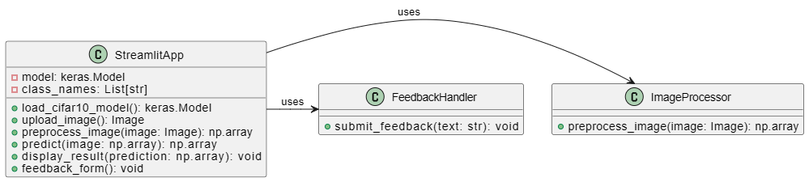
UML Diagram

Slide 6
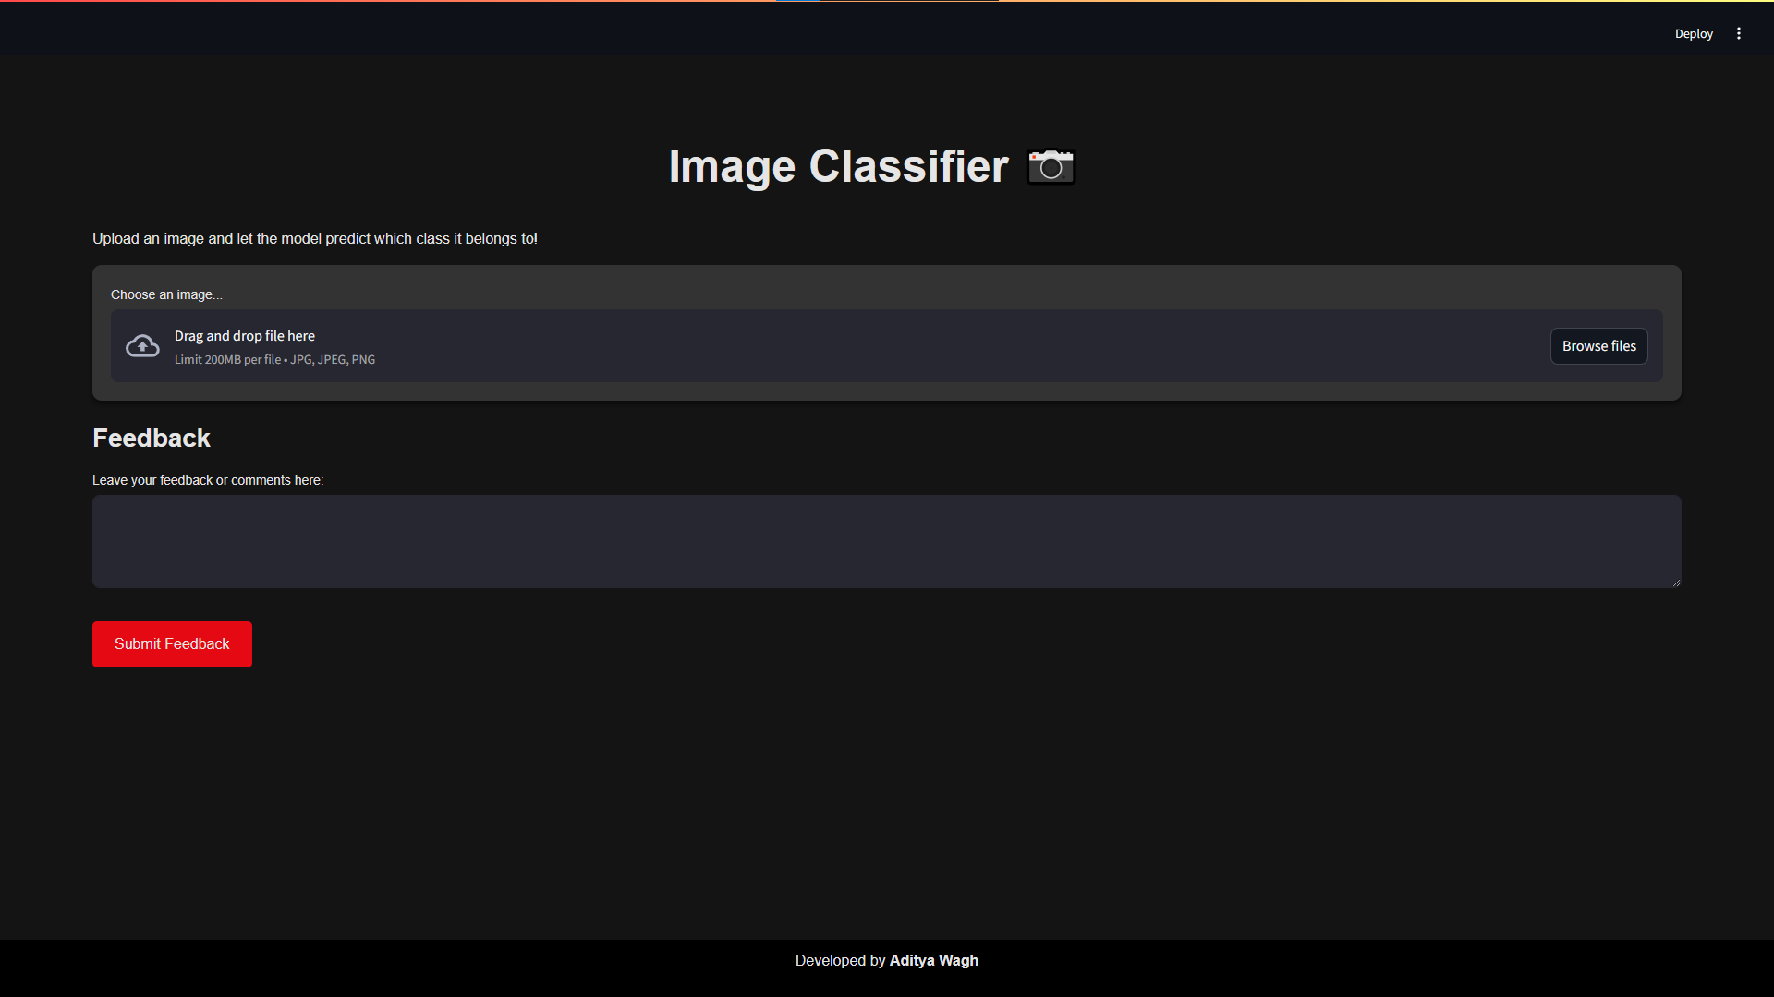
Webpage

Slide 7
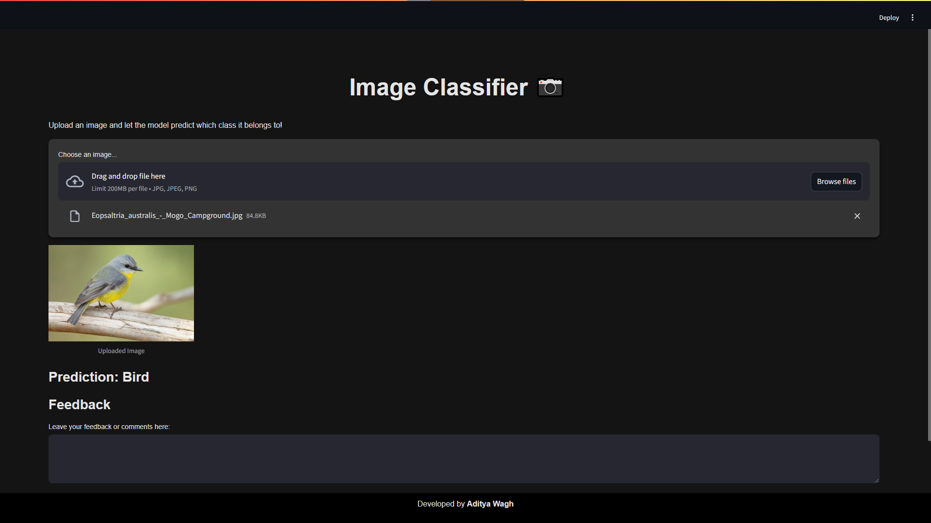
Webpage (After classification)

Slide 8

Feedback Option

Slide 9
Key Features
Real-Time Predictions: Instantly classify uploaded images using a pre-trained CNN model.
User-Friendly Interface: Simple and intuitive web design, making it accessible for users without technical expertise.
Support for Multiple Image Types: Handles common formats like JPG, JPEG, and PNG for easy uploads.

Slide 10
Future Enhancements
Improved Model Accuracy: Integrate advanced models like ResNet or EfficientNet for better image classification accuracy.
Mobile and Cloud Integration: Expand the app to support mobile devices and cloud-based processing for scalability and enhanced accessibility.
Enhanced User Interface: Add interactive features like drag-and-drop uploads and real-time visual feedback to improve the overall user experience.

Slide 11
Conclusion
Effective Image Classification: The app successfully classifies images in real-time using a CNN model, making advanced technology easy to use for anyone.
Smooth User Experience: With a simple and interactive design, users can easily upload images and get instant predictions.
Room for Improvement: There are many possibilities to improve the app, like using better models, making it work on mobile devices, and enhancing the user interface.

Slide 12
THANKYOU !

