Slide 1
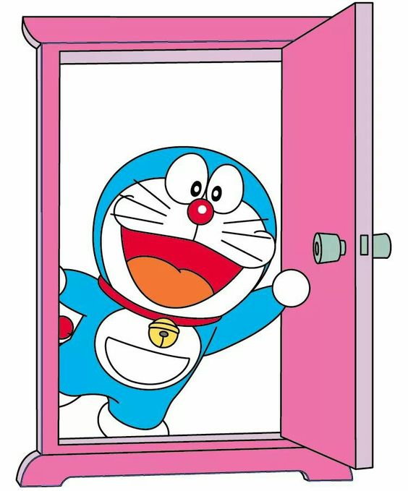
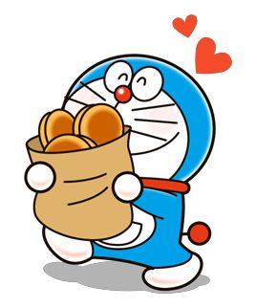
YOUR DORAEMON’S HERE!!
Hey you Nobita!
Hurry up! Lets get into this anywhere door and let the doracakes melt in our tongue.
We are here to bake you yum cakes and take you to fantasy world by telling you amazing stories.
We are ready to pack cake and sack you! Are you?

