Slide 1

Brandi
M. Eren
M. Scarcia
Pick&Place
GM Group
Milano, 19/02/2020

Slide 2
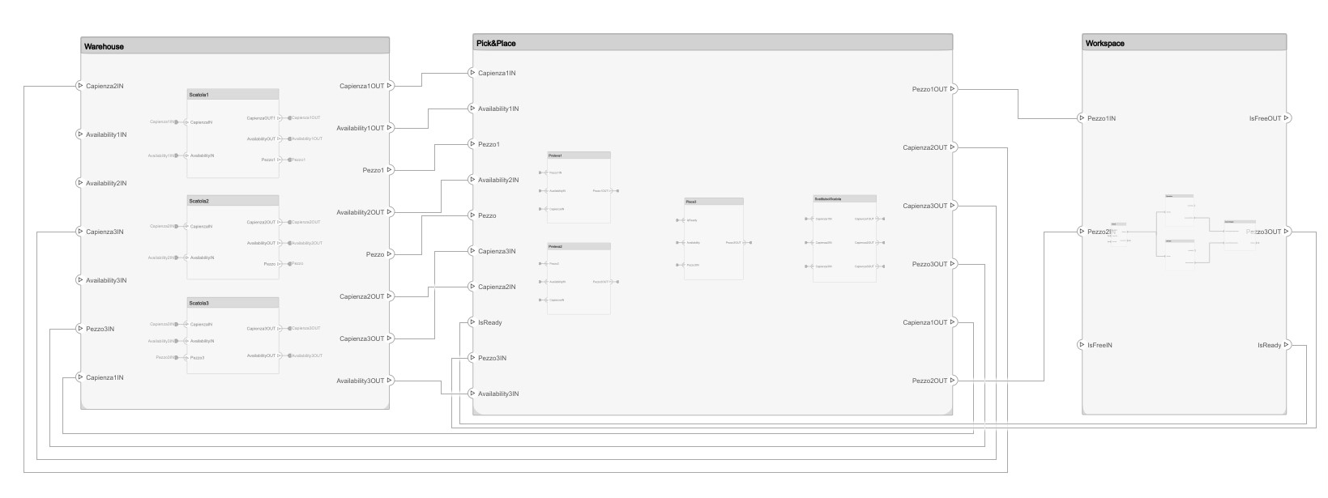
Component Model

Slide 3
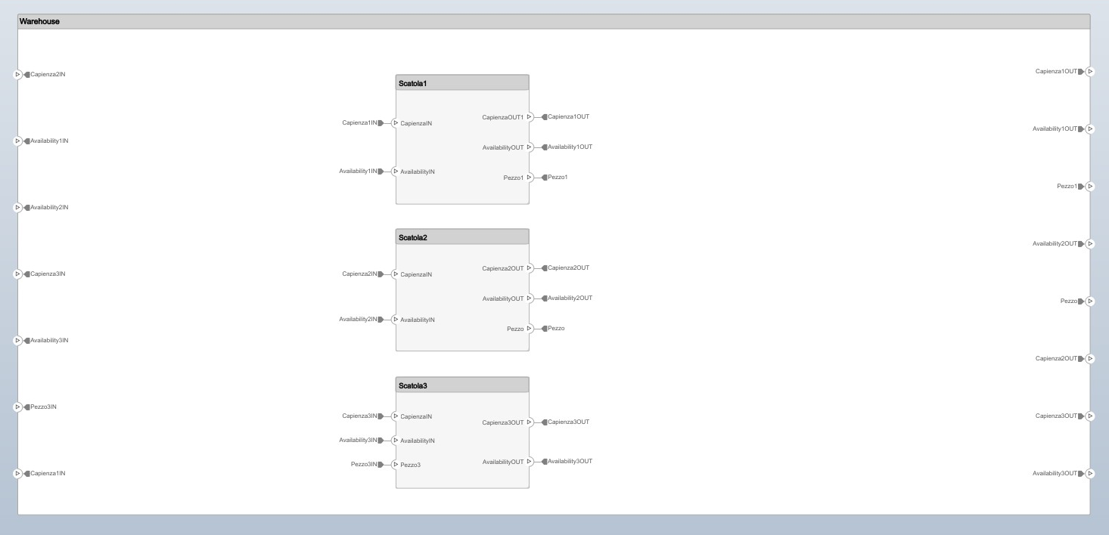
Component Model - Warehouse

Slide 4
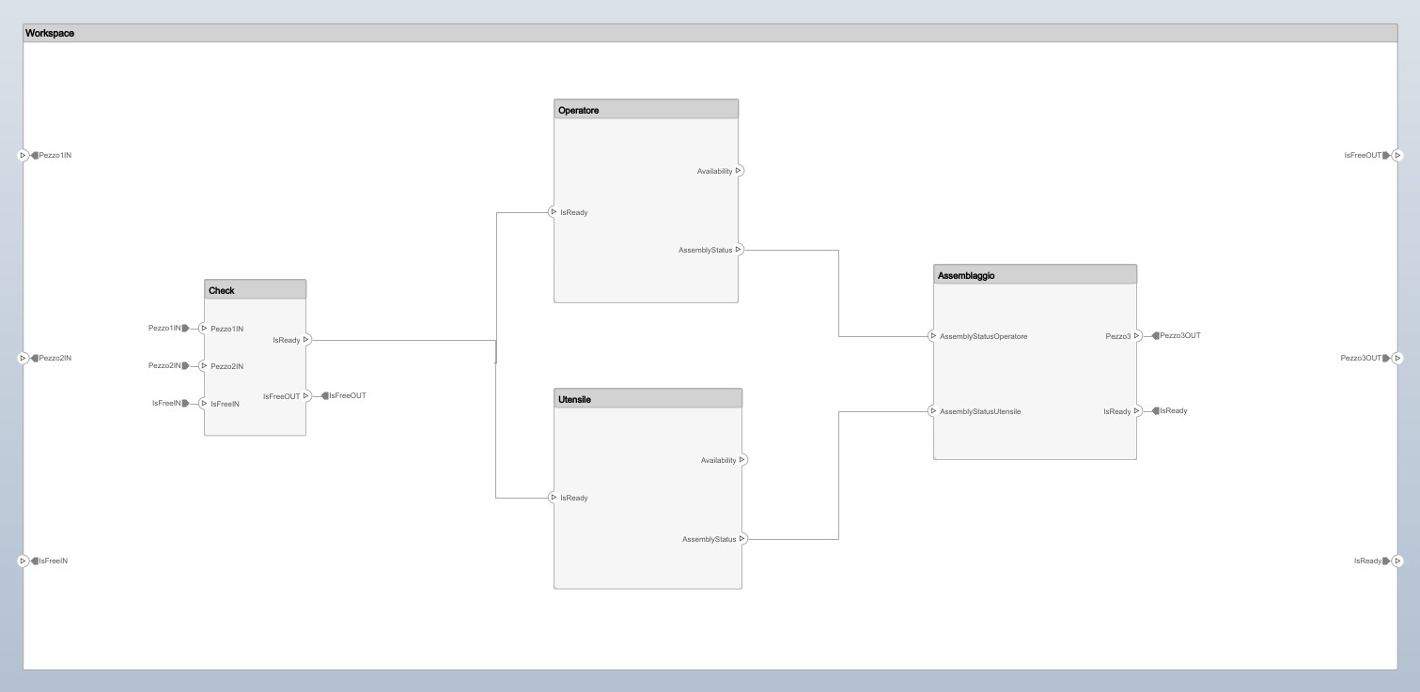
Component Model - Workspace

Slide 5
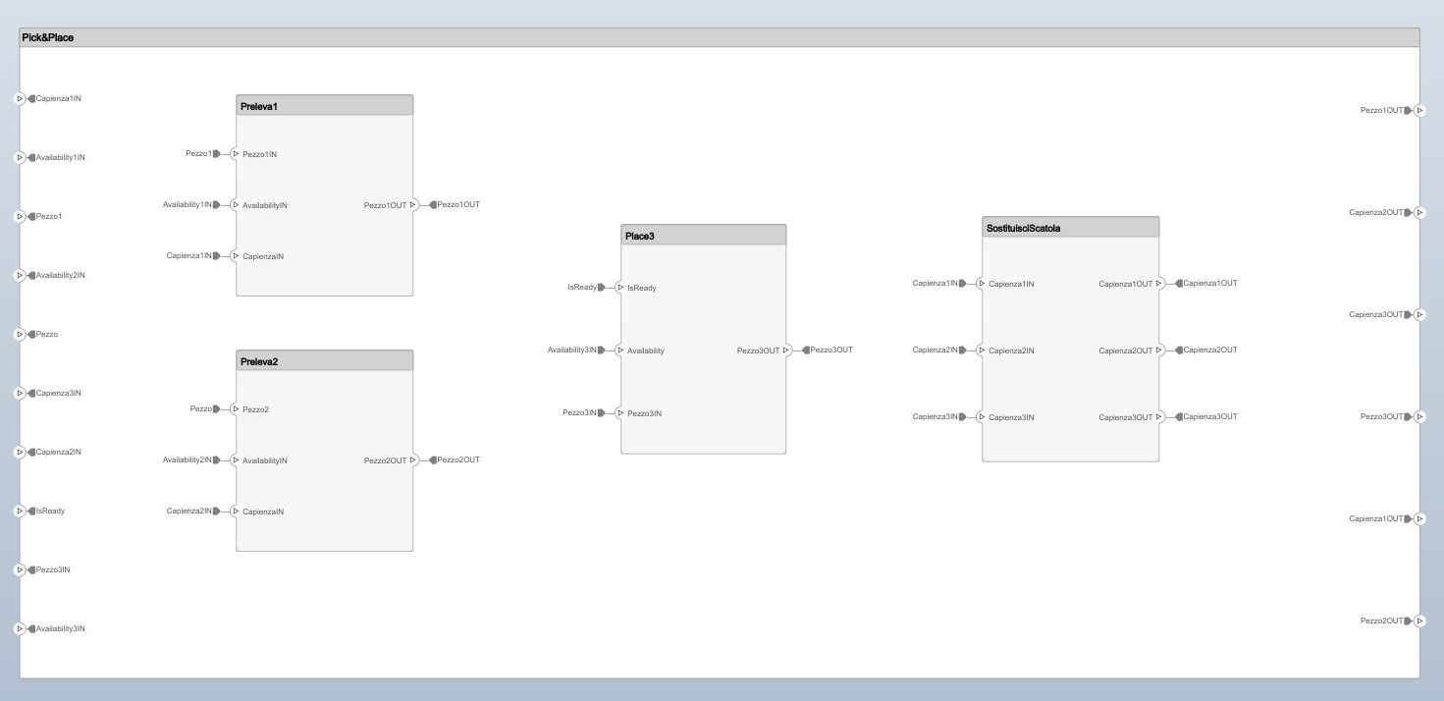
Component Model – Pick&Place

Slide 6
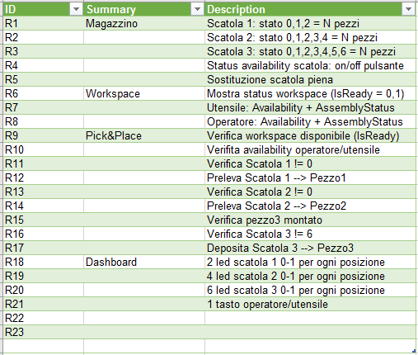
Requirements

