Slide 1

Brandi
M. Eren
M. Scarcia
Pick&Place
GM Group
Milano, 27/03/2020

Slide 2
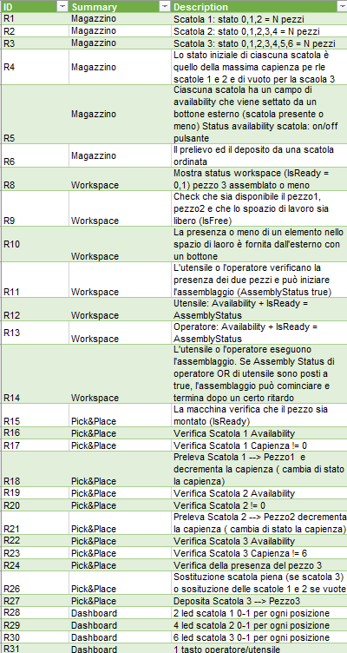
Phase 1 : Definitions of Requirements

Slide 3
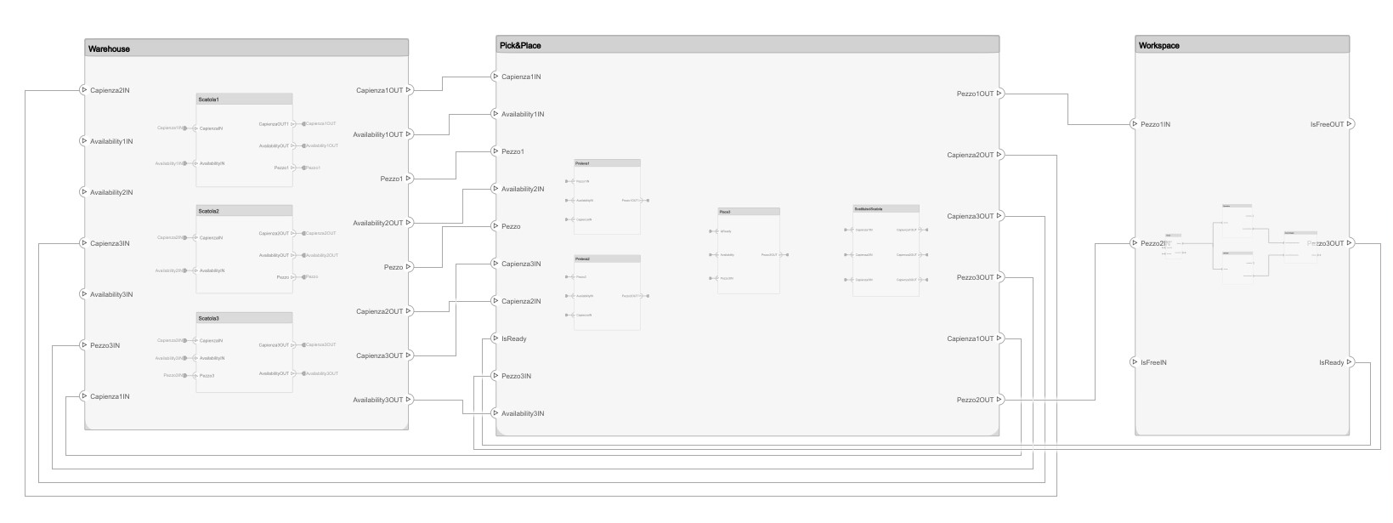
Phase 2 : General implementation System Composer

Slide 4
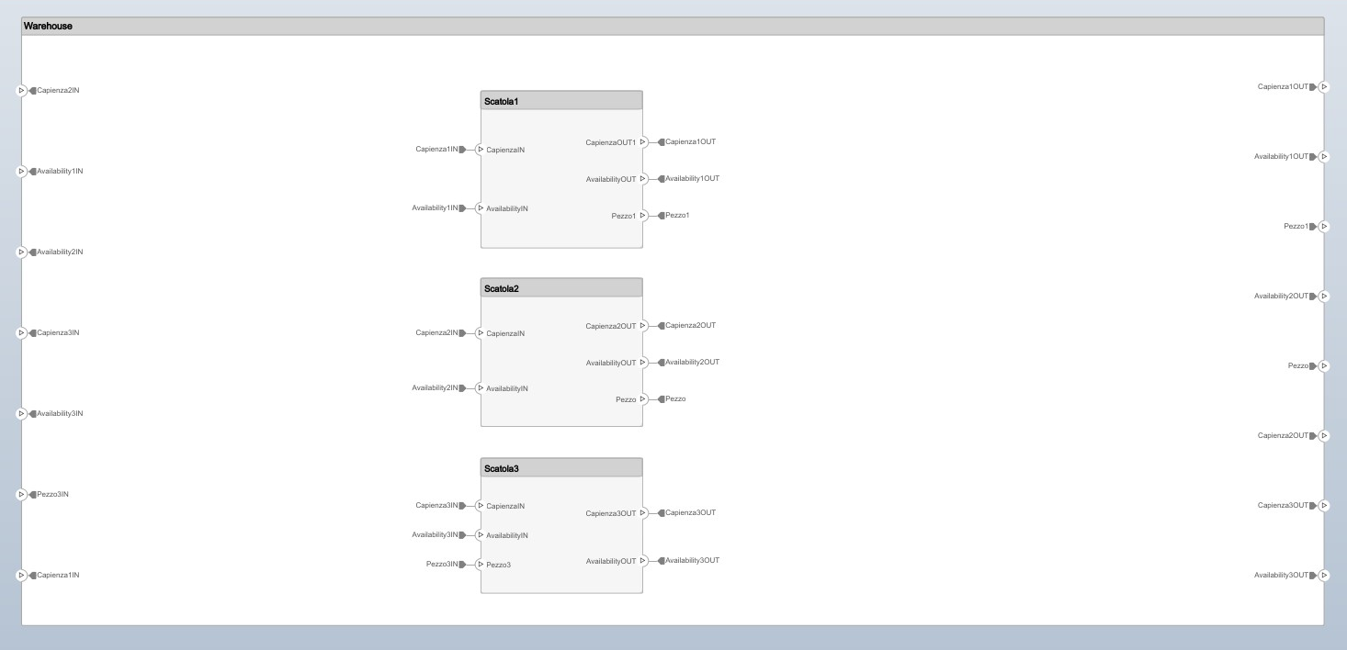
Phase 2 : System composer - Warehouse

Slide 5
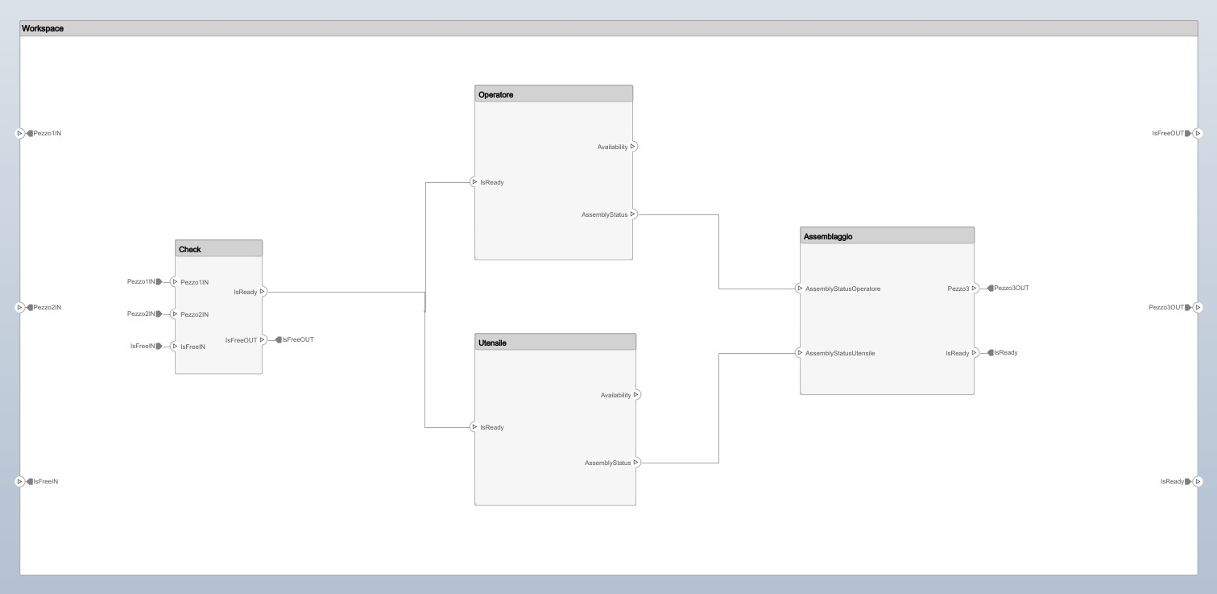
Phase 2 : System Composer- Workspace

Slide 6
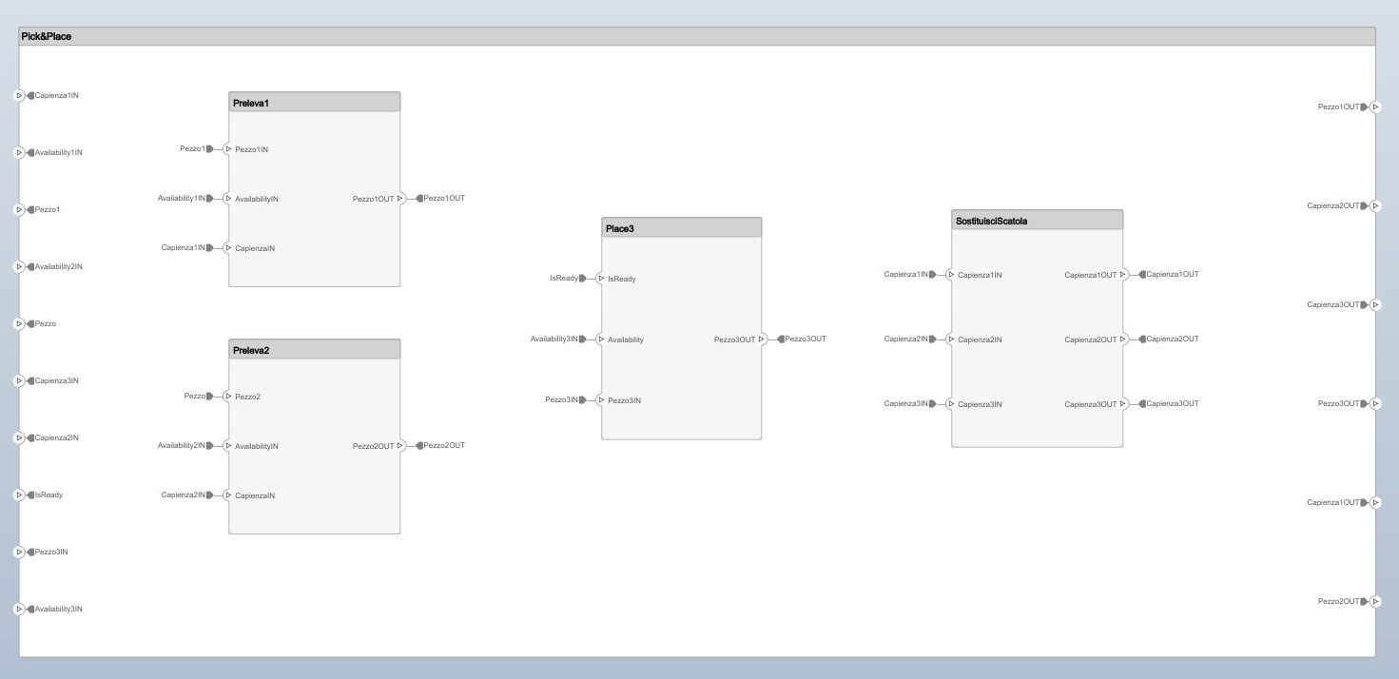
Phase 2 : System Composer Pick&Place

Slide 7
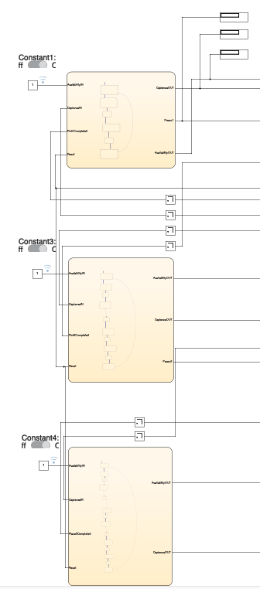

Phase 3: Simulink Implementation - Warehouse
Scatola 1
Scatola 2
Scatola 3

Slide 8
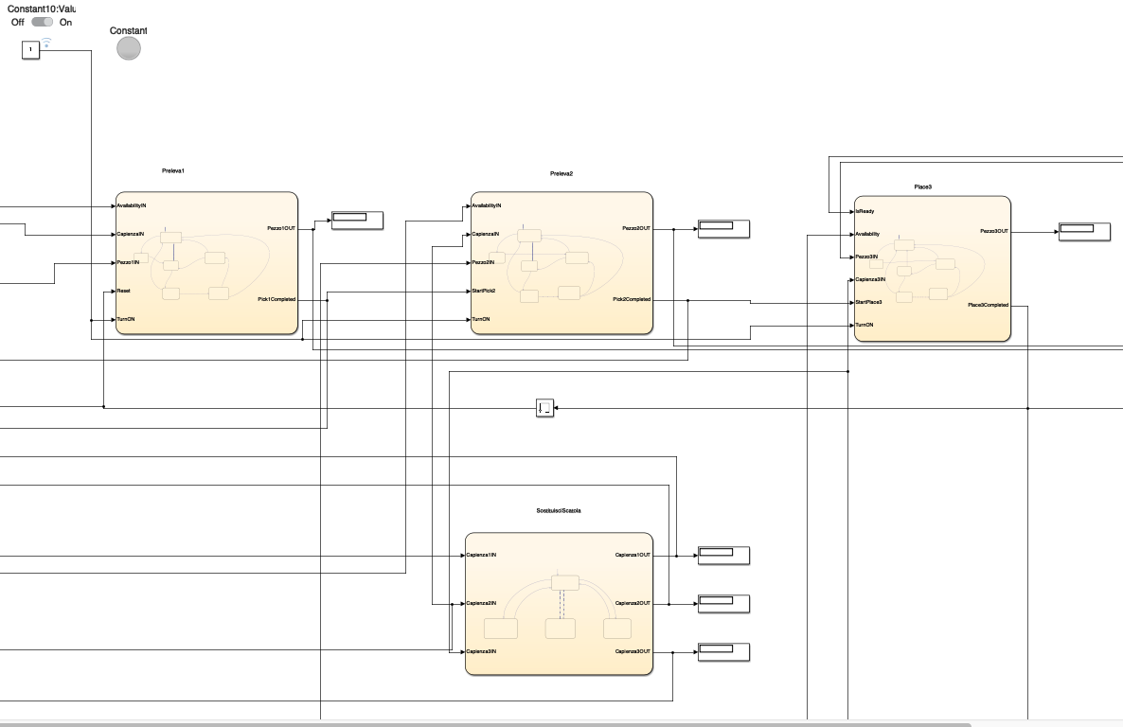
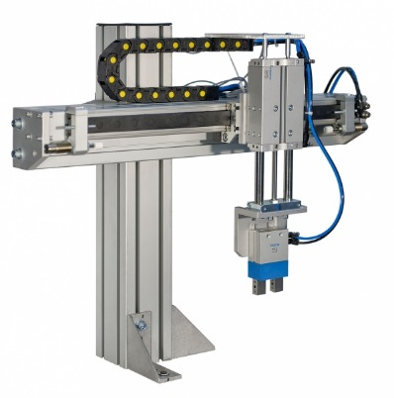
Phase 3: Simulink Implementation – Pick&Place
Preleva 1
Preleva 2
Place 3
SostituisciScatola

Slide 9
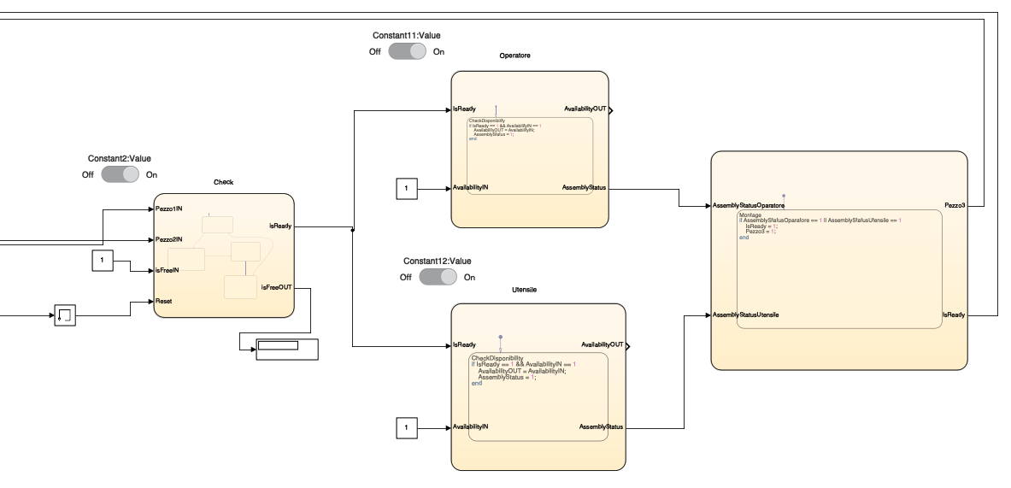
Phase 3: Simulink Implementation – Workspace
Operatore
Check
Assemblaggio
Utensile

Slide 10
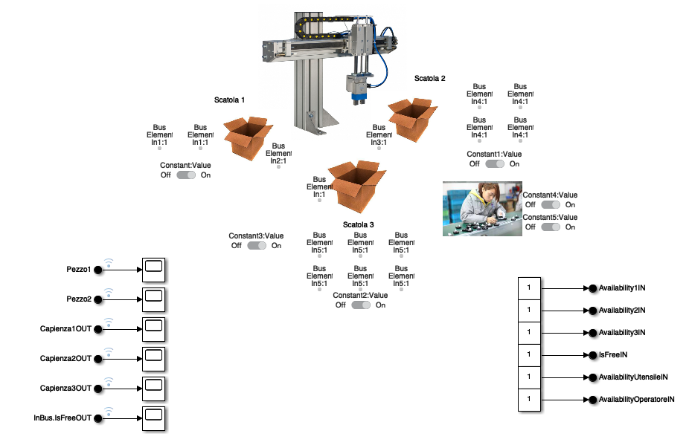
Phase 3: Simulink Implementation Dashboard v1

Slide 11
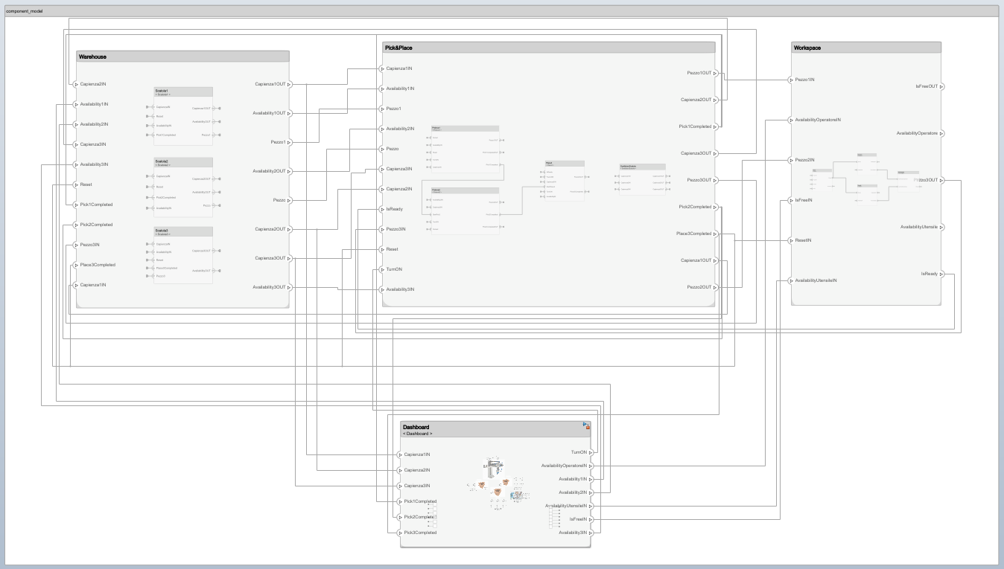
Phase 4: Including Simulink in System composer – All the components

Slide 12
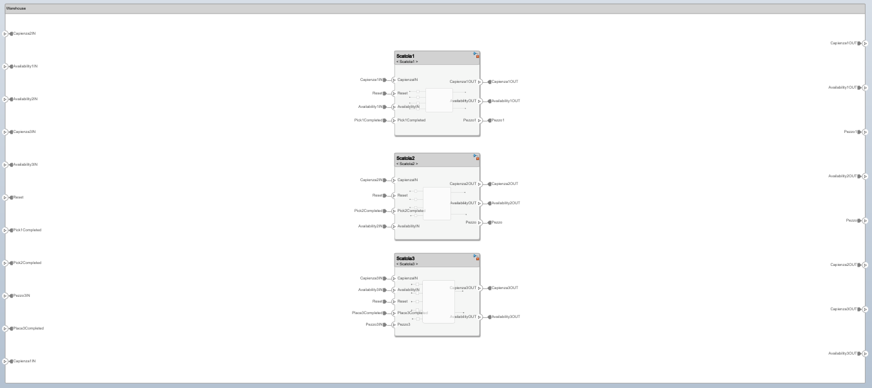
Phase 4: Including Simulink in System composer – Warehouse

Slide 13
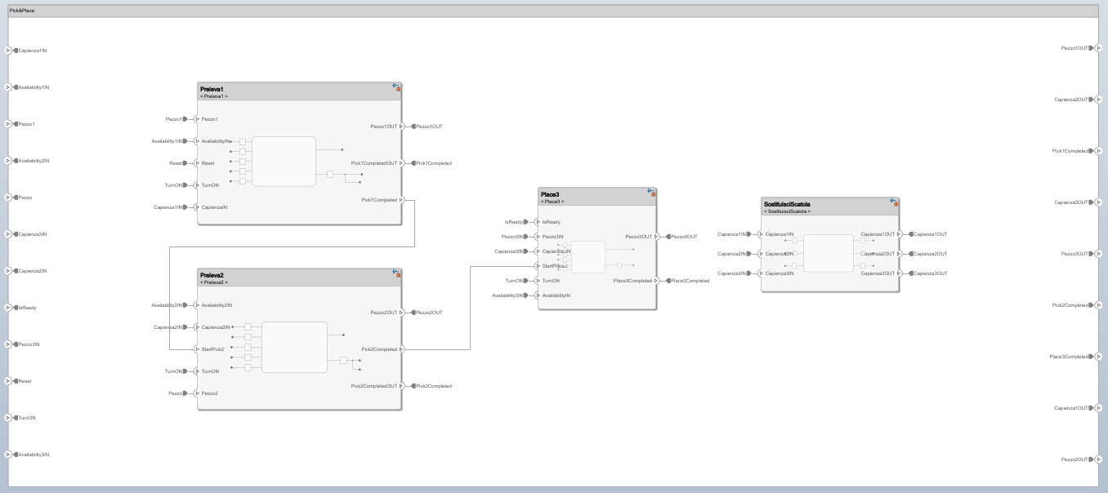
Phase 4: Including Simulink in System composer – Pick&Place

Slide 14
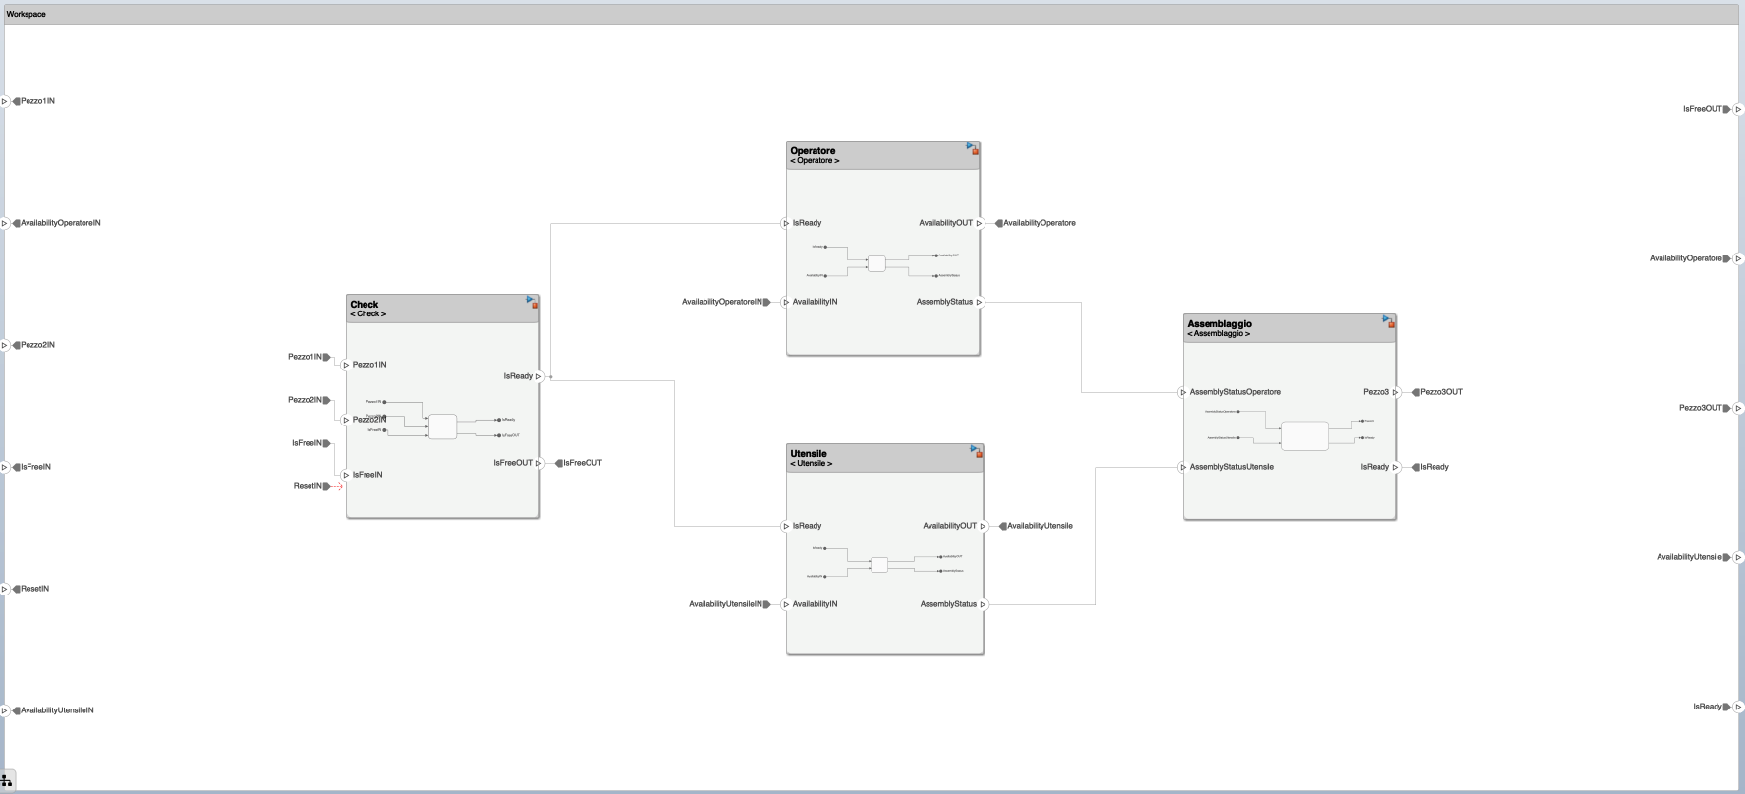
Phase 4: Including Simulink in System composer – Workspace

Slide 15
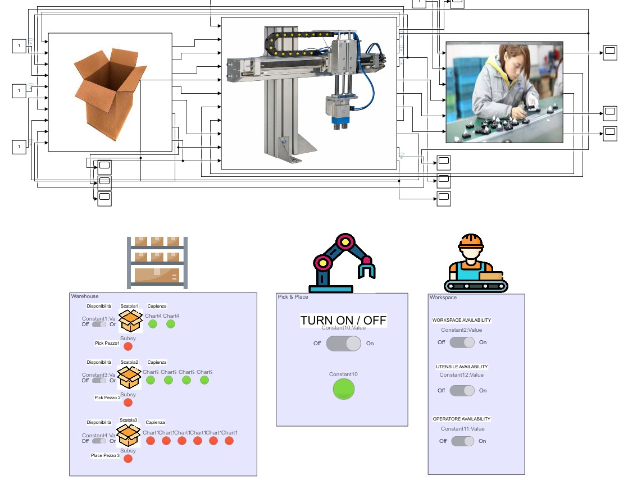
Phase 5: Final Simulink Debug – Dashboard V2

Slide 16
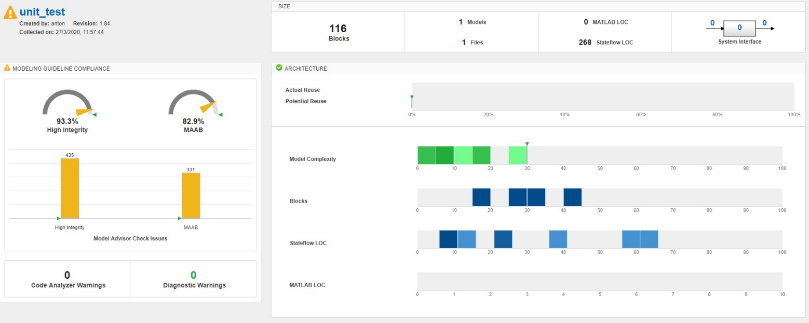
Phase 6: Report Generation & Metrics Dashboard
Simulink

