Slide 1
Cleaning Customer Data for Better Business Decisions
TECHNICAL PRESENTATION
PRESENTED BY
Anto Chriswin G - 192324093
Course: DSA0503-Query Processing For Data Science Date: 11 Aug 2026 Guide: Dr. Anuradha

Slide 2

INTRODUCTION
Customer data is collected from sales, registrations, transactions, surveys, and online platforms.
Real-world customer datasets often contain missing values, duplicate records, incorrect formats, and inconsistent information.
Poor-quality data can lead to incorrect analysis and unreliable business decisions.
Data cleaning transforms raw customer data into a consistent, accurate, and analysis-ready dataset.
Clean customer data helps businesses understand customer behavior, improve marketing, and make better strategic decisions.

Slide 3

PROBLEM STATEMENT
Businesses often maintain customer datasets containing:
Missing customer information
Duplicate customer records
Inconsistent names, cities, or categories
Incorrect data types and formats
Invalid or unrealistic values
Outliers in numerical attributes
Impact
Unclean Data → Incorrect Analysis → Poor Business Decisions

Slide 4
OBJECTIVES
The main objectives of this project are:
Identify and handle missing or incomplete customer information to ensure that important customer attributes are available and suitable for analysis.
Remove duplicate records and standardize inconsistent data such as customer names, gender, city names, categories, and other categorical values.
Validate data types and detect invalid values or outliers, including unrealistic ages, negative income or spending values, and unusual customer behavior.
Create a clean and reliable customer dataset that improves the accuracy of customer analysis, supports meaningful business insights, and enables better data-driven decisions.

Slide 5
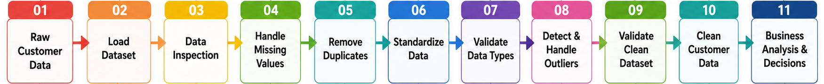
SALES FORECASTING WORKFLOW

Slide 6
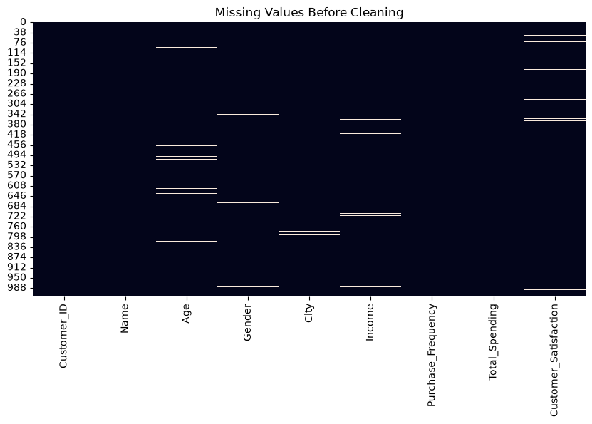
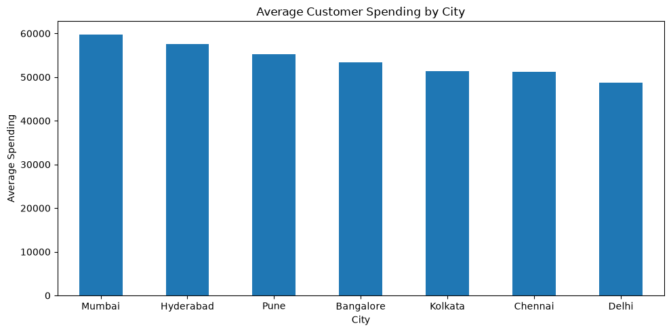
RESULTS

Slide 7
BUSINESS BENEFITS
Clean customer data enables businesses to:
Identify high-value customers by analyzing customer spending patterns and purchase frequency to focus resources on the most valuable customers.
Improve customer segmentation by grouping customers based on their spending, income, purchasing behavior, and other relevant characteristics.
Create targeted marketing campaigns by using reliable customer information to deliver personalized offers and promotions to specific customer groups.
Understand purchasing behavior by analyzing customer preferences, purchase frequency, spending patterns, and satisfaction levels.

Slide 8
CONCLUSION
Customer data quality is critical for reliable business analytics.
Data cleaning addresses missing values, duplicates, inconsistencies, invalid values, and outliers.
Python libraries such as Pandas and NumPy provide efficient tools for preprocessing customer data.
The cleaned dataset provides a reliable foundation for customer segmentation, prediction, marketing analysis, and business intelligence.
Therefore, effective data cleaning leads to more accurate insights and better business decisions

Slide 9


