Slide 1
Department of informatics
Informatics II
Exercise 3
Grgic Anto

Slide 2
Schedule (Corrected)
Date | Topic
27. Feb | C environment
06. Mar | Ex1(Introduction to C, basic sorting)
13. Mar | Ex2 (Recursion)
20. Mar | Ex3 (Complexity, Correctness)
27. Mar | Ex4 (Divide and Conquer, Recurrence)
03. Apr | NO LAB (Please attend another class) – Spring break
17. Apr | Ex6 (Pointers, Linked Lists)
24. Apr | Ex7(ADTs, Stacks, Queues)
01. May | NO LAB (Please attend another class) – Labor day
08. May | Ex9 (Hash Tables)
15. May | Ex10 (Dynamic Programming)
22. May | Ex11 (Graphs)
29. May | Recap
04. Jun | Exam at Messe 16:00-19:00

Slide 3
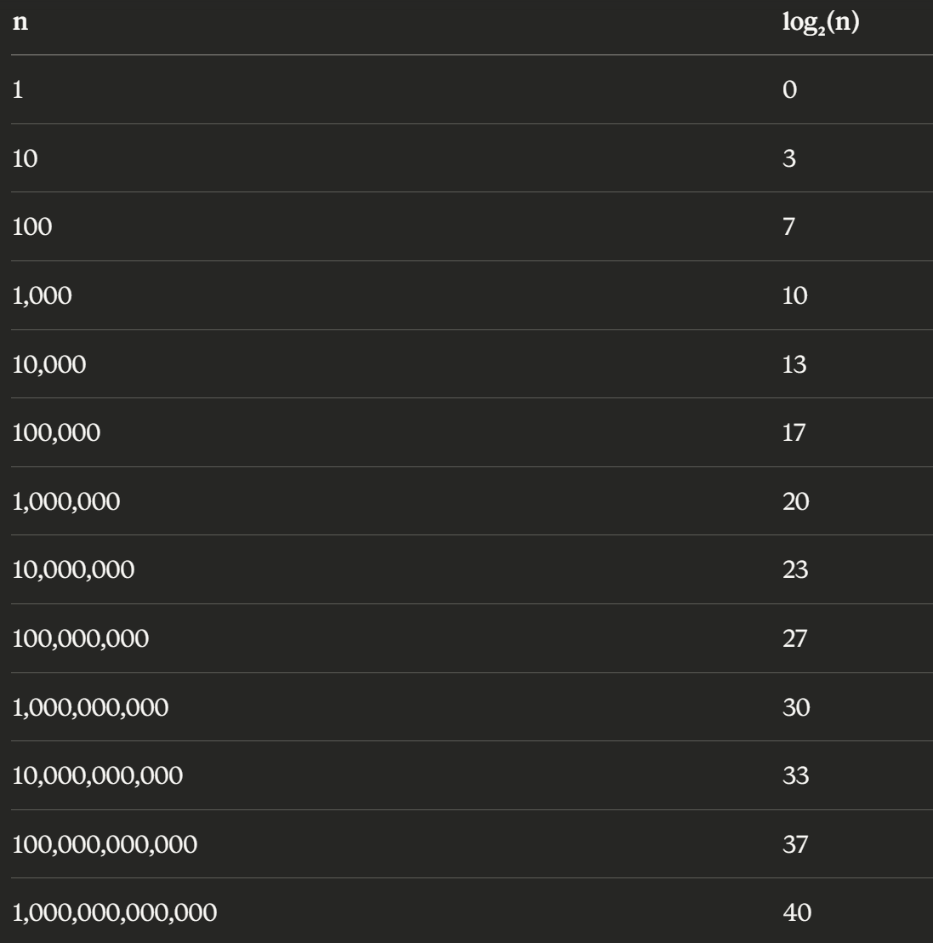
Binary search
- Array needs to be sorted
- Time complexity of O(log(n))
- Is that good? Why?
The idea is to delete half of the possibilities on each
Iteration of the algorithm by looking at the middle
of the array

Slide 4
Time complexity
- Exact runtime
- Exact number of operation the algorithm computes: T(n) = 32*n + 16
- Asymptotic Complexity
- Different kind of Asymptotic Complexities
- Simplified Exact runtime
- Focuses on “The biggest offender”
- T(n) = 32*n + 16 → O(n) = n
- Tells us how long an algorithm will take to compute based on it’s input length

Slide 5
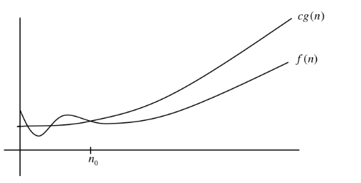
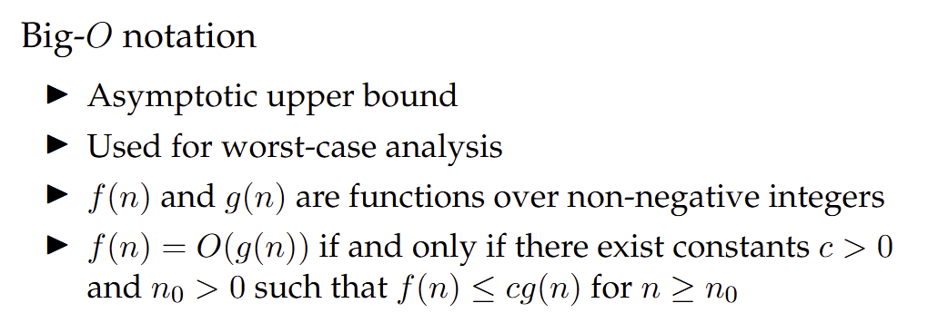
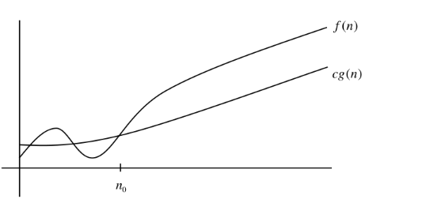
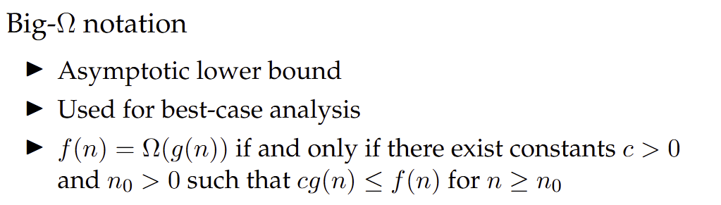
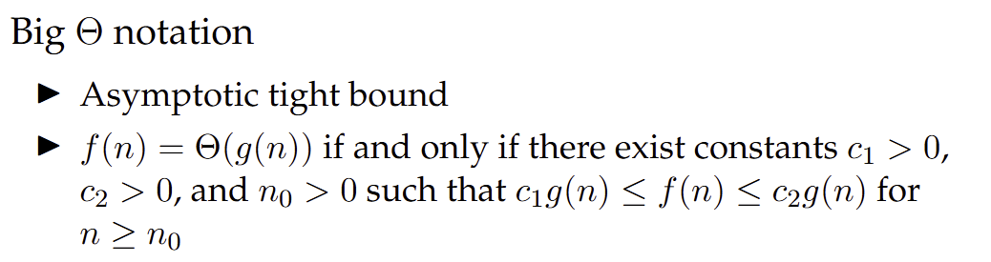
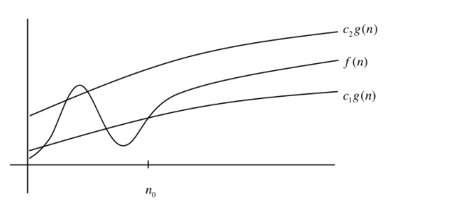
Time complexity
We only care about the behavior of f(n) and g(n) after a certain n₀

Slide 6
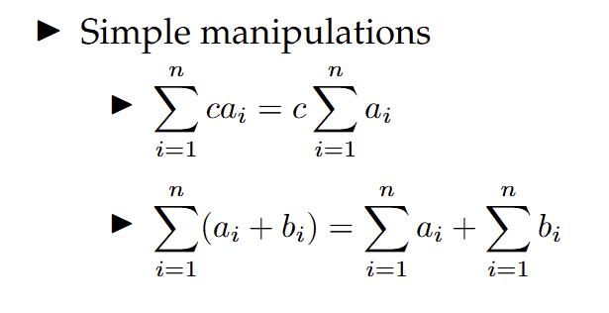
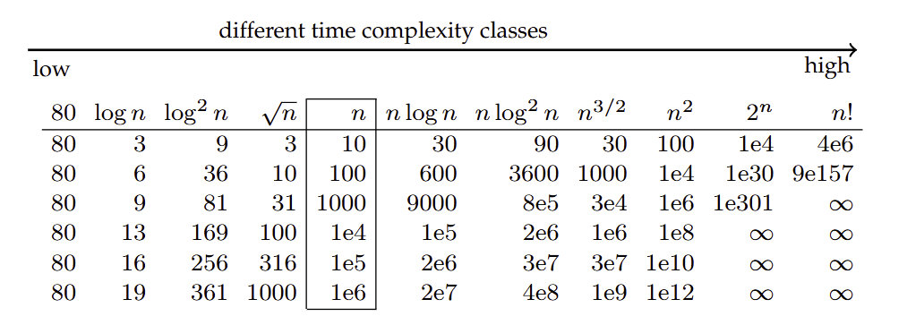
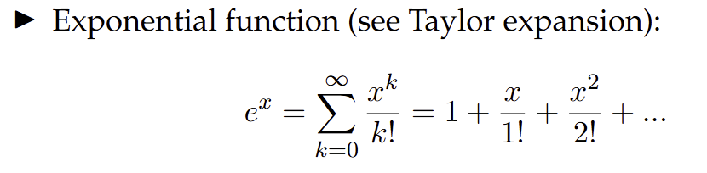
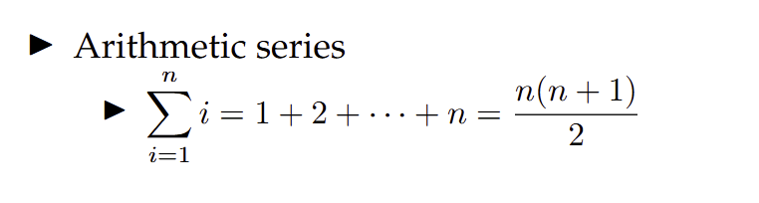
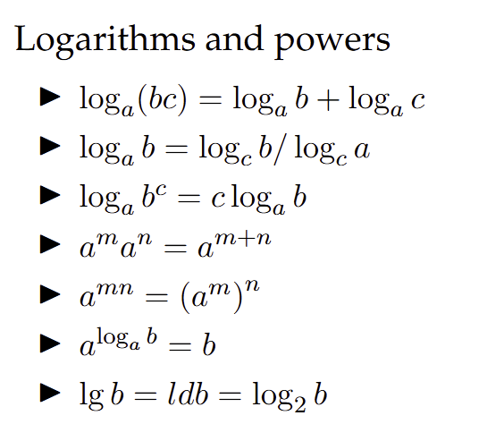
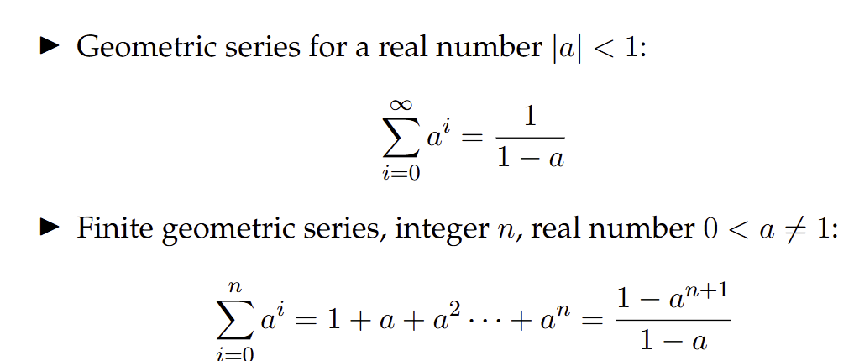
Time complexity (cheat sheet)

Slide 7
Task 1.
- Exercise to familiarize yourself with the binary search
- Look at the solutions, if you still have question ask directly to me or on OLAT

Slide 8
Task 2, 3, 4, 5.
- Use asymptotic complexity
- Use the cheat sheet

Slide 9
Thank you for your attention. If you have any question write in the Olat forum or come up to me.

