Slide 1
Department of informatics
Informatics II
Exercise 4
Grgic Anto

Slide 2
Schedule (Corrected)
Date | Topic
27. Feb | C environment
06. Mar | Ex1(Introduction to C, basic sorting)
13. Mar | Ex2 (Recursion)
20. Mar | Ex3 (Complexity, Correctness)
27. Mar | Ex4 (Divide and Conquer, Recurrence)
03. Apr | NO LAB (Please attend another class) – Spring break
17. Apr | Ex6 (Pointers, Linked Lists)
24. Apr | Ex7(ADTs, Stacks, Queues)
01. May | NO LAB (Please attend another class) – Labor day
08. May | Ex9 (Hash Tables)
15. May | Ex10 (Dynamic Programming)
22. May | Ex11 (Graphs)
29. May | Recap
04. Jun | Exam at Messe 16:00-19:00
*NEXT WEEK THIS EXERCISE CLASS WON’T TAKE PLACE.

Slide 3
Divide and Conquer Algorithms
- Basic Idea:
- Divide the main problem in small, more manageable problems
- Solve the smaller problems
- Combine the solutions of the smaller problems into one for the big problem
- Uses recursion as it’s mainframe
- (Asymptotically) faster than the “Brute force” counterparts
- But requires more memory space (For the recursive calls)
- Time complexity can be calculated with it’s recursive relation

Slide 4
Recursive relation
- Describe the exact runtime of one call
- The exact runtime has a recursive component, calling itself for another input: T(n) = 32*T(n-1) + f(n)
- Asymptotic complexity can be computed with:
- Repeated Substitution
- Substitution Method
- Recursion Tree
- Master Method

Slide 5
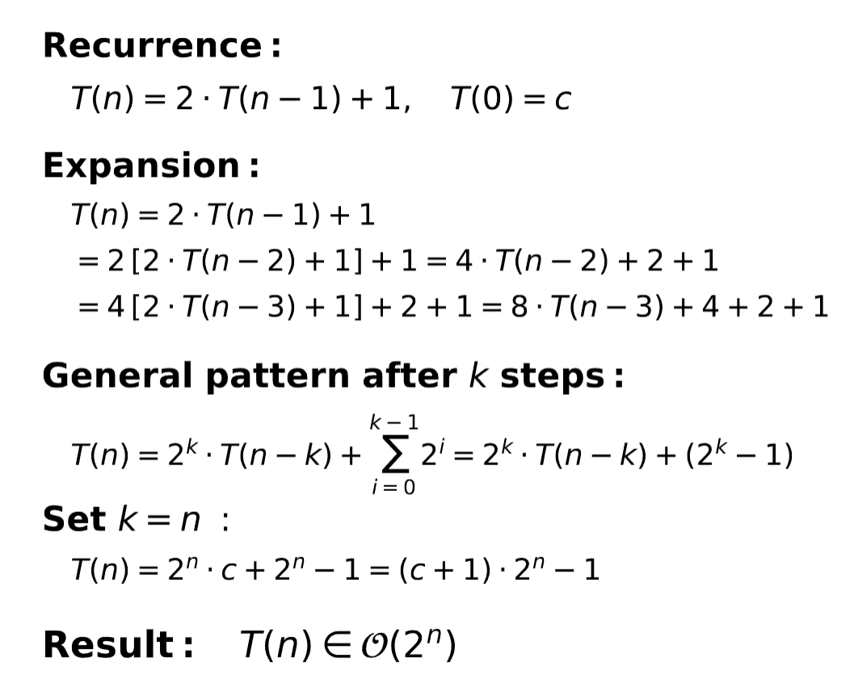
Repeated Substitution
- Not strictly formal but straight forward
- Substitute, and expand until a pattern emerges
- The pattern will depend on another variable (ex. k)
- Set your variable so that the recursive relation for T(n) calls the
base case
- Get the asymptotical complexity

Slide 6
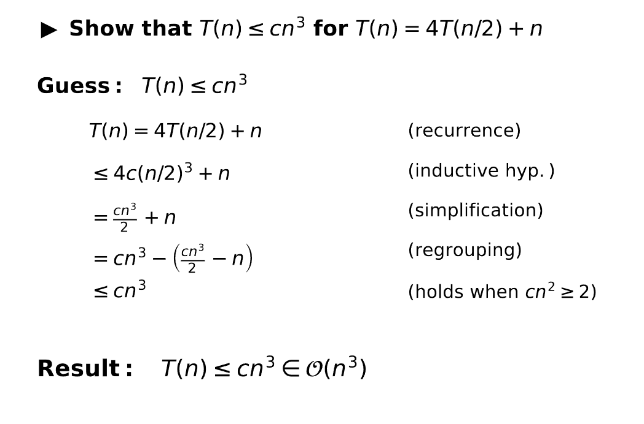
Substitution Method
- More formal, but requires a good guess
- Guess the form of the solution.
- Use induction to prove the solution
- Get the asymptotical complexity
*Note that here we are getting a upper bound. We could use the same process to find a lower bound (es. a constant would be trivial but still correct.)
To find a tight bound we would need to find an upper bound and a lower bound of the same asymptotic complexity.

Slide 7

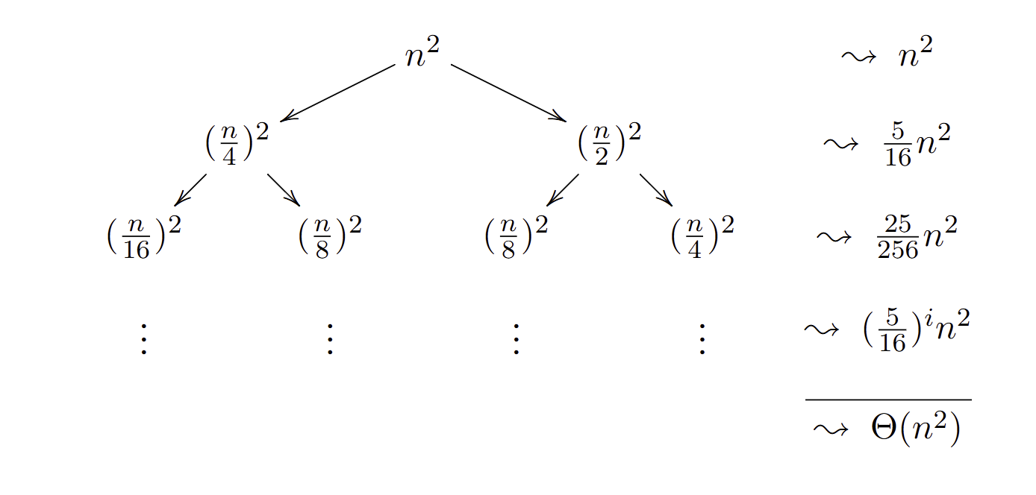
Recursion Tree
- Similar to the repeated substitution but graphical
- Get the basic cost (f(n))
- Expand the tree and add each level cost
- Find a pattern and calculate the asymptotic complexity

Slide 8
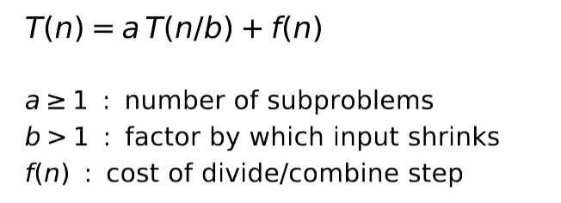
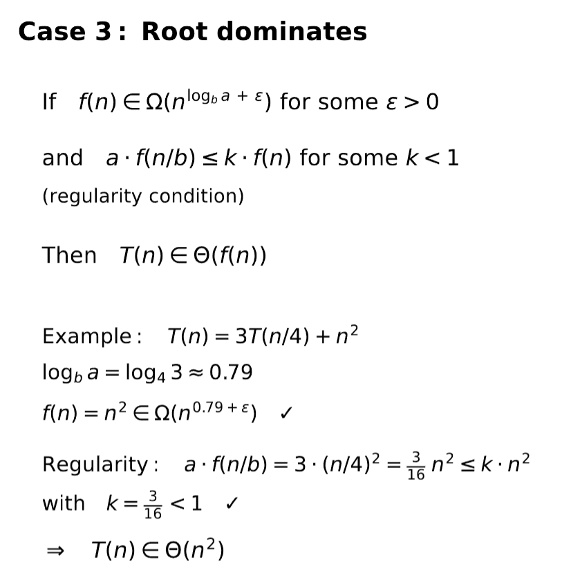
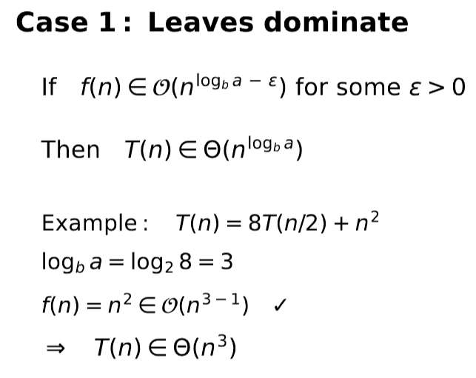
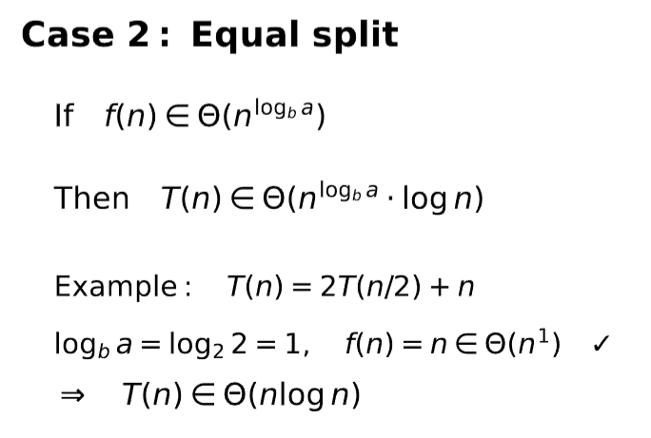
Master method
- The recurrence relation has to be in a specific form:
- Extract a, b and f(n)
- Check each case and simply insert the numbers:

Slide 9
Thank you for your attention. If you have any questions write in the Olat forum or come up to me.

