Slide 1
Department of informatics
Informatics II
Exercise 6
Grgic Anto

Slide 2
Schedule
Date | Topic
27. Feb | C environment
06. Mar | Ex1(Introduction to C, basic sorting)
13. Mar | Ex2 (Recursion)
20. Mar | Ex3 (Complexity, Correctness)
27. Mar | Ex4 (Divide and Conquer, Recurrence)
03. Apr | NO LAB (Please attend another class) – Spring break
17. Apr | Ex6 (Pointers, Linked Lists)
24. Apr | Ex7(ADTs, Stacks, Queues)
01. May | NO LAB (Please attend another class) – Labor day
08. May | Ex9 (Hash Tables)
15. May | Ex10 (Dynamic Programming)
22. May | Ex11 (Graphs)
29. May | Recap
04. Jun | Exam at Messe 16:00-19:00

Slide 3
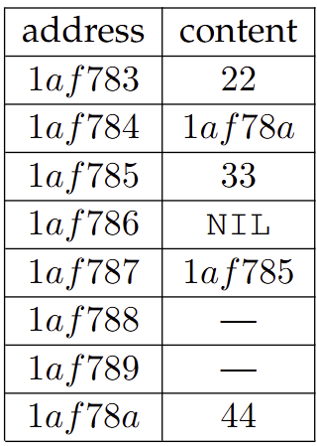
Pointers →
- To understand pointers and their utility it is important to understand how memory works in C
- A memory cell is composed of ADRESS and VALUE
- The Adress is the physical place in the RAM (or CPU) where the value gets saved, the value is it’s content
*Example from the lecture. On the left there is the address (expressed in hexadecimal base) and on the right different kind of values. This model is the one you are expected to know for the exam, but it is a simplification of the reality.

Slide 4
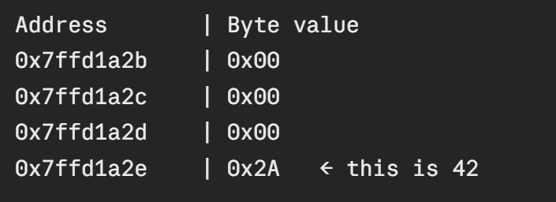
A more correct (but more complex) model
- Each address is a hexadecimal number between 0 and 2*64 – 1 (for 64 bit system).
- The Adress doesn’t occupy any memory, it uses the same concept of the algorithm to find prime number, where one creates an array of length N and if you want to look up if 50 is prime, you look the value at position 50
- Each “Value” cell has size of 1 byte (8 bit) and its itself a hexadecimal number.
- An integer a (4 Bytes) occupies 4 cells
- How does a program know how many cells to read?
When you declare a variable (Or when you pass it to a function) you
always have to specify it’s type. So the program at runtime always
knows the type of the variable and knows how many cells to read and
how to interpret/convert the number it gets (is it a integer, long, char,
array of int, ecc)
- A cell can never be empty!! This is why programs that recovery data
exists and can possibly recover deleted images, texts ecc.
A simple delete operation just “Forgets” the address where data gets
stored, but the data stays there until it gets overwritten by new data.
*0x preceding a number means “in hexadecimal base. 0b preceding a number mean binary.

Slide 5
Passing a variable by value VS by reference
- When passing variable in any language one has two options. Passing by value or by reference.
- Passing by value means that the “Value cell” gets copied and that copy is returned.
- Passing by reference means that the “Adress cell” gets copied and that copy is returned.
- Python always passes by reference (If you want to pass by value you need to manually copy a variable and pass the copy by reference)
- C always passes by value (If you want to pass by reference you need to pass the address)
- This is where pointers come into play

Slide 6
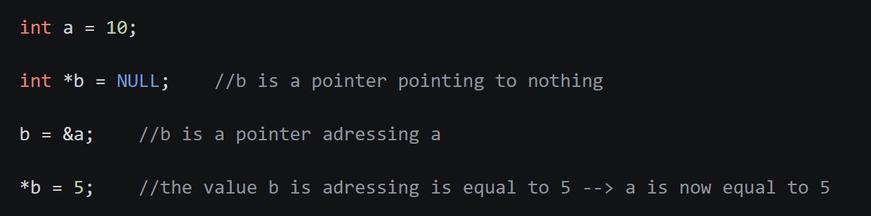
Pointers →
- Pointers are 8 Bytes long positive numbers
- Why are pointer useful? Because C always passes variable by value. Pointers lets you functionally pass a variable by reference.
- Syntax:
- * Has double meaning:
- if used in a declaration it means “This is a pointer”
- if used in an expression it means “Give me the value this pointer is addressing”
- & Can only be used in expressions and it means “Give me the address of this variable”
Since a is an integer (4 Bytes), it occupies 4 cells (1 Byte each).
&a is the address of the first cell (1 Byte). But *&a will give you a 4 bytes number.
That is because at runtime C knows a is an integer, and * operator will look all appropriate cells and combine them into one value

Slide 7
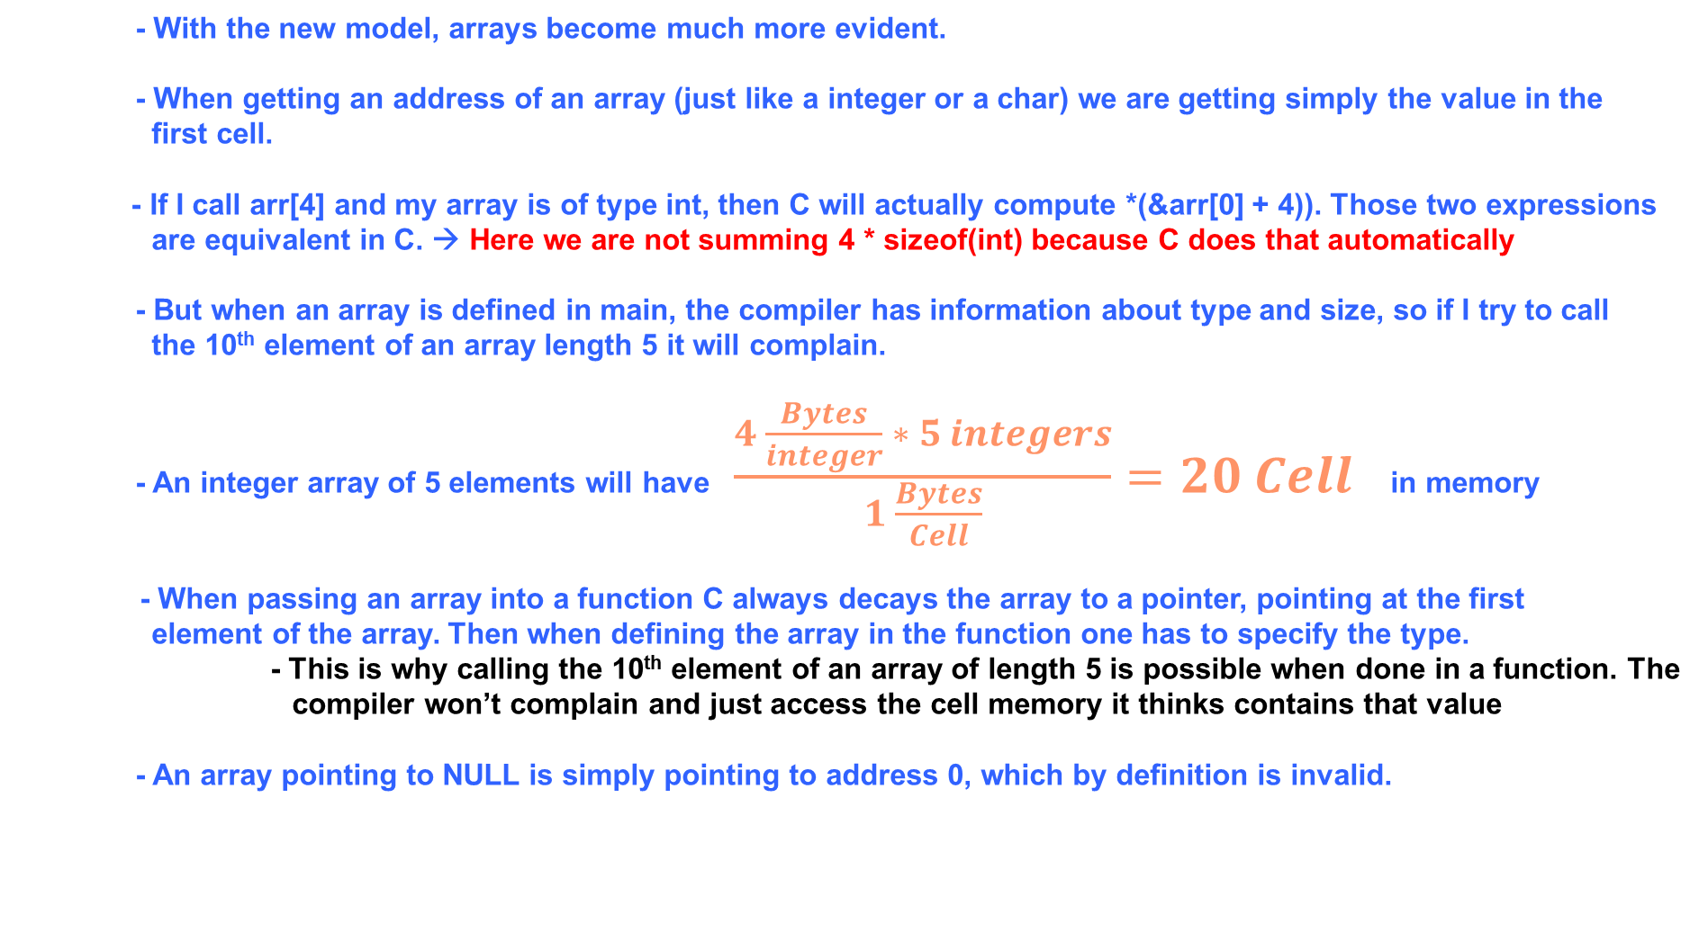
Arrays and Pointers
- With the new model, arrays become much more evident.
- When getting an address of an array (just like a integer or a char) we are getting simply the value in the first cell.
- If I call arr[4] and my array is of type int, then C will actually compute *(&arr[0] + 4)). Those two expressions
are equivalent in C. → Here we are not summing 4 * sizeof(int) because C does that automatically
- But when an array is defined in main, the compiler has information about type and size, so if I try to call the 10th element of an array length 5 it will complain.
- An integer array of 5 elements will have $\frac{4 \frac{Bytes}{integer} ∗ 5 integers}{1 \frac{Bytes}{Cell}}=20 Cell$ in memory
- When passing an array into a function C always decays the array to a pointer, pointing at the first element of the array. Then when defining the array in the function one has to specify the type.
- This is why calling the 10th element of an array of length 5 is possible when done in a function. The compiler won’t complain and just access the cell memory it thinks contains that value
- An array pointing to NULL is simply pointing to address 0, which by definition is invalid.

Slide 8
Malloc and free
- When defining any variable, C automatically hides the memory cells where it saved the value so no other program can overwrite it. But if I am directly working with memory, how can I guarantee that it won’t happen? → Malloc
- Malloc if a function in C that takes as input a number N and returns a pointer to a cell. This pointer points to a cell that has two properties:
- 1. the next N cells (in order) are free (not used by other programs).
- 2. the next N cells’s address will be hidden and other programs won’t be able to access them.
- When a program has done it’s job, C automatically set the cells it defined with variable to be free again, so other program can find and use them again. For memory cell you allocated with Malloc, you need to do that manually. → free
- Free is a function that take as input a variable and returns nothing.
- The memory cell holding the variable’s value will be visible again and other programs will have access to them.
- If the memory doesn’t get freed it will not be available to other programs until the ram gets reset (most commonly with a computer restart)

Slide 9
Structs and pointers
- A struct in C is a simple way to store data, they allow you to create your own variable type and use it.
- If you have a pointer to a struct and you want to access one of its fields you would have to do *(struct-pointer).field.
C has a notation to type this faster: struct -> next. This is especially useful when doing something like:
(*(*(*node).next).next).key or much more clear with the arrow notation: node->next->next->key

Slide 10
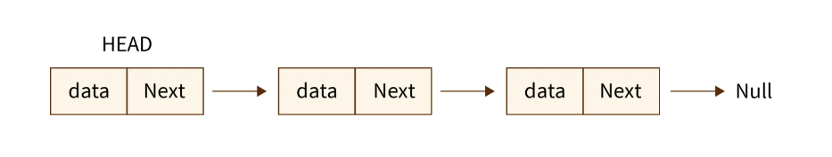
Linked lists
- A linked list is a list of nodes.
- Each node has at least two fields:
- The value associated to the node
- A pointer to the next node
- There are many types of linked lists with different properties
- Linked list
- Doubly linked list
- Circular linked lists
- Doubly circular linked list
- Etc.

Slide 11
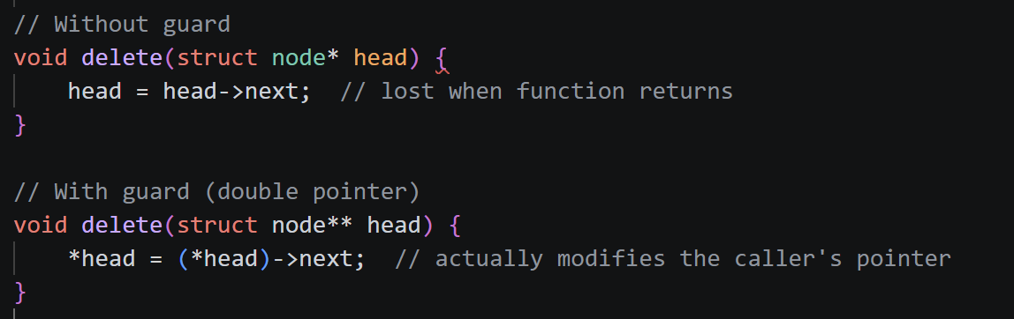
Guard/sentinel/dummy
- A guard is useful when passing a pointer in a function and wanting to modifying it
- A guard ensures that the modification of the pointer is propagated outside of the function’s scope

Slide 12
Exercises:
Task1: Getting familiar with pointer syntax
Task2: Starting using pointers
Task3: More pointers and structs

Slide 13
Thank you for your attention. If you have any questions write in the Olat forum or come up to me.

