Slide 1
Department of informatics
Informatics II
Exercise 7
Grgic Anto

Slide 2
Schedule
Date | Topic
27. Feb | C environment
06. Mar | Ex1(Introduction to C, basic sorting)
13. Mar | Ex2 (Recursion)
20. Mar | Ex3 (Complexity, Correctness)
27. Mar | Ex4 (Divide and Conquer, Recurrence)
03. Apr | NO LAB (Please attend another class) – Spring break
17. Apr | Ex6 (Pointers, Linked Lists)
24. Apr | Ex7(ADTs, Stacks, Queues)
01. May | NO LAB (Please attend another class) – Labor day
08. May | Ex8 (Binary (Search) Tree, AVL Tree)
15. May | Ex9 (Hash Tables)
22. May | Ex10 (Dynamic Programming)
29. May | Ex11 (Graphs)
04. Jun | Exam at Messe 16:00-19:00
The recap session has been shifted to next week!!
All topics from next week onwards will be discussed one week later!!
Next week on Friday is Labor day. If you want to participate in the recap session please visit another Lab!

Slide 3
Abstract Data Types (ADTs)
- ADTs are a mathematical abstract model of a data type
- ADTs describe the structure of a data type, which operation are available and computable and how those operation should behave (in terms of preconditions, postconditions, input/output)
- ADTs do NOT specify the implementation of the data type NOR the implementation of the operation (Example of
abstraction in software design)
- ADTs are the blueprint of a class, it tells you what data the class represent, which operations are available and how
the operation should behave, then the class implements the blueprint in concreate code.

Slide 4
Staks and queues
- Both are data structure used to hold data
- The main difference between them is how insertion/extraction work.
- Stacks: LIFO (Last In, First Out). Last element inserted into the stack is the first to get extracted.
- Stacks have one point of access, insertion is called push, extraction is called pop, the fist element to get extracted is called top.
- Queues: FIFO (First In, First Out). First element inserted into the queue is the first to get extracted.
- Queue have two point of access, insertion is called enqueue, extraction is called dequeue, the
first element to get extracted is called front.
- The basic operation they support are:
- push(e) / enqueue(e): Puts element e in the insertion point of access (top / rear)
- pop() / dequeue(): Takes element from extraction point of access (top / front), deletes it from the structure
and returns it.
- top() or peek()/ front(): Returns the element from extraction point of access (top / front) WITHOUT deleting
it from the structure.
- isEmpty(): Returns true is the structure is empty, false otherwise.

Slide 5
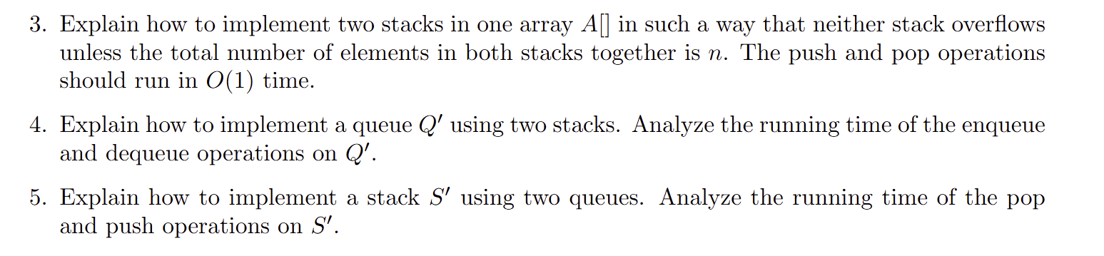
Exercises:
Task1: Creative use of Queue and Stacks

Slide 6
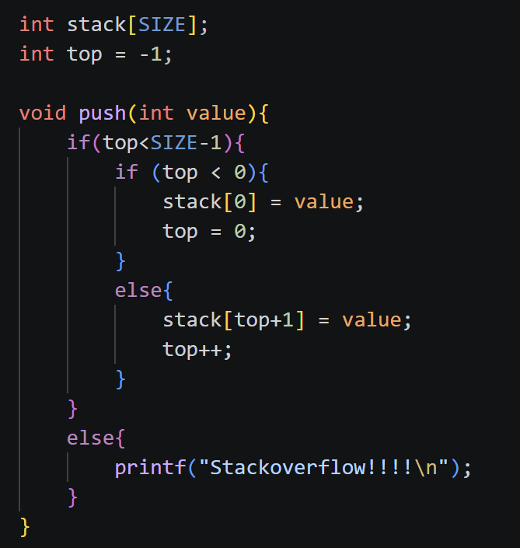
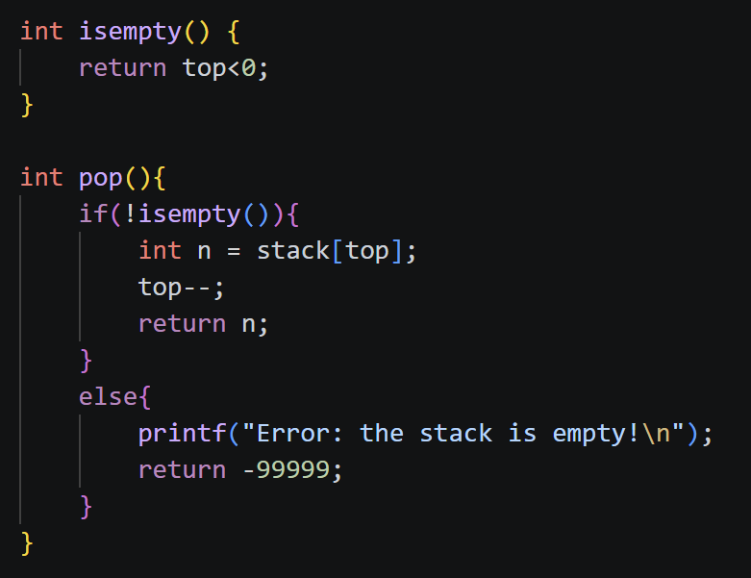
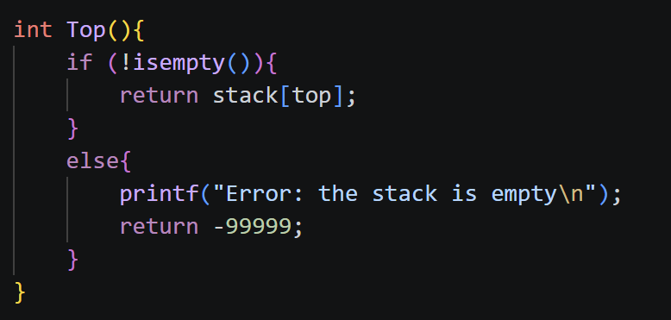
Exercises:
Task 2.1: Stacks with arrays

Slide 7
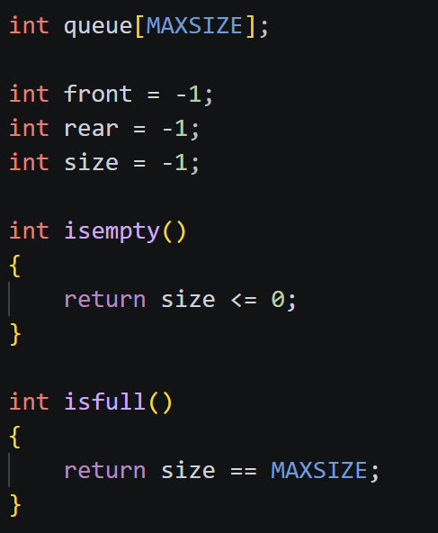
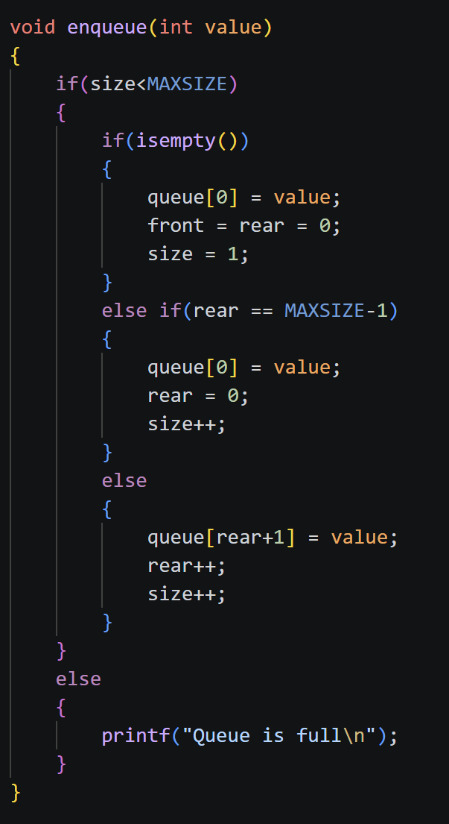
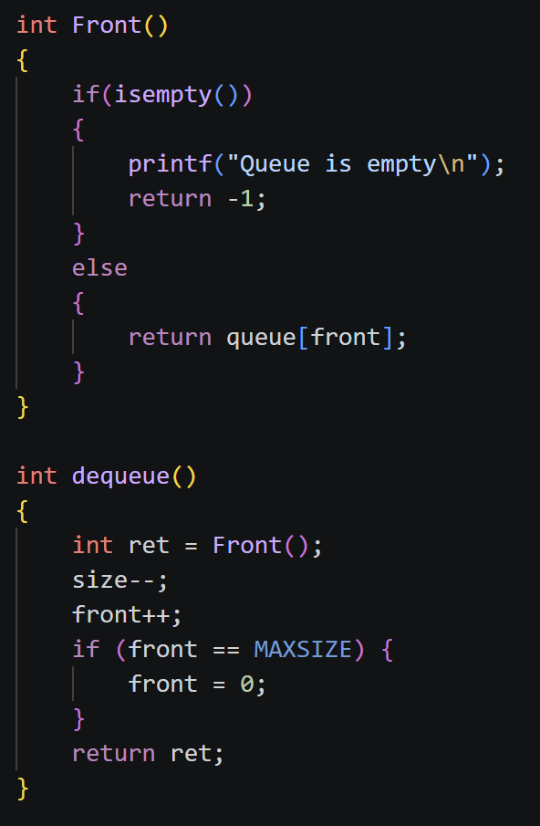
Task 2.2: Queues with arrays

Slide 8
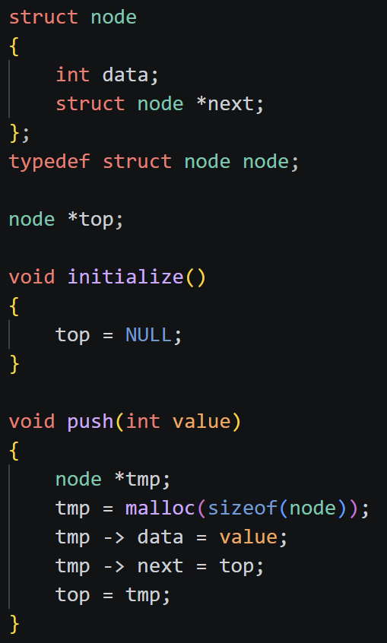
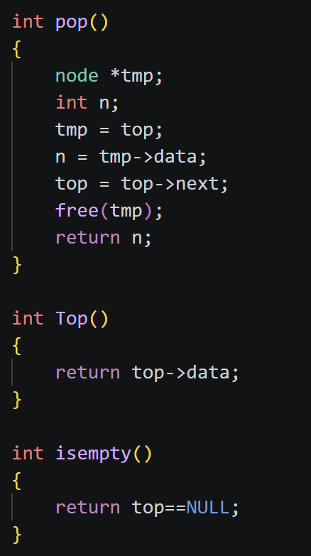
Task 2.3: Stacks with linked lists

Slide 9
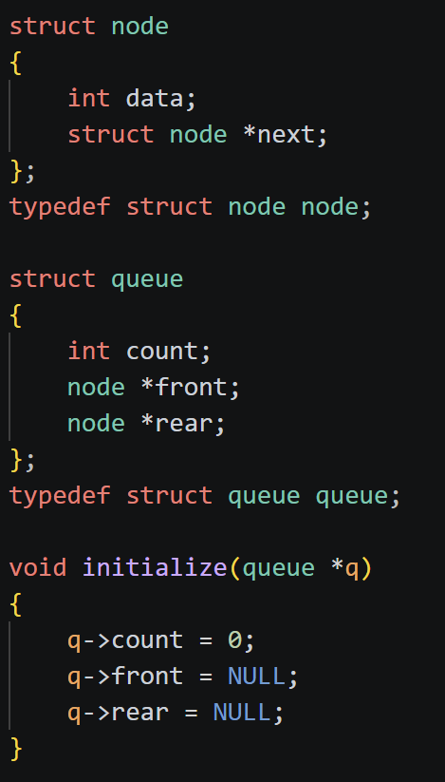
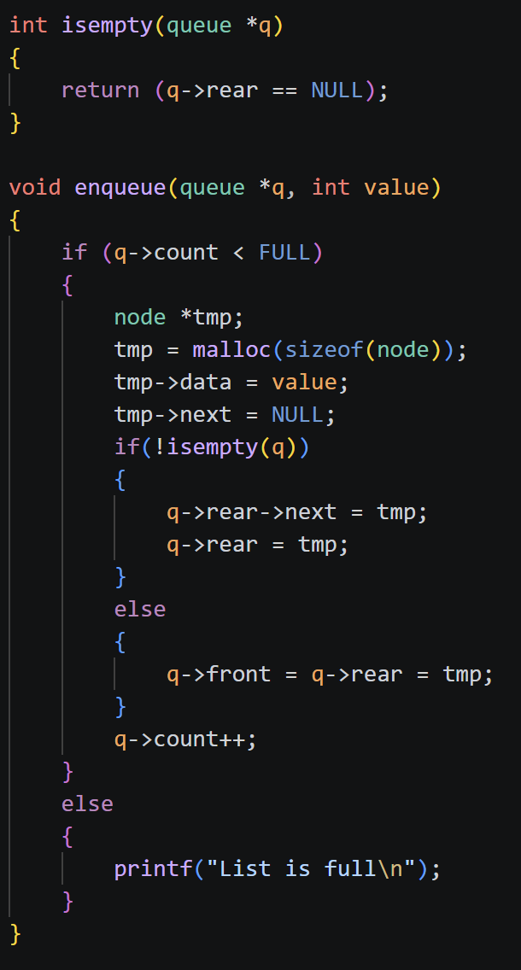
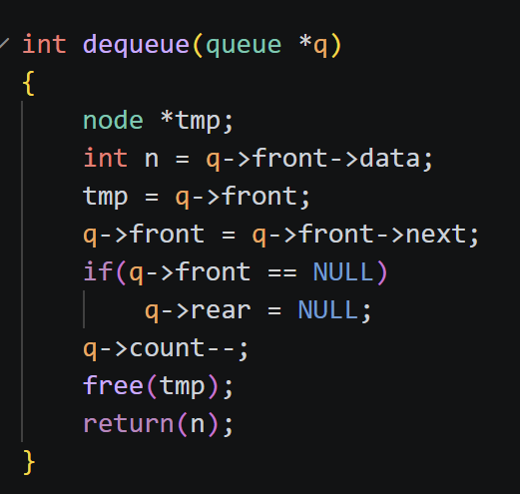
Task 2.4: Queue with linked lists

Slide 10
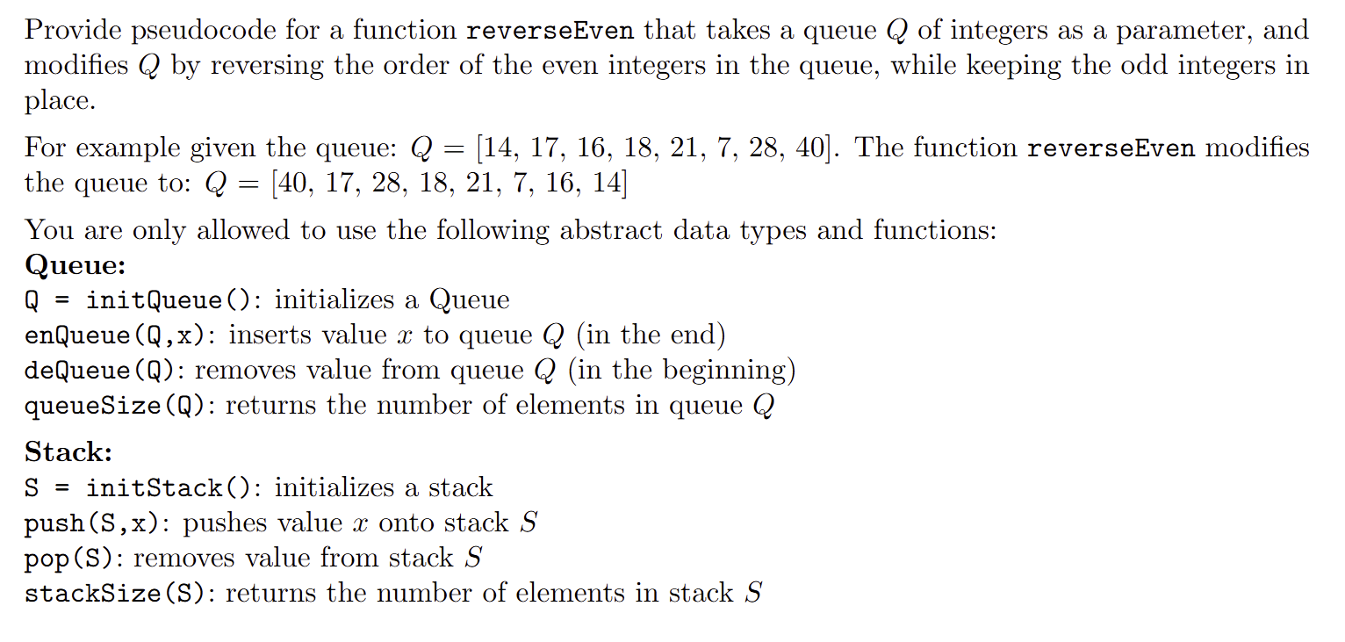
Task 3: Using Queue and Stacks in creative ways

Slide 11
Thank you for your attention. If you have any questions write in the Olat forum or come up to me.

