Slide 1
Department of informatics
Informatics II
Exercise 0
Grgic Anto

Slide 2
Schedule
Date | Topic
27. Feb | C environment
06. Mar | Ex1(Introduction to C, basic sorting)
13. Mar | Ex2 (Recursion)
20. Mar | Ex3 (Complexity, Correctness)
27. Mar | Ex4 (Divide and Conquer, Recurrence)
03. Apr | NO LAB (Please attend another class) – Spring break
17. Apr | Ex6 (Pointers, Linked Lists)
24. Apr | Ex7(ADTs, Stacks, Queues)
01. May | NO LAB (Please attend another class) – Labor day
08. May | Ex9 (Hash Tables)
15. May | Ex10 (Dynamic Programming)
22. May | Ex11 (Graphs)
29. May | Recap
04. Jun | Exam at Messe 16:00-19:00
*I will always try to finish at least 10-15 min before the official time so you have time to commute to Irchel.

Slide 3
What is Informatics II?
- Very different from Informatics I
- It is not a C course.
- You are already expected to know the basics of programming (What you learned in informatics I).
- You are expected to learn C on your own
- There are multiple tools online (Youtube videos, Stack overflow, Forums, AI).
- You will learn what you need for the exam by working on the weekly assignments.
- You are expected to be able to write in PseudoCode
- I encourage you to write all assignment codes in Pseudocode before implementing it in C.
- Algorithms and data structures are the primary focus of this course
- Simply reading the algorithm in class and understanding the solutions of the exercises is probably not going to be enough to pass this course. You are expected to apply the algorithms in the specific situation and adapt them to satisfy the requirements of the tasks. Staying up to date with the lectures and doing the assignment alone and with effort is the best way to train the skills you are going to need for the exam.

Slide 4
What is Informatics II?
- The exam will be pen and paper, no additional material is allowed.
- You will need to write code (C and Pseudocode) by hand.
- No obligatory attendance for class nor for exercises. No Handing-in exercises.
- The grade is 100% the exam grade.

Slide 5
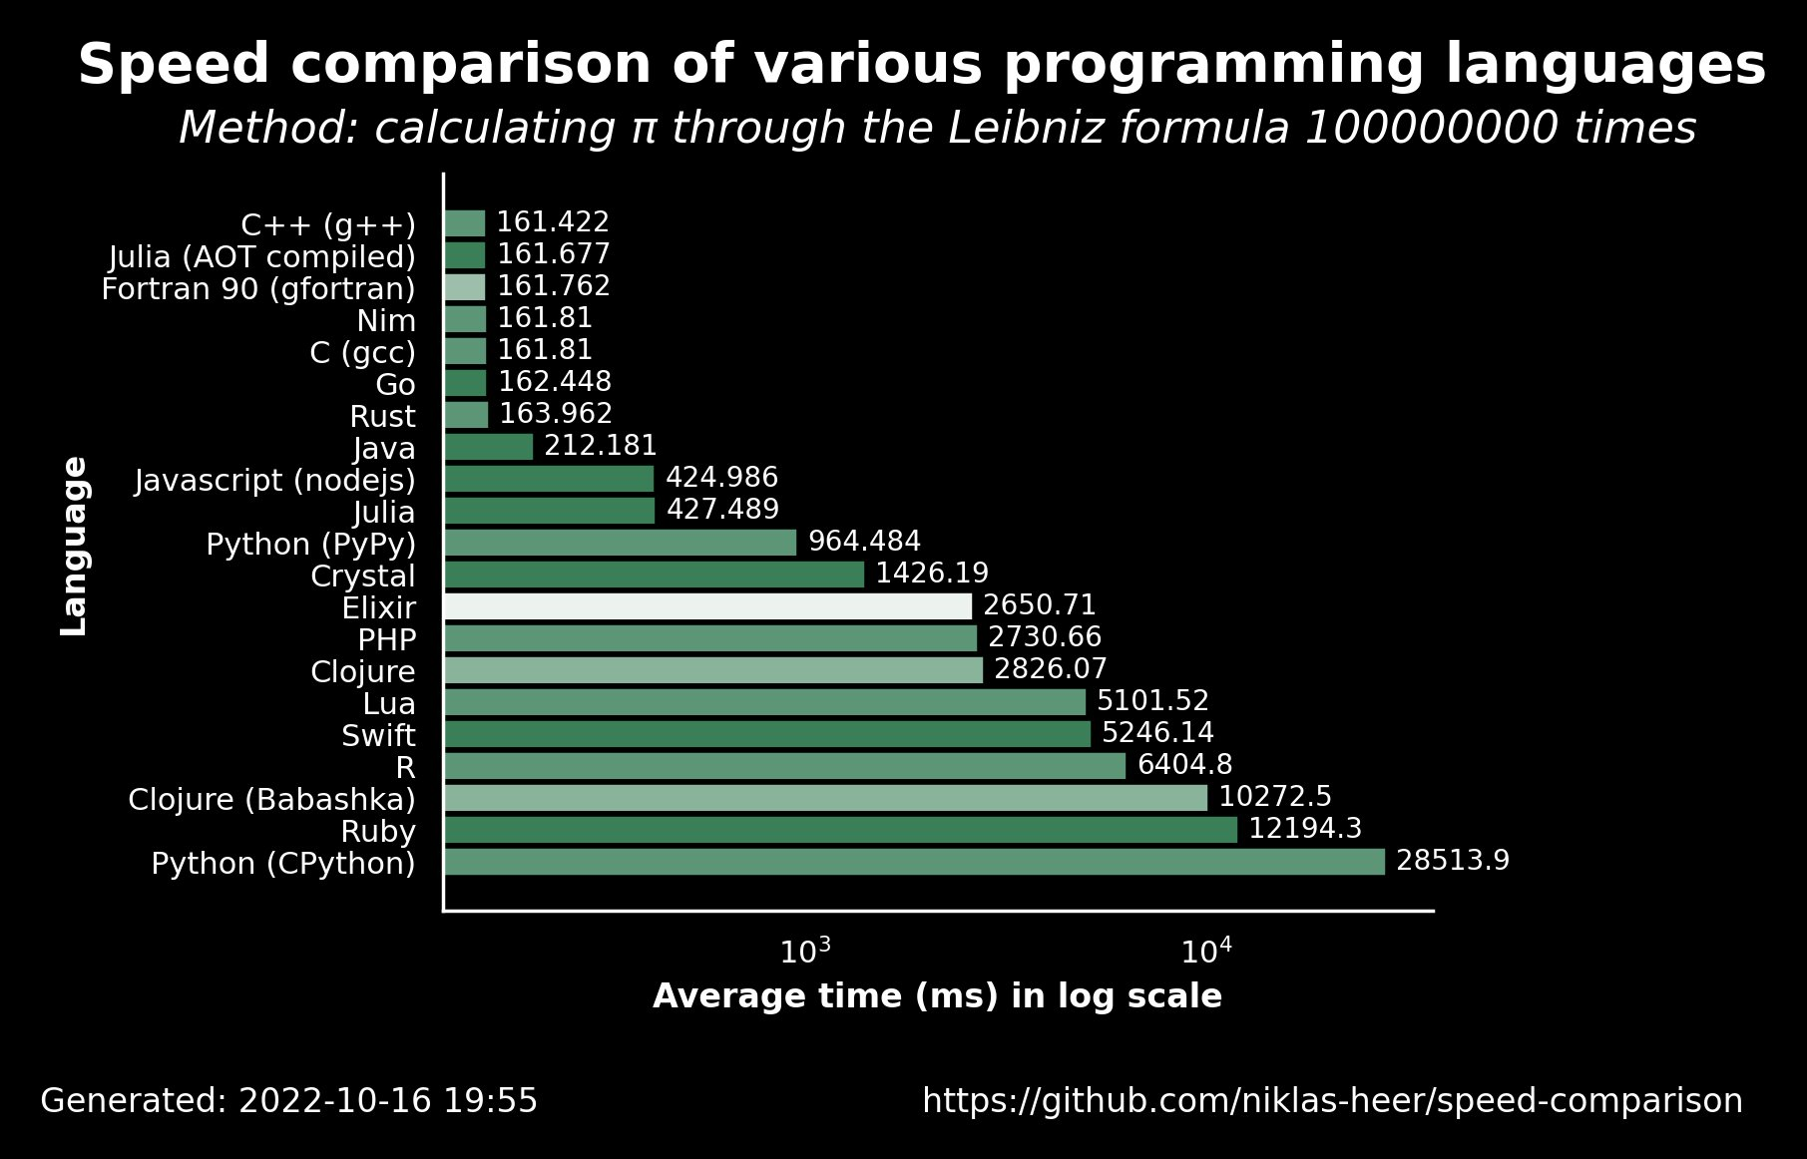

What is C?
- C is very fast (Compared to python).
- C needs to by compiled, then executed.
- Compiled: Translated into machine code (code CPU can read
and execute).
- Executed: The code runs and (hopefully) does what we
wrote it to do.
- C gives much more freedom than Python to work with data
- (More of it in the pointers lecture).
- C is much more strict than Python.
- Type declaration, semicolons, Array length declaration, ecc.

Slide 6
Task 1.
- MAC Users:
- You should have gcc already installed. To check open a terminal and type “gcc –version”.
- If you see a number version you are good to go.
- Windows Users:
- Go to https://www.msys2.org/ and follow the steps.
- Linux Users:
- You already know what you are doing.
If you are having any problems please come up to me.

Slide 7
Task 2.
- Compile and run the file “search.c”.
- What does it output?
- Can you explain why?

Slide 8
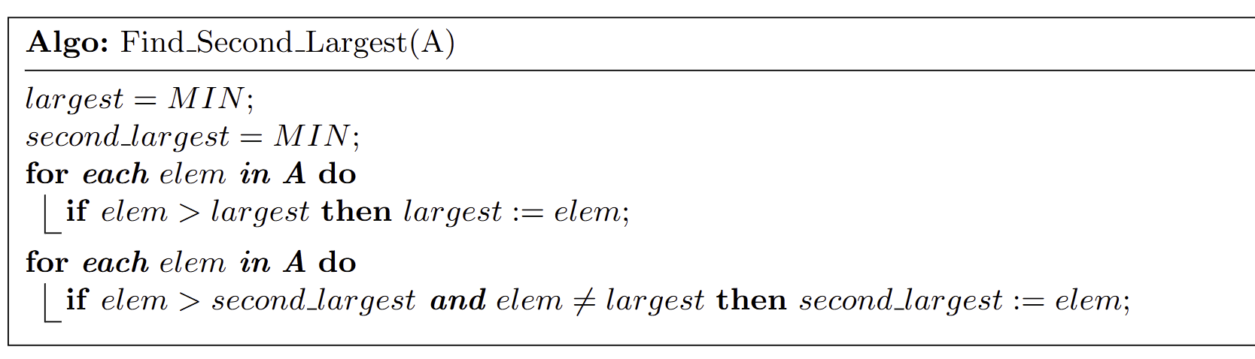
Task 3.
Anyone has any idea how to make it more efficient?

Slide 9
Task 4.
- Here is not asked to write a Pseudocode, but it’s always a good idea to do so.
- How do we write a matrix?
- What does it mean “Nested loop”?

Slide 10
Thank you for your attention. If you have any question write in the Olat forum or come up to me.

