Slide 1
Department of informatics
Informatics II
Exercise 1
Grgic Anto

Slide 2
Schedule (Corrected)
Date | Topic
27. Feb | C environment
06. Mar | Ex1(Introduction to C, basic sorting)
13. Mar | Ex2 (Recursion)
20. Mar | Ex3 (Complexity, Correctness)
27. Mar | Ex4 (Divide and Conquer, Recurrence)
03. Apr | NO LAB (Please attend another class) – Spring break
17. Apr | Ex6 (Pointers, Linked Lists)
24. Apr | Ex7(ADTs, Stacks, Queues)
01. May | NO LAB (Please attend another class) – Labor day
08. May | Ex9 (Hash Tables)
15. May | Ex10 (Dynamic Programming)
22. May | Ex11 (Graphs)
29. May | Recap
04. Jun | Exam at Messe 16:00-19:00

Slide 3
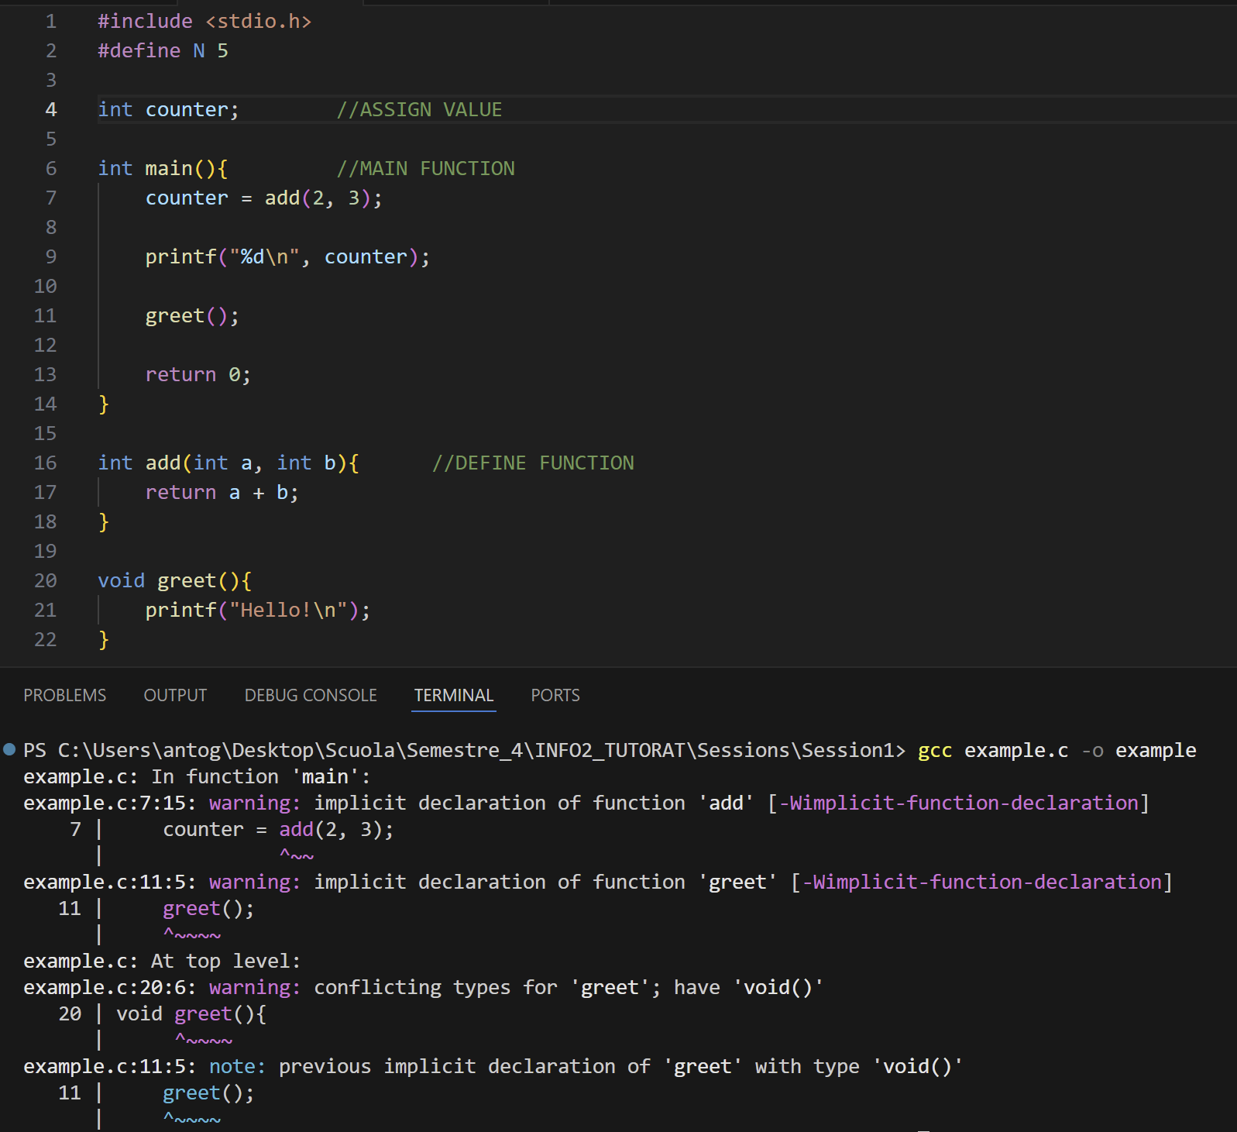
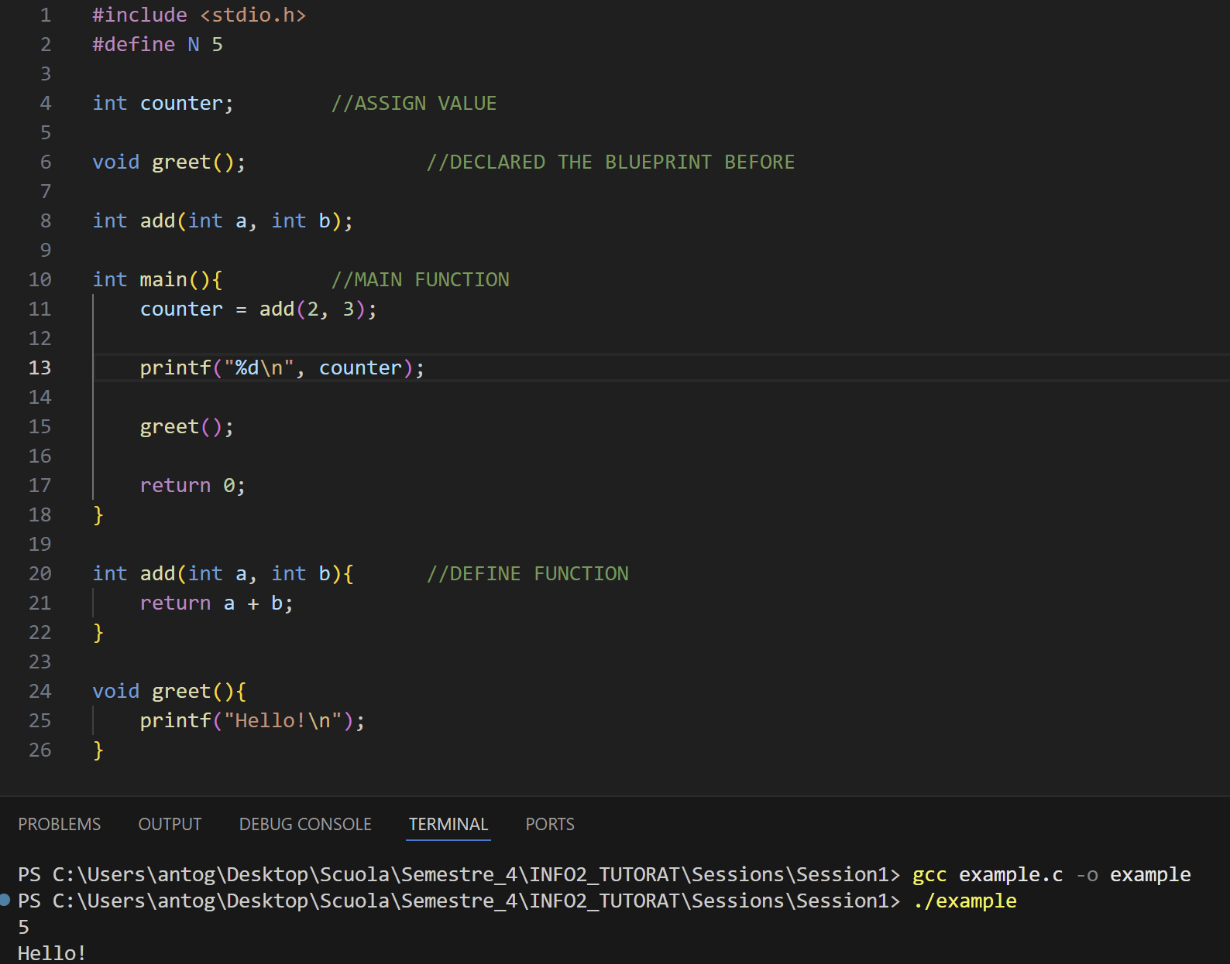
From last week:
Either declare the function before the main, or define it completely before!!

Slide 4
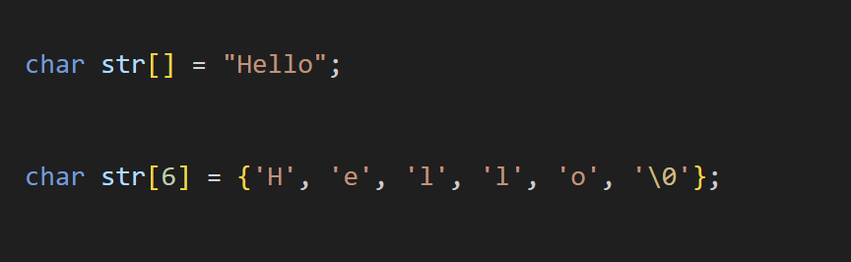
From last week:
Equivalent, but the first option is easier to write

Slide 5
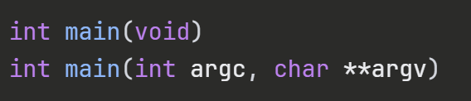

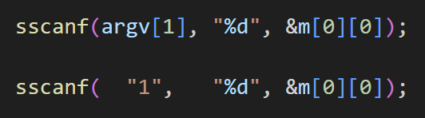
More c syntax
There are two standard main signatures
argc = the length of the imput.
**argv = a pointer to pointer of chars, or an array of pointer to chars, or an array of strings.
argc = 5
argv[0] = “./program”
argv[1] = “1”
.
.
.
argv[4] = “4”
*Note that argv[i] are not integer but chars, so if you want to use them as numbers you need to convert them to integers.
We will come back to this example once pointer are seen in class!

Slide 6
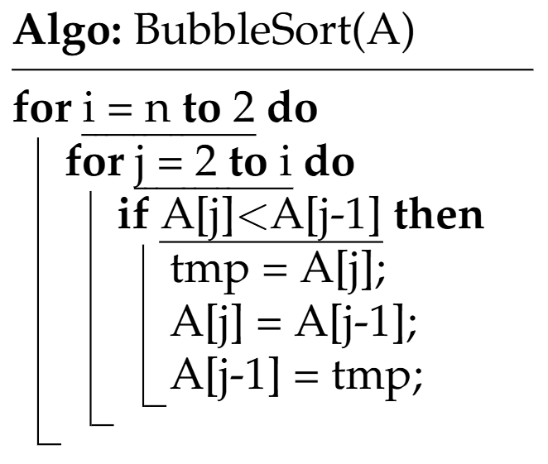
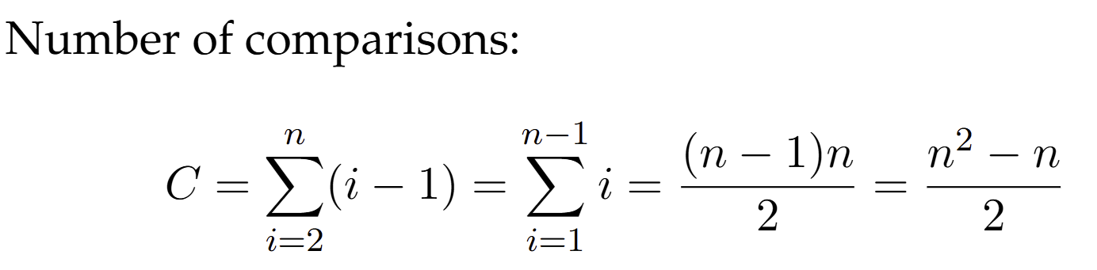
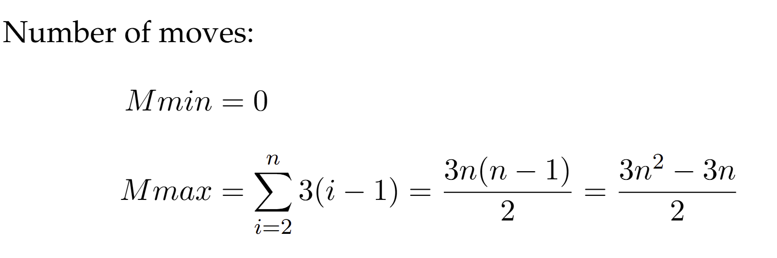
Bubble sort

Slide 7
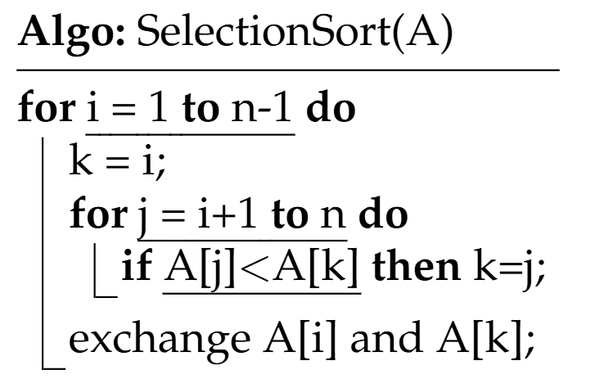
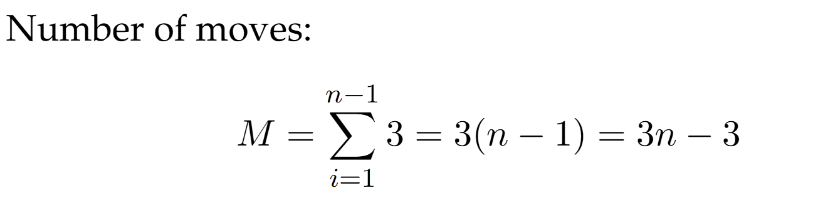
Selection sort

Slide 8
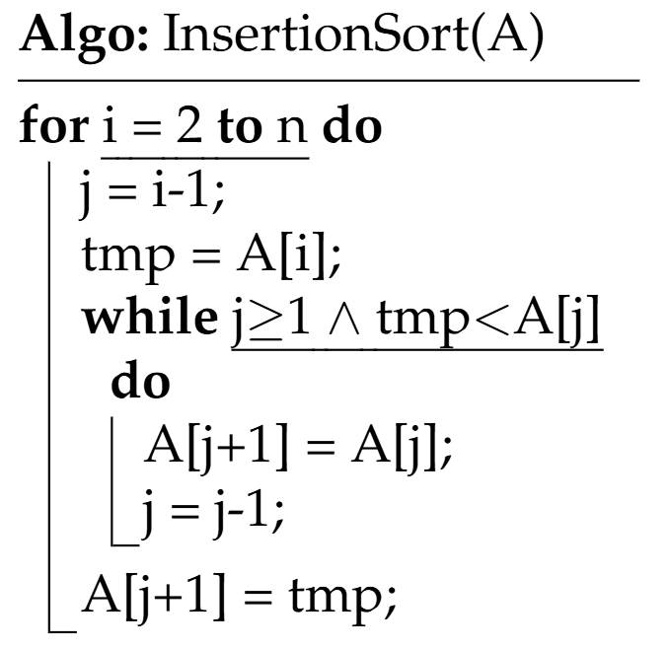
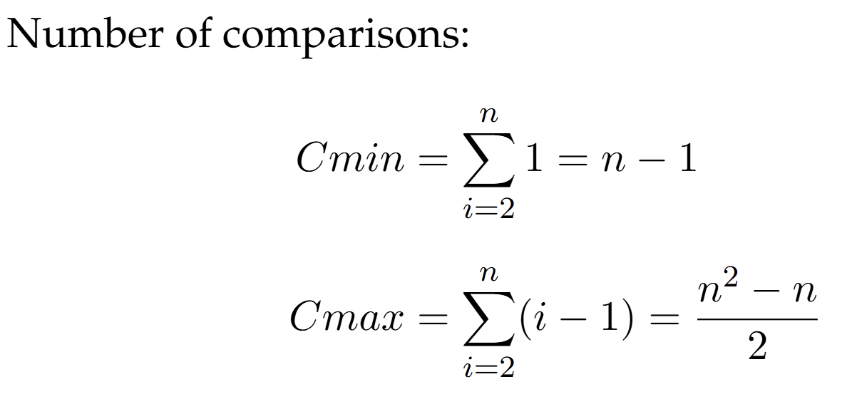
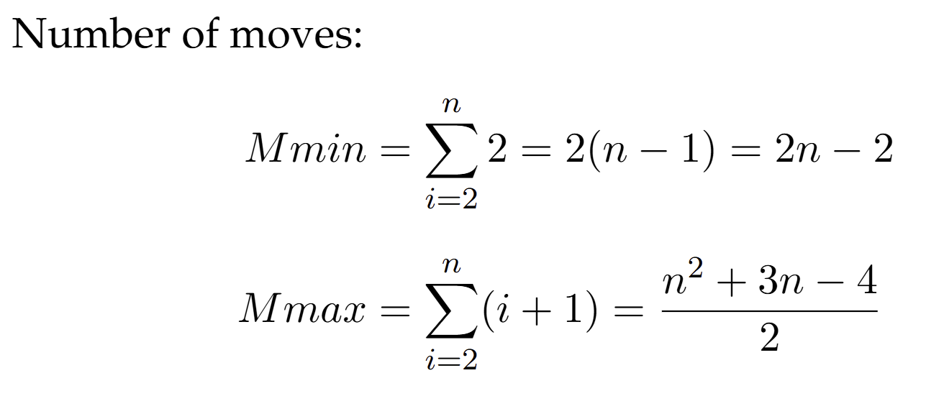
Insertion sort

Slide 9
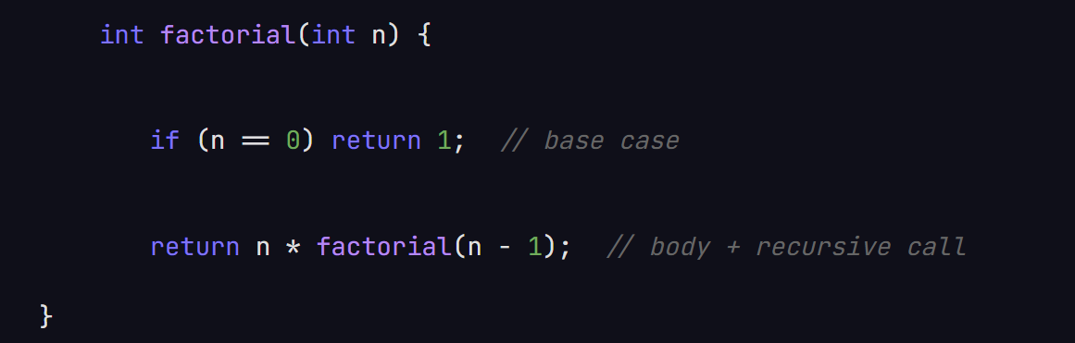
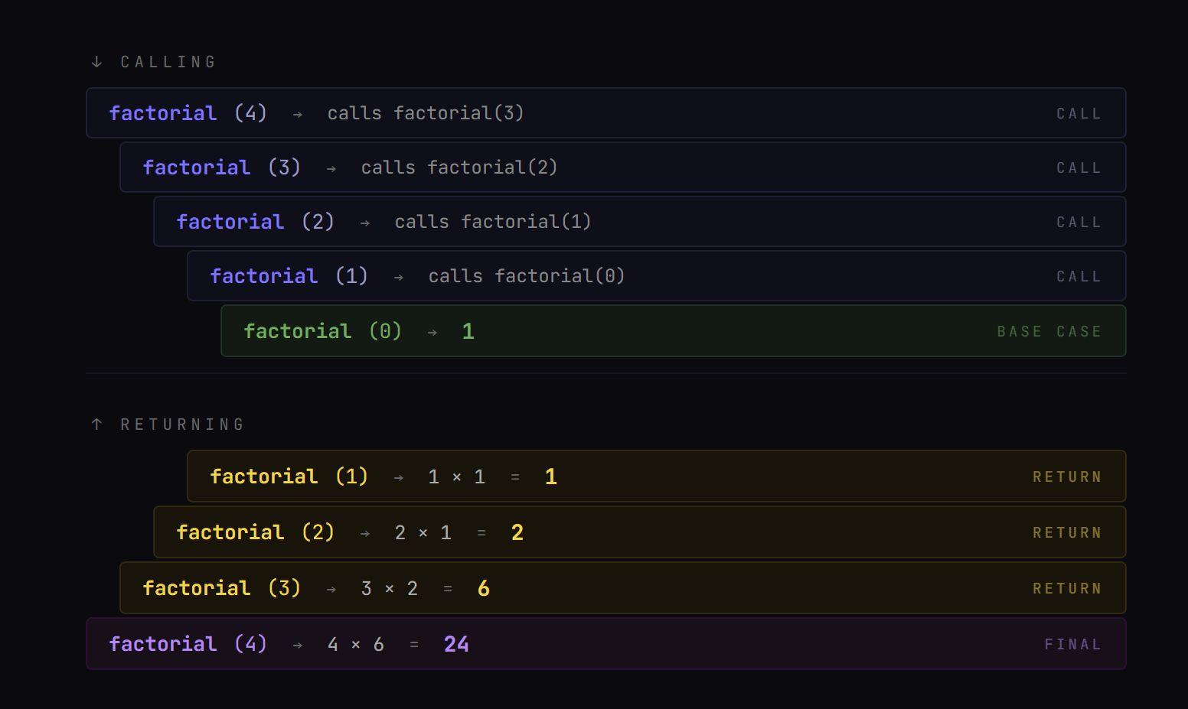
Recursion
Base case: A simple value is returned. The calling “loop” stops and the returning “loop” starts.
Body: Some kind of operation get applied (Often to the r recursive call’s returning value).
Recursive call: The function calls itself with a parameter that depends on the parameter of the current iteration.

Slide 10
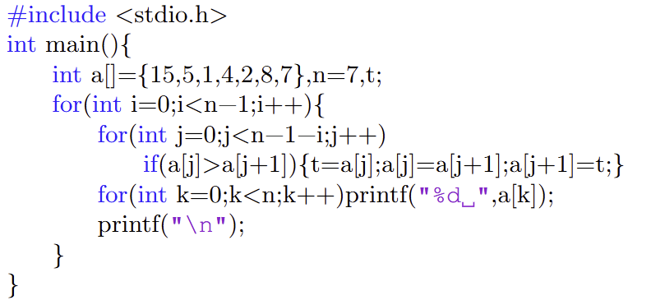
Task 1.
Anyone has any idea how to make it more efficient?
-How would you change the algorithm if:
-You wanted to start from the right side?
-You wanted to order it in descending order?
-you wanted to star from the right side and order it in descending order?

Slide 11
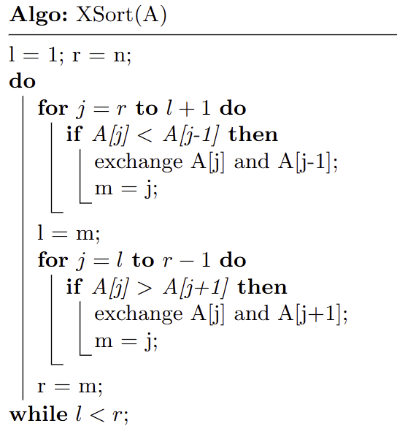

Task 2.
- Write down the values you know at the beginning.
- Write down the values after each loop.

Slide 12
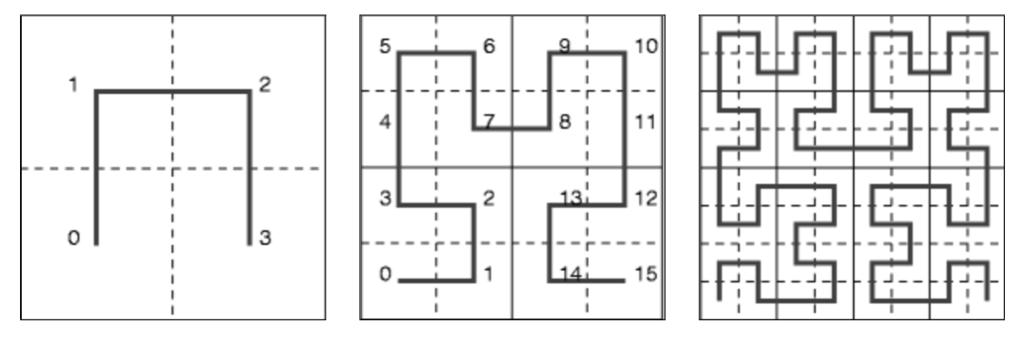
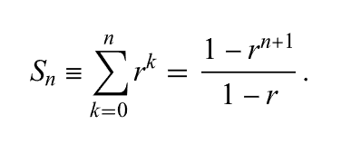
Task 3.
- Start simple and abstract.
- Try to find a pattern
- Add specific values later

Slide 13
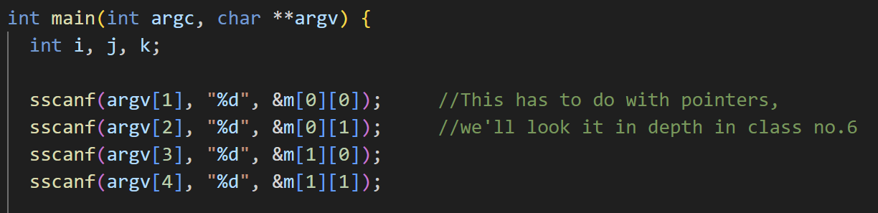
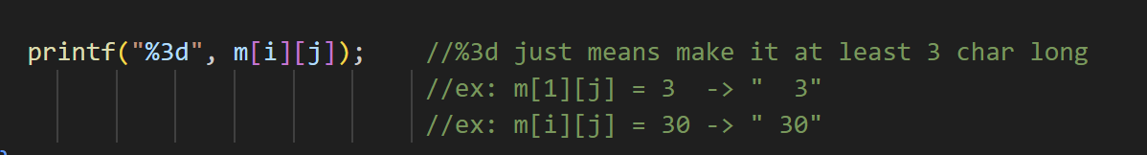
Task 4.
- Simple task to get you familiar with c

Slide 14
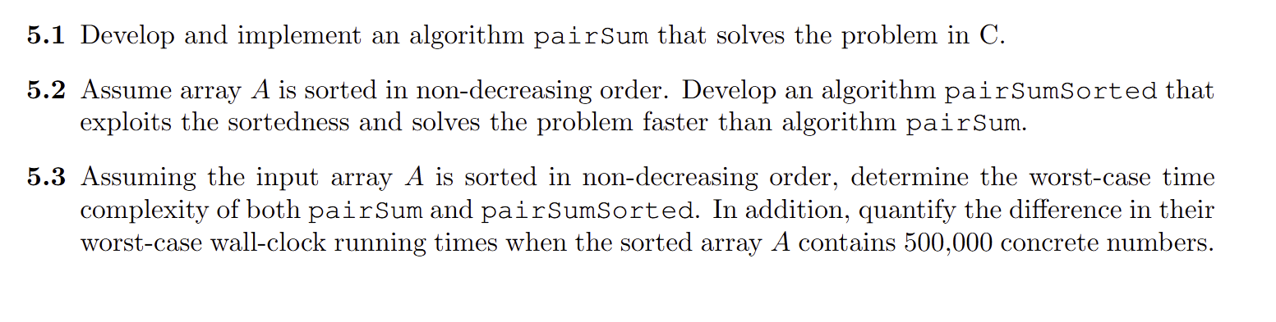
Task 5.

Slide 15
Thank you for your attention. If you have any question write in the Olat forum or come up to me.

