Slide 1
Department of informatics
Informatics II
Exercise 2
Grgic Anto

Slide 2
Schedule (Corrected)
Date | Topic
27. Feb | C environment
06. Mar | Ex1(Introduction to C, basic sorting)
13. Mar | Ex2 (Recursion)
20. Mar | Ex3 (Complexity, Correctness)
27. Mar | Ex4 (Divide and Conquer, Recurrence)
03. Apr | NO LAB (Please attend another class) – Spring break
17. Apr | Ex6 (Pointers, Linked Lists)
24. Apr | Ex7(ADTs, Stacks, Queues)
01. May | NO LAB (Please attend another class) – Labor day
08. May | Ex9 (Hash Tables)
15. May | Ex10 (Dynamic Programming)
22. May | Ex11 (Graphs)
29. May | Recap
04. Jun | Exam at Messe 16:00-19:00

Slide 3
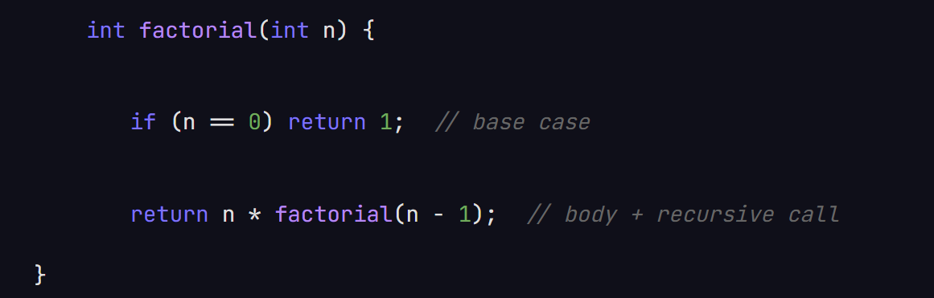
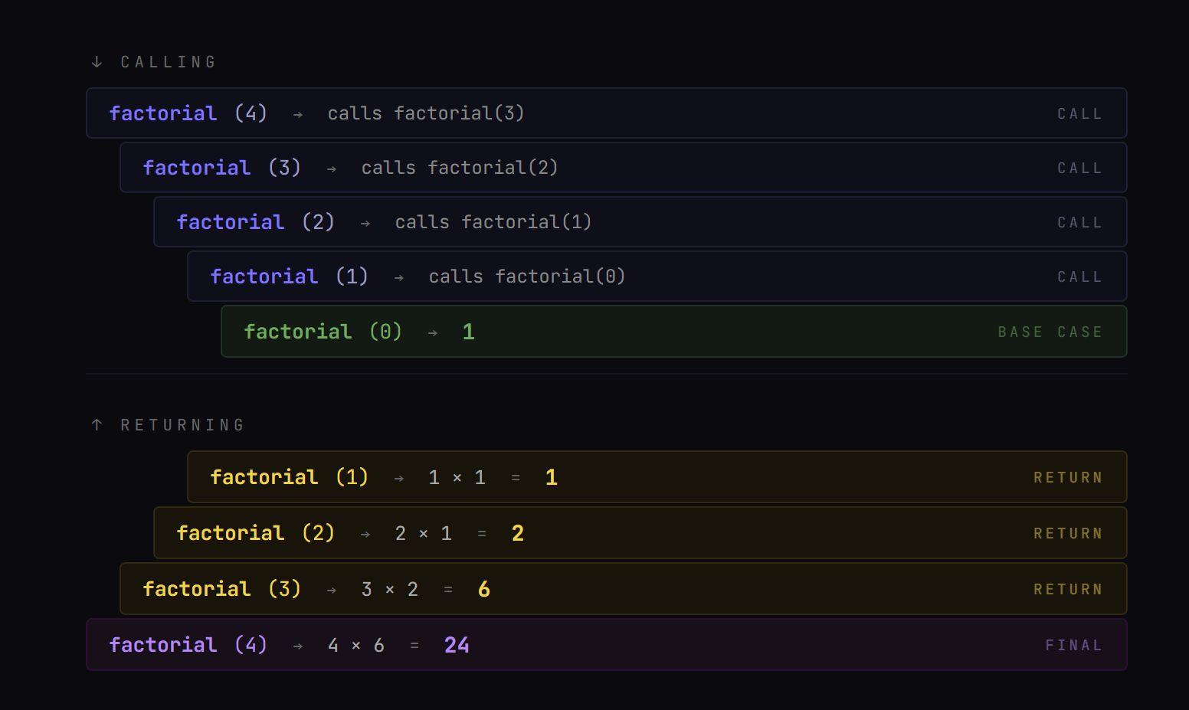
Recursion
Base case: A simple value is returned. The calling “loop” stops and the returning “loop” starts.
Body: Some kind of operation get applied (Often to the r recursive call’s returning value).
Recursive call: The function calls itself with a parameter that depends on the parameter of the current iteration.

Slide 4
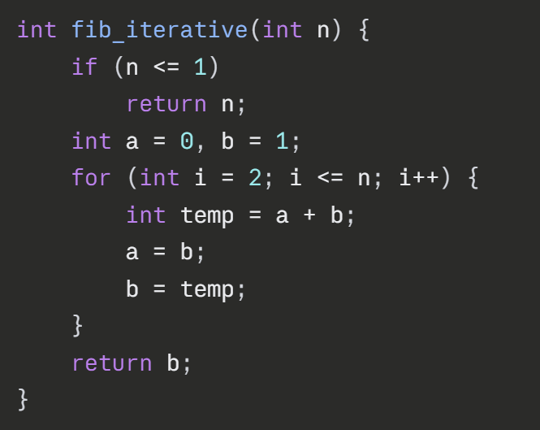
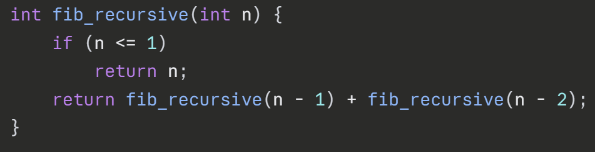
Recursion
Why use recursion?
- Sometimes is easier to implement than iterative counterpart.
- When using divide and conquer algorithms or when solving DPs. (More of it in Ex.4 and Ex.10)
Why not use recursion?
- Requires memory space.
- Can perform same calculation multiple times (Without memoization).
- Harder to debug.
VS

Slide 5
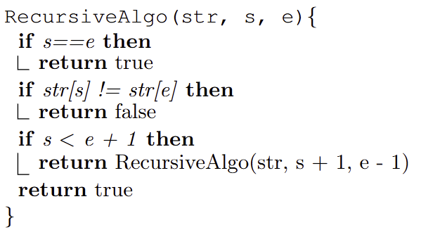
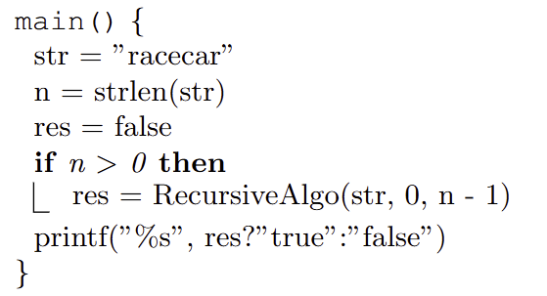
Task 1.
-What is s, what is e and what is str when we call RecursiveAlgo() the 1st time?
-What are the possible returns of RecursiveAlgo()?
-What are the base cases?
-What are the cases we do the recursive call?
-How does str, s and e change when we make the recursive call?

Slide 6
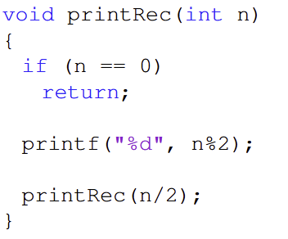
Task 2.
- Compute is by hand.
- Remember the call stack.

Slide 7
Task 3.
- Use recursion:
- Base case?
- Body?
- Recursion step?

Slide 8
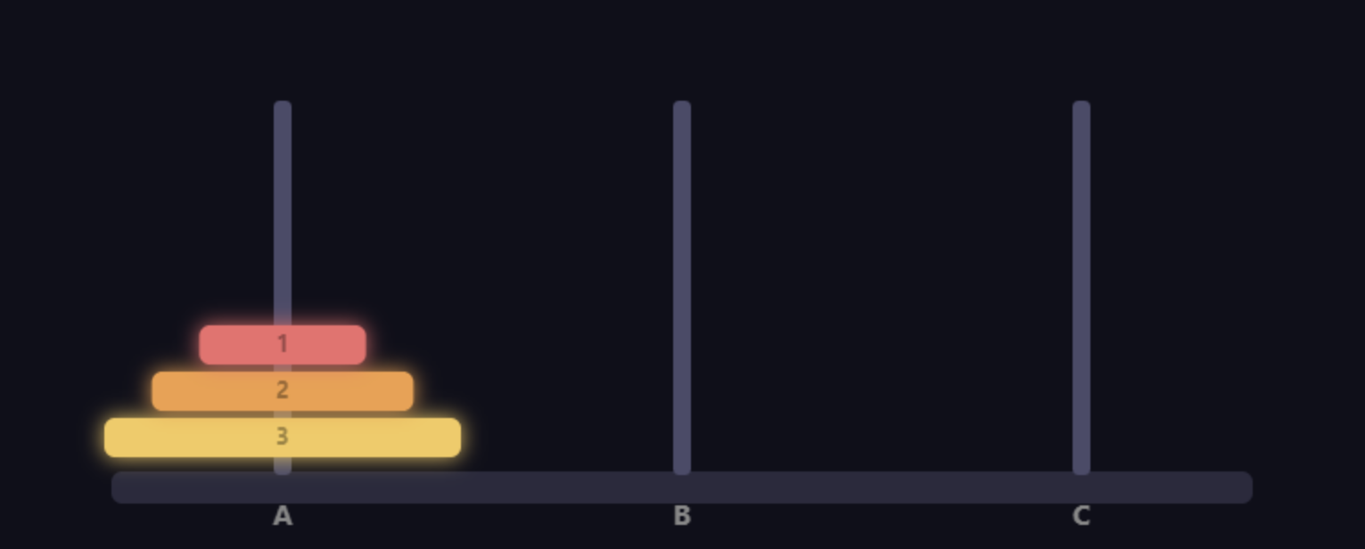
Task 3.
See animation on Olat:

Slide 9
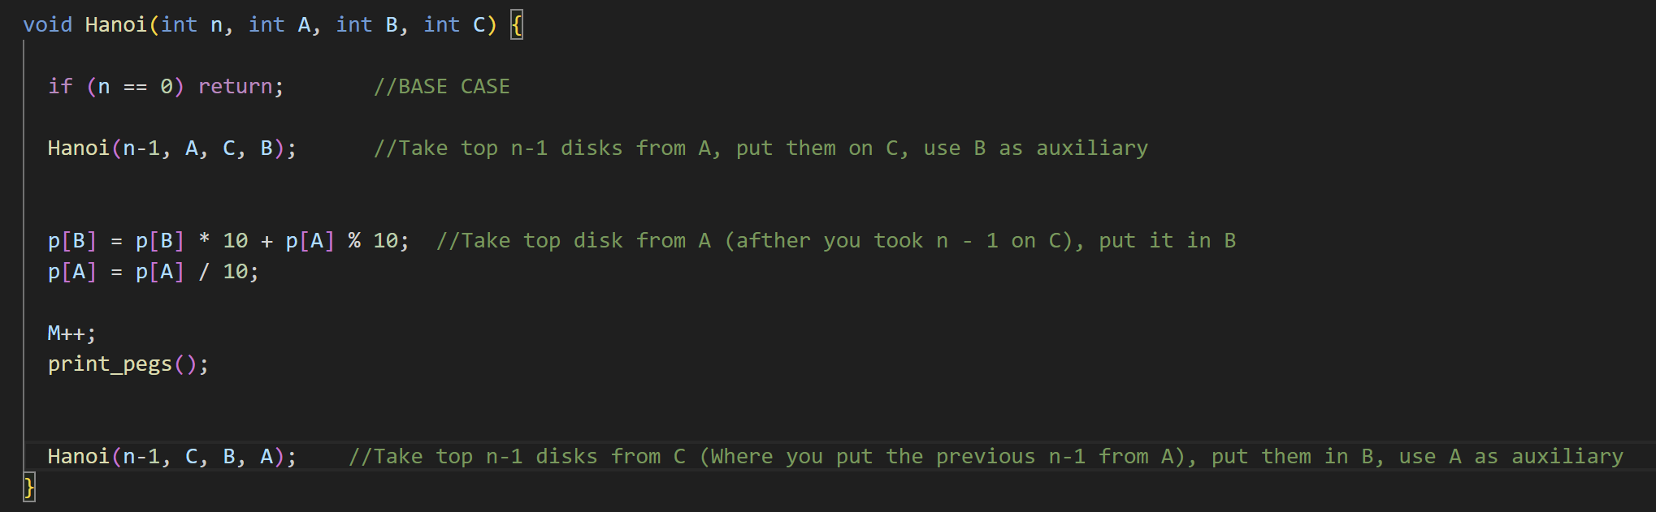
Task 3.
Understanding the solution:

Slide 10
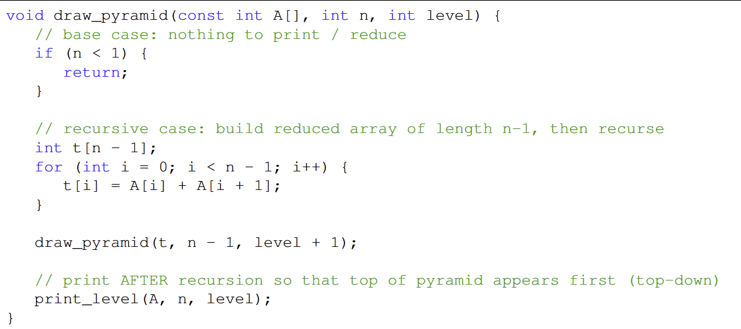
Task 4.
This is how you find out the size on an array in the main (it doesn’t work in functions)

Slide 11
Thank you for your attention. If you have any question write in the Olat forum or come up to me.

