Slide 1
Weprotect
The Security women need

Slide 2

Presented BY:
1: Anto Jayson(Leader)
2:Anurag Sen
3:Tushar Saxena
Sarthak Sachdeva

Slide 3
Introduction and motive
This interface seeks to provide women safety by reporting criminal incidents at the earliest to the respective guardian authorities like The Police Service, their family members, friends, etc.
Description

Slide 4
Description
This Application is for the Safety of Women and this app can be activated by a single click, whenever need arises. A single click on this app identifies the location through giolocation.ai and sends an instant SMS comprising this location URL along with the Alert message to guardian contacts like the nearest police protocol centres to help the one in the danger situations. The unique feature of this application is to trace the location with accuracy (with time accuracy being 1second) and send a caution/alert SMS to the registered guardian contacts as soon as possible.
The app is thoughtful about women’s safety concerns and makes the job of communicating crime to the law enforcement department easy and rapid.

Slide 5
Challenges we ran into
The location tracing interface has to be precise, it needs to detect the exact coordinates and report it as an SMS. This process hears easy but is actually tough to implement. The geolocation.ai for android was deployed for this challenge and we used Location sensor for application building.The position of a person walking keeps on changing, thus is they are using this application interface while moving, the procedure to detect gets tough. Thus we had to set the Time interval accuracy to 1second. It updates the location tracing in 1 second intervals.The User Interface has to be easy to use and simple, thus efforts were made to keep it simple and easy to use. It requires no prerequisites. Thus even a person aged 5year can use it comfortably.The Application interface uses Location of the device used. Thus it depends on the network connectivity. Thus to give the best experience we kept it on a low bandwidth fetching important messages out as SMS.While the information from the watch's geo location was giving the co-ordinates it was not a 100% accurate. It had an error rate of 35%. While we tried to solve the problem we realised that it is dependant on the network towers nearby/ the routers present and not the person itself.

Slide 6
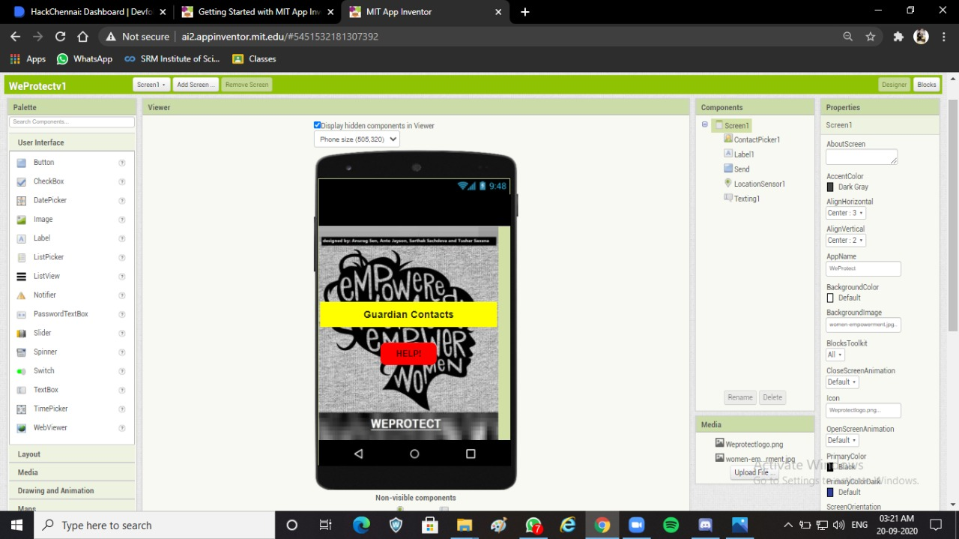
For making app we took help from MIT App Inverter

Slide 7
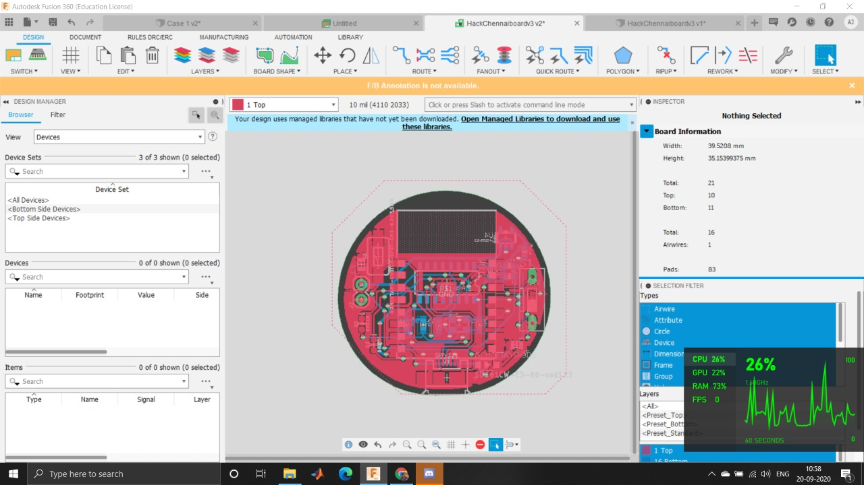
Hardware components
For the hardware we have used ESP12 E as the microcontroller, which will send and receive data using wifi. When the button on the watch is pressed It will transmit the live co-ordinates using Geolocation to the emergency contact stored by the user and then to the nearest police station. This would ensure that the people would come to the person’s aid as soon as possible. The PCB was designed using Eagle CAD and modeled using Fusion 360. The dimensions of the dial is 33mm which is approximately 3 cm

Slide 8
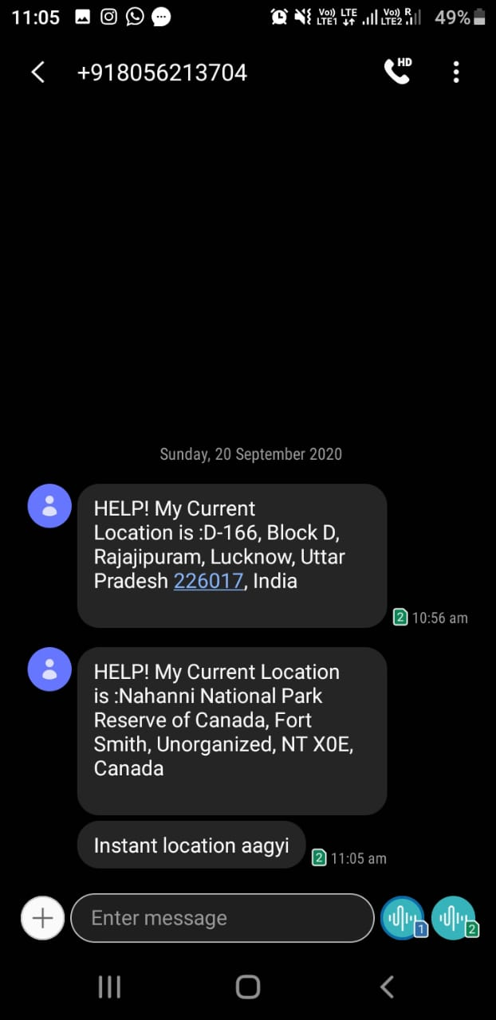
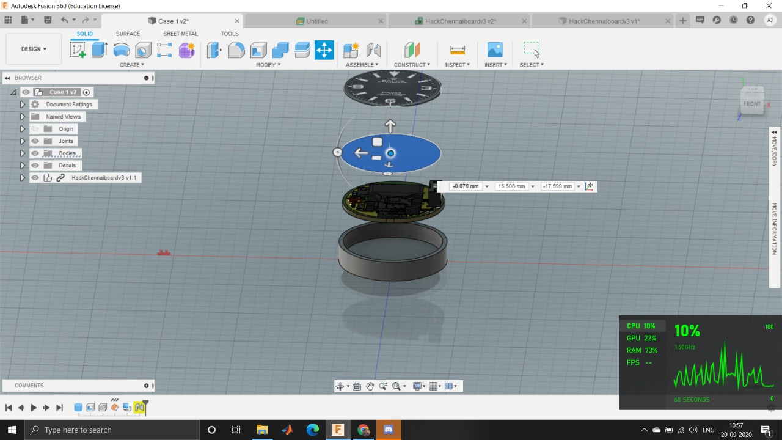
Hardware and Message

