Slide 1


MINI PROJECT · DATA ANALYSIS WITH PYTHON
AI-Generated Content
Detection Pattern
HUMAN
Detecting Human vs. ChatGPT-Written Answers Using the HC3 Dataset
CHATGPT
INDUSTRY Technology — Artificial Intelligence & Digital Content Moderation
STUDENT NAME
STUDENT ID
COURSE
BATCH CODE
Anto Jeberz J
AF05310496
AIML
ANP-D7444

Slide 2


Industry Overview
Selected Industry
Technology / Artificial Intelligence — the field of Digital Content Integrity & Moderation, which builds tools to tell human-written content apart from AI-generated content.
Generative language models such as ChatGPT can now produce answers that read as fluently as human writing. This has created a fast-growing industry of detection tools and platform safeguards used across education, publishing, social media and customer support — all of which rely on identifying measurable differences between human and AI text.
Where This Matters
Education & Academic Integrity
Why Data Analysis Matters Here
Journalism & Publishing
Every detection method — simple heuristics or trained classifiers — depends on first finding real, measurable signals in text.
Exploratory analysis quantifies which linguistic features actually separate human and AI writing before any model is built.
It also exposes a dataset's limits (era of model, source skew) so conclusions are not over-trusted.
Social Platforms & Moderation
Hiring & Content Screening
AI-Generated Content Detection Pattern | Mini Project — Data Analysis with Python
2

Slide 3

Problem Statement
The Problem
Why It Matters
Who Is Affected
With ChatGPT and similar models now able to generate fluent, human-like answers at scale, it is increasingly hard to tell whether a piece of text was written by a person or a machine.
Undetected AI text threatens academic integrity, lets misinformation spread under a false air of authenticity, and strains content moderation and trust at platform scale.
Students & educators, platform moderators (Reddit, Quora, forums), journalists & publishers, and employers or readers judging whether written work is genuine.
AI-Generated Content Detection Pattern | Mini Project — Data Analysis with Python
3

Slide 4

Project Objectives
Build a Clean, Balanced Dataset
Transform the raw, nested HC3 corpus into a tidy, answer-level dataset balanced 50/50 between Human and ChatGPT.
1
Engineer Interpretable Features
Derive linguistic features — word count, sentence structure, first-person usage, question marks — for every answer.
2
Quantify Stylistic Differences
Measure and visualize how human and ChatGPT writing styles differ, overall and across content sources.
5 Objectives
Guiding This
Project
3
Identify the Strongest Signals
Find which features correlate most with the authorship label to prioritize for future modeling.
4
Lay a Reproducible Foundation
Produce a cleaned CSV and analysis pipeline ready to support a future AI-content classifier.
5
AI-Generated Content Detection Pattern | Mini Project — Data Analysis with Python
4

Slide 5


Proposed Solution & Analysis Questions
Proposed Solution
Rather than jumping straight to a black-box classifier, this project first uses descriptive and exploratory Python analysis to surface measurable, human-interpretable stylistic signals — producing a clean dataset and EDA report that can ground a future AI-content classifier (e.g. a TF-IDF + Logistic Regression baseline).
pandas Cleaning, reshaping nested JSON & grouping
NumPy Array ops & aggregation for chart data
matplotlib Distribution, trend & correlation visuals
Key Analysis Questions
Q1
How does answer length (word count) differ between Human and ChatGPT answers?
Q2
Do Human and ChatGPT writing styles differ in sentence structure and sentence length?
Q3
How often do Human vs ChatGPT answers use first-person language and embedded questions?
Q4
How is the data distributed across content sources — Reddit ELI5, finance, medicine, open QA, Wikipedia?
Q5
Which features correlate most strongly with the authorship label?
Q6
After cleaning and balancing, is the dataset large and clean enough for future model training?
AI-Generated Content Detection Pattern | Mini Project — Data Analysis with Python
5

Slide 6
Dataset Information
Raw Dataset
Cleaned / Final Dataset
24,322
5
52,346
4 + 5
rows
columns
rows
columns
question, human_answers, chatgpt_answers, index, source
answer, label, source, question + 5 engineered features
DATASET NAME
HC3 — Human ChatGPT Comparison Corpus
SOURCE
Hugging Face — Hello-SimpleAI/HC3 (“all” subset)
FILE FORMAT
CSV
Each raw row pairs a question with one or more human answers and one or more ChatGPT (GPT-3.5-era) answers, drawn from five sources: Reddit ELI5, finance, medicine, open QA and Wikipedia CS/AI. The data was restructured to one answer per row for analysis.
Important Features / Columns
answer
label (0=Human / 1=ChatGPT)
source
word_count
sentence_count
avg_sentence_len
first_person
question_marks
AI-Generated Content Detection Pattern | Mini Project — Data Analysis with Python
6

Slide 7

Data Collection & Understanding
Collection: Public HC3 dataset downloaded from Hugging Face (Hello-SimpleAI/HC3, “all” subset) as a CSV file.
Source: Reddit ELI5, finance, medicine, open QA and Wikipedia CS/AI; ChatGPT answers generated by a GPT-3.5-era model.
Data types: question / answers / source are text (object); the unused index column is float64.
Missing values: index column: 21,801 of 24,322 rows null (≈87%) — dropped entirely.
Duplicates: 509 exact duplicate rows detected and removed.
Jupyter Notebook — Initial Understanding
>>> df.info()
RangeIndex: 24322 entries
question 24322 object
human_answers 24322 object
chatgpt_answers 24322 object
index 2521 float64
source 24322 object
>>> df.duplicated().sum()
509
>>> df["source"].value_counts()
reddit_eli5 16603
finance 3933
medicine 1248
open_qa 1187
wiki_csai 842
24,322
5
5
509
raw rows
columns
sources
duplicates
AI-Generated Content Detection Pattern | Mini Project — Data Analysis with Python
7

Slide 8
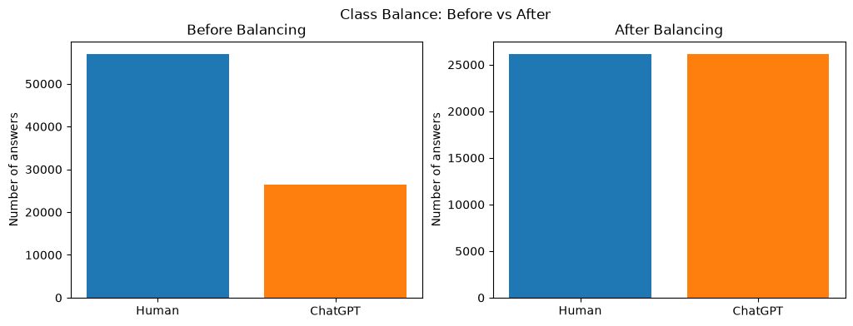
Data Cleaning & Transformation
Missing values: Dropped the index column (87% null, unused identifier).
Duplicates: Removed 509 duplicate rows, then duplicate answer text later in the pipeline.
Parsing / types: JSON-decoded human_answers / chatgpt_answers into individual answer rows.
Inconsistent values: Fixed spacing artifacts ("do n't" → "don't") and stripped the giveaway phrase "As an AI language model".
Filtering: Dropped null/blank answers and answers under 20 words.
New columns: Engineered word_count, sentence_count, avg_sentence_len, first_person, question_marks.
Transformation: Exploded nested lists to one answer per row, then balanced Human/ChatGPT via downsampling (random_state=42).
Jupyter Notebook Output — Class Balance
Down-sampling the majority Human class to match ChatGPT (26,173 each) produces a perfectly balanced 52,346-row dataset.
24,322
→
23,813
→
83,400
→
75,191
→
52,346
Rows through the cleaning pipeline (raw → final balanced dataset)
AI-Generated Content Detection Pattern | Mini Project — Data Analysis with Python
8

Slide 9

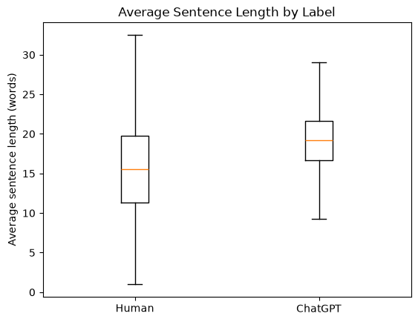
Exploratory Data Analysis (EDA)
pandas
NumPy
matplotlib
Jupyter Notebook Output — Sentence Length
Major Analysis Performed
Word-count distribution & descriptive statistics (mean, median, std) grouped by label.
Writing-style feature means by label: sentence count, avg. sentence length, first-person use, question marks.
Per-source breakdown of answer volume (Reddit ELI5, finance, medicine, open QA, wiki_csai).
Correlation analysis between all engineered features and the authorship label.
134.0 / 173.1
Mean word count (Human / ChatGPT)
ChatGPT's sentence length is tightly clustered around ~19 words; human sentences vary far more widely, from very short to long run-ons.
163.7 / 61.6
Std. dev. of length (Human / ChatGPT)
AI-Generated Content Detection Pattern | Mini Project — Data Analysis with Python
9

Slide 10
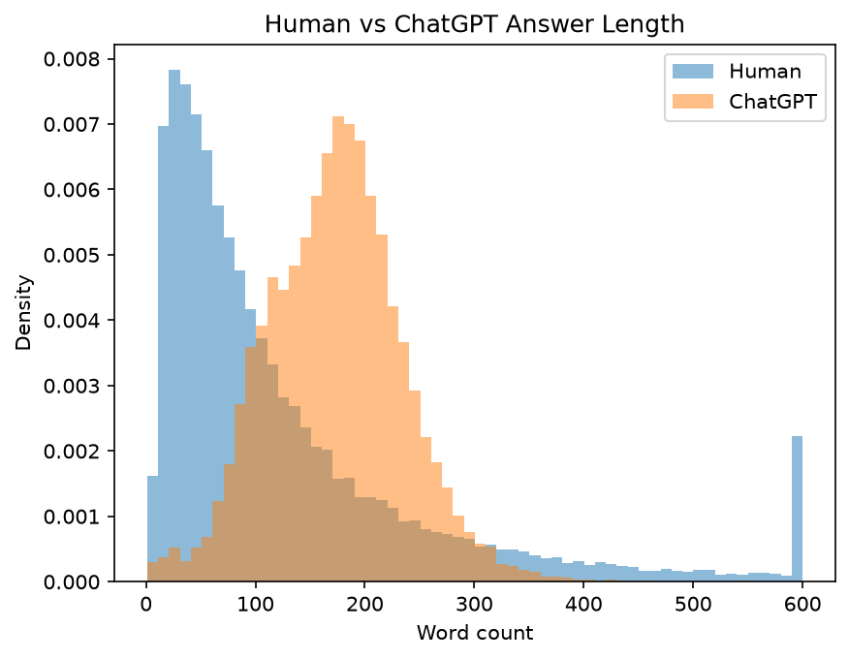
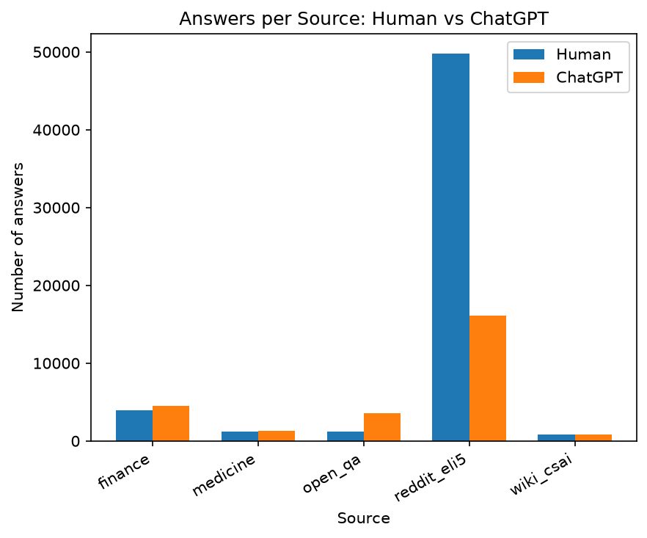
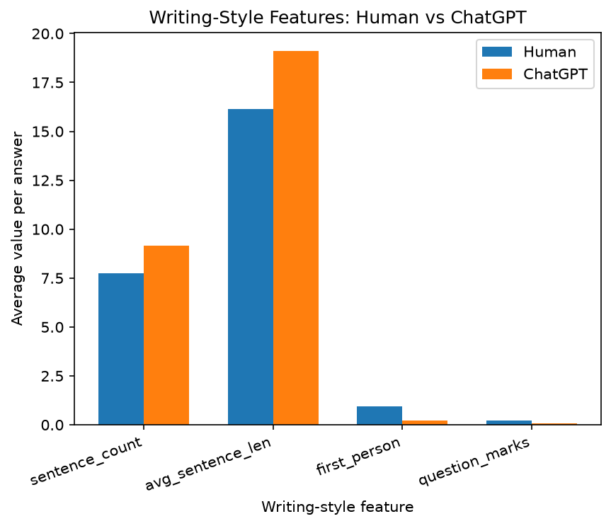
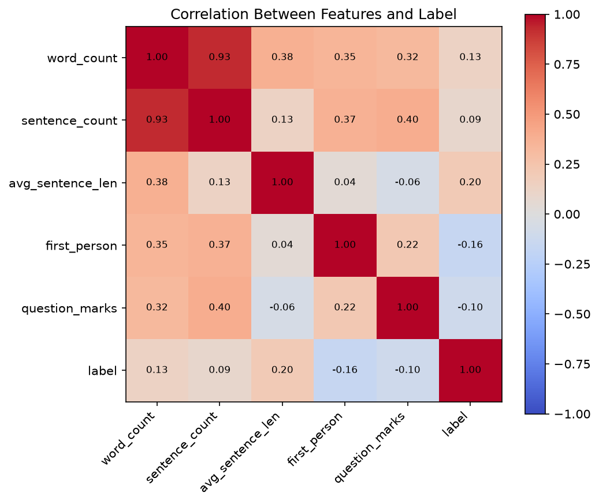
Data Visualization
Answer Length Distribution
Answers per Source
Human replies skew short with a long tail; ChatGPT forms a tight bell curve near 150–200 words — ChatGPT's length is templated, human length is free-form.
Reddit ELI5 dominates the data and contributes far more Human than ChatGPT replies per question — overall stats skew toward informal Reddit style.
Writing-Style Feature Comparison
Feature Correlation Heatmap
ChatGPT writes longer, more uniform sentences; Humans use far more first-person language and embedded questions — a conversational signature.
avg_sentence_len (+0.20) and first_person (−0.16) correlate most with label, but no single feature is strongly discriminative alone.
AI-Generated Content Detection Pattern | Mini Project — Data Analysis with Python
10

Slide 11

Key Insights & Recommendations
174 vs 83
0.95 vs 0.21
19.1 vs 16.1
0.22 vs 0.07
Median words: ChatGPT vs Human
First-person use: Human vs ChatGPT
Avg. words/sentence: ChatGPT vs Human
Question marks/answer: Human vs ChatGPT
Key Insights
Recommendations
ChatGPT answers are longer and far more consistent in length (std. dev. 61.6 vs 163.7 words).
Humans use first-person words (I, me, my) about 4.5× more often than ChatGPT.
Humans embed more questions inside their answers than ChatGPT does.
ChatGPT writes longer, more uniform sentences than human answers.
No single feature strongly correlates with label alone (max |r| = 0.20) — a combination of features would be needed for reliable classification.
Build a TF-IDF + Logistic Regression baseline classifier on top of this cleaned, balanced dataset.
Split train/test by question, not by answer, so answers to the same question never leak across the split.
Evaluate performance separately per source (Reddit ELI5 vs finance/medicine/open QA/wiki_csai).
Re-test findings against newer-generation LLMs, since HC3's ChatGPT answers are GPT-3.5-era and the style gap may be narrowing.
AI-Generated Content Detection Pattern | Mini Project — Data Analysis with Python
11

Slide 12

Conclusion
What Was Achieved
Major Findings
A raw, nested 24,322-row HC3 corpus was transformed into a clean, balanced, answer-level dataset of 52,346 rows (50/50 Human vs ChatGPT) with 5 engineered linguistic features.
Consistent, measurable differences in length, sentence structure, first-person usage and question use separate Human from ChatGPT text — even without a trained classifier.
How This Helps
Future Scope
Confirms that AI-content detection is tractable via interpretable text statistics, giving educators and platforms measurable signals rather than opaque “AI-detector” scores.
A TF-IDF + Logistic Regression baseline, question-level train/test splits, per-source evaluation, and re-testing against current-generation LLMs.

