Slide 1

DEPARTMENT OF CSE (ARTIFICIAL INTELLIGENCE AND MACHINE LEARNING) ACADEMIC YEAR 2025 - 2026 SEMESTER III ARTIFICIAL INTELLIGENCE LABORATORY MINI PROJECT REVIEW <Chess AI Using Minimax Algorithm with Alpha–Beta Pruning>
REGISTER NUMBER | 2117240030007
NAME | Anto Jenishia A
YEAR | II
SECTION | A
FACULTY IN-CHARGE | Mrs. M. Divya

Slide 2
PROBLEM STATEMENT
Overview: Artificial Intelligence (AI) enables machines to think and act intelligently by applying search, reasoning, and decision-making techniques. Game-playing is a classic AI domain where algorithms evaluate multiple future states to choose the best move. This project applies these AI principles to build a Chess-playing agent using the Minimax algorithm with Alpha–Beta pruning.
Problem Statement: To develop an intelligent chess agent capable of competing with a human player by evaluating board states, predicting opponent moves, and selecting optimal strategies efficiently using heuristic functions.
Expected Result: A Python-based chess AI that makes intelligent, strategic, and non-repetitive moves, aiming for checkmate while avoiding stalemates.
Possibilities: Future improvements may include deeper search, adaptive difficulty, or machine learning–based evaluation for stronger gameplay.

Slide 3
THEORETICAL BACKGROUND
Theoretical Background: Game-playing AI applies adversarial search where two agents compete with opposing goals. The Minimax algorithm evaluates all possible future moves to choose the one that minimizes the opponent’s advantage and maximizes its own. Alpha–Beta pruning optimizes this process by eliminating branches that cannot affect the final decision, reducing computation time.
Literature Survey: Early AI chess systems like IBM’s Deep Blue used Minimax with advanced heuristics to defeat world champions. Later algorithms introduced Monte Carlo Tree Search, Neural Networks (AlphaZero), and Reinforcement Learning, but Minimax remains foundational for classical game AI. Minimax with Alpha–Beta pruning provides a balance between intelligence and simplicity. It’s efficient, deterministic, and ideal for implementing search-based decision-making in a small-scale chess AI project.
Algorithm Explanation:
Generate all possible moves.
Recursively simulate each move (Minimax).
Evaluate board states using a heuristic function (material, mobility, center control).
Use Alpha–Beta pruning to skip unnecessary branches.
Select the move with the best evaluation score.

Slide 4
IMPLEMENTATION AND CODE
Link to code in Git-hub Repository
List | Git-hub Repository Links
Implementation of Code Link | https://github.com/AntoJenishia/Chess-AI/blob/main/chess_ai.py
Word Document Report Link | https://github.com/AntoJenishia/Chess-AI/blob/main/AI_LAB_MINI_PROJECT_2117240030007_REPORT.docx
PPT Link | https://github.com/AntoJenishia/Chess-AI/blob/main/AI_LAB_MINI_PPT_2117240030007.pptx

Slide 5
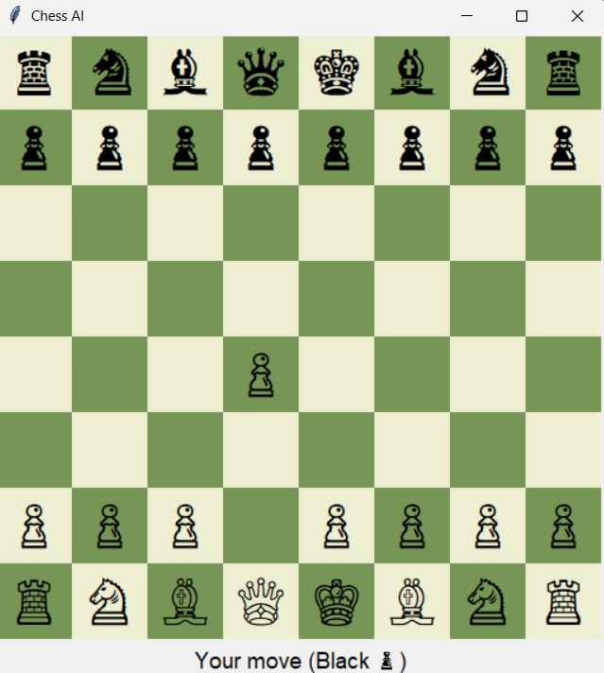
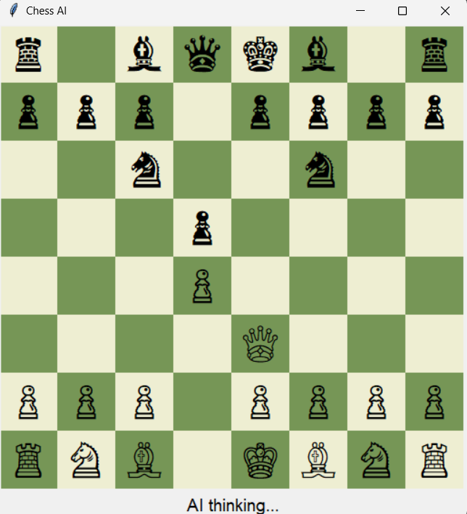
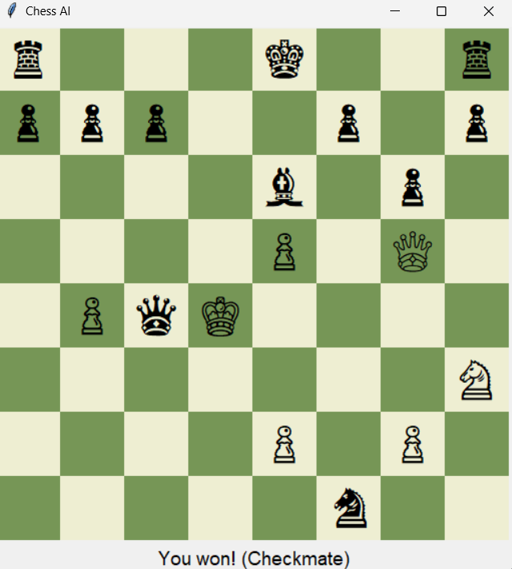
OUTPUT AND RESULTS

Slide 6
OUTPUT AND RESULTS
Explanation: The program lets a user play against the AI. After each human move, the AI evaluates possible states, applies Alpha–Beta pruning to reduce search space, and selects the best move based on a heuristic evaluation (material balance, mobility, and check conditions). The AI avoids repetitive or random moves and aims for checkmate.
Results:
Successfully built a functional chess AI using only Python.
Demonstrates adversarial search, heuristic evaluation and rational agent behavior.
Handles checkmate, stalemate, and legal move validation.
Future Enhancements:
Add difficulty levels (vary search depth).
Integrate machine learning for dynamic evaluation.
Include move hints, game history and timer.
Explore Monte Carlo Tree Search or Reinforcement Learning for advanced play.

Slide 7
REFERENCES
Russell, S. & Norvig, P. (2021). Artificial Intelligence: A Modern Approach (4th Edition). Pearson Education. Sebastian Lague (2018). “The Coding Train – Minimax and Alpha-Beta Pruning (YouTube Series)”. [YouTube Channel: Sebastian Lague – Game AI Playlist]
python-chess Library Documentation. https://python-chess.readthedocs.io/en/latest/
GeeksforGeeks (2020). “Minimax Algorithm in Game Theory | Set 1 and 2 (Introduction & Alpha-Beta Pruning).” https://www.geeksforgeeks.org/dsa/minimax-algorithm-in-game-theory-set-1-introduction/
Wikipedia Contributors. (2024). “Alpha–Beta Pruning.” https://en.wikipedia.org/wiki/Alpha–beta_pruning

