Slide 1

DEPARTMENT OF CSE (ARTIFICIAL INTELLIGENCE AND MACHINE LEARNING) ACADEMIC YEAR 2025 - 2026 SEMESTER III ARTIFICIAL INTELLIGENCE LABORATORY MINI PROJECT REVIEW <SENTIMENT ANALYSIS OF SOCIAL MEDIA COMMENTS USING SVM>
REGISTER NUMBER | 2117240030007
NAME | Anto Jenishia A
YEAR | II
SECTION | A
FACULTY IN-CHARGE | Mrs. M. Divya

Slide 2
PROBLEM STATEMENT
Introduction
Artificial Intelligence (AI) enables machines to perform human-like tasks such as learning and decision-making
Natural Language Processing (NLP) helps machines understand human language
Sentiment analysis identifies emotional tone in text data
Social media generates massive amounts of user opinions daily
Manual analysis is difficult → need for automated solutions
Problem Statement
Classify social media comments into positive, negative, and neutral sentiments
Handle noisy, informal text (slang, emojis, abbreviations)
Provide not just prediction but also confidence and insights
Goal
Develop an AI-based sentiment analysis system
Provide accurate real-time predictions
Generate confidence scores and analytics
Enable batch processing and trend analysis
Build a scalable web-based application

Slide 3
THEORETICAL BACKGROUND
Theoretical Background
Sentiment analysis is a supervised machine learning problem
Text is converted to numerical form using TF-IDF
TF-IDF captures importance of words in documents
Classification models used:
Logistic Regression
Support Vector Machine (SVM)
Naive Bayes
Literature Survey
Classical ML models:
Fast, efficient, interpretable
Deep learning models (BERT, LSTM):
Higher accuracy but computationally expensive
Research shows SVM performs well for text classification
Justification for Algorithm
SVM works well with high-dimensional text data
Provides good generalization
Efficient for small and medium datasets
Logistic Regression selected based on best F1 score

Slide 4
THEORETICAL BACKGROUND
Algorithm Explanation with Example
Step 1: Input text → preprocessing
Step 2: Convert text → TF-IDF vector
Step 3: Apply trained model → predict sentiment
Example:
“I love this product” → Positive
“This is terrible” → Negative
Output includes:
Sentiment label
Confidence score
Probability distribution

Slide 5
IMPLEMENTATION AND CODE
Link to code in Git-hub Repository
List | Git-hub Repository Links
Implementation of Code Link | https://github.com/AntoJenishia/sentiment-analyser
Word Document Report Link | https://github.com/AntoJenishia/sentiment-analyser/blob/main/AIML_AL23421_ML_MINI_PROJECT_2117240030007_IV.docx
PPT Link | https://github.com/AntoJenishia/sentiment-analyser/blob/main/ML_LAB_MINI_PPT_2117240030007.pptx

Slide 6
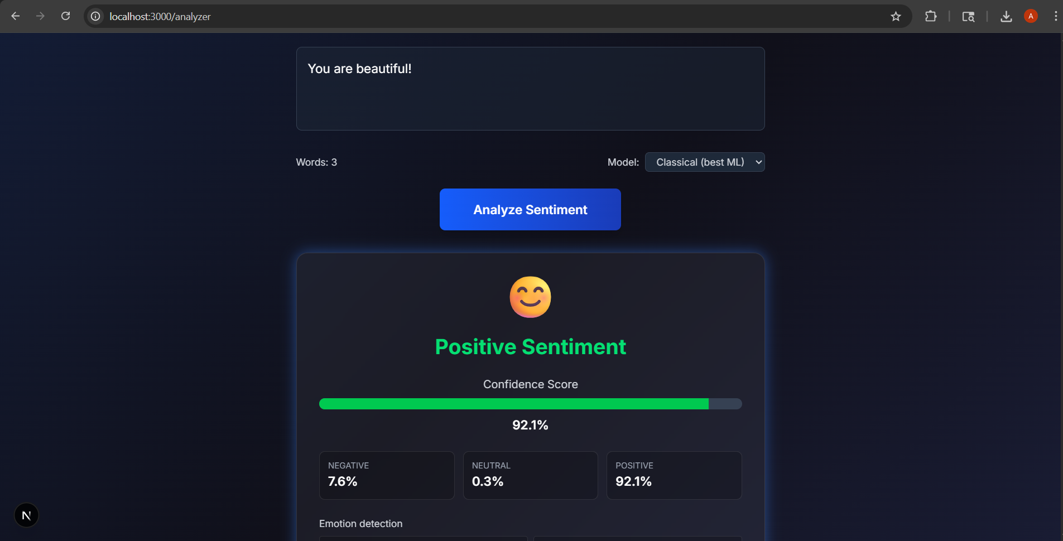
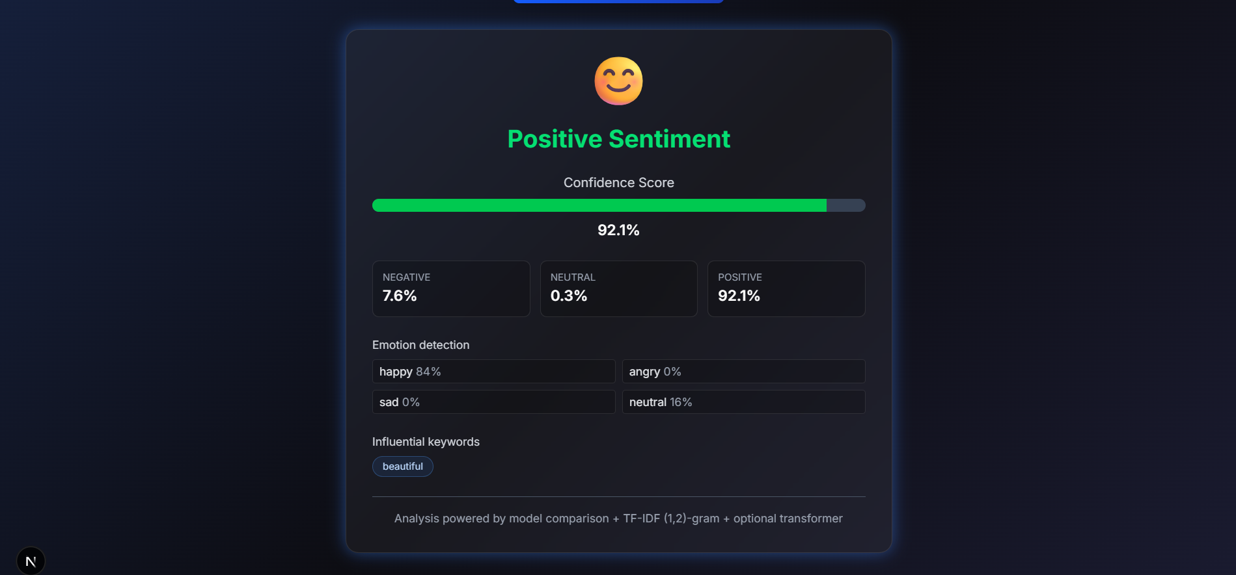
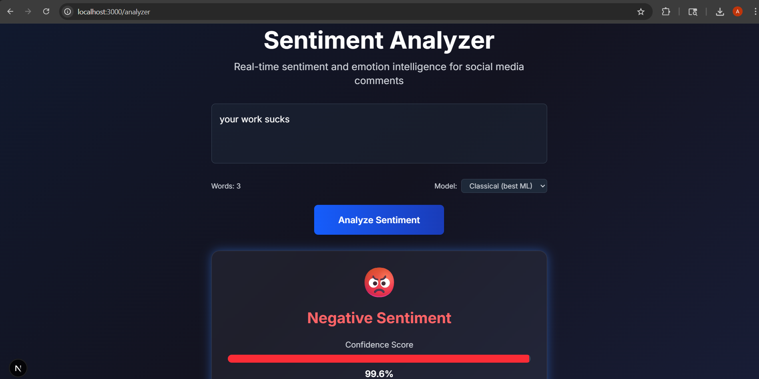
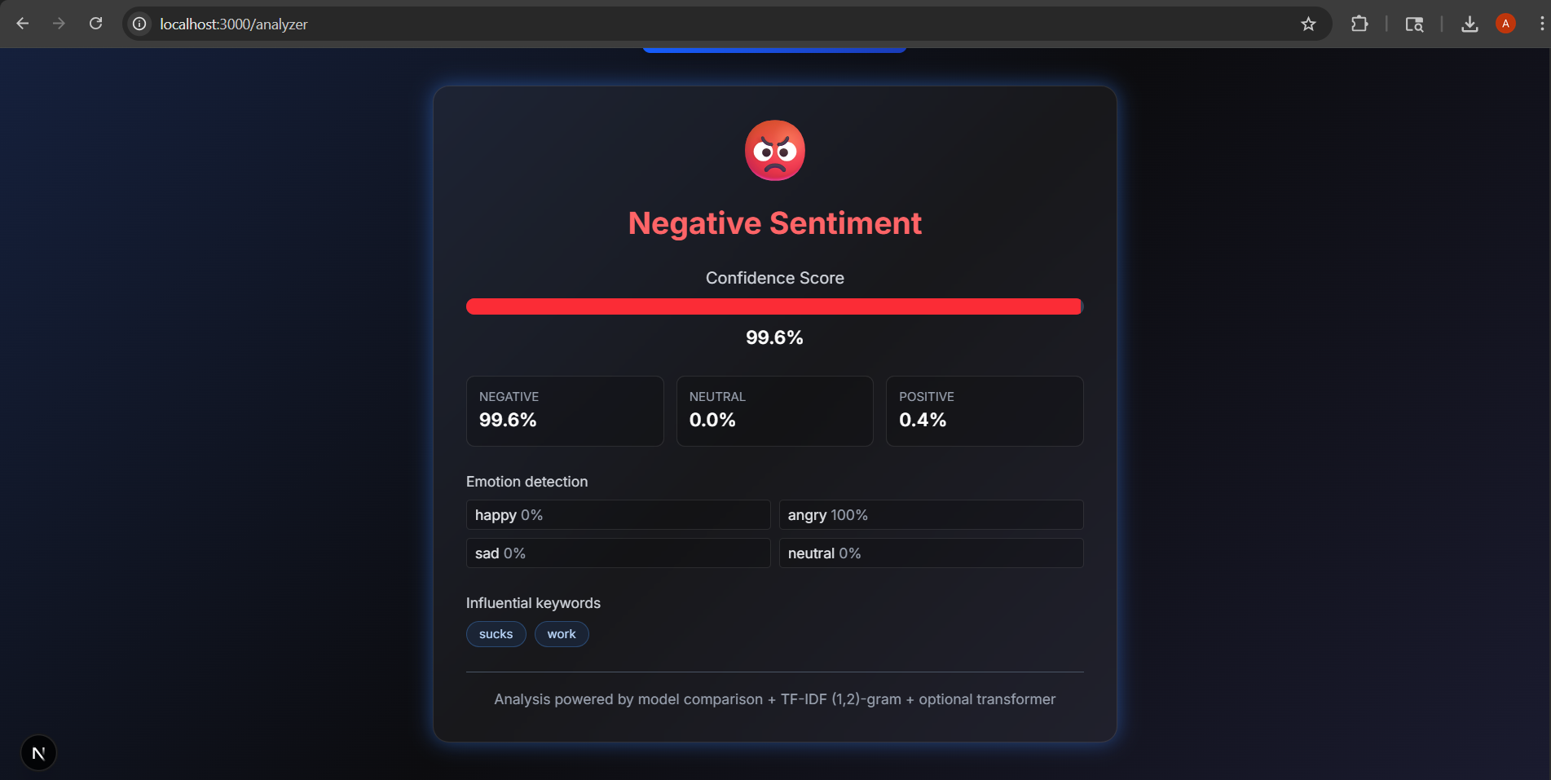
OUTPUT AND RESULTS

Slide 7
OUTPUT AND RESULTS
Results and Future Enhancements
The results of the project demonstrate that the SVM-based model is capable of accurately classifying sentiments in textual data, even with a relatively small dataset.
The integration with FastAPI allows real-time predictions, making the system suitable for web-based applications. However, the performance can be further improved by using larger and more diverse datasets.
Future enhancements include incorporating a neutral sentiment class, using advanced deep learning models such as BERT, improving text preprocessing techniques, and deploying the system on cloud platforms for scalability.
Additionally, integrating real-time social media data streams can further enhance the practical applicability of the system.

Slide 8
REFERENCES
Scikit-learn Documentation. Machine Learning in Python. Available at: https://scikit-learn.org
FastAPI Documentation. Modern, Fast Web Framework for Building APIs. Available at: https://fastapi.tiangolo.com
Jurafsky, D., & Martin, J. H. (2023). Speech and Language Processing. Pearson.
Kaggle. Sentiment Analysis Datasets and Tutorials. Available at: https://www.kaggle.com
Manning, C. D., Raghavan, P., & Schütze, H. (2008). Introduction to Information Retrieval. Cambridge University Press.
Pedregosa, F., et al. (2011). Scikit-learn: Machine Learning in Python. Journal of Machine Learning Research, 12, 2825–2830.

