Slide 1
RURAL ARTISANS MARKETING WEBSITE.
DEPARTMENT OF COMPUTER SCIENCE AND ENGINEERING
GE19612-PROFESSIONAL READINESS FOR INNOVATION, EMPLOYABILITY AND ENTREPRENEURSHIP.
AGNES C - 210701019
ANTO ROSHAN P - 210701029

Slide 2
PROBLEM STATEMENT
How might we develop a unique platform to market traditional products, supporting the livelihood of rural artisans and pottery makers, fostering economic sustainability and preserving cultural heritage?

Slide 3
ABSTRACT
In an era marked by globalization and industrialization, traditional crafts and the livelihoods of rural artisans face unprecedented challenges. This project is a visionary mobile application designed to revolutionize the marketing of traditional products while supporting the livelihoods of rural artisans and pottery makers. Grounded in the principles of economic sustainability and cultural heritage preservation, this serves as a unique platform to bridge the gap between artisans and consumers. The app features intuitive browsing and purchasing interfaces, allowing users to explore artisanal creations and make purchases directly from the creators. By facilitating direct transactions between artisans and consumers, the app eliminates intermediaries and empowers artisans to control their pricing and profit margins, thereby enhancing their economic independence and sustainability. By harnessing the power of technology and community-driven initiatives, our project aims to create a more equitable and culturally vibrant marketplace for traditional crafts.

Slide 4
EXISTING SYSTEM
Etsy: Etsy is a popular online marketplace that connects artisans and craftspeople with customers worldwide. It features a wide range of handmade and vintage items, including traditional crafts and pottery.
Novica: Novica is an e-commerce platform that specializes in handmade goods sourced from artisans around the world. It offers a curated selection of traditional crafts, including pottery, textiles, jewelry, and home decor.
Crafts Atlas: Crafts Atlas is a mobile app that connects users with artisans and craftspeople in India. It features a directory of artisans, workshops, and craft clusters across the country, allowing users to discover and purchase traditional products directly from the makers.

Slide 5
PROPOSED SYSTEM
While existing platforms like Etsy, Novica, and others have made significant strides in connecting artisans with customers and supporting traditional crafts, there are several potential changes or enhancements that could be made to further improve the system:
Increased Visibility for Rural Artisans
Direct Communication Channels
Sustainability Initiatives
Mobile Accessibility
Localized Support

Slide 6
MODULES
User Authentication and Profile Management
Search and Filter Functionality
Product Listings and Catalog
Shopping Cart and Checkout
Secure Payment Gateway
Support and Feedback Module

Slide 7
ALGORITHMS REQUIRED
Search and Filter Algorithm: Implement an algorithm to efficiently search and filter products based on user preferences, such as category, price range, or location. Techniques like binary search or hash tables can be useful for fast retrieval of relevant data.
Recommendation Algorithm: Develop a recommendation system to suggest products to users based on their browsing history, purchase behavior, or preferences. Collaborative filtering or content-based filtering techniques can be employed for personalized recommendations.
Geolocation Algorithm: Utilize geolocation algorithms to determine the user's location and provide relevant information, such as nearby artisans or events. Algorithms like geocoding and geofencing can help in this regard.

Slide 8
ALGORITHMS REQUIRED
Image Recognition Algorithm: Implement image recognition algorithms to automatically tag and categorize product images uploaded by artisans. Machine learning techniques like convolutional neural networks (CNNs) can be used for image recognition tasks.
Natural Language Processing (NLP) Algorithm: Employ NLP algorithms to analyze product descriptions, customer reviews, and other textual data. This can help in sentiment analysis, topic modeling, and extracting relevant information.

Slide 9
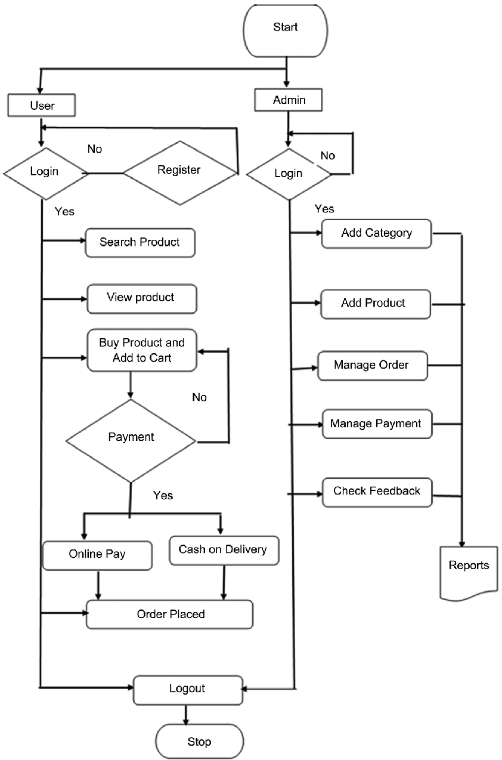
SYSTEM ARCHITECTURE

Slide 10
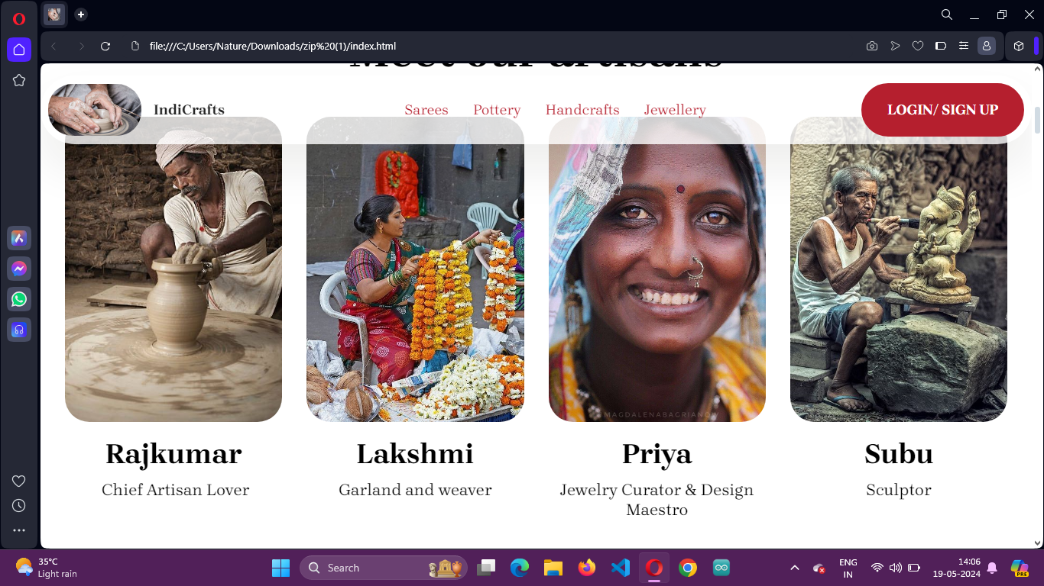
OUTPUT

Slide 11
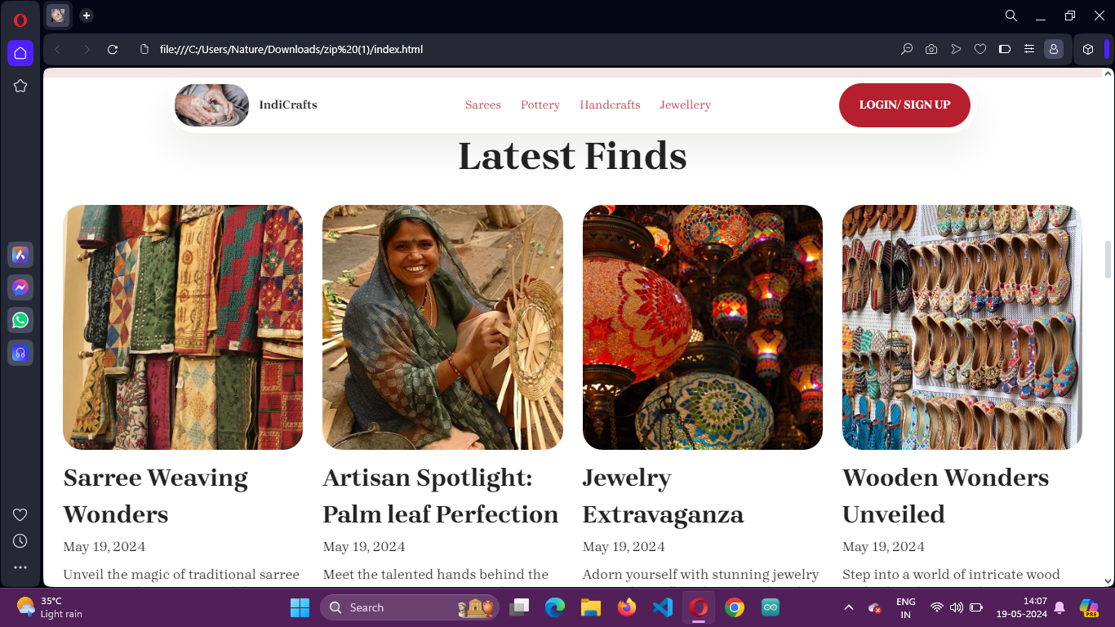

Slide 12
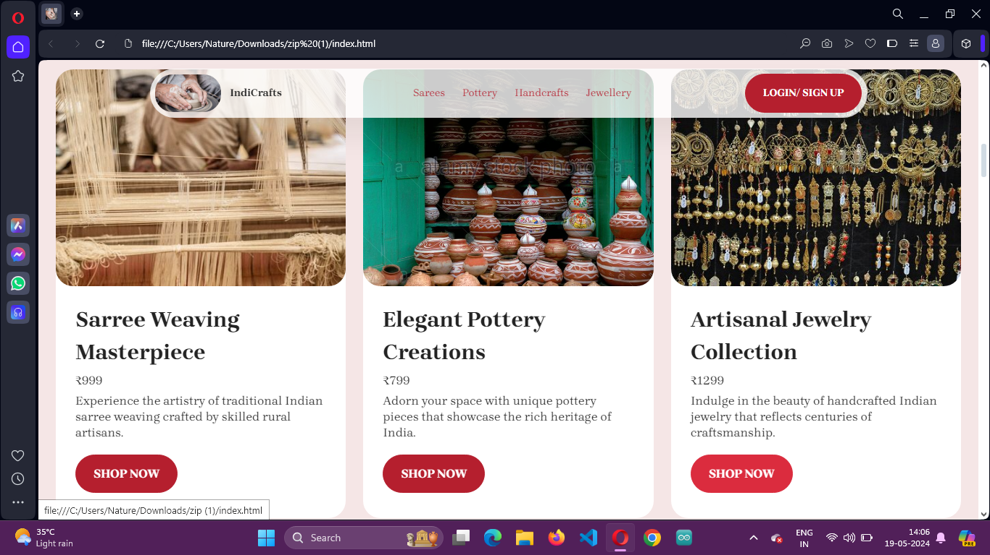

Slide 13
CONCLUSION
In conclusion, the development of the rural artisans marketing website represents a pivotal milestone in the intersection of technology, entrepreneurship, and cultural preservation. Through the utilisation of digital platforms, we have established a channel for rural craftsmen to present their age-old workmanship to a worldwide audience, surpassing geographical limitations and conventional market restrictions. The internet acts as a market for actual goods, but it also gives artisans—who have long been neglected and marginalised by mainstream commerce—hope and empowerment.

Slide 14
THANK YOU

