Slide 1


Python for data analysis
UAV intrusion set, Antoine Cohen, Antoine Cordel

Slide 2
Goal of the Project
In this project we tried to design the best classification model for a given dataset.
The dataset we have been working on is « Unmanned Aerial Vehicle (UAV) Intrusion Detection Data Set ».
The link provided was no longer valid, so we used the same database from a different source.
The link provided : « https://archive.ics.uci.edu/ml/datasets/Unmanned+Aerial+Vehicle+%28UAV%29+Intrusion+Detection »
The link we used : « http://mason.gmu.edu/~lzhao9/materials/data/UAV/?fbclid=IwAR1_Wv1IgZnv9iZIm24CpTQxFb0e15XA6ZSJsF8dv8iHK2NRnBW8SQoKn9g »

Slide 3
The dataset
In our dataset we have 6 different table split into two categories :
The first three include, bidirectionnal-flow mode (uplink, downlink, and both-link) information about a Bebop Parrot, DBPower and Dji Sparke dronem respectively.
The last three contain only uni-directional flows mode, for the same drones.

Slide 4

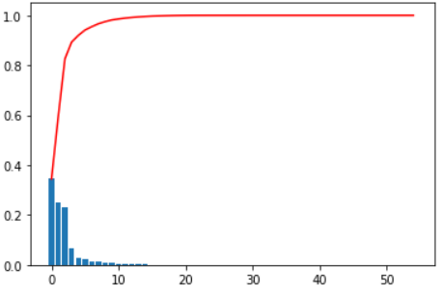
Our Thought process
We started by looking at the number of variables needed for the information set using the basis of a PCA.
We found that about ten variables carried 100% of the information.

Slide 5
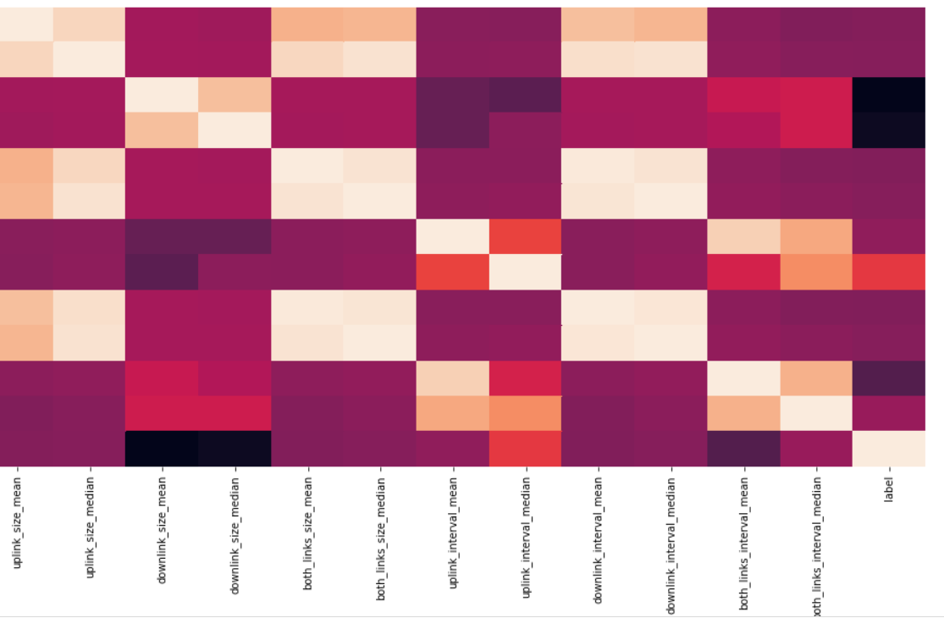
Check on the correlation
Then we tried to determine the correlated and necessary variables in order to obtain the best possible results in our classification
From this we selected 6 variables:
Uplink_size_mean/ Uplinl_size_median/ downlink_size_mean/ downlink_size_median/ both_links_size_mean/ both_links_size_median

Slide 6
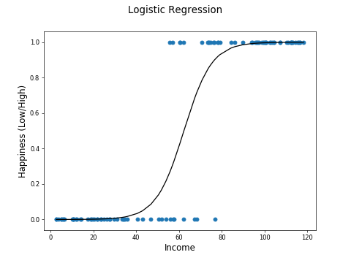
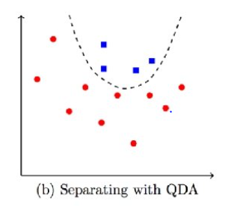
Methods that we used
Finally, we used seaborn’s pairplot function to see how each feature looks in comparaison to our target, and if we noticed any pattern we’d try that works well for it. For exemple if we get plot tthat look like this : We would try a logistic regression.
And if we have plot that look like this :
It would be QDA

Slide 7
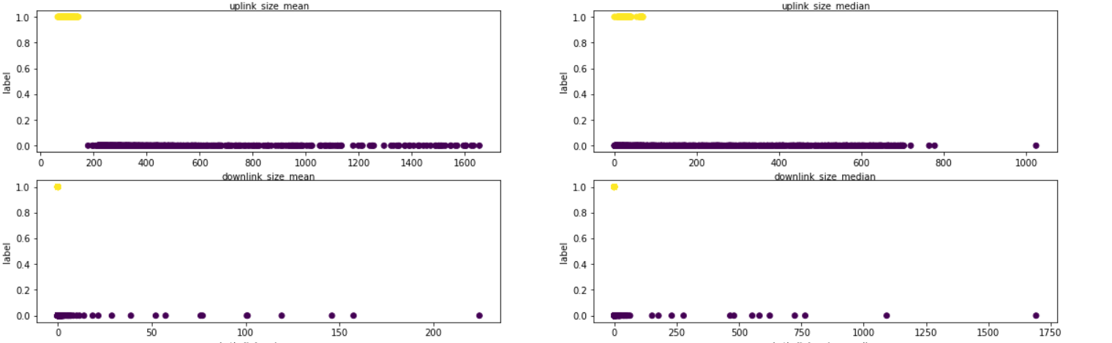
Result
Finally we had this kind of plot, so we choosed to do some logistic regression

Slide 8
Link to the code
« https://colab.research.google.com/drive/1D4AEFMUovkTRs87ftcsFpS8BVOAsc-2Y »

