Slide 1
6-Classifiez automatiquement des biens de consommation
NLP and Image Classification

Slide 2
Summary
Part 1 : Preliminary
Part 2 : Cleaning and EDA
Part 3 : Text classification feasibility
Part 4 : Image classification feasibility
Part 5 : Supervized image classification with data augmentation
Part 6 : Test of Edamam API
Part 7 : Conclusion

Slide 3

Part 1 : Preliminary
Mission: From the database and the images provided:
In a first iteration, carry out a feasibility study of a classification engine:
For text with Bag Of Word and Word Embedding approaches
For images with SIFT/ORB/SURF and CNN Transfer Learning approaches
Secondly, carry out a supervised classification of images with data augmentation
Test the Edamam API on the word Champagne

Slide 4
Part 1 : Preliminary
Environment :
Azure Studio : Virtual machine size Standard_DS12_v2 (4 cores, 28 GB RAM, 56 GB disk)
Python 3.8.5

Slide 5
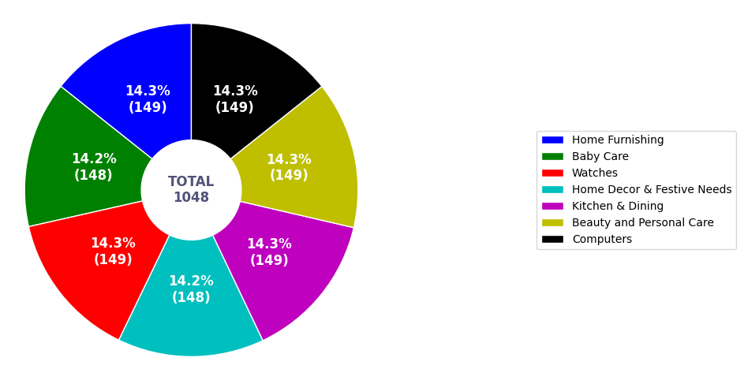
Part 2 : Cleaning and EDA
Cleaning :
Duplicated : None
Empty cells :
Column ‘Brands’ : 712 filleds cells for 1050 total => column ‘Brands’ removed
Two rows with empty cells removed
Feature Engineering ;
One column added with labels extracted from column ‘product_category_tree’ :
Liste of labels :

Slide 6
Part 2 : Cleaning and EDA
Text preparation :
Lowering case : Before : Analog Watch => After : analog watch
Removing punctuation : price: rs. => price rs
Tokenizing : analog watch for boys => 'analog', 'watch', 'for', 'boys'
Removing stopwords : 'analog', 'watch', 'for', 'boys’ => 'analog', 'watch', 'boys'
Removing non english words : 'price', 'rs', '399', 'whether’ => 'price', 'whether',
Lemmatizing : 'comes’ => 'come'

Slide 7
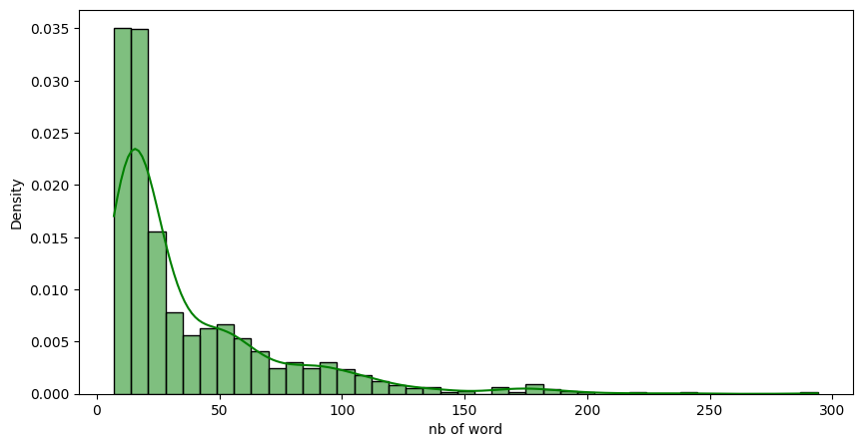
Part 2 : Cleaning and EDA
Exploration :
Number of words per text description (from column ‘description’) :

Slide 8
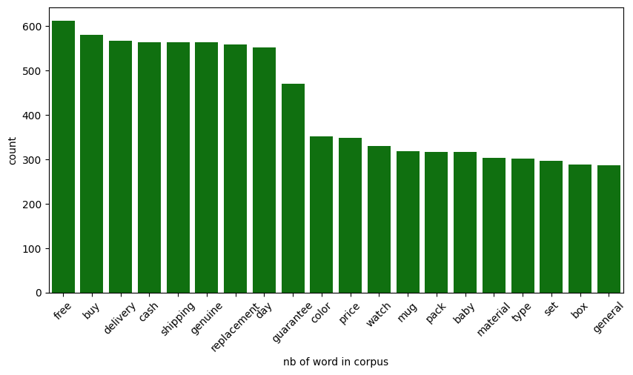
Part 2 : Cleaning and EDA
Exploration :
Pareto of word frequencies in the corpus :

Slide 9
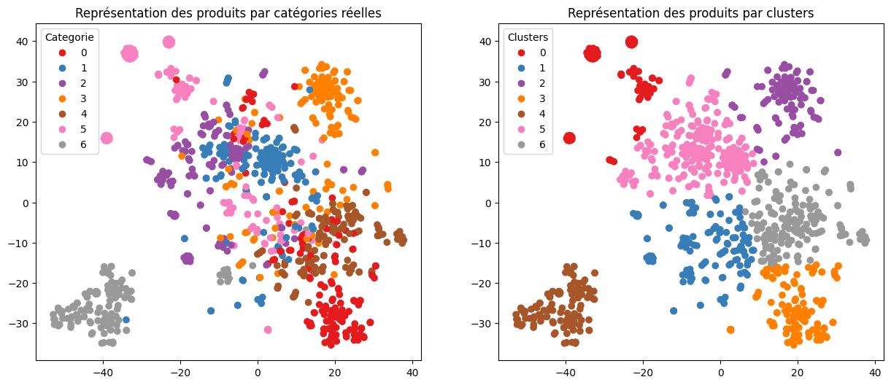
Part 3 : Text classification feasibility
1st Approach : Bag of words CountVectorizer
CountVectorizer is a text feature extraction technique used to convert a collection of text documents into a matrix of token counts.
Acc : 0.39

Slide 10
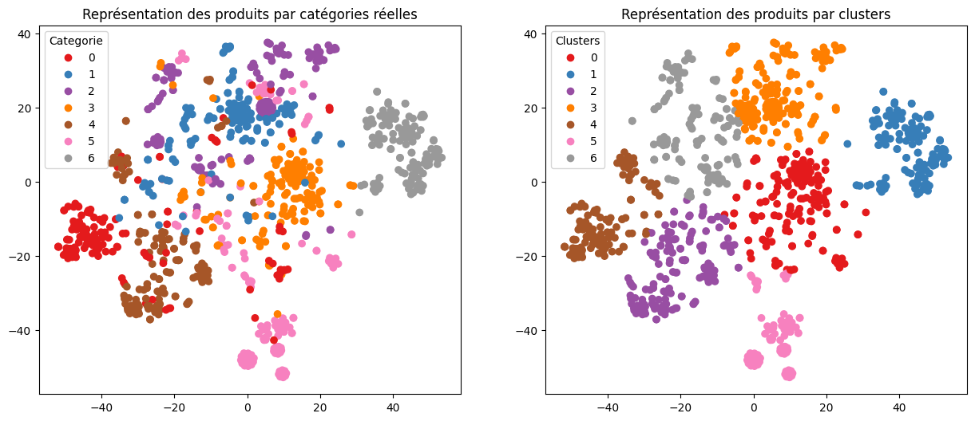
Part 3 : Text classification feasibility
2nd Approach : Bag of words TfidfVectorizer
TF-IDF (Term Frequency-Inverse Document Frequency) is a numerical statistic used to evaluate the importance of a word in a document by measuring its frequency in the document and inversely scaling it by the frequency of the word across all documents in the corpus.
Acc : 0.47

Slide 11
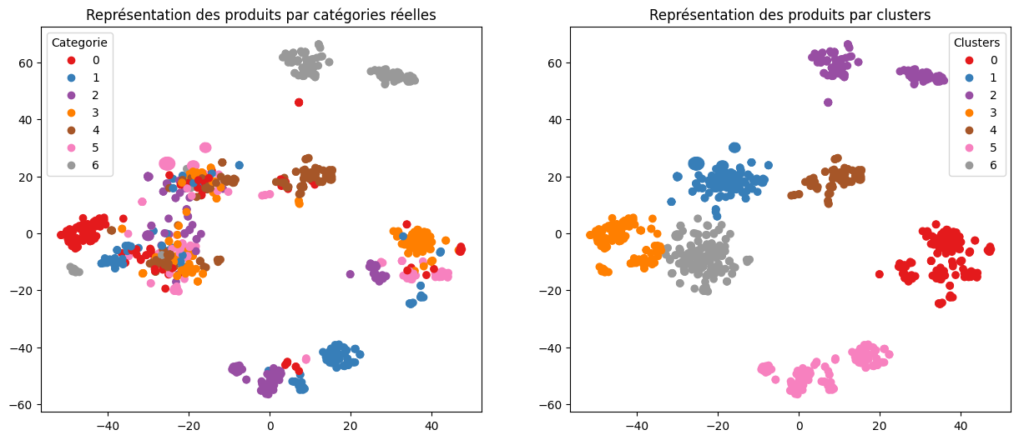
Part 3 : Text classification feasibility
3rd Approach : Word embedding Word2Vec
Word2Vec is a neural network-based algorithm used to create word embeddings that represent words as vectors in a high-dimensional space based on their context and meaning.
Acc : 0.29

Slide 12
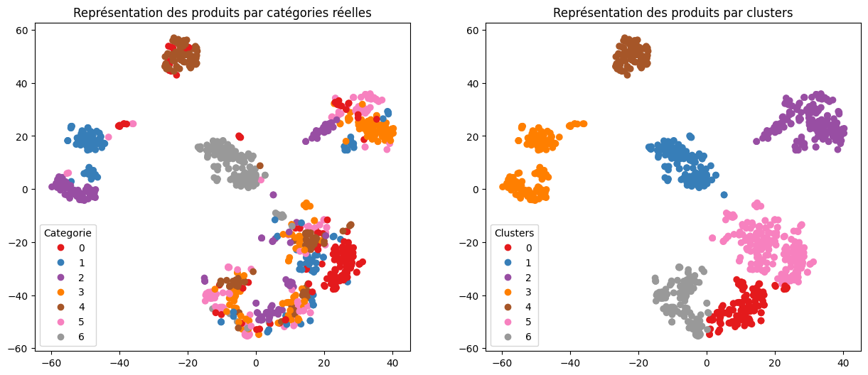
Part 3 : Text classification feasibility
4th Approach : Word embedding BERT
BERT (Bidirectional Encoder Representations from Transformers) is a pre-trained deep learning model for natural language processing (NLP) that uses a transformer-based architecture to generate contextualized word embeddings.
Acc : 0.28

Slide 13
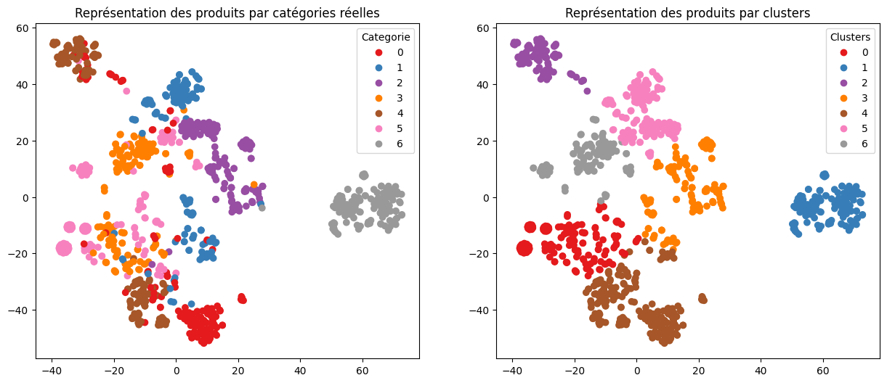
Part 3 : Text classification feasibility
5th Approach : Word embedding USE
USE (Universal Sentence Encoder) is a pre-trained deep learning model for encoding and embedding sentences and short text inputs into high-dimensional vectors that capture semantic information and meaning.
Acc : 0.44

Slide 14
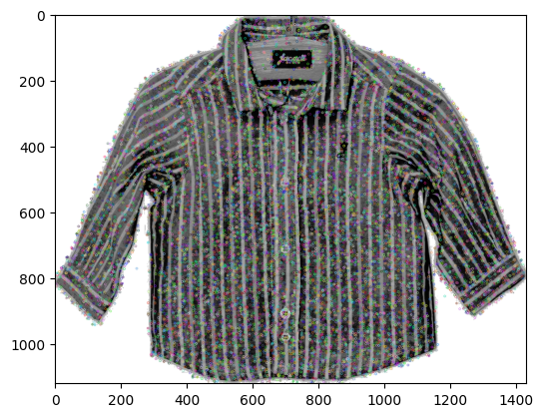
Part 4 : Image classification feasibility
1st approach : SIFT
SIFT (Scale-Invariant Feature Transform) is a computer vision algorithm used for feature detection and description of local keypoints in images.

Slide 15
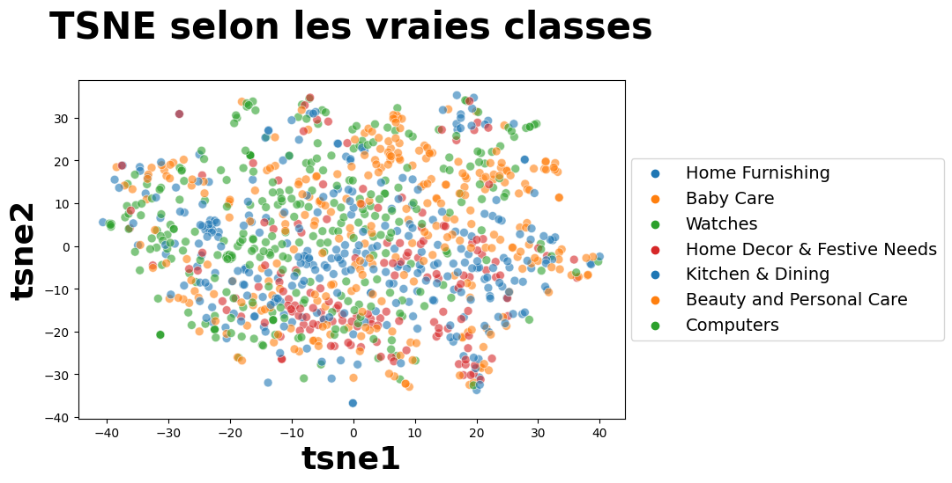
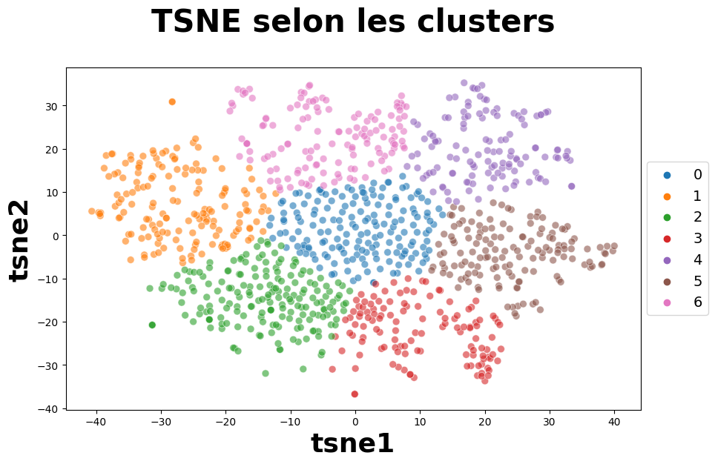
Part 4 : Image classification feasibility
1st approach : SIFT
Acc : 0.05

Slide 16
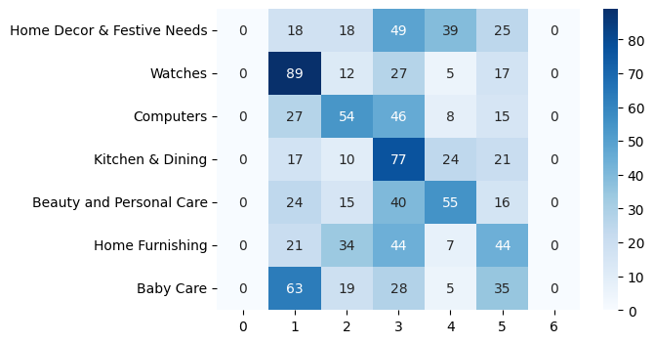
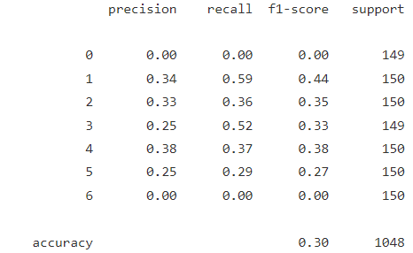
Part 4 : Image classification feasibility
1st approach : SIFT
Acc : 0.05

Slide 17
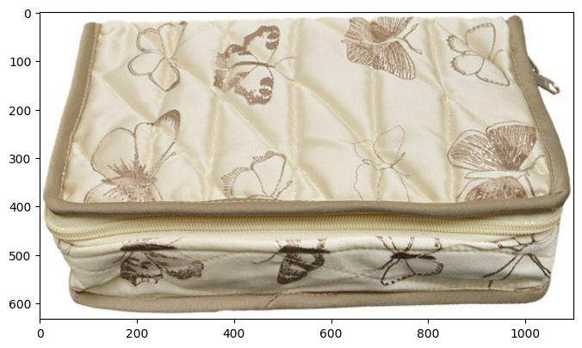
Part 4 : Image classification feasibility
1st approach : SIFT – example of confusion
True : Beauty and Personal Care – Pred : Baby Care

Slide 18
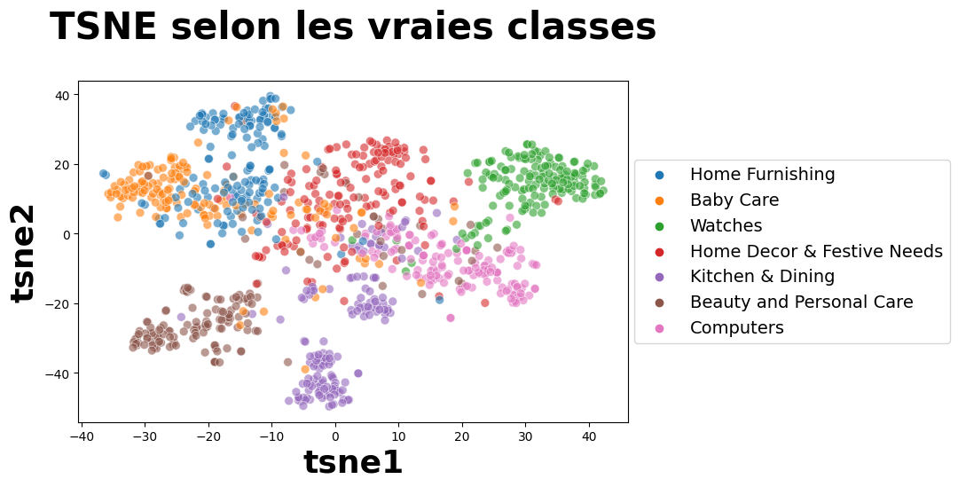
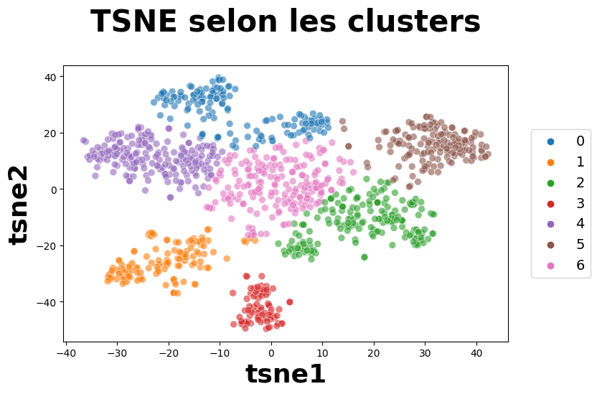
Part 4 : Image classification feasibility
2nd approach : VGG16 transfer learning
VGG16 transfer learning is a deep learning technique that uses a pre-trained VGG16 convolutional neural network as a feature extractor for image classification tasks on new datasets.
Acc : 0.45

Slide 19
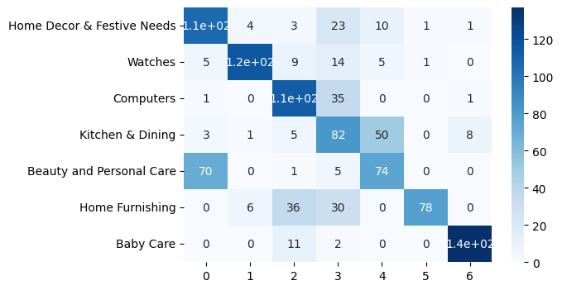
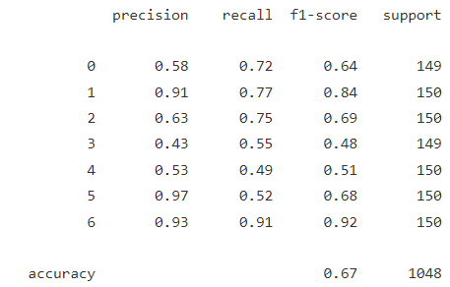
Part 4 : Image classification feasibility
2nd approach : VGG16 transfer learning

Slide 20
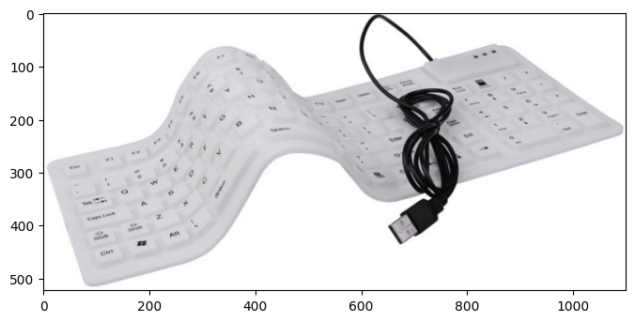
Part 4 : Image classification feasibility
2nd approach : VGG16 transfer learning – example of confusion
True : Computers – Pred : Home Decor & Festive Needs

Slide 21
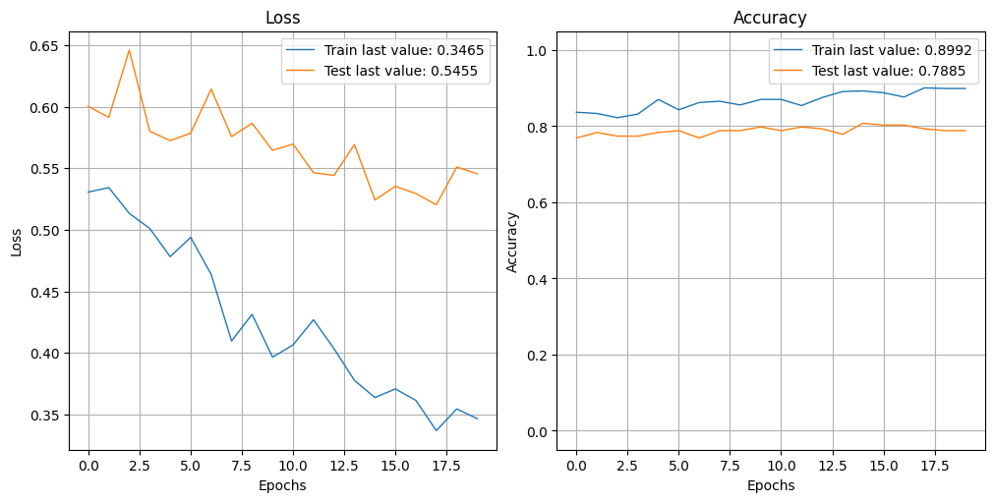
Part 5 : Supervized image classification with data augmentation
VGG16 transfer learning with data augmentation
VGG16 transfer learning with data augmentation for image classification is a deep learning technique that uses a pre-trained VGG16 convolutional neural network as a feature extractor and data augmentation to improve the accuracy of image classification tasks on new datasets.
Acc : 0.79
ARI : 0.58

Slide 22
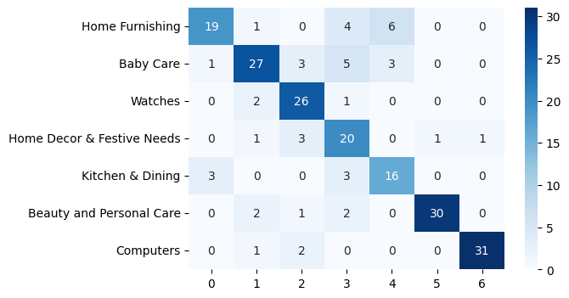
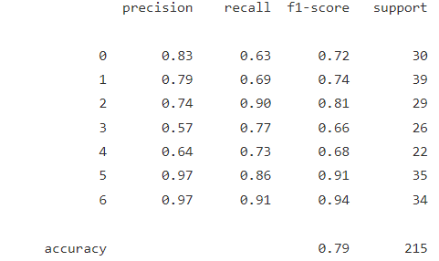
Part 5 : Supervized image classification with data augmentation
VGG16 transfer learning with data augmentation
Acc : 0.79

Slide 23
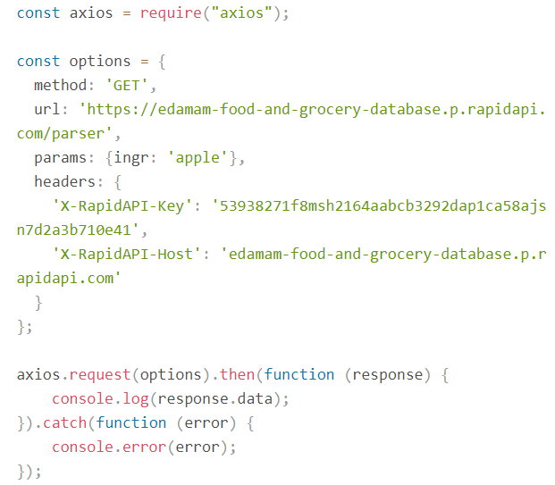

Part 6 : Test of Edamam API
Edamam API test with word « Champagne »
Edamam API is a food and nutrition database and API service that provides access to extensive data on food items, their nutritional information, and recipe recommendations.

Slide 24
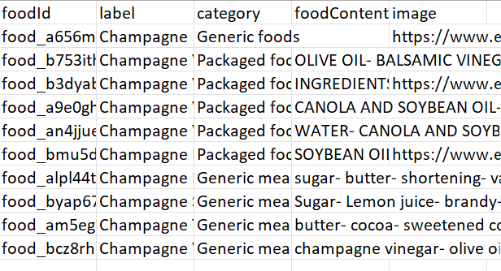
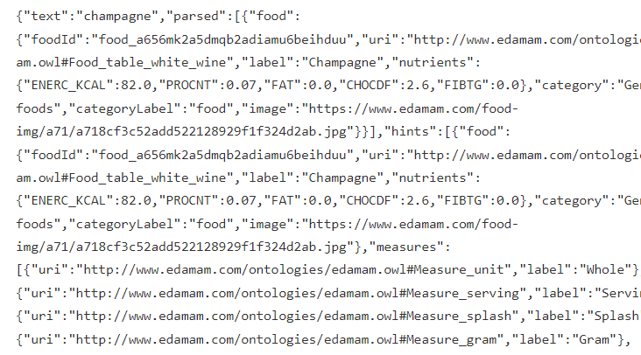
Part 6 : Test of Edamam API
Edamam API test with word « Champagne »
Result of the request with the word « champagne »
Result of the request after processing

Slide 25
Part 7 : Conclusion
Unsupervized text classification results
Unsupervized image classification results
model | ARI | prediction time (seconds)
CountVectorizer | 0.39 | 0.05
TfidfVectorizer | 0.47 | 0.04
Word2Vec | 0.29 | 0.18
BERT | 0.28 | 205.70
USE | 0.44 | 0.93
model | ARI | prediction time (seconds)
SIFT | 0.44 | 520.90
VGG16 | 0.45 | 233.83

Slide 26
Part 7 : Conclusion
Supervized image classification with data augmentation results
Accuracy : 0.79 (ARI : 0.58) –
predicting time done on the whole set with the trained model is 80 seconds
Test API
The has been tested and found OK
The data gathered show some missing pictures and values. It would be worth carrying out an EDA on the database.

