Slide 1
Implémentez un modèle de scoring
Deployment of a scoring application on the web

Slide 2
Summary

Slide 3
Preliminary
Mission : deploy on internet a classification algorithm to predict a solvability proability for potential customers of « Prêt à dépenser » applying for a loan.
Requirements : ensure the transparency of the classification for the customers on an interactive dashboard.

Slide 4
Exploratory Data Analysis
Data are dispatched among nine files :
HomeCredit_columns_description.csv
POS_CASH_balance.csv
application_test.csv
application_train.csv
bureau.csv
bureau_balance.csv
credit_card_balance.csv
installments_payments.csv
previous_application.csv
sample_submission.csv

Slide 5
Exploratory Data Analysis
As suggested, we use the cleaning and merging job done on :
https://www.kaggle.com/code/jsaguiar/lightgbm-with-simple-features/script
The final resulting dataset :
506 features
356251 rows :
307507 for modelization
48744 for new customers
More details :
"data\Profile_Report.html"

Slide 6
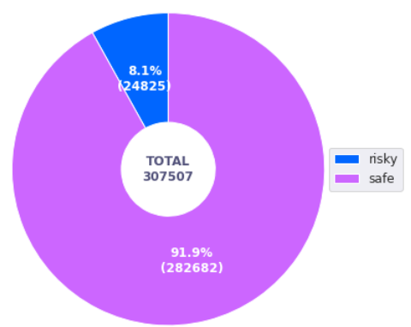
Exploratory Data Analysis
Further, we remove features contributing to bivariate correlations above 0.90.
506 features => 434 features
We check how balanced the data for modelization are:

Slide 7
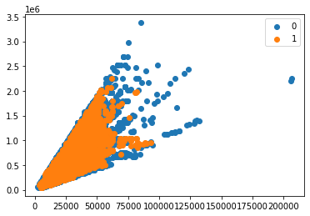
Modelization
Balancing data with BorderlineSMOTE
BorderlineSMOTE is a data augmentation technique used in machine learning to balance imbalanced datasets by generating synthetic minority samples near the borderline between the minority and majority classes.
Before : Counter({0: 12759, 1: 1116})*
After :Counter({0: 12759, 1: 12759})*
* “0” stands for customer with no solvability risk
and “1” stands for customer with a solvability risk

Slide 8
Modelization
RandomizedSearch is a hyperparameter tuning technique in machine learning that randomly samples from a defined search space to find the optimal combination of hyperparameters for a given model
We cross validate four models with RandomizedSearch :
DummyClassifier
LogisticRegression
RandomForestClassifier
LGBMClassifier
We select the best model according to its minimal custom metric on the test sample:
Custom Metric = 10FN + FP

Slide 9
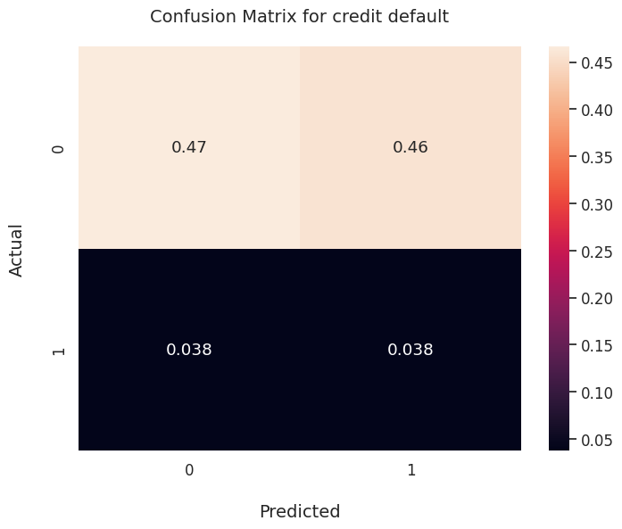
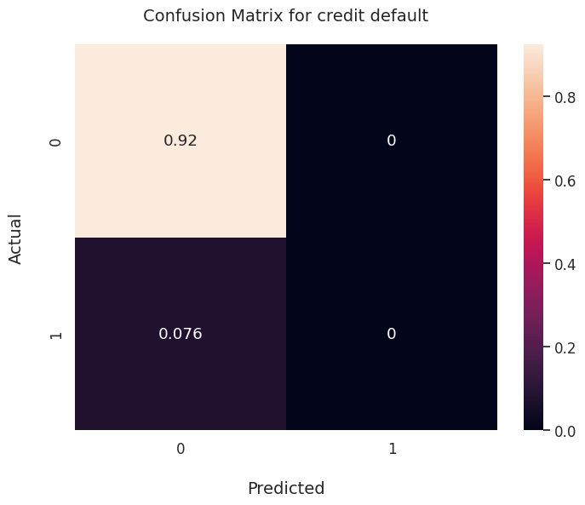
Modelization
DummyClassifier
LogisticRegression

Slide 10
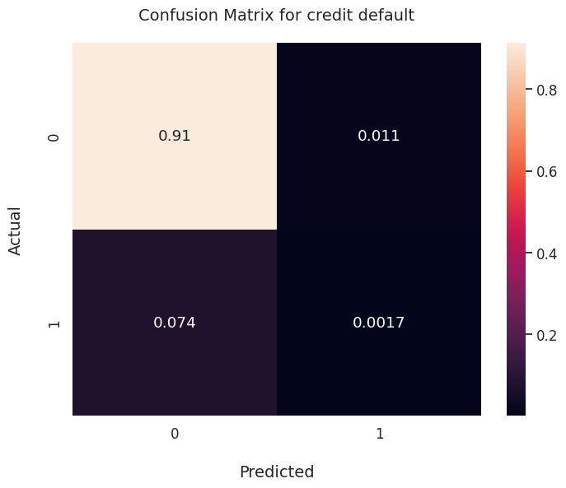
Modelization
RandomForestClassifier
LGBMClassifier

Slide 11
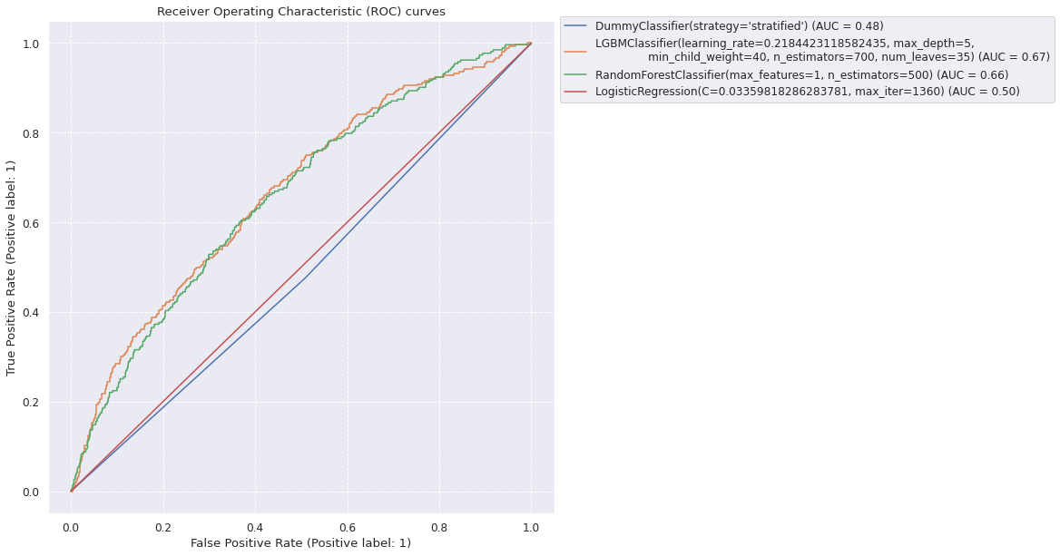
Modelization

Slide 12
Modelization
Best model : LGBMClassifier
models | auc | F1 | Custom Cost train | Custom Cost test | Accuracy
DummyClassifier(strategy='stratified') | 0.501545 | 0.132256 | 2.75 | 0.837994 | 0.504468
LGBMClassifier(learning_rate=0.218442311858243... | 0.505480 | 0.039088 | 0.41 | 0.751802 | 0.914961
(DecisionTreeClassifier(max_features=1, random... | 0.500000 | 0.000000 | 0.37 | 0.758144 | 0.924186
LogisticRegression(C=0.03359818286283781, max_... | 0.500000 | 0.000000 | 5.00 | 0.758144 | 0.924186

Slide 13
Modelization
The score obtained in the previous table are for a probability threshold of 0.5
Now we measure the score for several threshold values between 0 and 1
Probality threshold optimization :
Best Cost on test sample : 0.6264053041222254
Best Threshold : 0.09

Slide 14
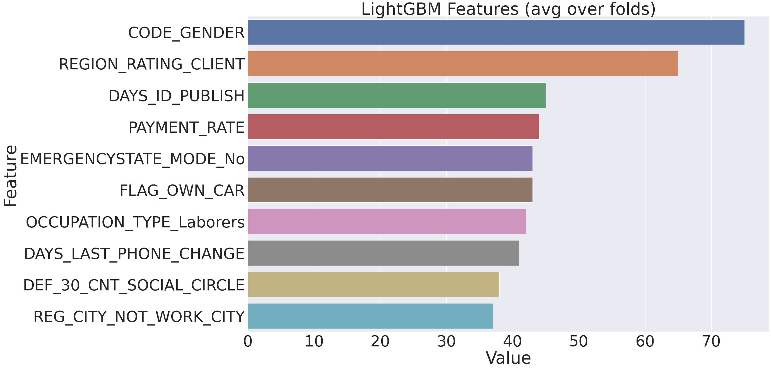
Modelization
Feature importance

Slide 15
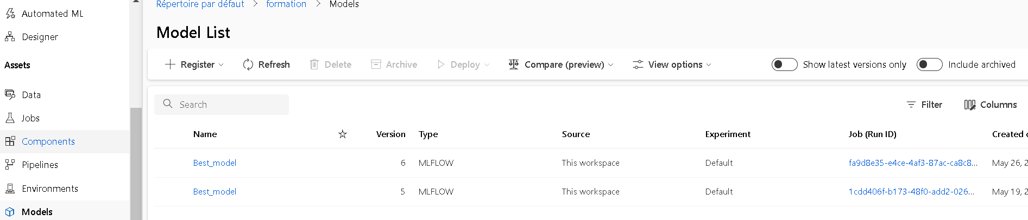
Recording experiments and models with MLFlow
We record models in Microsof Azure studio :

Slide 16
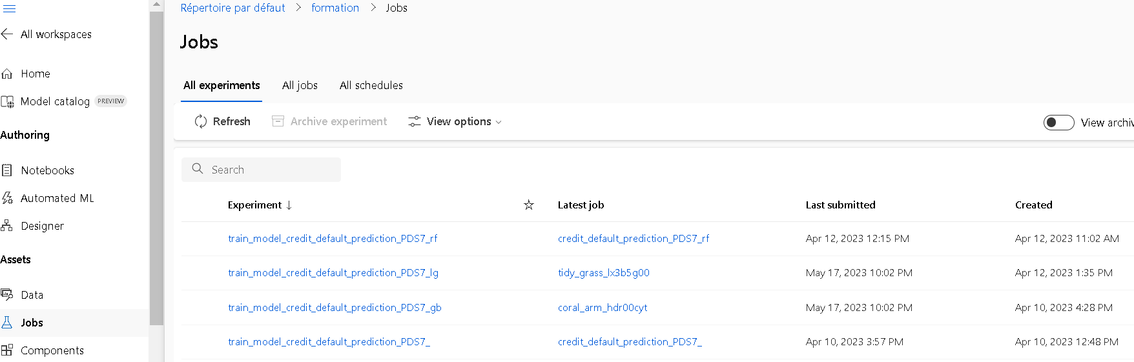
Recording experiments and models with MLFlow
We record experiments in Microsof Azure studio :

Slide 17
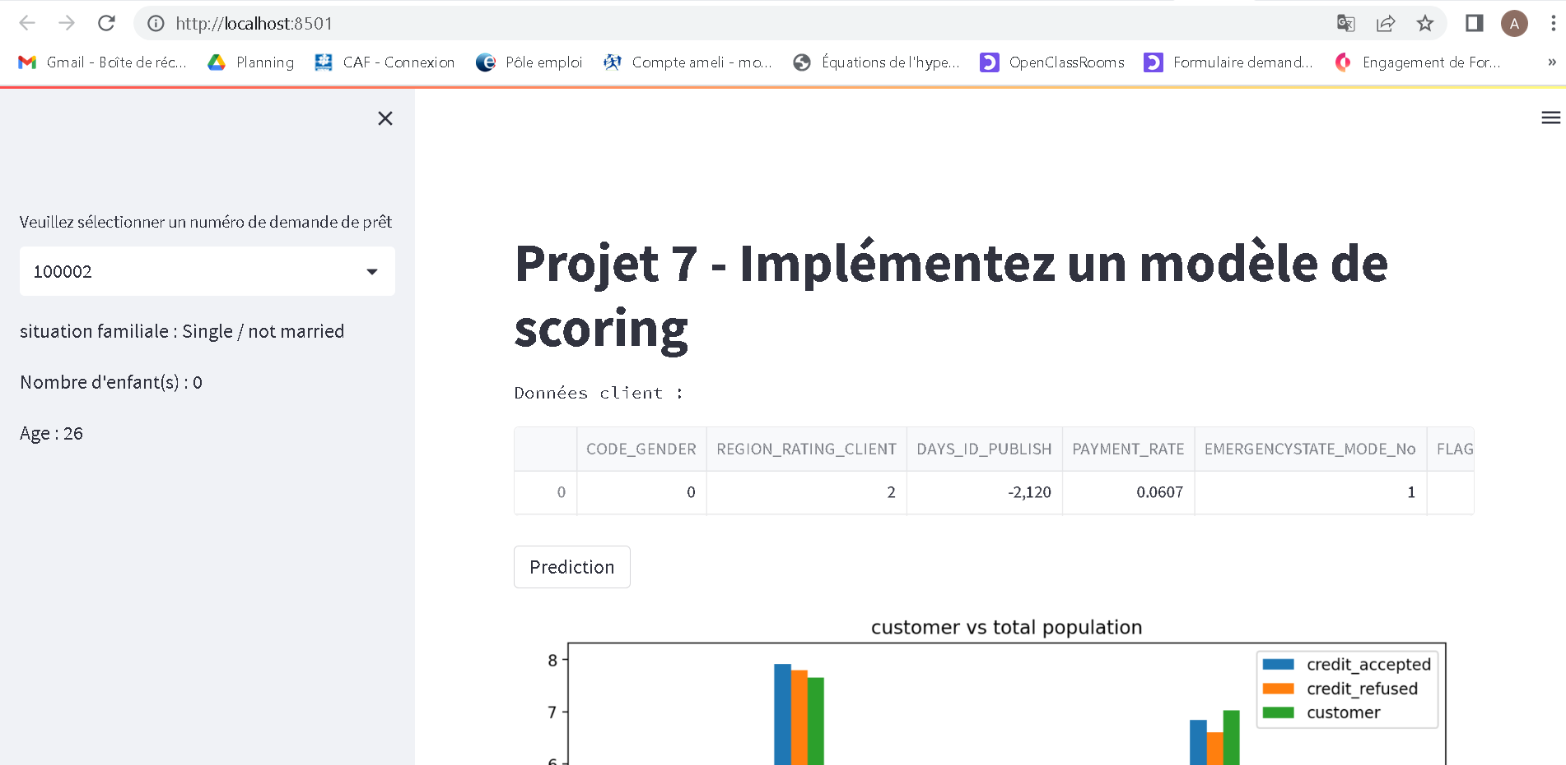
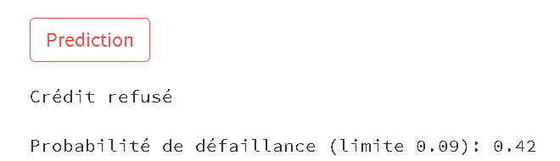
API and Dashboard with Streamlit
1-Enter loan number
2-Display basic customer info
3-Display all customer info
4-When pushed, gives the status of the customer (accepted/refused) and the failure probability

Slide 18
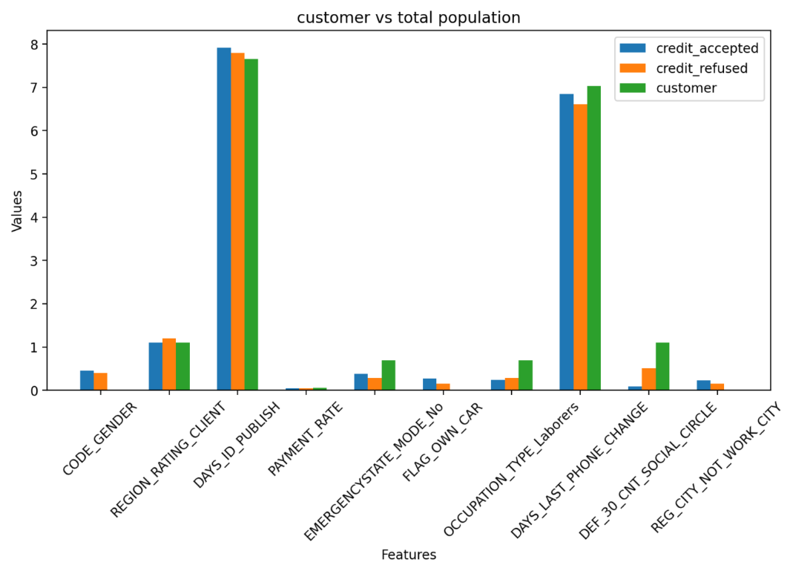
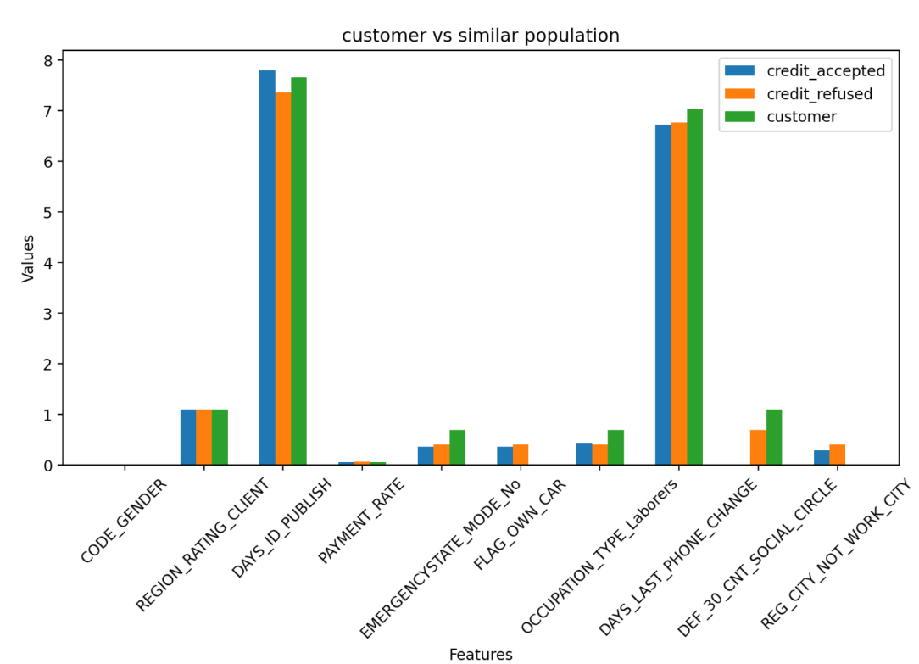
API and Dashboard with Streamlit
Customer compared to similar population (same age +/- 5y and same gender) on the important features
Customer compared to all population on the important features

Slide 19
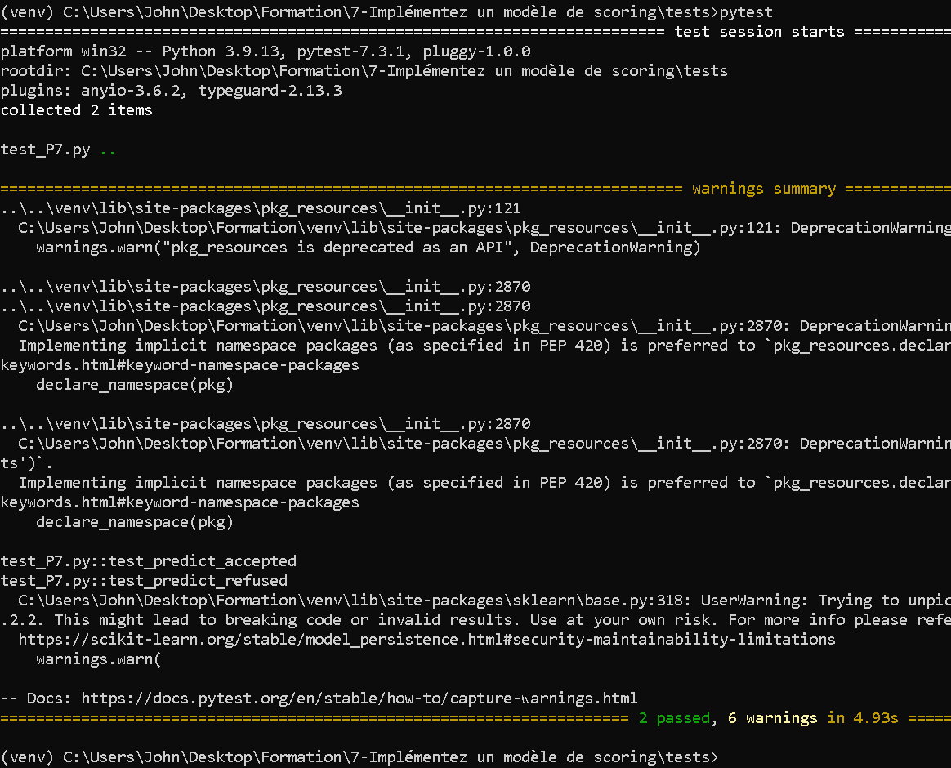

Testing with Pytest
Two tests are implemented in the file « tests/test_P7.py » ichecking the ability of the algorithm to correctly predict an « accepted » and a « refused » customer.
See the implementation of the tests below :

Slide 20
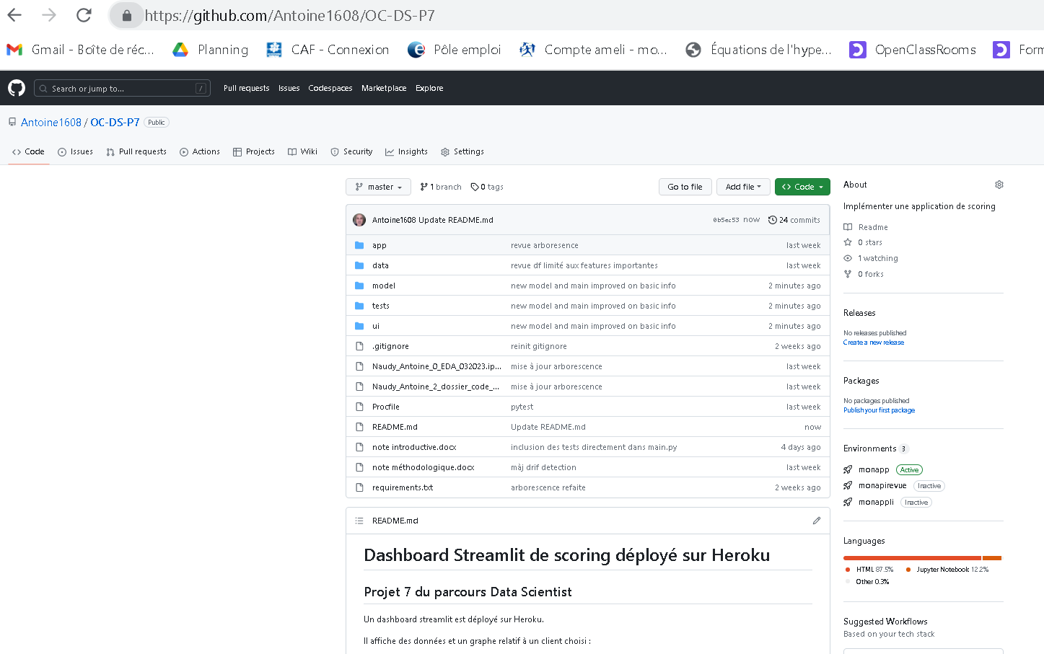

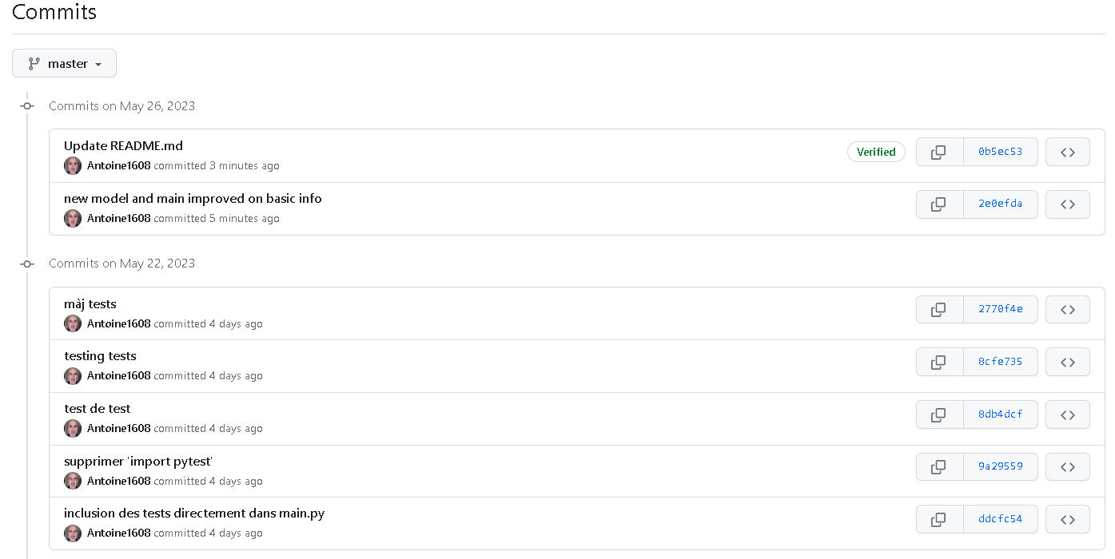
Sharing code and versioning with Github
Commit history

Slide 21
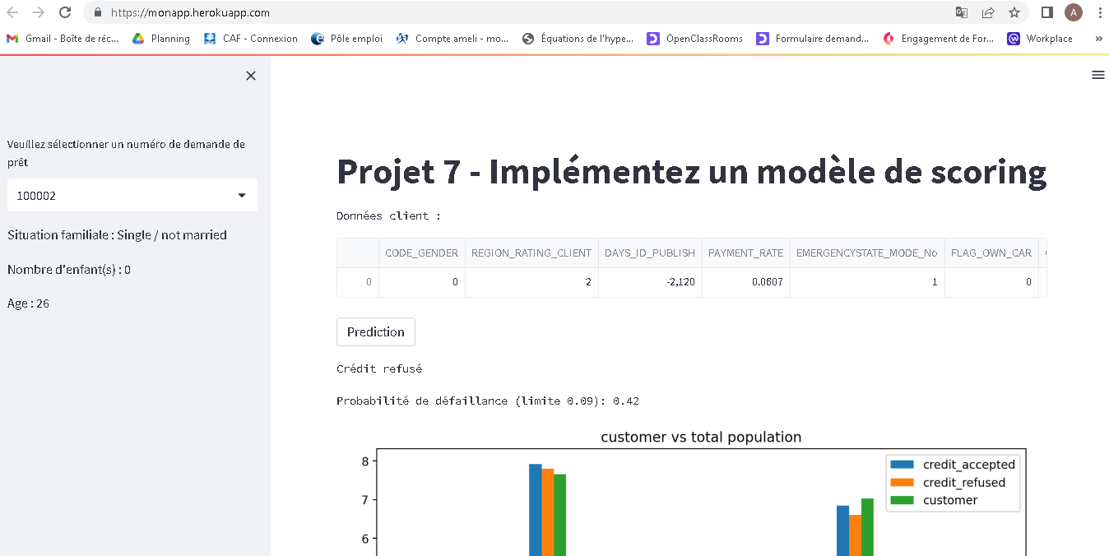
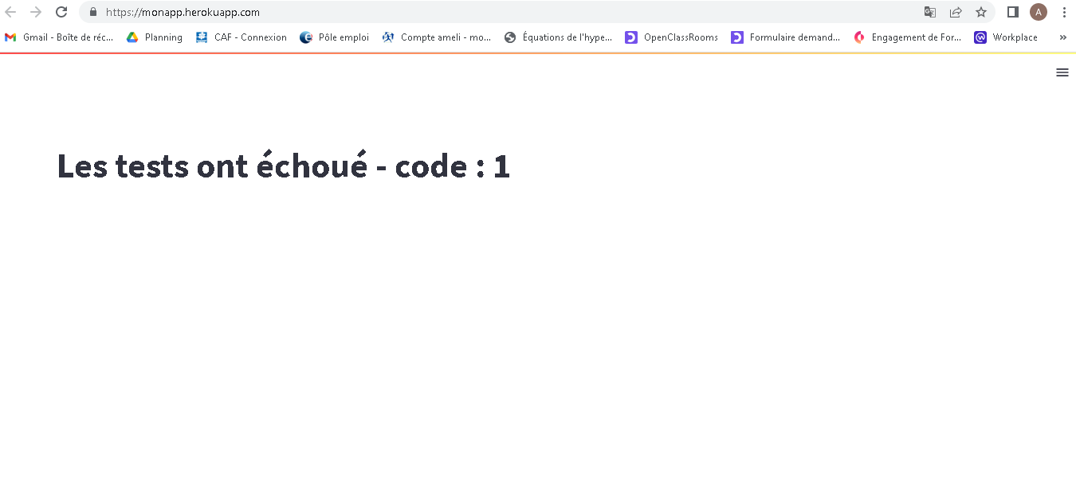
Deployment of the API on internet with Heroku
The API can be accessed on the url :
https://monapp.herokuapp.com/
The tests are integrated in the API
In case of failure the user gets a message

Slide 22
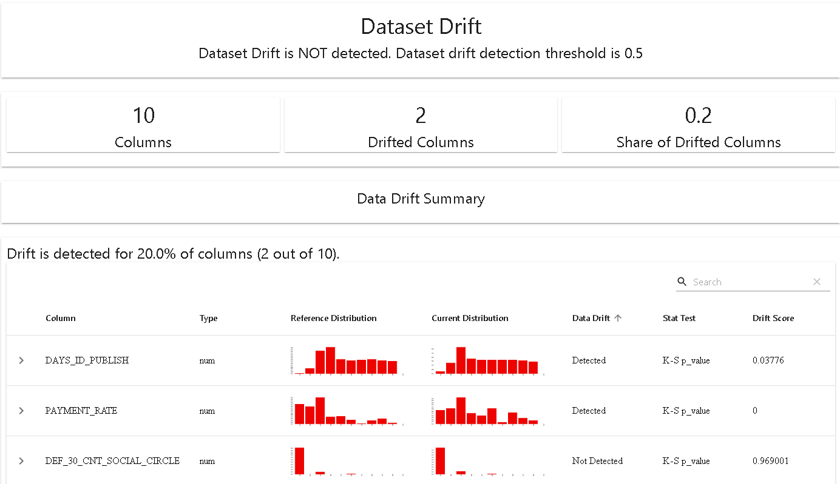
Drift analysis
The drift analysis shows two features drifting between the « application_train » data and the « application_test » data :
DAYS_ID_PUBLISH with a K-S p_value of 0.03776
PAYMENT_RATE with a K-S p_value of 0
See :
"tests\drift_report.html"

