Slide 1
Implémentez un modèle de scoring
Deployment of a scoring application on the web

Slide 2
Summary

Slide 3
Preliminary
Mission : deploy on internet a classification algorithm to predict a solvability proability for potential customers of « Prêt à dépenser » applying for a loan.
Requirements : ensure the transparency of the classification for the customers on an interactive dashboard.

Slide 4
Exploratory Data Analysis
Data are dispatched among nine files :
HomeCredit_columns_description.csv
POS_CASH_balance.csv
application_test.csv
application_train.csv
bureau.csv
bureau_balance.csv
credit_card_balance.csv
installments_payments.csv
previous_application.csv
sample_submission.csv

Slide 5
Exploratory Data Analysis
As suggested, we use the cleaning and merging job done on :
https://www.kaggle.com/code/jsaguiar/lightgbm-with-simple-features/script
The final resulting dataset :
506 features
356251 rows :
307507 for modelization
48744 for new customers
More details :
"data\Profile_Report.html"

Slide 6
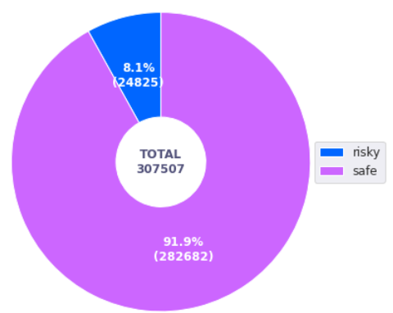
Exploratory Data Analysis
Further, we remove features contributing to bivariate correlations above 0.90.
506 features => 434 features
We check how balanced the data for modelization are:

Slide 7
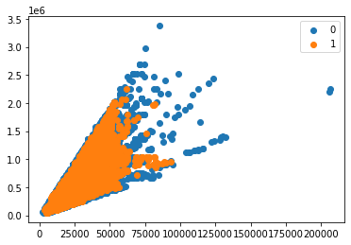
Modelization
Balancing data with BorderlineSMOTE
BorderlineSMOTE is a data augmentation technique used in machine learning to balance imbalanced datasets by generating synthetic minority samples near the borderline between the minority and majority classes.
Before : Counter({0: 12759, 1: 1116})*
After :Counter({0: 12759, 1: 12759})*
* “0” stands for customer with no solvability risk
and “1” stands for customer with a solvability risk

Slide 8
Modelization
RandomizedSearch is a hyperparameter tuning technique in machine learning that randomly samples from a defined search space to find the optimal combination of hyperparameters for a given model
We cross validate four models with RandomizedSearch :
DummyClassifier
LogisticRegression
RandomForestClassifier
LGBMClassifier
We select the best model according to its minimal custom metric on the test sample:
Custom Metric = 10FN + FP

Slide 9
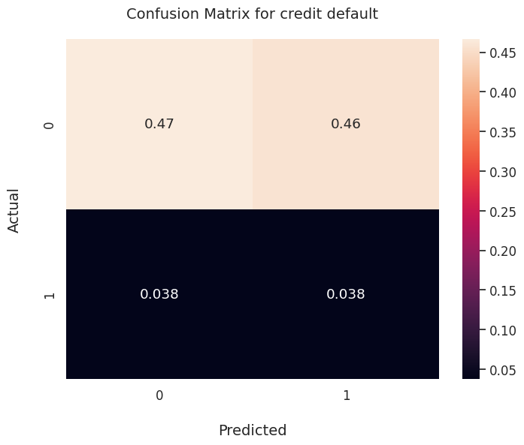
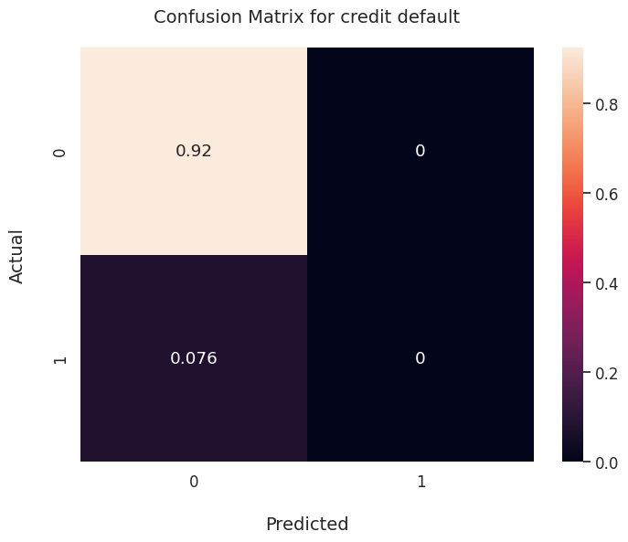
Modelization
DummyClassifier
LogisticRegression

Slide 10
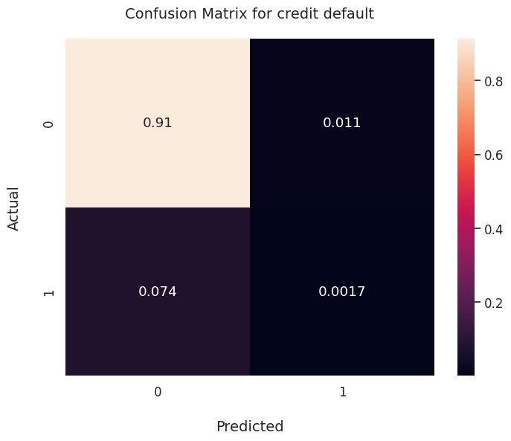
Modelization
RandomForestClassifier
LGBMClassifier

Slide 11
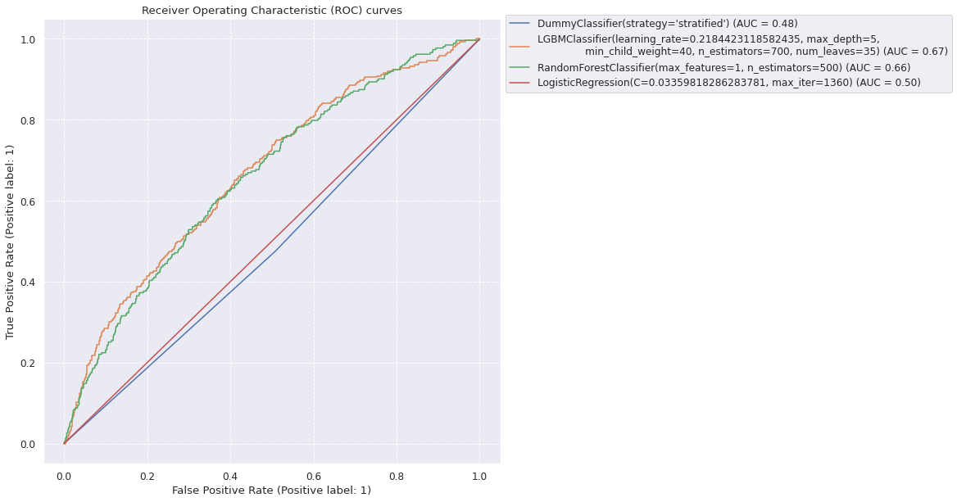
Modelization

Slide 12
Modelization
Best model : LGBMClassifier
models | auc | F1 | Custom Cost train | Custom Cost test | Accuracy
DummyClassifier(strategy='stratified') | 0.501545 | 0.132256 | 2.75 | 0.837994 | 0.504468
LGBMClassifier(learning_rate=0.218442311858243... | 0.505480 | 0.039088 | 0.41 | 0.751802 | 0.914961
(DecisionTreeClassifier(max_features=1, random... | 0.500000 | 0.000000 | 0.37 | 0.758144 | 0.924186
LogisticRegression(C=0.03359818286283781, max_... | 0.500000 | 0.000000 | 5.00 | 0.758144 | 0.924186

Slide 13
Modelization
The score obtained in the previous table are for a probability threshold of 0.5
Now we measure the score for several threshold values between 0 and 1
Probality threshold optimization :
Best Cost on test sample : 0.6264053041222254
Best Threshold : 0.09

Slide 14
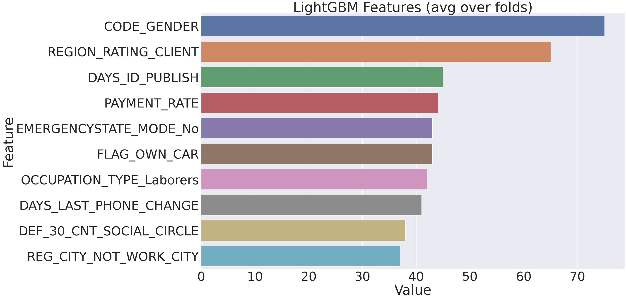
Modelization
Feature importance

Slide 15
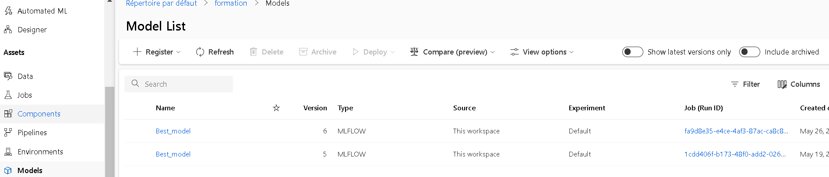
Recording experiments and models with MLFlow
We record models in Microsof Azure studio :

Slide 16
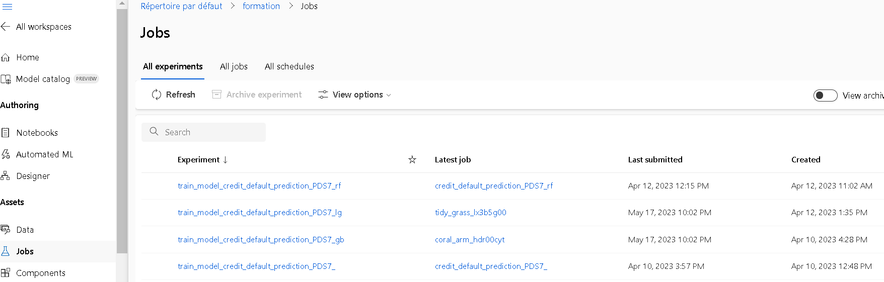
Recording experiments and models with MLFlow
We record experiments in Microsof Azure studio :

Slide 17
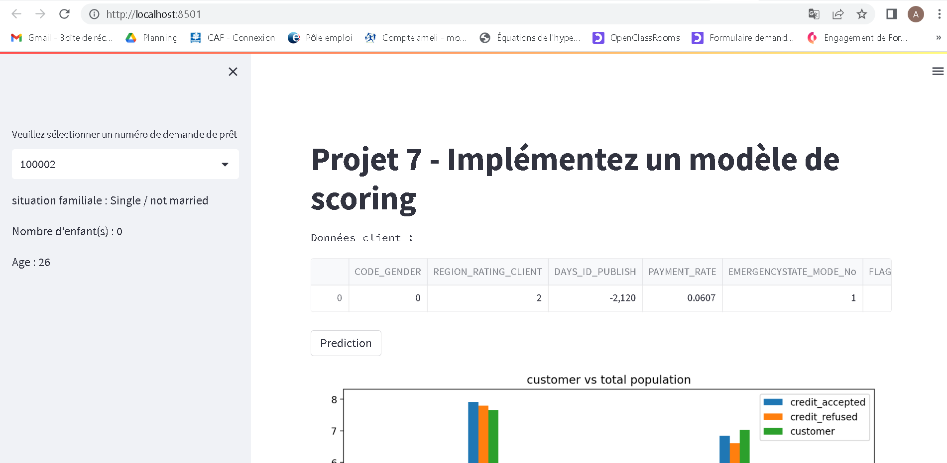
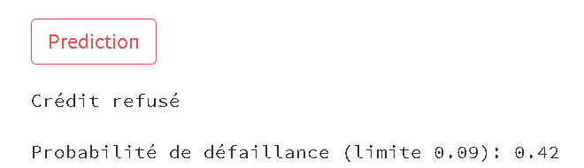
API and Dashboard with Streamlit
1-Enter loan number
2-Display basic customer info
3-Display all customer info
4-When pushed, gives the status of the customer (accepted/refused) and the failure probability

Slide 18
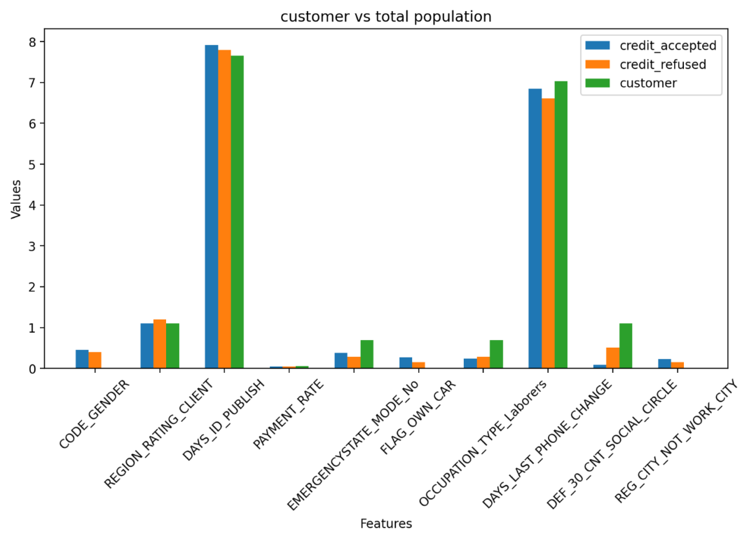
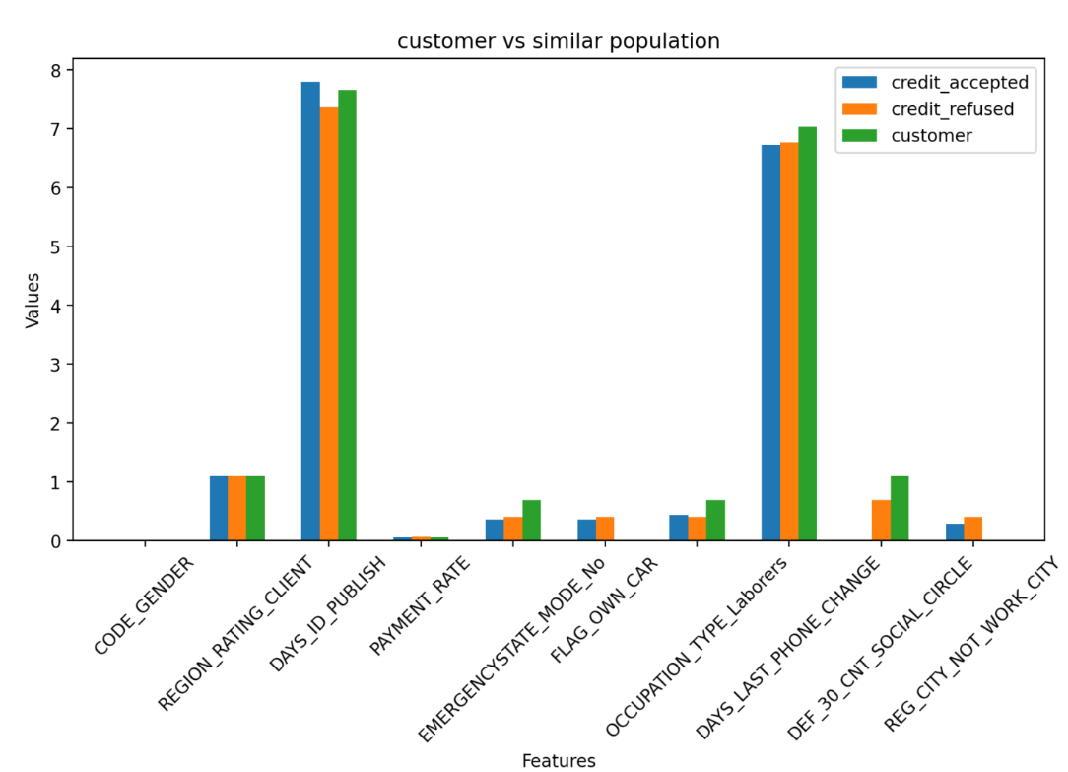
API and Dashboard with Streamlit
Customer compared to similar population (same age +/- 5y and same gender) on the important features
Customer compared to all population on the important features

Slide 19
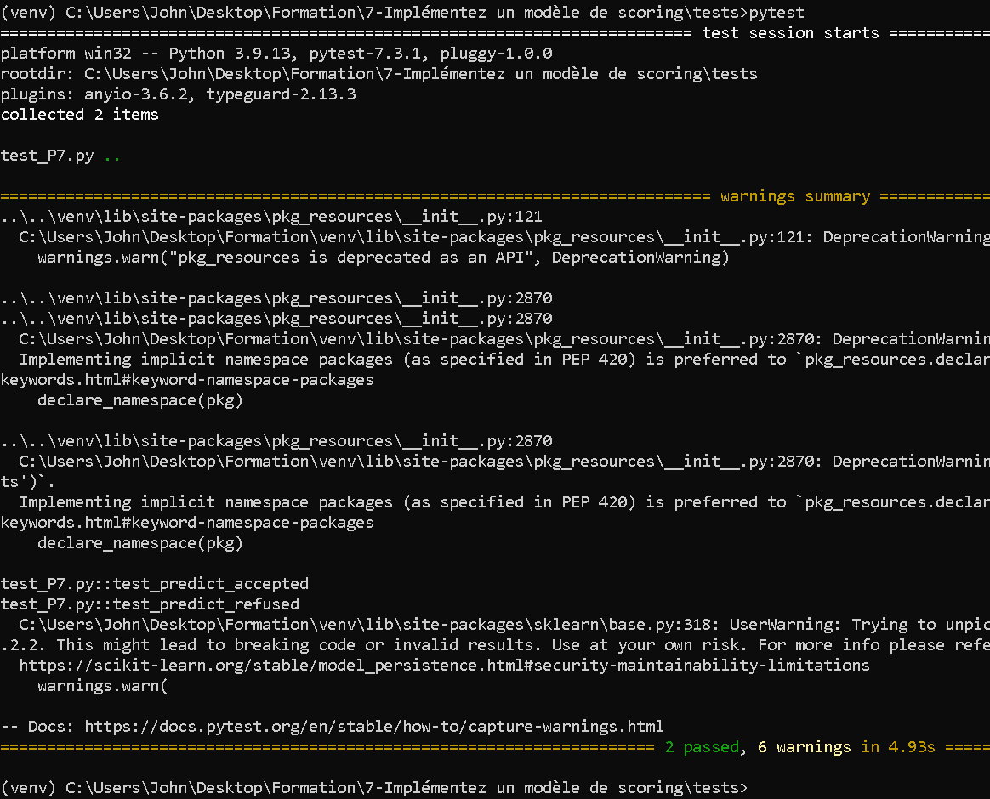

Testing with Pytest
Two tests are implemented in the file « tests/test_P7.py » ichecking the ability of the algorithm to correctly predict an « accepted » and a « refused » customer.
See the implementation of the tests below :

Slide 20
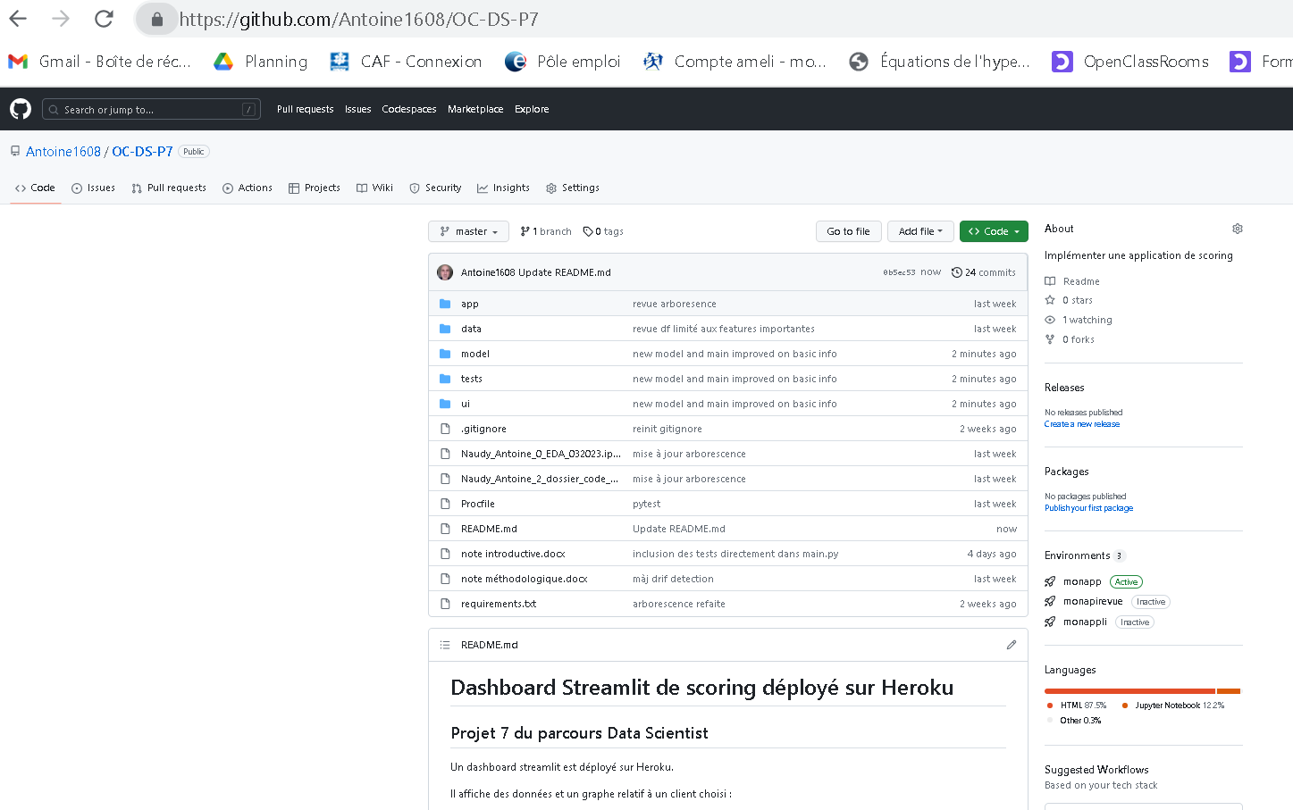

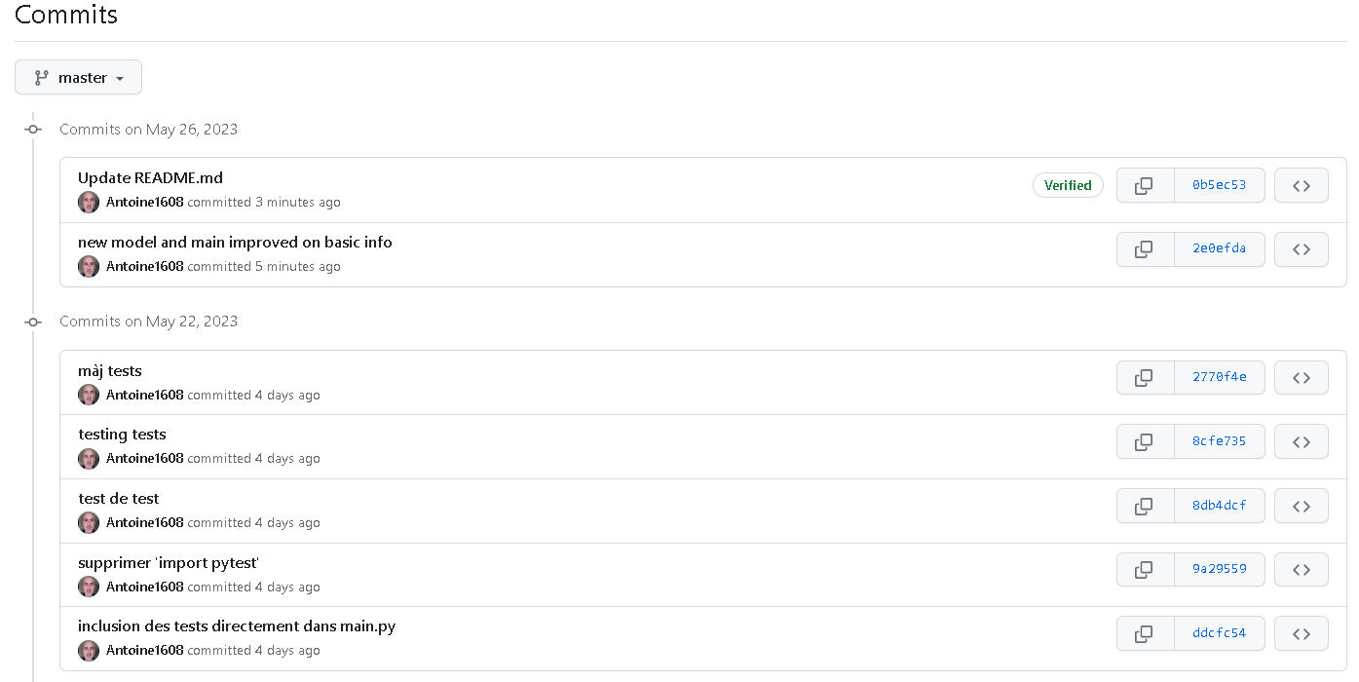
Sharing code and versioning with Github
Commit history

Slide 21
Deployment of the API on internet with Heroku

Slide 22
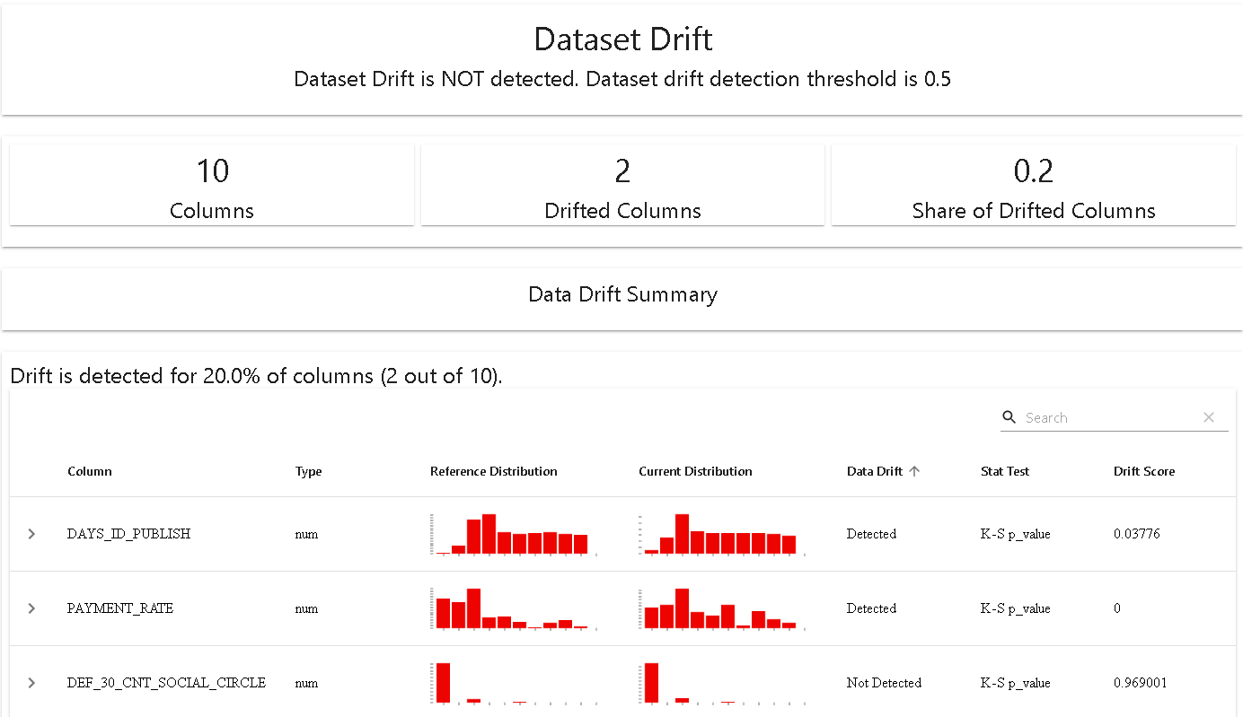
Drift analysis
The drift analysis shows two features drifting between the « application_train » data and the « application_test » data :
DAYS_ID_PUBLISH with a K-S p_value of 0.03776
PAYMENT_RATE with a K-S p_value of 0
See :
"tests\drift_report.html"

