Slide 1
Green leasing offer presentation
Antoine Mellerio
Clément Girault
Pierre de Boisredon
Ruben Viscaino
Sylvain Delgendre
Zidi Yang

Slide 2
Summary
Vision and planning
Capabilities
Delivery
General context (Why?)
Market analysis and opportunities (Why now?)
Brand positioning and strategy (What ?)
Roadmap (When?)
Selection of KPIs (How ?)
Revenue analysis and predictions (Set-up & run)
Costs analysis and predictions (Set-up & run)
Margin analysis (Set-up & run)
NLP methodology (How ?)
NLP results (Prototype and validate)
Data next steps
Risks and next steps for the project

Slide 3
Vision and planning

Slide 4

General context
The client, a French bank, has noticed that leasing has become a fast growing and profitable activity.
To differentiate from its competitor, our client wants to develop a leasing offer for green cars, focused on electric cars.
The initial target is the Ile de France region.

Slide 5
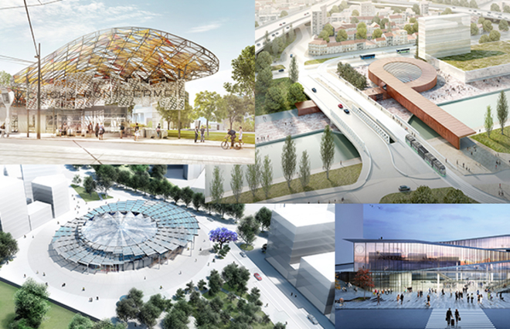
General context
Grand Paris Express
Crit’air
Green car sector
1. New subway lines
2. Green subway stops
1. Ban on old cars
By 2025 10+ years old diesel cars and 15+ year old fuel cars will be banned
2. Restriction for polluting cars
During pollution peaks, only green cars can driven
1. Electric cars
+45% of sales in France between 2020 and 2021
Hybrid cars
+70% of sales in France between 2020 and 2021
https://www.20minutes.fr/economie/3208347-20211231-automobile-marche-francais-plus-bas-2021-vehicules-electriques-plus-haut
https://www.lesnumeriques.com/voiture/marche-automobile-francais-pas-de-reprise-miracle-en-2021-l-electrique-poursuit-son-ascension-n173851.html

Slide 6






Market analysis and opportunities
The market is made of three groups of competitors :
Specialized actors
Car manufacturers
Banks
Competitors specialized exclusively in car leasing offers
Both green and ordinary cars
Selling cars was historically their core business
Leasing contracts has become predominant and is now proposed by most car manufacturers
Leasing is not part of their original offers
Take advantage of the synergies that exist with their different offers

Slide 7
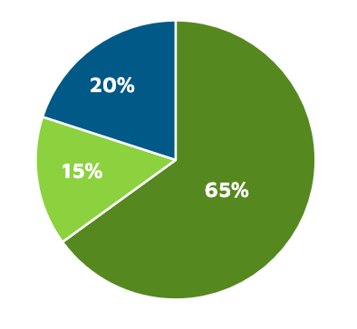
Market analysis and opportunities
Car leasing market share in France by category of competitors
65% of the market is held by car manufacturers.
20% of the market is held by banks
15% of the market is held by specialized actors.
How much is the total market worth ?

Slide 8
Market analysis and opportunities
Total estimated yearly demand in green car leasing contracts in the Ile de France region (2022)
30 240 contracts
Population of Ile-de-France region
Motorization rate
Renewal frequency
Share of green cars
Share of leased cars
12M
45%
1/10
years
8%
70%
×
×
×
×
≈
≈
≈

Slide 9
Market analysis and opportunities
The legal context and the renovation projects influence the development of a green leasing offer :
Legal context
Renovation projects
Electric cars benefit from environmental measures :
June 2021 : ban of crit’air 4 and 5 vehicles in Paris
2023 : ban of crit’air 3 vehicles in Paris
99% of the current car fleet banned in Paris by 2030 according to a study by Direct Assurance
The Grand Paris project well encourage travels by public transport :
In the long-term, we consider a decrease in the motorization rate in Paris, from 39% in 2017 to 34% in 2030 according to a study.
However, this project will have little impact in the whole region, with a motorization rate dropping from 81% to 80% in 2030 according to this same study.
Source : https://blog.direct-assurance.fr/infospratiques/grand-paris-fin-de-circulation-des-voitures-moteur-thermique
Source : https://www.apur.org/fr/nos-travaux/evolution-mobilites-grand-paris-tendances-historiques-evolutions-cours-emergentes

Slide 10
Brand positioning and strategy
Our strategy and brand positioning revolves around three key points :
1. A just-in-time strategy
Develop both LLD and LOA contracts while optimizing the buyouts or renewals at the end of the contracts. Little time and resources are spent to sell the used cars.
Implementing this strategy relies on an outstanding customer service.
2. A targeted offer
Develop an offer that sticks to the Ile de France demand :
small and cheap electric cars for Intramuros travels. Typical model : Renault Zoé.
premium electric cars for longer travels. Typical model : Tesla model 3.
An offer that targets both companies and individuals
3. Generating synergies
Develop attractive packages to benefit from the bank’s existing offers :
Insurance at preferential rates
Loan at preferential rates for a potential buyout
Utilize the bank’s client base as a mean for customer acquisition at launch.
Notes:
Pour le point 1), l’idée c’est d’être capable de vendre la voiture à la fin du contrat sans perdre de temps et de ressources. Pour cela il faut que le client soit satisfait tout au long de son contrat de leasing, grâce à une expérience client forte, que la voiture corresponde parfaitement à ses attentes, aucun défauts dans la voiture, etc.

Slide 11
Roadmap
Launch of the Tesla model 3 and Renault Zoé green leasing offer.
Ban on crit’air 3 vehicules in Paris.
The offer reaches its breakeven point.
2022
2023
2024
2025
Marketing campaign broadcasting ads on TV.
Launch of new models of green leasing contracts.
Launch of green leasing offers nationwide.

Slide 12
Capabilities

Slide 13
Selection of KPIs
Market KPIs
Financial KPIs
Customer KPIs
1. Market share
Reach 20% of the market share among bank competitors by 2025.
2. Carbon emissions
Reach less than 30g of carbon emission per kilometer*
*Electric models currently emit around 33 grams of CO₂ per km driven, which is one quarter that of the most popular conventional vehicle, a 2019 Ford Fiesta.
1. Growth
Reach a growth in sales of +50% per year while remaining profitable.
2. Margin per contract
Reach a net margin per contract of 3000€/unit.
1. Service renewal rate
Reach a buyout ratio of 25% at the end of the contract.
Reach a renewal rate of 50% for a new leasing contract at the end of each contract.
2. Satisfaction rate
Reach a satisfaction rate of 95% of clients.

Slide 14
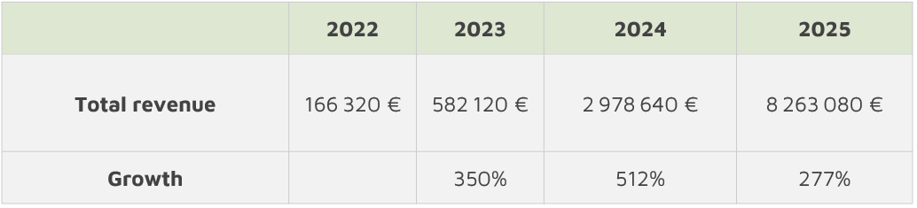
Revenue analysis and predictions

Slide 15

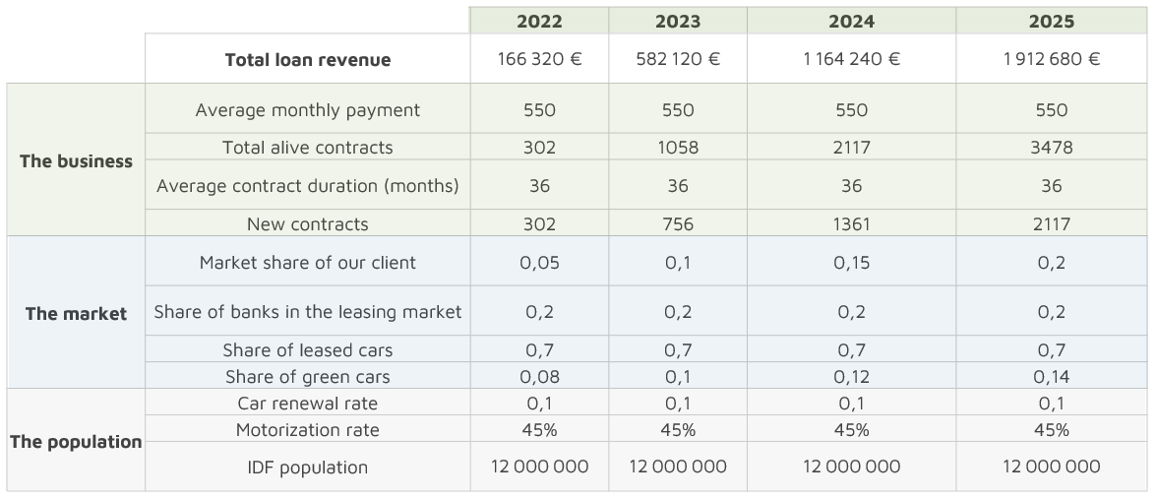
Revenue analysis and predictions
Notes:
La taille du marché, de 30 240 contrats par an en 2022 établi en slide 7 correspond ici à la multiplication 0,7*0,08*0,1*45%*12 000 000.

Slide 16
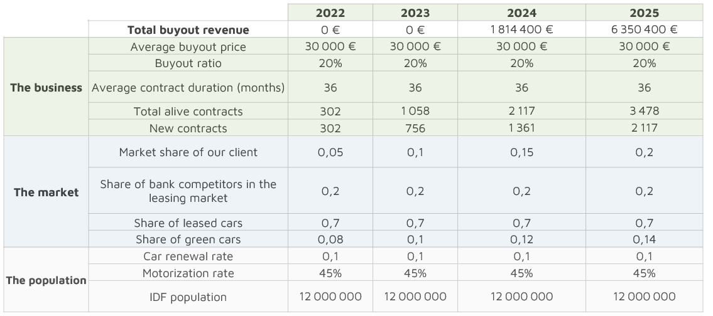
Revenue analysis and predictions

Slide 17
Cost analysis and prediction
We differentiate two different kind of costs:
Variable costs
Fixed costs
Insurance costs: repairing leased cars insured through our services
Car reconditioning for unbought vehicles
Car acquisitions
Parking lots rental
Marketing
Salaries
IT cost

Slide 18
Cost analysis and prediction
Total estimated fixed costs :
4 Millions €/year
Parking lots rental
Marketing
Salaries
IT costs
0.4M
+
0.8M
+
2.4M
+
0.4M
Notes:
Parking : nb de voitures maximum * prix annuel d’une place en région parisienne : 4000 * 100
Marketing: revenu 2025 * 10%
Salaire: revenu 2025* 30%
IT : revenu 2025* 5%
L’idée est de calculer nos couts approximatifs à partir d’une estimation de nos revenus de long terme

Slide 19
Cost analysis and prediction
Total estimated variable costs by car:
46,000 €/car
Acquisition
Repairing
Reconditionning
35k
4k
7k
+
+
Notes:
Acquisition: prix moyen avec 40% de zoé, 40% de tesla model 3 et 20% de véhicules plus chères + un rabais de 15% environ parce qu’achat direct au producteur :
(0.4 * 32k + 0.4 * 42k + 0.2 * 60k) * 0.85
Repairing lié aux accidents: ~ 15% du prix d’une voiture sur toute sa durée de vie
Reconditionning: 25% du prix du véhicule, seulement pour les véhicules non achetés en fin de contrat

Slide 20
Margin analysis
Breakeven :
1052 contracts per year
Notes:
Leasing revenue per unit = 36 (months) *550€

Slide 21
Limits of our model
We have identified two limits to our model :
1. Requires huge investments
2. A gap in time between cash flows
An important part of our revenue comes from buyouts at the end of the contract, hence a delay between the moment we buy the car and the moment the car is sold. To limit this risk :
Utilizing synergies, by taking advantage of the bank’s huge liquidities to cover this gap.
A just-in-time logic so as to sell the car as soon as the contract ends.
Despite being a profitable market, this business requires heavy investments and liquidities to cover the acquisition costs.
For instance, the cash required to acquire enough cars to cover the demand of 2025 amounts to 46000€ * 2117 = 97M€.

Slide 22
NLP Methodology
Methodology
Limits
1. Web scrapping
Scrapped caradisiac forum for interesting models: Tesla model 3, Renault Zoé and Peugeot e-2008
2. WordClouds
Created wordcloud based on word importance for each brand
3. Sentiment analysis
Used Vader to extract sentiments for relevant models
1. Unique forum
All of our data come from a unique forum so they might be biased
2. Bias
The forum is mostly used to talk about car problems which implies a bias in the data
Data imbalance
The quantity of data available for each model is widely variable

Slide 23
Delivery

Slide 24
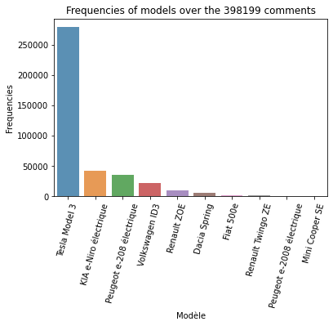
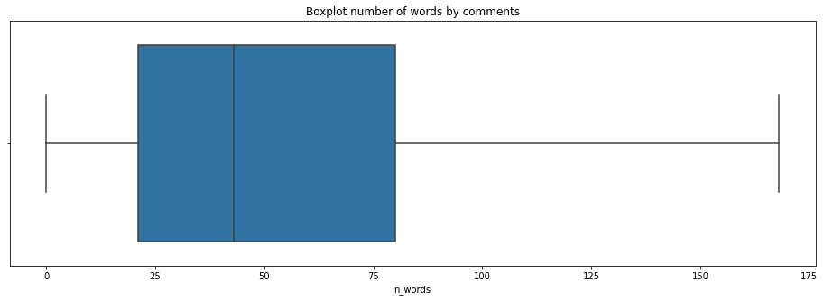
Data exploration
Repartition of the number of words per comment
→ median of 43
→ we can remove the comments too short on which sentiment analysis will be hard to execute
→ Tesla model is much more discussed hence it would be good to have it available

Slide 25
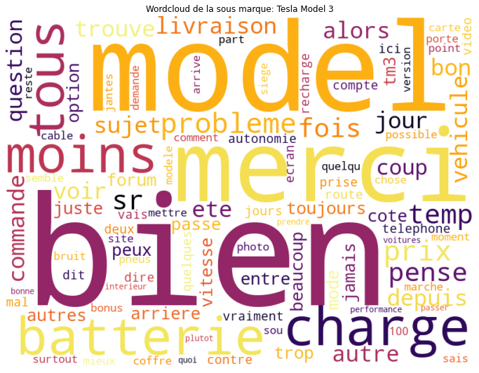

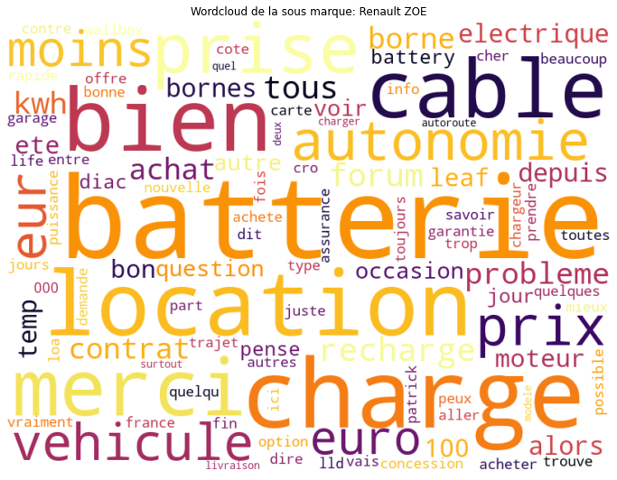
Wordclouds for different car models
We created word clouds for each potential car based on specialized forums:
Word Cloud for the Tesla Model 3
Word Cloud for the Peugeot e-2008
Word Cloud for the Renault Zoé
Positive words
Words linked to electricity
Negative words
Notes:
Limite pour le NLP:
Scrapping d’un unique forum
Différence de nombre de messages entre chaque type de modèle
Nécessité de réaliser des analyses plus détaillés que des simples wordClouds

Slide 26
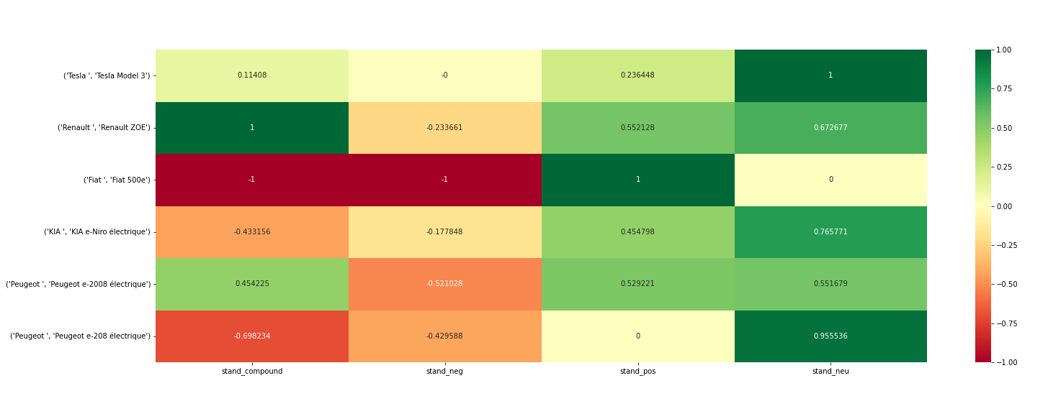
Sentiment analysis

Slide 27
Data next steps
Increase income
Limit costs
1. Selling data
Selling data about car usage would bring mid-term revenues
Data marketing
Using digital marketing with the bank’s data can speed-up client acquisition
1. Churn
By using a prediction model we can detect churn and try to keep clients via marketing methods
2. Detect problems
By using NLP over customer feedbacks, we can detect issues with our product and improve it quickly

Slide 28
Risks and next steps for the project
The green leasing market in the Ile de France region is profitable. However, profits only emerge after a few years, since an important proportion of the income comes from buyouts.
This cash flow gap implies a significant cash requirement for the bank until the business is profitable, which can be a source of risk and additional financial costs. Utilizing synergies can limit this risk.
Next steps :
Consider other income sources
Measure customer satisfaction
Segmentate the financial analysis by car (Renault Zoé vs Tesla)
Measure the impact of the cash flow gap

Slide 29
Conclusion
A completer : Model type chosen, profitability, etc.

