Slide 1
STATISTICAL LEARNING
Facial recognizer
—
Fischer discriminant analysis
GUÉNA Vincent - MELLERIO Antoine

Slide 2
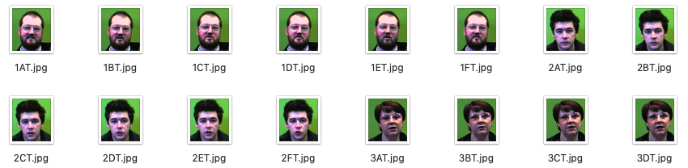

INTRODUCTION
Dataset :
Process :

Slide 3
PREPROCESSING
1 - conversion into black & white
2 - grouping into one matrice :
200 × 180
…
1 x 3600
…
150
1 x 3600
200 × 180

Slide 4
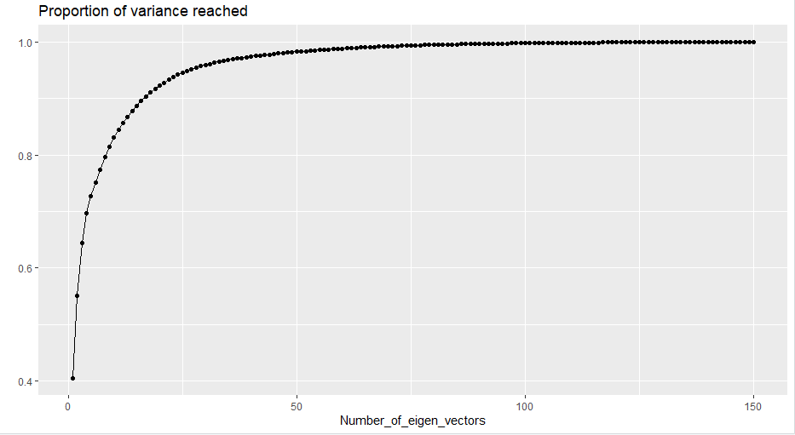
PRINCIPAL COMPONENT ANALYSIS
for the FDA : number of classes - 1 = 24 eigenvectors
—> 94% of the variance

Slide 5
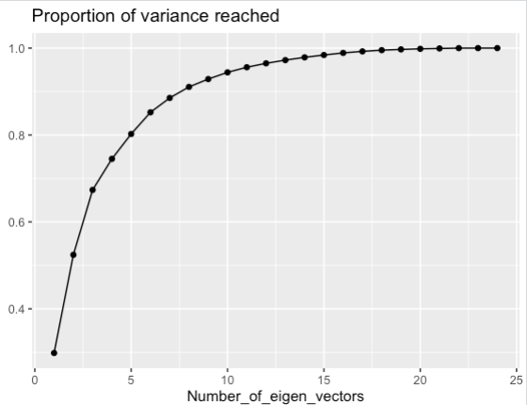
FISCHER DISCRIMINANT ANALYSIS
0,992
17
99% of the variance —> 17 eigenvectors

Slide 6
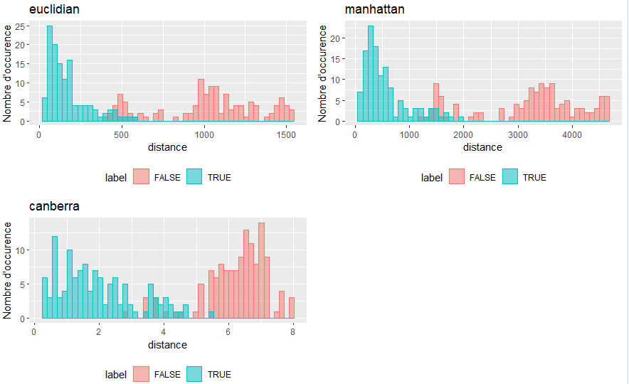
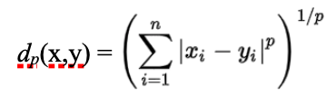

K-NN CLASSIFIER
N_neighbor = N_class = 6
 | Number of overlapping distances
Euclidean | 34
Manhattan | 37
Canberra | 104
Distances between new pictures of each class and all the dataset

Slide 7
K-NN CLASSIFIER
Distances between new pictures of each class and all the dataset
800
10 errors —> threshold = 800
accuracy = 96%

Slide 8
CONCLUSION
Parameters :
PCA : Number of components = 24
FDA : Number of components = 17
K-NN :
}
Number of neighbors = 6
Similarity metric = euclidean distance
Identifying threshold = 800
accuracy = 96%
Possible Improvements :
more components after the FDA
bigger, more complete and more varied dataset

Slide 9
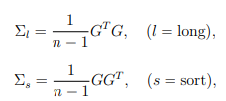
PRINCIPAL COMPONENT ANALYSIS - details
applying the PCA in order to reduce the size of the database while preserving maximum of variance
the variance covariance matrix is too large (size 3600×3600=13Mbit)
$G=[x_{i,j}−µ]$ $x_{i,j}$ element of the database,
$µ$ mean of the database
$φ_{s}$ the eigenvectors of $Σ_{s}$ → $G^{t}φ_{s}$ the eigenvectors of $Σ_{l}$

Slide 10

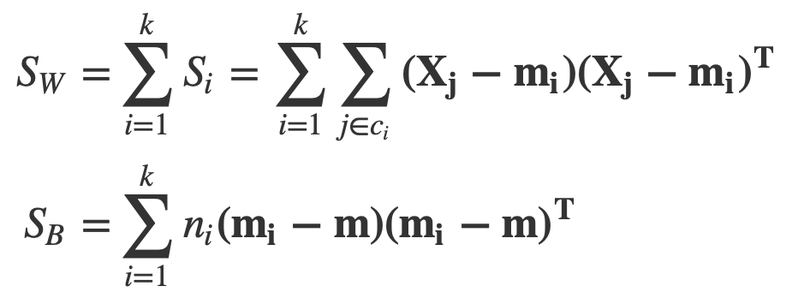
FISCHER DISCRIMINANT ANALYSIS - details
reduce the size of the database while preserving the variance
minimizing the within class variance
& maximizing the between class variance
eigen vectors of where :

