Slide 1
Code improvements
Add 2 additional lines (+filtering of the bores)
Add Machine Learning models : Extra Trees and Gradient Boosting
Add an averaging models and scripts to apply inference in the pipeline:
3 ensemble methods
3 ensemble methods + 1 Neural Network

Slide 2
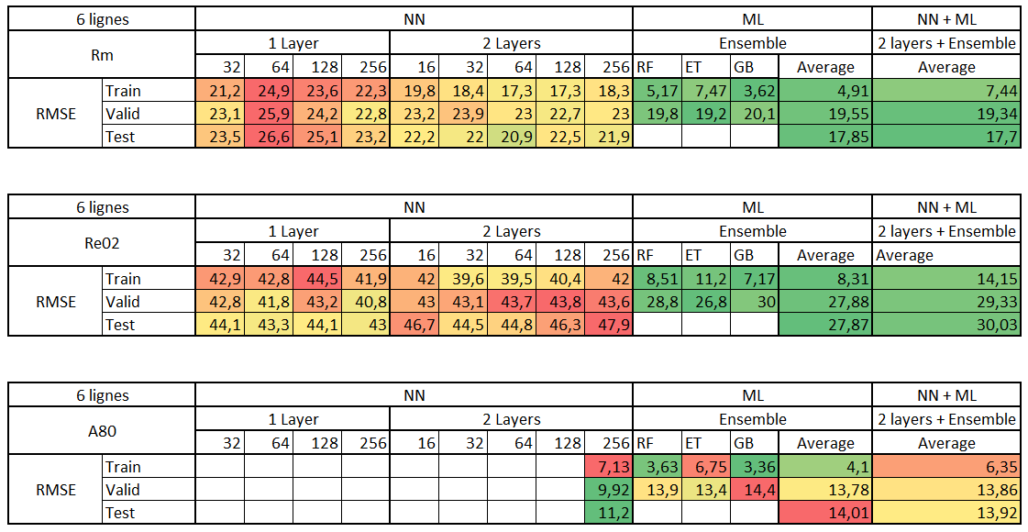

Slide 3
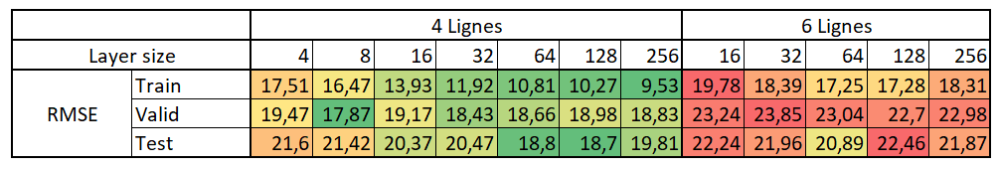

6 lines vs 4 lines
Meilleure généralisation – résultats quasiment identiques sur le train, valid et test

Slide 4
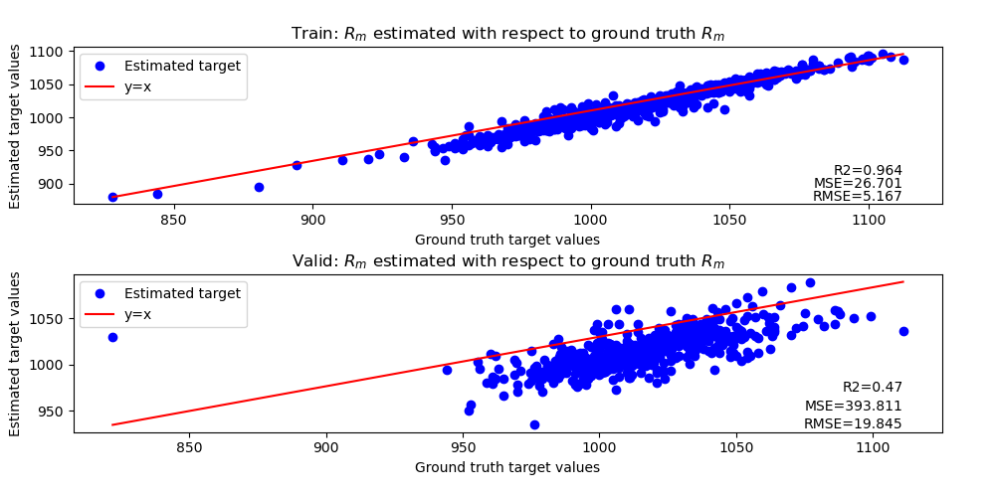
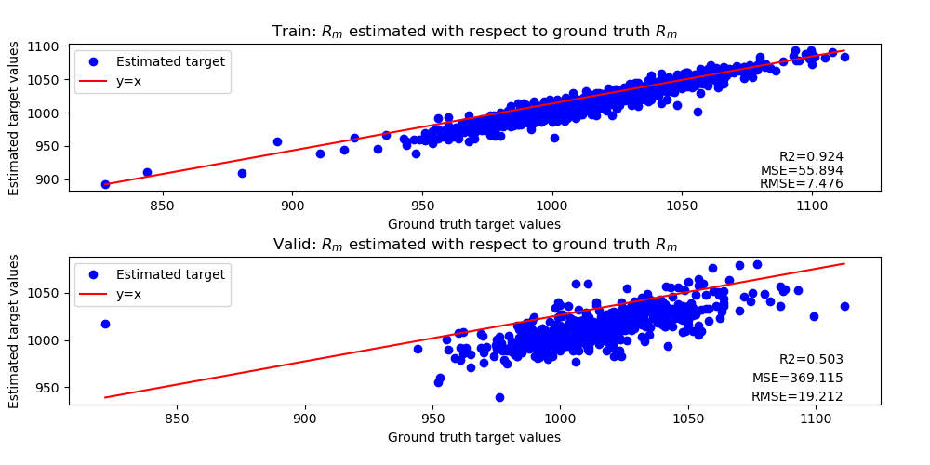
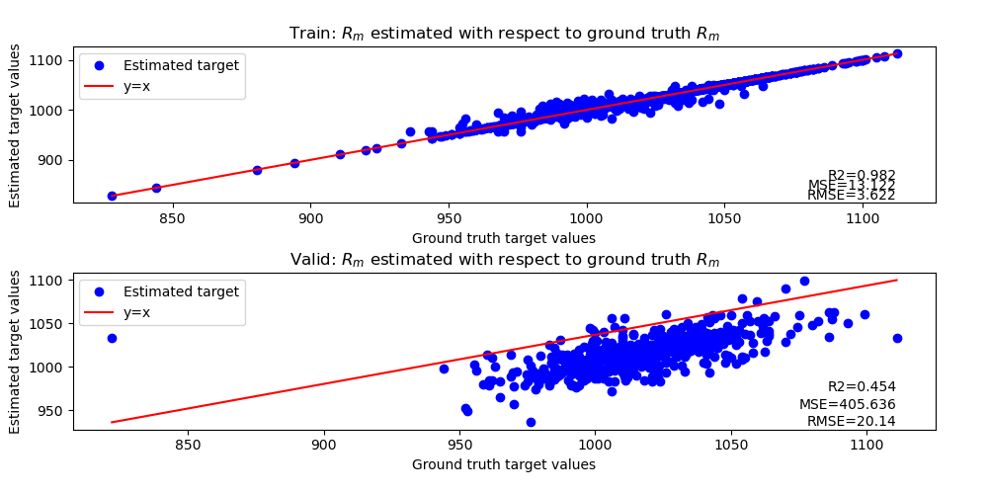
Comparaison of RF, ET and GB
Random Forest
Extra Trees
Gradient Boosting

Slide 5
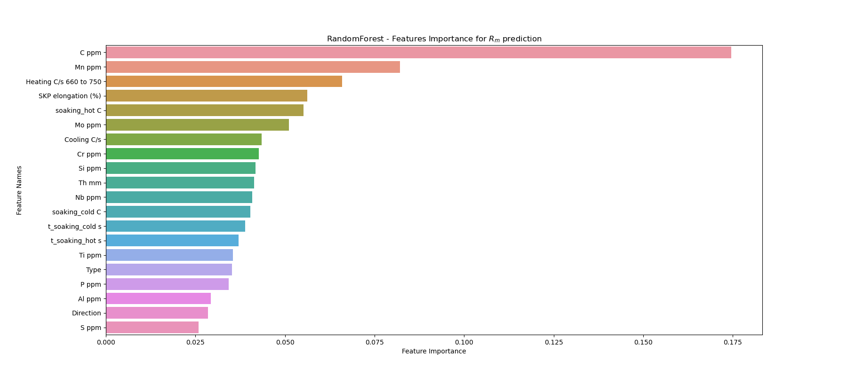
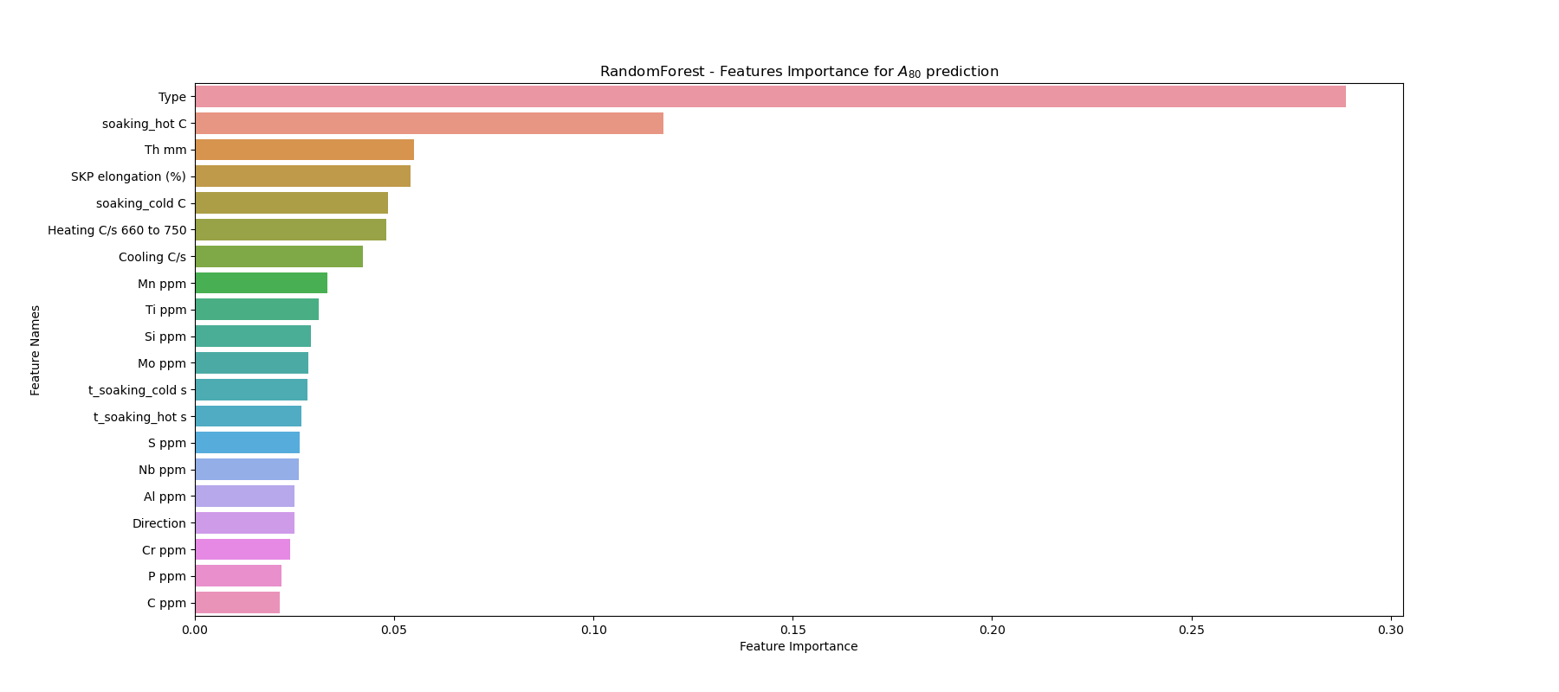
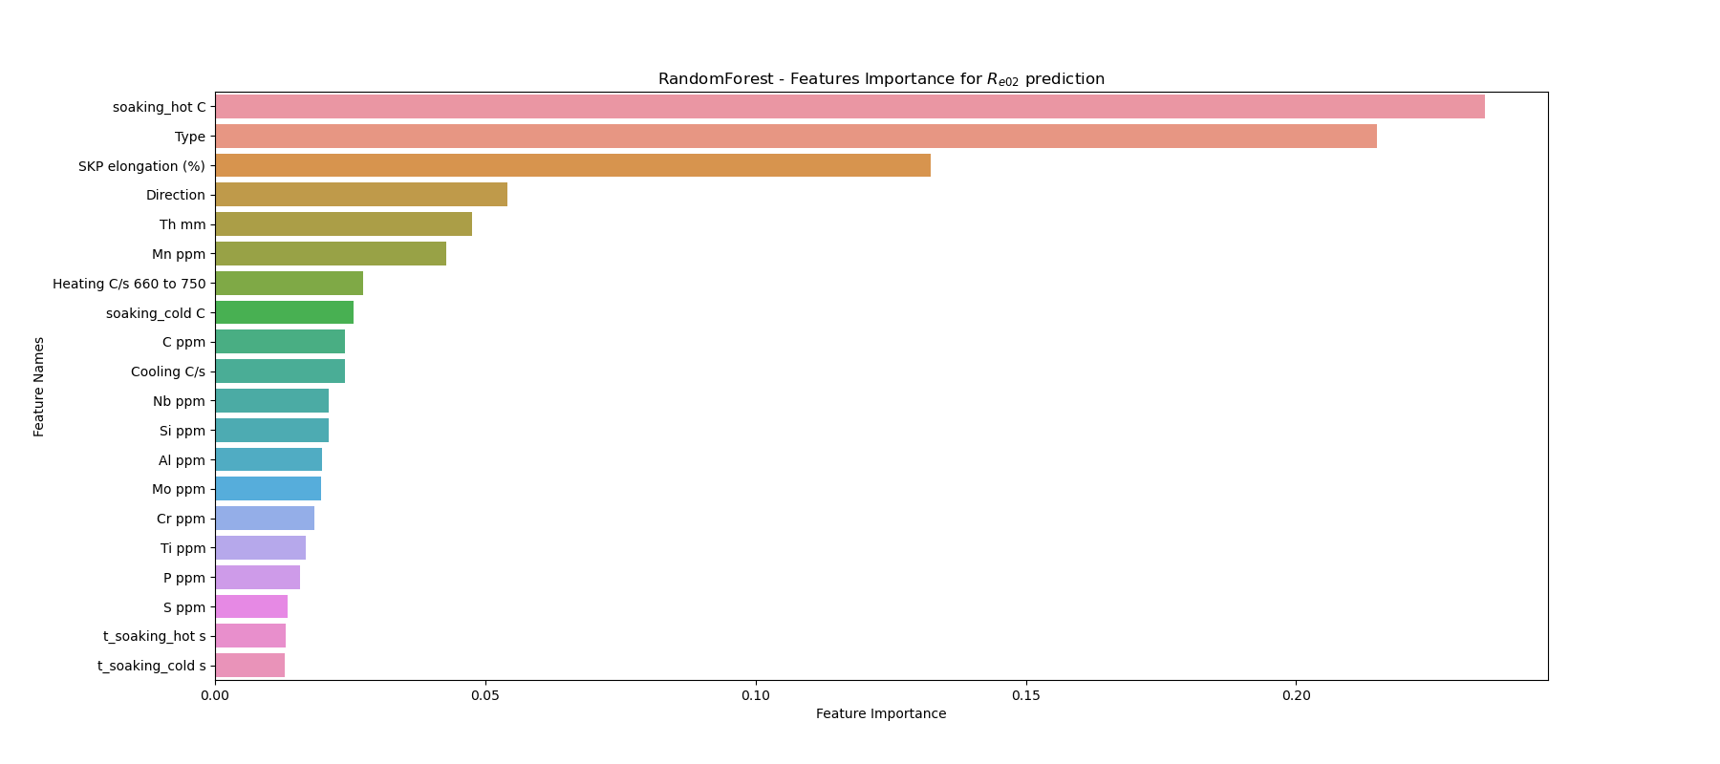

Slide 6
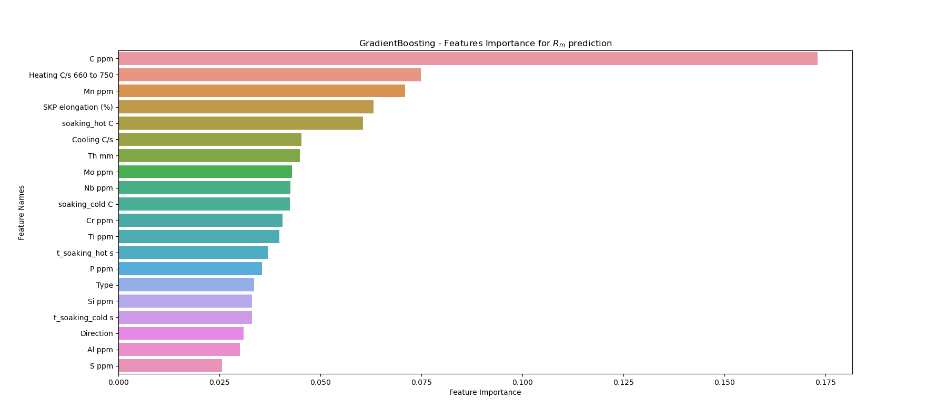
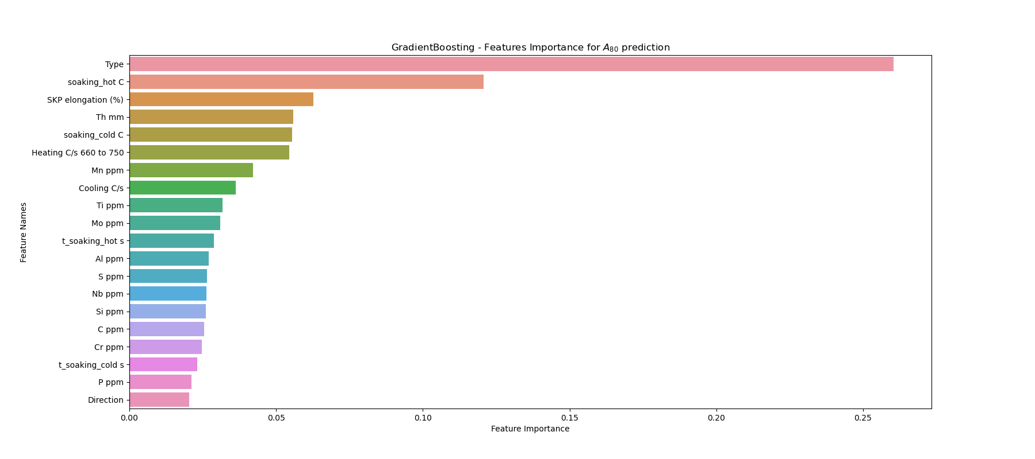
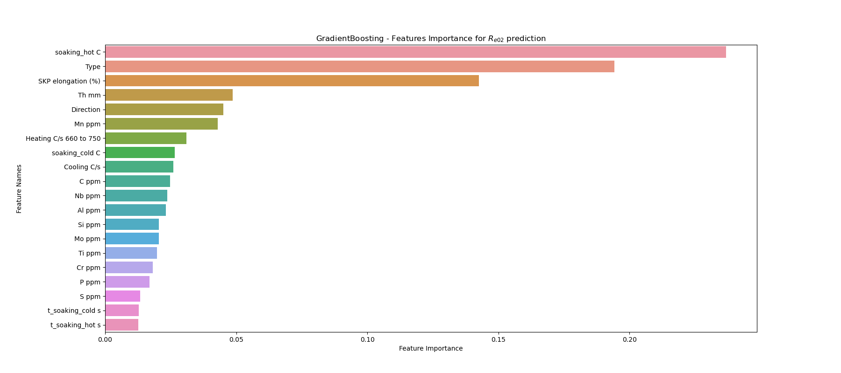

Slide 7
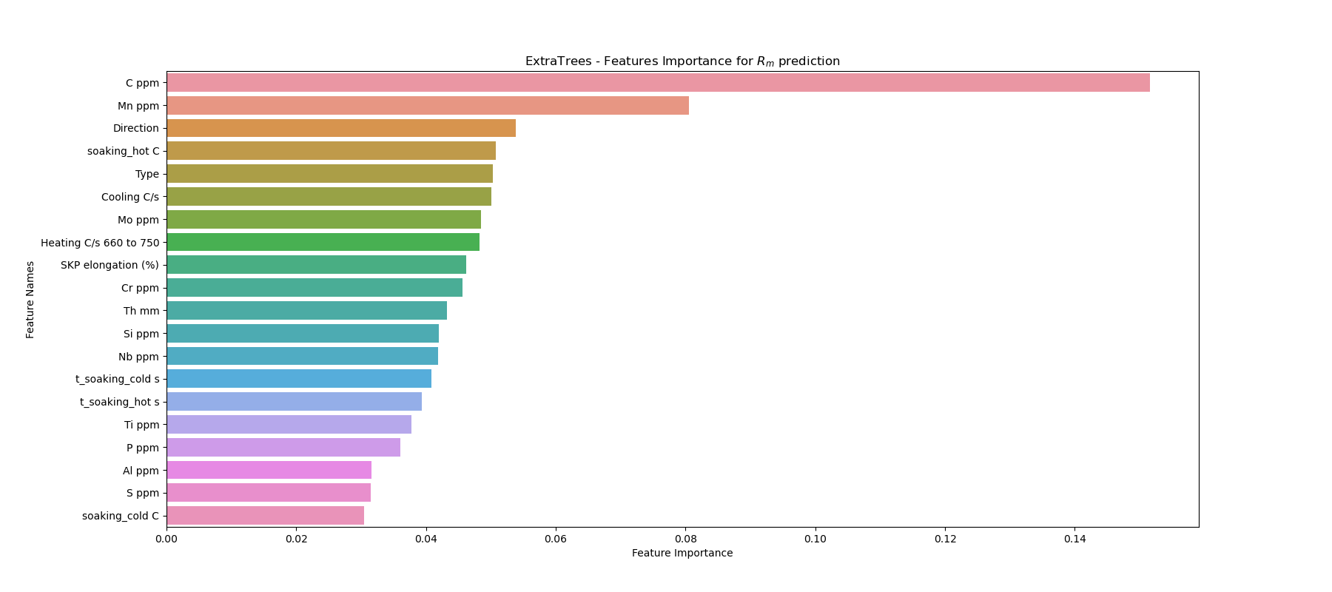
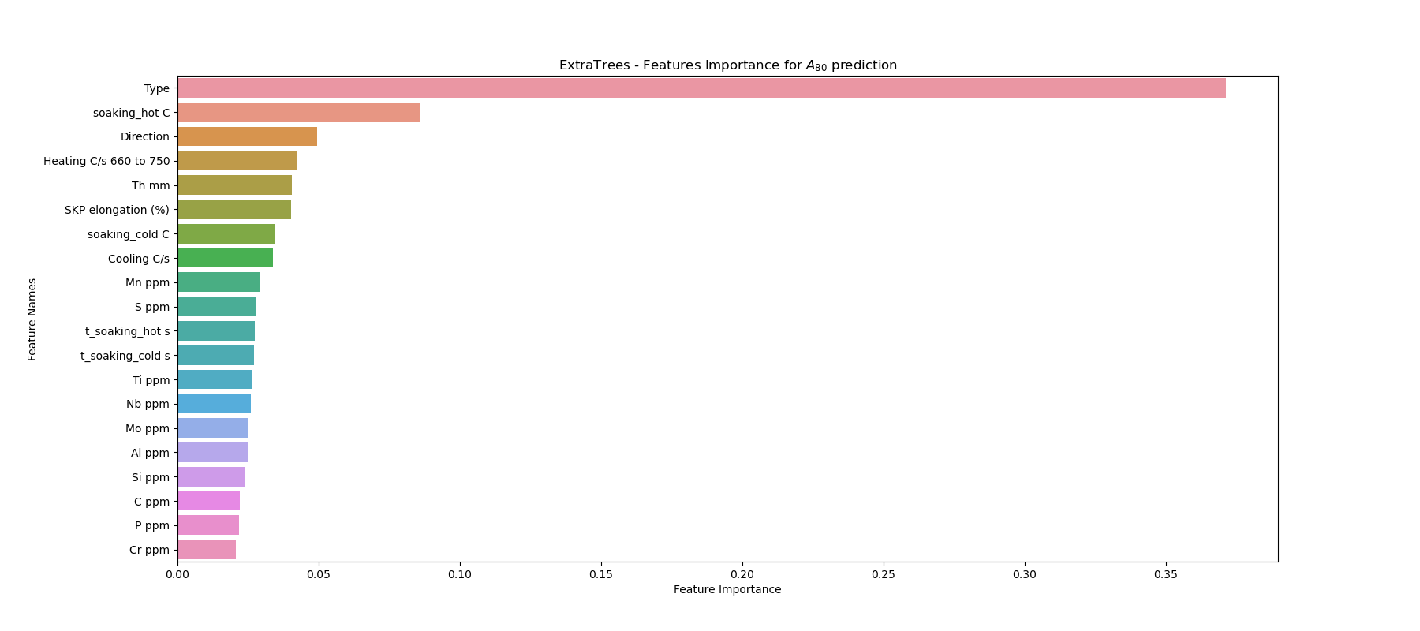
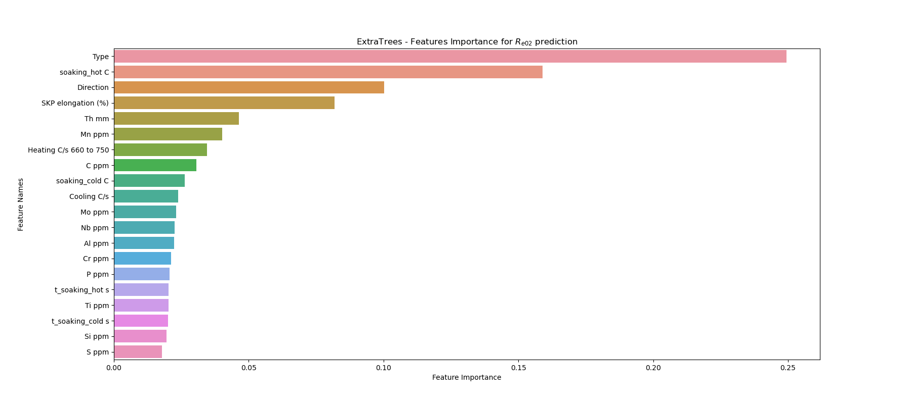

Slide 8
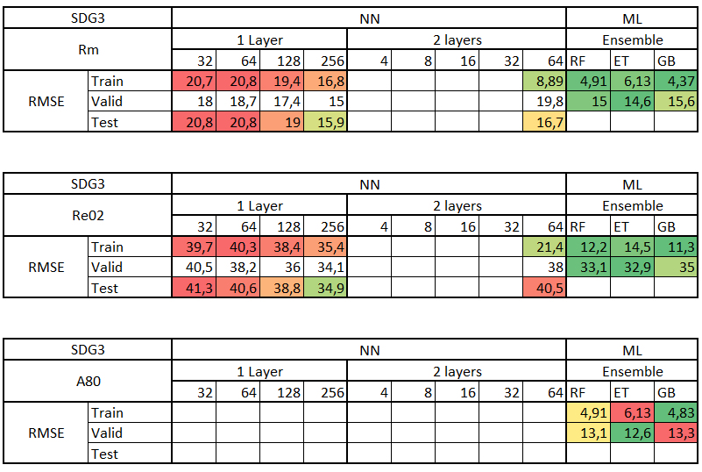
SDG3
# points | 642
Direction | L
Type | I20

Slide 9
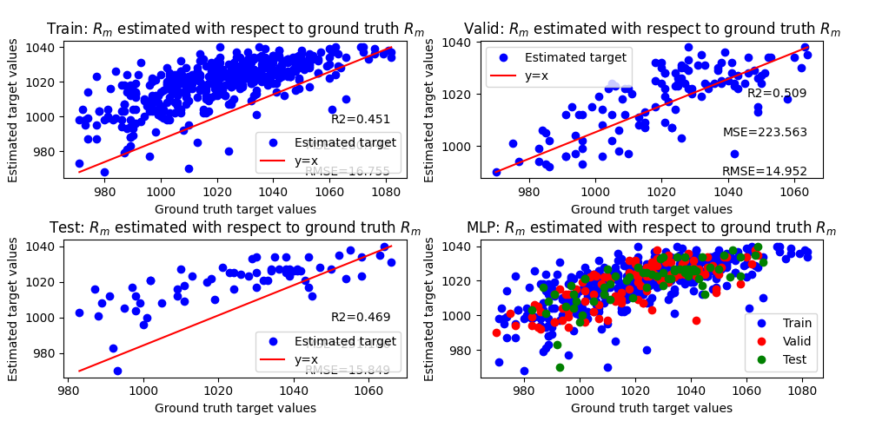
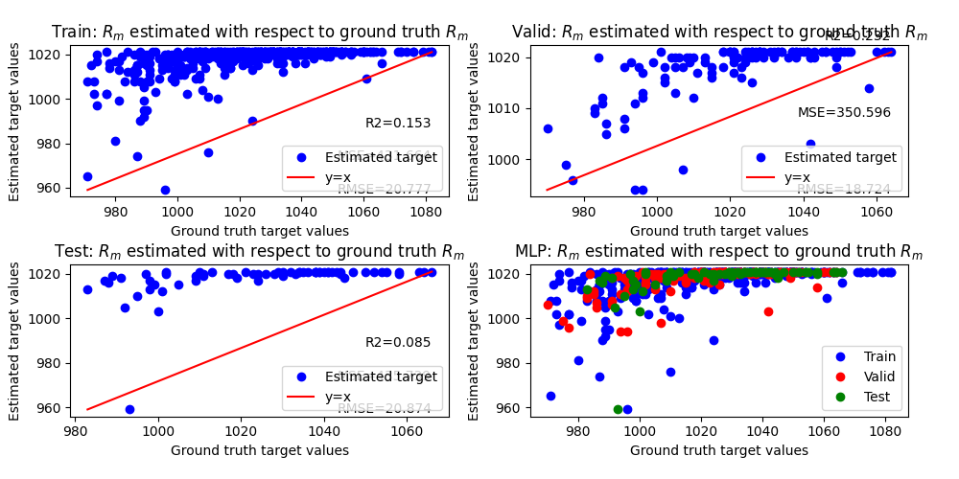
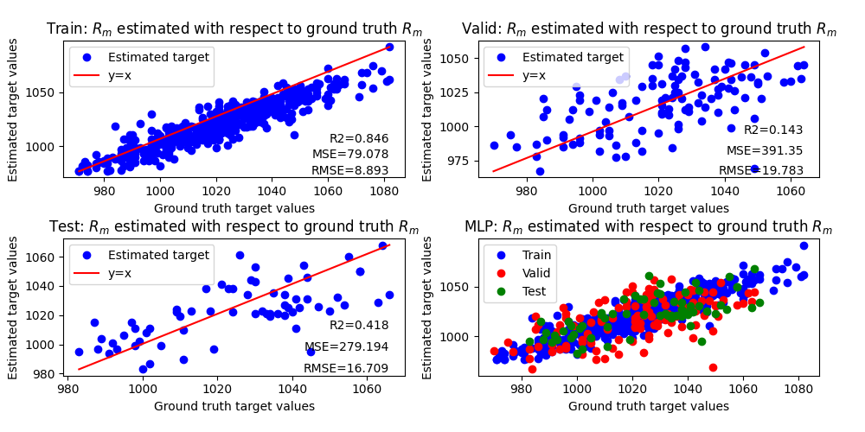
Problem visualization
1 Layer - 256
1 Layer - 64
2 Layer - 64

Slide 10
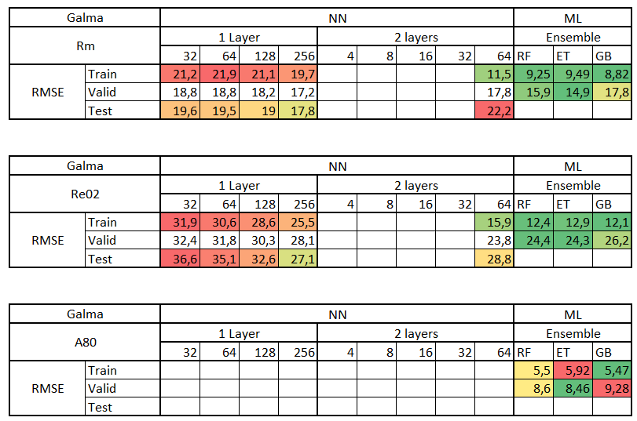
Galma
# points | 305
Direction | T
Type | JI5 - I20

Slide 11
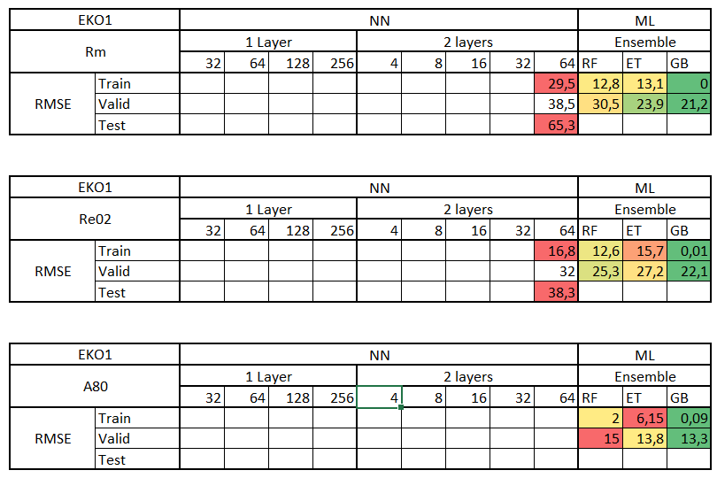
EKO1
# points | 50
Direction | L
Type | I20

Slide 12
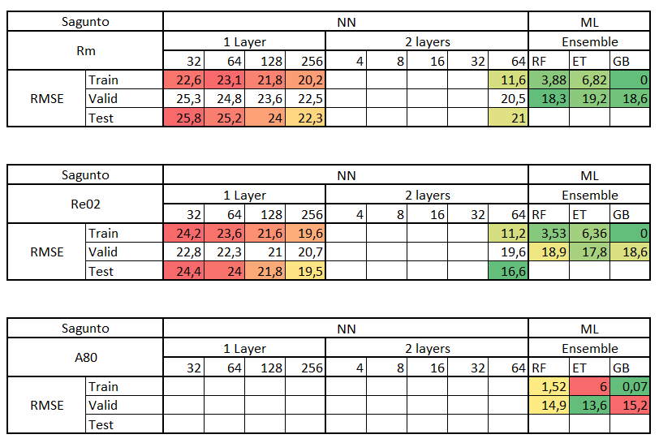
Sagunto
# points | 999
Direction | L
Type | I20

Slide 13
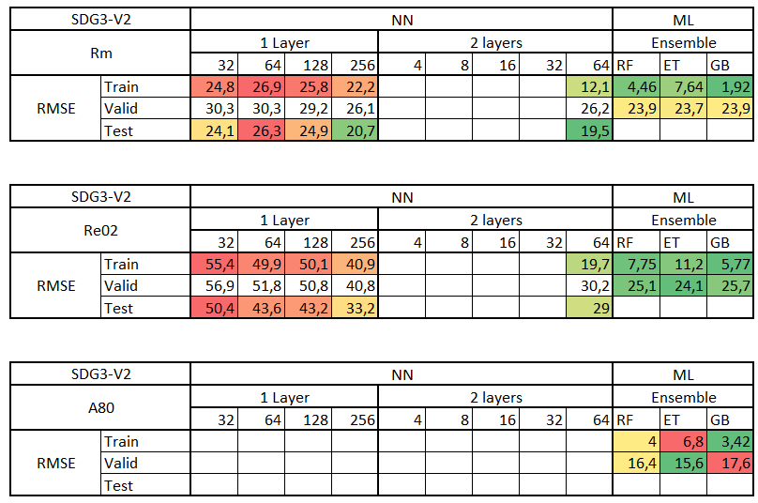
SDG3-V2
# points | 791
Direction | T - L
Type | I20

Slide 14
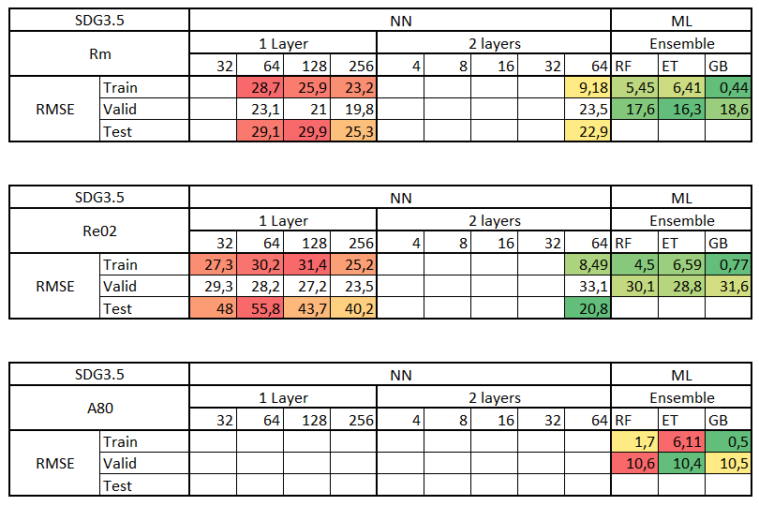
SDG3.5
# points | 177
Direction | T - L
Type | I20

Slide 15
Conclusion
6 lines : Ensemble methods seem to work better but averaging their results with a NN brings better generalization;
NN are bad when we have very little data (EKO – 50 samples);
Features importance does not change from one line to another;

