Slide 1
Tweezer_design
A short userguide

Slide 2
Aim of the module
Implement the (simplified) swirling SAW equation into a realistic IDT geometry
2 steps: (i) design of the individual spiraling transducers and (ii) integration and routing over a wafer

Slide 3
Design of the IDT
Use Wafer_design_part1.py
Inputs: the project folder, the slowness curve (slowness, psi) as a matlab array, the IDT design file (csv) and the reticule files (here mirror and reticule - svg)
Outputs: the initial routing file (svg) and data.p (a binary python file describing the IDT_group dictionary)

Slide 4
Integration and routing over a wafer
Use Wafer_design_part2.py
Inputs: the project folder, the modified routing file (svg) and data.p (a binary python file describing the IDT_group dictionary)
Outputs: a gds file for the lithography and a svg for export

Slide 5
Step by step
From the OS, create a directory with the project name (say Wafer1)
In this directory, place the .mat file containing a, slowness and psi (three matlab line vectors (1*N))
Psi should range between 0 and pi-epsilon
Don’t forget to copy the reticule files (svg format) to this folder

Slide 6
Step by step
Copy the file Example.csv (in the example folder) so that you can edit it at will
To do that, you can use any software able to edit a csv file (Excel, OpenOffice...)
The header of each column corresponds to one setting for an IDT. You can use a variable number of rows which will results in the same number of IDTs

Slide 7
Step by step
You can use several layers of isotropic materials
The slowness is specified is s/m
Each layer is identified by « _spam » where spam is the material name (_0, _1 and _2 in the example, but it could be _glass, _water, _PMMA). The order of the layers is not important, the script uses the zlayer information

Slide 8
Step by step
Once you’re finished with the csv file, save it.
Note: for French users, remove all the commas. It is convenient on OpenOffice to set outils/options/paramètres liguistiques/langues
Note: it is important to save the file as an ASCII or UTF8. In open office this can be done in File/save as, choose csv format, and check the box for Edit Filter Settings.
Start Wafer_design_part1.py

Slide 9
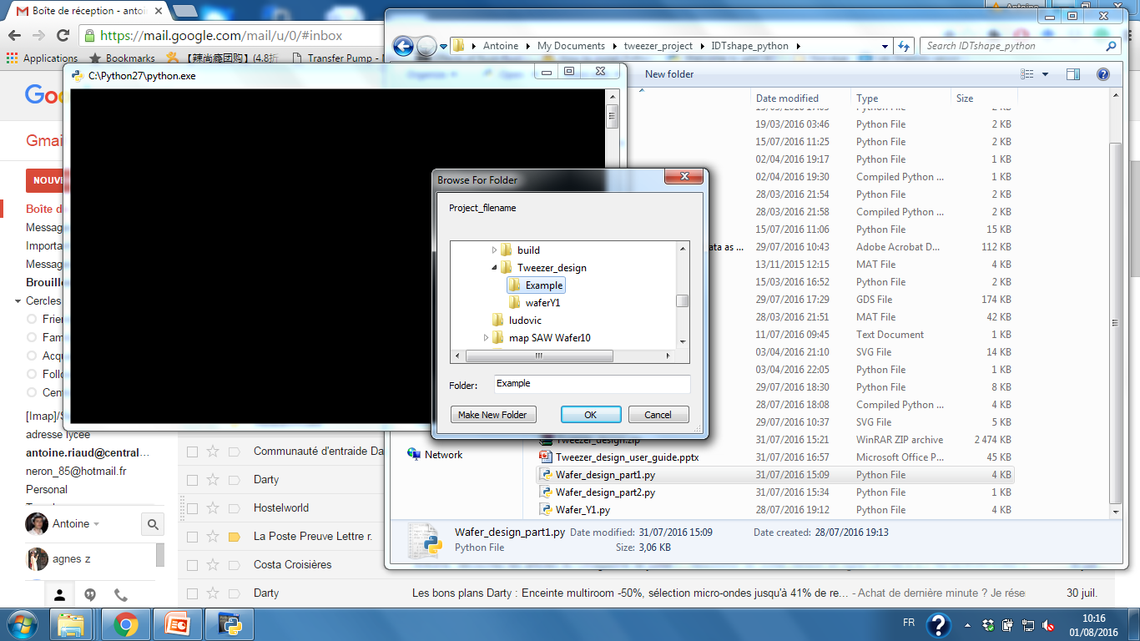
Step by step
Select the directory of the project (here Example)

Slide 10
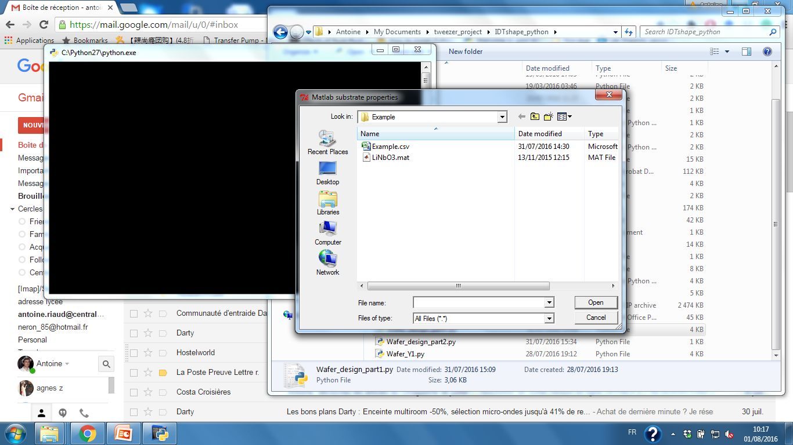
Step by step
Select the matlab file containing the slowness curve (here LiNbO3.mat)

Slide 11
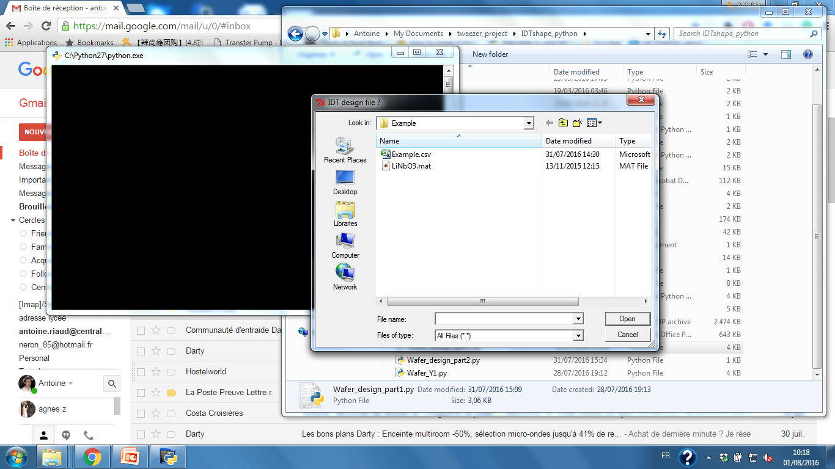
Step by step
Select the csv file containing the design parameters

Slide 12
Step by step
Select the csv file containing the design parameters

Slide 13
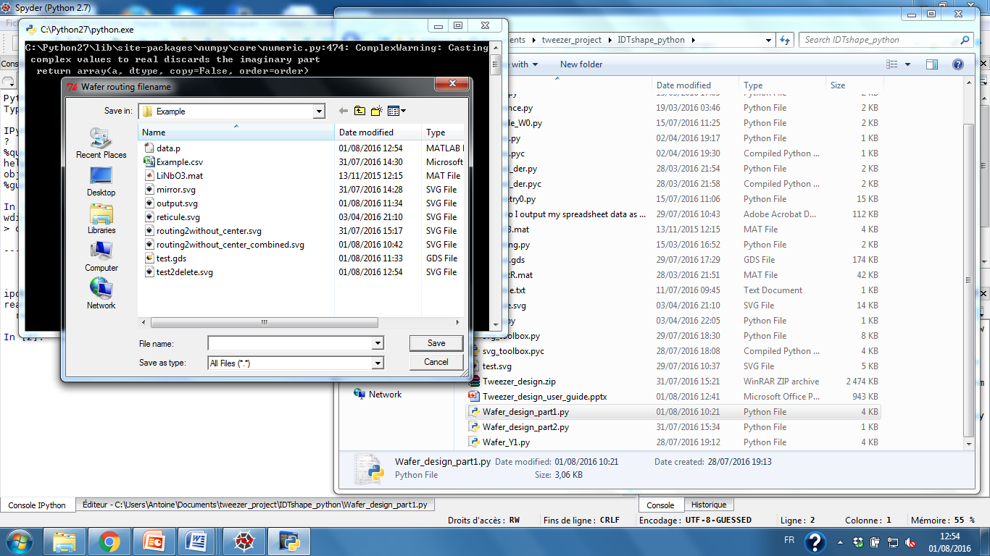
Step by step
Select/create the svg file to save the routes of the wafer

Slide 14
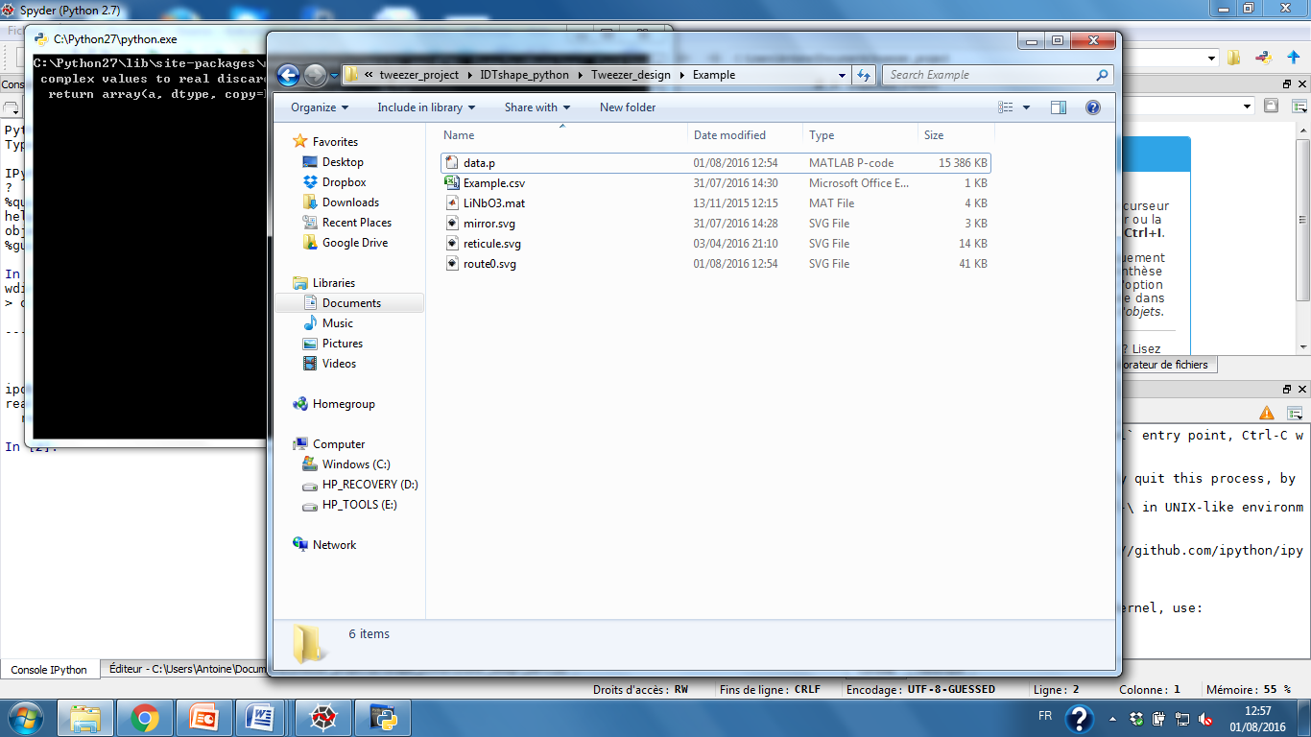
Step by step
Now, the working directory contains several files (see next diapo)

Slide 15
Step by step
data.p is a binary file containing all the variables used by the python code. It is essential to combine the two scripts Wafer_design_part1,2
Example.csv is the wafer design file
LiNbO3.mat gives the slowness of the piezoelectric surface
mirror.svg and reticule.svg are the targets at the center of the substrate
route0.svg is the routing file for the wafer. We have to edit it to make a realistic design

Slide 16
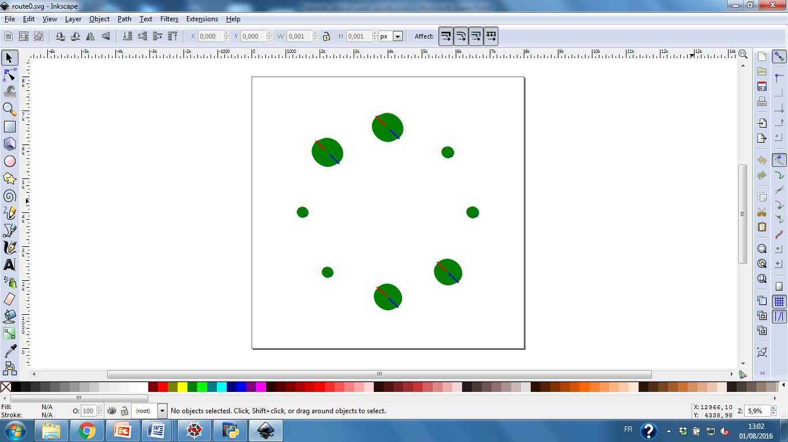
Step by step
The routing file is coded with 3 colors. Other colors are not significant.

Slide 17
Step by step
Red polygons and blue polygons are opposite polarities and will be used for the final design
Green polygons indicate the extent of the IDT
You can add new elements (alignement marks by drawing them in red or blue)
When drawing, do not:
Overlap points or polygons
Draw polygons with interior boundaries (see http://toblerity.org/shapely/manual.html#polygons)
Use curve lines
Use groups
Leave anything else than straight path in the final figure. See next diapo for the conversions.

Slide 18
Step by step
Use « path/object to path » to convert geometric objects and text to path
Use « path/stroke to path » to converta stroke to a path
After selecting the « Edit path by node » (F2), Use « Make selected segments line » to convert curved path to straight segments
Press Ctrl+A and then Ctrl+Shift+G to ungroup everything

Slide 19
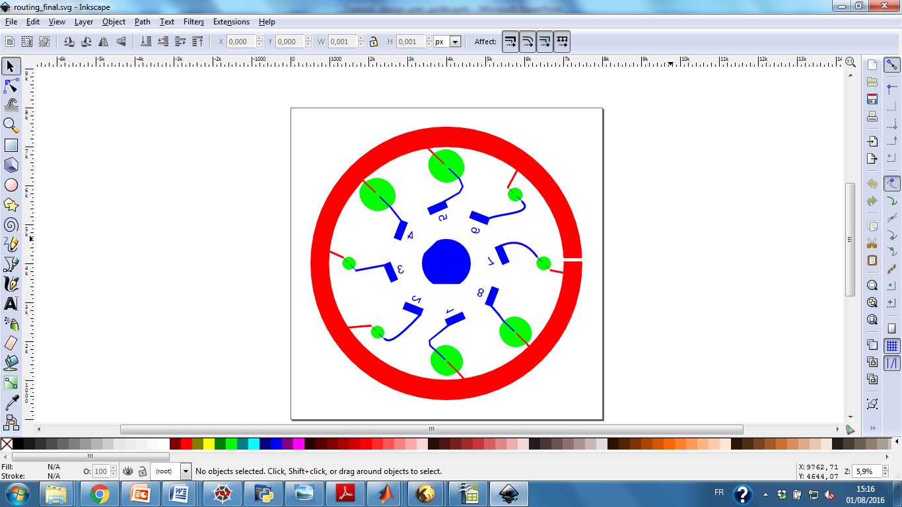
Step by step
x
ψ
y
This is the final result. Note that the axis are different in Inkscape !

Slide 20
Step by step
After saving the routing file, start Wafer_design_part2.py

Slide 21
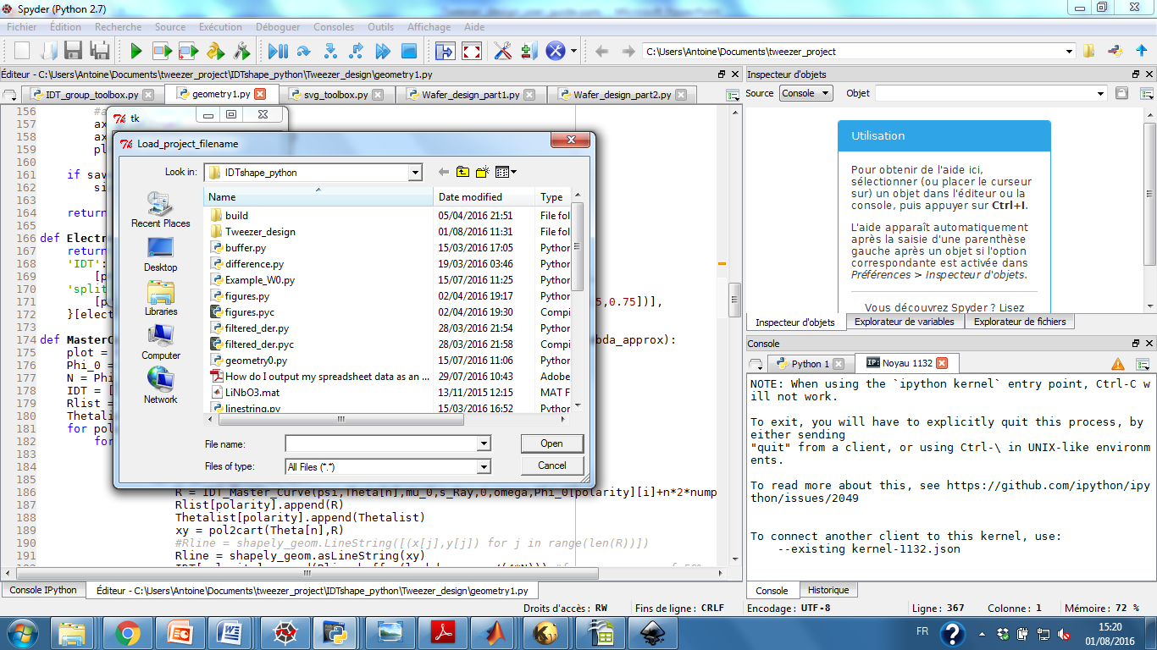
Step by step
Select data.p, the file where the IDT was saved during Wafer_design_part1

Slide 22
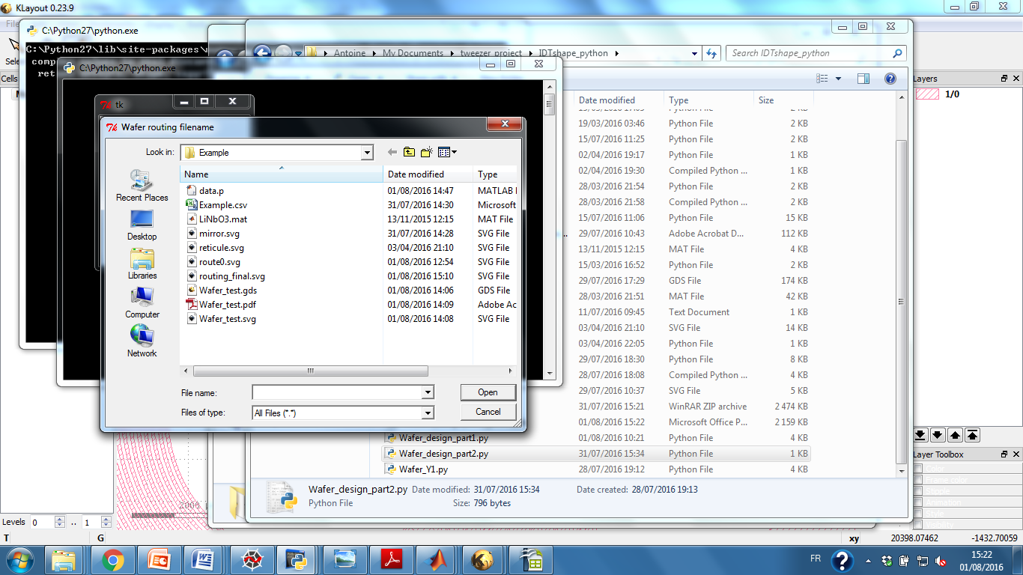
Step by step
Select the routing file routing_final.svg we just created. A prompt may appear to tell you some objects will be ignored. Depending on the expected result, you can ignore it.

Slide 23
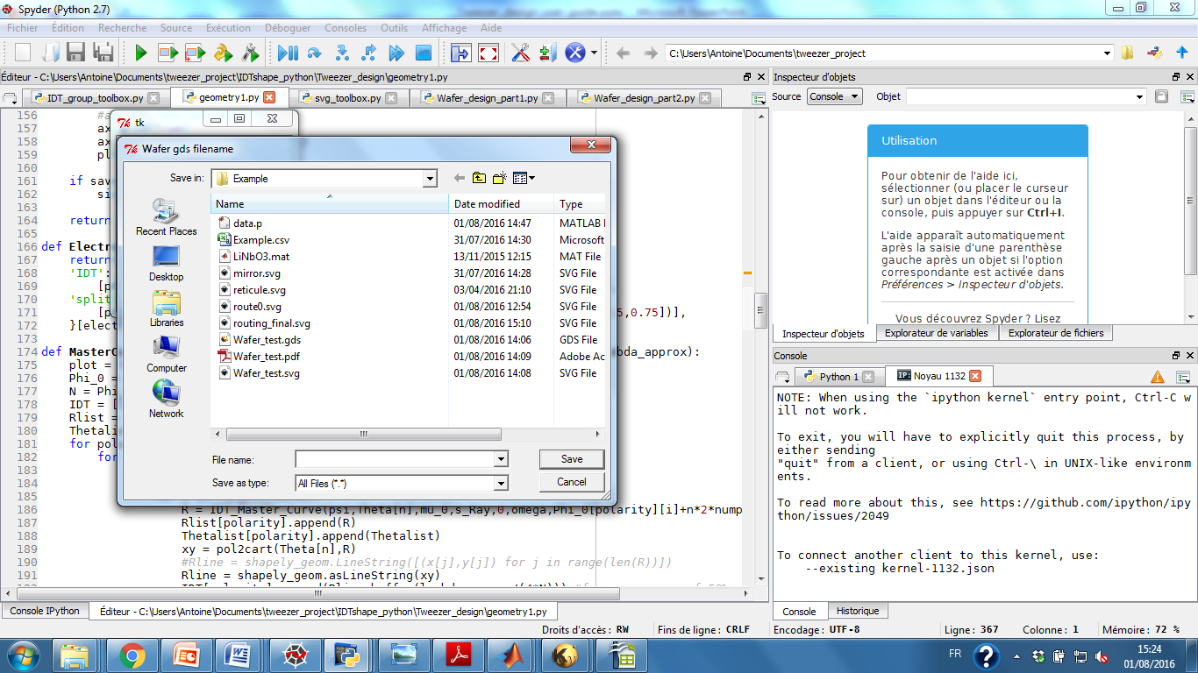
Step by step
Enter the name of the .gds file you want to create. This is for the lithography mask printer.

Slide 24

Step by step
Enter the name of the .svg file you want to create. This is useful to generate pdf or eps files (with inkscape) and share your design.

Slide 25
Step by step
That’s it, your gds has been generated
Now, the svg file looks uggly. Just remove the edges with Inkscape: « Object/fill and stroke » and then in the stroke tab, set the stroke color to none (X)
You can now save the file as eps/pdf by using file/save a copy and choosing the format

