Slide 1
SNARKs for Ethereum
Sean Bowe Zcash
Casey Detrio Ethereum foundation
Joshua Gancher Cornell University
Yuncong Hu Cornell University
Andrew Miller IC3, University of Maryland, Zcash
Eran Tromer Tel Aviv University, Columbia University, Zcash
IC3-Ethereum Bootcamp 27 July 2016

Slide 2

Bringing zero-knowledge SNARKs to Ethereum
Smart contracts where some of the computation is performed off-blockchain
without sacrificing integrity
with zero knowledge
Scalability
Privacy-preserving cryptocurrency
Zerocash over Ethereum (ZoE)
First milestone: Baby ZoE

Slide 3












Baby ZoE
${\text{cm}}_{1}$
Simple coin mixer contract
Can deposit and later withdraw anonymously
Fixed denomination
Protocol based on commitments and Merkle trees [Sander Ta-Shma 1999]
CRH
${\text{cm}}_{2}$
CRH
${\text{cm}}_{3}$
CRH
${\text{cm}}_{4}$
$$\text{root}$$
CRH
${\text{cm}}_{5}$
CRH
${\text{cm}}_{6}$
CRH
${\text{cm}}_{7}$
CRH
${\text{cm}}_{8}$
$$\text{cm}$$
commit
$$r$$
$$\text{sn}$$

Slide 4
Baby ZoE implementation components
Arithmetic circuit expressing the NP statement for the zkSNARK
Contract
Extend the Ethereum VM to support native SNARK verification

Slide 5
Native SNARK verification
snarkverify precompile
XXX specs XXX
Parity EVM patch
Rust wrapper for libsnark

Slide 6
Circuit

Slide 7
BabyZoE contract
State
Code

Slide 8
Demo

Slide 9
Next steps
Grown-up ZoE
Variable denomination
Splitting and joining coins
Payment destinations
General smart contracts that rely on ZK proofs
…
…
Gyges contracts
Hawk XXXX talk to Andrew
…

Slide 10
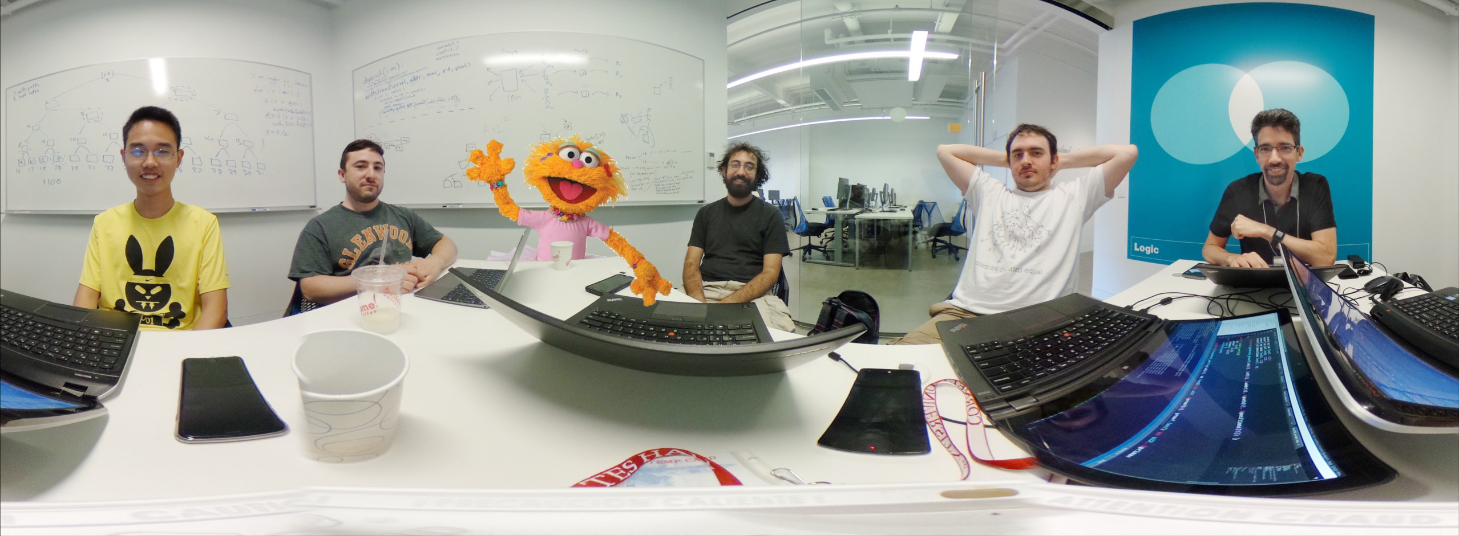
Help baby ZoE grow and prosper
github.com/…

