Slide 1
Artificial Neural Nets
Prof N Wiratunga
References
Python Machine Learning: Sebastian Raschka and Vahid Mirjalili
Make your own Neural Net: Tariq Rashid
Neural Nets for Machine Learning: Geoffrey Hinton
Deep Learning Tutorial: Hung-yi Lee

Slide 2
Outline
COURSE WORK OUT!
Recap of perceptron
Artificial Neural Nets (multilayer perceptrons)
Forward propagation in ANNs
Error computation
Backpropagation of errors
Weight update with gradient descent

Slide 3
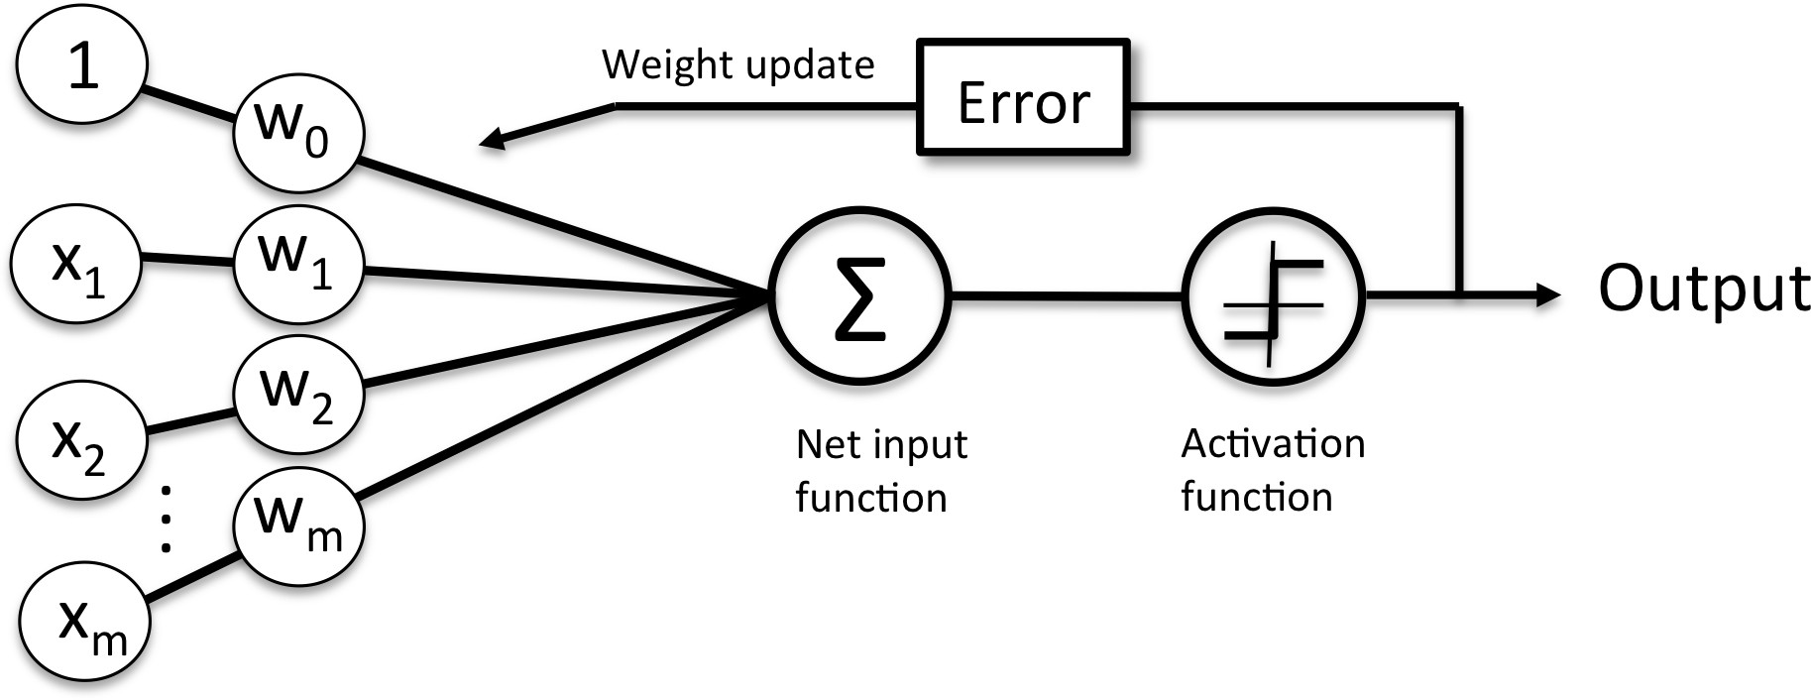

Perceptron Architecture
bias
if z ≥ 0
otherwise
Ф(z)
output a
value+1 or -1
$$W^{T}X$$

Slide 4
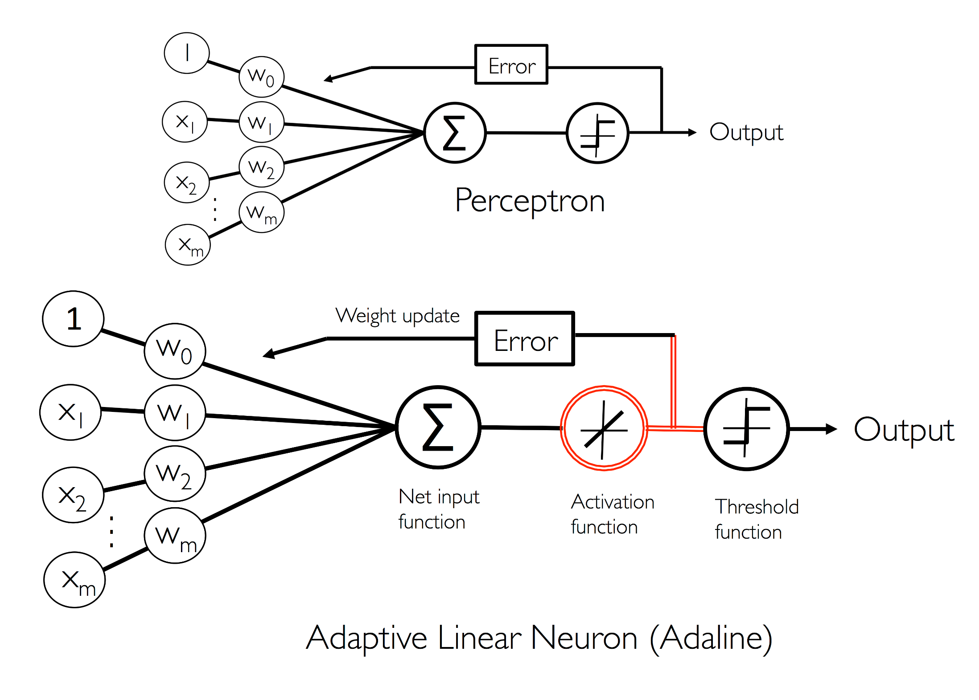
Use
value+1 or -1
in error compute
Use net input, z
in error compute

Slide 5
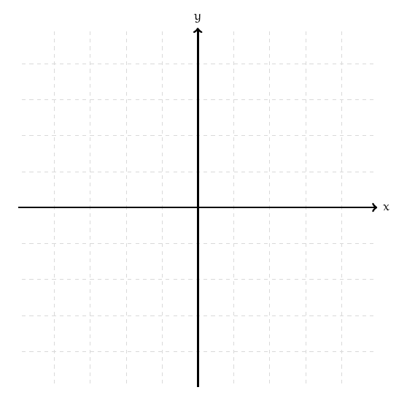
Advantages of the Adaline error function
The linear activation function is differentiable
Unlike the unit step function (in the perceptron)
It is convex
Can use gradient descent to learn the weights
Step activation
Ф(z) = 1 when z>=0, else -1
Linear activation
Ф(z) = z
Notes:
A convex function is a continuous function whose value at the midpoint of every interval in its domain does not exceed the arithmetic mean of its values at the ends of the interval.

Slide 6
Outline
Recap of perceptron
Artificial Neural Nets (multilayer perceptrons)
Forward propagation in ANNs
Error computation
Backpropagation of errors
Weight update with gradient descent

Slide 7
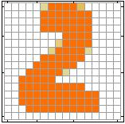
Example Application
Handwriting Digit Recognition
Machine
“2”
Notes:
“Hello world” for deep learning
Data: http://yann.lecun.com/exdb/mnist/

Slide 8
Handwriting Digit Recognition
Input
Output
y₁
is 0
x₁
0.1
y₂
is 1
x₂
0.7
The image is “1”
……
……
……
y₁₀
0.2
is 9
x₇₈₄
28 x 28 = 784
black → 0
white → 255
Each dimension represents the confidence of a digit.
Notes:
The same for even more complex tasks.
pixel values range from 0 (black background) to 255 (white foreground)

Slide 9


Example Application
Handwriting Digit Recognition
y₁
Machine
y₂
“2”
……
……
x₇₈₄
y₁₀
$$f:R^{784}→R^{10}$$
the function $f$ is represented by neural network

Slide 10
Element of Neural Network
Neuron
$$f:R^{K}→R$$
g(z)
…
Activation function
weights
we use g(z)
sometimes for Ф(z)
bias
Notes:
sigmoid

Slide 11
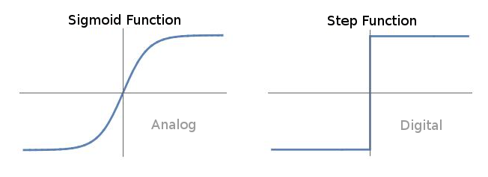
Sigmoid function
Notes:
Multi-layer perceptrons are trained using backpropapagation. A requirement for backpropagation is a differentiable activation function. That's because backpropagation uses gradient descent on this function to update the network weights.

Slide 12
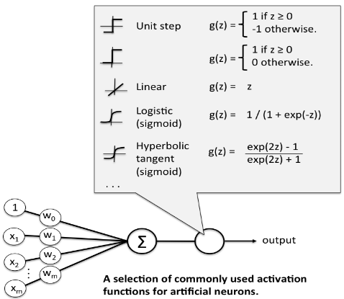
Activation Functions

Slide 13
Neural Network
neuron
Input
Layer 1
Layer 2
Layer L
Output
……
y₁
……
y₂
……
……
……
……
……
……
y_{M}
Input Layer
Output Layer
Hidden Layers
Deep means many hidden layers
Notes:
Fully Connected Feedforward Network
You can always connect the neurons in your own way.
“+” is ignored
Each dimension corresponds to a digit (10 dimension is needed)

Slide 14
Training a Neural Net - overview
An iterative algorithm; each iteration of training is an “epoch”
At each iteration for given training instances
do a forward pass
compute the error and aggregate it
Back propagate the error in the current epoch
Use the error to update the weights

Slide 15
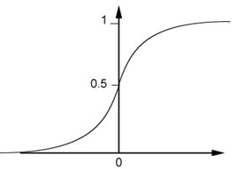
Example of Neural Network- Forward pass
1
4
0.98
1
-2
1
-1
-2
0.12
-1
1
0
Sigmoid Function
Ф(z)
Ф(z)
Notes:
Ignore +

Slide 16
Forward pass - Example
1
4
0.98
2
0.86
3
0.62
1
-2
-1
-1
1
0
-2
-1
-2
0.12
-2
0.11
-1
0.83
-1
1
-1
4
0
0
2

Slide 17
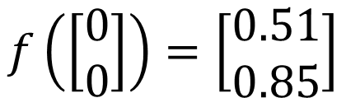

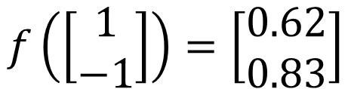
Forward pass - Example
1
0.73
2
0.72
3
0.51
0
-2
-1
-1
1
0
-2
-1
0.5
-2
0.12
-1
0.85
0
1
-1
4
0
0
2
$$f:R^{2}→R^{2}$$
$$f\left(\left[\begin{matrix}1 \\ −1\end{matrix}\right]\right)=\left[\begin{matrix}0.62 \\ 0.83\end{matrix}\right]$$
$$f\left(\left[\begin{matrix}0 \\ 0\end{matrix}\right]\right)=\left[\begin{matrix}0.51 \\ 0.85\end{matrix}\right]$$
Different parameters define different function
Notes:
For example, if we modify “1” to “2”, then we have another function

Slide 18
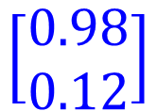


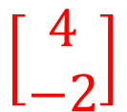

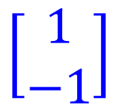

Forward pass - Matrix Operation
1
4
0.98
1
-2
1
-1
-2
0.12
-1
1
0
$$\left[\begin{matrix}1 & −2 \\ −1 & 1\end{matrix}\right]$$
$$\left[\begin{matrix}1 \\ −1\end{matrix}\right]$$
$$\left[\begin{matrix}1 \\ 0\end{matrix}\right]$$
$$\left[\begin{matrix}0.98 \\ 0.12\end{matrix}\right]$$
$$\text{Ф}\left( \right)$$
$$=$$
$$+$$
$$\left[\begin{matrix}4 \\ −2\end{matrix}\right]$$
Notes:
Make sure you know how to do it
author: Adam Coates, Baidu, Inc.
Deep Learning (hopefully faster)
http://videolectures.net/deeplearning2015_coates_deep_learning/

Slide 19



Forward pass - Matrix Operation
……
y₁
W¹
W²
W^{L}
……
y₂
b¹
b²
b^{L}
……
……
……
……
……
x
a¹
a²
y
……
y_{M}
W¹
x
b¹
+
$$\text{Ф}\left( \right)$$
a¹
b²
W²
+
$$\text{Ф}\left( \right)$$
W^{L}
b^{L}
a^{L-1}
+
$$\text{Ф}\left( \right)$$

Slide 20


Neural Network - Matrix Operation
……
y₁
W¹
W²
W^{L}
……
y₂
b¹
b²
b^{L}
……
……
……
……
……
x
a¹
a²
y
……
y_{M}
y
x
Using parallel computing techniques to speed up matrix operation
$$=f\left( \right)$$
W^{L}
…
W²
W¹
x
b¹
b²
…
b^{L}
+
+
+
$$\text{Ф}\left( \right)$$
$$=\text{Ф}\left( \right)$$
$$\text{Ф}\left( \right)$$
x

Slide 21
Forward Pass – Softmax for output calculation
Softmax layer as the output layer
Ordinary Layer
y₁
In general, the output of network can be any value.
y₂
May not be easy to interpret
y₃
Notes:
Original output layer is local

Slide 22
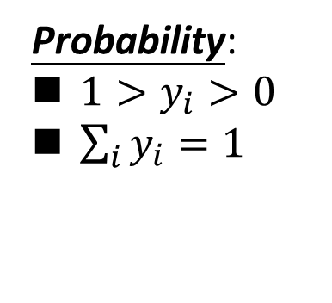
Forward pass - Softmax
Probability:
$1>y_{i}>0$
$\sum_{i}{y_{i}=1}$
Softmax layer as the output layer
Softmax Layer
3
20
0.88
1
2.7
0.12
-3
0.05
≈0
Notes:
Why is it named soft max?
Monotonicity of softmax
Non-locality of softmax

Slide 23
Training a Neural Net - overview
An iterative algorithm; each iteration of training is an “epoch”
At each iteration for training instances
do a forward pass
compute the error and aggregate it
Back propagate the error in the current epoch
Use the error to update the weights

Slide 24


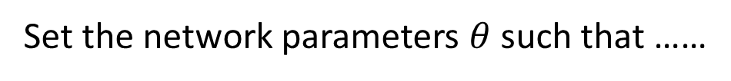
Compute Error to guide network training
$$θ=\left\{W^{1},b^{1},W^{2},b^{2},⋯W^{L},b^{L}\right\}$$
……
y₁
is 1
0.1
……
y₂
0.7
is 2
Softmax
……
……
……
……
y₁₀
is 0
0.2
Set the network parameters $θ$ such that ……
Input:
How to let the neural network achieve this
y₁ has the maximum value
Input:
y₂ has the maximum value

Slide 25








Training Data
Preparing training data: images and their labels
“5”
“0”
“4”
“1”
“9”
“2”
“1”
“3”
Using the training data to find the network parameters.

Slide 26

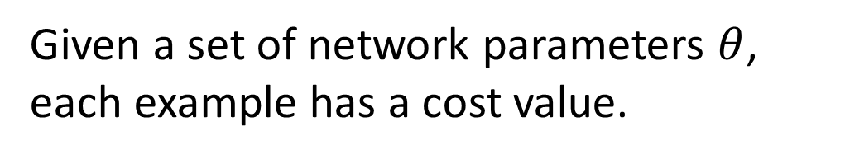
Compute Error
Given a set of network parameters $θ$, each example has a cost value.
“1”
……
y₁
0.2
1
……
y₂
0
0.3
……
……
……
$$error(θ)$$
……
……
……
y₁₀
0
0.5
target
Error can be some function of the difference between the predicted and expected target.
Notes:
With softmax, the summation of all the ouputs would be one.
Can be considered as probability if you want ……

Slide 27
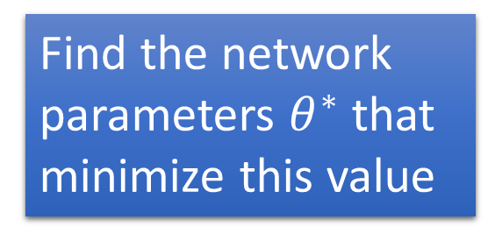


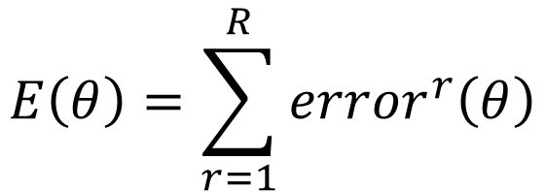






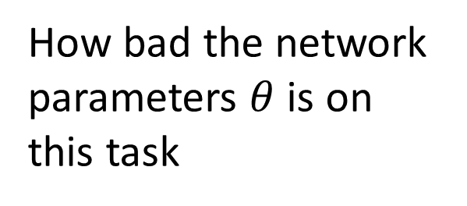
Compute Error
For all training data …
Total Cost:
NN
$$E\left(θ\right)=\sum_{r=1}^{R}{{error}^{r}\left(θ\right)}$$
x¹
y¹
$${\hat{y}}^{1}$$
$${error}^{1}\left(θ\right)$$
x²
NN
y²
$${\hat{y}}^{2}$$
How bad the network parameters $θ$ is on this task
$${error}^{2}\left(θ\right)$$
x³
NN
y³
$${\hat{y}}^{3}$$
$${error}^{3}\left(θ\right)$$
……
……
……
……
Find the network parameters $θ^{∗}$ that minimize this value
x^{R}
NN
y^{R}
$${\hat{y}}^{R}$$
$${error}^{R}\left(θ\right)$$
Notes:
Randomly picked one
Two approaches update the parameters towards the same direction, but stochastic is faster!
Better!

Slide 28
Training a Neural Net - overview
An iterative algorithm; each iteration of training is an “epoch”
At each iteration for training instances
do a forward pass
compute the error and aggregate it
Back propagate the error in the current epoch
Use the error to update the weights

Slide 29





Backward pass – Error propagation
$$ehidden$$
1
$$wih$$
$$who$$
$$eoutput$$
$$Inputs$$
-1
W_{ih} are weights from input to hidden layers
W_{ho} are weights from hidden to output layers

Slide 30
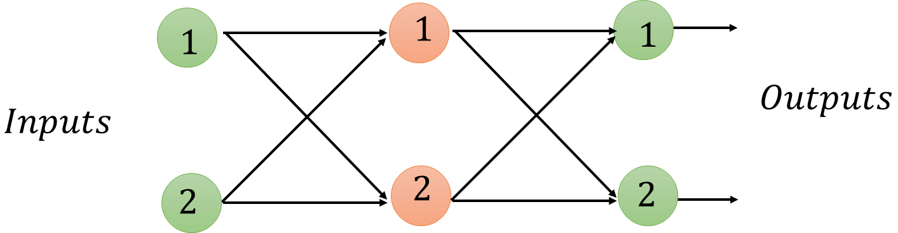












Backward pass – Error propagation
$$0.32$$
$$e1=0.42$$
$$w11=2$$
$$e1=0.8$$
$$w12=1$$
$$0.48$$
$$w21=3$$
$$0.1$$
$$w22=4$$
$$e2=0.88$$
$$0.4$$
$$e2=0.5$$
e₁ ₌ e1(output) * (w11/w11+w21) + e2(output)* w12/(w12+w22)
Notes:
Note how 0.5 error is proportionately split between the weights of W12 and W22.
The new error in the hidden layer is a summation of the proportions e.g. 0.42 = 0.32 + 0.1
Error at the outputs is simply the difference between the desired and actual output.
Error associated with the internal nodes is less straight forward. One approach is to split the output layer errors in proportion to the size of the connected link weights and then recombine these bits at each internal node.

Slide 31









Backward pass – Error propagation
$$0.252$$
$$e1=0.42$$
$$e1=0.362$$
$$e1=0.8$$
$$w11=3$$
$$w12=1$$
$$0.168$$
$$w21=2$$
$$0.11$$
$$w22=7$$
$$0.77$$
$$e2=0.88$$
$$e2=0.5$$
$$e2=0.938$$
Notes:
Note how 0.5 error is proportionately split between the weights of W12 and W22

Slide 32


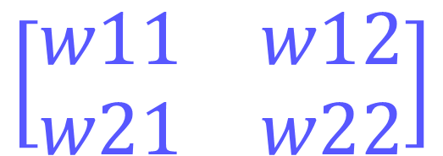
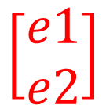
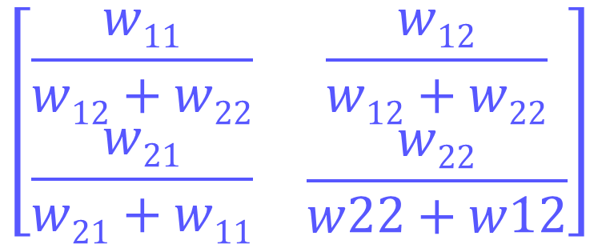

Error propagation – Matrix operation
$$\left[\begin{matrix}\frac{w11}{w12+w22} & \frac{w12}{w12+w22} \\ \begin{aligned}\frac{w21}{w21+w11}\end{aligned} & \frac{w22}{w22+w12}\end{matrix}\right]$$
$$.$$
$$\left[\begin{matrix}e1 \\ e2\end{matrix}\right]$$
$$errorhidden$$
$$=$$
$$with some short cuts we can implment this as:$$
$$\left[\begin{matrix}w11 & w12 \\ w21 & w22\end{matrix}\right]$$
$$.$$
$$errorhidden$$
$$=$$
$$\left[\begin{matrix}e1 \\ e2\end{matrix}\right]$$
$$this weight matrix is a transpose of W which is WT$$

Slide 33
Error propagation – Matrix operation
Error _{hidden} = W^{T} _{hidden_output} * error_{output}

Slide 34
Training a Neural Net - overview
An iterative algorithm; each iteration of training is an “epoch”
At each iteration for training instances
do a forward pass
compute the error and aggregate it
Back propagate the error in the current epoch
Use the error to update the weights

Slide 35
How do we actually update weights?
We know how to propagate errors
error is needed to guide how we adjust the weights
Working out the weights is hard
too many possible combinations
too many functions of functions being combined
Solution - use gradient descent to workout the right weights
as long as we pick the right error function

Slide 36
Cost or Error Functions
ML algorithms often define an objective function
This function is optimized during learning
It is often a cost function we want to minimize
Popular : Learns weights as the sum of squared errors (SSE)
SSE =
Notes:
SSE has some nice properties making it more suitable
- Error function is smooth and continuous making gradient descent work well – there are no gaps or abrupt jumps
Gradient gets smaller nearer the minimum; meaning the risk of over shooting the objective gets smaller if we use it to moderate the step sizes
- the algebra needed to work out the slope for gradient descent is easier

Slide 37
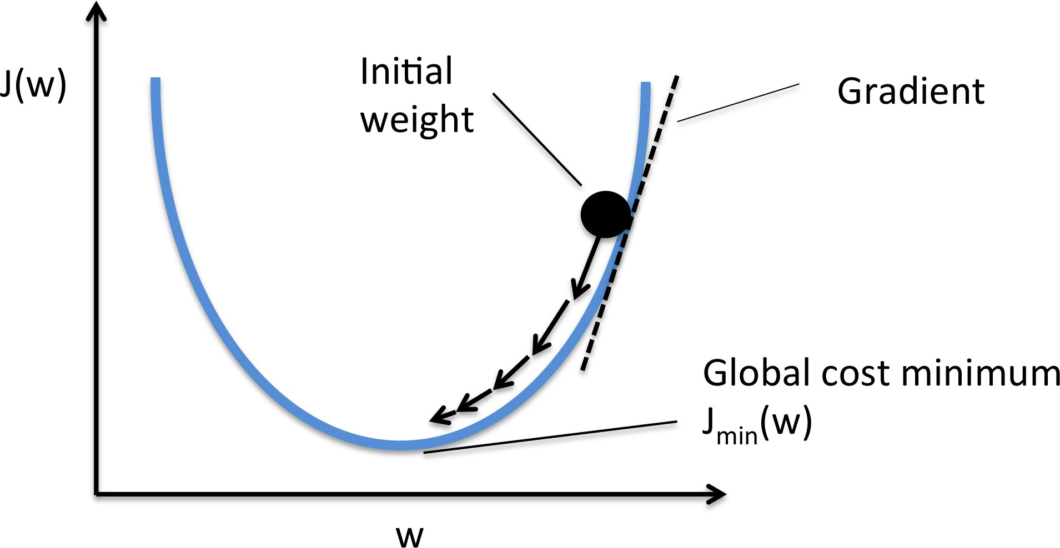
Gradient Descent
Error
gradient points in the direction of the greatest rate of increase of the function, and its magnitude is the slope of the graph in that direction.
∂E
∂w
Global minimum
Notes:
The questions we need to ask here are how does the error change as the weight changes.
The slope is marked on the graph and in this case it is a positive gradient.
We want to follow the downward direction so we move towards the left
This means we decrease w a little.
So we modify w opposite to the direction of the gradient i.e. decrease w when positive gradient and increase w when negative gradient.
Make sure to stop and avoid overshooting the minima
As we get closer to the minima the slope gets shallower.

Slide 38

Gradient Descent - Intuition
https://www.analyticsvidhya.com/blog/2017/03/introduction-to-gradient-descent-algorithm-along-its-variants/
Notes:
Suppose you are at the top of a mountain, and you have to reach a lake which is at the lowest point of the mountain (a.k.a valley). A twist is that you are blindfolded and you have zero visibility to see where you are headed. So, what approach will you take to reach the lake?
The best way is to check the ground near you and observe where the land tends to descend. This will give an idea in what direction you should take your first step. If you follow the descending path, it is very likely you would reach the lake.
Gradient refers to the slope of the ground. You step in the direction where the slope is steepest downwards.
Basically we can picture GD optimization as a hiker (the weight coefficient) who wants to climb down a mountain (cost function) into a valley (cost minimum), and each step is determined by the steepness of the slope (gradient) and the leg length of the hiker (learning rate).

Slide 39
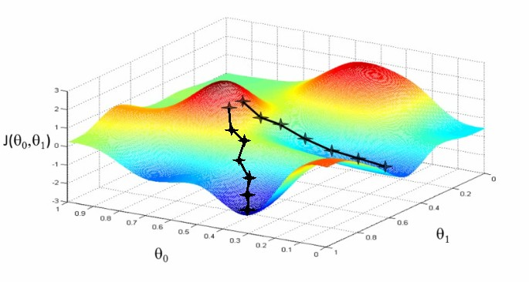
Gradient Descent - Intuition
Error
https://www.analyticsvidhya.com/blog/2017/03/introduction-to-gradient-descent-algorithm-along-its-variants/
Notes:
J is the error
We want to find theta values (our weight and bias parameters) that minimise the error
We can also get stuck in a local minima that is not the global minima
So training several times with different starts is typical

Slide 40
New weight = old weight + gradient
Learning rate
gradient
∂E
∂w_{old}
∆w_{old} = -η
w_{new} = w_{old} + ∆w_{old}

Slide 41




Gradient Computation
j=1
k= 1
i=1
$$wjk$$
$$wij$$
$$Inputs$$
$$Outputs$$
i=2
j=2
k=2

Slide 42
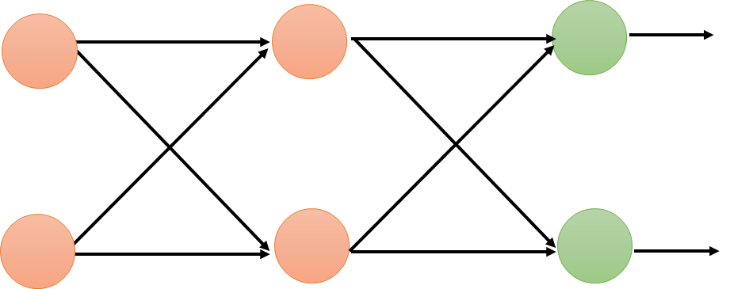








Gradient Computation – update weights
$$weights$$
$$wij$$
$$wjk$$
j=1
k= 1
$$ok$$
i=1
$$Outputs$$
$$Inputs$$
i=2
j=2
k=2
$$hidden node outputs$$
$$oj$$

Slide 43
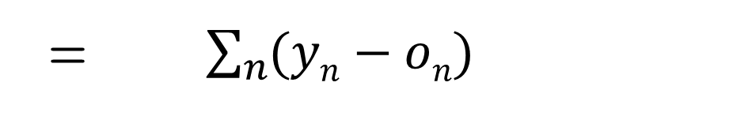
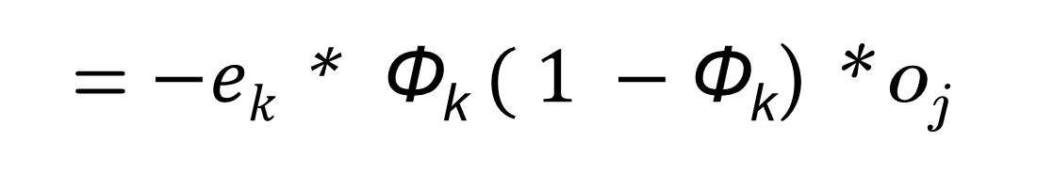
Gradient Computation – hidden to output layer
To compute the gradient of the cost function, we need to compute the partial derivative of the cost function with respect to each weight w_{j} ,
∂E
∂w_{jk}
= $\sum_{n}{(yn−on)}$
∂
∂w_{jk}
Solving this results:
∂E
∂w_{jk}
= $− \left(yk−ok\right)$* $sigmoid (\sum_{j}{wjk∗oj)} ( 1 −sigmoid (\sum_{j}{wjk∗oj))} ∗oj$
∂E
∂w_{jk}
= $−ek$* Ф_{k}$( 1 −\text{Ф}\text{k}$) * o_{j}
Notes:
First part is simply the target minus the predicted
The sum expression insides the sigmoid is simply the signal to the final layer node
The last part is the output from the previous hidden layer node j

Slide 44
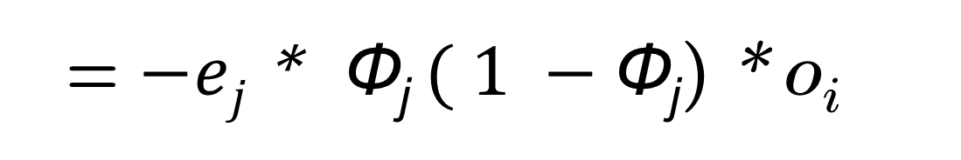
Gradient Computation – input to hidden layer
∂E
∂w_{ij}
= $−ej$* $sigmoid (\sum_{i}{wij∗oi)} ( 1 −sigmoid (\sum_{i}{wij∗oi)}∗oi$
Note O_{i} now becomes the inputs
∂E
∂w_{ij}
= $−ej$* Ф_{j}$( 1 −\text{Ф}\text{j}$) * o_{i}
Notes:
First part, e, is simply the error from the recombined back-propogated error assigned to the hidden node
Sigmoid functions remain the same except the summations relate to the preceding layers of the network
The last part is the output from the previous layer which here is the input

Slide 45
Weight update – Matrix operation
Node
Output
From next layer
Learning
rate
∆w_{jk} = -η * E_{k} * O_{k}(1-O_{k}) * O_{j}^{T}
Node
Output
from previous
layer
Error from
Next layer
node

Slide 46














Weight update – worked example
$$0.32$$
$$e1=0.42$$
$$oj1=0.4$$
$$e1=0.8$$
$$w11=2$$
$$w12=1$$
$$0.48$$
$$0.1$$
$$w21=3$$
$$w22=4$$
$$oj2=0.5$$
$$e2=0.88$$
$$0.4$$
$$e2=0.5$$

Slide 47
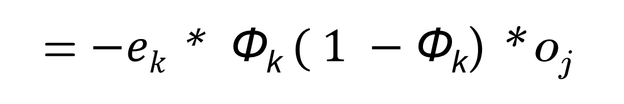
o_{j} is simply o_{j=1}, because
we are interested in the
weight w₁₁ which is 0.4
0.8
∂E
∂w_{jk}
= $−ek$* Ф_{k}$( 1 −\text{Ф}\text{k}$) * o_{j}
(2.0*0.4) + (3*0.5) = 2.3
Ф = 1 / 1 + e^{2.3} is then 0.909
The middle expression is then 0.909 (1 – 0.909) = 0.083

Slide 48
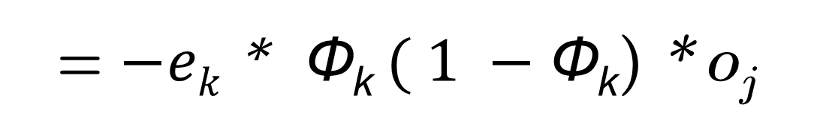
∂E
∂w_{jk}
= $−ek$* Ф_{k}$( 1 −\text{Ф}\text{k}$) * o_{j}
= -0.8 * 0.083 * 0.4
= -0.0265
∂E
∂w_{jk}
∆w_{jk} = -η
If learning rate say is 0.01
It gives us a weight change of –(0.1 * -0.0265) = + 0.00265
So the new w11 is the original 2.0 plus 0.00265 = 2.00265

Slide 49



Besides local minima ……
Error
Very slow at the plateau
Stuck at saddle point
Stuck at local minima
$$\text{∆}W≈0$$
∆$W=0$
∆$W=0$
parameter space

Slide 50
Note on batch_size
ANN iterative algorithm
For e in epoch
For batch in sample(training_instances, batch_size)
do a forward pass
compute the error and aggregate it
Back propagate the error in the current epoch
Use the error to update the weights
Notes:
In gradient descent (GD) in a given epoch we pass over the entire training dataset to compute the error and make a change to the weights.
GD can be quite costly since we are only taking a single step for one pass over the training set. Thus, the larger the training set, the slower our algorithm updates the weights and the longer it may take until it converges to the global cost minimum
An alternative is stochastic gradient descent (SGD; sometimes also referred to as iterative or on-line GD) where in a given epoch we form (consecutive) batches from the training dataset and pass through each batch computing error and making a change to the weights. This means we can make several tweaks to the weights in a given epoch.
This is controlled by the batch_size (hyper parameter). When batch_size = 1 we update the weights after each training sample.
Here, the term "stochastic" comes from the fact that the gradient based on a single training sample is a "stochastic approximation" of the "true" cost gradient. Due to its stochastic nature, the path towards the global cost minimum is not "direct" as in GD, but may go "zig-zag" if we are visualizing the cost surface in a 2D space.

Slide 51
Conclusions
A neural network’s error is a function of the internal weights i.e. parameters of the network
Improving the network means reducing the error – by changing those weights
Choosing the weights directly is too difficult – use gradient descent to improve the weights by descending the error
Descend in small steps in the direction of the greatest downward slope
That slope forms the amount by which the weight is updated

